Slide 1
Managing the Patient With Tuberous Sclerosis Complex

Slide 2
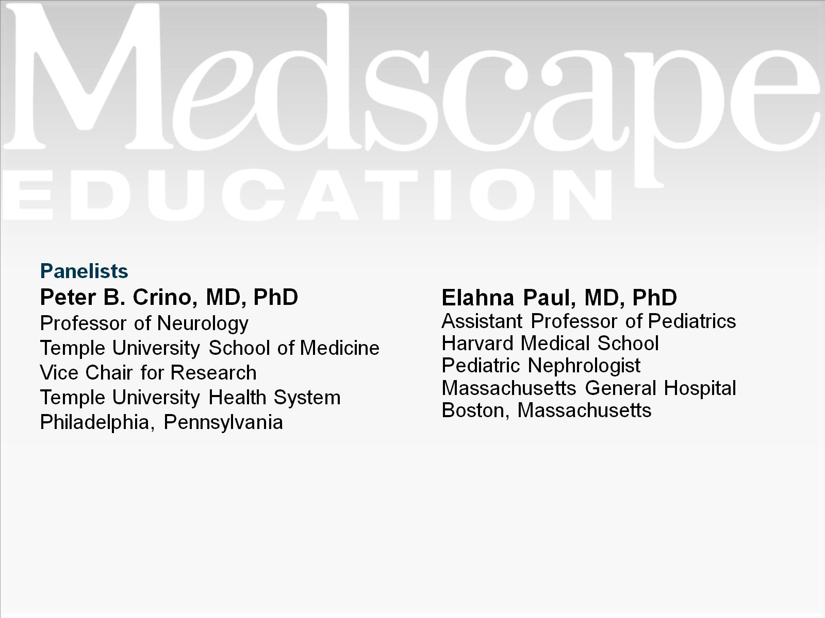

Slide 3
Program Goal

Slide 4
Overview of Tuberous Sclerosis Complex

Slide 5
Case 1: A 3-Month-Old Girl

Slide 6
Video of Infantile Spasms

Slide 7
Results of the CT Scan

Slide 8
Approaching the Diagnosis of TSC

Slide 9
Case 1: CT Scan Follow-up

Slide 10
Case 1: Initial Treatment

Slide 11
Case 1: Diagnosis of TSC

Slide 12
Results of the MRI

Slide 13
Case 1: Follow-up

Slide 14
Abdominal CT Scan

Slide 15
TSC Clinical Diagnostic Criteria

Slide 16
Case 2: A 16-Year-Old Girl With a Known Diagnosis of TSC

Slide 17
Case 2: Presentation

Slide 18
Issues to Consider

Slide 19
Case 2: SEGA

Slide 20
Treatment Options for SEGA

Slide 21
Case 2: Treatment

Slide 22
Case 2: Follow-up

Slide 23
Common Adverse Effects of Everolimus

Slide 24
Duration of Treatment

Slide 25
Case 3: A 35-Year-Old With Renal Involvement

Slide 26
Case 3: TSC-Related Medical Issues

Slide 27
Case 3: Past Renal Imaging

Slide 28
Case 3: Current Renal Status Age 35 y

Slide 29
Case 3: MRI Results at Age 35 y

Slide 30
Case 3: Lipid-Poor Solid Mass

Slide 31
Case 3: Large Renal AML

Slide 32
Large Renal AML: Embolization

Slide 33
Large Renal AML: mTOR Inhibitors

Slide 34
TSC: Final Thoughts

Slide 35
Abbreviations

Slide 36
Abbreviations (cont)

Slide 37
References

Slide 38
References (cont)

Slide 39
References (cont)

Slide 40
References (cont)

