Slide 1
Overweight and Obesity: Validation as a Chronic Disease

Slide 2
Overweight and Obesity Is Currently Defined Based Upon BMI

Slide 3
BMI: Advantages

Slide 4
BMI: Disadvantages

Slide 5
Definition of “Disease”

Slide 6
Adiposopathy: Summary

Slide 7
Adiposopathy: Summary (cont)

Slide 8
Adiposopathy: Summary (cont)

Slide 9
Obesity Treatment Recommendations

Slide 10
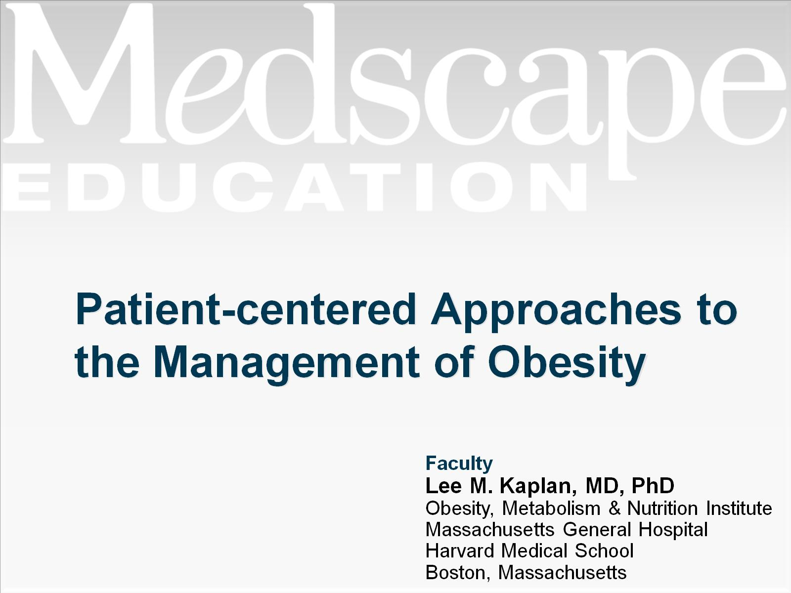
Patient-centered Approaches to the Management of Obesity

Slide 11
Historical View of Obesity

Slide 12
Current Perspective of Obesity

Slide 13
Obesity: A Failure of Weight Regulation

Slide 14
Macroenvironmental Influences*

Slide 15
Microenvironmental Influences*

Slide 16
Composition of Popular Diets

Slide 17
Physical Activity Extends Weight Loss: Look AHEAD Trial

Slide 18
Effects of Chronic Exercise

Slide 19
Practical Guidance: Embrace Modest Weight Loss

Slide 20
Practical Guidance: Go Slow and Try Different Approaches

Slide 21
The 5As for Obesity Management

Slide 22
The 5As of Obesity Management

Slide 23
Ask

Slide 24
Assess

Slide 25
The 4Ms of Obesity

Slide 26
Advise

Slide 27
Advise (cont)

Slide 28
Agree

Slide 29
Assist

Slide 30
Putting It All Together

Slide 31
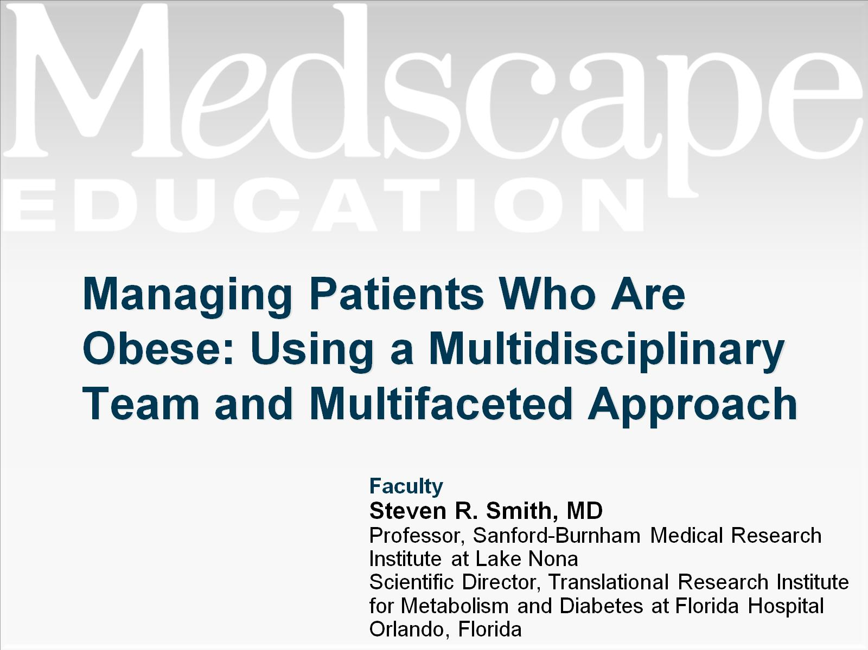
Managing Patients Who Are Obese: Using a Multidisciplinary Team and Multifaceted Approach

Slide 32
Strategies to Improve a Multidisciplinary Team Approach

Slide 33
What to Assess?

Slide 34
Multifaceted Approach to a Multifaceted Problem

Slide 35
Approaches to Weight Management

Slide 36
Macronutrient Proportion and Body Weight in Adults

Slide 37
Taking the Next Step

Slide 38
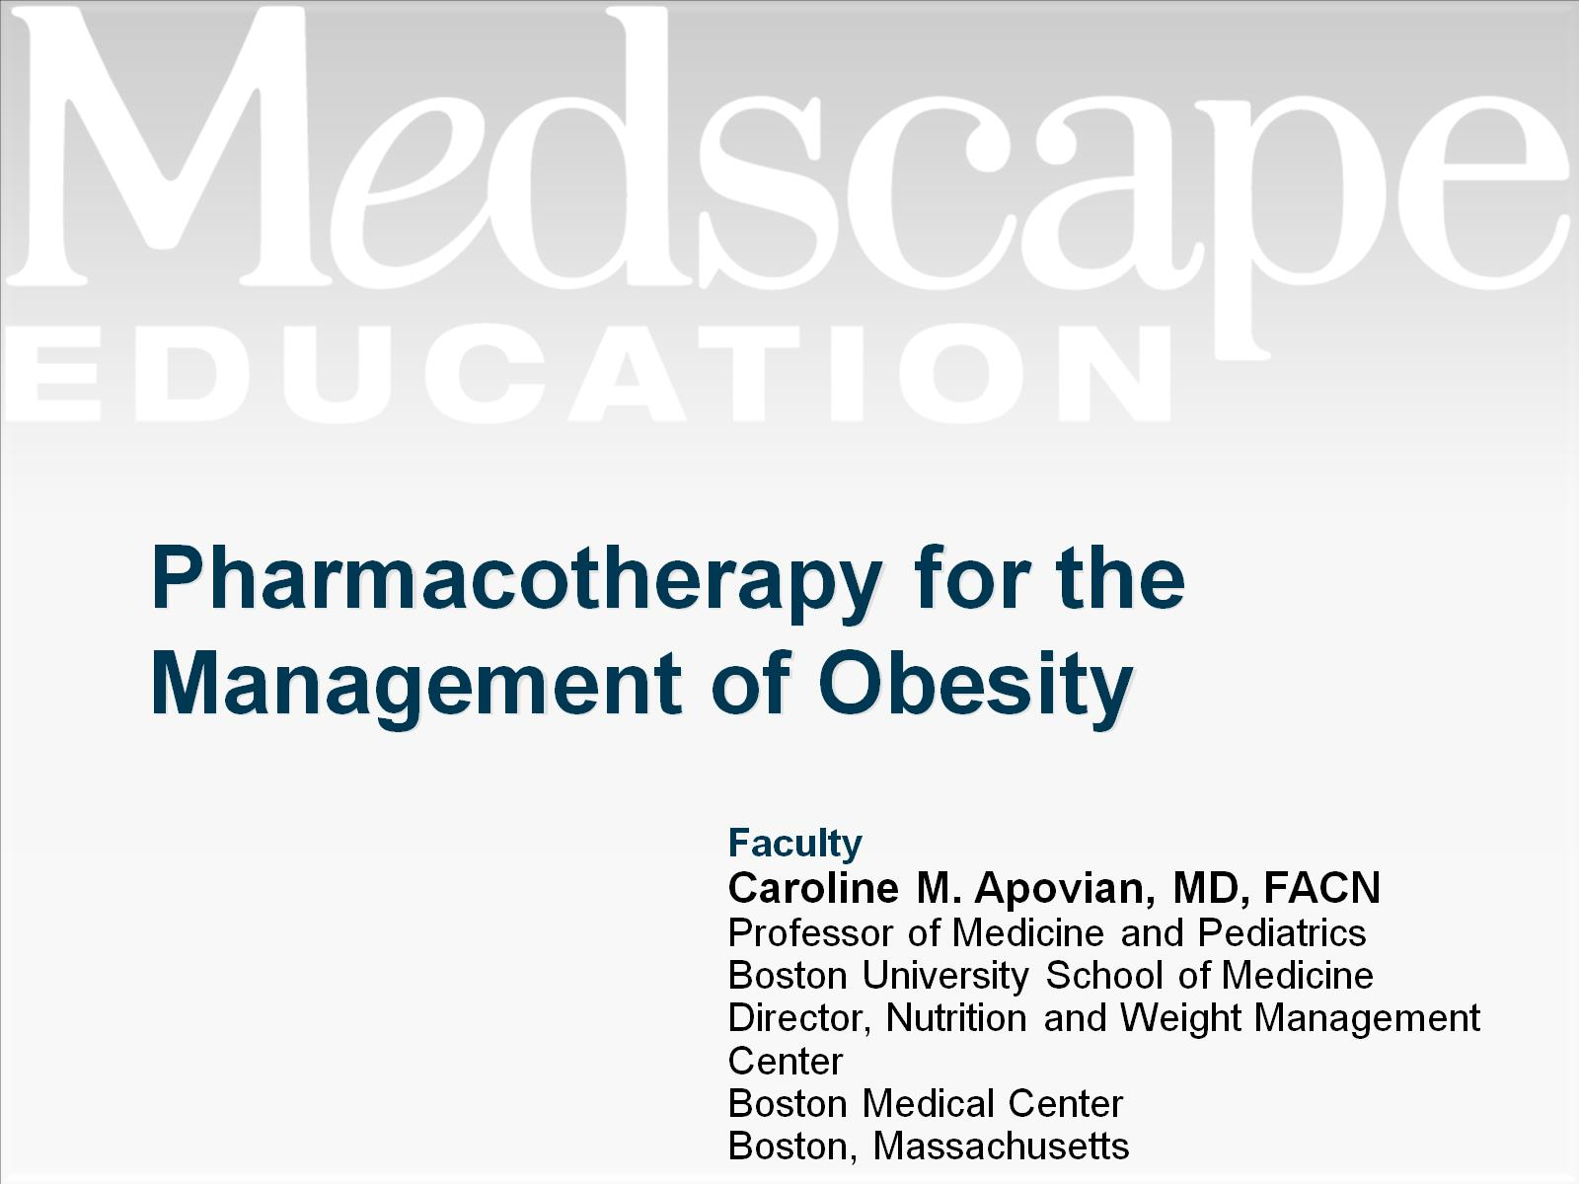
Pharmacotherapy for the Management of Obesity

Slide 39
Hormonal and Neural Pathways Regulate Food Intake and Body-Fat Mass

Slide 40
Hypothetical “Feed-forward” Positive Feedback Mechanism to Drive Weight Up

Slide 41
Anti-Obesity Drugs and Their Complex Pathways

Slide 42
The Problem

Slide 43
Newly Approved and Investigational Anti-Obesity Medications

Slide 44
Safety Information

Slide 45
Safety Information (cont)

Slide 46
Bringing it All Together: Recipe for an Effective Weight Loss Plan

Slide 47
Obesity Is a Complex Disease With Multiple Determinants

Slide 48
There Are Multiple Options for Obesity Treatment

Slide 49
Current Hierarchical Provision of Obesity Care by Physicians

Slide 50
Applying the Modified 5As for Obesity Management

Slide 51
Alternative Strategy Ask. Advise. Refer. = 5As

Slide 52
New Hierarchical Provision of Obesity Care by Physicians

Slide 53
Patient Encounter

Slide 54
Intensification of Therapies to Achieve Weight Loss Goals

Slide 55
Take Home Tips

Slide 56
Abbreviations

Slide 57
Abbreviations (cont)

Slide 58
References

Slide 59
References (cont)

Slide 60
References (cont)

Slide 61
References (cont)

Slide 62
References (cont)

