Slide 1
Cleveland Clinic Perspectives on Multiple Sclerosis Care: Challenges and Best Practices

Slide 2
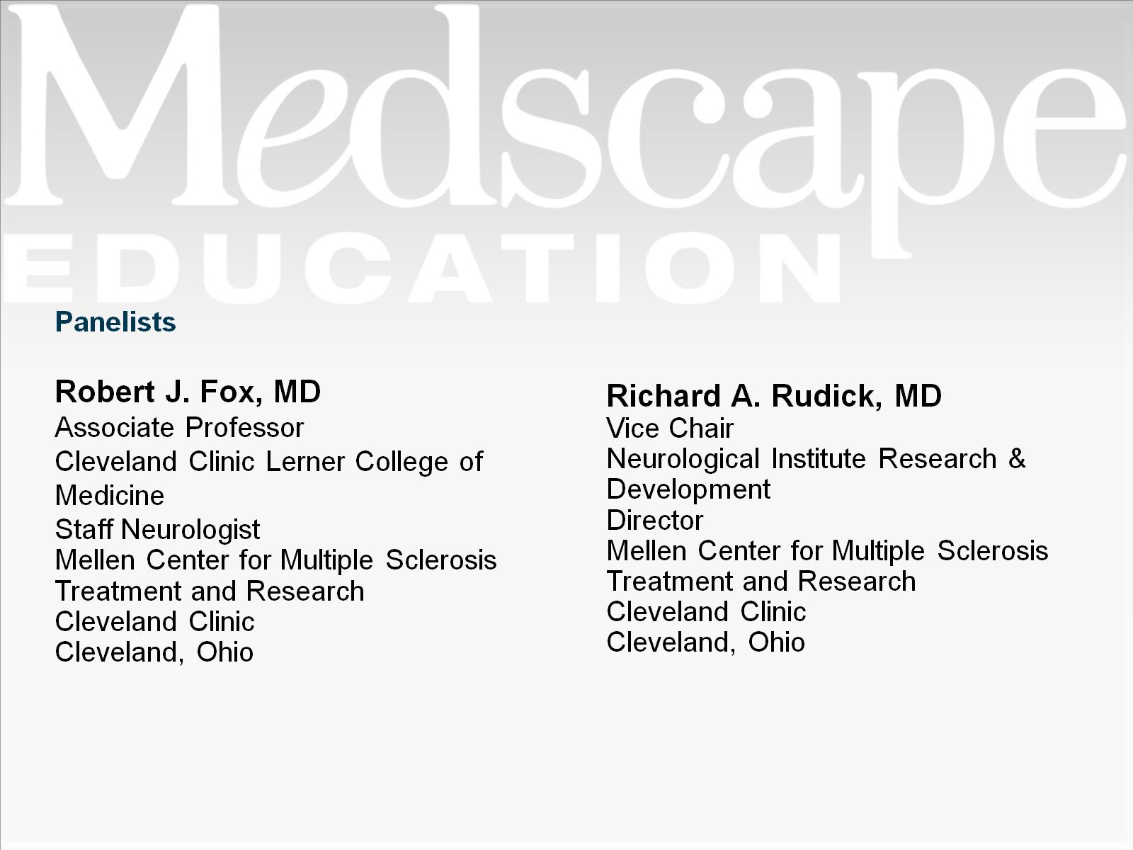

Slide 3
Disclaimer

Slide 4
Program Goals

Slide 5
Introduction

Slide 6
Changes in the MS Field

Slide 7
Factors That May Determine Prognosis

Slide 8
Diagnostic Considerations

Slide 9
Goals of Treatment

Slide 10
Managing Risks of Treatment

Slide 11
Making Treatment Decisions

Slide 12
An Emerging Concept: Disease-free Status (No Evident Disease Activity)

Slide 13
Components of Comprehensive MS Care

Slide 14
Components of Comprehensive MS Care (cont)

Slide 15
Identifying and Overcoming Barriers

Slide 16
Cleveland Clinic Mellen Center Resources

Slide 17
Cleveland Clinic Mellen Center Resources (cont)

Slide 18
Future Developments

Slide 19
Summary

Slide 20
Abbreviations

Slide 21
References

Slide 22
References (cont)

Slide 23
References (cont)

Slide 24
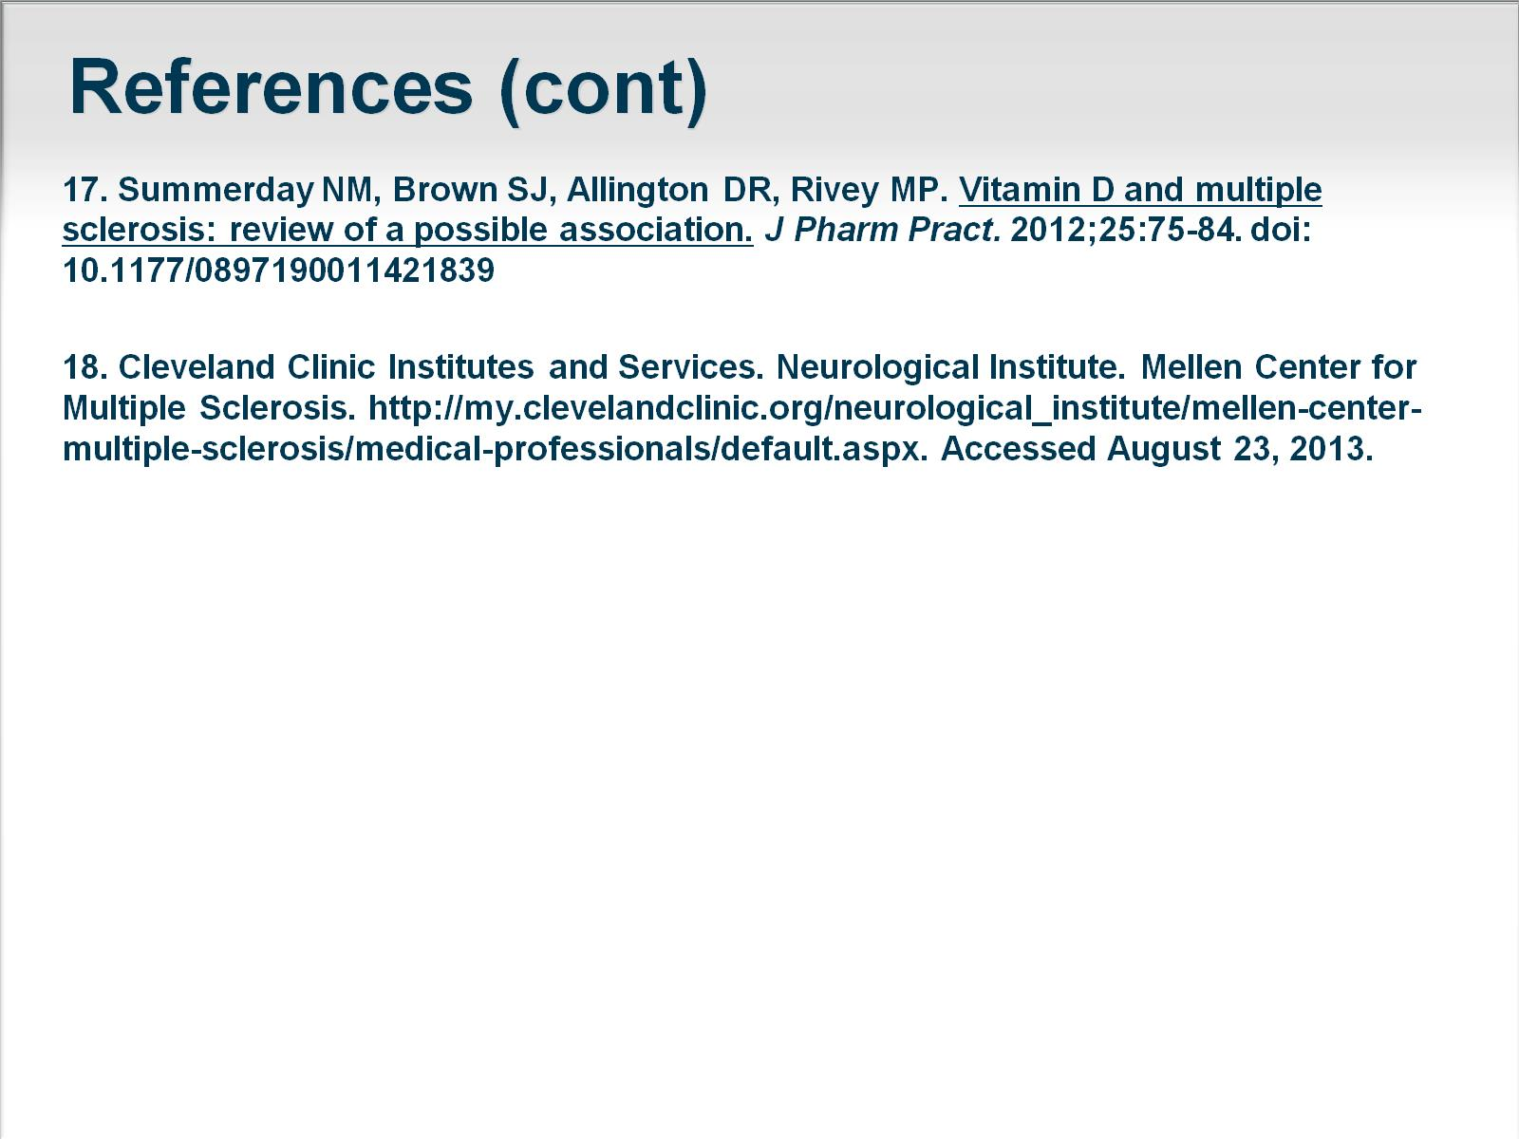
References (cont)

