Slide 1
Best Practices in the Diagnosis of Clinically Isolated Syndrome and Clinically Definite MS
Notes:
Best Practices in the Diagnosis of Clinically Isolated Syndrome and Clinically Definite MS
Matilde Inglese, MD, PhD
Associate Professor of Neurology, Radiology, and Neuroscience
Icahn School of Medicine at Mount Sinai, New York, New York
Additional images courtesy of Max Bester, MD, Department of Diagnostic and Interventional Neuroradiology, University Medical Centre Hamburg-Eppendorf (UKE), Hamburg, Germany

Slide 2
Notes:
Multiple sclerosis (MS) is a clinical diagnosis, dependent on a detailed history, careful neurologic examination, and supportive paraclinical investigations, including magnetic resonance imaging (MRI) scans, evaluation of cerebrospinal fluid (CSF), visual evoked potentials (VEPs), and blood tests to exclude confounding diagnoses.
Classic MS diagnostic criteria require the evidence of lesions in the central nervous system (CNS) disseminated in space (DIS) and disseminated in time (DIT) (ie, >1 clinical episode involving >1 area of the CNS (brain, spinal cord, and optic nerves)).^{[1]} About two-thirds of patients experiencing a single episode of suspected demyelination -- also known as clinically isolated syndrome (CIS) -- have cerebral white matter (WM) lesions indistinguishable from those seen in clinically definite MS (CDMS). Since the presence of such lesions increases the likelihood of developing CDMS, the formal MRI features for DIS and DIT were incorporated within the diagnostic criteria for MS by an international panel in 2001. There are 3 diagnostic categories: possible MS, MS, or not MS.

Slide 3
Notes:
Because the duration of gadolinium (Gd) enhancement in MS is usually <6 weeks, an MRI scan of the brain that is performed at 3 months after the initial clinical event and that demonstrates a new Gd-enhancing lesion would indicate a new CNS inflammatory event and would meet the criteria for DIT.
If there are no Gd-enhancing lesions but there is a new T2 lesion, a repeat MRI scan after another 3 months is needed with demonstration of a new T2 lesion or Gd-enhancing lesion.
In primary-progressive MS (PPMS) with the presence of abnormal CSF (ie, oligoclonal bands), DIS can be demonstrated using MRI or abnormal VEP; DIT can be demonstrated using MRI or continued progression of disability for 1 year. The sensitivity of the 2001 McDonald criteria is 47% and the specificity is 91%.^{[1]}

Slide 4
Notes:
In light of subsequent studies, the 2001 criteria were revised in 2005.^{[2]} This revision is also known as the International Panel (IP) criteria. A constant feature in the 2001 and 2005 criteria is the use of the Barkhof-Tintoré criteria. However, the 2005 criteria for DIS differ from the earlier version in that any number of cord lesions can substitute for brain lesions, and a cord lesion is assigned the same status as an infratentorial lesion.

Slide 5
Notes:
For DIT, the 2005 criteria were more substantially revised to include a new T2 lesion occurring ≥1 month after clinical onset.^{[2]}
In PPMS, a clinical progression over 1 year is required, associated with 2 out of 3 of the following criteria: 1) DIS demonstrated by ≥2 T2 spinal cord lesions or 9 T2 brain lesions; 2) 4 to 8 brain lesions plus abnormal VEPs; 3) abnormal CSF (ie, presence of oligoclonal bands).
The sensitivity of the 2005 McDonald criteria is 60% and specificity is 88%.^{[2]}

Slide 6
Notes:
How familiar are you with the revised McDonald criteria for diagnosis of MS?
◻ I am very familiar with the criteria and apply them in my practice
◻ I am very familiar with the criteria but do not apply them in my practice
◻ I am somewhat familiar with the criteria and do not apply them in my practice
◻ I am not very familiar with the criteria

Slide 7
Notes:
The criteria were further revised in 2010 to allow for an earlier MS diagnosis.^{[3]} In the McDonald 2010 revision, lesion dissemination in space can be confirmed with just one T2 lesion in at least 2 of 4 characteristic locations: juxtacortical, periventricular, posterior fossa, and in the spinal cord.

Slide 8
Notes:
Per the 2010 criteria, simultaneous presence of asymptomatic Gd-enhancing and nonenhancing lesions at the baseline scan suffices for the diagnosis of lesion DIT.^{[3]} Additionally, a new T2 lesion identified on a second scan performed at any time after the clinical episode can be used to confirm DIT.
According to the McDonald criteria 2010 revision, a diagnosis of PPMS requires the clinical assessment of 1 year of disease progression (retrospectively or prospectively determined) and 2 out of 3 of the following criteria: 1) evidence for DIS in the brain based on ≥1 T2 lesions in at least 1 area characteristic for MS (periventricular, juxtacortical, or infratentorial); 2) evidence for DIS in the spinal cord based on ≥2 T2 lesions in the cord; 3) positive CSF (ie, evidence of oligoclonal bands). The sensitivity of the 2010 McDonald criteria is 72% and specificity is 87%.^{[3]}

Slide 9
Notes:
Spinal cord lesions have been incorporated in the MS diagnostic criteria since 2001. These lesions became increasingly important in the subsequent revisions and are now given the same weight as brain lesions. While a spinal MRI is always prescribed in CIS patients with spinal cord symptomatology to identify the cause of the symptoms, it is usually not requested in CIS patients presenting with brain symptoms, although asymptomatic spinal cord lesions are quite frequent.

Slide 10
Notes:
The aim of a study by Sombekke and colleagues was to assess the contribution of spinal cord lesions in diagnosing MS according to 2010 McDonald criteria and in predicting conversion to CDMS.^{[4]} In 121 CIS patients with either spinal cord (n=63) or brain symptom (n=58) onset, 36 patients fulfilled the McDonald criteria based on brain MRI only and 6 additional patients fulfilled the criteria based on the brain and spine MRI. In nonspinal CIS patients who did not fulfill McDonald brain MRI criteria (n=42), the presence of a spinal cord lesion was associated with a higher risk of conversion to CDMS and with a shorter time to conversion. The presence of spinal cord lesions may facilitate MS diagnosis and can also predict conversion to CDMS. For these reasons, spinal cord MRI is recommended in nonspinal CIS patients.^{[4]}

Slide 11
Notes:
Which of these statements best reflects the use of MRI in your practice? (Select all that apply)
◻ Obtain Gd-enhanced MRI of brain and spinal cord at baseline
◻ Obtain Gd-enhanced MRI every 6 months while the patient is on treatment
◻ Obtain Gd-enhanced MRI annually while the patient is on treatment
◻ Obtain cervical spine MRI every 2 years
◻ Obtain new MRI scans if the patient switches therapy

Slide 12
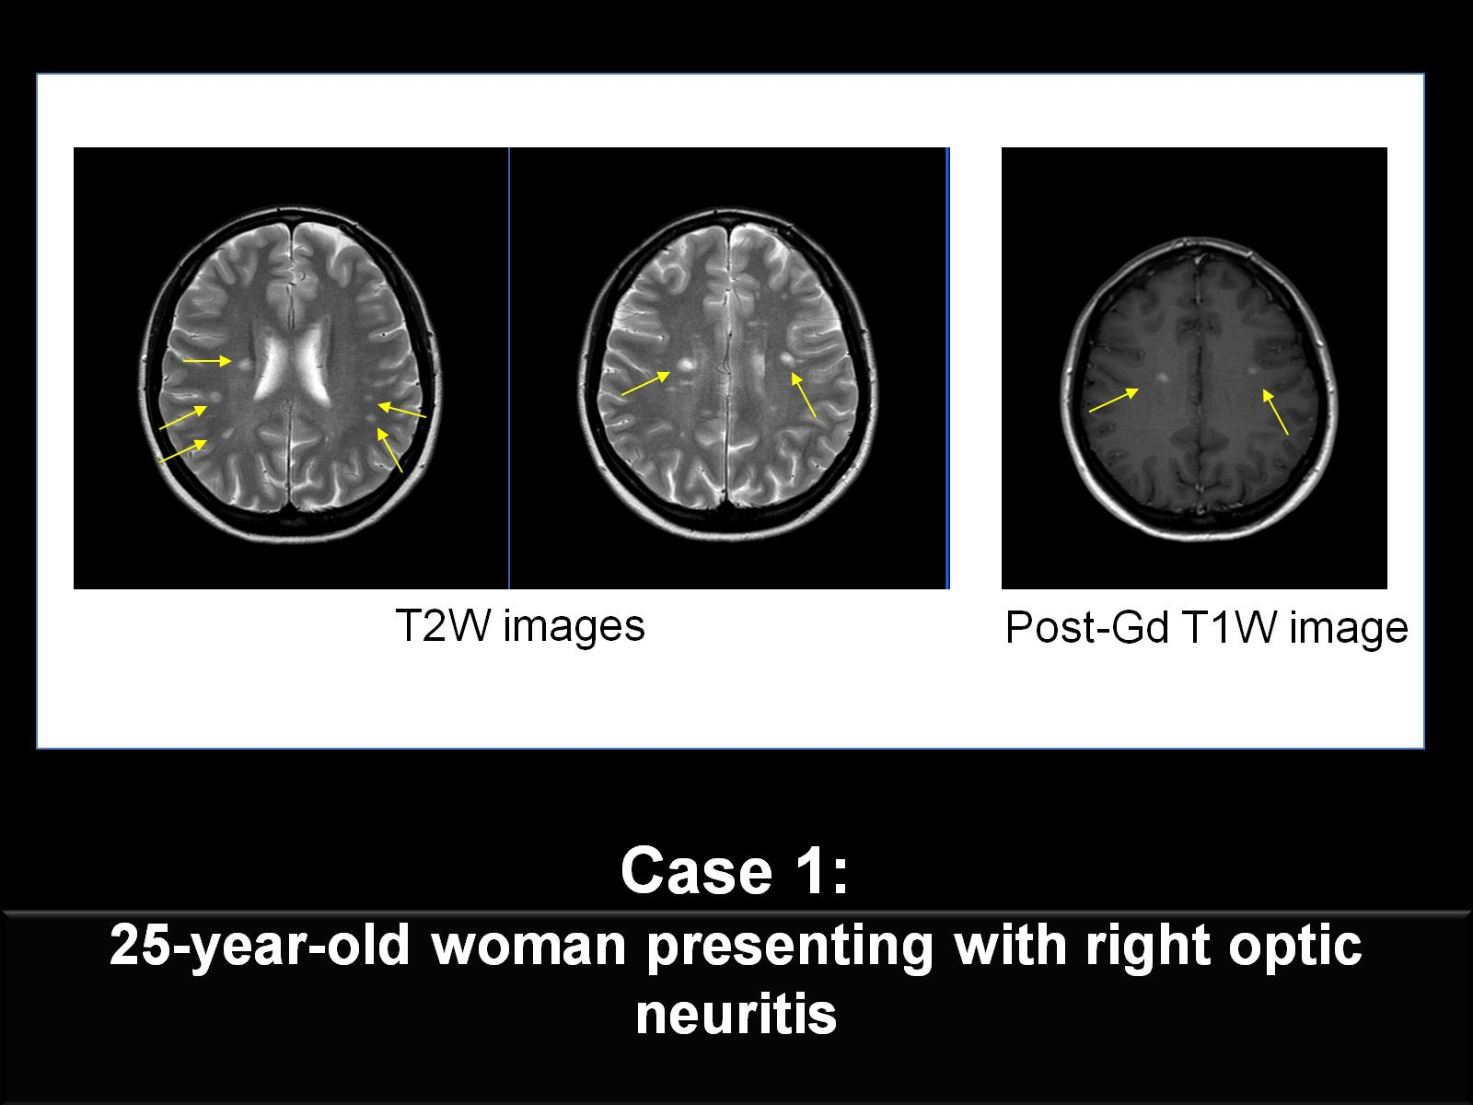
Notes:
We will now look at some real-life cases that illustrate how MS diagnostic criteria apply to clinical practice. The first case is a 25-year-old woman presenting with an episode of right optic neuritis that resolved completely after steroid treatment. CSF analysis revealed the presence of oligoclonal bands.
Clinical MRI shows multiple foci of increased T2 signal in the right periventricular white matter, in the right centrum semiovale, and in the subcortical WM bilaterally. Two of the WM T2 hyperintense lesions show nodular Gd enhancement on the corresponding postcontrast T1-weighted image. This patient fulfills the 2010 McDonald diagnostic criteria for DIS and DIT.

Slide 13
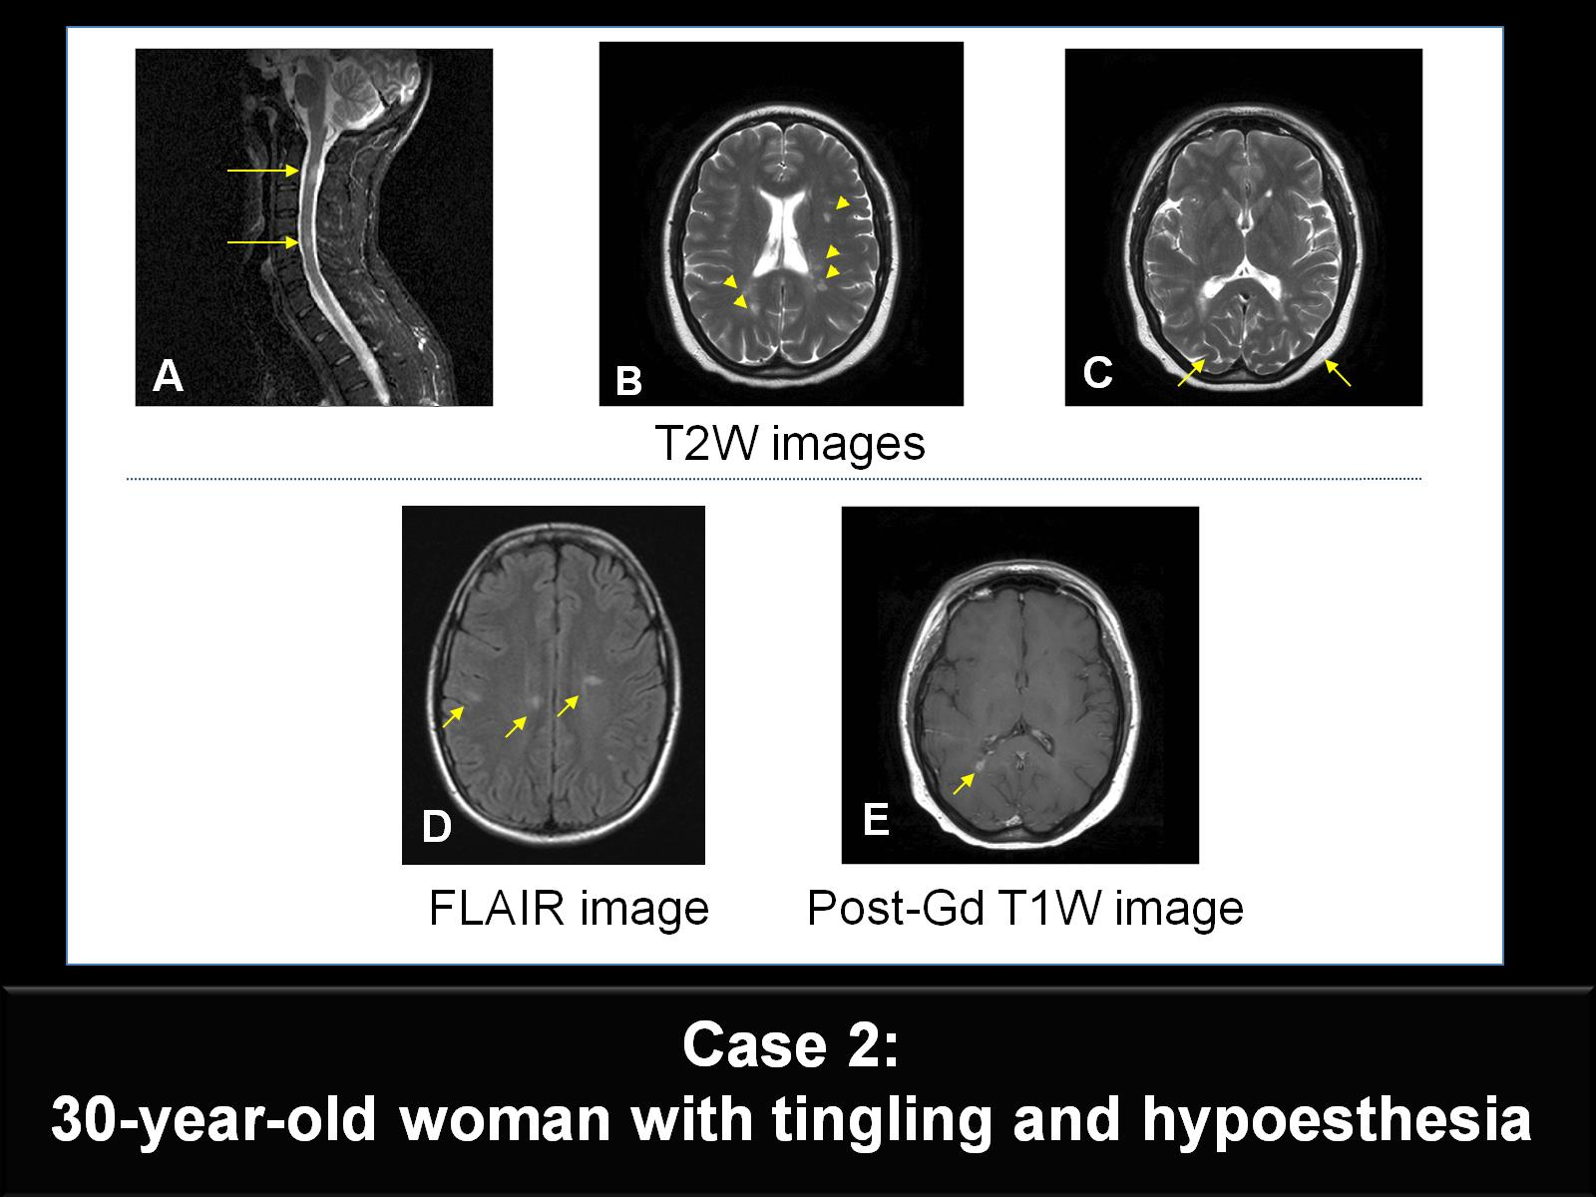
Notes:
In the second case, a 30-year-old woman presents with an episode of tingling and hypoesthesia in the right upper and lower limbs. Cervical spinal cord MRI (Figure A) shows increased areas of T2 signal in the right dorsal spine at the C2 and C5 levels. Brain MRI shows multifocal areas of increased T2 (Figures B, C) and fluid-attenuated inversion recovery (FLAIR) signal (Figure D) in the periventricular and subcortical WM. One of the right periventricular hypointense lesions shows Gd-enhancement on the corresponding postcontrast T1-weighted image (Figure E). The patient fulfills the 2010 McDonald diagnostic criteria for DIS and DIT.

Slide 14
Notes:
Cortical and subcortical gray matter (GM) pathology in MS has been largely neglected because of the predominant interest in WM inflammatory demyelination and because of the difficulty in visualizing GM lesions using either conventional histochemical staining or MRI methods.
Cortical lesions are poorly detectable on routine MRI sequences such as T2-weighted (T2W) spin echo and FLAIR for several reasons: 1) smaller lesion size; 2) smaller difference in T1 and T2 relaxation times between lesions and surrounding tissue in gray matter than in white matter; 3) low inflammatory infiltration of cortical lesions and the less-frequent association with blood-brain barrier breakdown; and 4) partial volume effect resulting from the CSF of adjacent cortical sulci.^{[5]}
It has been shown that an improvement in cortical lesion detection in MS can be achieved by using a double-inversion recovery (DIR) sequence.^{[5]} In the brain, DIR is used to selectively image the GM by nulling the signal from WM and CSF. The images on this slide illustrate GM imaging using this technique in a patient.
In a DIR study of a large patient population, cortical lesions were detected in the majority of patients with relapsing-remitting MS (64%) and secondary progressive MS (70%), as well as in 37% of patients with CIS.^{[6]} This finding indicates that although cortical lesions are present in all MS phenotypes, the occurrence of cortical inflammation in this disease is an early phenomenon. Importantly, patients with cortical lesions were shown to have higher Expanded Disability Status Scale (EDSS) scores, a greater WM T2 lesion load, and a reduced brain volume than did patients with MS who did not have cortical lesions. A 3-year longitudinal follow-up study demonstrated that the number and volume of cortical lesions increased over time at a significantly greater rate in patients with clinical progression than was seen in patients who were clinically stable.^{[7]}

Slide 15
Notes:
However, a large proportion of cortical lesions may remain undetected, even when DIR imaging is used. Only 10% to 20% of the cortical lesions that are identified by immunohistological techniques are also detected on DIR images. DIR imaging increases cortical lesion detection rates per patient by an average of 152% when compared with FLAIR imaging and 500% when compared with conventional T2W MRI. The combination of DIR with other MRI sequences, such as phase-sensitive inversion recovery (PSIR), increases the cortical lesion detection rate. Combined PSIR and DIR images showed a 337% improvement in the total number of lesions detected compared with FLAIR alone.^{[8.9]} Currently, however, an optimal imaging technique that detects all cortical lesions is lacking.

Slide 16
Notes:
Readers should become acquainted with signal intensities in archicortical and paleocortical areas, such as the insula, which may be inherently higher on DIR images. Caution should be taken to avoid mistaking these features for cortical lesions.^{[10]}
Because DIR images at 1.5T and 3T are relatively noisy, cortical vessels may be mistaken for cortical lesions. Diffuse symmetric high signal changes in the occipital cortex do not represent real cortical abnormalities and are considered to be artifacts.
There is a higher propensity of DIR to vessel and CSF pulsation artifacts, particularly in the posterior fossa.

Slide 17
Notes:
Filippi and colleagues conducted a study to evaluate the contribution that detecting cortical lesions can make in the diagnostic workup of patients with CIS to predict the development of CDMS.^{[11]} They first tested 80 patients (training sample) and then validated their findings in 39 patients (validation sample). The presence of ≥1 cortical lesions, ≥1 infratentorial lesions, and ≥1 Gd-enhancing lesions or ≥1 spinal cord lesions were independent predictors of CDMS. The accuracy of the MS diagnostic criteria for DIS is increased when considering the presence of a cortical lesion on baseline MRIs of patients with CIS.­
However, such lesions have poor sensitivity for DIT and may not be useful for this purpose. The interpretation of intracortical lesions in patients with primary progressive MS is not distinguished from those with relapsing-remitting or secondary progressive MS, and will require further study. White matter- gray matter lesion detection at 3T may not be as strongly developed compared with the results at 1.5T.^{[8]}
Also, subpial lesions may escape DIR detection, and clearly differentiating between mixed juxtacortical or intracortical lesions and pure intracortical lesions may still be difficult.^{[12]}
A: Kaplan-Meier survival curves showing the probability of conversion to CDMS in the training sample of patients, classified based on the fulfillment of disease DIS (yes/no) according to the new criteria. Data take into account intracortical lesions (black lines), the revised IP criteria (dotted gray lines), and the Swanton/MAGNIMS criteria (gray lines).
B: Kaplan-Meier survival curves showing the probability of conversion to CDMS for patients classified according to the different criteria for DIS in the validation sample.^{[11]}

Slide 18
Notes:
Different DIR sequences are used in MS research centers for visualizing cortical lesions with results that are difficult to compare in the absence of a "gold standard." A multinational meeting of 12 researchers from 6 European MS centers was organized in Amsterdam in 2010 to reach consensus and propose recommendations for scoring cortical lesions. The recommendation criteria were tested on DIR images acquired from 18 MS patients in the 6 European centers according to local MRI protocols. A modest agreement was reached (complete agreement in 19.4% of lesions), suggesting that consistency in MR field strength and acquisition protocols should be applied in prospective studies before incorporating cortical lesion assessment in MS diagnostic criteria.^{[10]}
The obligatory criteria recommended by this expert panel are shown here.

Slide 19
Notes:
Shown here are the supportive recommendations from the European expert consensus panel.^{[10]}

Slide 20
Abbreviations

Slide 21
Abbreviations (cont)

Slide 22
References

Slide 23
References (cont)

Slide 24
References (cont)

