Slide 1
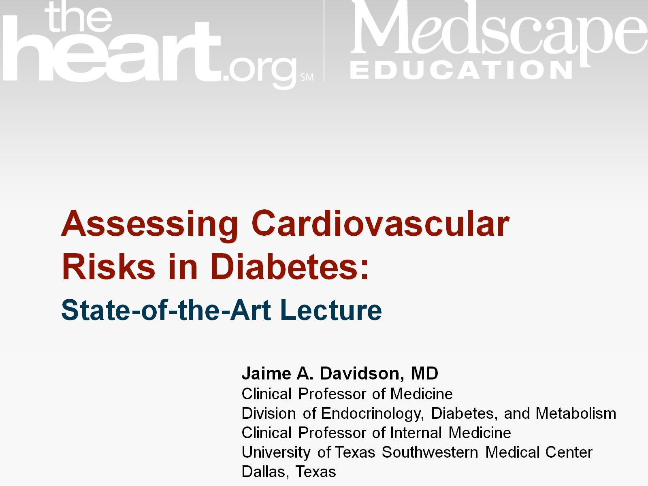
Assessing Cardiovascular Risks in Diabetes:

Slide 2
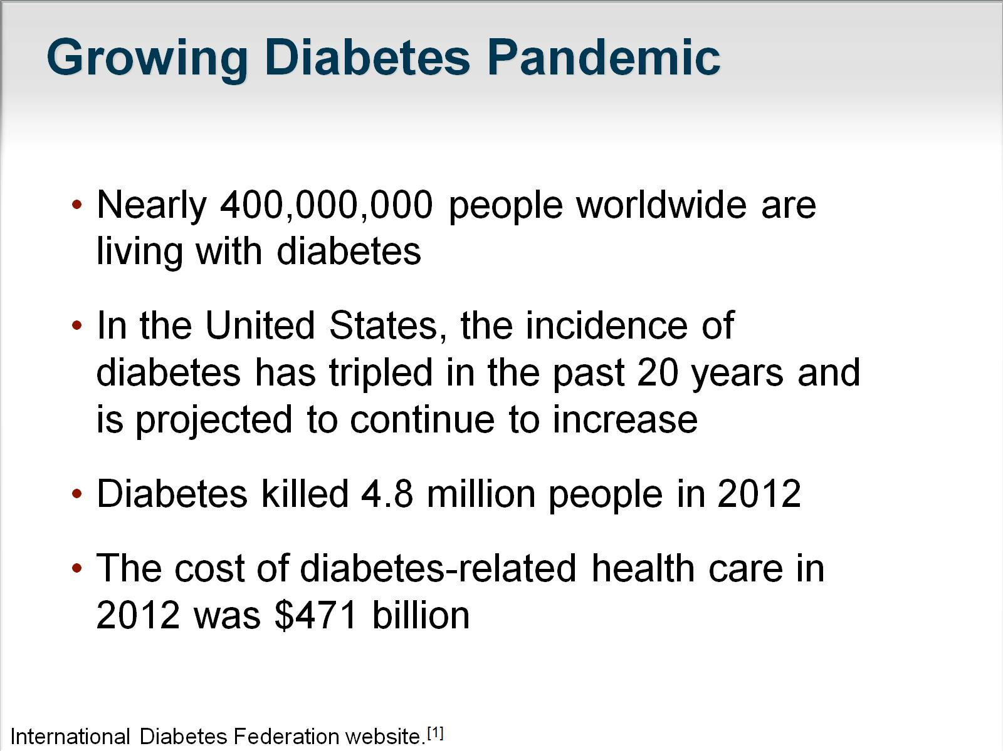
Growing Diabetes Pandemic

Slide 3
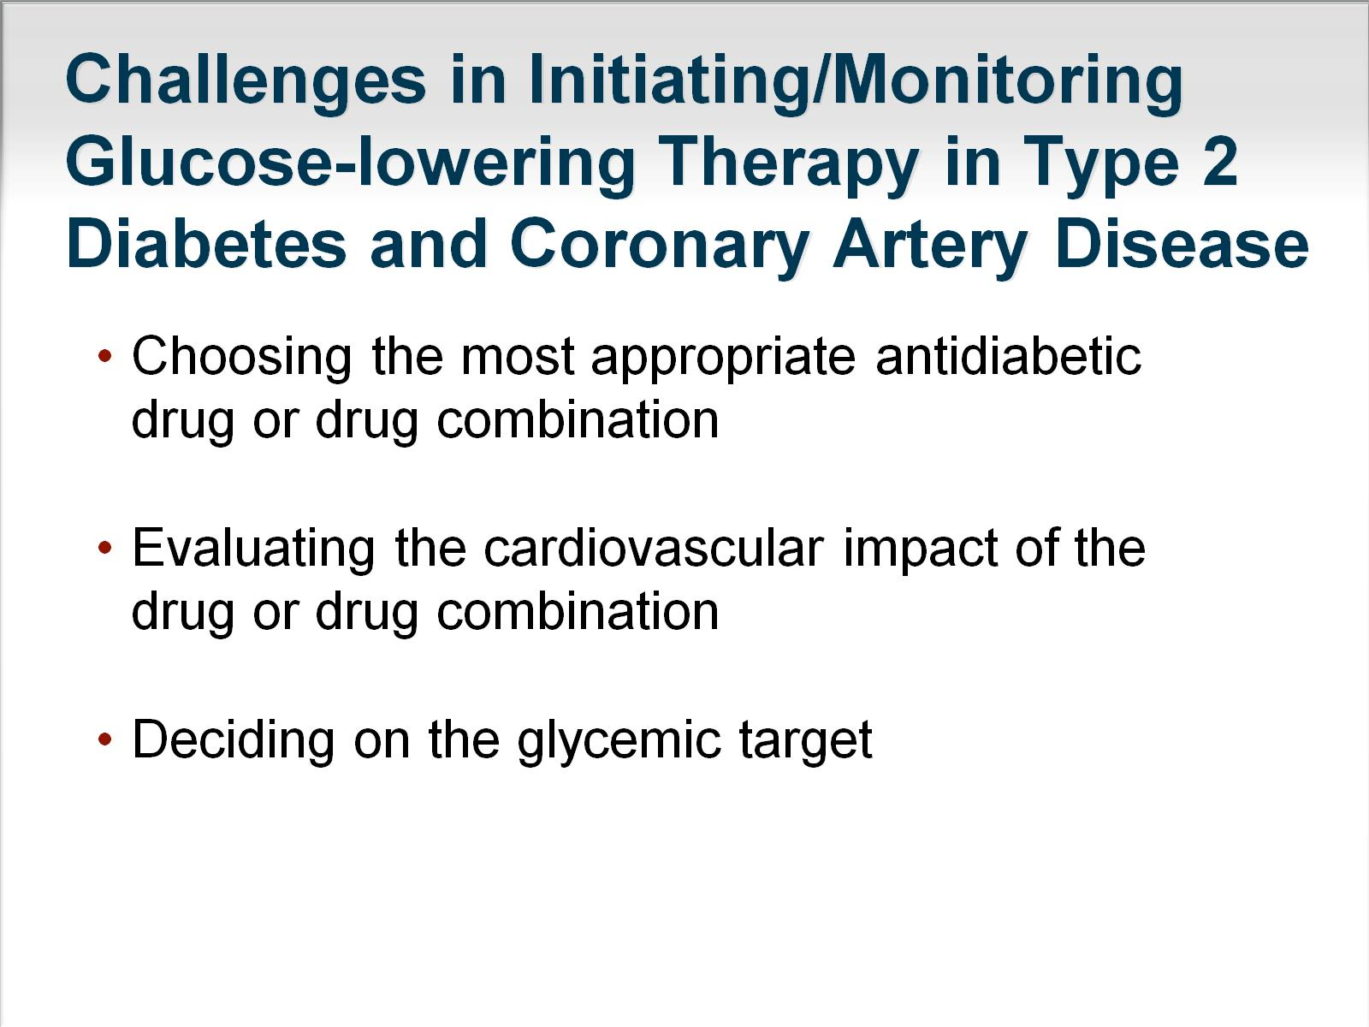
Challenges in Initiating/Monitoring Glucose-lowering Therapy in Type 2 Diabetes and Coronary Artery Disease

Slide 4
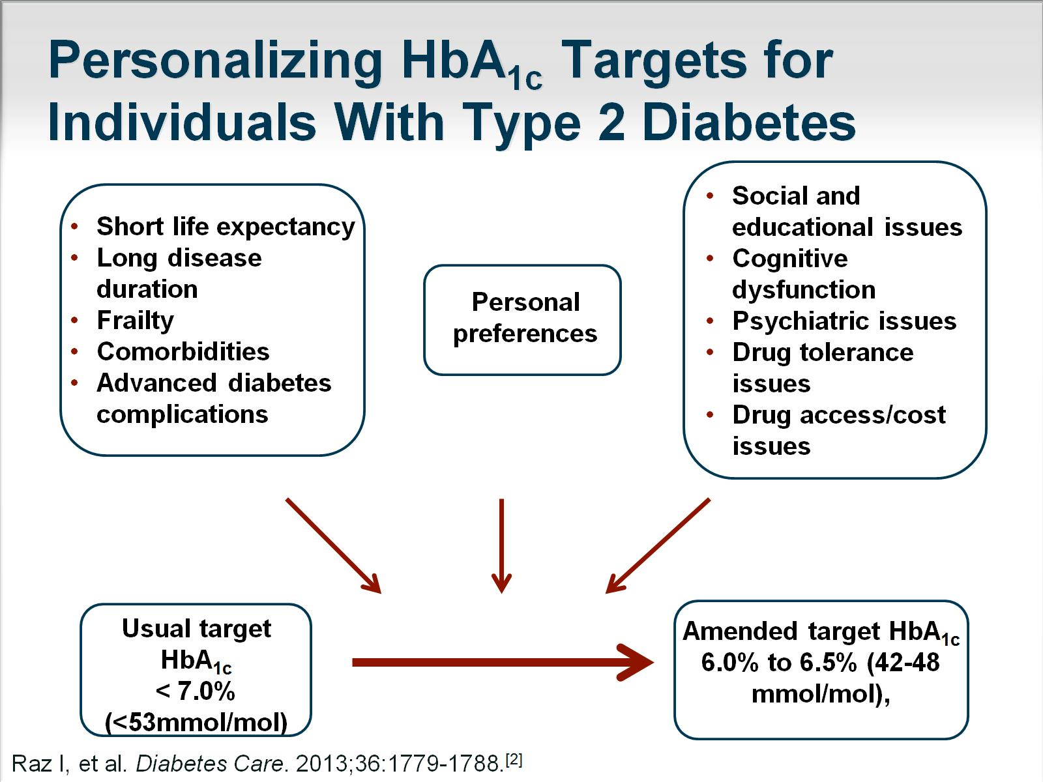
Personalizing HbA_{1c} Targets for Individuals With Type 2 Diabetes

Slide 5
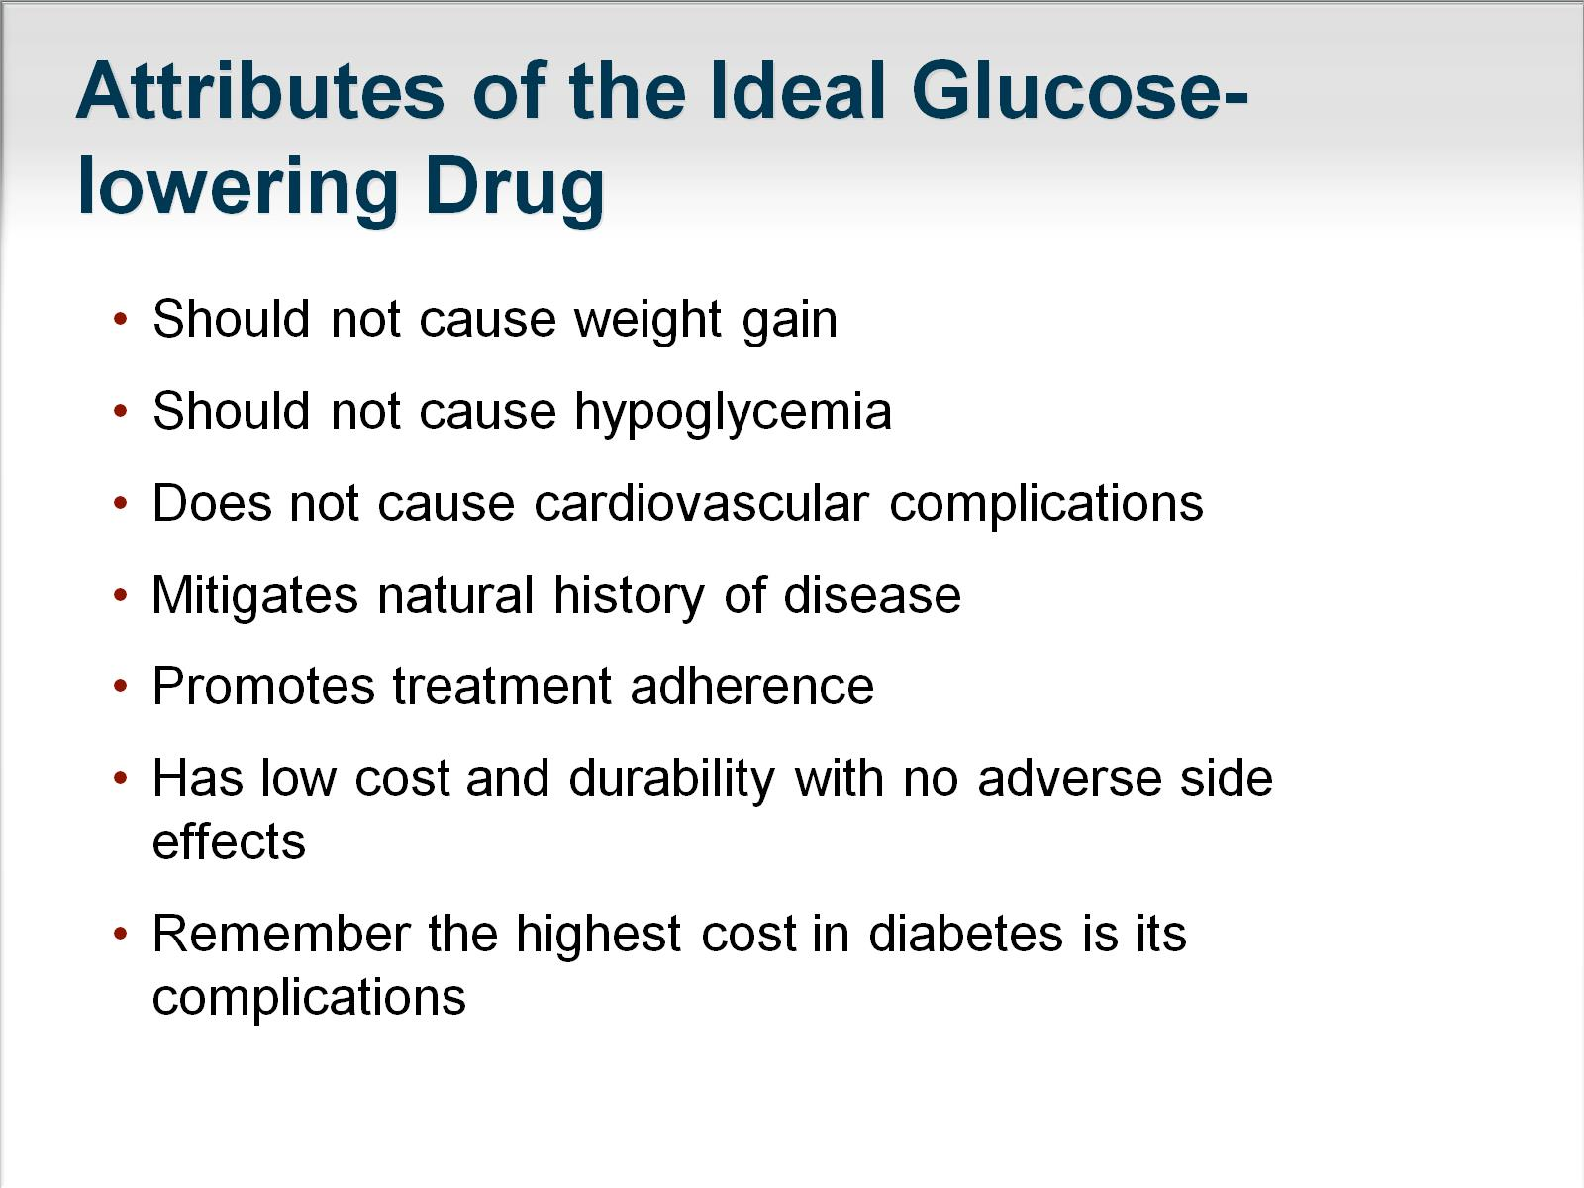
Attributes of the Ideal Glucose-lowering Drug

Slide 6
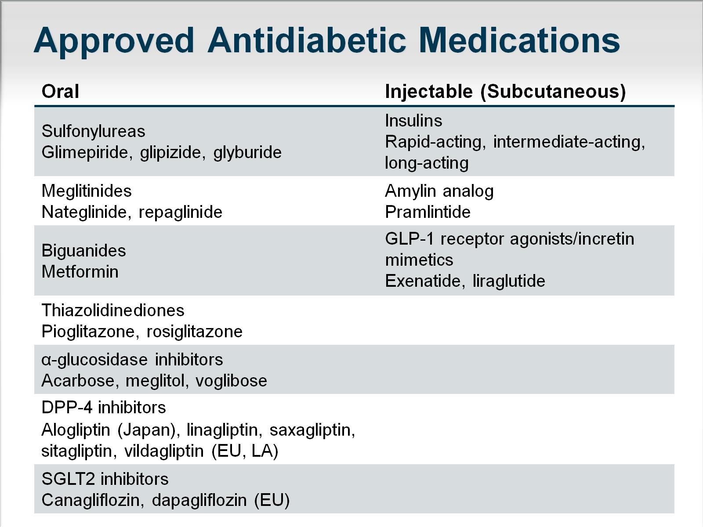
Approved Antidiabetic Medications

Slide 7
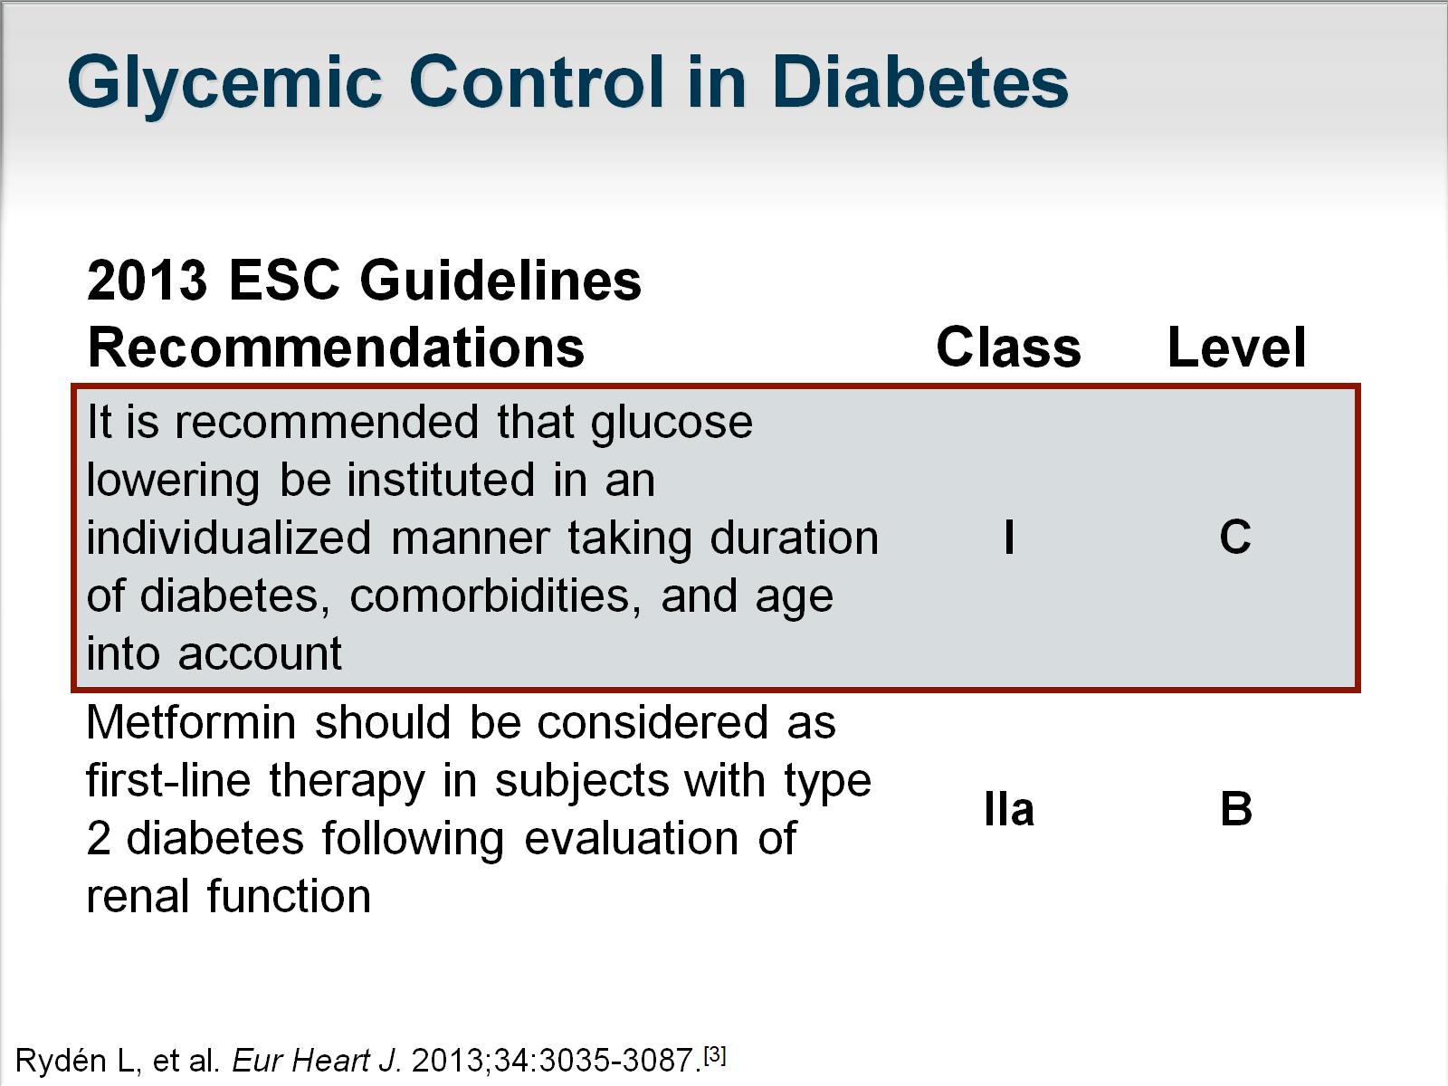
Glycemic Control in Diabetes

Slide 8
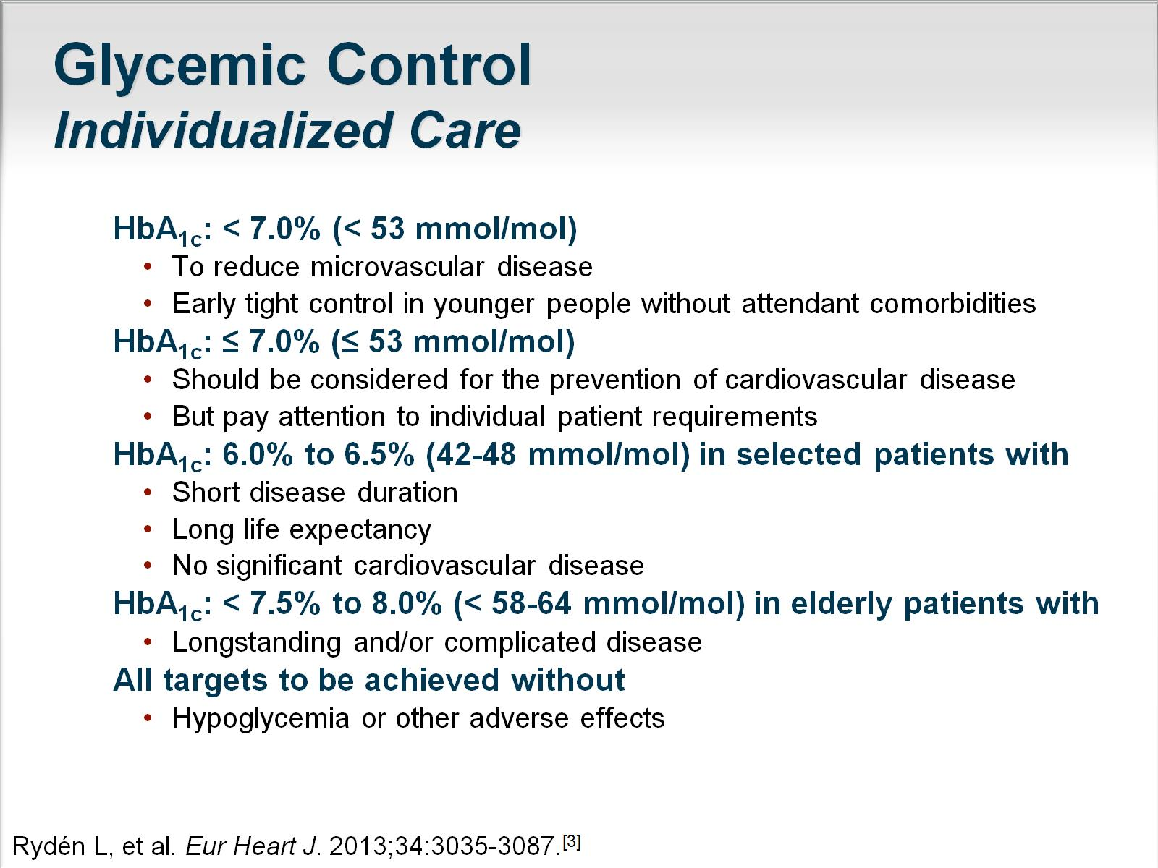
Glycemic Control
Individualized Care

Slide 9
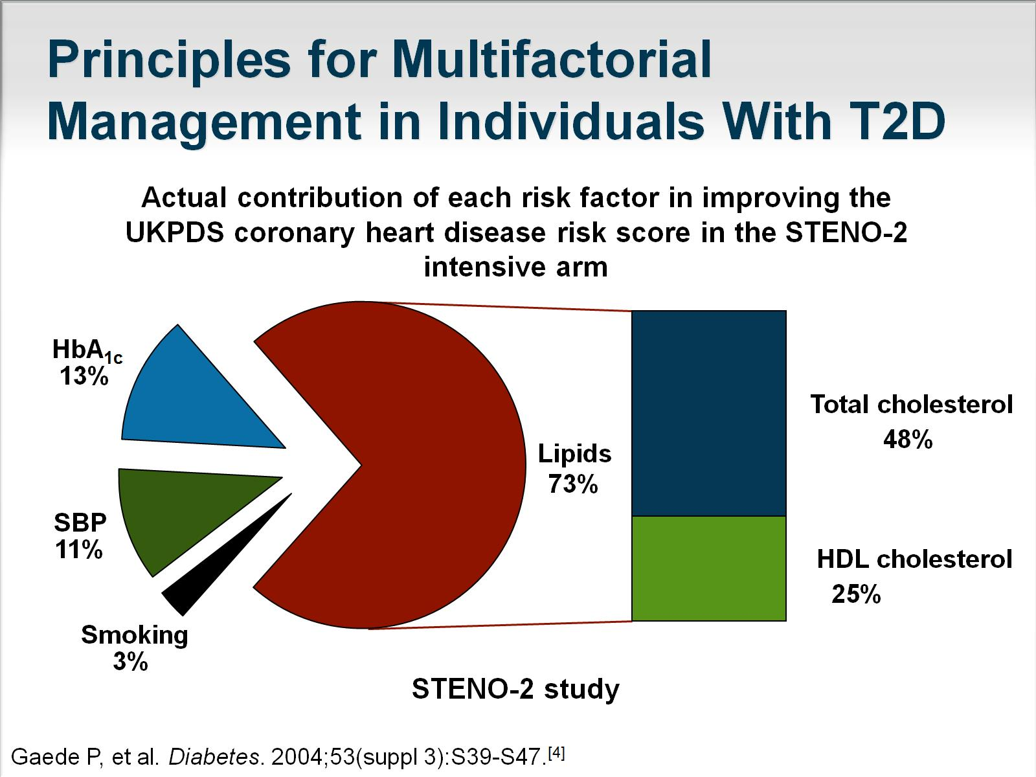
Principles for Multifactorial Management in Individuals With T2D

Slide 10
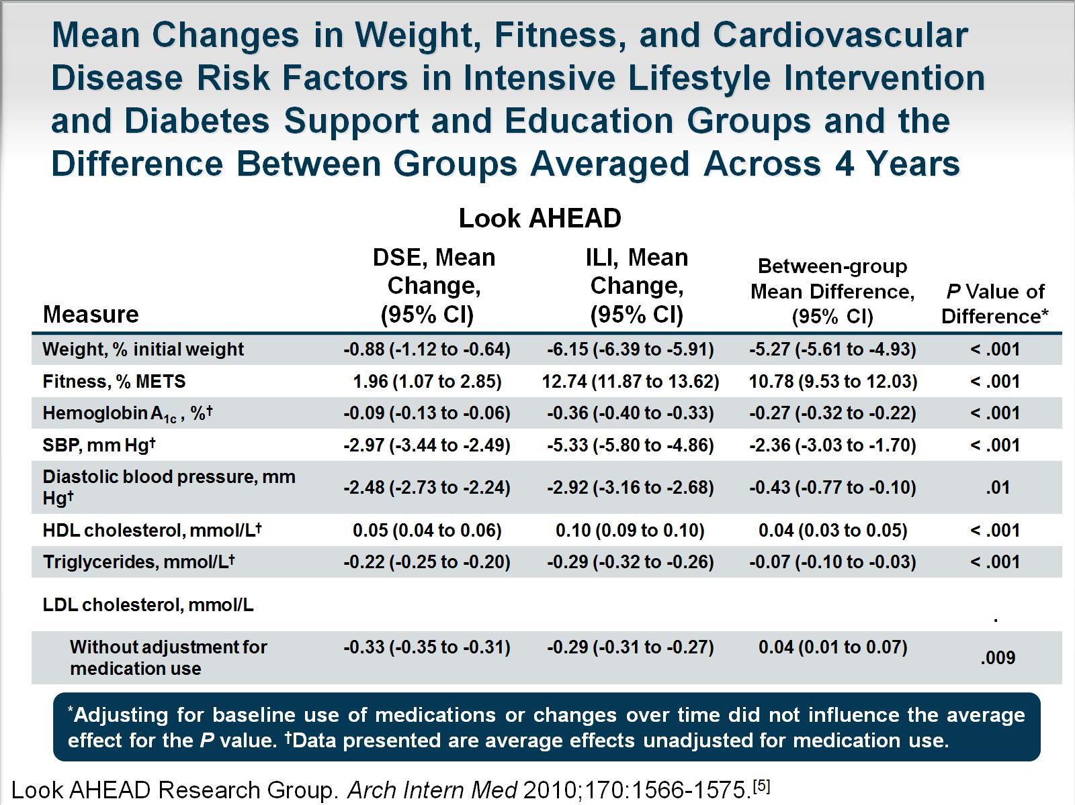
Mean Changes in Weight, Fitness, and Cardiovascular Disease Risk Factors in Intensive Lifestyle Intervention and Diabetes Support and Education Groups and the Difference Between Groups Averaged Across 4 Years

Slide 11
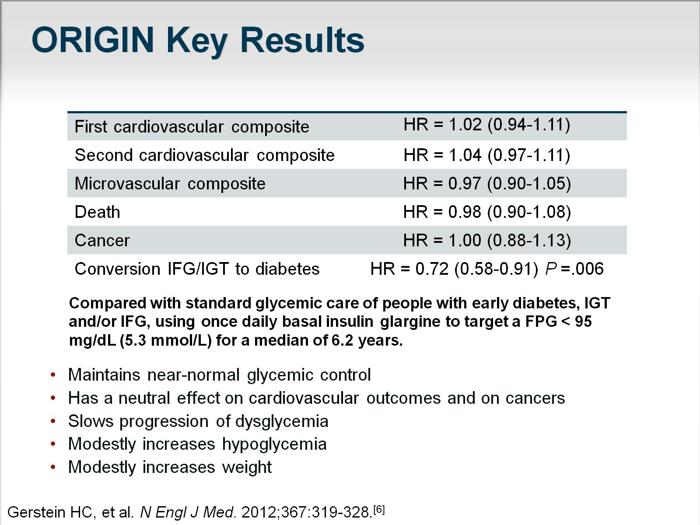
ORIGIN Key Results

Slide 12
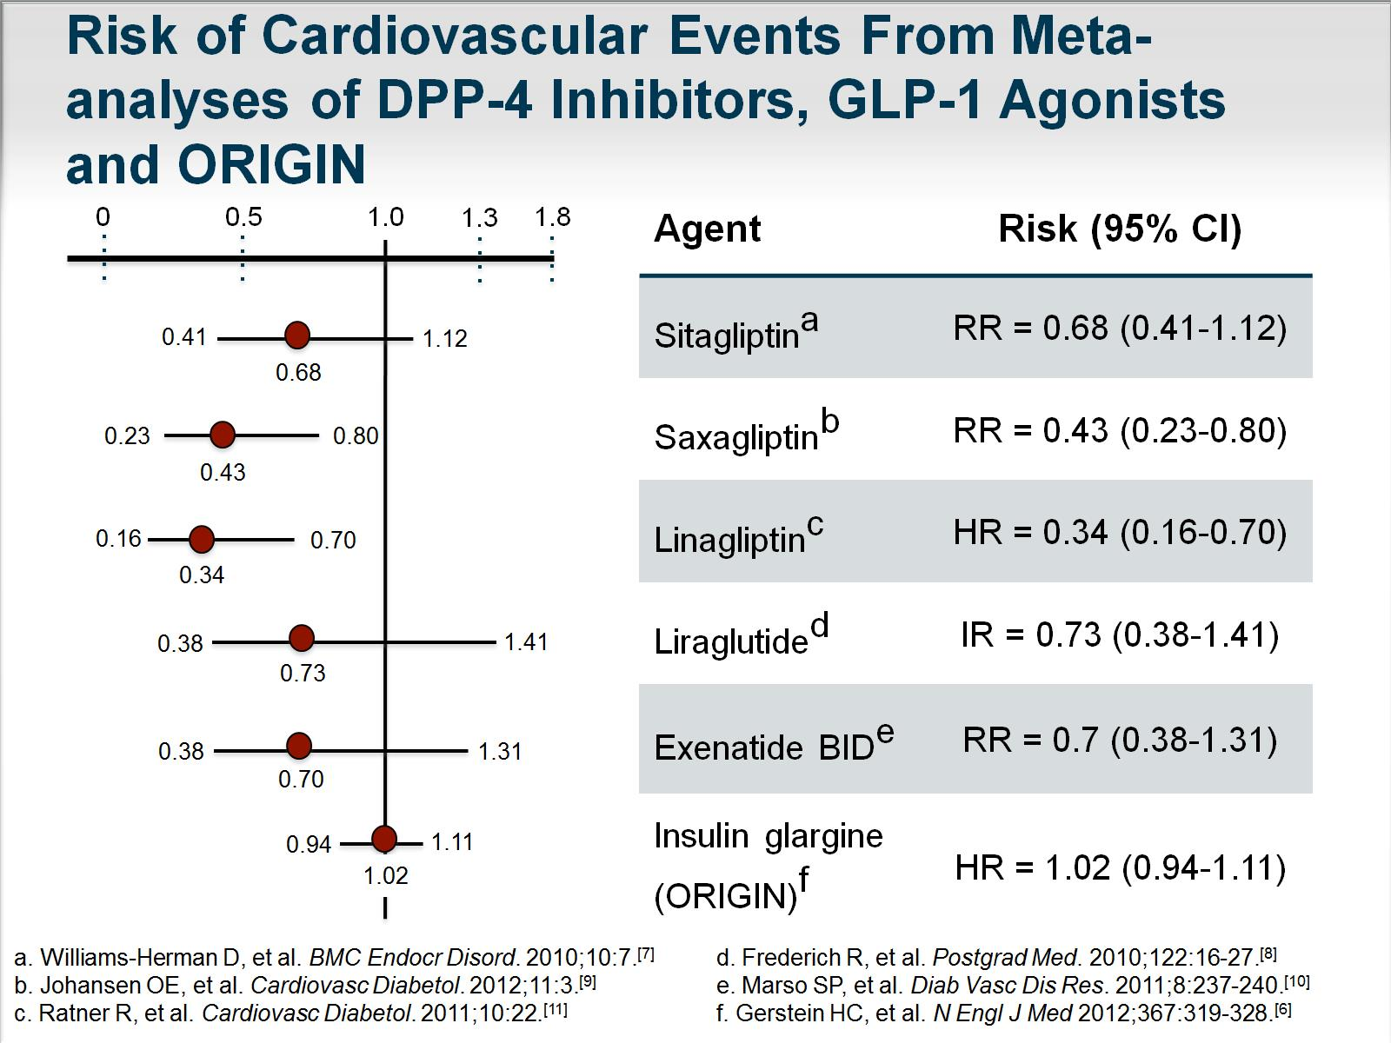

Slide 13
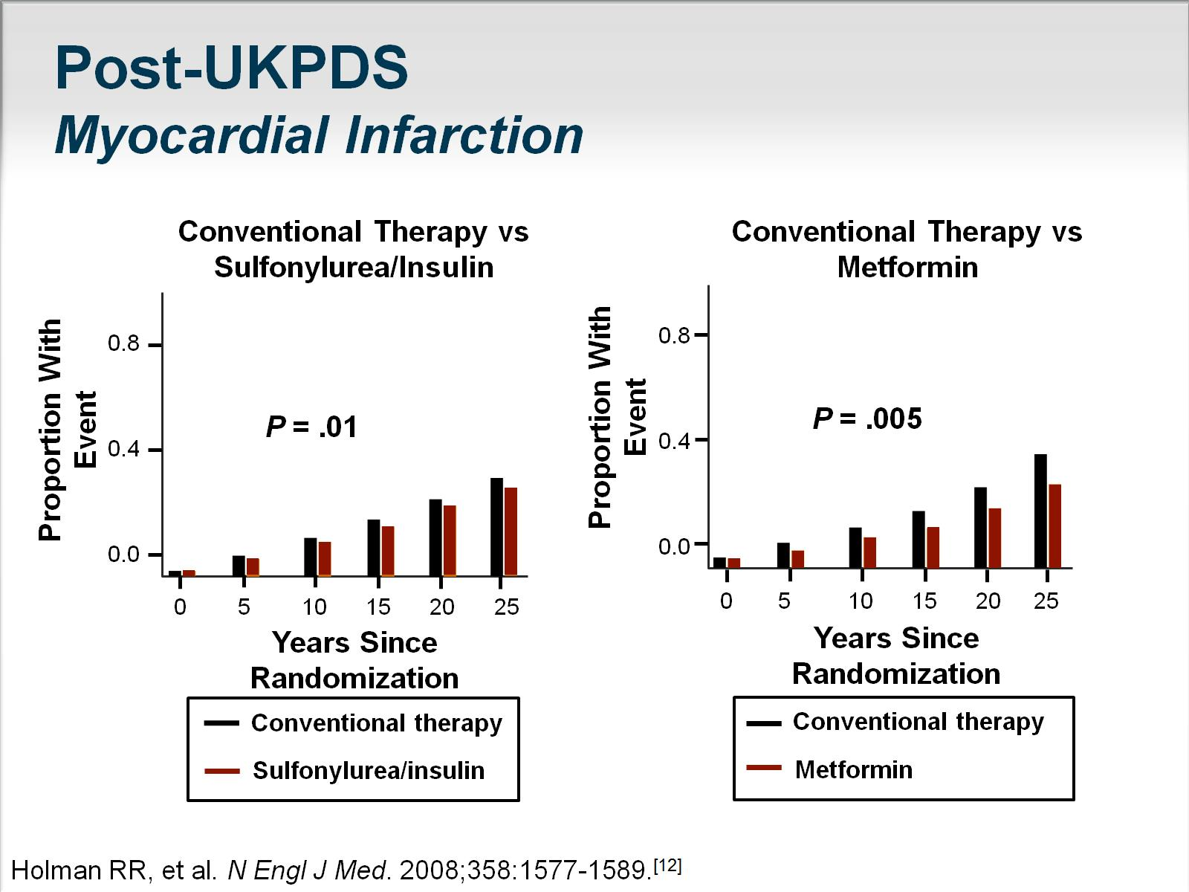

Slide 14
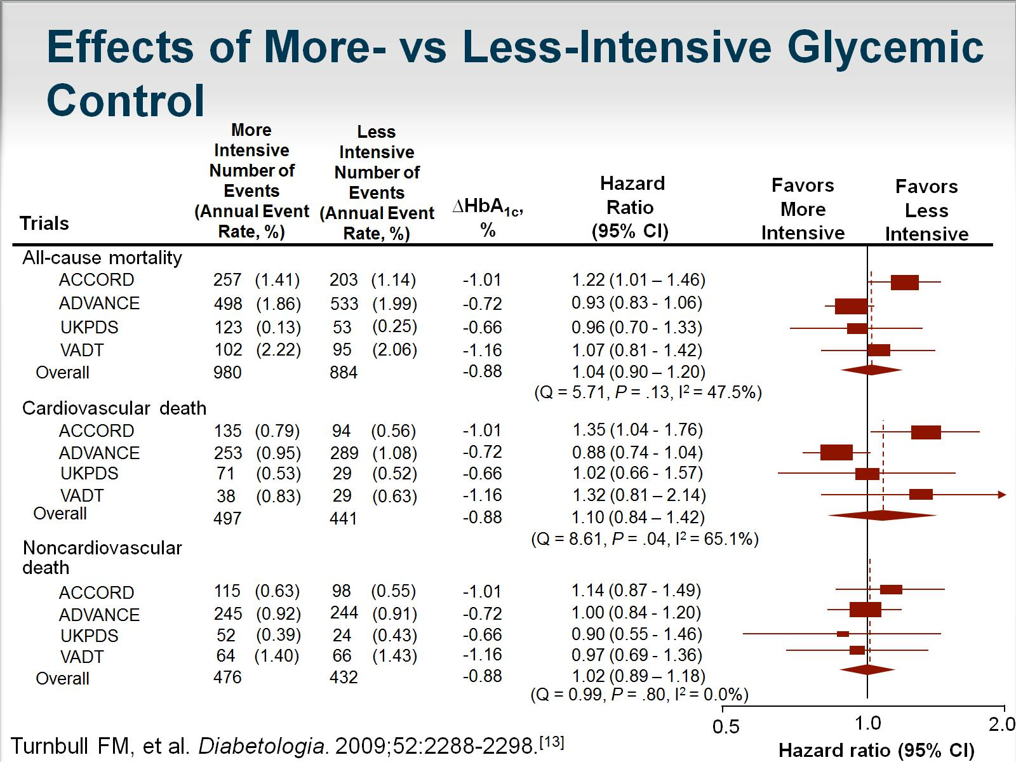

Slide 15
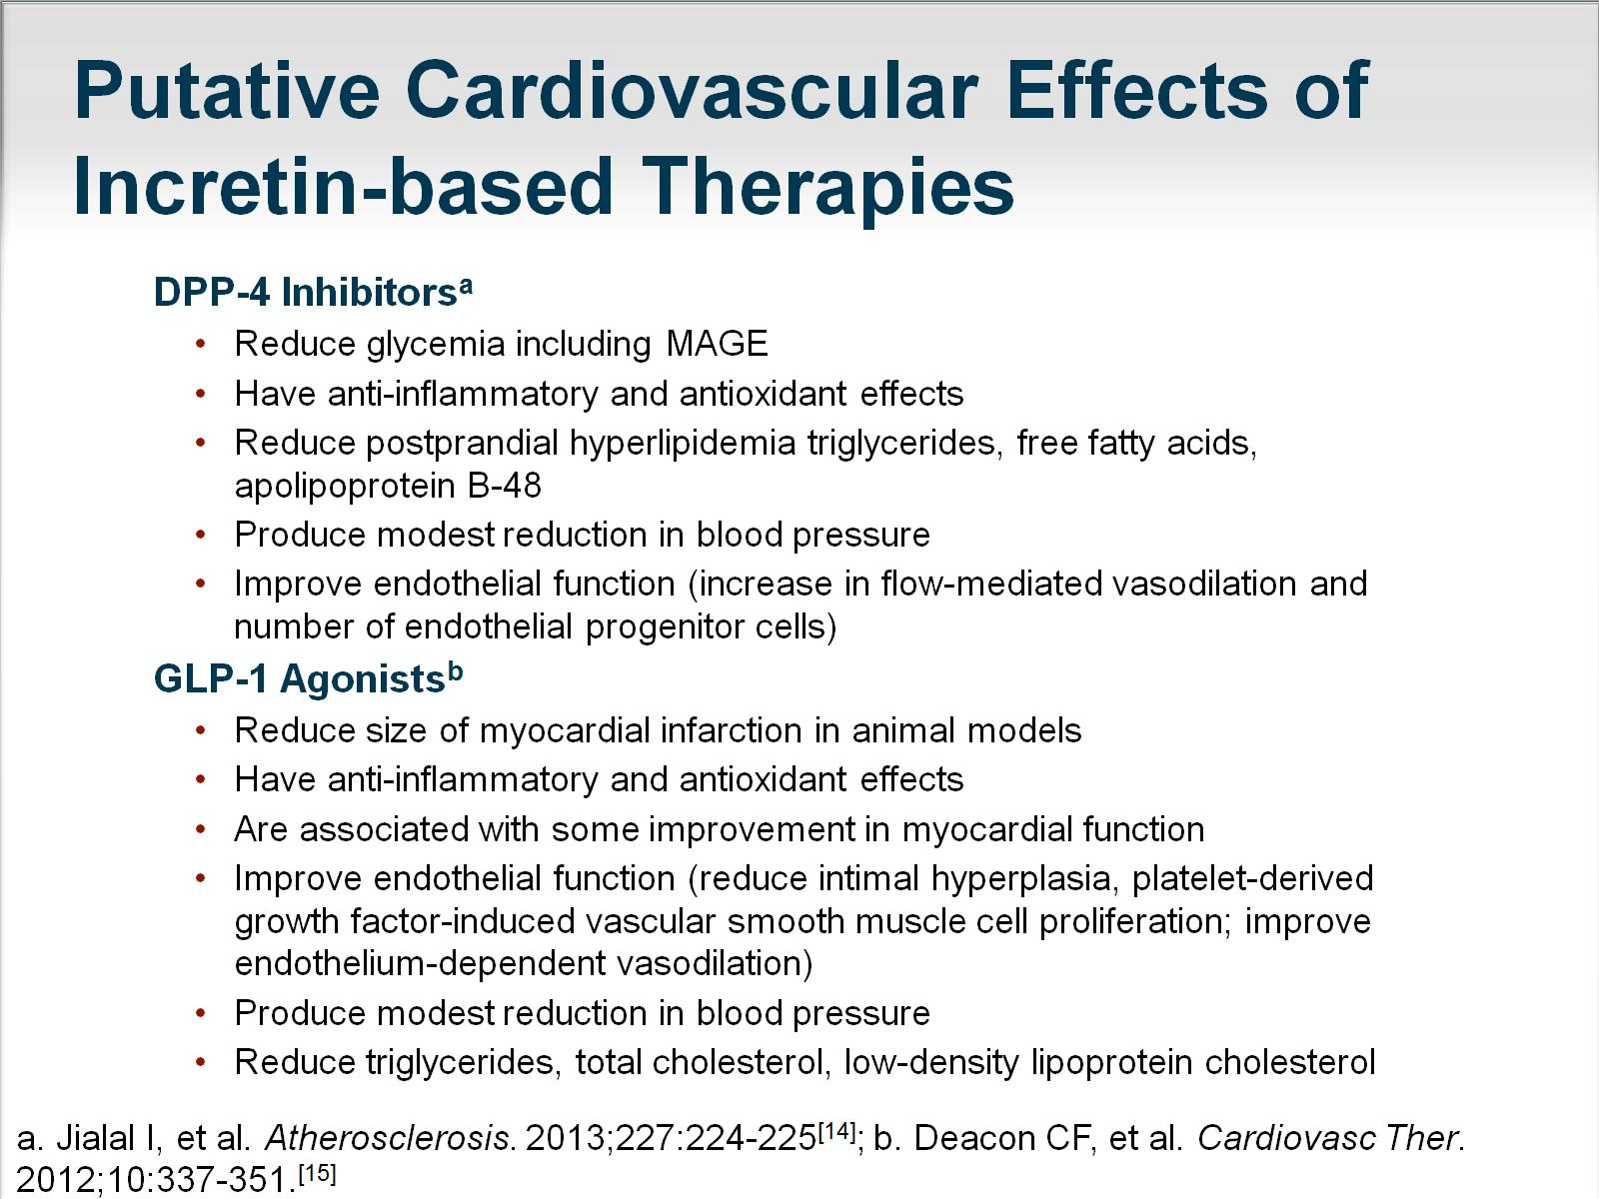

Slide 16
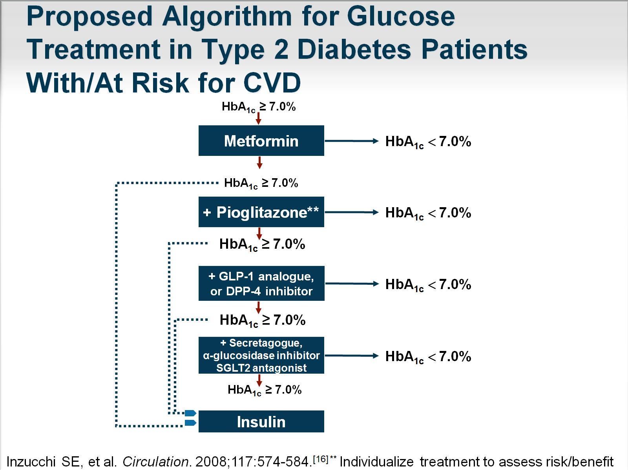
Proposed Algorithm for Glucose Treatment in Type 2 Diabetes Patients With/At Risk for CVD

Slide 17
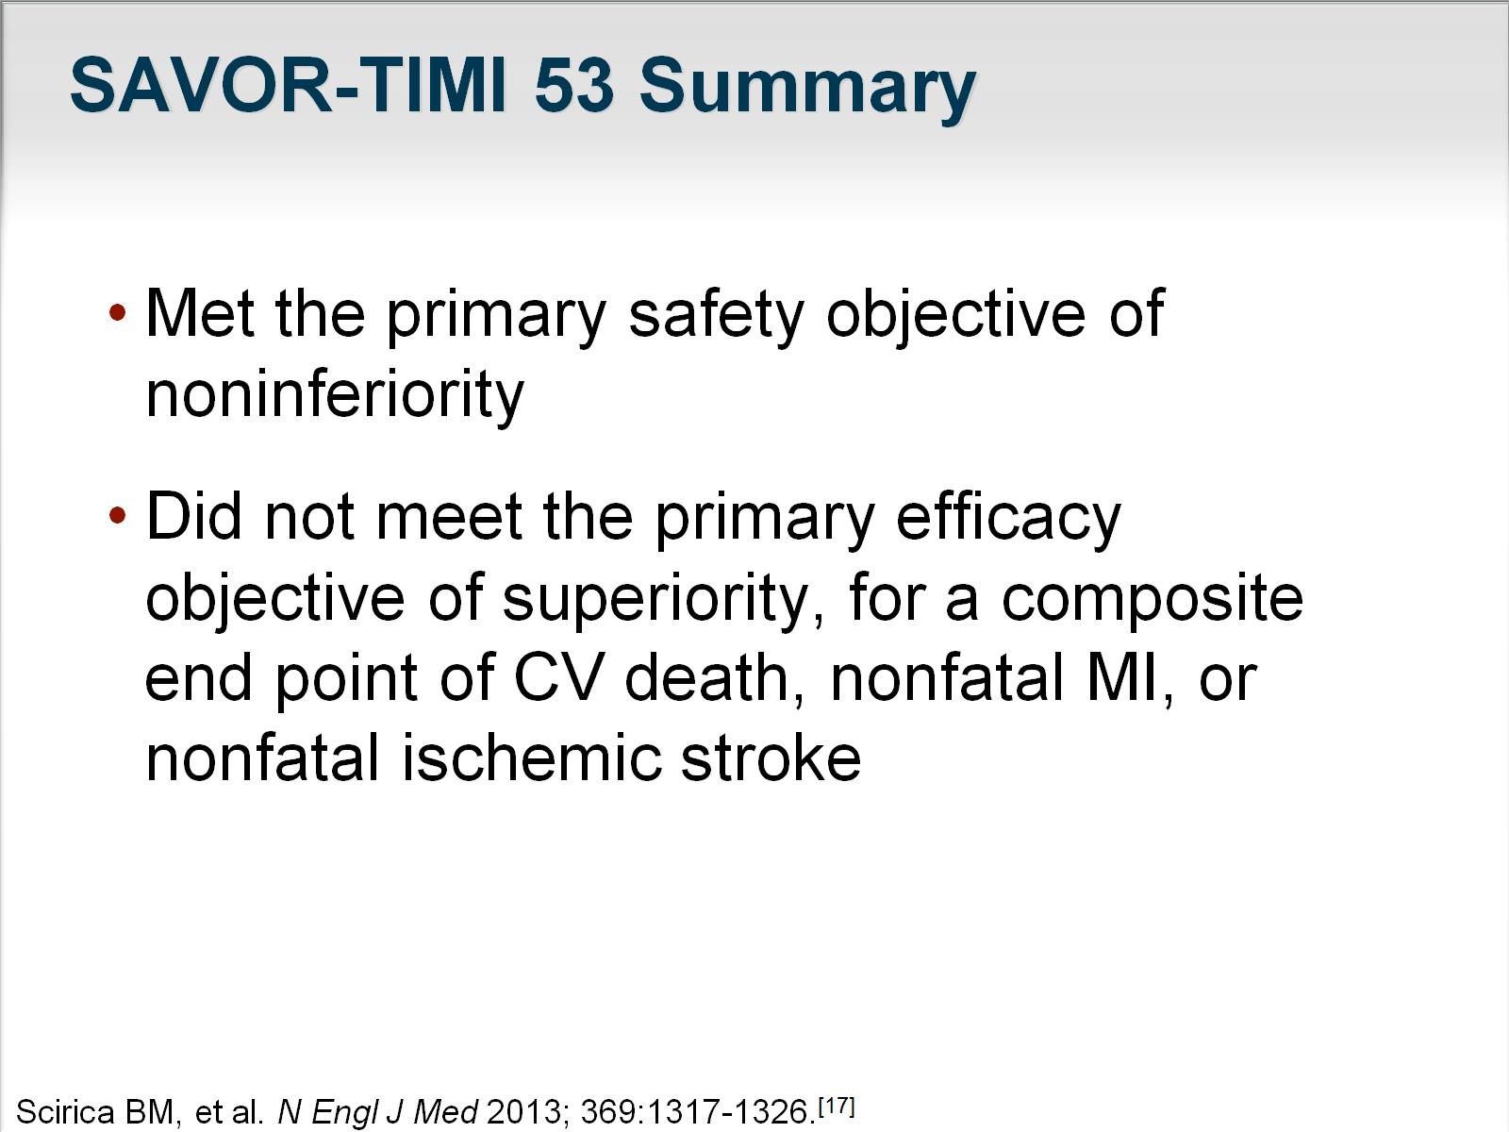
SAVOR-TIMI 53 Summary

Slide 18
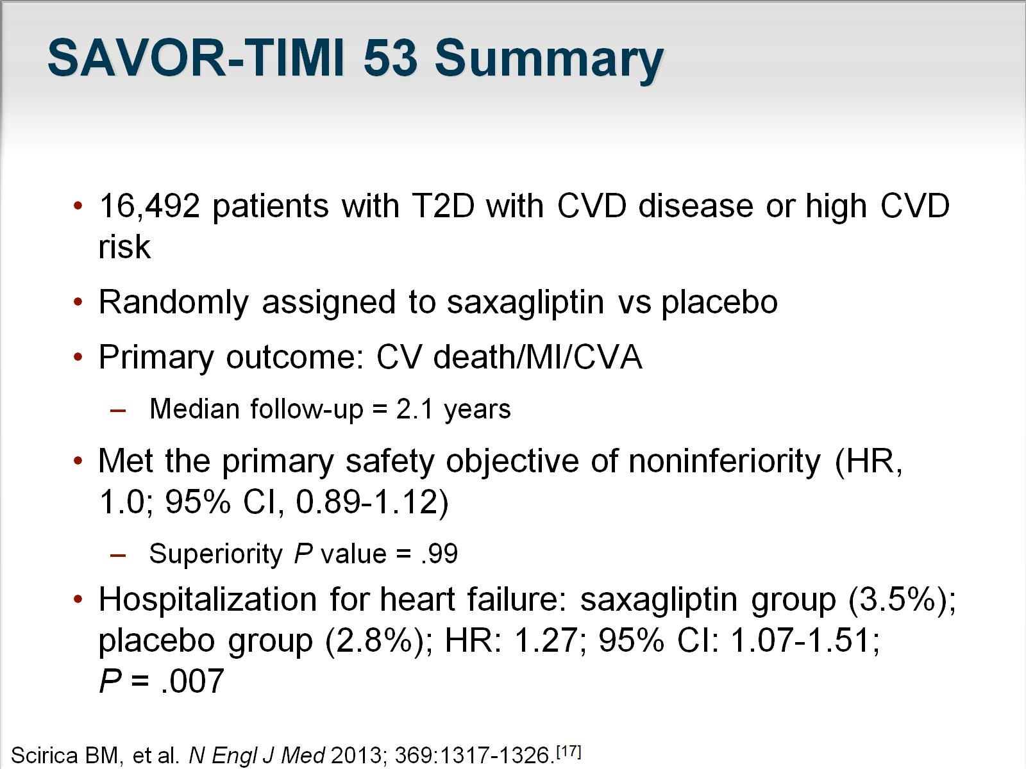
SAVOR-TIMI 53 Summary

Slide 19
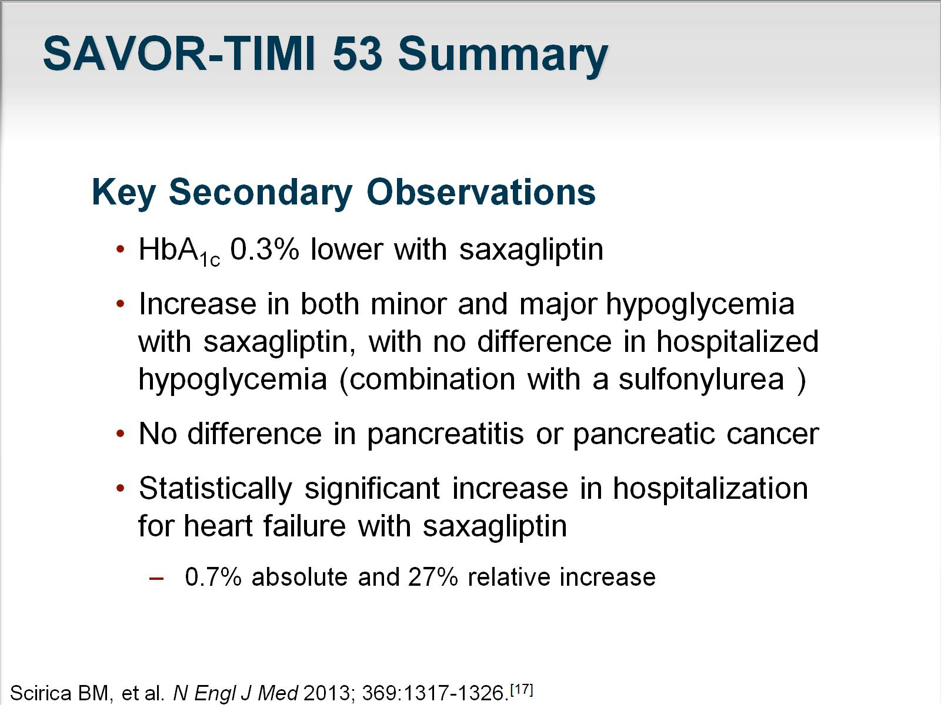
SAVOR-TIMI 53 Summary

Slide 20
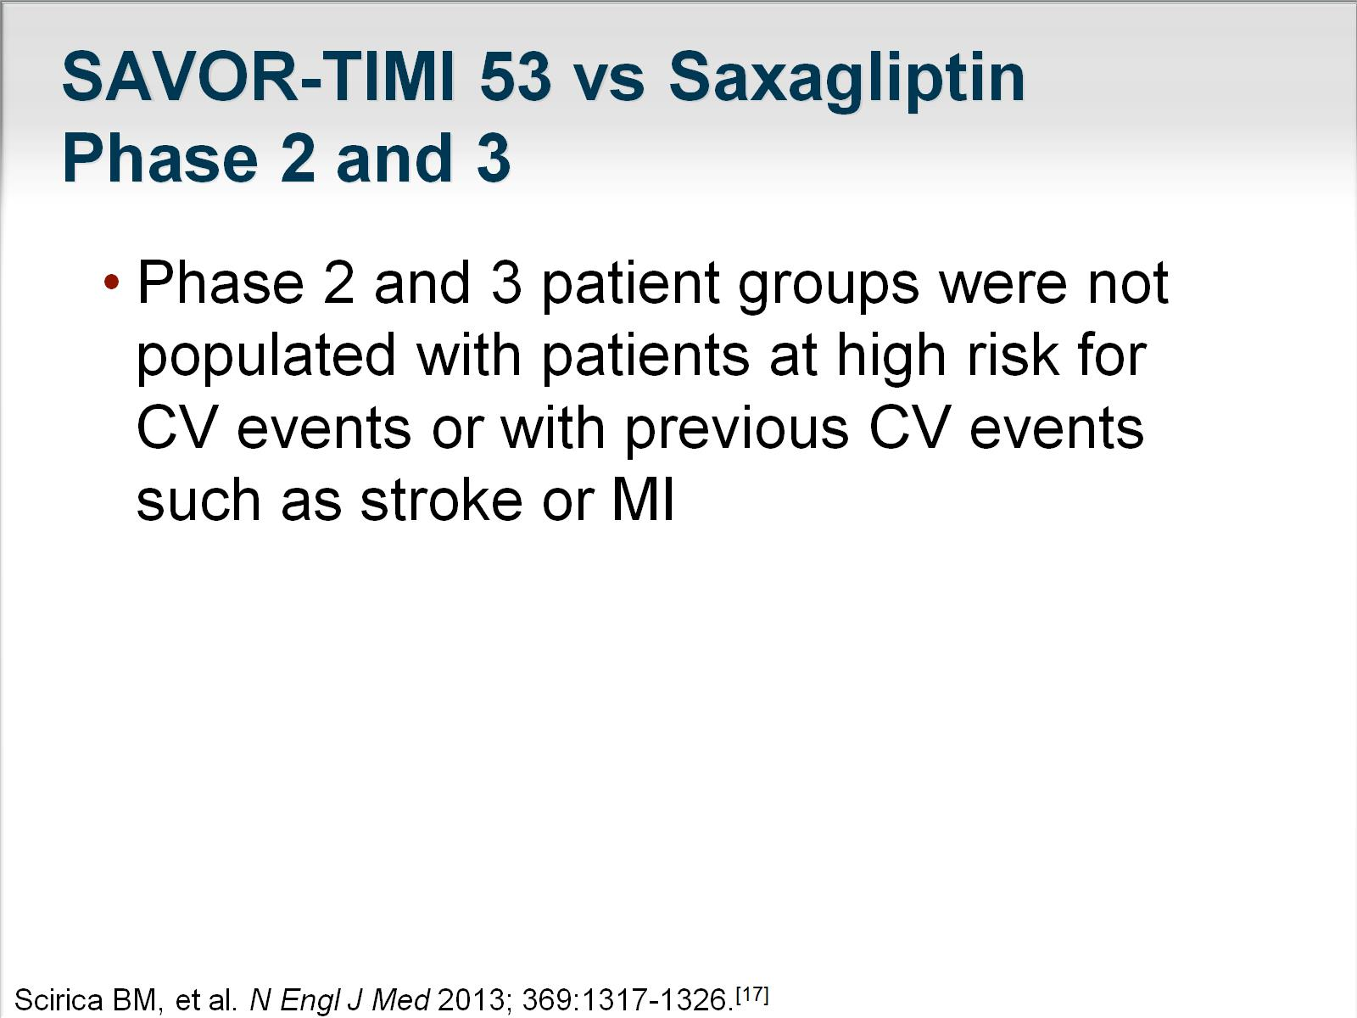
SAVOR-TIMI 53 vs Saxagliptin Phase 2 and 3

Slide 21
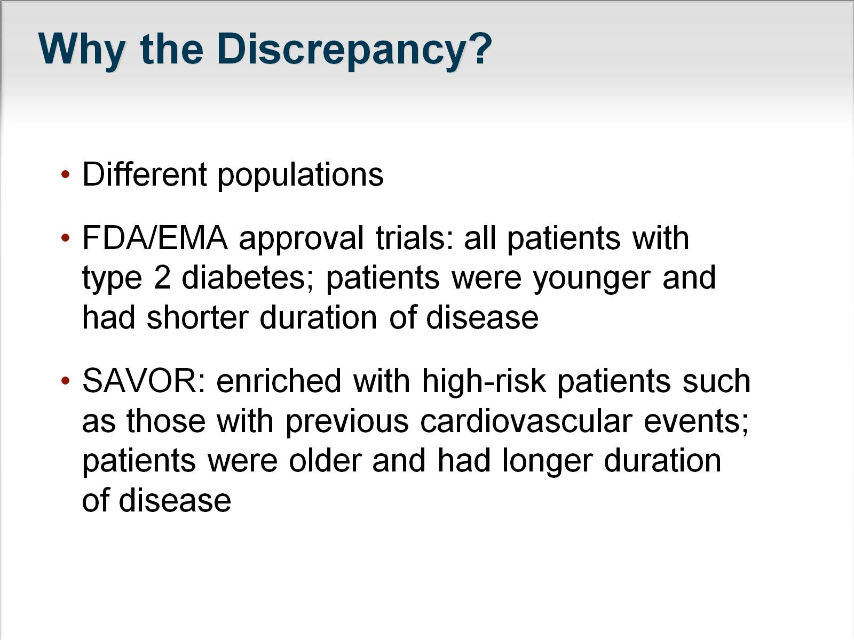
Why the Discrepancy?

Slide 22
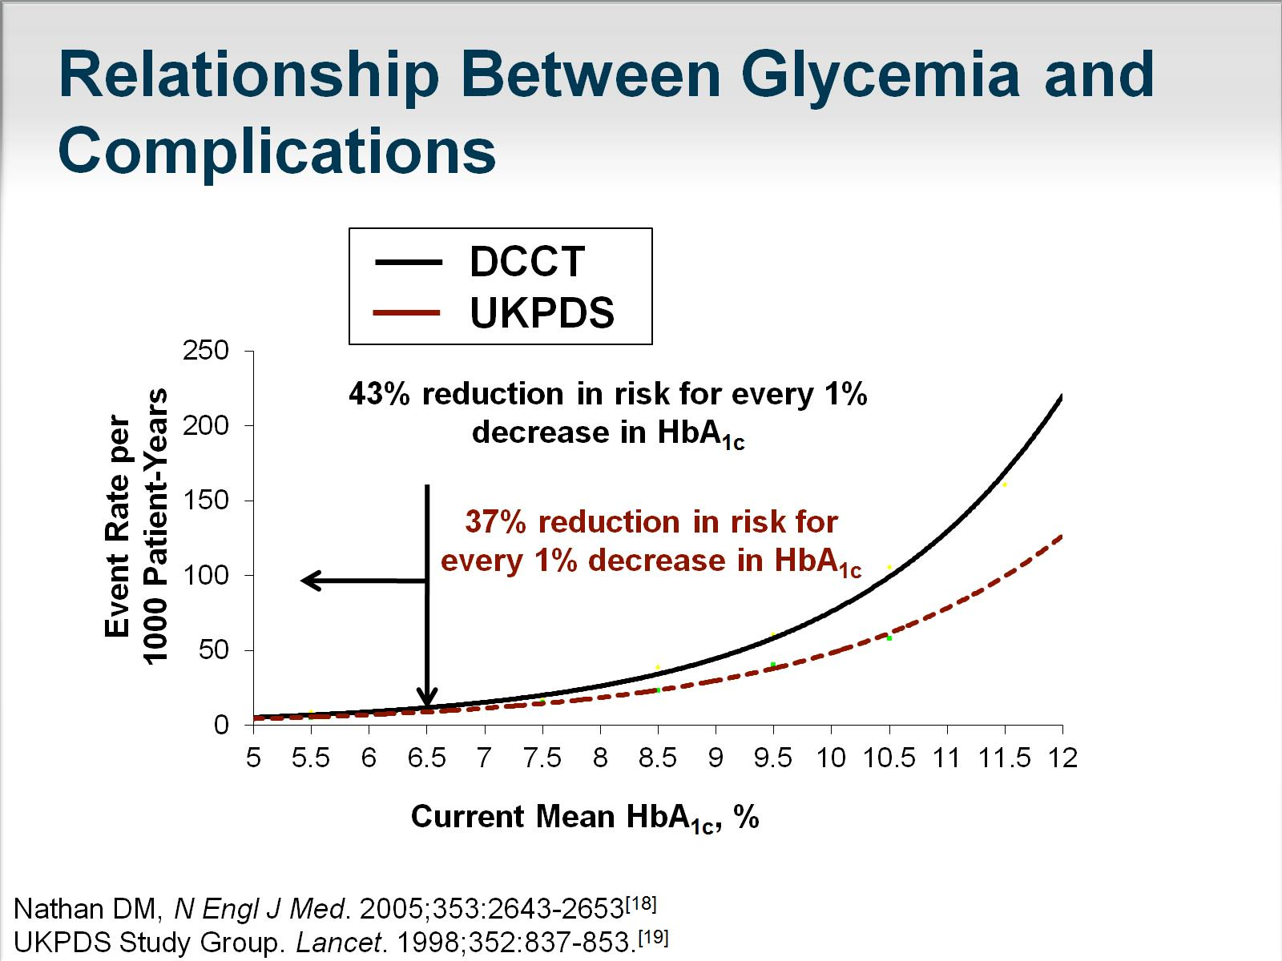

Slide 23
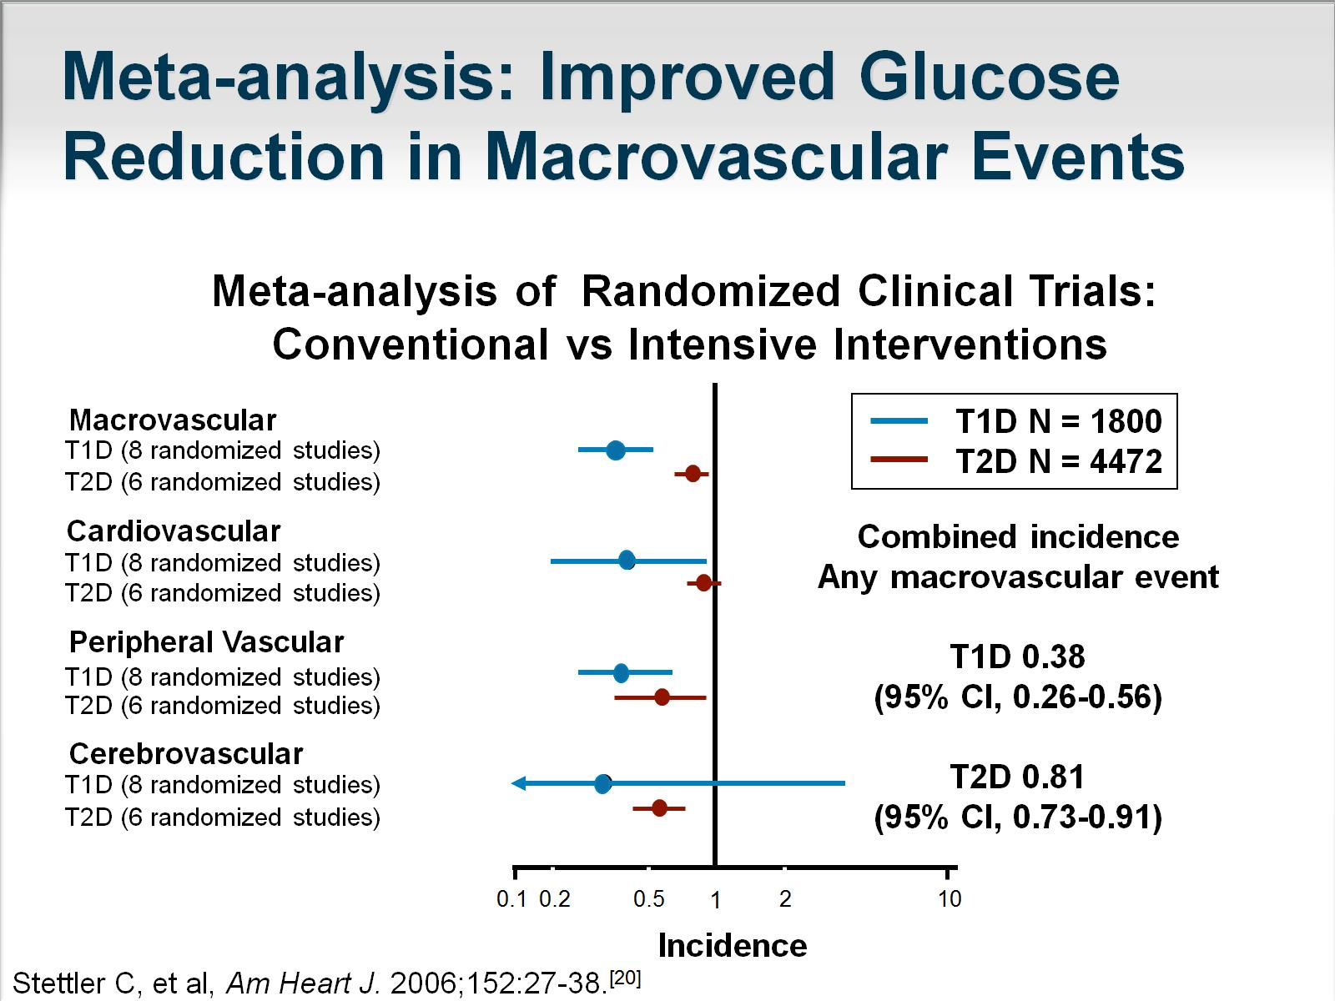
Meta-analysis: Improved Glucose
Reduction in Macrovascular Events

Slide 24
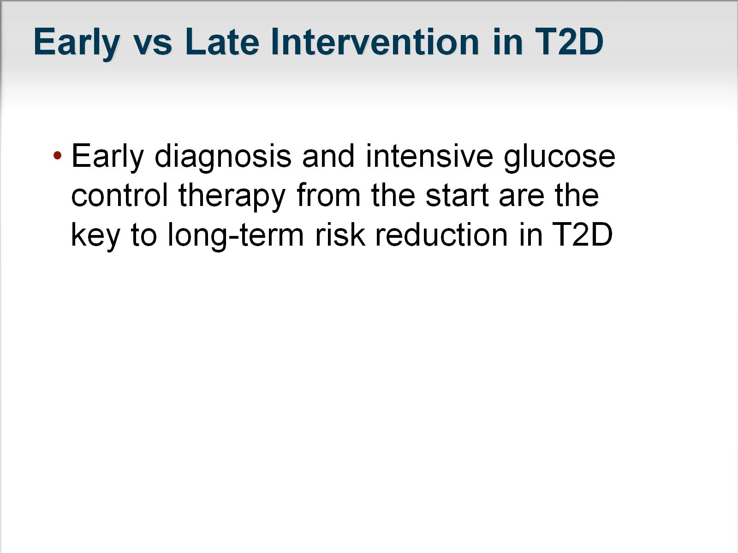
Early vs Late Intervention in T2D

Slide 25
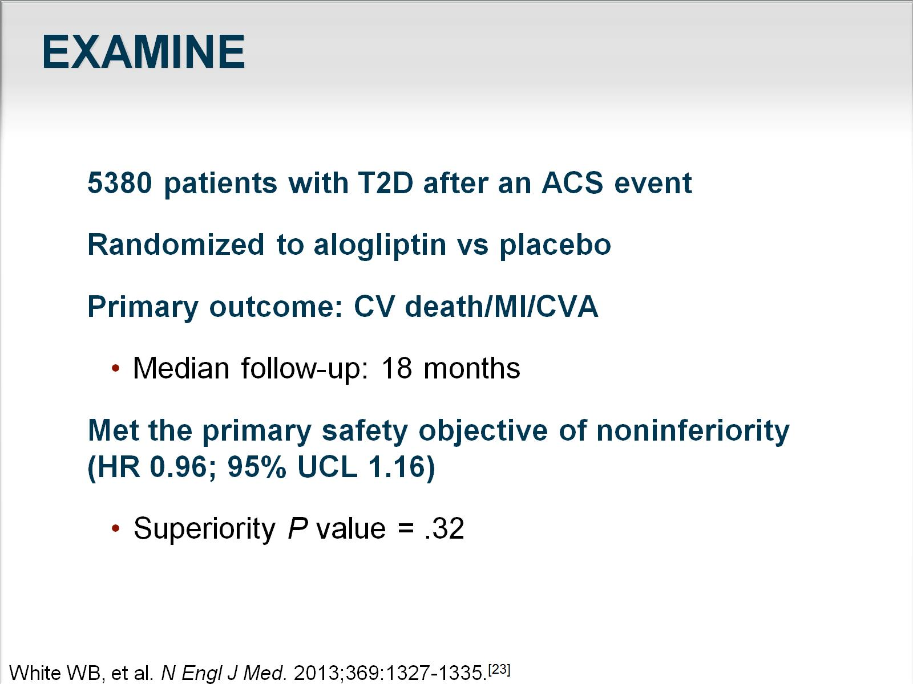
EXAMINE

Slide 26
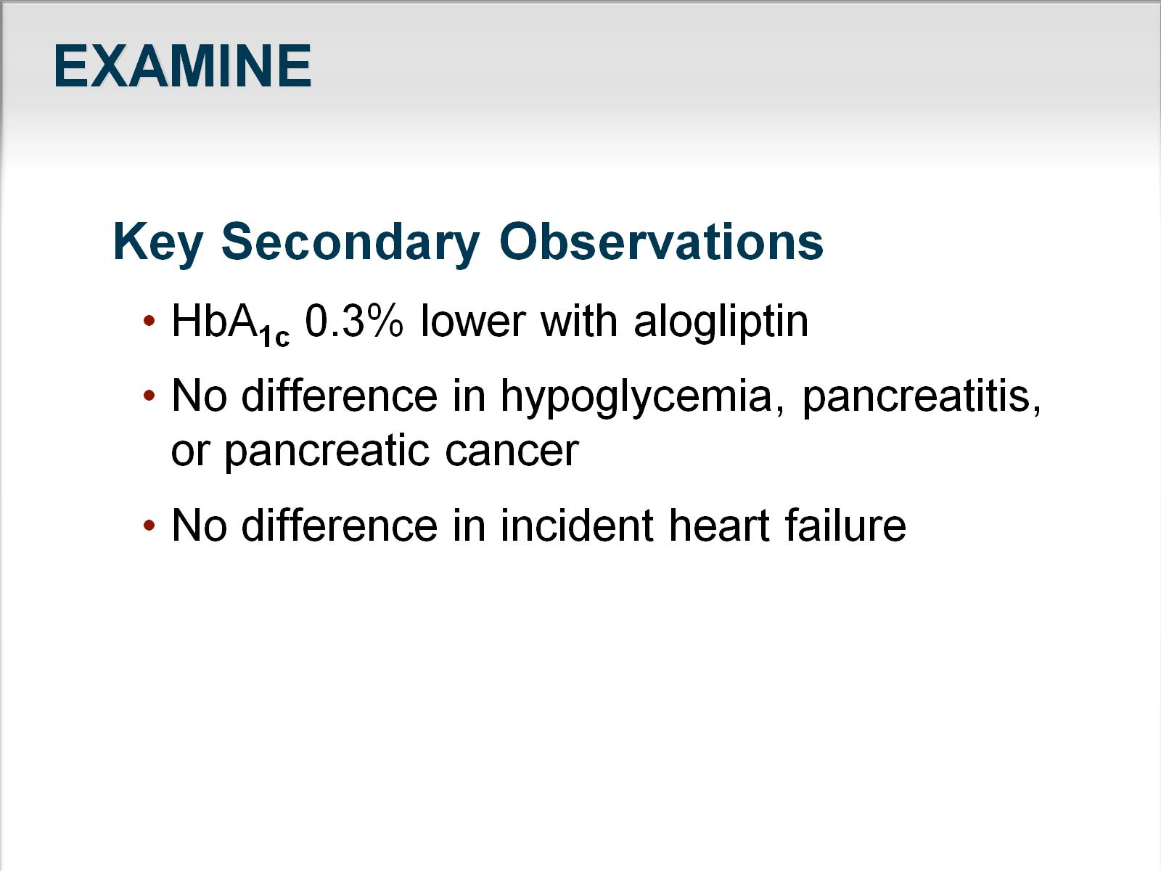
EXAMINE

Slide 27
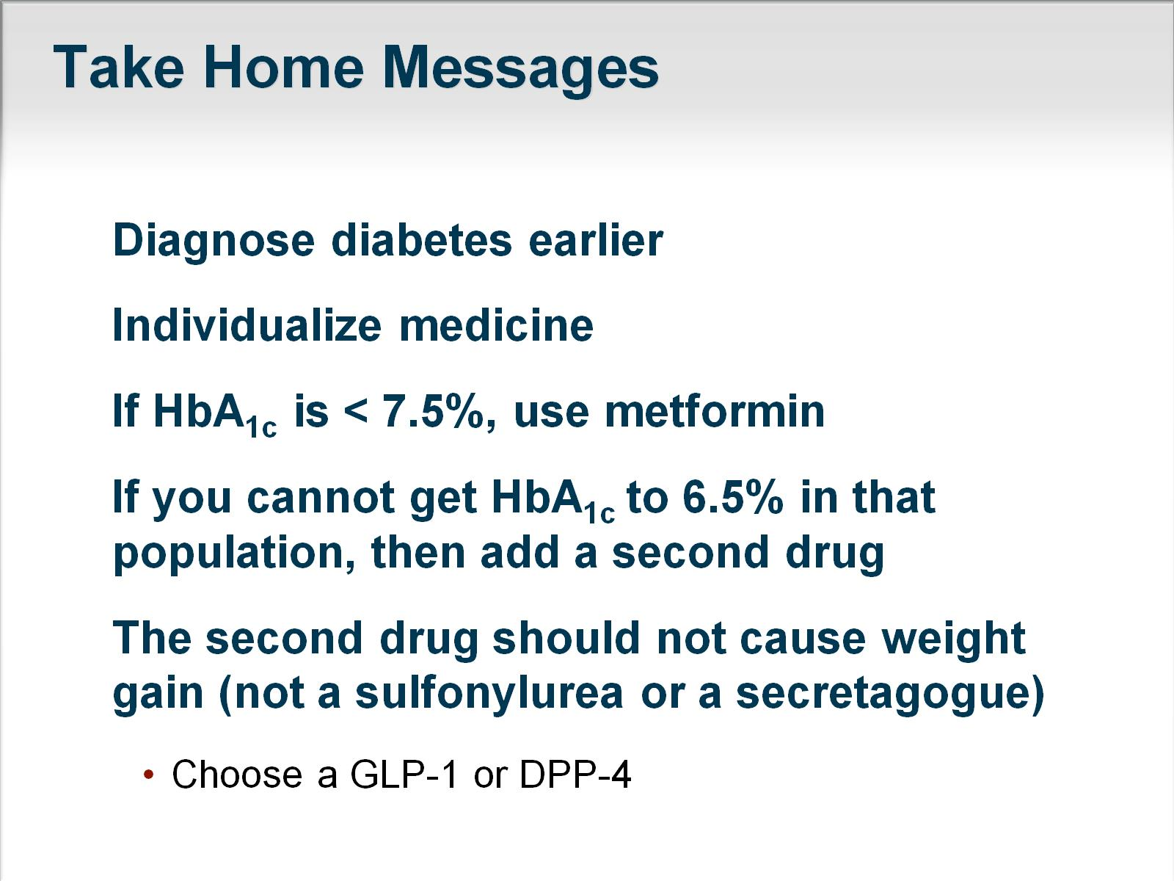
Take Home Messages

Slide 28
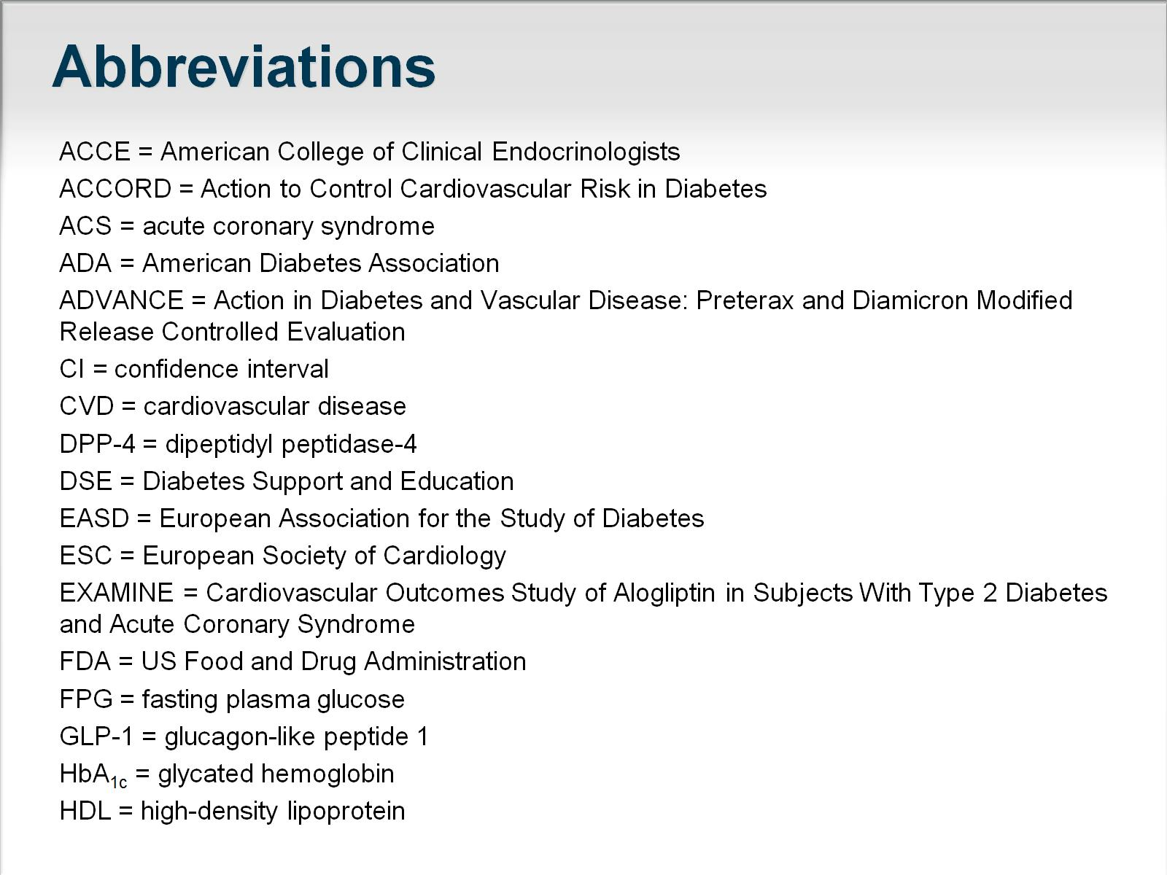
Abbreviations

Slide 29
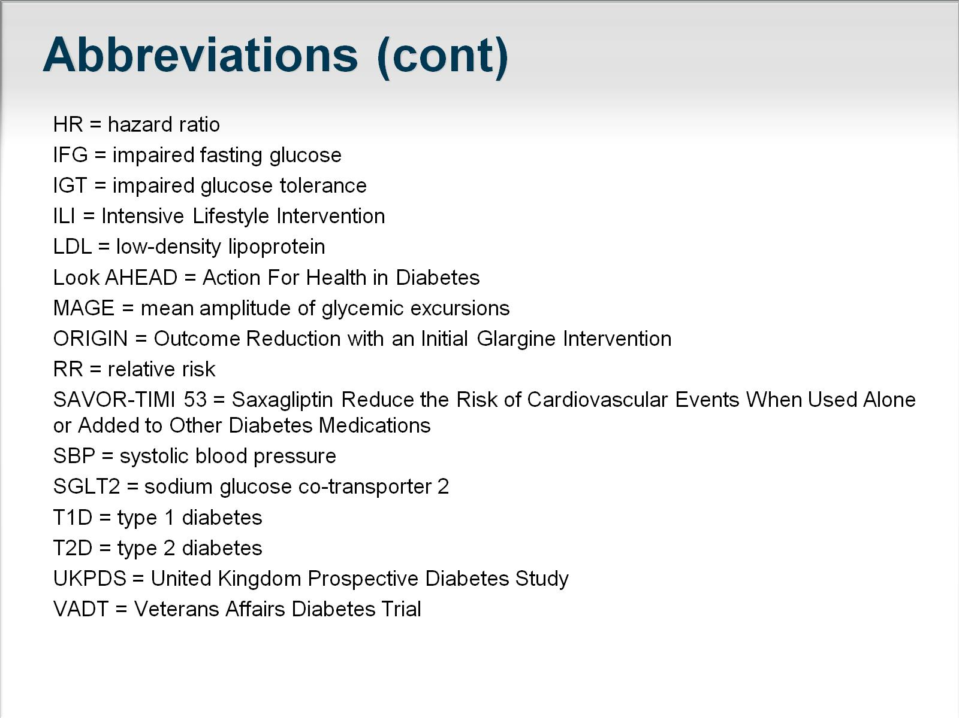
Abbreviations (cont)

Slide 30
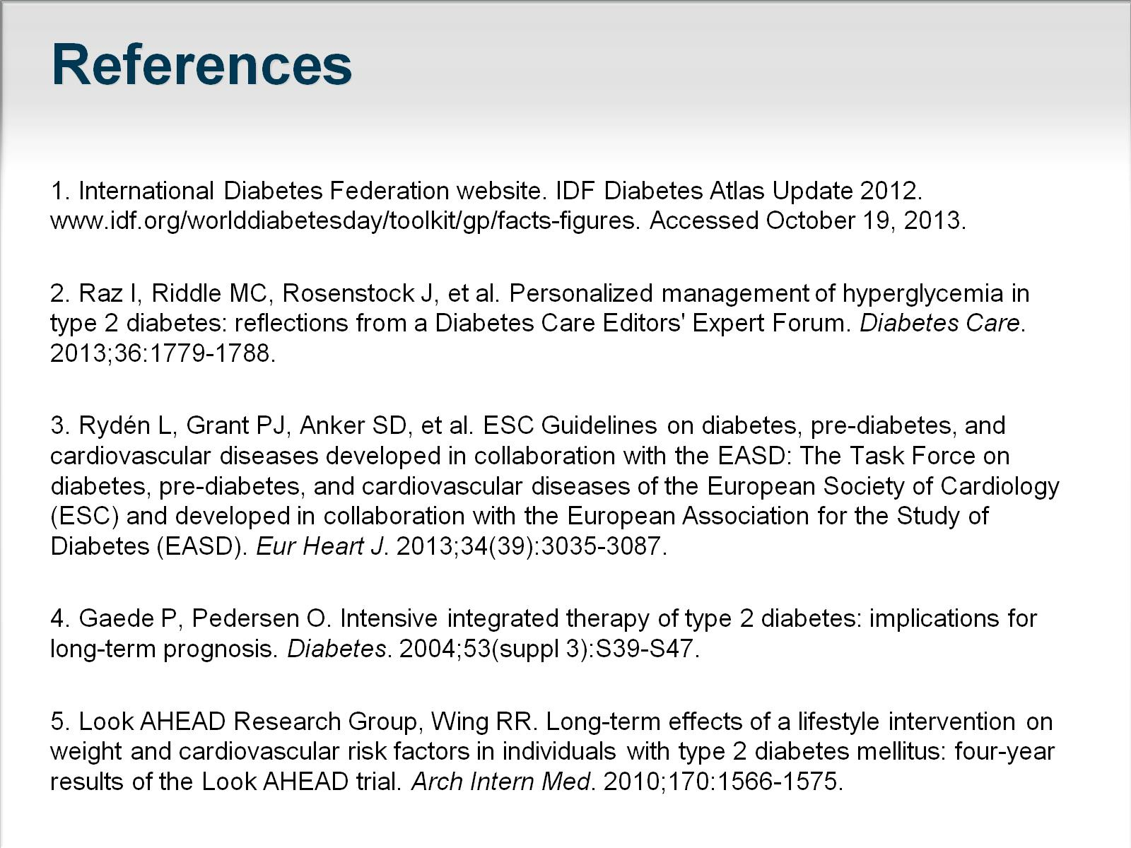
References

Slide 31
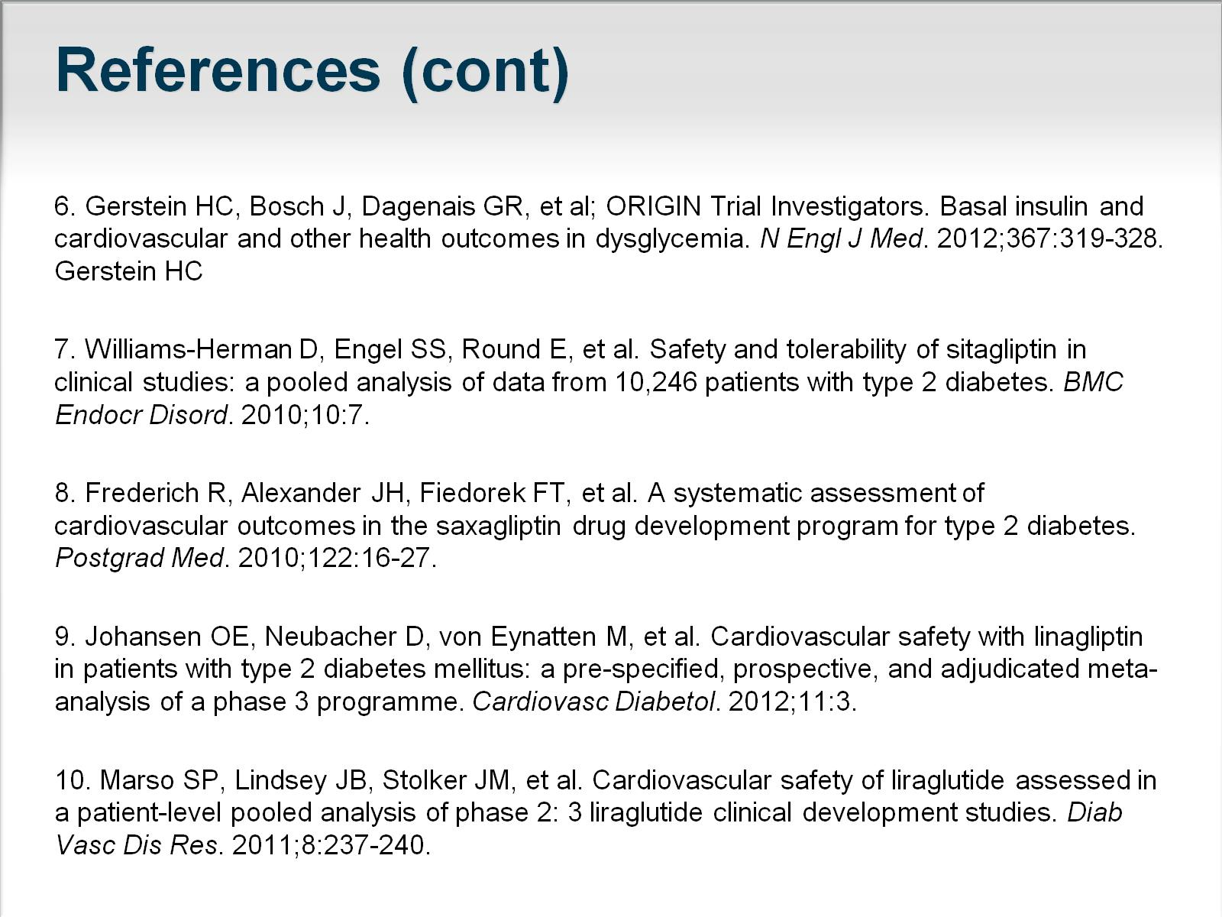
References (cont)

Slide 32
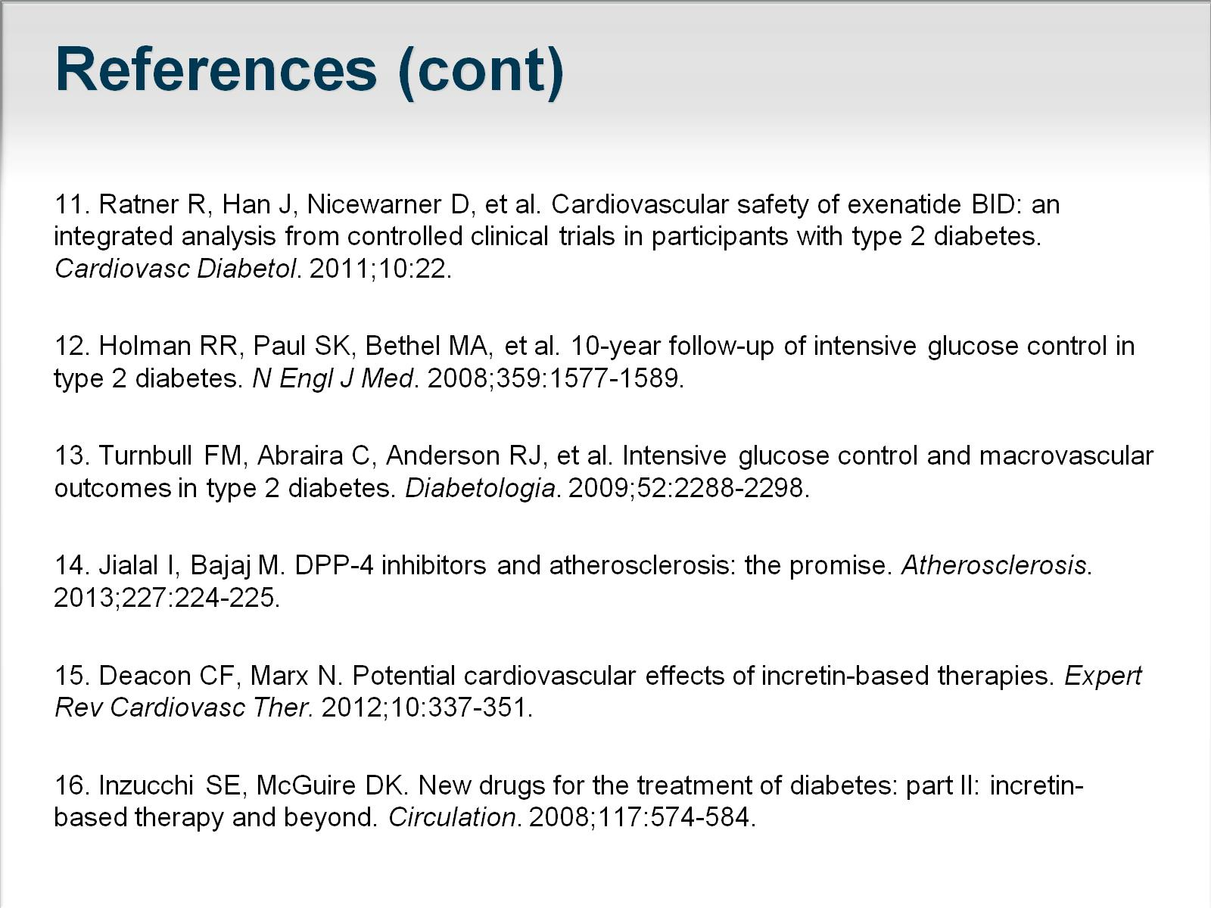
References (cont)

Slide 33
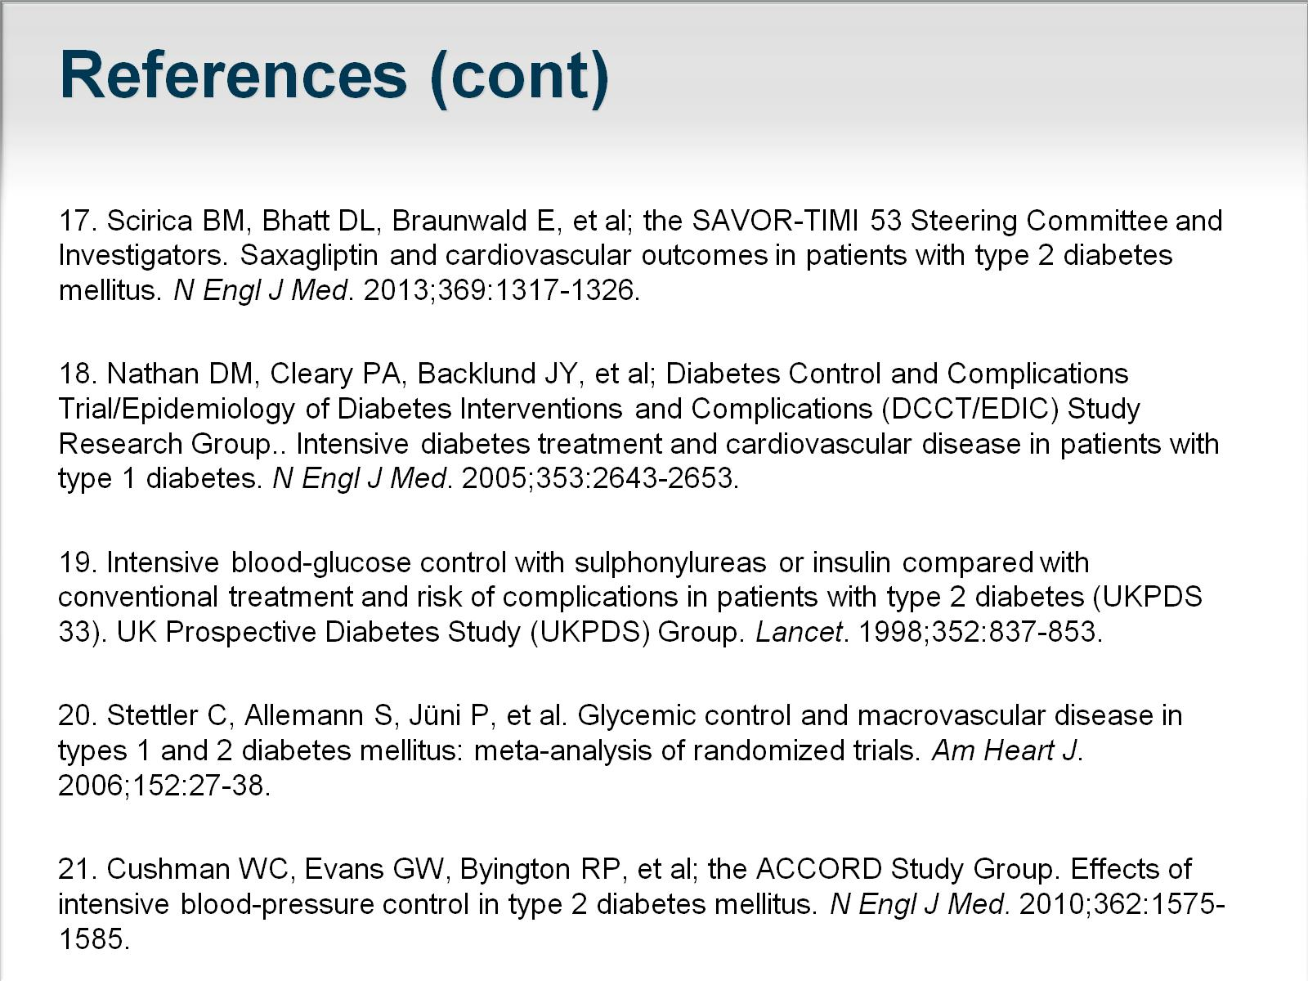
References (cont)

Slide 34
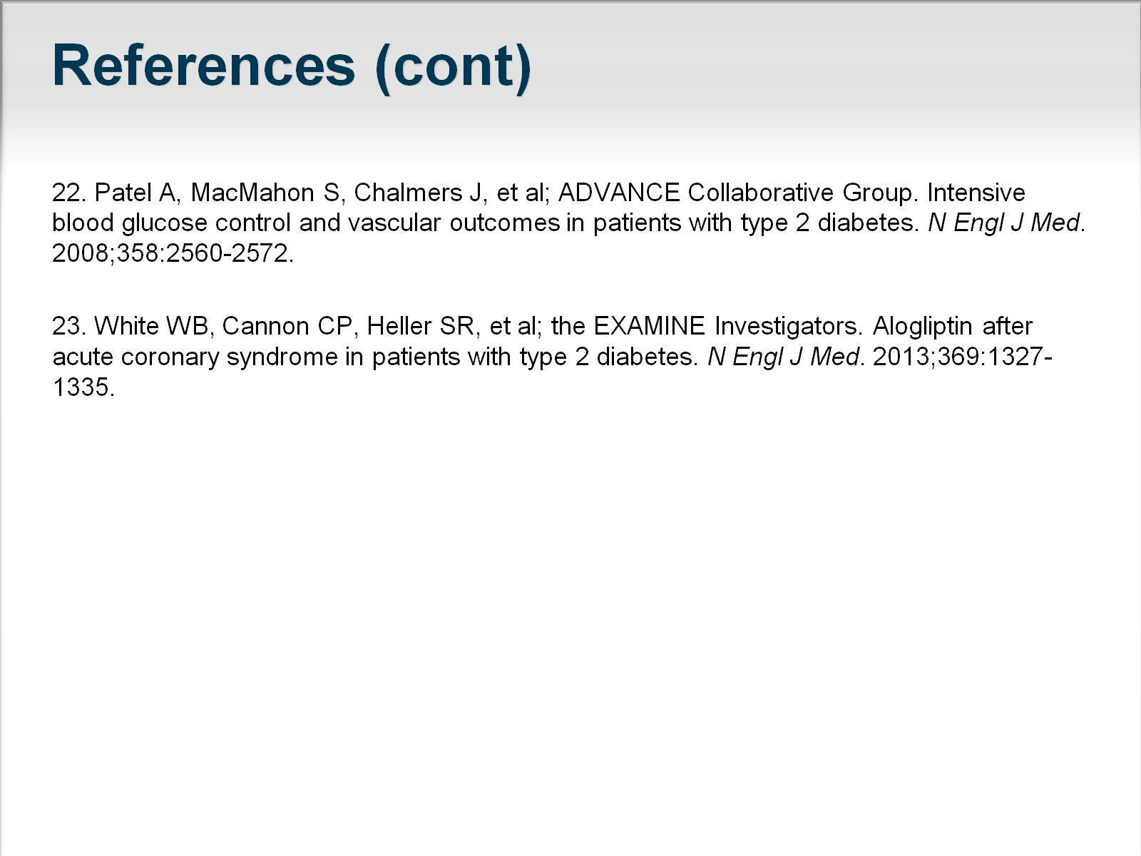
References (cont)

