Slide 1
Novel Anticoagulants in Atrial Fibrillation
Chair
Eugene Braunwald, MD
Distinguished Hersey Professor of Medicine
Harvard Medical School
Founding Chairman
The TIMI Study Group
Brigham and Women's Hospital
Boston, Massachusetts
Notes:
Title Slide Layout

Slide 2
Anticoagulants in Nonvalvular AF
Elaine M. Hylek, MD, MPH
Professor of Medicine
Boston University School of Medicine
Director
Thrombosis Clinic and Anticoagulation Service
Boston University Medical Center
Boston, Massachusetts
Notes:
Title Slide Layout

Slide 3
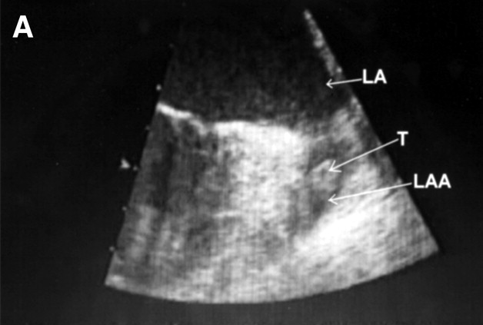
Transesophageal Echocardiography Depicting a Left Atrium Appendage Thrombus
Parekh A, et al. Circulation. 2006;114:e513-e514.^{[1]}
Notes:
Content Slide Layout: TEXT

Slide 4
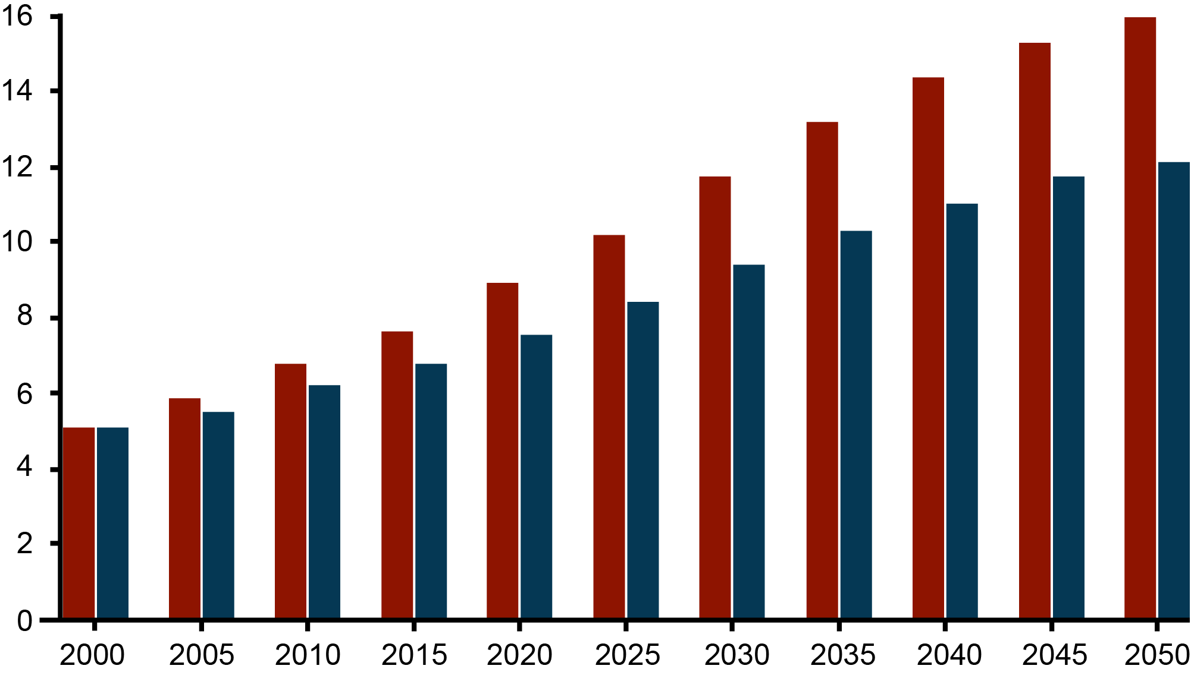
Projected Number of US Persons With AF Between 2000-2050
Continued increase in AF incidence rate
No increase in AF incidence rate
15.9
15.2
14.3
13.1
11.7
11.7
12.1
11.1
10.2
10.3
8.9
9.4
8.4
Projected Number of Persons With AF, million
7.7
7.5
6.7
6.8
5.9
6.1
5.1
5.6
5.1
Year
Miyasaka, Y, et al. Circulation. 2006;114:119-125.^{[2]}
Notes:
Content Slide Layout: TEXT

Slide 5
Prevalence of AF by Age
IMAGE NO LONGER AVAILABLE
Feinberg WM, et al. Arch Intern Med. 1995;155:469-473.^{[3]}
Notes:
Content Slide Layout: TEXT

Slide 6
Atrial Fibrillation
Morbidity and Mortality
4- to 5-fold increased risk of stroke
Doubling the risk for dementia
Tripling the risk for heart failure
40% to 90% increased risk for overall mortality
Risk of stroke in AF patients by age group
  1.5% in 50 to 59 year age group
  23.5% in 80 to 89 year age group
Benjamin EJ, et al. Circulation. 2009;119:606-618.^{[4]}
Notes:
Content Slide Layout: TEXT

Slide 7
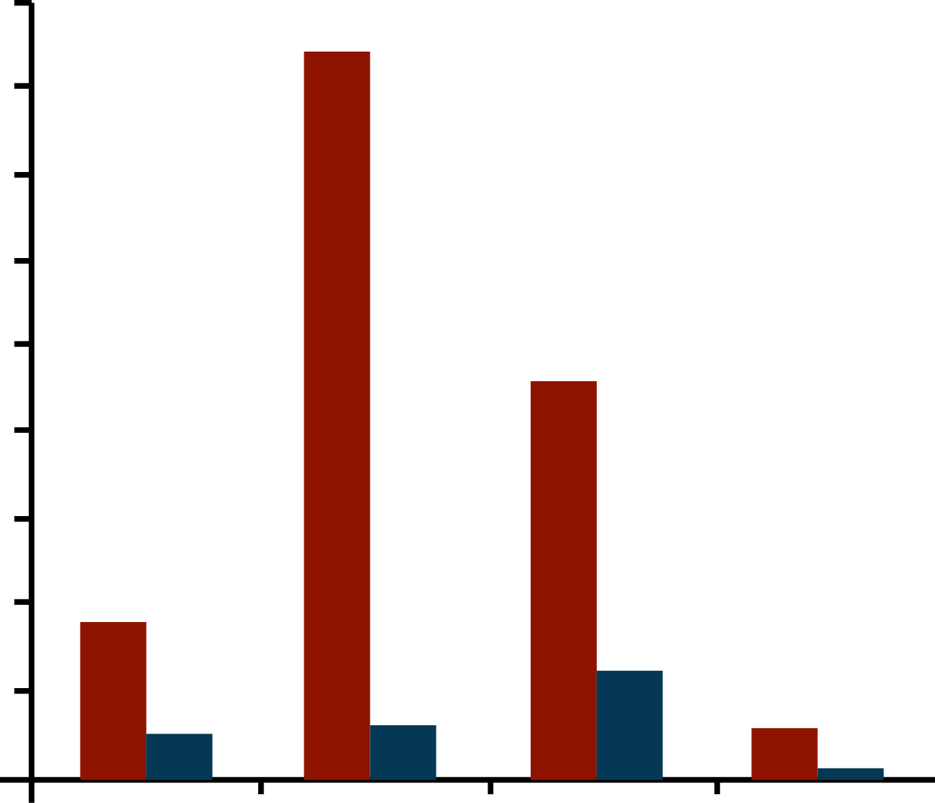
Atrial Fibrillation
Staggering Costs
Distribution of $6.65 Billion (2005 US dollars) in Annual AF Treatment Costsª
Average Annual Cost Comparison Between Patients With and Without AF^{b}
9
8
With AF
7
Without AF
6
Cost, b
5
Cost, th
4
3
2
1
0
Drug
Inpatient
Outpatient
Other*
a. Coyne KS, et al. Value Health. 2006;9:348-356.^{[5]}
b. Wu EQ, et al. Curr Med Res Opin. 2005;21:1693-1699.^{[6]}
*labs, tests

Slide 8
Hazards of Warfarin
Medication | Annual National Estimate of Hospitalizations (N = 99,628) |  | Proportion of Emergency Department Visits Resulting in Hospitalization
Most commonly implicated medications | no. | % (95% CI) | %
Warfarin | 33,171 | 33.3 (28.0-38.5) | 46.2
Insulins | 13,854 | 13.9 (9.8-18.0) | 40.6
Oral antiplatelet agents | 13,263 | 13.3 (7.5-19.1) | 41.5
Oral hypoglycemic agents | 10,656 | 10.7 (8.1-13.3) | 51.8
Opioid analgesics | 4778 | 4.8 (3.5-6.1) | 32.4
Antibiotics | 4205 | 4.2 (2.9-5.5) | 18.3
Budnitz DS, et al. N Engl J Med. 2011;365:2002-2012.^{[7]}
Notes:
Content Slide Layout: TEXT

Slide 9
Hazards of Warfarin
Therapeutic Category and Adverse Event Manifestation | Annual National Estimate of Hospitalizations, % (95% CI) | Proportion of Emergency Department Visits Resulting in Hospitalization, %
Hematologic agents
Intracranial hemorrhage | 5.6 (2.1-9.1) | 99.7
Hemoptysis | 2.0 (1.1-2.8) | 73.6
Gastrointestinal hemorrhage | 40.8 (29.9-51.7) | 84.7
Genitourinary hemorrhage | 4.7 (3.2-6.2) | 42.4
Epistaxis | 6.1 (4.3-8.0) | 10.6
Skin or wound hemorrhage | 6.8 (4.5-9.1) | 24.5
Other type of hemorrhage | 5.3 (2.7-8.0) | 27.5
Elevated INR, abnormal laboratory values, or drug toxicity not otherwise described | 23.7 (16.8-30.6) | 59.5
Budnitz DS, et al. N Engl J Med. 2011;365:2002-2012.^{[7]}
Notes:
Content Slide Layout: TEXT

Slide 10
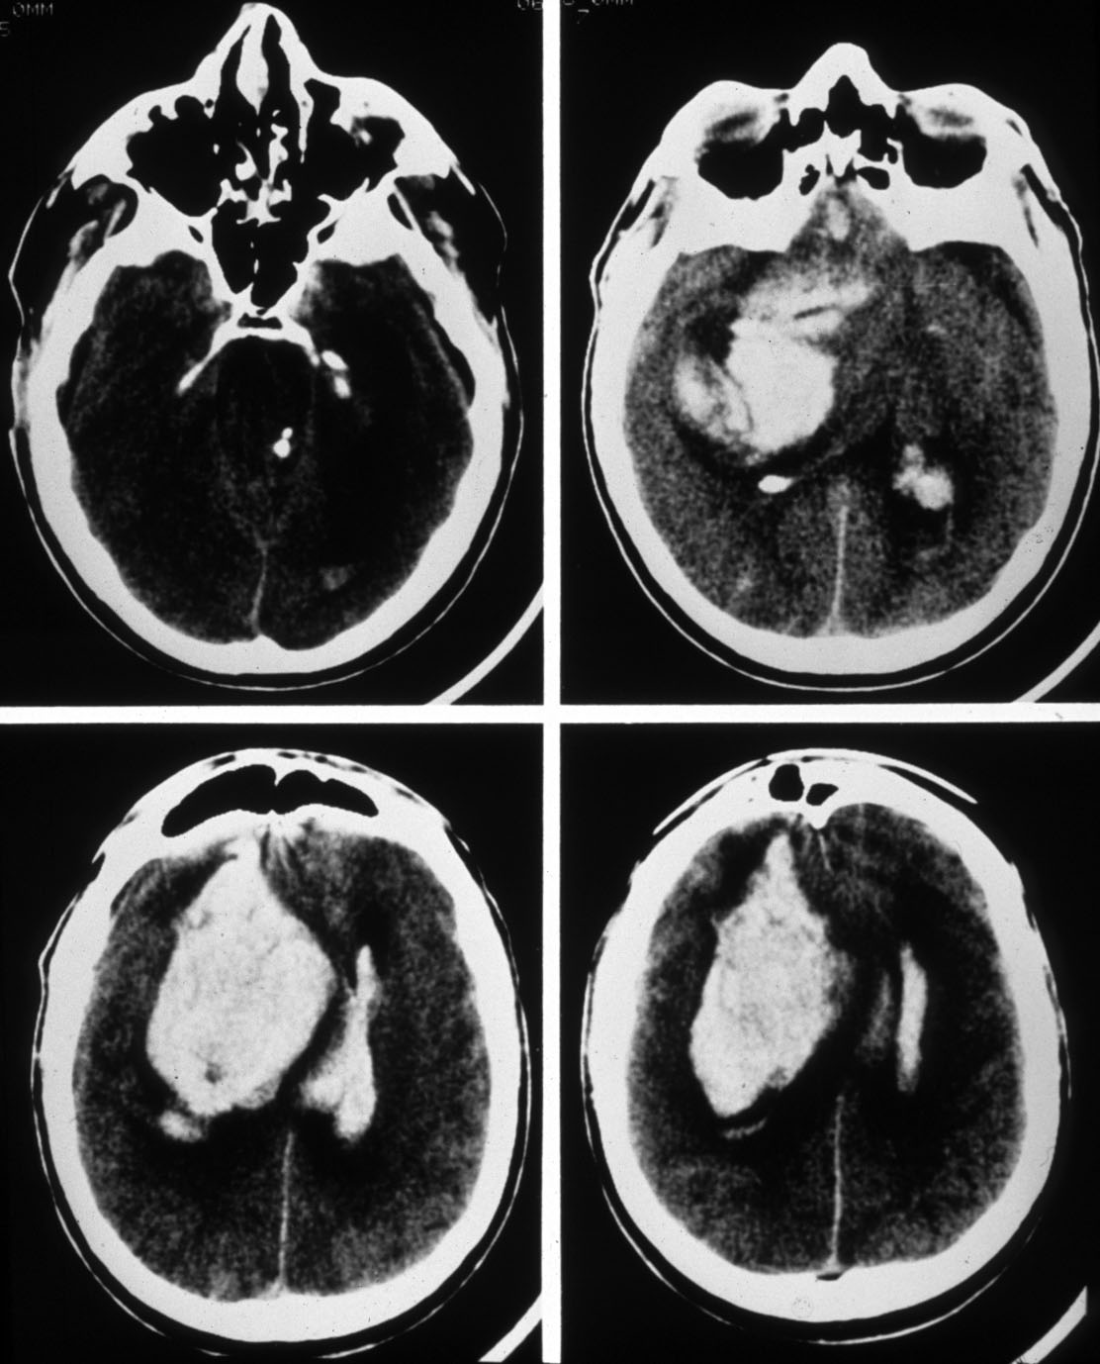
ICH on Warfarin
OR age ≥ 80 years 2.8 (1.3 to 5.8) P < .001
2/3 occur with an INR in 2.0-3.0 range
46% mortality
17% major deficit
Hylek EM, et al. Ann Intern Med. 1994;120:897-902.^{[8]}
Notes:
Content Slide Layout: TEXT

Slide 11
Optimizing Benefit and Reducing Risk
Hemorrhage
Thrombosis
AF stroke associated with a 30-day mortality of 24%
Notes:
Content Slide Layout: TEXT

Slide 12
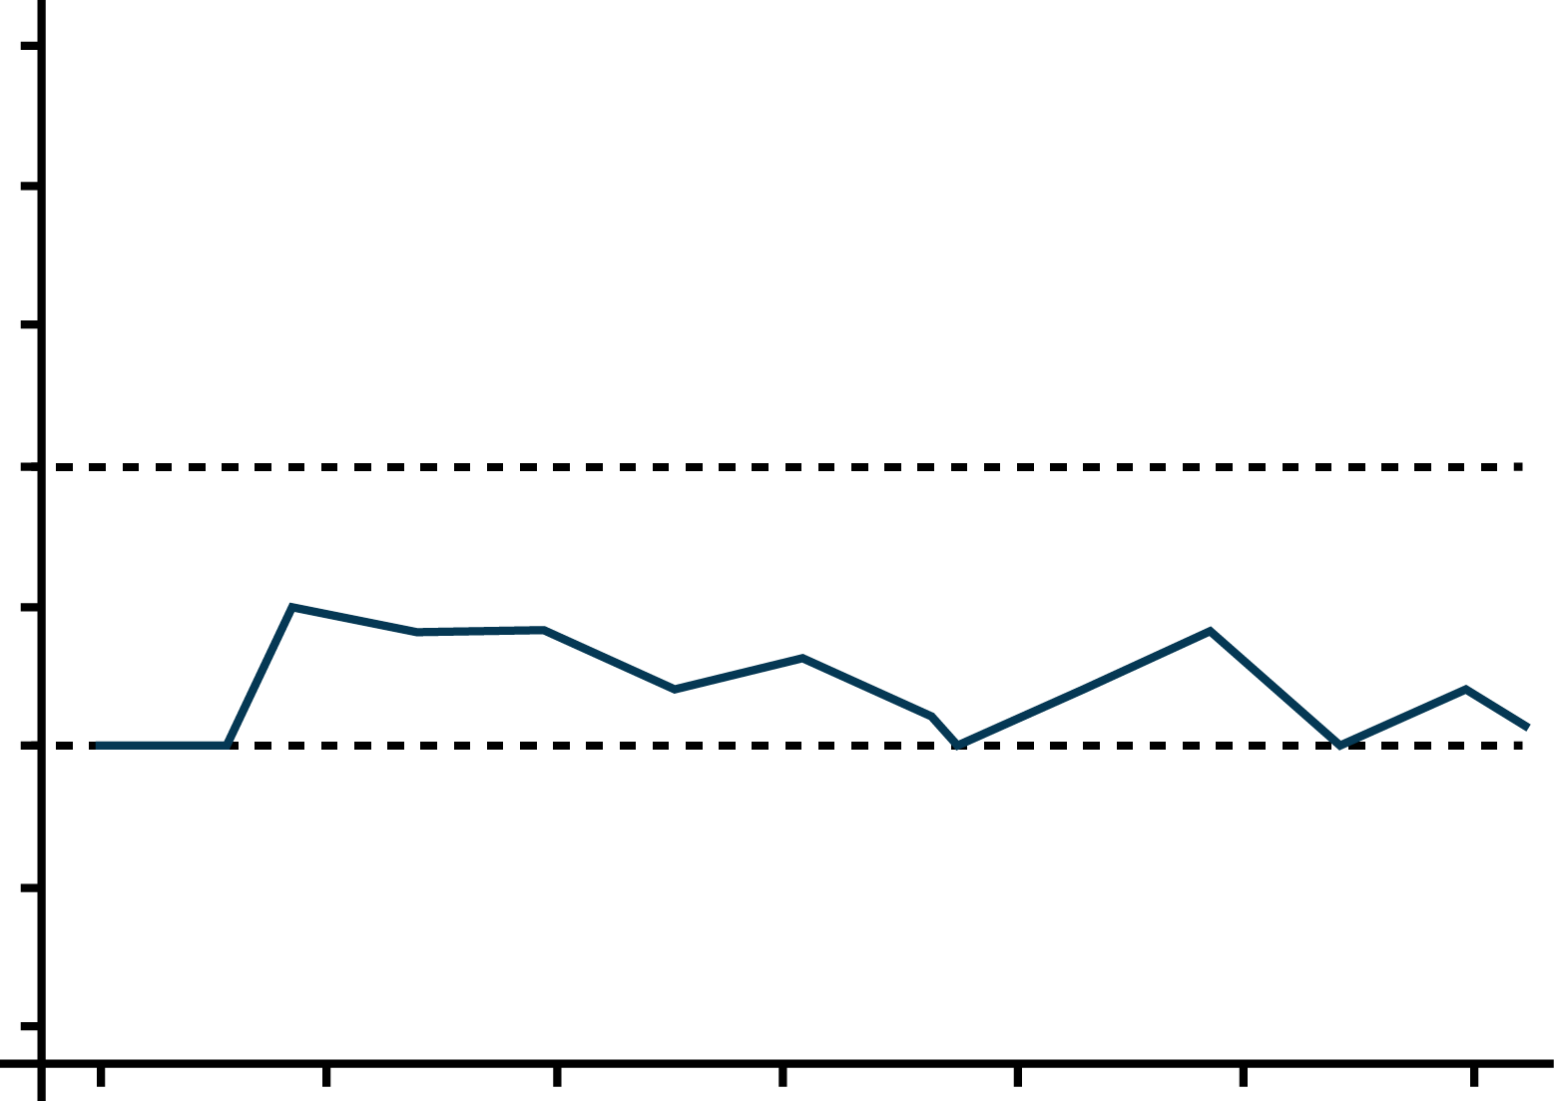
Patient With Low INR Variability
4.5
Pt 3012, sigma = 12.5
Pt 1038, sigma = 0.01
4.0
3.5
3.0
INR
2.5
2.0
1.5
1.0
0
50
100
150
200
250
300
d
Rose AJ, et al. J Gen Intern Med. 2007 Jul;22(7):997-1002^{[9]}
Notes:
Content Slide Layout: TEXT

Slide 13
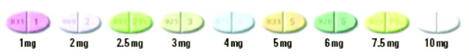
Warfarin Dosing Is Complex
Factors That Correlate With Warfarin Dose
Age, sex
Body surface area or weight
Amiodarone
Other drugs (eg, acetaminophen)
Race
Plasma vitamin K level
Decompensated CHF
Active malignancy
Genetic status
VKORC1
(up to 25%)
Other factors
(up to 40%)
CYP2C9
(up to 15%)
Age, sex, weight
(10–20%)
CHF = congestive heart failure; CYP2C9 = cytochrome P450 2C9; INR = international normalized ratio; VKORC1 = vitamin K epoxide reductase complex subunit 1
AMA website.^{[10]}
Notes:
Content Slide Layout: TEXT

Slide 14
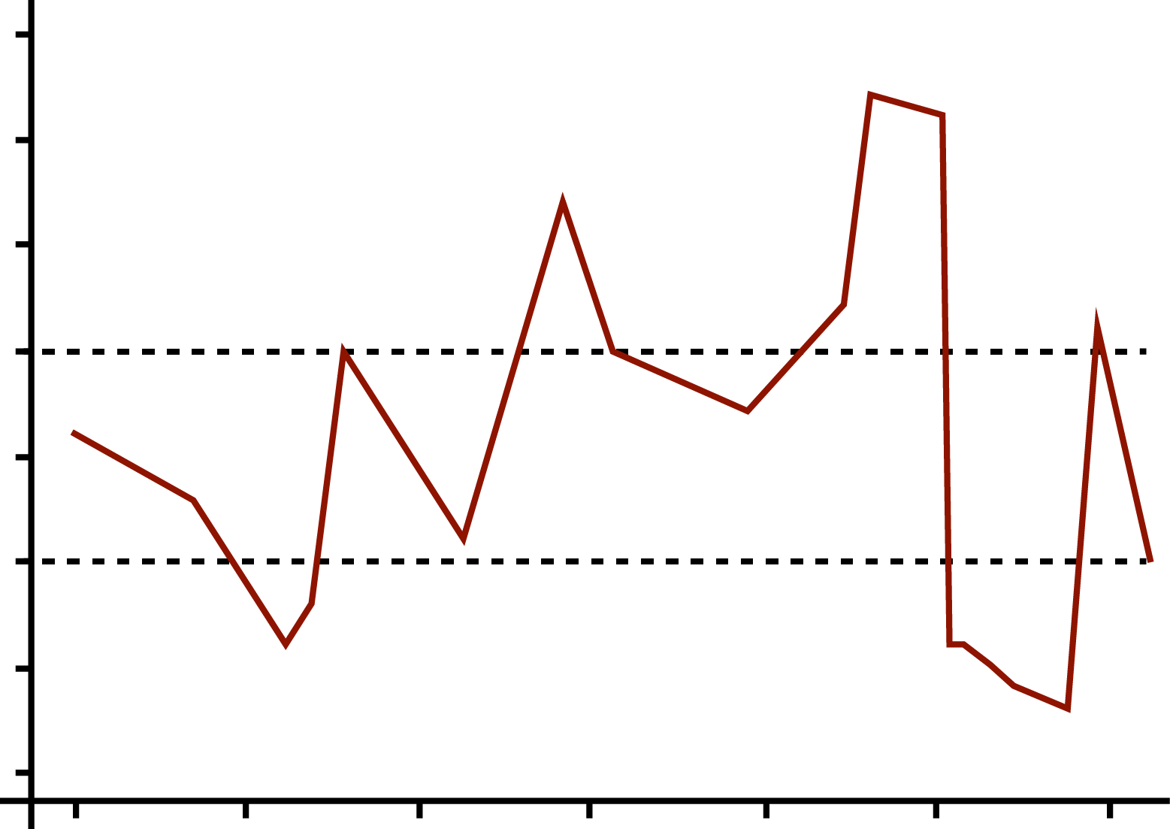
Patient With High INR Variability
4.5
Pt 3012, sigma = 12.5
Pt 1038, sigma = 0.01
4.0
3.5
3.0
INR
2.5
2.0
1.5
1.0
0
50
100
150
200
250
300
d
Rose AJ, et al. J Gen Intern Med. 2007 Jul;22(7):997-1002^{[9]}
Notes:
Content Slide Layout: TEXT

Slide 15
BAFTA: Role of Aspirin?
Primary Analysis
End point | Warfarin | Aspirin | Hazard Ratio (95% CI) | NNT
Fatal or nonfatal disabling stroke or significant arterial embolism (% annum) | 1.8 | 3.8 | 0.48 (0.28–0.80) | 50
Mant J, et al. Lancet. 2007;370:493-503.^{[11]}

Slide 16
BAFTA: Role of Aspirin?
Bleeding Complications With Warfarin vs Aspirin in AF Patients > 75 Years
End point | Warfarin | Aspirin | Hazard ratio (95% CI)
Major extracranial hemorrhage, % annum | 1.4 | 1.6 | 0.87 (0.43-1.73)
All major hemorrhages, % annum | 1.9 | 2.2 | 0.96 (0.53-1.75)
Mant J, et al. Lancet. 2007;370:493-503.^{[11]}

Slide 17
ESC 2012 Updated Guidelines for AF
Yes
< 65 years and lone AF (including females)
No
Assess risk of stroke
(CHA₂DS₂-VAS_{c} score)
0
1
> 2
Oral anticoagulant therapy
Assess bleeding risk
(HAS-BLED score)
Consider patient values
and preferences
No antithrombotic therapy
NOAC
VKA
Camm AJ, et al. Europace. 2012;14:1385-1413.^{[12]}
Notes:
Content Slide Layout: TEXT

Slide 18
Antithrombotic Rx for New AF
Garfield Registry (19 countries)
100
80
60
Patients, %
40
20
0
CHADS₂ Score
Kakkar AJ, et al. PLoS One. 2013;8:e63479.^{[13]}

Slide 19
Novel Anticoagulants for Stroke Prevention in Atrial Fibrillation
Dabigatranª
RE-LY
Reported September 2009
Apixaban^{c}
ARISTOTLE
Reported September 2011
↓
↓
2009 2010 2011 2012 2013 2014
↑
↑
Rivaroxaban^{b}
ROCKET-AF
Reported November
2010
Edoxaban^{d}
ENGAGE
Report November 2013
a. Connolly SJ, et al. N Engl J Med. 2009;361:1139-1151.^{[14]}
b. Patel MR, et al. N Engl J Med. 2011;365:883-891.^{[15]}
c. Granger CB, et al. N Engl J Med. 2011;365:981-992.^{[16]}
d. Giugliano RP, et al. N Engl J Med. 2013;369:2093-2104.^{[17]}

Slide 20
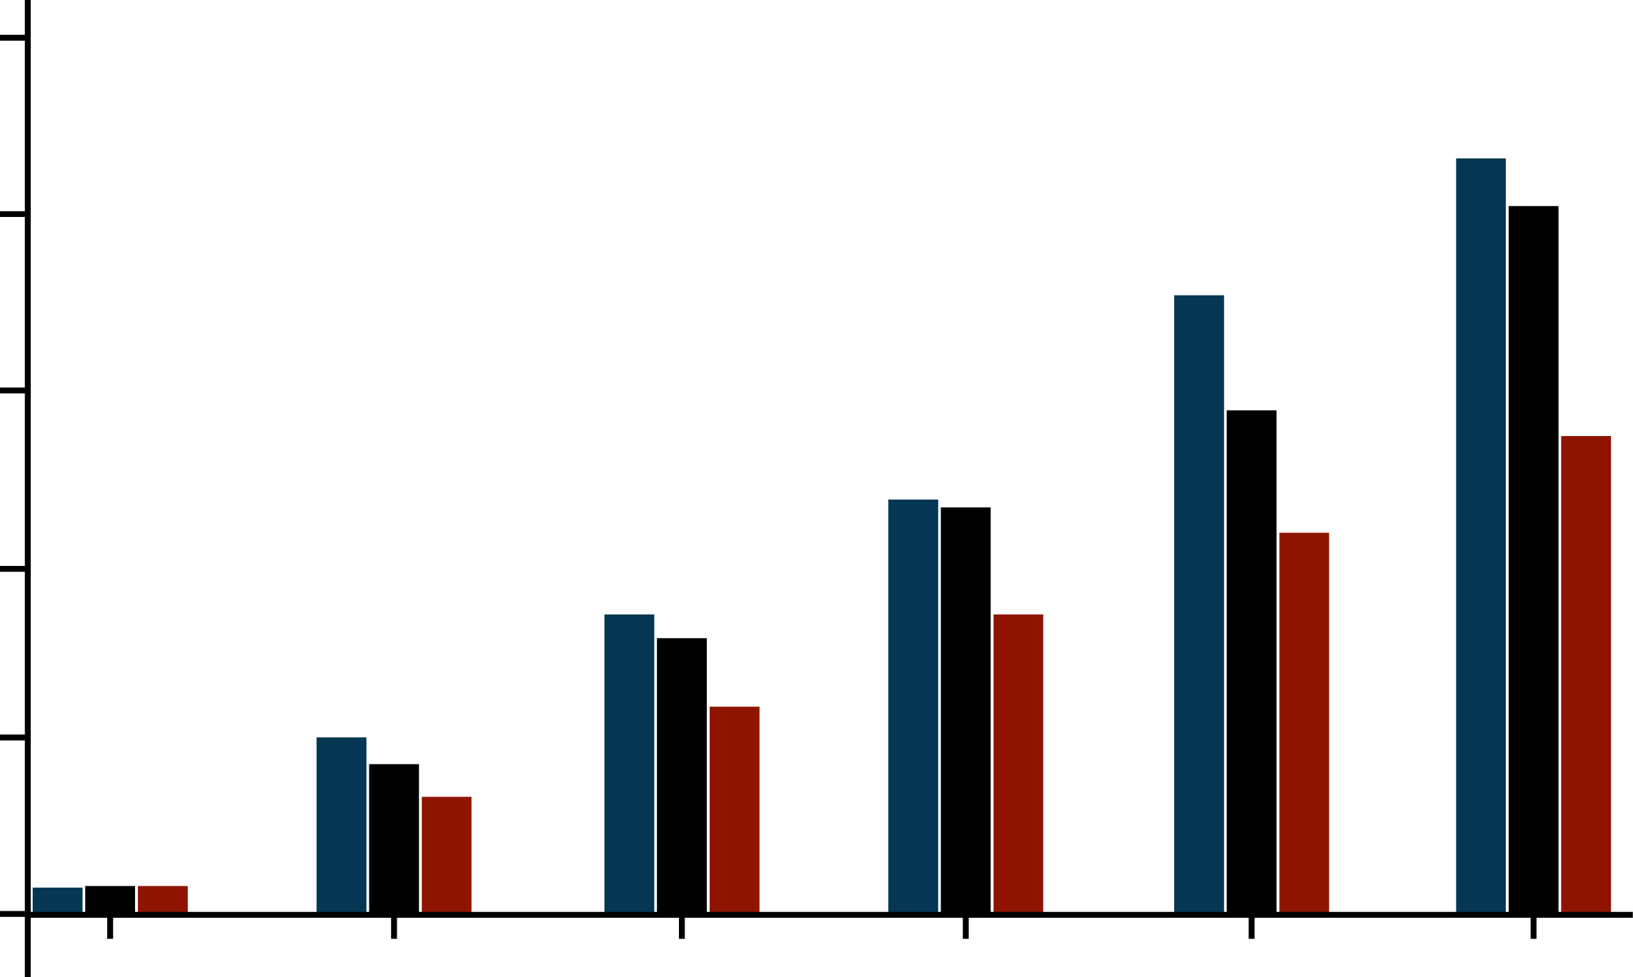
RE-LY Time to First Stroke / SEE
RR 0.91
(95% CI: 0.74-1.11)
P < .001 (noninferiority)
P = .34 (superiority)
1.69%
0.05
Warfarin
Dabigatran 110 mg
Dabigatran 150 mg
1.53%
RRR
34%
1.11%
0.04
0.03
RR 0.66
(95% CI: 0.53-0.82)
P < .001 (superiority)
Cumulative Hazard Rates
0.02
0.01
0.0
0
0.5
1.0
1.5
2.0
2.5
y
Connolly SJ, et al. N Engl J Med. 2009;361:1139-1151.^{[14]}
Notes:
Content Slide Layout: TEXT

Slide 21
Incidence of Major Hemorrhage:
Dabigatran vs Warfarin (RE-LY)
 | Rate | RR | P
*Dabigatran 110 mg BID | 2.71% | 0.80 | .003 (sup)
Dabigatran 150 mg BID | 3.11% | 0.93 | .31 (sup)
Warfarin | 3.36%
*Dabigatran 110-mg dose associated with a 20% RRR in major hemorrhage compared with warfarin.
More GI bleeds with 150-mg dose compared with warfarin.
Connolly SJ, et al. N Engl J Med. 2009;361:1139-1151.^{[14]}
Notes:
Content Slide Layout: TEXT

Slide 22
ROCKET AF: Primary Efficacy Outcome
Stroke and non-CNS Embolism
 | Rivaroxaban Event Rate | Warfarin Event Rate | HR (95% CI) | P Value
On Treatment N = 14,143 | 1.70 | 2.15 | 0.79 (0.65-0.95) | .015
ITT N = 14,171 | 2.12 | 2.42 | 0.88 (0.74-1.03) | .117
0.5
1.0
2.0
Rivaroxaban
better
Warfarin
better
Event Rates are per 100 patient-years
Based on Safety on Treatment or Intention-to-Treat thru Site Notification populations
Patel MR, et al. N Engl J Med. 2011;365:883-891.^{[15]}
Notes:
Content Slide Layout: TEXT

Slide 23
Primary Safety Outcomes
 | Rivaroxaban | Warfarin
 | Event Rate or N (Rate) | Event Rate or N (Rate) | HR (95% CI) | P Value
Major | 3.60 | 3.45 | 1.04 (0.90, 1.20) | .576
>2 g/dL Hgb drop | 2.77 | 2.26 | 1.22 (1.03, 1.44) | .019
Transfusion (> 2 units) | 1.65 | 1.32 | 1.25 (1.01, 1.55) | .044
Critical organ bleeding | 0.82 | 1.18 | 0.69 (0.53, 0.91) | .007
Bleeding causing death | 0.24 | 0.48 | 0.50 (0.31, 0.79) | .003
Intracranial Hemorrhage | 55 (0.49) | 84 (0.74) | 0.67 (0.47, 0.94) | .019
Intraparenchymal | 37 (0.33) | 56 (0.49) | 0.67 (0.44, 1.02) | .060
Intraventricular | 2 (0.02) | 4 (0.04)
Subdural | 14 (0.13) | 27 (0.27) | 0.53 (0.28, 1.00) | .051
Subarachnoid | 4 (0.04) | 1 (0.01)
Event Rates are per 100 patient-years Based on Safety on Treatment Population
Patel MR, et al. N Engl J Med. 2011;365:883-891.^{[15]}
Notes:
Content Slide Layout: TEXT

Slide 24
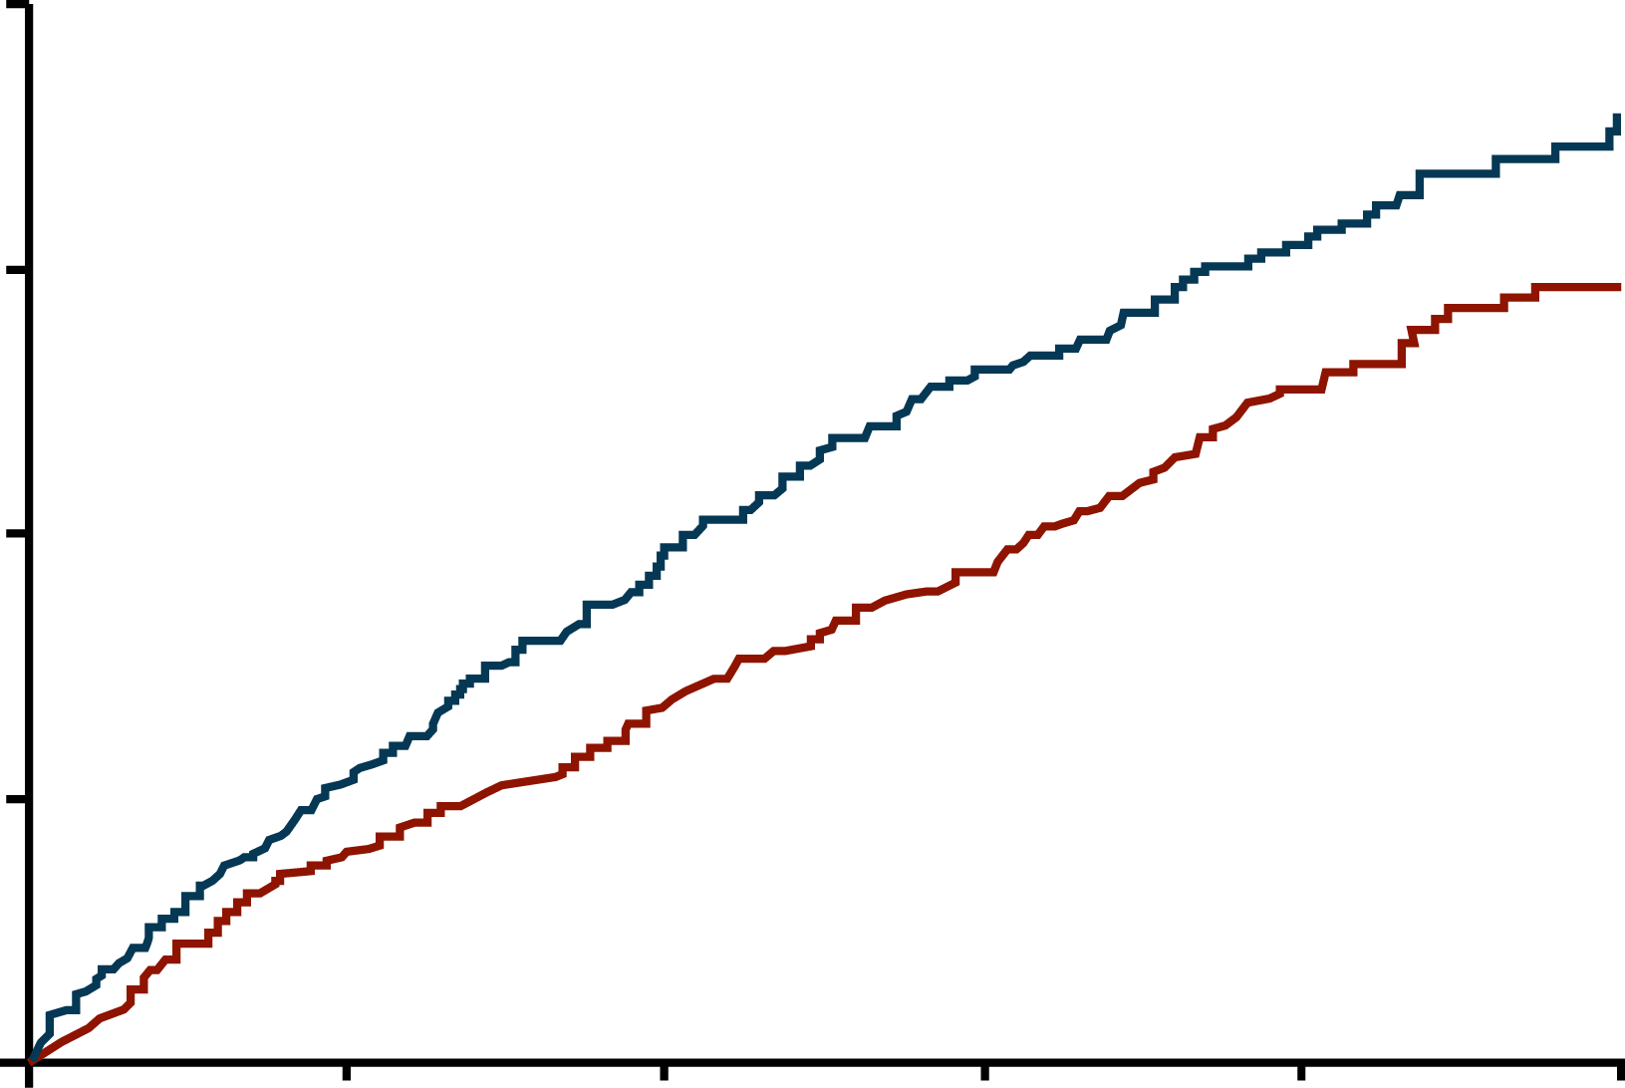
Primary Outcome
Stroke (ischemic or hemorrhagic) or systemic embolism
4
P (noninferiority) < .001
21% RRR
Warfarin
Apixaban
3
Event, %
2
1
Apixaban 212 patients, 1.27% per year
Warfarin 265 patients, 1.60% per year
HR 0.79 (95% CI, 0.66–0.95); P (superiority) = .011
0
0
6
12
18
24
30
m
No. at Risk
Apixaban 9120 8726 8440 6051 3464 1754
Warfarin 9081 8620 8301 5972 3405 1768
Granger CB, et al. N Engl J Med. 2011;365:981-992.^{[16]}
Notes:
Content Slide Layout: TEXT

Slide 25
Bleeding Outcomes
Outcome | Apixaban (N = 9088) | Warfarin (N = 9052) | HR (95% CI) | P Value
 | Event Rate, %/y | Event Rate, %/y
Primary safety outcome: ISTH major bleeding* | 2.13 | 3.09 | 0.69 (0.60-0.80) | < .001
Intracranial | 0.33 | 0.80 | 0.42 (0.30-0.58) | < .001
Gastrointestinal | 0.76 | 0.86 | 0.89 (0.70-1.15) | .37
Major or clinically relevant non-major bleeding | 4.07 | 6.01 | 0.68 (0.61-0.75) | < .001
GUSTO severe bleeding | 0.52 | 1.13 | 0.46 (0.35-0.60) | < .001
TIMI major bleeding | 0.96 | 1.69 | 0.57 (0.46-0.70) | < .001
Any bleeding | 18.1 | 25.8 | 0.71 (0.68-0.75) | < .001
*Part of sequential testing sequence preserving the overall type I error
Granger CB, et al. N Engl J Med. 2011;365:981-992.^{[16]}
Notes:
Content Slide Layout: TEXT

Slide 26
New Antithrombotic Therapies Compared to Warfarin
Intracranial Hemorrhage
Dabigatran 150 mg bidª
Dabigatran 110 mg bidª
Rivaroxaban 20 mg bid^{b}
Apixaban 5 mg bid^{c}
0.1
1.0
2.0
a. Connolly SJ, et al. N Engl J Med. 2009;361:1139-1151.^{[14]}
b. Patel MR, et al. N Engl J Med. 2011;365:883-891.^{[15]}
c. Granger CB, et al. N Engl J Med. 2011;365:981-992.^{[16]}
Notes:
Content Slide Layout: TEXT

Slide 27
Trials With New Agents vs Warfarin in AF
 | RE-LYª | ROCKET AF^{b} | ARISTOTLE^{c}
Sample size | 18,113 | 14,266 | 18,201
New treatment | dabigatran 110 mg & 150 mg BID | rivaroxaban 20 mg qd | apixaban 5 mg BID
Design | Noninferiority PROBE | Noninferiority Double-blind | Noninferiority Double-blind
CHADS₂ | ≥ 1 | ≥ 2 | ≥ 1
Primary outcome | Stroke or systemic embolism | Stroke or systemic embolism | Stroke or systemic embolism
Safety outcome | Primary: Major bleeding | Primary: Major bleeding | Primary: Major bleeding
CHADS₂ ≥ 3, % | 32 | 87 | 30
VKA naïve, % | 50 | 38 | 43
TTR, %* | 64 | 55 | 62
* Percent time spent in therapeutic INR range 2-3
a. Connolly SJ, et al. N Engl J Med. 2009;361:1139-1151.^{[14]} b. Patel MR, et al. N Engl J Med. 2011;365:883-891.^{[15]} c. Granger CB, et al. N Engl J Med. 2011;365:981-992.^{[16]}
Notes:
Content Slide Layout: TEXT

Slide 28
Clinical Pharmacology of Novel Anticoagulants
Jeffrey Weitz, MD, FRCP(C)
Professor of Medicine and Biochemistry
McMaster University
Executive Director
Thrombosis & Atherosclerosis Research Institute
Hamilton, Ontario, Canada
Notes:
Title Slide Layout

Slide 29
Limitations of Warfarin
Heparin bridging
Complicates peri-procedural management
Slow onset
Slow offset
Food/drug interactions
Narrow therapeutic window
Variable dosing
Frequent monitoring

Slide 30
New Oral Anticoagulants
Factor Xa
Thrombin
Rivaroxaban
Apixaban
Edoxaban
Dabigatran

Slide 31
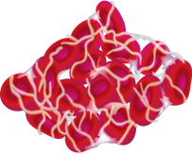
Targets of New Oral Anticoagulants
Initiation
Phase
Contact
TF
VIIa
IX
Platelet
Surface
Propagation
Phase
VIII
Warfarin
Apixaban
Rivaroxaban
Edoxaban
Xa
Common
Pathway
Thrombin
Dabigatran etexilate
Thrombin
Activity
Fibrinogen
Fibrin

Slide 32
Comparative Pharmacology
Characteristic | Rivaroxaban | Apixaban | Edoxaban | Dabigatran
Target | Factor Xa | Factor Xa | Factor Xa | Thrombin
Prodrug | No | No | No | Yes
Bioavailability, % | 80 | 60 | 62 | 6
Dosing | od (BID) | BID | od | BID (od)
Half life, h | 7-11 | 12 | 9-11 | 12-17
Renal, % | 33 (66) | 25 | 50 | 80
Monitoring | No | No | No | No
Interactions | 3A4/P-gp | 3A4/P-gp | P-gp | P-gp
Heidbuchel H, et al. Eur Heart J. 2013;34:2094-2106.^{[18]}

Slide 33
Dose and Frequency
Apixabanª
Peak to Trough Ratio ~3
Rivaroxaban^{b}
Peak to Trough Ratio ~18
Apixaban 2.5 mg BID
Steady State Concentration, ng/mL
Rivaroxaban 10 mg QD
Steady State Concentration, ng/mL
140
Apixaban 2.5 mg BID
140
Rivaroxaban 10 mg qd
120
120
100
100
80
80
Steady State Concentration, ng/mL
Steady State Concentration,
ng/mL
60
60
40
40
20
20
0
0
0
6
12
18
24
0
6
12
18
24
Time, h
Time, h
a. Frost C, et al. Br J Clin Pharmacol. 2013;75:476-487.^{[19]}
b. Mueck W, et al. Thromb J. 2013;11:10.^{[20]}

Slide 34
Edoxaban
Edo = “Bay-entrance” or “estuary”; the ancient name for Tokyo
Xa = Factor Xa
ban = Inhibitor

Slide 35
Pharmacokinetic/dynamic Profile of Single-Dose Edoxaban
1000
10 mg
40
10 mg
30 mg
30 mg
60 mg
60 mg
90 mg
35
90 mg
120 mg
120 mg
100
150 mg
30
150 mg
25
Edoxaban concentration, ng/mL
Prothrombin time, sec
10
20
15
1
10
0
4
8
12
16
20
24
0
4
8
12
16
20
24
Time, h
Time, h
Rapidly absorbed with C_{max} within 1-2 hours.
C_{max} and AUC increased in a dose-related manner.
Rapid increase in PT with peak effect within 1-2 hours.
Ogata K, et al. J Clin Pharmacol. 2010;50:743-753.^{[21]}

Slide 36
Phase 2 Study of Edoxaban in Patients With AF
Edoxaban 30 mg od
Follow-up assessment
Randomisation
Edoxaban 60 mg od
Screening
Edoxaban 30 mg BID
Edoxaban 60 mg BID
Active control (Warfarin)
≤ 30 days
Day 1
3-month randomised treatment period
+30 days
after last dose
Weitz JI, et al. Thromb Haemost. 2010;104:633-641.^{[22]}

Slide 37
All Bleeds for Edoxaban Relative to Warfarin
20
*
2.5
Ratio, edoxaban/warfarin
2.0
15
*
1.5
10
Bleeding incidence, %
*
1.00
*
5
0.5
13/235
17/234
31/244
33/180
20/250
0
30 mg od
60 mg od
30 mg BID
60 mg BID
Warfarin
With the same total daily dose of 60 mg, more bleeding with 30 mg BID regimen than with 60 mg od regimen
* Upper bound for one-sided 67% CI for ratio of incidence rates (Edoxaban/Warfarin): 0.80, 1.04, 1.79, and 2.58
Giugliano RP et al. ISTH 2009. Abstract OC-WE-003.^{[23]}

Slide 38
Edoxaban Phase 2 Dose Finding Study in AF
Exposure and Bleeding
C_{max}
AUC
C_{min}
300
250
200
150
100
50
0
4000
3000
2000
1000
150
100
50
0
ng/mL
ng*h/mL
ng/mL
30
od
60
od
30
BID
60
BID
30
od
60
od
30
BID
60
BID
30
od
60
od
30
BID
60
BID
35
30
25
20
15
10
5
0
Edoxaban
Bleeding incidence, %
30
od
60
od
30
BID
60
BID
Weitz JI, et al. Thromb Haemost. 2010;104:633-641.^{[22]}

Slide 39
A Single Dose of Edoxaban Inhibits Thrombin Generation >24 Hours
40
20
0
–20
Mean Change From Baseline Thrombin, mean ± SD
–40
–60
(A) Edoxaban
(B) Enoxaparin
–80
–100
0 12 24 36 48 60 72 84
Time Postdose, h
Zahir H, et al. Thromb Haemost. 2012;108:166-175.^{[24]}

Slide 40
Effect of Once- or Twice-daily Edoxaban on D-dimer Levels
Warfarin-naïve Patients
500
400
300
D-dimer Median, ng/mL
200
Edoxaban 30 mg od
Edoxaban 60 mg od
Edoxaban 30 mg BID
Edoxaban 60 mg BID
Warfarin
100
0
–2 0 2 4 6 8 10 12
After Randomisation, wk
Weitz JI, et al. Thromb Haemost. 2010;104:633-641.^{[22]}

Slide 41
Drug-drug Interactions
 | Transporter | CYP Metabolism
Rivaroxaban | P-gp | Yes
Apixaban | P-gp | Yes
Edoxaban | P-gp | Minimal
Dabigatran | P-gp | None

Slide 42
P-glycoprotein (P-gp)
Member of the ABC (ATP-binding cassette) superfamily
Transporter protein found in gut, kidney, and liver
In gut, P-gp limits drug absorption by transporting drug out of cells

Slide 43
P-glycoprotein (cont)
Absorption
Intestinal Tract
P-gp
Excretion
Lumen

Slide 44
CYP3A4-mediated Metabolism
Hepatocyte
Dabigatran
Edoxaban
Systemic Circulation
Rivaroxaban
Apixaban
CYP3A4
Metabolism

Slide 45
Important Drug-drug Interactions With NOACs
 | Via | Dabigatran | Apixaban | Rivaroxaban | Edoxaban
Verapamil | P-gp and CYP3A4 inhibition | +12-180% (use lower dose) | No data | Minor effect (use with caution if CrCl 15-50 mL/min) | + 53% (reduce dose by 50%)
Diltiazem | P-gp and CYP3A4 inhibition | No effect | + 40% | Minor effect (use with caution if CrCl 15-50 mL/min) | No data
Amiodarone | P-gp inhibition | Minor effect (use with caution if CrCl 15-50 ml/min) | No data | Minor effect (use with caution if CrCl 15-50 mL/min) | Minimal effect
Dronedarone | P-gp and CYP3A4 inhibition | +70-100% (use lower dose) | No data | No data | +85% (Reduce dose by 50%)
Conazole antifungals | P-gp and CYP3A4 inhibition | +150% (use lower dose) | +100% (use with caution) | +160% (use with caution) | No data
Heidbuchel H, et al. Eur Heart J. 2013; 34:2094-2106.^{[18]}

Slide 46
Advantages of New Oral Anticoagulants Over Warfarin
Feature | Warfarin | New Orals
Onset | Slow | Rapid
Dosing | Variable | Fixed
Food effect | Yes | No
Interactions | Many | Few
Monitoring | Yes | No
Offset | Long | Short

Slide 47
Unique Properties of NOACs and
Their Clinical Significance
Property | Significance
Short half-life | Adherence critical
Renal excretion | Careful patient selection; monitor creatinine clearance; adjust dose if necessary
Drug-drug interactions | Drug-specific

Slide 48
Conclusions
New oral anticoagulants are more convenient than warfarin
New oral anticoagulants are at least as effective as warfarin and appear to be safer
Edoxaban is a promising new oral anticoagulant, which will add to our armamentarium

Slide 49
The ENGAGE-AF TIMI-48 Trial
Robert P. Giugliano, MD, SM
Co-Principal Investigator, ENGAGE AF-TIMI 48
Senior Investigator, TIMI Study Group
CV Medicine, Brigham and Women’s Hospital
Associate Professor of Medicine, Harvard Medical School, Boston, Massachusetts
Notes:
Title Slide Layout

Slide 50
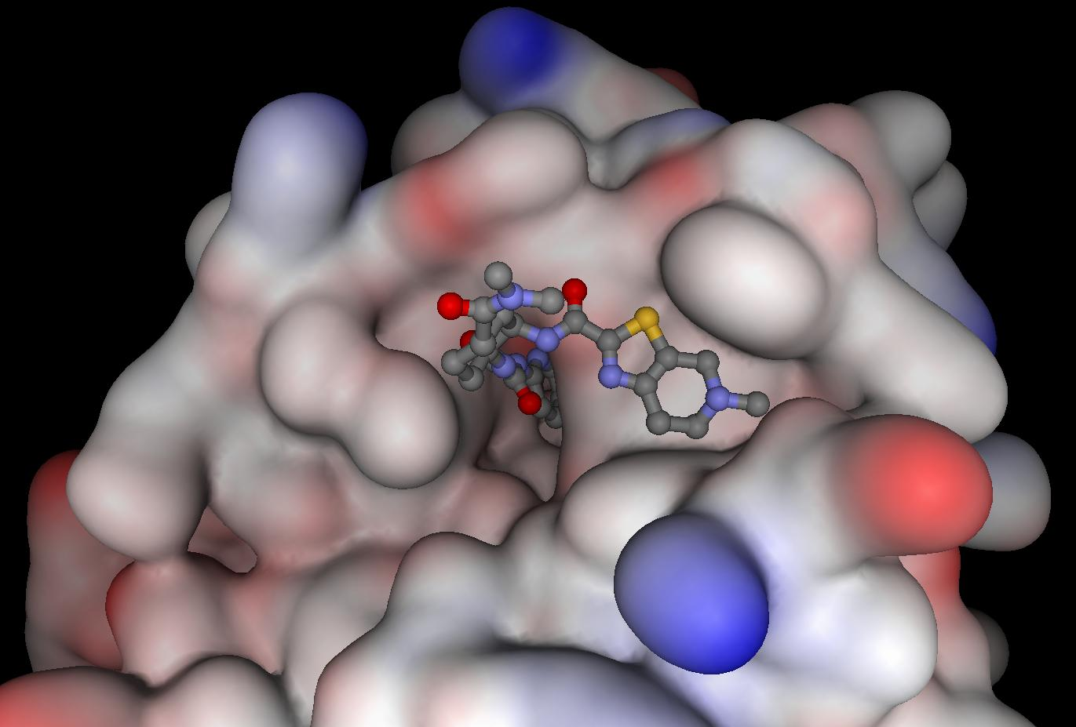
Background
Warfarin in AF: ↓stroke 64% vs placebo
Warfarin ↑bleeding and has well-known limitations
3 NOACs at least as effective; ↓hem stroke by 51%ª
Edoxaban seated in Factor Xa catalytic center
Direct oral
FXa inhibitor
Once daily
~50% renal clearance
62% oral bioavailability
Peak 1-2 h
Dose↓ 50% if:^{b}
CrCl 30-50 mL/m
Weight ≤ 60 kg
Strong P-gp inhib
t_{1/2} ~10-14 h
AF=atrial fibrillation; CrCl=creatinine clearance; FXa=Factor Xa;
NOAC=new oral anticoagulant; P-gp=p-glycoprotein
a. Dogliiotti A, et al. Clin Cardiol. 2013;36:61-7.^{[25]}
b. Salazar DE, et al. Thromb Haemost. 2012;107:925-936.^{[26]}

Slide 51
Study Objectives
To determine if 2 dose regimens (60 mg and 30 mg QD) of edoxaban were noninferior to warfarin with respect to the composite primary efficacy endpoint of stroke (ischemic or hemorrhagic) and SEE in patients with nonvalvular AF at moderate-high risk for stroke
Notes:
51

Slide 52
Trial Organization
TIMI Study Group
Eugene Braunwald (Study Chair) Elliott M. Antman (Principal Investigator)
Robert P. Giugliano (Co-Investigator) Christian T. Ruff (Co-Investigator)
Suzanne Morin (Director) Stephen D. Wiviott (CEC)
Laura Grip (Project Director) Sabina A. Murphy (Statistics)
Abby Cange (Project Manager) Naveen Deenadayalu (Statistics)
Sponsor: Daiichi Sankyo
Michele Mercuri Hans Lanz Indravadan Patel
Minggao Shi James Hanyok
CRO: Quintiles
Maureen Skinner Shirali Patel Dean Otto
Joshua Betcher Carmen Reissner
Data Safety Monitoring Board
Freek W.A. Verheugt (Chair) Allan Skene (Statistician)
Jeffrey Anderson Shinya Goto
J. Donald Easton Kenneth Bauer
Executive Committee
Eugene Braunwald Elliott M. Antman Robert P. Giugliano
Michele Mercuri Stuart Connolly John Camm
Michael Ezekowitz Jonathan Halperin Albert Waldo
Notes:
52

Slide 53
National Lead Investigators
UNITED STATES (3907) |  | CHINA (469) |  | DENMARK (219) |  | CROATIA (127)
E. Antman; R. Giugliano |  | Y. Yang |  | P. Grande |  | M. Bergovec
POLAND (1278) |  | HUNGARY (464) |  | ESTONIA (191) |  | PHILIPPINES (125)
W. Ruzyllo |  | R. Kiss |  | J. Voitk |  | N. Babilonia
CZECH REPUBLIC (1173) |  | ROMANIA (410) |  | MEXICO (190) |  | THAILAND (115)
J. Spinar |  | M. Dorobantu |  | A. García-Castillo |  | P. Sritara
RUSSIAN FEDERATION (1151) |  | SLOVAKIA (405) |  | PORTUGAL (180) |  | TURKEY (111)
M. Ruda |  | T. Duris |  | J. Morais |  | A. Oto
UKRAINE (1148) |  | UNITED KINGDOM (400) |  | PERU (173) |  | FRANCE (110)
A. Parkhomenko |  | J. Camm |  | M. Horna |  | J.J. Blanc
ARGENTINA (1059) |  | ISRAEL (283) |  | ITALY (169) |  | AUSTRALIA (102)
E. Paolasso |  | B. Lewis |  | P. Merlini; M. Metra |  | P. Aylward
JAPAN (1010) |  | SERBIA (277) |  | SPAIN (166) |  | GREECE (51)
Y. Koretsune; T. Yamashita |  | M. Ostojic |  | J.L. Zamorano |  | D. Alexopoulos
GERMANY (913) |  | SOUTH AFRICA (277) |  | NETHERLANDS (153) |  | FINLAND (42)
V. Mitrovic |  | A. Dalby |  | T. Oude Ophuis |  | M. Nieminen
CANADA (774) |  | CHILE (254) |  | BELGIUM (149) |  | NORWAY (34)
D. Roy |  | R. Corbalan |  | H. Heidbuchel |  | D. Atar
BRAZIL (707) |  | SWEDEN (252) |  | COLOMBIA (141) |  | SWITZERLAND (5)
J.C. Nicolau |  | S. Juul-Möller |  | R. Botero |  | T. Moccetti
INDIA (690) |  | TAIWAN (234) |  | GUATEMALA (136)
B. SomaRaju |  | S. Chen |  | G. Sotomora
BULGARIA (520) |  | SOUTH KOREA (230) |  | NEW ZEALAND (131)
A. Goudev |  | N. Chung |  | H. White
Notes:
53

Slide 54
Study Design
21,105 Patients
AF on electrical recording within last 12 mo
CHADS₂ ≥ 2
RANDOMIZATION
1:1:1 randomization is stratified by CHADS₂ score 2–3 vs 4-6
and need for edoxaban dose reduction*
Double-blind, Double-dummy
Warfarin
(INR 2.0-3.0)
High-dose Edoxaban
60* mg od
Low-dose Edoxaban
30* mg od
*Dose reduced by 50% if
- CrCl 30-50 mL/min
- weight ≤ 60 kg
- strong P-gp inhibitor
1º Efficacy EP = Stroke or SEE
2º Efficacy EP = Stroke or SEE or CV mortality
1º Safety EP = Major Bleeding (ISTH criteria)
Noninferiority
Upper 97.5% CI
RR, 1.38
CI = confidence interval CrCl = creatinine clearance;
ISTH=International Society on Thrombosis and Haemostasis
P-gp = P-glycoprotein; SEE=systemic embolic event
Ruff CT, et al. Am Heart J. 2010; 160:635-641.^{[27]}
Notes:
54

Slide 55
Characteristics Requiring Dose Reduction of Edoxaban
Edoxaban dose was halved from 60 → 30 mg or from 30 → 15 mg od, if one or more of the following present
At randomization
  CrCl 30-50 mL/min
  Body weight ≤ 60 kg
  Concomitant use of specific P-gp inhibitor
  (quinidine, verapamil)*
During study
  CrCl 30-50 mL/min and > 20% drop from baseline
  Body weight ≤ 60 kg and > 10% drop from baseline
  Concomitant use of specific P-gp inhibitors
  (quinidine, verapamil, dronedarone)*
*If concomitant P-gp inhibitors were discontinued, then dosage was restored to full dose
CrCl = creatinine clearance; P-gp = P-glycoprotein; od = once daily.

Slide 56
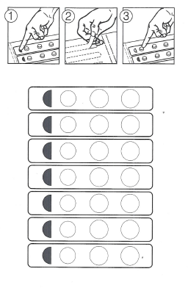
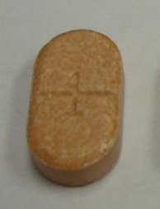

Trial Implementation
Double Dummy: All pts receive Active Rx and Placebo
Edoxaban or Placebo
Warfarin or Placebo
Day
1
2
1 mg
2.5 mg
3
4
5
Double
Blind
POC encrypted measurement
(6-digit code)
6
7
Notes:
56

Slide 57
Primary End Pointsª
Primary efficacy
  Time to first stroke (ischemic or hemorrhagic) or SEE
Principal safety
  Major bleeding as defined by ISTH^{b}
    Fatal bleeding, and/or
    Symptomatic bleeding in a critical area or organ
    Bleeding causing ≥ 2 g/dL (1.24 mmol/L) hemoglobin loss, adjusted for transfusion
Efficacy and safety outcomes adjudicated by a clinical events committee, unaware of study drug assignment
SEE = systemic embolic event;
ISTH = International Society on Thrombosis and Haemostasis
a. Ruff CT, et al. Am Heart J. 2010; 160:635-641.^{[27]}
b. Schulman S, Kearon C. J Thromb Haemost. 2005;3:692-694.^{[28]}

Slide 58
Key Secondary Composite Efficacy Outcomes
Stroke, SEE, and CV mortality (including fatal bleeding)
MACE
  composite of non-fatal MI,
  non-fatal stroke, non-fatal SEE, and death due to CV cause or bleeding
Stroke, SEE, and all-cause mortality
CV = cardiovascular; MACE = major adverse cardiovascular events
MI = myocardial infarction; SEE = systemic embolic event
Ruff CR et al. Am Heart J 2010; 160:635-641.

Slide 59
Patient Flow Diagram
21,105 randomized
Warfarin
(n = 7036; ITT)
Edoxaban 60 mg
(n = 7035; ITT)
Edoxaban 30 mg
(n = 7034; ITT)
N = 24 no study drug
N = 23 no study drug
N = 32 no study drug
7012 included in mITT and
Safety analysis
7012 included in mITT and
Safety analysis
7002 included in mITT and
Safety analysis
6157
Completed end date visit
6228
Completed end date visit
6250
Completed end date visit
879 did not complete the end date visit
  811 Died#
  68 Withdrew consent
  0 Lost to follow-up
807 did not complete the end date visit
  746 Died #
  61 Withdrew consent
  0 Lost to follow-up
783 did not complete the end date visit
  720 Died #
  62 Withdrew consent
  1 Lost to follow-up†
Giugliano RP, et al. N Engl J Med. 2013; 369:2093-2104.^{[17]}
† Known to be alive after database lock
#deaths before the study end date was announced

Slide 60
Population/Analysis Definitions
Populations
Analyses
mITT*, On-Treatment†
Primary efficacy
(Noninferiority)
Intent-to-Treat (ITT)
All randomized
Superiority
All events
Safety, On-Treatment†
Principal Safety
Major Bleeding (ISTH definition)
* mITT = All patients who took at least 1 dose
† On-Treatment = 1st dose → last dose +3 days or end of double-blind treatment
ISTH=International Society on Thrombosis and Haemostasis
Giugliano RP, et al. N Engl J Med. 2013; 369:2093-2104.^{[17]}

Slide 61
Baseline Characteristics
Median age [IQR] | 72 [64-78]
Female sex | 38%
Paroxysmal atrial fibrillation | 25%
CHADS₂ (mean) | 2.8 ± 1.0
CHADS₂ ≥ 3 | 53%
CHADS₂ ≥ 4 | 23%
Dose reduced at randomization | 25%
Prior VKA experience | 59%
Aspirin at randomization | 29%
Amiodarone at randomization | 12%
Medications at randomization
Aspirin | 29%
Thienopyridine | 2.3%
Amiodarone | 12%
Digoxin or digitalis preparation | 30%
No differences across treatment groups
Giugliano RP, et al. N Engl J Med. 2013; 369:2093-2104.^{[17]}
Notes:
61

Slide 62
Key Trial Metrics
21,105 Patients, 1393 Centers, 46 Countries
Received drug / enrolled | 99.6%
Completeness of follow-up | 99.5%
Final visit or died/enrolled | 99.1%
Off drug (patients/y) | 8.8%
Withdrew consent, no data | 0.9%
Lost to follow-up | n = 1
Median TTR [Interquartile range] | 68.4% [56.5-77.4]
Giugliano RP, et al. N Engl J Med. 2013; 369:2093-2104.^{[17]}
Notes:
62

Slide 63
Primary Efficacy End Point (Stroke/SEE) mITT Population While on Treatment
Noninferiority Analysis: Edoxaban vs Warfarin
Treatment | N | n | Incidence, %/yr | HR (97.5% CI) | P for non-inferiority
Warfarin (median TTR 68.4%) | 7012 | 232 | 1.50 | - | -
Edoxaban 60* mg QD | 7012 | 182 | 1.18 | 0.79 (0.63–0.99) | < .0001
Edoxaban 30* mg QD | 7002 | 253 | 1.61 | 1.07 (0.87–1.31) | .005
Hazard ratio (97.5% CI)
Non-inferiority P Values | Superiority P Values
P < .0001 | P = .017
P = .005 | P = .44
Warfarin TTR 68.4%
Edoxaban 60* mg QD
vs warfarin
0.79
Edoxaban 30* mg QD
vs warfarin
1.07
*Dose reduced by 50% in selected pts
1.38
0.50
1.00
2.0
edoxaban noninferior
Giugliano RP, et al. N Engl J Med. 2013; 369:2093-2104.^{[17]}

Slide 64
Primary End Point
Stroke/SEE (2.8 years median f/u)
Superiority Analysis (ITT, Overall): Edoxaban vs Wafarin
Treatment | N | n | Incidence, %/yr | HR (97.5% CI) | P for superiority
Warfarin (median TTR 68.4%) | 7036 | 337 | 1.80 | - | -
Edoxaban 60* mg QD | 7035 | 296 | 1.57 | 0.87 (0.73–1.04) | 0.08
Edoxaban 30* mg QD | 7034 | 383 | 2.04 | 1.13 (0.96–1.34) | 0.10
Warfarin TTR 68.4%
Hazard ratio (97.5% CI)
Edoxaban 60* mg QD
vs warfarin
P Values for Superiority
P = .08
P = .10
0.87
Edoxaban 30* mg QD
vs warfarin
1.13
*Dose reduced by 50% in selected pts
0.50
1.00
2.0
edoxaban superior
edoxaban inferior
Giugliano RP, et al. N Engl J Med. 2013; 369:2093-2104.^{[17]}

Slide 65
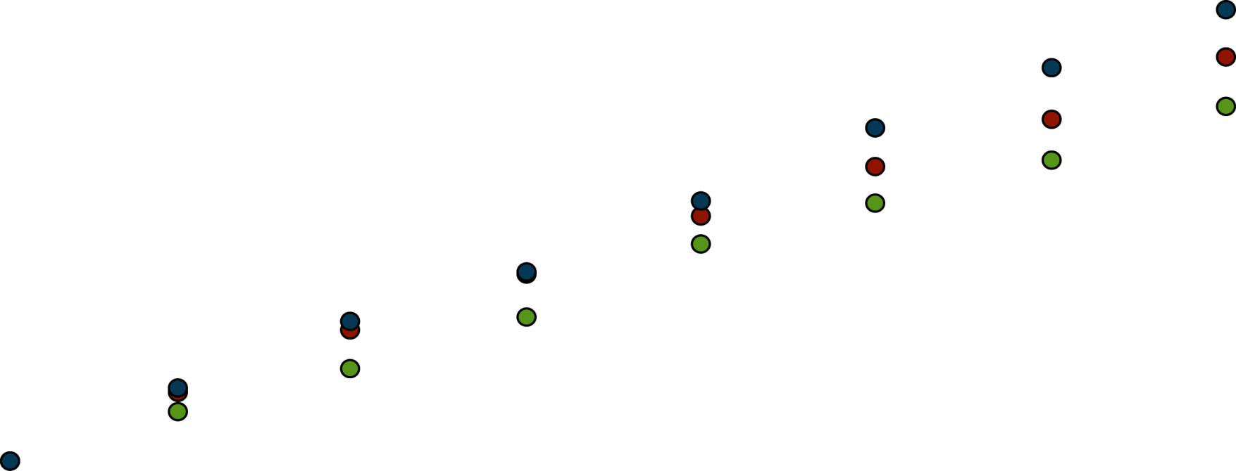
Stroke/SEE (ITT Population)
8
6
4
2
0
Edoxaban 30 mg (HR = 1.13, 0.96–1.34)
Warfarin (median TTR 68.4%)
Edoxaban 60 mg (HR = 0.87, 0.73–1.04)
Stroke or systemic embolic event, %
0 0.5 1.0 1.5 2.0 2.5 3.0 3.5
y
Number at risk
Warfarin 7036 6798 6615 6406 6225 4593 2333 536
Edox (60) 7035 6816 6650 6480 6283 4659 2401 551
Edox (30) 7034 6815 6631 6461 6277 4608 2358 534
SEE=systemic embolic event; ITT=Intent-to-Treat;
TTR=time in therapeutic range; HR=hazard ratio
Giugliano RP, et al. N Engl J Med. 2013; 369:2093-2104.^{[17]}

Slide 66
Key Secondary Outcomes
IMAGE NO LONGER AVAILABLE
Giugliano RP, et al. N Engl J Med. 2013; 369:2093-2104.^{[17]}

Slide 67
Subgroups 1
Efficacy
IMAGE NO LONGER AVAILABLE
Giugliano RP, et al. N Engl J Med. 2013; 369:2093-2104.^{[17]}

Slide 68
Subgroups 2
Efficacy
IMAGE NO LONGER AVAILABLE
Giugliano RP, et al. N Engl J Med. 2013; 369:2093-2104.^{[17]}

Slide 69
Subgroups 3
Efficacy
IMAGE NO LONGER AVAILABLE
Giugliano RP, et al. N Engl J Med. 2013; 369:2093-2104.^{[17]}

Slide 70
Main Safety Results
Safety Cohort on Treatment
IMAGE NO LONGER AVAILABLE
Giugliano RP, et al. N Engl J Med. 2013; 369:2093-2104.^{[17]}

Slide 71
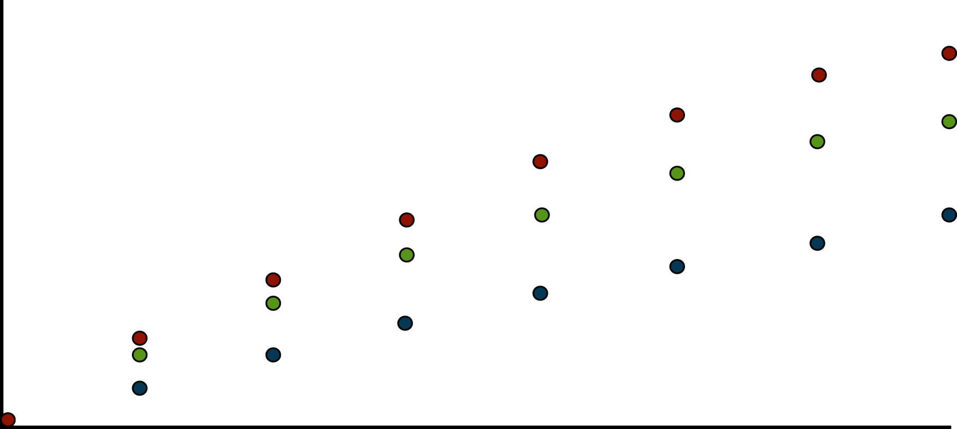
Major Bleeding (Safety Cohort, on Treatment)
12
10
8
6
4
2
0
Warfarin (Median TTR = 68.4%)
Edoxaban 60 mg (HR = 0.80, 0.71–0.91)
Edoxaban 30 mg (HR = 0.47, 0.41–0.55)
Major bleeding, %
0 0.5 1.0 1.5 2.0 2.5 3.0 3.5
y
Number at risk
Warfarin 7012 6166 5630 5278 4941 3446 1687 970
Edox (60) 7012 6039 5594 5232 4910 3471 1706 945
Edox (30) 7002 6218 5791 5437 5110 3635 1793 986
TTR=time in therapeutic range; HR=hazard ratio.
Giugliano RP, et al. N Engl J Med. 2013; 369:2093-2104.^{[17]}

Slide 72
Bleeding
Outcome | Warfarin (n = 7012) | Edox 60 mg (n = 7012) | Edoxaban 60 mg vs Warfarin |  | Edoxaban 30 mg (n = 7002) | Edoxaban 30 mg vs Warfarin
 | %/y | %/y | HR | P | %/y | HR | P
Major bleeding | 3.43 | 2.75 | 0.80 | < .001 | 1.61 | 0.47 | < .001
Life-threatening bleeding | 0.78 | 0.40 | 0.51 | < .001 | 0.25 | 0.32 | < .001
CRNM bleeding | 10.15 | 8.67 | 0.86 | < .001 | 6.60 | 0.66 | < .001
Minor bleeding | 4.89 | 4.12 | 0.84 | . 002 | 3.52 | 0.72 | < .001
Major or CRNM bleeding | 13.02 | 11.10 | 0.86 | < .001 | 7.97 | 0.62 | < .001
Any overt bleeding | 16.40 | 14.15 | 0.87 | < .001 | 10.68 | 0.66 | < .001
Data are from the Safety cohort during the on-treatment period
CRNM=clinically relevant non-major
Giugliano RP, et al. N Engl J Med. 2013; 369:2093-2104.^{[17]}

Slide 73
Net Clinical Outcomes
Edoxaban 60* mg od
vs warfarin
Edoxaban 30* mg od
vs warfarin
Hazard Ratio
(95% CI)
P Value
vs Warfarin
Warfarin TTR 68.4%
0.89
P = .003
Stroke, SEE, death, major bleeding
0.83
P < .001
0.88
Disabling stroke, life-threatening
bleeding, death
P = .008
0.83
P < .001
0.88
Stroke, SEE, life-threatening
bleeding, death
P = .003
0.89
P = .007
0.5
0.71
1.0
*Dose reduced by 50% in selected pts
SEE=systemic embolic event
edoxaban superior
edoxaban inf
Giugliano RP, et al. N Engl J Med. 2013; 369:2093-2104.^{[17]}
Notes:
73

Slide 74
Tolerability and Adverse Events
*Dose reduced by 50% in selected pts
Points, %
Points, %
Points, %
P < .001 for each edoxaban dose vs warfarin
P = NS
P = NS
Giugliano RP, et al. N Engl J Med. 2013; 369:2093-2104.^{[17]}
Notes:
74

Slide 75
Safety Data
 | Warfarin (n = 7012) | Edox 60 mg (n = 7012) | Edox 30 mg (n = 7002)
Hepatic cases adjudicated,* % | 2.2 | 2.2 | 2.2
Hepatocellular injury present | 1.2 | 1.3 | 1.1
Hepatic injury and cholestasis | 0.3 | 0.2 | 0.3
Cholestasis | 0.1 | 0.1 | 0.1
Other | 0.6 | 0.6 | 0.7
No liver injury present | < 0.1 | 0.1 | < 0.1
Neoplasms | 6.6 | 6.5 | 6.1
Bone fractures | 5.3 | 4.7 | 5.5
Deep vein thrombosis or pulmonary embolism | 0.4 | 0.4 | 0.3
Giugliano RP, et al. N Engl J Med. 2013; 369:2093-2104.^{[17]}

Slide 76
Transition Strategy
At trial completion, patients transitioned to open-label oral anticoagulation using a detailed transition plan
Transition to open-label VKA
  Active low-dose edoxaban and open-label VKA were overlapped for 2 weeks or until the INR reached 2.0 (whichever came first)
  Frequent INR measurements mandated (≥ 3 times during day 4-14)
  Approved VKA dosing algorithm was required (goal INR 2.0-3.0)
Transition to open label NOAC
  If INR was < 2.0 thrombin inhibitor or FXa inhibitor was started
  If INR was ≥ 2.0, repeat INR until < 2.0
INR = International Normalized Ratio
NOAC = new oral anticoagulant; VKA = vitamin K antagonist

Slide 77
Transition Period Outcomes
Events After Transition to Open-label Anticoagulant | Warfarin (n = 4503) | High-dose Edoxaban (n = 4526) | Low-dose Edoxaban (n = 4613)
Stroke or SEE* through 30 d | 7 (0.16%) | 7 (0.15%) | 7 (0.15%)
Major Bleeds through 14 d | 6 (0.13%) | 4 (0.09%) | 5 (0.10%)
Data shown include all patients on blinded study drug at the end of the treatment period
SEE=systemic embolic event. No SEEs occurred during the 30-day transition period.
Notes:
77

Slide 78
Unique Study Features
Largest (n = 21,105) RCT for stroke prevention in AF with a NOAC with longest follow-up (median 2.8 y)
Once-daily dosing regimen
Dynamic dose adjustments at and after randomization providing data on 3 doses over a fourfold range
Minimal missing data
Well managed warfarin therapy, median TTR 68.4%
Comprehensive and successful 14-day transition plan including edoxaban + VKA overlap at study end
Wealth of ancillary studies exploring disease state, pharmacology and mechanism of action

Slide 79
Summary
Compared with well-managed warfarin (TTR 68.4%), once-daily edoxaban
  Noninferior for stroke/SEE (both regimens)
  High dose ↓stroke/SEE on Rx (trend ITT)
  Both regimens significantly reduced
    Major bleeding (20/53%)
    ICH (53/70%)
    Hem stroke (46/67%)
    CV death (14/15%)
Superior net clinical outcomes
No excess in stroke or bleeding during transition → oral anticoag at end of trial
Notes:
79

Slide 80
Meta-Analysis of 72,000 Patients With AF Treated With Novel Anticoagulants
Christian T. Ruff, MD, MPH
TIMI Study Group
Brigham and Women’s Hospital
Harvard Medical School
Boston, Massachusetts
Notes:
Title Slide Layout

Slide 81
Stroke Prevention in AF Warfarin vs Placebo
AFASAK-1 (671)
SPAF (421)
BAATAF (420)
CAFA (378)
SPINAF (571)
EAFT (439)
64%
All Trials (n = 6)
100% 50% 0% -50% -100%
Warfarin Better
Warfarin Worse
Hart RG, et al. Ann Intern Med. 2007;146:857-867.^{[29]}
Notes:
Content Slide Layout: TEXT

Slide 82
Pivotal Warfarin-Controlled Trials
Stroke Prevention in AF
Warfarin vs Placebo
2,900 Patients
NOACs vs Warfarin
71,683 Patients
ROCKET AF
(Rivaroxaban)
2010
ENGAGE AF-TIMI 48
(Edoxaban)
2013
6 Trials of Warfarin vs Placebo
1989-1993
RE-LY
(Dabigatran)
2009
ARISTOTLE
(Apixaban)
2011
Notes:
Content Slide Layout: TEXT

Slide 83
Meta-Analysis
First to contain data from all 4 phase 3 warfarin-controlled trials
Robust sample size
  Precision in assessing relative benefit of NOACs in key clinical subgroups
  Effects of agents on important secondary outcomes
Pooled data for FXa and thrombin inhibitors
  Target key coagulation enzymes
  Trials share similar design
  Agents used interchangeably clinically and grouped together by guidelines
Separate meta-analysis of low-dose dabigatran and edoxaban
Comprehensive picture of the NOACs as a therapeutic option
Notes:
Content Slide Layout: TEXT

Slide 84
Comparative PK/PD of NOACs
 | Dabigatran | Rivaroxaban | Apixaban | Edoxaban
Target | IIa (thrombin) | Xa | Xa | Xa
Hours to C_{max} | 1-3 | 2-4 | 3-4 | 1-2
Half-life, hours | 12-17 | 5-13 | 12 | 10-14
Renal Clearance, % | 80 | 33* | 27 | 50
Transporters | P-gp | P-gp | P-gp | P-gp
CYP Metabolism, % | None | 32 | < 32 | <4
CYP = cytochrome P450; P-gp = P-glycoprotein
*33% renally cleared; 33% excreted unchanged in urine.
Heidbuchel H, et al. Eur Heart J. 2013;34:2094-2106.^{[18]}
Notes:
Content Slide Layout: TEXT

Slide 85
NOAC SPAF Trials
 | RE-LYª | ROCKET AF^{b} | ARISTOTLE^{c} | ENGAGE AF^{d}
Drug | Dabigatran | Rivaroxaban | Apixaban | Edoxaban
# Randomized | 18,113 | 14,266 | 18,201 | 21,105
Dose (mg) | 150, 110 | 20 | 5 | 60, 30
Frequency | Twice Daily | Once Daily | Twice Daily | Once Daily
Dose Adjustment, % | No | 20 → 15 | 5 → 2.5 | 60 → 30 30 → 15
At Baseline | 0 | 21 | 5 | 25
After Randomization | No | No | No | >9
Target INR (Warfarin) | 2.0-3.0 | 2.0-3.0 | 2.0-3.0 | 2.0-3.0
Design | PROBE* | 2x blind | 2x blind | 2x blind
*PROBE = prospective, randomized, open-label, blinded end point evaluation
a. Connolly SJ, et al. N Engl J Med. 2009;361:1139-1151.^{[14]}
b. Patel MR, et al. N Engl J Med. 2011;365:883-891.^{[15]}
c. Granger CB, et al. N Engl J Med. 2011;365:981-992.^{[16]}
d. Giugliano RP, et al. N Engl J Med. 2013;369:2093-2104.^{[17]}
Notes:
Content Slide Layout: TEXT

Slide 86
Baseline Characteristics
 | RE-LYª (Dabigatran) | ROCKET-AF^{b} (Rivaroxaban) | ARISTOTLE^{c} (Apixaban) | ENGAGE AF^{d} (Edoxaban)
# Randomized | 18,113 | 14,264 | 18,201 | 21,105
Age, years | 72 ± 9 | 73 [65-78] | 70 [63-76] | 72 [64-78]
Female, % | 37 | 40 | 35 | 38
Paroxysmal AF, % | 32 | 18 | 15 | 25
VKA naïve, % | 50 | 38 | 43 | 41
Aspirin use,% | 40 | 36 | 31 | 29
CHADS₂
0-1
2
3-6
a. Connolly SJ, et al. N Engl J Med. 2009;361:1139-1151.^{[14]}
b. Patel MR, et al. N Engl J Med. 2011;365:883-891.^{[15]}
c. Granger CB, et al. N Engl J Med. 2011;365:981-992.^{[16]}
d. Giugliano RP, et al. N Engl J Med. 2013;369:2093-2104.^{[17]}
Notes:
Content Slide Layout: TEXT

Slide 87
Trial Metrics
 | RE-LYª (Dabigatran) | ROCKET AF^{b} (Rivaroxaban) | ARISTOTLE^{c} (Apixaban) | ENGAGE AF^{d} (Edoxaban)
Median Follow-up, y | 2.0 | 1.9 | 1.8 | 2.8
Median TTR | 66 | 58 | 66 | 68
Lost to Follow-up, N | 20 | 32 | 90 | 1
*TTR, time in therapeutic range
a. Connolly SJ, et al. N Engl J Med. 2009;361:1139-1151.^{[14]}
b. Patel MR, et al. N Engl J Med. 2011;365:883-891.^{[15]}
c. Granger CB, et al. N Engl J Med. 2011;365:981-992.^{[16]}
d. Giugliano RP, et al. N Engl J Med. 2013;369:2093-2104.^{[17]}
Notes:
Content Slide Layout: TEXT

Slide 88
All NOACs
Stroke or SEE
Risk Ratio (95% CI)
RE-LY
0.66 (0.53 - 0.82)
[150 mg]
ROCKET AF
0.88 (0.75 - 1.03)
ARISTOTLE
0.80 (0.67 - 0.95)
ENGAGE AF-TIMI 48
0.88 (0.75 - 1.02)
[60 mg]
Combined
0.81 (0.73 - 0.91)
[Random Effects Model]
P < .0001
N = 58,541
0.5
1
2
Favors NOAC
Favors Warfarin
Heterogeneity P = .13
Ruff CT, et al. Lancet. 2013;Early Online Publication.^{[30]}
Notes:
Content Slide Layout: TEXT

Slide 89
Secondary Efficacy Outcomes
Risk Ratio (95% CI)
Ischemic Stroke
0.92 (0.83 - 1.02)
P = .10
Hemorrhagic Stroke
0.49 (0.38 - 0.64)
P < .0001
MI
0.97 (0.78 - 1.20)
P = .77
All-Cause Mortality
0.90 (0.85 - 0.95)
P = .0003
2
0.2
0.5
1
Favors NOAC
Favors Warfarin
Heterogeneity P = NS for all outcomes
Ruff CT, et al. Lancet. 2013;Early Online Publication.^{[30]}
Notes:
Content Slide Layout: TEXT

Slide 90
All NOACs
Major Bleeding
Risk Ratio (95% CI)
RE-LY
0.94 (0.82-1.07)
[150 mg]
ROCKET AF
1.03 (0.90-1.18)
ARISTOTLE
0.71 (0.61-0.81)
ENGAGE AF-TIMI 48
0.80 (0.71-0.90)
[60 mg]
Combined
0.86 (0.73-1.00)
[Random Effects Model]
P = .06
N = 58,498
0.5
1
2
Heterogeneity P = .001
Favors NOAC
Favors Warfarin
Ruff CT, et al. Lancet. 2013;Early Online Publication.^{[30]}
Notes:
Content Slide Layout: TEXT

Slide 91
Secondary Safety Outcomes
Risk Ratio (95% CI)
ICH
0.48 (0.39 - 0.59)
P < .0001
1.25 (1.01 - 1.55)
GI Bleeding
P = .043
1
2
0.2
0.5
Heterogeneity
ICH, P = .22
GI Bleeding, P = .009
Favors NOAC
Favors Warfarin
Ruff CT, et al. Lancet. 2013;Early Online Publication.^{[30]}
Notes:
Content Slide Layout: TEXT

Slide 92
Subgroups
Stroke or SEE
 |  |  |  | Risk Ratio (95% CI) | P-Interaction
Age, y | < 75 > 75 |  |  | 0.85 (0.73-0.99) 0.78 (0.68-0.88) | P = .38
Gender | Female Male |  |  | 0.78 (0.65-0.94) 0.84 (0.75-0.94) | P = .52
Diabetes | No Yes |  |  | 0.83 (0.74-0.93) 0.80 (0.69-0.93) | P = .73
Prior Stroke or TIA | No Yes |  |  | 0.78 (0.66-0.91) 0.86 (0.76-0.98) | P = .30
CrCl | < 50 50-80 > 80 |  |  | 0.79 (0.65-0.96) 0.75 (0.66-0.85) 0.98 (0.79-1.22) | P = .12
CHADS₂ Score | 0-1 2 3-6 |  |  | 0.75 (0.54-1.04) 0.86 (0.70-1.05) 0.80 (0.72-0.89) | P = .76
VKA Status | Naïve Experienced |  |  | 0.75 (0.66-0.86) 0.85 (0.70-1.03) | P =.31
Center-Based TTR | < 66% > 66% |  |  | 0.77 (0.65-0.92) 0.82 (0.71-0.95) | P = .60
0.5
1
2
Favors NOAC
Favors Warfarin
Ruff CT, et al. Lancet. 2013;Early Online Publication.^{[30]}
Notes:
Content Slide Layout: TEXT

Slide 93
Subgroups
Major Bleeding
 |  |  |  | Risk Ratio (95% CI) | P-Interaction
Age | < 75 > 75 |  |  | 0.79 (0.67-0.94) 0.93 (0.74-1.17) | P = .28
Gender | Female Male |  |  | 0.75 (0.58-0.97) 0.90 (0.72-1.12) | P = .29
Diabetes | No Yes |  |  | 0.71 (0.54-0.93) 0.90 (0.78-1.04) | P = .12
Prior Stroke or TIA | No Yes |  |  | 0.85 (0.72-1.01) 0.89 (0.77-1.02) | P = .70
CrCl | < 50 50-80 > 80 |  |  | 0.74 (0.52-1.05) 0.91 (0.76-1.08) 0.85 (0.66-1.10) | P = .57
CHADS₂ Score | 0-1 2 3-6 |  |  | 0.60 (0.45-0.80) 0.88 (0.65-1.20) 0.86 (0.71-1.04) | P = .09
VKA Status | Naïve Experienced |  |  | 0.84 (0.76-0.93) 0.87 (0.70-1.08) | P =.78
Center-Based TTR | < 66% > 66% |  |  | 0.69 (0.59-0.81) 0.93 (0.76-1.13) | P = .022
0.2
0.5
1
2
Favors NOAC
Favors Warfarin
Ruff CT, et al. Lancet. 2013;Early Online Publication.^{[30]}
Notes:
Content Slide Layout: TEXT

Slide 94
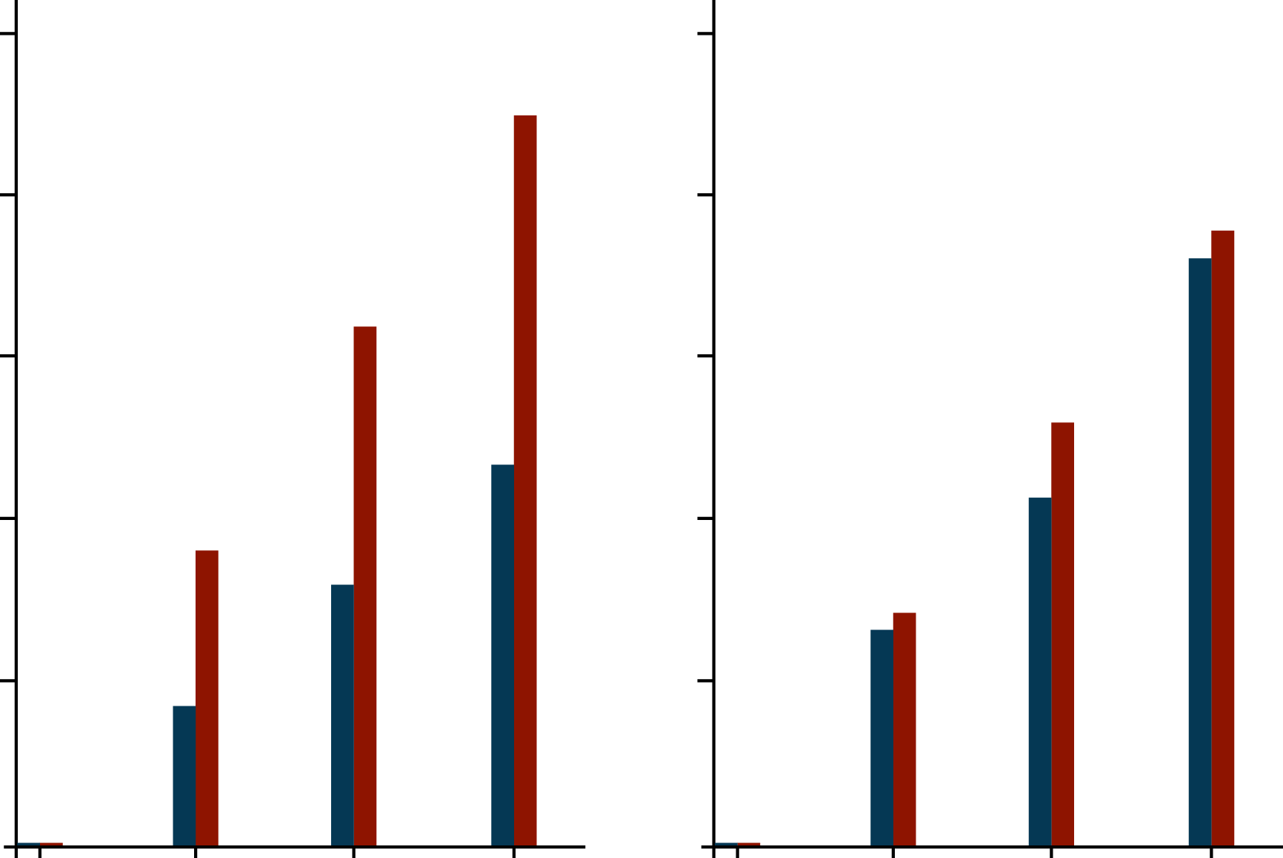
ACTIVE-W
Stroke or SEE
Clopi + ASA
VKA
P-interaction = .013
0.10
TTR ≥ 65%
0.10
TTR < 65%
0.08
0.08
RR = 1.11
P = .47
RR = 1.83
P < .0001
0.06
0.06
Event Rate, %
0.04
0.04
0.02
0.02
0.0
0.0
0.0 0.5 1.0 1.5
y
0.0 0.5 1.0 1.5
Connolly SJ, et al. Circulation. 2008;118:2029-2037.^{[31]}
Notes:
Content Slide Layout: TEXT

Slide 95
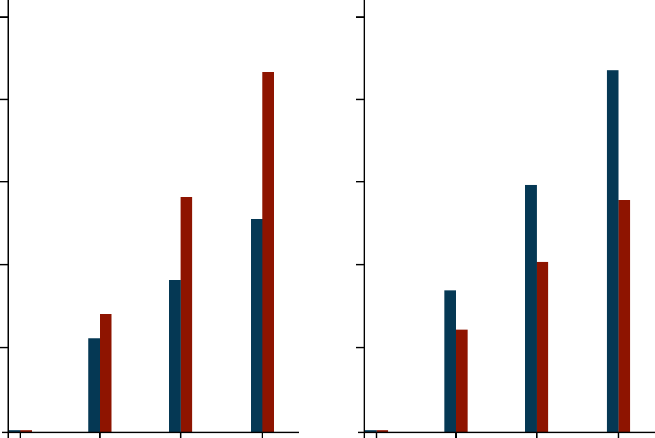
ACTIVE-W
Major Bleeding
C+A
OAC
P-interaction = .0006
0.05
TTR ≥ 65%
0.05
TTR < 65%
0.04
0.04
RR = 1.55
P = .027
RR = 0.68
P = .08
0.03
0.03
Event Rate, %
0.02
0.02
0.01
0.01
0.0
0.0
0.0 0.5 1.0 1.5
0.0 0.5 1.0 1.5
y
Connolly SJ, et al. Circulation 2008;118:2029-2037.^{[31]}
Notes:
Content Slide Layout: TEXT

Slide 96
Low Dose Regimens
Efficacy and Safety Outcomes
Dabigatran 110 mg and Edoxaban 30 mg
Risk Ratio (95% CI)
Stroke or SEE
1.03 (0.84-1.27)
P = .74
Ischemic Stroke
1.28 (1.02-1.60)
P = .045
Hemorrhagic Stroke
0.33 (0.23-0.46)
P < .0001
MI
1.25 (1.04-1.50)
P = .019
All-Cause Mortality
0.89 (0.83-0.96)
P = .003
Major Bleeding
0.65 (0.43-1.00)
P = .05
ICH
0.31 (0.24-0.41)
P < .0001
GI Bleeding
0.89 (0.57-1.37)
P = .58
0.2
0.5
1
2
Favors Low Dose NOAC
Favors Warfarin
Heterogeneity
P = NS for outcomes except:
Major Bleeding, P = < .001
GI Bleeding, P = .01
N = 26,107
Ruff CT, et al. Lancet. 2013;Early Online Publication.^{[30]}
Notes:
Content Slide Layout: TEXT

Slide 97
Conclusions
NOACs significantly reduce stroke (⬇19%)
  Primarily driven by reduction in hemorrhagic stroke (⬇51%)
NOACs significantly reduce mortality (⬇10%)
Trend toward less bleeding
  Substantial reduction in ICH (⬇52%)
  Increased GI bleeding (⬆25%)
The relative efficacy and safety of NOACs consistent across a wide spectrum of AF patients
  Even less bleeding when INR not as well controlled
Low-dose NOAC regimens reduce mortality and have a very favorable bleeding profile but more ischemic events
Differences in agents, patients, and trials may not be accounted for
  Heterogeneity major bleeding and GI bleeding
Notes:
Content Slide Layout: TEXT

Slide 98
The Future of Antithrombotic Therapy for Atrial Fibrillation
A. John Camm, MD
Professor of Clinical Cardiology
St George's University of London
Consultant Cardiologist Cardiothoracic Department
St George's Hospital
London, United Kingdom
Notes:
Title Slide Layout

Slide 99
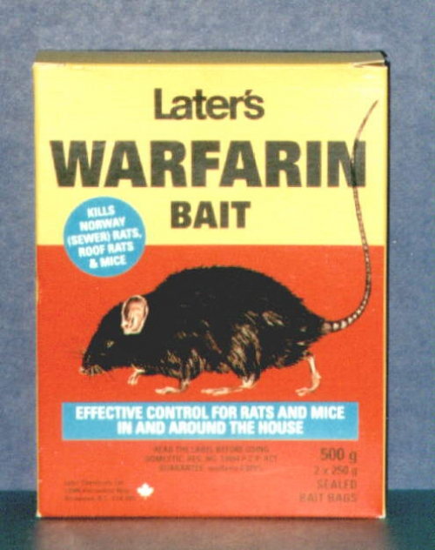
1933 - A Dead Bull and Blood That Would Not Clot
Wisconsin
Alumni
Research
Foundation
COUMARIN
“In 1941, Karl Paul Link successfully isolated the anticoagulant factor, which initially found commercial application as a rodent-killer. Warfarin is now one of the most widely prescribed medicines in the world.”
Notes:
99
Content Slide Layout: graph

Slide 100
VKA Therapy in AF
6 trials, 2900 patients with AF
Highly selected patients, uncertain INR control
Target
INR
Range
2.8-4.2
2.0-4.5
1.5-2.7
2.0-3.0
1.4-2.8
2.5-4.0
RRR (95 % CI)
AFASAK I, 1989; 1990
SPAF I, 1991
BAATAF, 1990
CAFA, 1991
SPINAF, 1992
EAFT, 1993
All trials (n = 6)
RRR: 64%
100 %
50 %
0
- 50 %
- 100 %
Favours Warfarin
Favours Placebo
or Control
RRR all-cause mortality 26% (3% to 43%)
Absolute increase in risk of major ECH 0.3%/year
ECH = extracranial haemorrhage RRR = relative risk reduction
Adapted from Hart RG, et al. Ann Intern Med. 2007;146:857-867.^{[29]}
Notes:
100
Content Slide Layout: graph

Slide 101
Warfarin-treated Patients
Better Outcome Irrespective of Risks
All-cause mortality, ischemic stroke, and intracranial bleeds in relation to use of oral anticoagulation in patients with different combinations of stroke and bleeding risks
CHA₂DS₂-VASc 0–2 p
CHA₂DS₂-VASc ≥3 p
1.0
P < .00001
(n = 1,787)
1.0
P < .00001
(n = 59,817)
0.8
0.8
OAC
No OAC
0.6
0.6
OAC
HAS-BLED ≥3 p
Proportion surviving
Proportion surviving
0.4
0.4
no OAC
0.2
0.2
HRs range from 0.26- 0.72
0.0
0.0
Risk for intracranial bleeding
0
1
2
3
4
Years
0
1
2
3
4
Years
1.0
P < .00001
(n = 43,395)
1.0
P < .00001
(n = 53,797)
0.8
0.8
OAC
0.6
0.6
HAS-BLED 0–2 p
Proportion surviving
Proportion surviving
no OAC
0.4
0.4
0.2
0.2
0.0
0.0
Years
0
1
2
3
4
Years
0
1
2
3
4
Risk for embolic stroke
Friberg L, et al. Circulation. 2012;125:2298-2307.^{[32]}
Notes:
101
Content Slide Layout: graph

Slide 102
Warfarin Use in Primary Care -- UK
Initiation of VKA
41,000 chronic AF treated by GPs in UK
Administrative database study
Diagnosed after January 2000
100
100
Age 40-64
Age 65-69
80
80
Age 70-74
Age 75-79
60
60
Age 80-84
%
%
Age 85+
40
40
20
20
0
0
0
2
4
6
0
2
4
6
Years after diagnosis
Years after starting treatment
Gallagher AM, et al. J Thromb Haemost. 2008;6:1500-1506.^{[32]}
GPs, general practitioners; UK, United Kingdom.
Notes:
102
Content Slide Layout: graph

Slide 103
Suboptimal TTR and Risk of Stroke
1.0
Warfarin TTR group*
71%–100%
61%–70%
0.9
51%–60%
41%–50%
31%–40%
Cumulative survival
≤30%
0.8
No warfarin
IMAGE NO LONGER AVAILABLE
0.7
0.6
0
500
1000
1500
2000
Survival to stroke, d^{b}
Meta-analysis of TTR (%) of AF patients treated with warfarin in the community
TTR > 70% is necessary to reduce stroke risk in patients with CHADS₂ score ≥ 2 compared with the non-warfarin treatment group (P = .025)
*No. of warfarin-treated patients in each group is defined by proportion of time spent within INR target range
TTR, time in therapeutic range
Baker WL, et al. J Manag Care Pharm. 2009;15:244-252.^{[34]}
Morgan CL, et al. Thromb Res. 2009;124:37-41.^{[35]}
Notes:
103
Content Slide Layout: graph

Slide 104
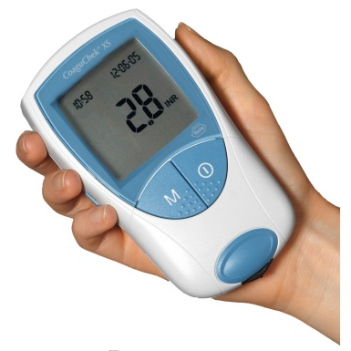
Patient Self-testing/Management
Reduces Major Thromboembolic Events
Meta-analysis: major thromboembolic events in PST/PSM versus usual care
Study, year | Events/Total, n/n
Long-term studies (≥ 12 mo) | PST or PSM | Usual care
Sidhu and O’Kane (2001) | 1/51 | 0/49
Körtke et al (2001 and 2007) | 16/579 | 32/576
Menéndez-Jándula et al (2005) | 4/368 | 20/369
Fitzmaurice et al (2005) | 4/337 | 3/280
Siebenhofer et al (2008) | 6/99 | 13/96
Eitz et al (2008) | 14/470 | 21/295
Matchar et al (2010) | 33/1,465 | 31/1,457
Soliman Hamad et al (2009) | 0/29 | 1/29
0.1
0.2
0.5
1
2
5
10
Favours PST or PSM
Favours usual care
Peto odds ratio (95% CI)
Bloomfield HE, et al. Ann Int Med. 2011;154:472-482.^{[36]}
Notes:
104
Content Slide Layout: graph

Slide 105
Warfarin -- Modern Role
Standard of Care for the Following Patient Groups
Warfarin with monitoring should be the standard of care if
  There is a risk of nonadherence
  Renal impairment is present
  The patient has ACS ± angioplasty ± stent (DES)
  A mechanical heart valve is in situ
  The patient has hypertrophic cardiomyopathy
  The patients are children or adolescents
  A drug that has an antidote is preferred
  The patient is intolerant to the new drugs
  Cost is an issue

Slide 106
INR Values in Range for
Tecarfarin vs Warfarin
6-16 week study; titration weeks 1 – 3 excluded (N = 64)
 | INR in Specified Range, Mean %
INR Range | Warfarin | Tecarfarin | P
< 1.5 | 3.9 | 1.2 | .0022
1.5-1.9 | 22.4 | 14.2 | .0009
2.0-3.0 | 59.3 | 71.5 | .0009
3.1-4.0 | 11.1 | 11.9 | .0009
> 4.0 | 3.3 | 1.2 | .0727
Ellis DJ, et al. Circulation. 2009;120:1029-1035.^{[37]}
Notes:
106
Content Slide Layout: graph

Slide 107
Stroke Prevention
DOAC Effect
Stroke or systemic embolism
ICH
Relative Hazard Ratio (95% CI)
Category
W vs Dabigatran 110
W vs Rivaroxaban
W vs Dabigatran 150
W vs Apixaban 5
W vs Placebo
W vs W_{low dose}
W vs Aspirin
W vs Aspirin + Clop
W vs Ximelagatran
W vs Dabigatran 110
W vs Rivaroxaban
W vs Dabigatran 150
W vs Apixaban 5
0 0.3 0.6 0.9 1.2 1.5 1.8 2.0
Major bleeding
W vs Dabigatran 110
W vs Rivaroxaban
W vs Dabigatran 150
W vs Apixaban 5
0 0.3 0.6 0.9 1.2 1.5 1.8 2.0
Favours warfarin
Favours other Rx
0 0.3 0.6 0.9 1.2 1.5 1.8 2.0
Favours warfarin
Favours other Rx
Modified from Camm AJ. Eur Heart J. 2009;30:2554-2555.^{[39]}
Notes:
107
Content Slide Layout: graph

Slide 108
Summary of ENGAGE TIMI-48 Results
0.79
Stroke and SEE: mITT on-treatment
Stroke and SEE: ITT
Hemorrhagic stroke: ITT
Ischemic stroke: ITT
Major bleed: safety cohort
CRNM bleed: safety cohort
Death: ITT
CV death: ITT
Stroke, SEE, major bleed, death: ITT
1.07
0.87
1.13
0.54
0.33
1.00
1.41
//
0.47
0.80
0.66
0.86
0.92
0.87
0.86
Edoxaban 60 mg
0.85
Edoxaban 30 mg
0.89
0.83
0.00
0.50
1.00
1.50
Edoxaban better
Warfarin better
Giugliano RP, et al. N Engl J Med. 2013; 369:2093-2104.^{[17]}
Notes:
108
Content Slide Layout: graph

Slide 109
NOAC 4-trial Meta-analysis Full Dose
Prespecified meta-analysis of all 71,683 patients
Trial | Stroke and Systemic Embolism | P | Major Bleeding | P
RE-LY |  | .0001 |  | .34
ROCKET AF |  | .12 |  | .72
ARISTOTLE |  | .012 |  | < .0001
ENGAGE TIMI 48* |  | .10 |  | .0002
Combined |  | < .0001 |  | .06
0.5
Favours DOAC
1
0.5
Favours DOAC
1
* Edoxaban is not approved for clinical use
Ruff CT, et al. Lancet. 2013;Early Online Publication.^{[30]}
Notes:
109
Content Slide Layout: graph

Slide 110
Efficacy vs Safety
NOAC 4-trial Meta-analysis Full Dose
Result | Pooled DOAC, Events/Total | Pooled Warfarin, Events/Total | Risk Ratio |  | 95% CIs | P
Efficacy
Ischaemic Stroke | 665/29292 | 724/29221 | 0.92 | 0.83-1.02 |  | .10
Hemorrhagic stroke | 130/29292 | 263/29221 | 0.49 | 0.38-0.64 |  | < .0001
Myocardial Infarction | 413/29292 | 432/29221 | 0.97 | 0.78-1.20 |  | .97
All Cause mortality | 2022/29292 | 2245/29221 | 0.90 | 0.851-0.95 |  | .0003
Safety
ICH | 204/29287 | 425/29211 | 0.48 | 0.39-0.59 |  | < .0001
GI bleeding | 751/29287 | 591/29211 | 1.25 | 1.01-1.55 |  | .043
* Edoxaban is not approved for clinical use
0.25
Favours NOAC
1
2
Ruff CT, et al. Lancet. 2013;Early Online Publication.^{[30]}
Notes:
110
Content Slide Layout: graph

Slide 111
Advantages of Edoxaban
Evaluated in a large trial with long follow-up, excellent
warfarin-control
Evaluated in a relatively high-risk population (CHADS₂ = 2.8)
Once-daily therapy
Theoretically 4-fold dosing with 3 doses
  Realistically single dose (60 mg) with a step down to 30 mg for frail or vulnerable patients (successful dose-reduction strategy)
  ? possibility of using standard dosing 30 mg for patients in populations at high-bleeding risk (less bleeding events but more ischemic strokes)
Low rate of major bleeding and ICH (less GI bleeding with 30 mg dose)
Possibility of using low dose in patients with more powerful P-gp inhibitors such as dronedarone
* Edoxaban is not approved for clinical use

Slide 112
Concerns about the NOACs
Need for real world data
Choice VKA vs NOAC / which NOAC?
Lack of monitoring -- insecurity about dosing/adherence
No simple spot checks -- “need-to-know” occasions
Short half-life -- concern about missed doses
No antidote, yet -- how to manage major bleeding
Drug-drug interactions -- under- and overdosing
Clinical development not complete (eg, peri-ablation)
Contra-indications -- valvular AF
Need for regular renal function testing
Expense for healthcare system and/or patients

Slide 113
ICH and GI Bleeding Events
New Users - Dabigatran and Warfarin -- Mini-Sentinel
October 2010 through December 2011
Analysis | Dabigatran Incidence (# events/ 100,000 days) | Warfarin Incidence (# events/ 100,000 days)
GI hemorrhage
Analysis with required diagnosis of AF | 1.6 | 3.5
Sensitivity analysis without required diagnosis of AF | 1.6 | 3.1
ICH
Analysis with required diagnosis of AF | 0.8 | 2.4
Sensitivity analysis without required diagnosis of AF | 0.9 | 1.9
Southworth MR, et al. N Engl J Med. 2013;368:1272-1274.^{[41]}
Notes:
113
Content Slide Layout: graph

Slide 114
Dabigatran and Warfarin in “Real World”
Danish Registry of Medicinal Product Statistics, a dabigatran-treated group and a 1:2 propensity matched warfarin-treated group of n = 4978 and n = 8936, respectively
 | Warfarin D150 matched† N = 3996 | Dabigatran 150 mg N = 2239 | Warfarin D110 matched N = 4940 | Dabigatran 110 mg N = 2739
Primary
Stroke | 109 / 3626 / 3.0 | 60 / 1722 / 3. 5 | 157 / 4333 / 3.6 | 62 / 2299 / 2.7
Systemic embolism | 8 / 3684 / 0.2 | 4 / 1758 / 0.2 | 18 / 4402 / 0.4 | 6 / 2322 / 0.3
Intracranial bleeding | 27 / 3680 / 0.7 | 1 / 1760 / 0.1 | 42 / 4398 /1.0 | 6 / 2323 / 0.3
Secondary endpoints
Death from any cause | 72 / 3689 / 4.7 | 52 / 1760 / 3.0 | 453 / 4411/ 10.3 | 185/ 2326 / 8.0
GI bleeding | 53 / 3661 / 1.5 | 26 / 1749 / 1.5 | 90 / 4369 / 2.1 | 28 / 2311 /1.2
Traumatic intra cranial bleeding | 11 / 3684 / 0.3 | 0 / 1760 / 0 | 10 / 4408 / 0.2 | 4 / 2324 / 0.2
Major bleeding | 104 / 3630 / 2.9 | 37 / 1744 / 2.2 | 151 / 4329/ 3.5 | 65 / 2296 / 2.8
Larsen TB, et al. J Am Coll Cardiol. 2013;61:2264-2273.^{[42]}
Notes:
114
Content Slide Layout: graph

Slide 115
Uptake of Oral Anticoagulants
PINNACLE Registry
% High risk nonvalvular AF anticoagulated
PINNACLE website.^{[43]}

Slide 116
Results of NOAC vs Warfarin Phase 3
Outcomes vs warfarin |  | Dabigatranª |  | Rivaroxaban^{b} | Apixaban^{c} | Edoxaban^{d}
 |  | 110 mg | 150 mg |  |  | 30 mg | 60 mg
 | stroke/systemic embolism | Non-inferiority | Superiority | Noninferiority | Superiority | (UT) Non-inferiority | (FT) Non-inferiority
 | stroke | No | Yes | No | Yes | No | No
 | ischaemic/ unspecified stroke | No | Yes | No | No | No | No
 | haemorrhagic stroke | Yes | Yes | Yes | Yes | Yes | Yes
 | disabling/fatal stroke | No | Yes | No | Yes | No | No
 | vascular death | No | Yes | No | No | Yes | Yes
 | all-cause death | No | No | No | Yes | Yes | Yes
 | Major bleeding | Yes | No | No | Yes | Yes | Yes
 | ICH | Yes | Yes | Yes | Yes | Yes | Yes
 | GI bleeding | No | Yes | Yes | No | No | Yes
 | treatment discontinuation | No | No | No | Yes | Yes | Same
FT = favorable trend
a. Connolly SJ, et al. N Engl J Med 2009;361:1139-1151^{[14]} b. Patel MR, et al. N Engl J Med 2011;365:883-891^{[15]} c. Granger CB, et al. N Engl J Med 2011;365:981-992^{[16]} d. Giugliano RP, et al. N Engl J Med. 2013;369:2093-2104.^{[17]}
Notes:
a. Connolly SJ, et al. N Engl J Med. 2009;361:1139-1151^{[14]}; b. Patel MR, et al. N Engl J Med. 2011;365:883-891.^{[15]}; c. Granger CB, et al. N Engl J Med. 2011;365:981-992^{[16]}; d. Giugliano RP, et al. N Engl J Med. 2013;369:2093-2104.^{[17]}

Slide 117

How to Choose a NOAC?
Indirect comparison
Adverse event profile
Subgroup analyses
Non-AF trials
Experience
Registries
Local DTC decisions
Single drug choice
Cost-benefit analyses
Notes:
117
Content Slide Layout: graph

Slide 118
General AF Treatment Guidance
Atrial Fibrillation
Nonvalvular*
Valvular*
No anti-thrombotic therapy
< 65 y, no CV disease
Dose-adjusted VKA
INR:2-3)
Assess TE Risk
Dashed lines indicate less preferable or less validated options:
* = mechanical or rheumatic, † = not “female” only
§= dual antiplatelet therapy preferred
‡ = see SPC for specific indications
1-2%
> 2%
Modified from the 2012 focused update of the ESC Guidelines for the management of atrial fibrillation
Oral anticoagulant therapy
Assess bleeding risk Consider patient values and preferences
CHA₂DS₂-VASc:1 and not suitable for, or refusing NOAC or warfarin
Suitable for oral anticoagulant therapy
CHA₂DS₂-VASc:≥2 refusing OAC
CHA₂DS₂-VASc:≥2 unsuitable for OAC
Consider
ASA + clopidogrel or ASA only§
Dose-adjusted VKA
INR:2-3)
NOAC drugs‡
Apixaban
Dabigatran
Rivaroxaban
Consider
ASA + clopidogrel or ASA only§
Consider LAAO,
or LAA excision
Camm AJ, et al. Europace. 2012;14:1385-1413.^{[12]}
Notes:
118
Content Slide Layout: graph

Slide 119
Effect on DOAC Plasma Levels from D-D interactions, and Recommendations
 | via | Dabigatran | Apixaban | Edoxaban | Rivaroxaban
Atorvastatin | P-gp weak CYP3A4 | +18% | no data | no effect | no effect
Digoxin | P-gp | no effect | no data | no effect | no effect
Verapamil | P-gp weak CYP3A4 | +12-180% reduce dose take together | no data | +53% (SR) reduce dose | minor effect use with caution if CrCl: 15-50ml/min
Diltiazem | P-gp weak CYP3A4 | no effect | +40% | no data | minor effect use with caution if CrCl: 15-50ml/min
Quinidine | P-gp | +50% | no data | +80% reduce dose | +50%
Amiodarone | P-gp | +12-60% | no data | no effect | minor effect use with caution if CrCl: 15-50ml/min
Dronedarone | P-gp weak CYP3A4 | +70-100% | no data | +88% reduce dose | No data yet
www.NOACforAF.eu
Not recommended/contraindicated Reduce dose
Reduce dose if 2 factors or more No data yet
Heidbuchel H, et al. Eur Heart J. 2013;34:2094-2106.^{[18]}
Notes:
119
Content Slide Layout: graph

Slide 120
Cost Effectiveness of NOAC
Dabigatran Sensitivity Analysis (< 80 years)
Rate ischemic stroke
20% higher - 20% lower
£4985/QALY
Discounting rate
1% - 5%
F-U costs
25% increase - 25% decrease
RR hemorrhagic stroke
Upper - lower CI
RR intra cranial hemorrhage
Upper - lower CI
Time horizon
10 years - lifetime
% pts INR 2-3
40% - 80%
Warfarin monitoring costs
60% decrease - 20% increase
RR ischemic stroke
Upper - lower CI
ICER, £/QALY
Kansal AR, et al. Heart. 2012;98:573-578.^{[44]}

Slide 121
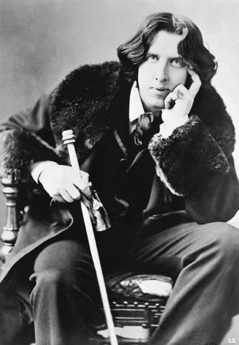
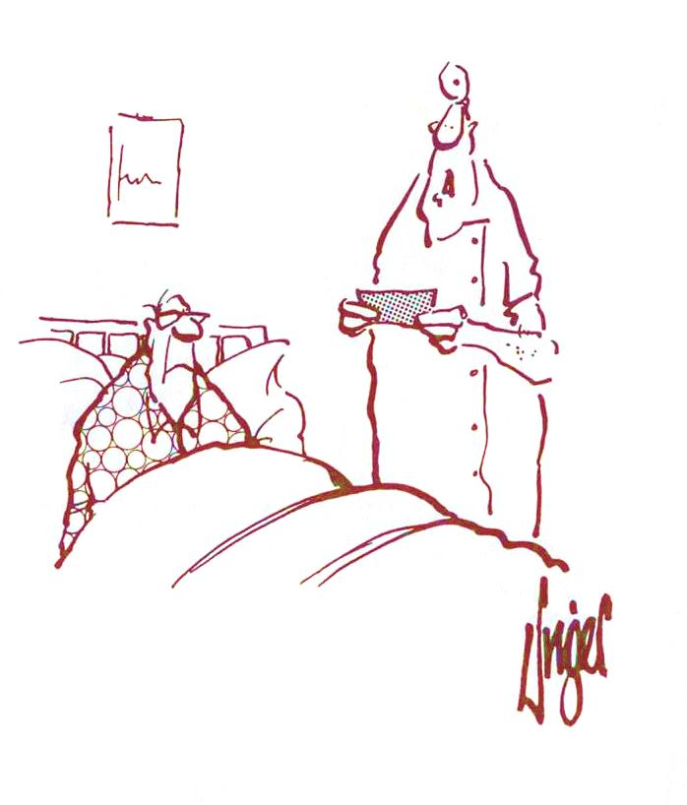
The Paradox of Progress
“We have studied many thousands of patients and have shown that this new drug is much better than the old, but all these studies have made the new drug far too expensive – we’ll just forget about it”
"A cynic is a man who knows the price of everything but the value of nothing."
If the price is everything then the value is nothing
Oscar Wilde
Lady Windermere's Fan
(1892)
Notes:
121
Content Slide Layout: graph

