Slide 1
ICD-10: Getting From Here to There

Slide 2
ICD-9 Transitioning to ICD-10

Slide 3
Program Goals

Slide 4
My ICD-9 Experience

Slide 5
Enhancements With ICD-10

Slide 6
Partnering With Industry

Slide 7
Activity Agenda

Slide 8
Diagnosis Codes vs Procedure Codes

Slide 12
Case Scenario: Crushed Left Femur

Slide 13
Determination of Characteristics

Slide 14
Case Scenario: ICD-9 vs ICD 10

Slide 15
Benefits of ICD-10

Slide 16
Benefits of ICD-10: Clinical

Slide 17
Benefits of ICD-10: Operational

Slide 18
Benefits of ICD-10: Professional

Slide 19
Benefits of ICD-10: Financial

Slide 20
The Road to 10: The Small Physician Practice's Route to ICD-10

Slide 21
A Customized Action Plan: 5 Steps

Slide 22
Preparation: Plan Your Journey

Slide 23
Train Your Team

Slide 24
Common Codes

Slide 25
Clinical Scenarios

Slide 26
Clinical Scenarios (cont)

Slide 27
Documentation Primer

Slide 28
Documentation Primer (cont)

Slide 29
Training and Educational Resources

Slide 30
Preparation: Update Your Processes

Slide 31
Update Your Processes: Checklist

Slide 32
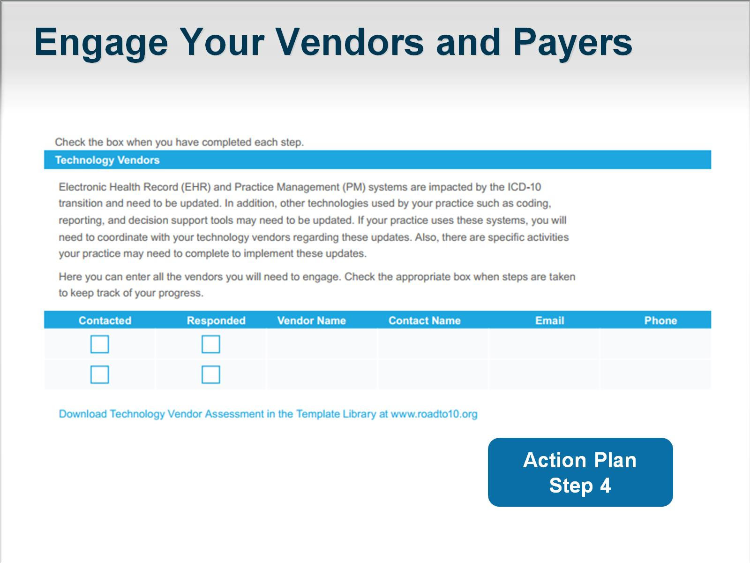
Engage Your Vendors and Payers

Slide 33
Technology Partner Assessment

Slide 34
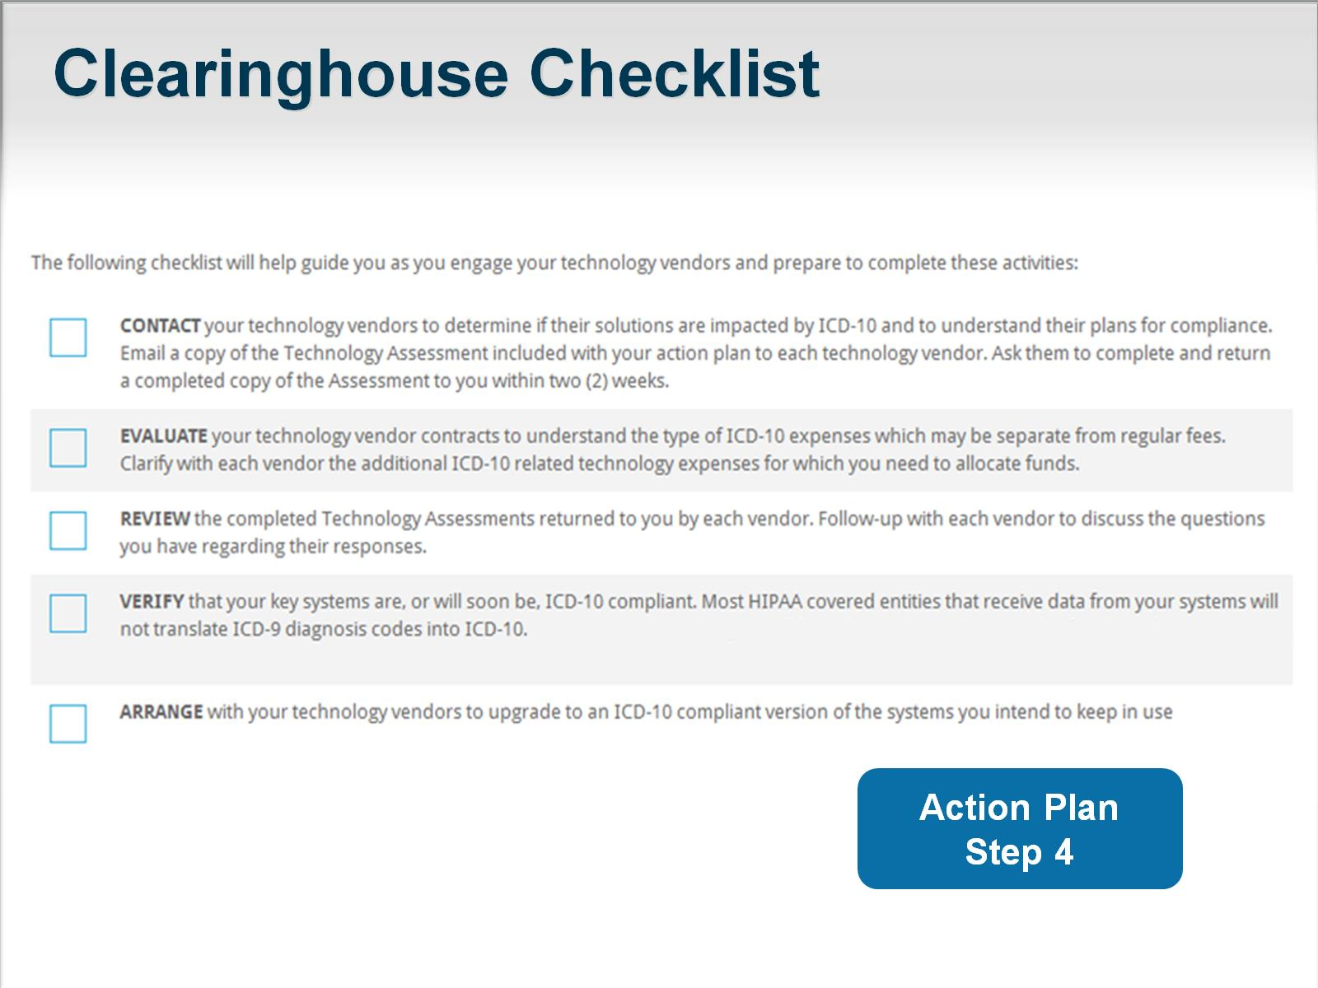
Clearinghouse Checklist

Slide 35
Test Your Systems and Processes

Slide 36
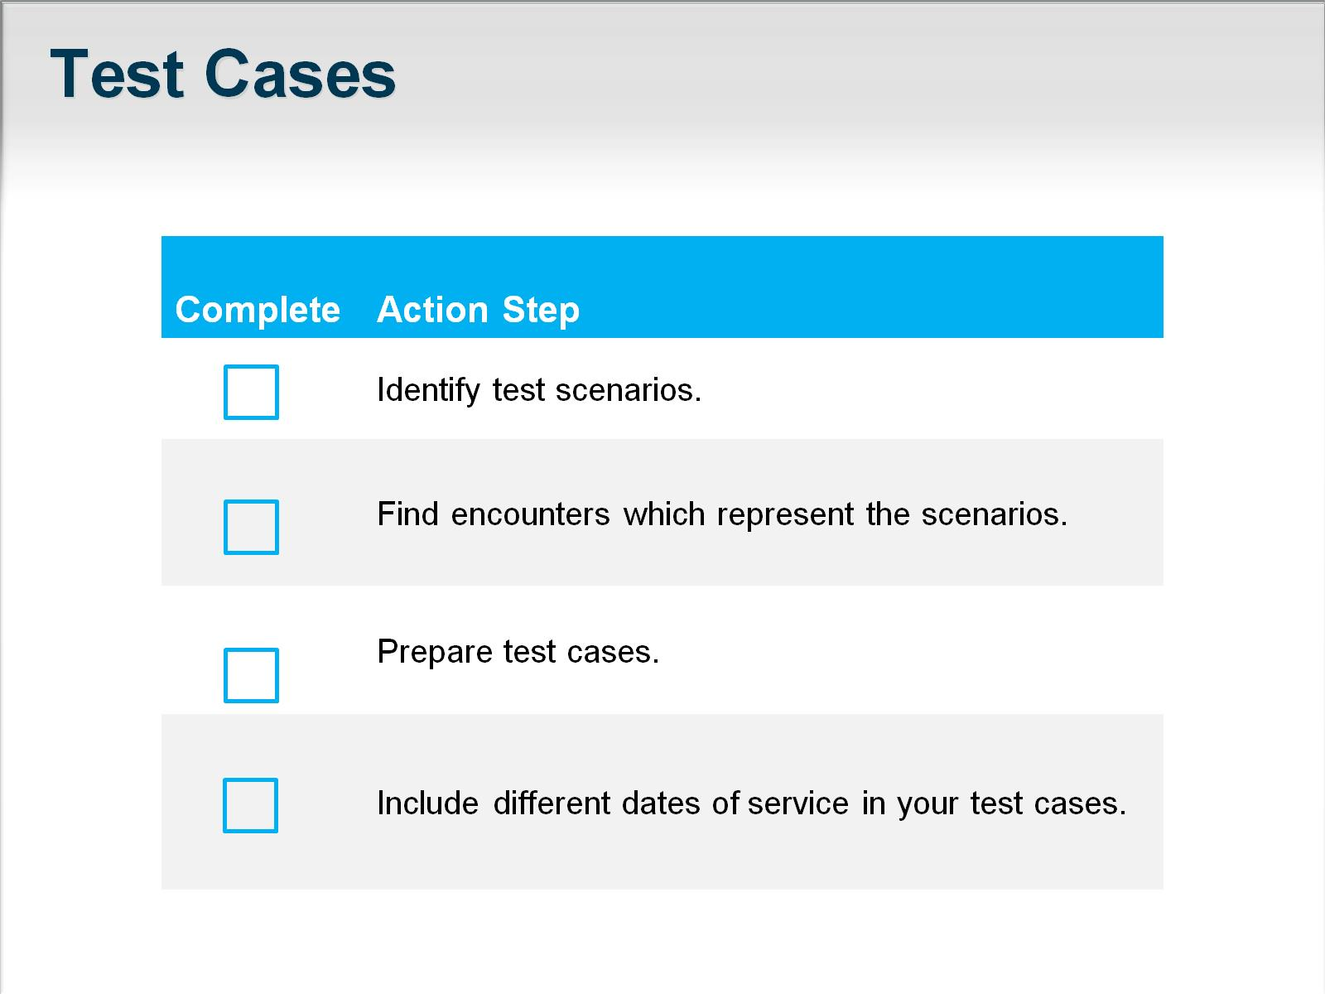
Test Cases

Slide 37
Internal Testing

Slide 38
External Testing

Slide 39
Practice Coding in ICD-10

Slide 40
Delegate!

Slide 41
Key Takeaways

Slide 42
Key Takeaways (cont)

Slide 43
Key Takeaways (cont)

Slide 44
Abbreviations

Slide 45
References

