Slide 1
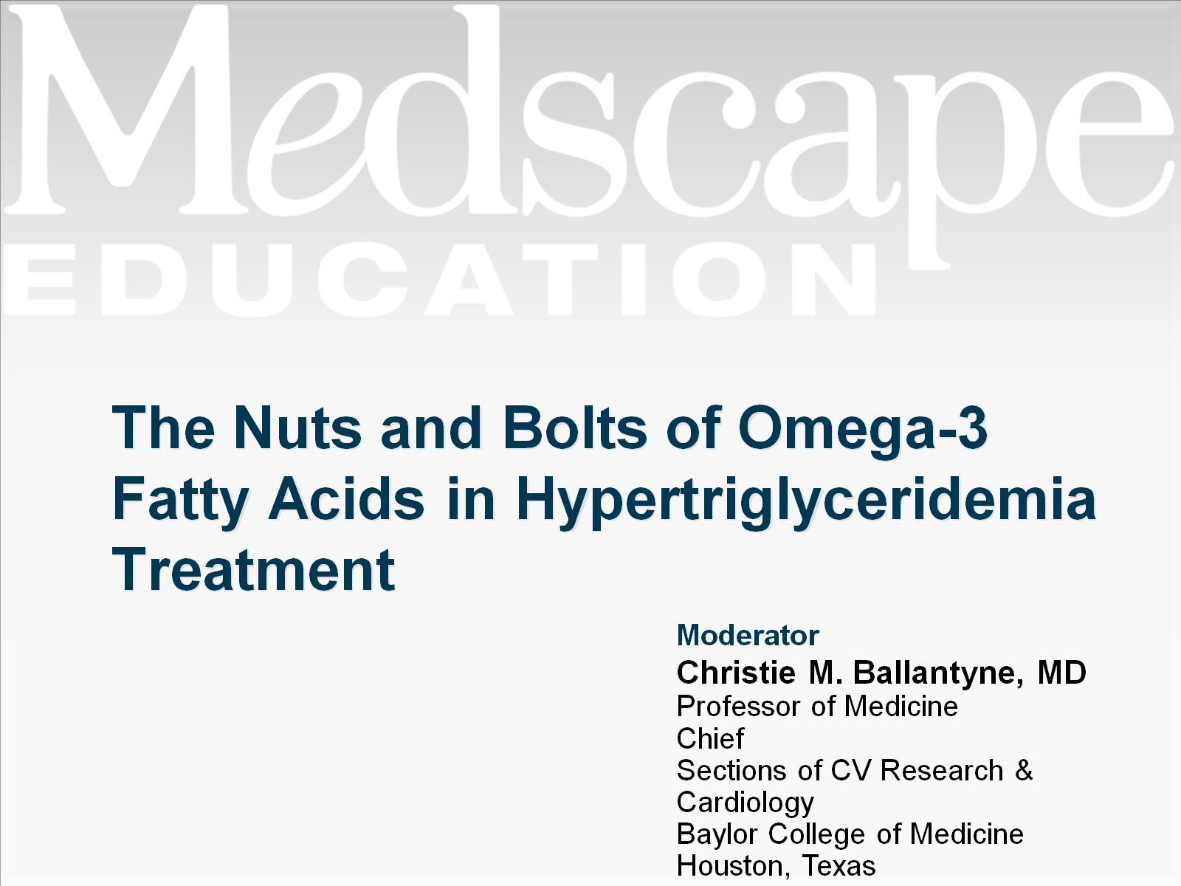
The Nuts and Bolts of Omega-3 Fatty Acids in Hypertriglyceridemia Treatment

Slide 2


Slide 3
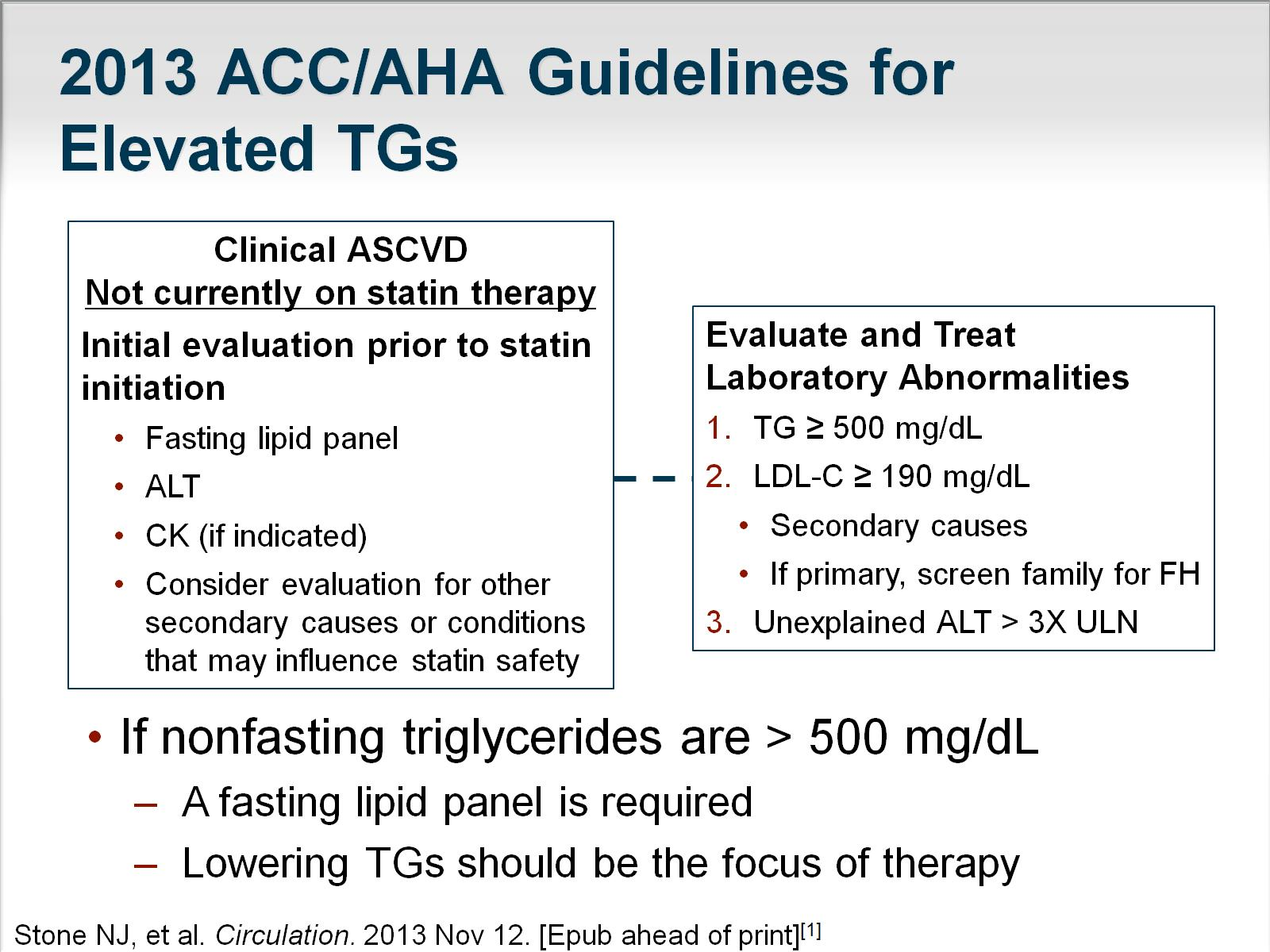
2013 ACC/AHA Guidelines for Elevated TGs

Slide 4
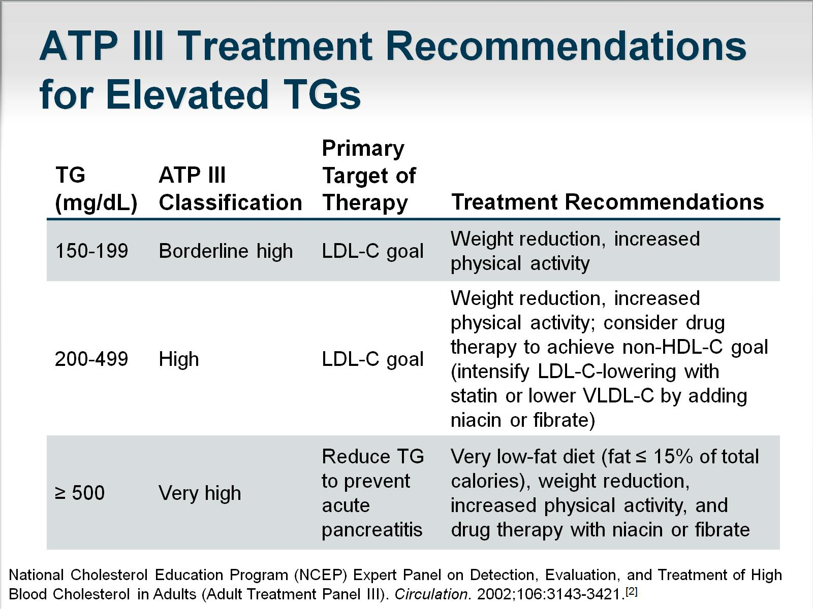
ATP III Treatment Recommendations for Elevated TGs

Slide 5
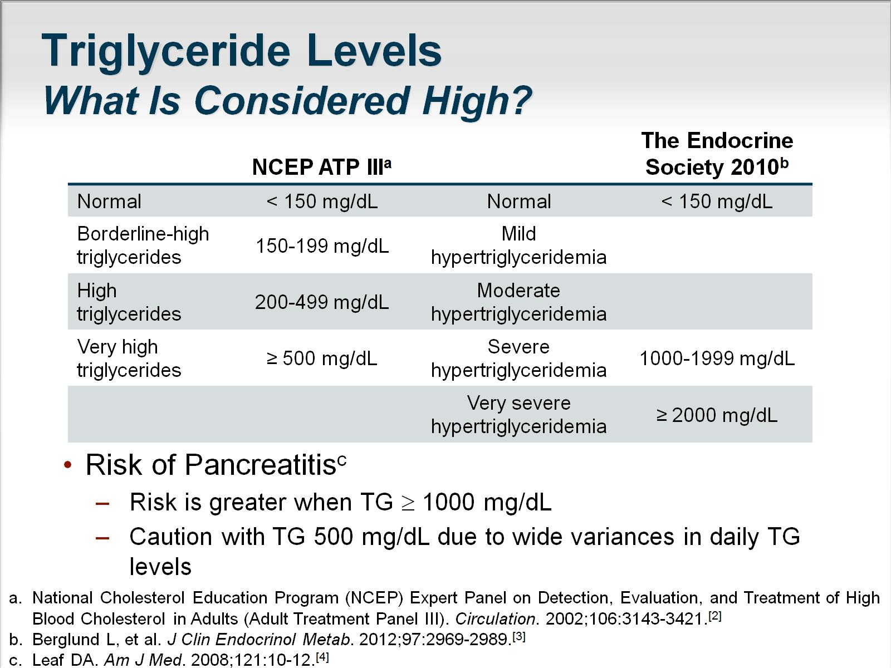
Triglyceride Levels
What Is Considered High?

Slide 6
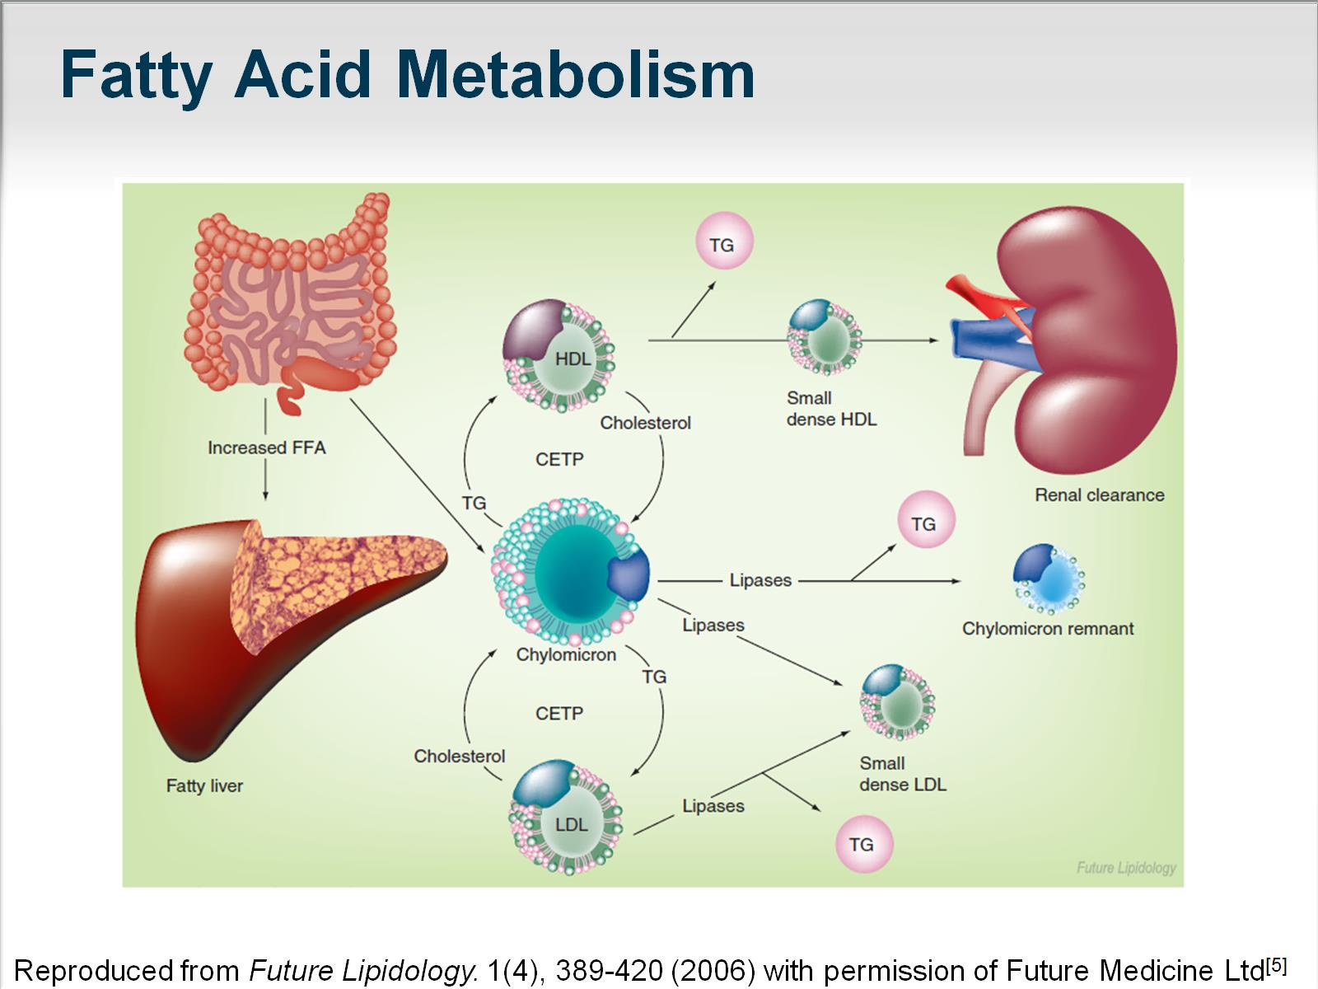

Slide 7
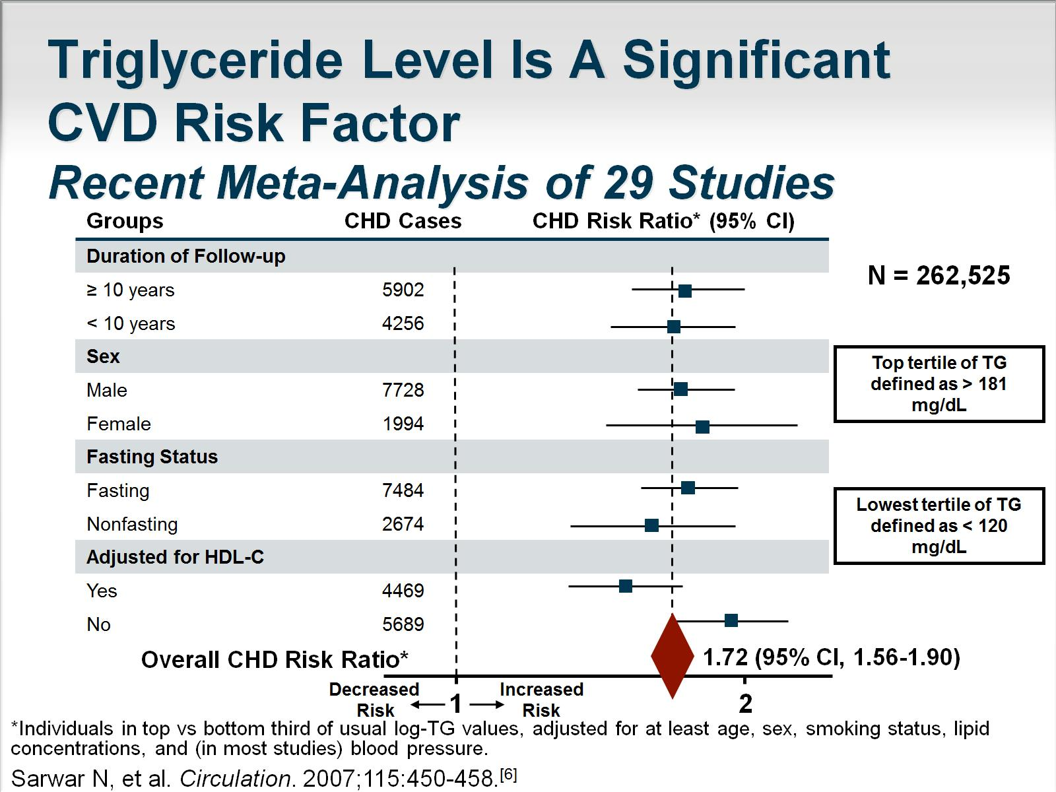
Triglyceride Level Is A Significant CVD Risk Factor
Recent Meta-Analysis of 29 Studies

Slide 8
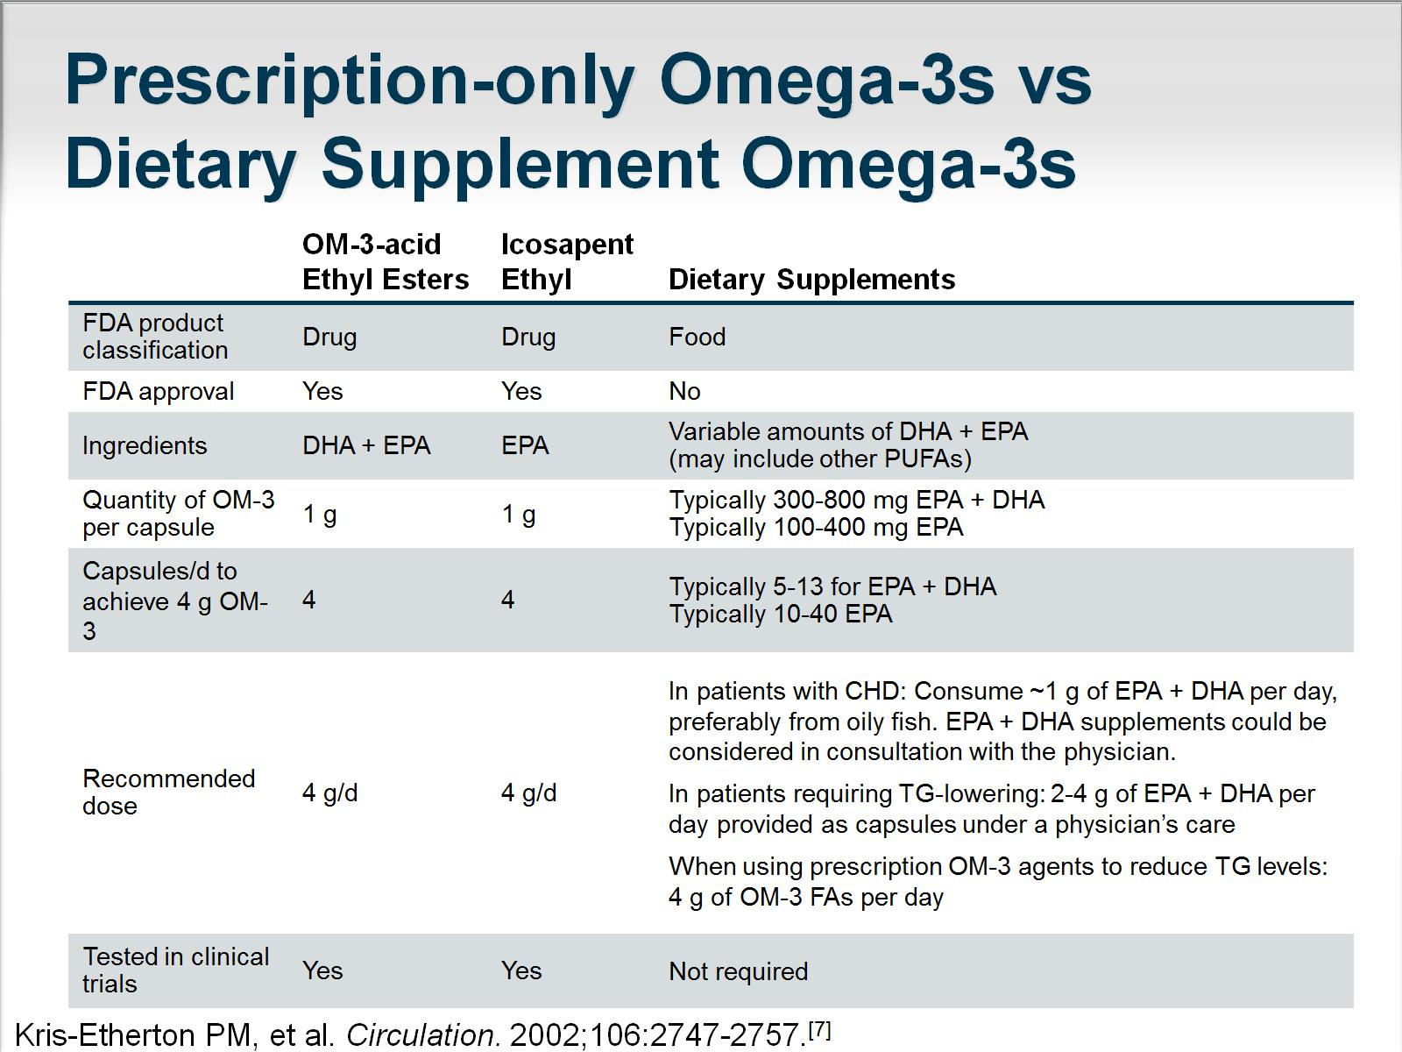
Prescription-only Omega-3s vs
Dietary Supplement Omega-3s

Slide 9
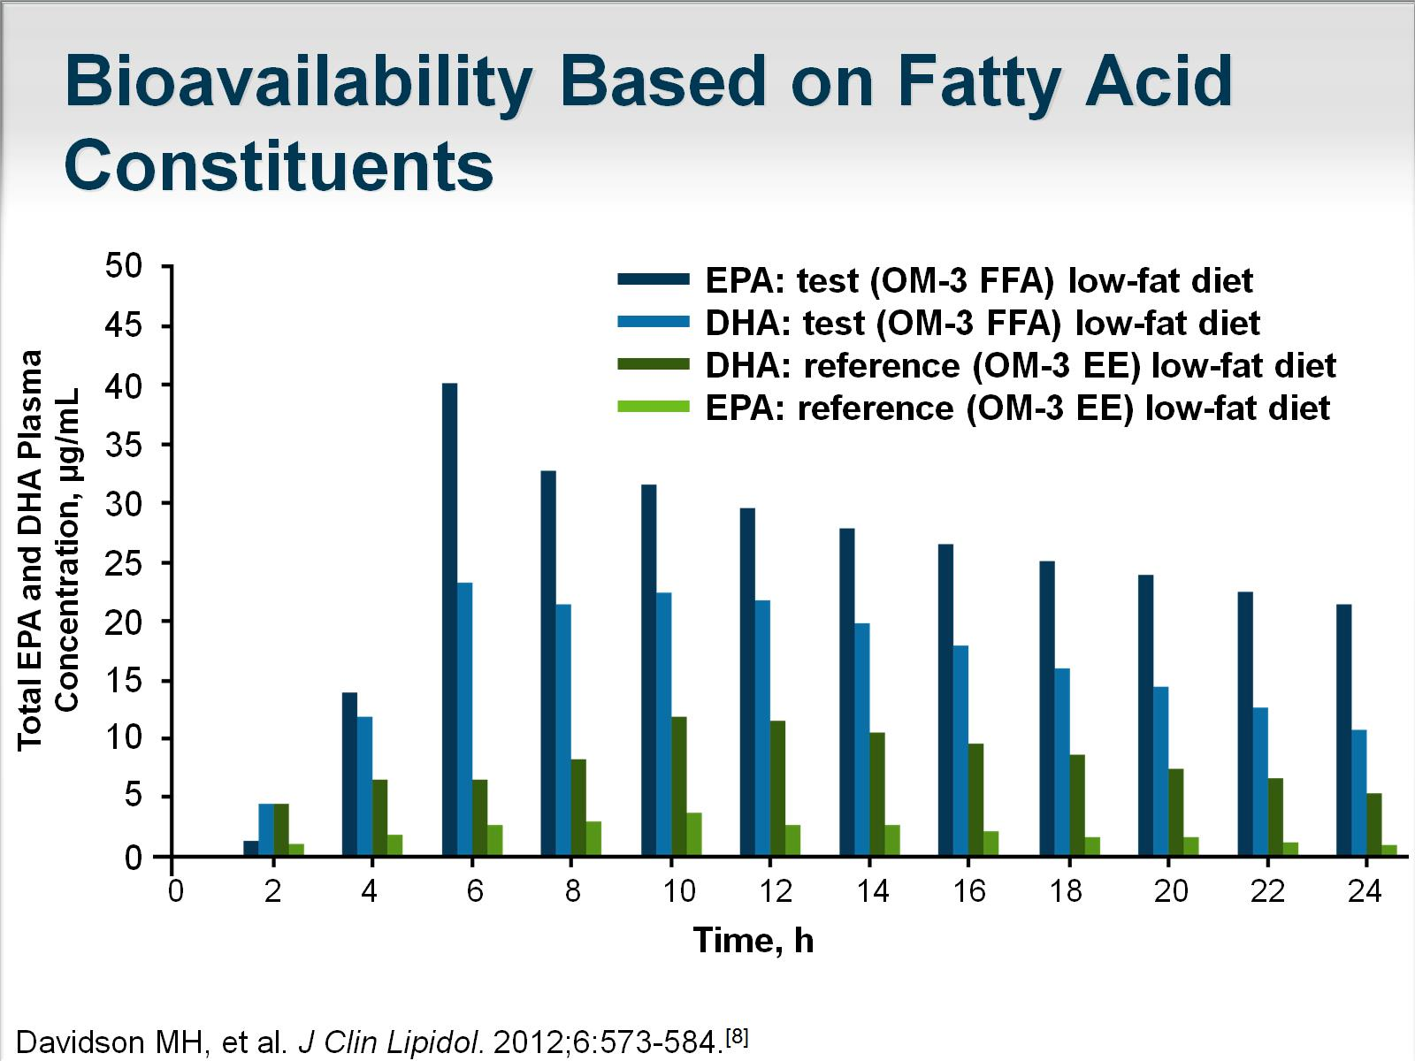
Bioavailability Based on Fatty Acid Constituents

Slide 10
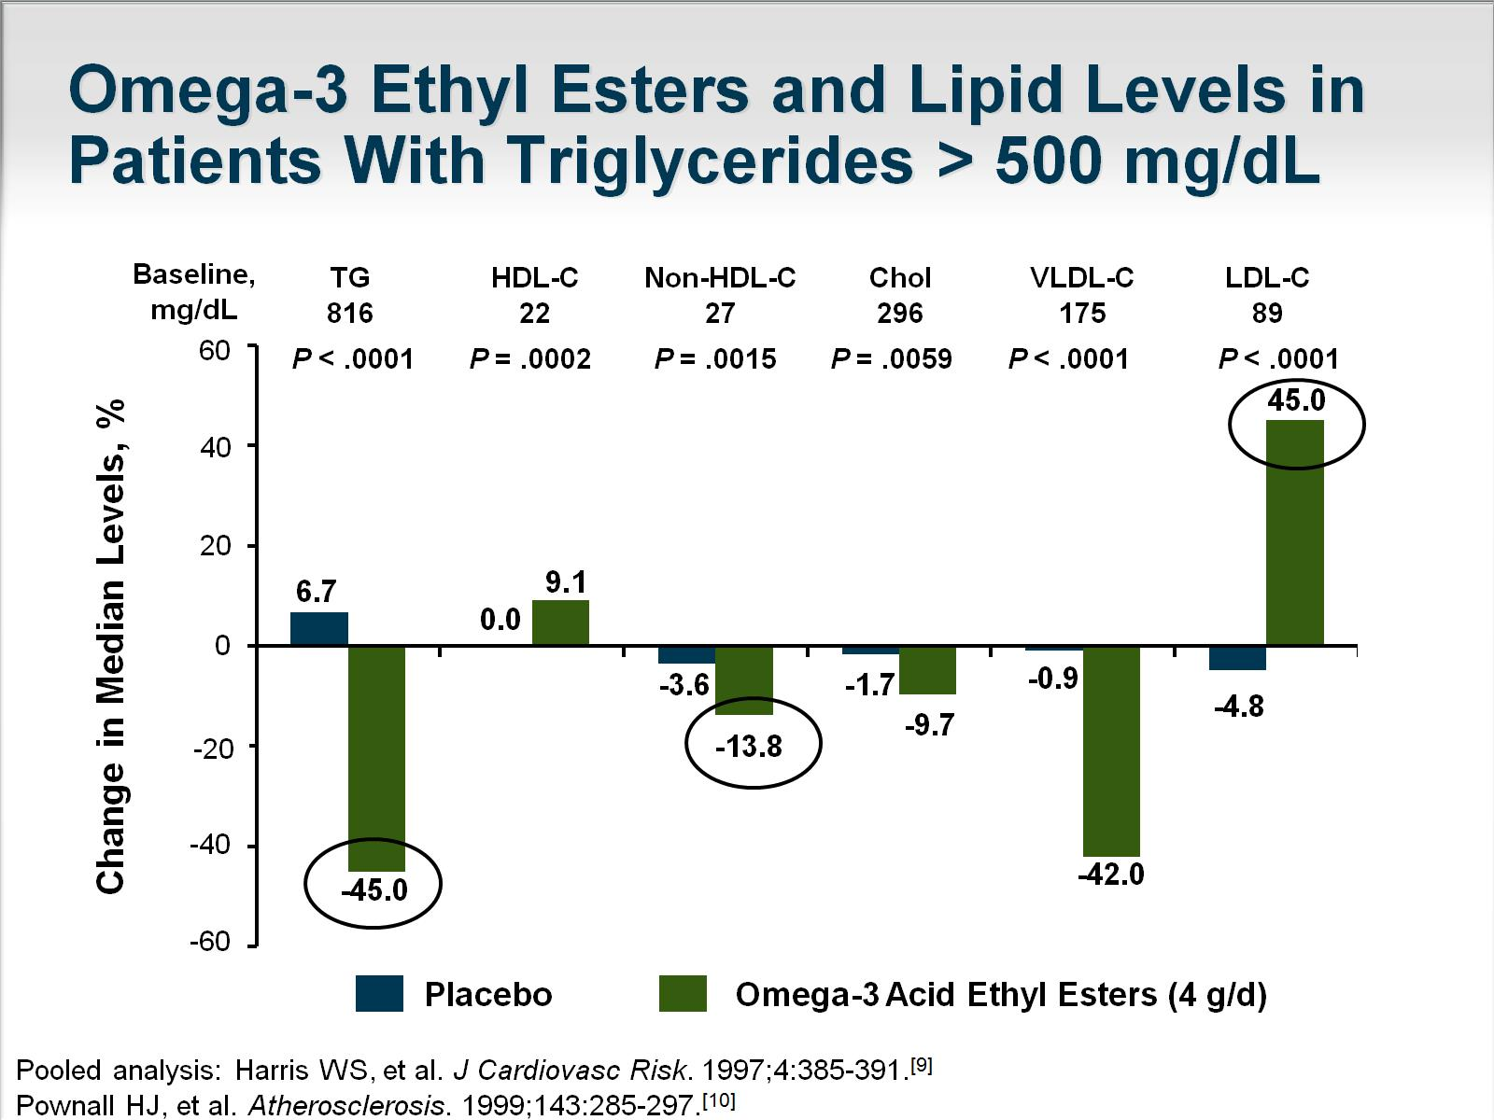
Omega-3 Ethyl Esters and Lipid Levels in Patients With Triglycerides > 500 mg/dL

Slide 11
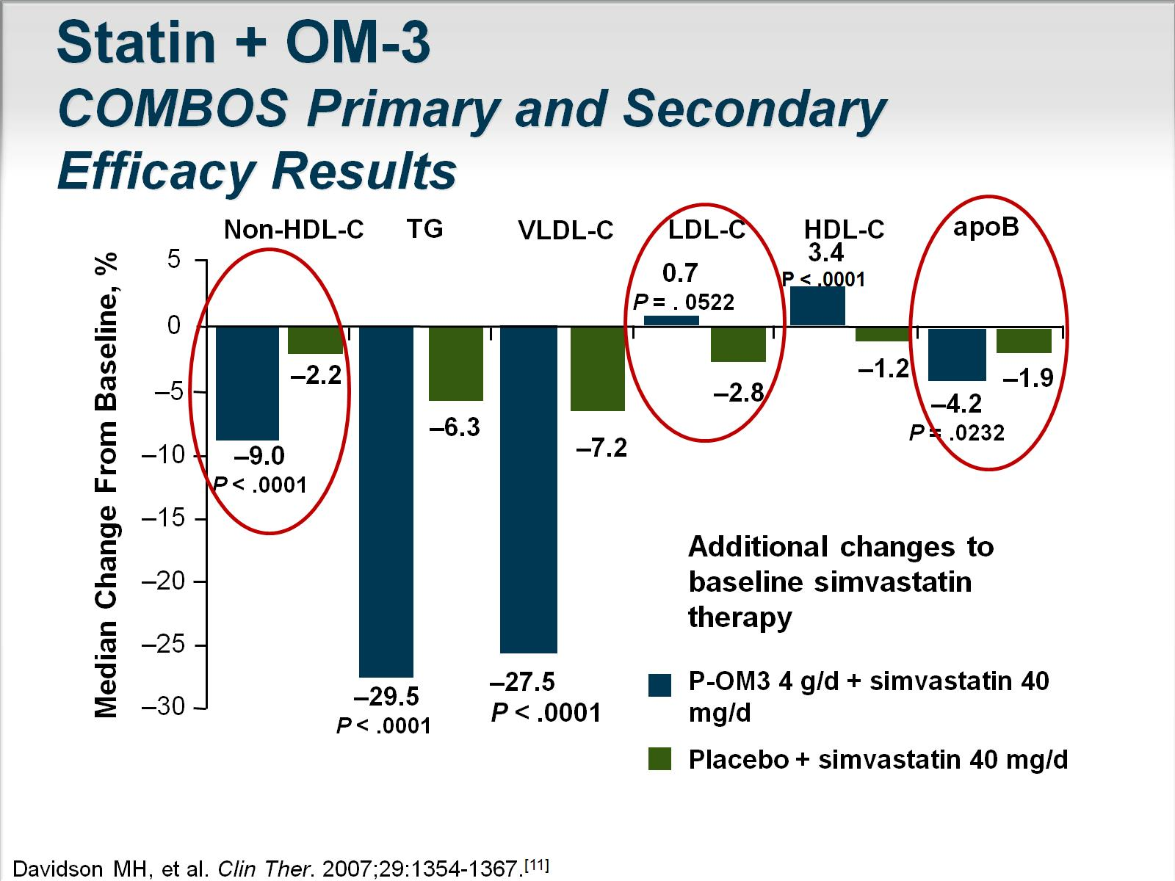
Statin + OM-3
COMBOS Primary and Secondary Efficacy Results

Slide 12
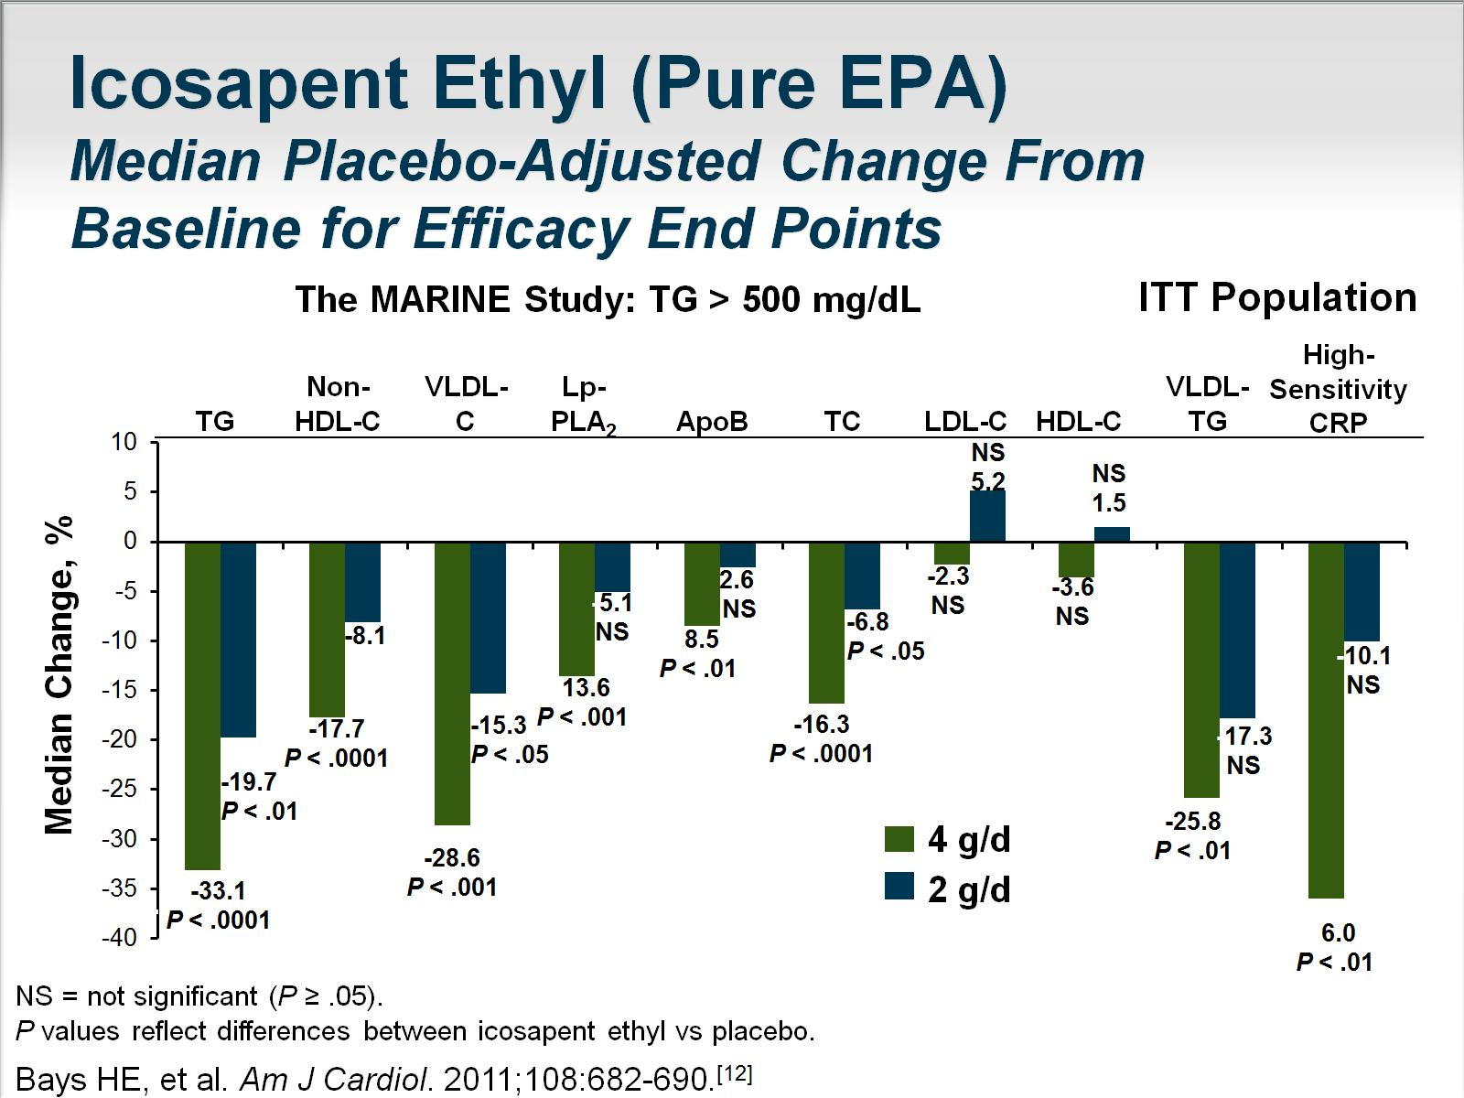
Icosapent Ethyl (Pure EPA)
Median Placebo-Adjusted Change From Baseline for Efficacy End Points

Slide 13
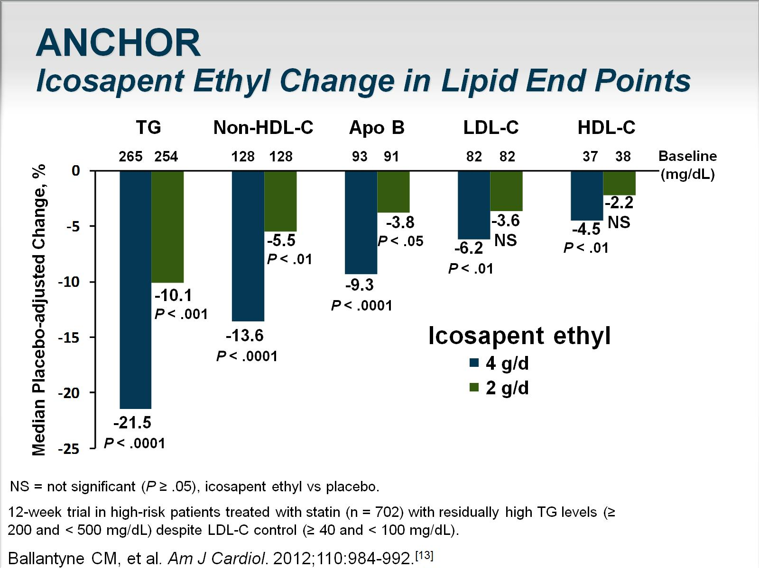
ANCHOR
Icosapent Ethyl Change in Lipid End Points

Slide 14
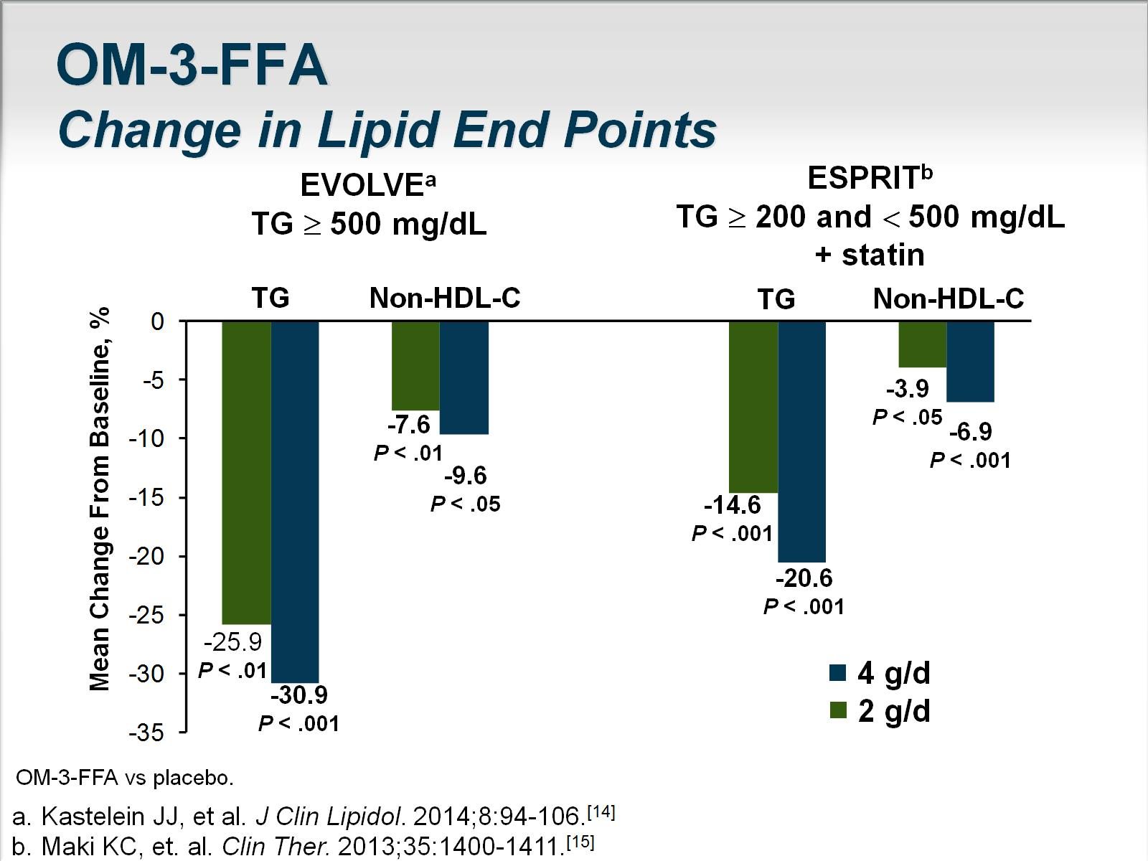
OM-3-FFA
Change in Lipid End Points

Slide 15
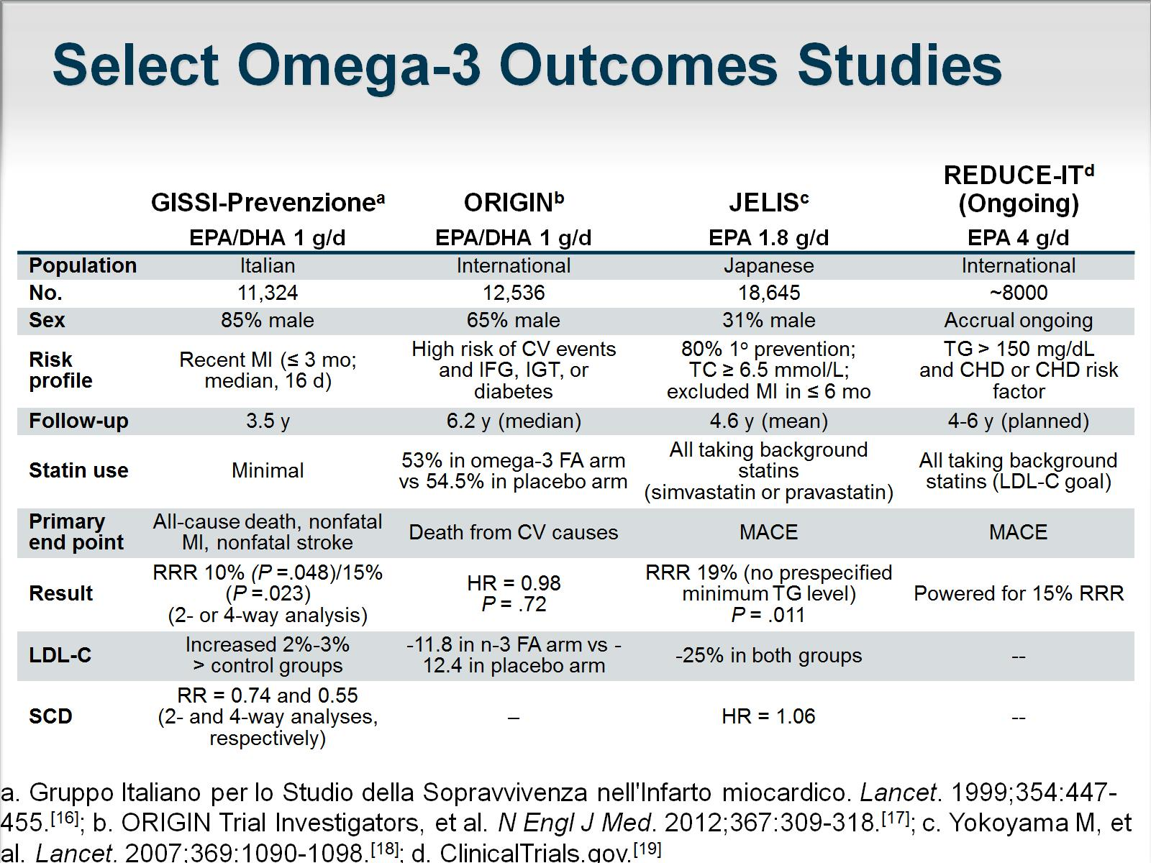
Select Omega-3 Outcomes Studies

Slide 16
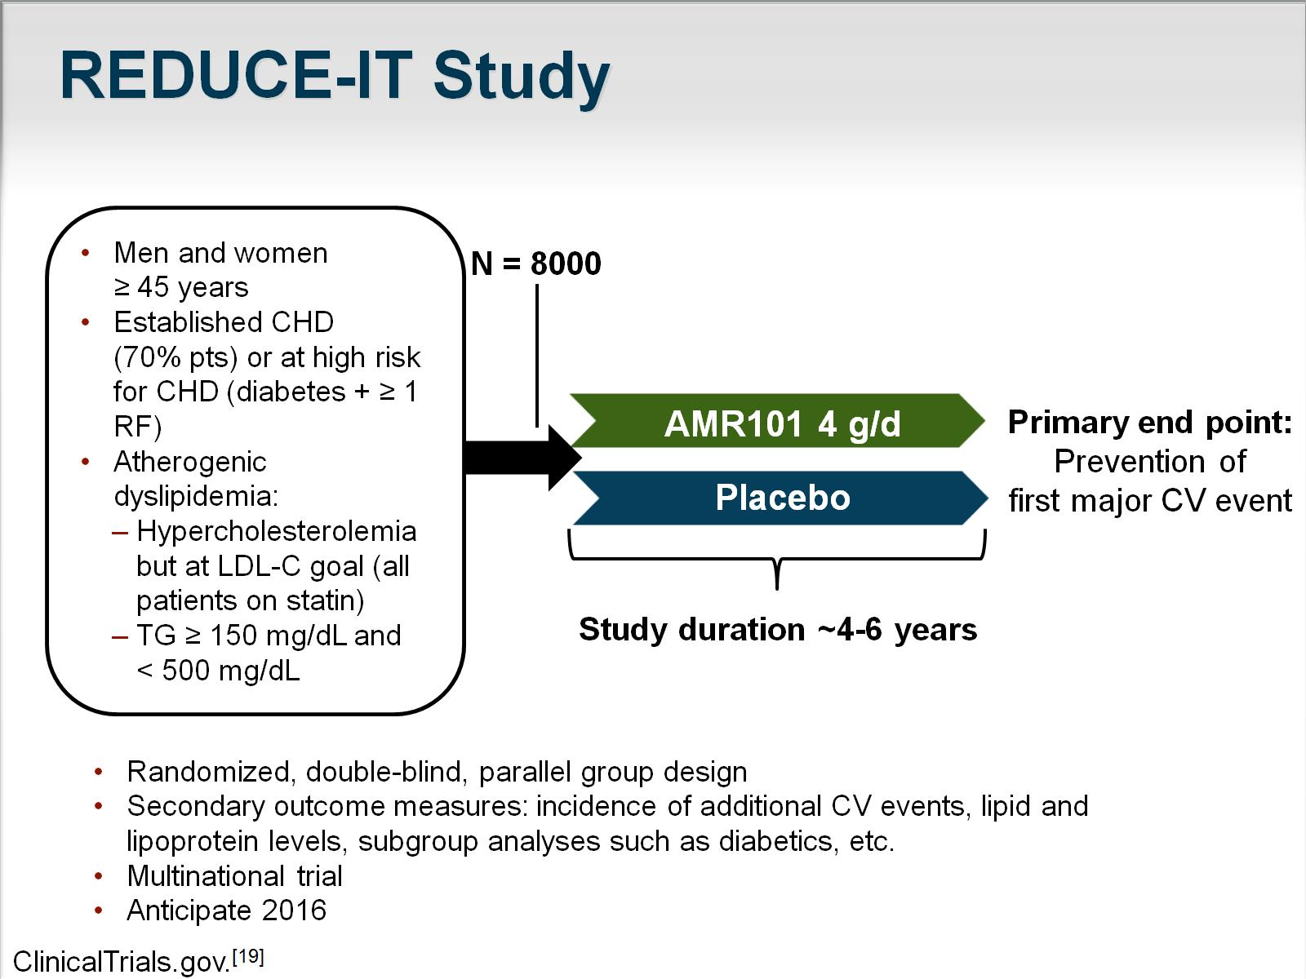
REDUCE-IT Study

Slide 17
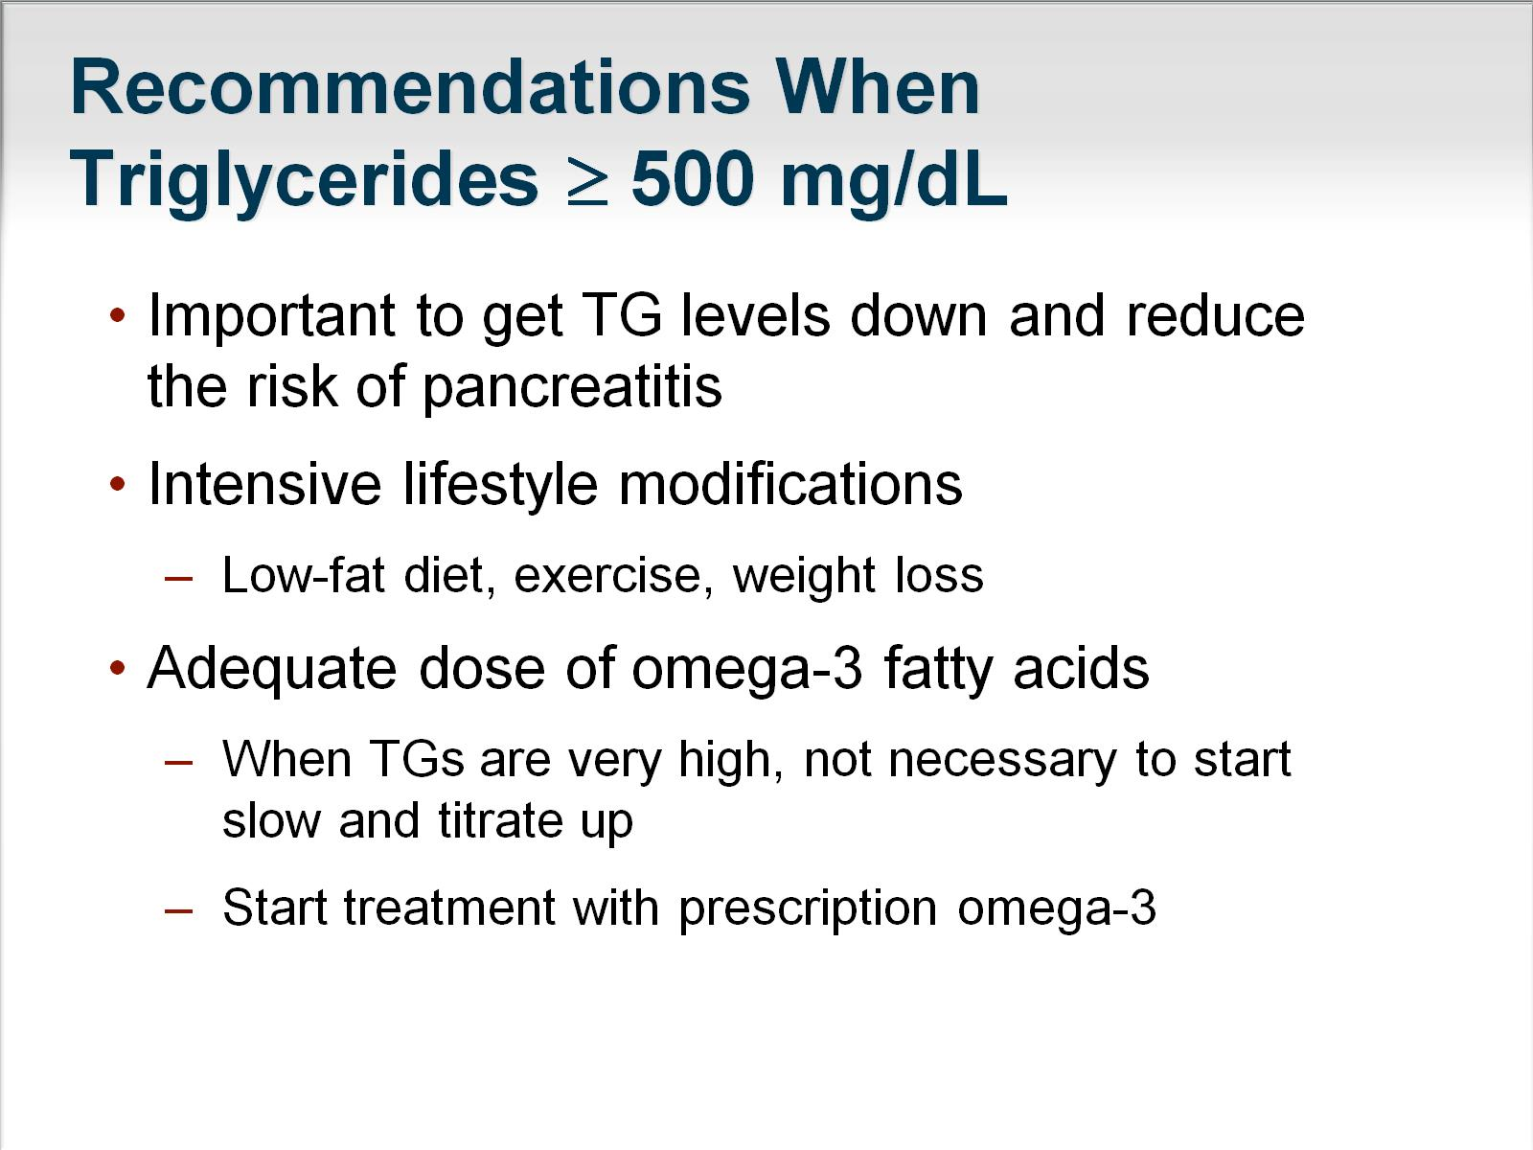
Recommendations When Triglycerides ≥ 500 mg/dL

Slide 18
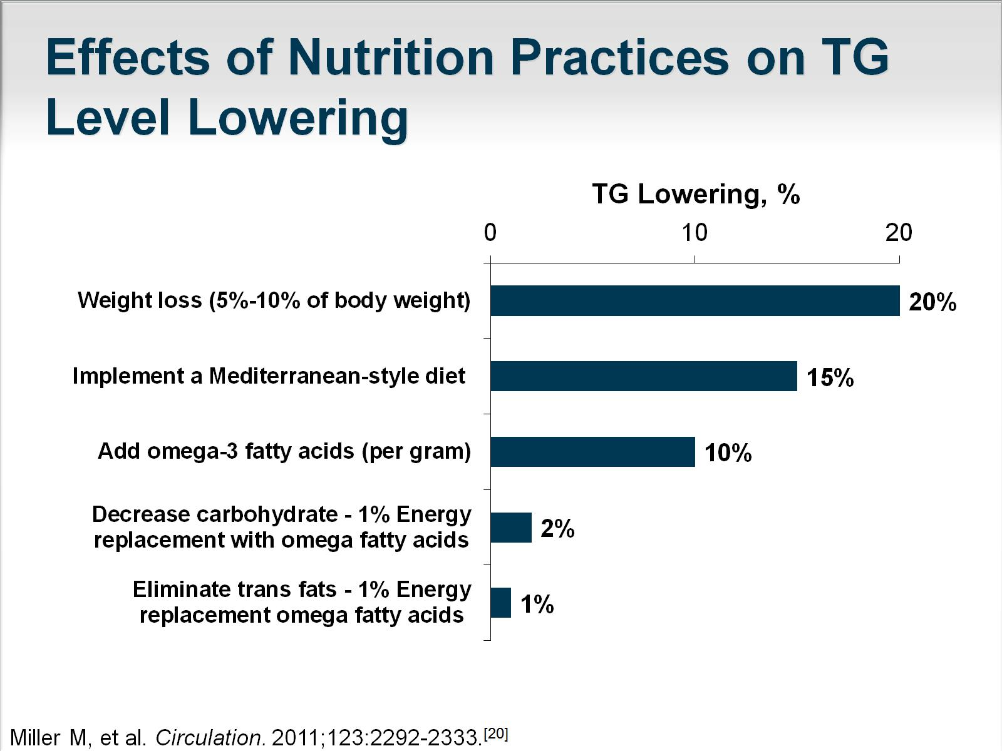
Effects of Nutrition Practices on TG Level Lowering

Slide 19
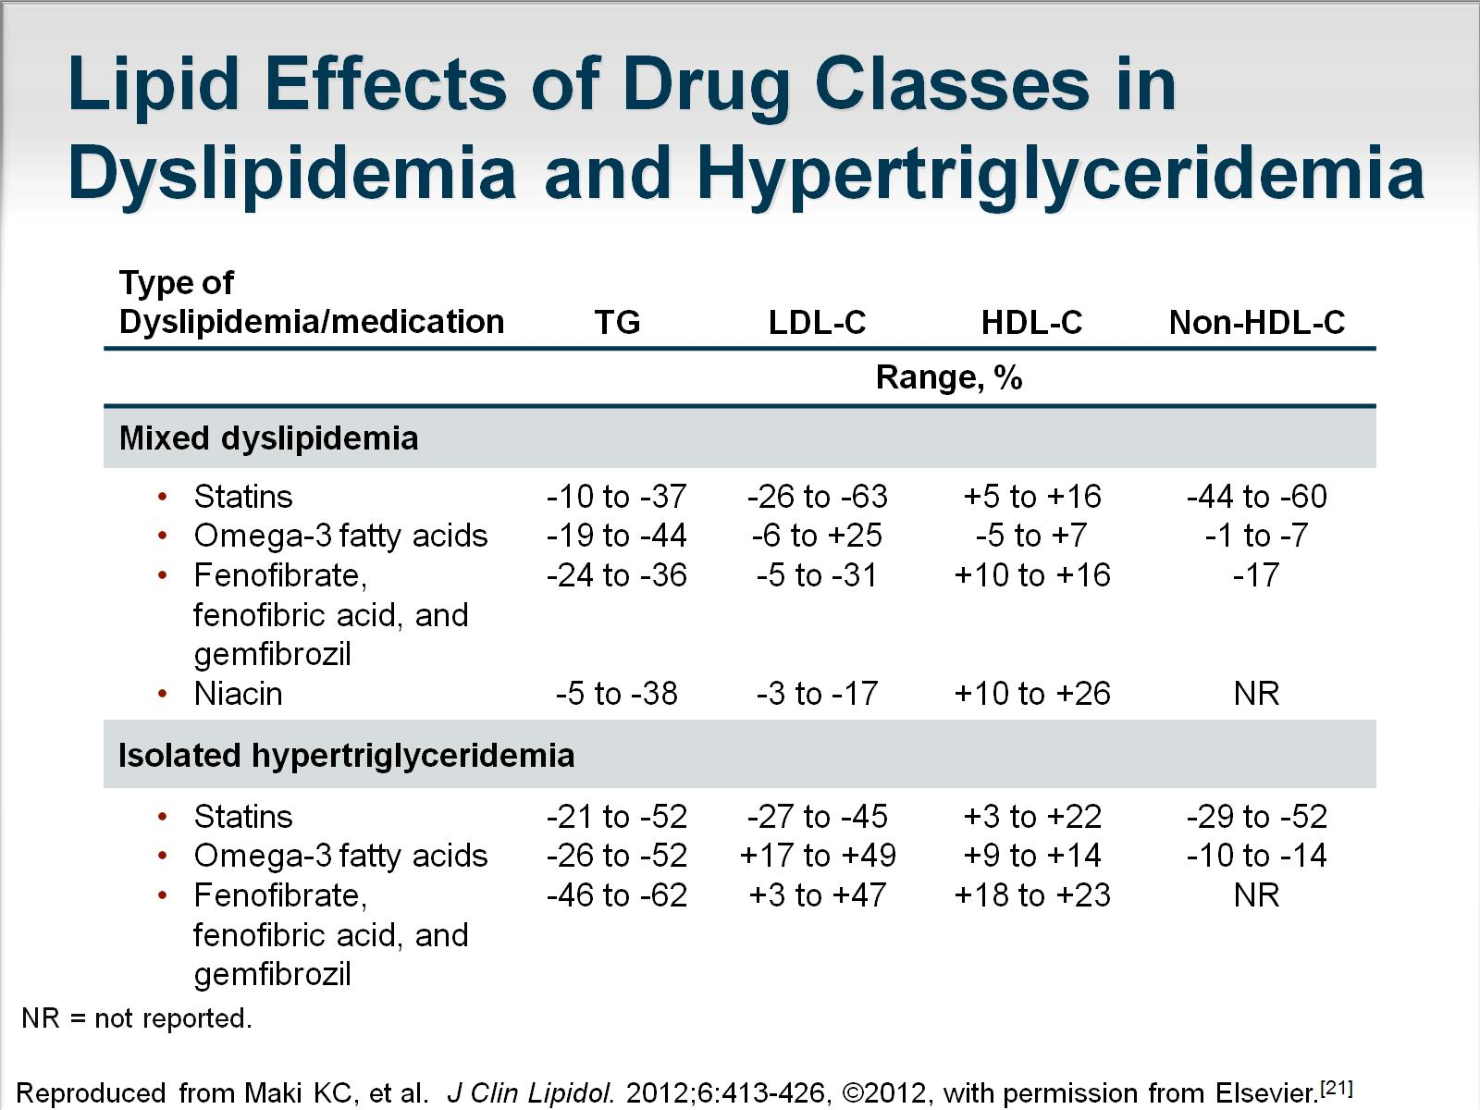
Lipid Effects of Drug Classes in Dyslipidemia and Hypertriglyceridemia

Slide 20
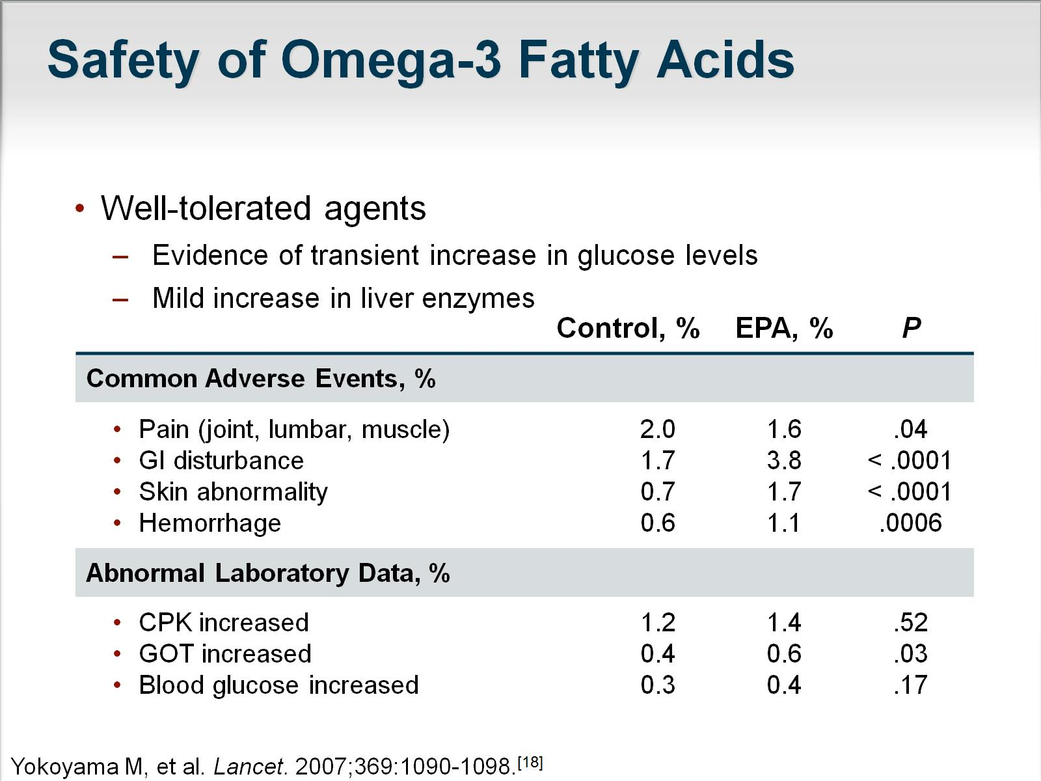
Safety of Omega-3 Fatty Acids

Slide 21
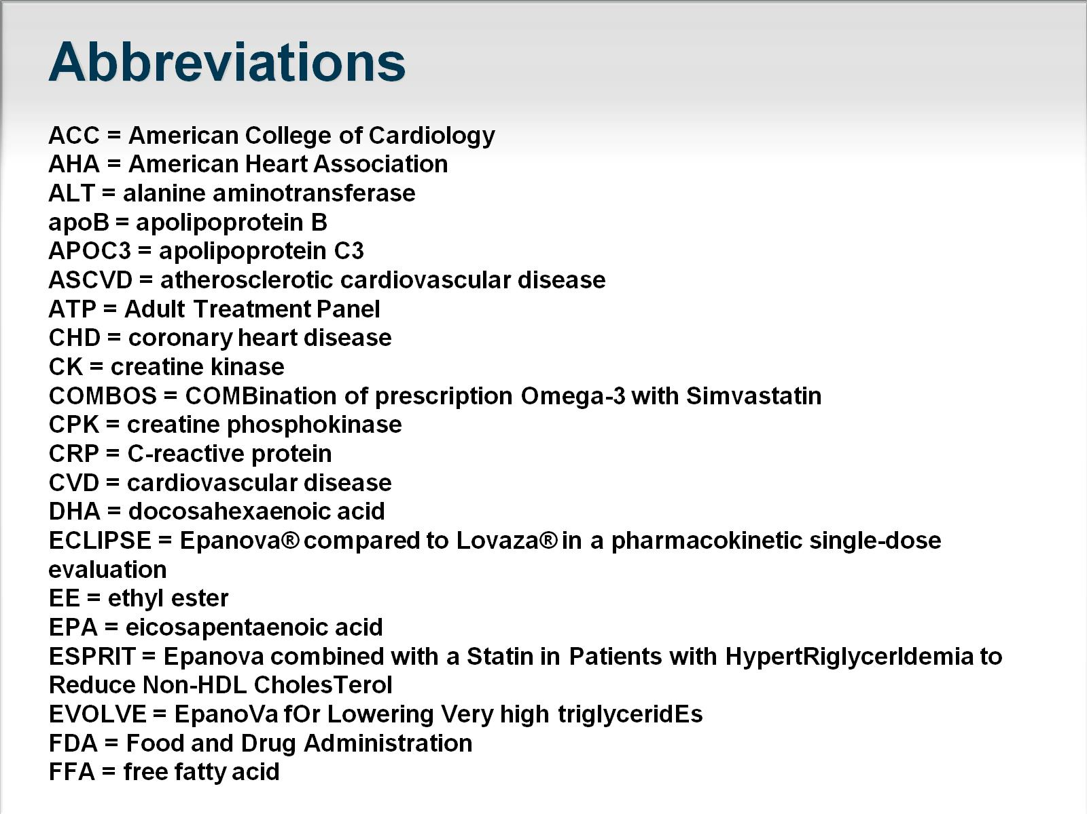
Abbreviations

Slide 22
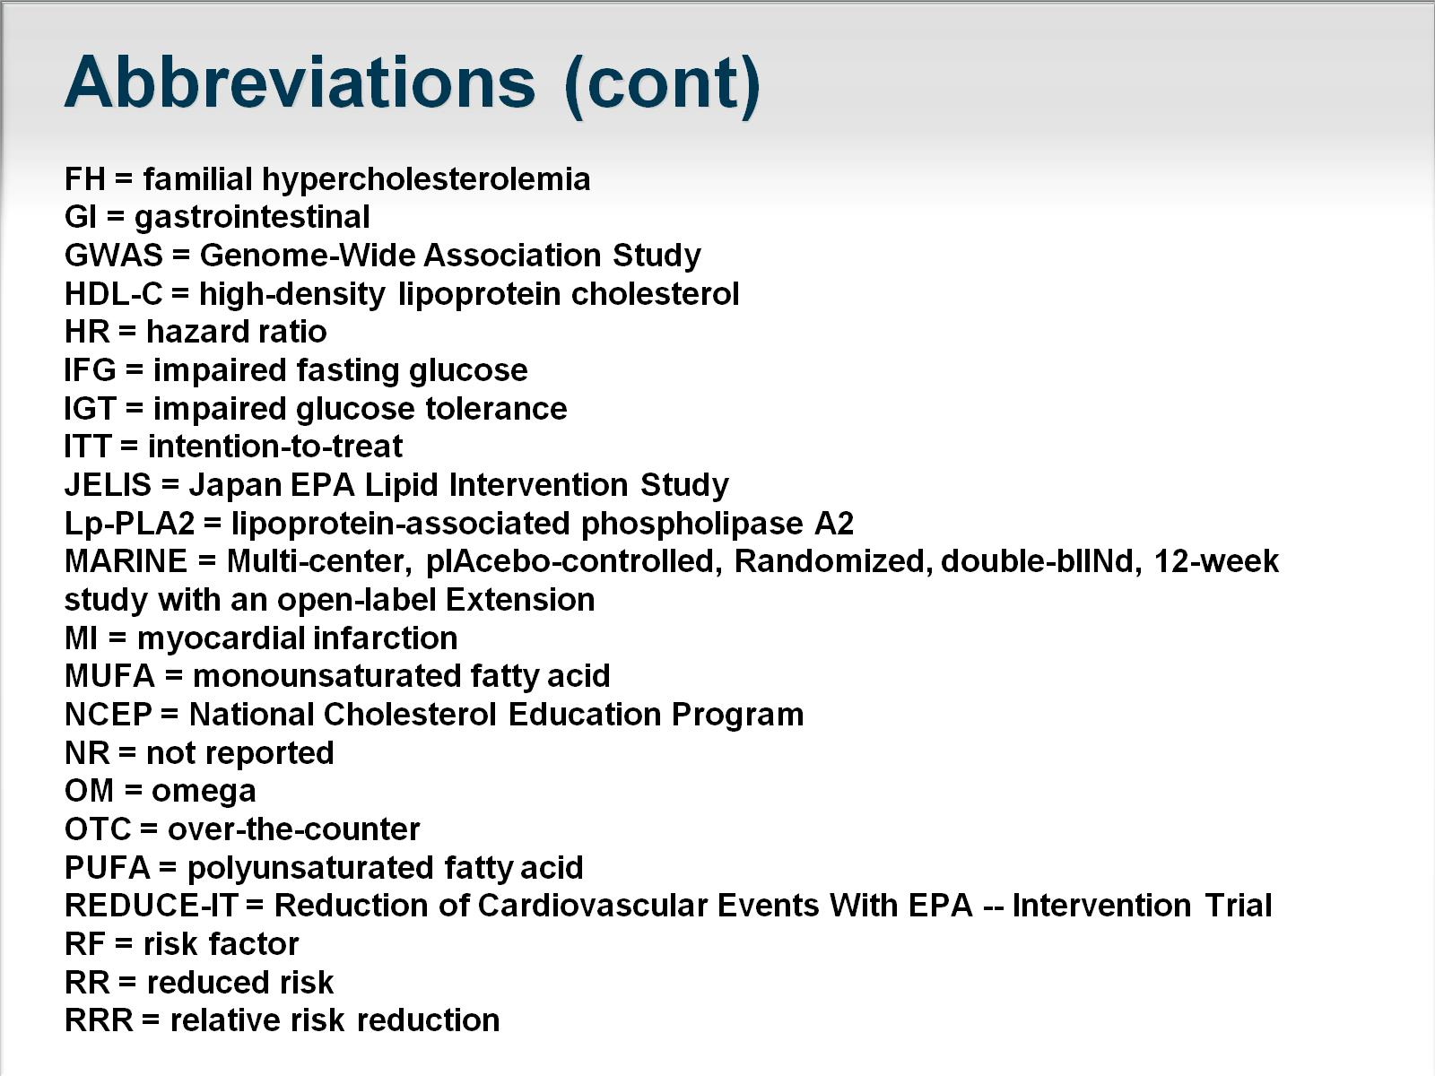
Abbreviations (cont)

Slide 23
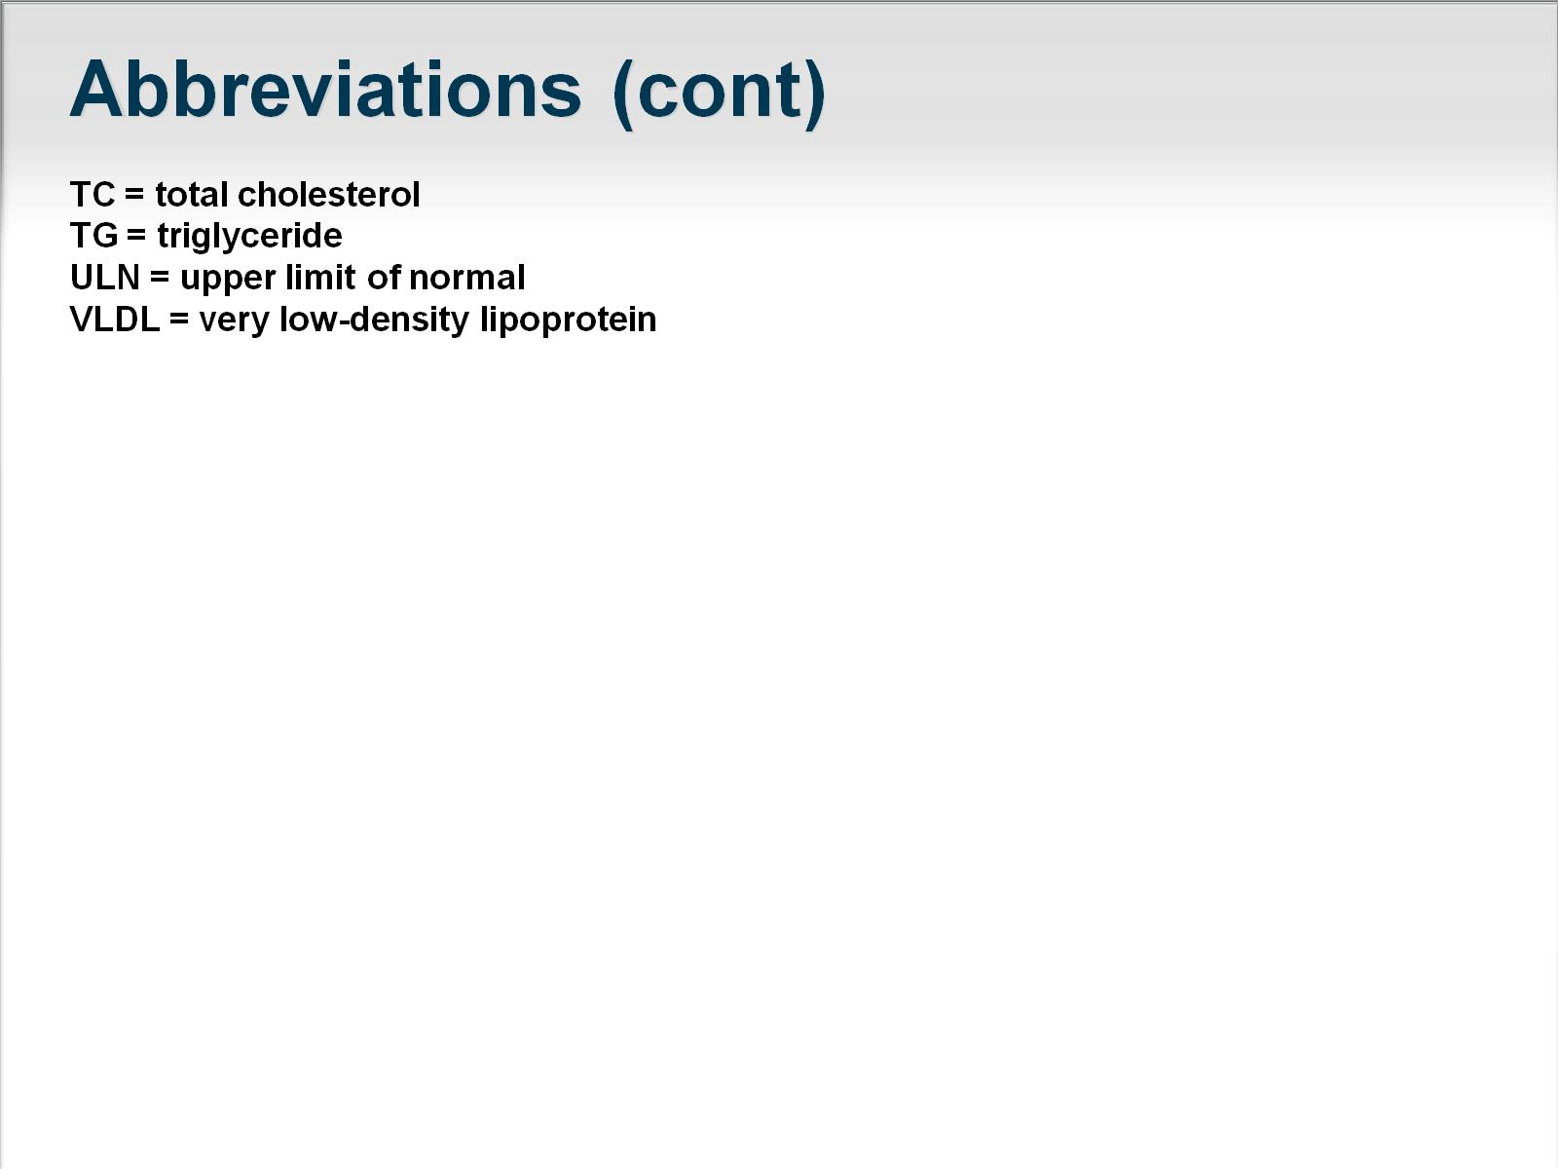
Abbreviations (cont)

Slide 24
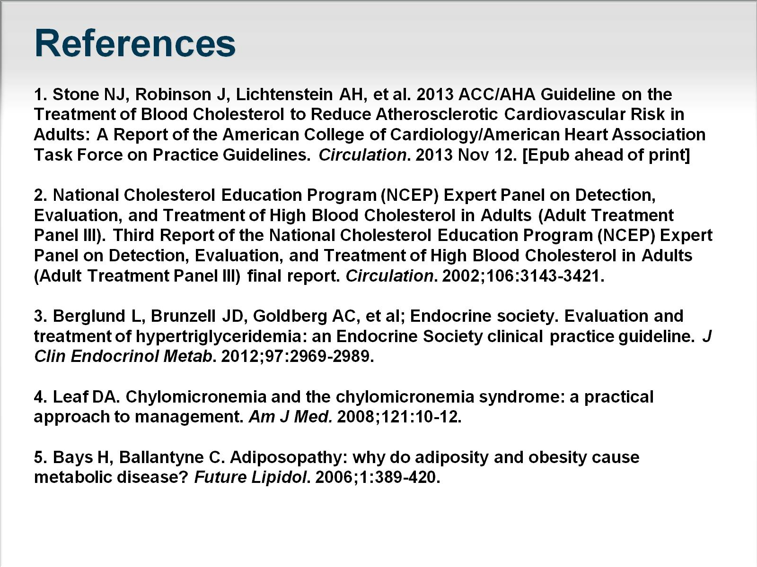
References

Slide 25
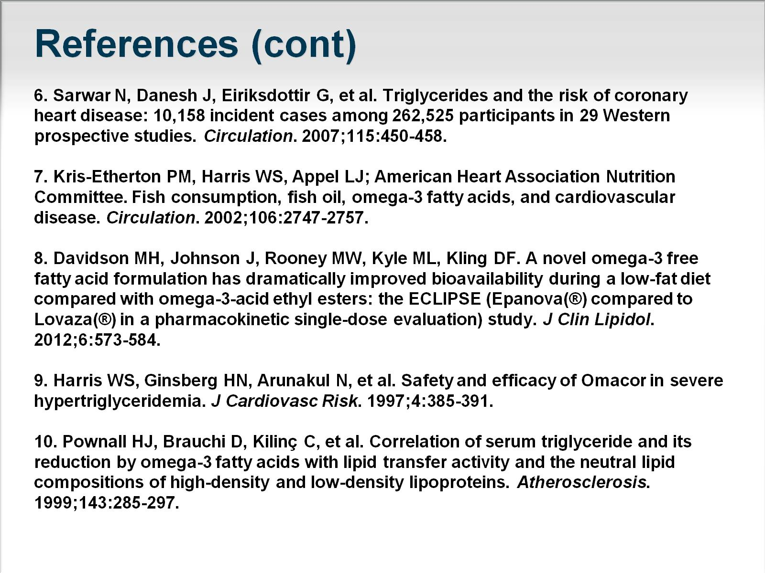
References (cont)

Slide 26
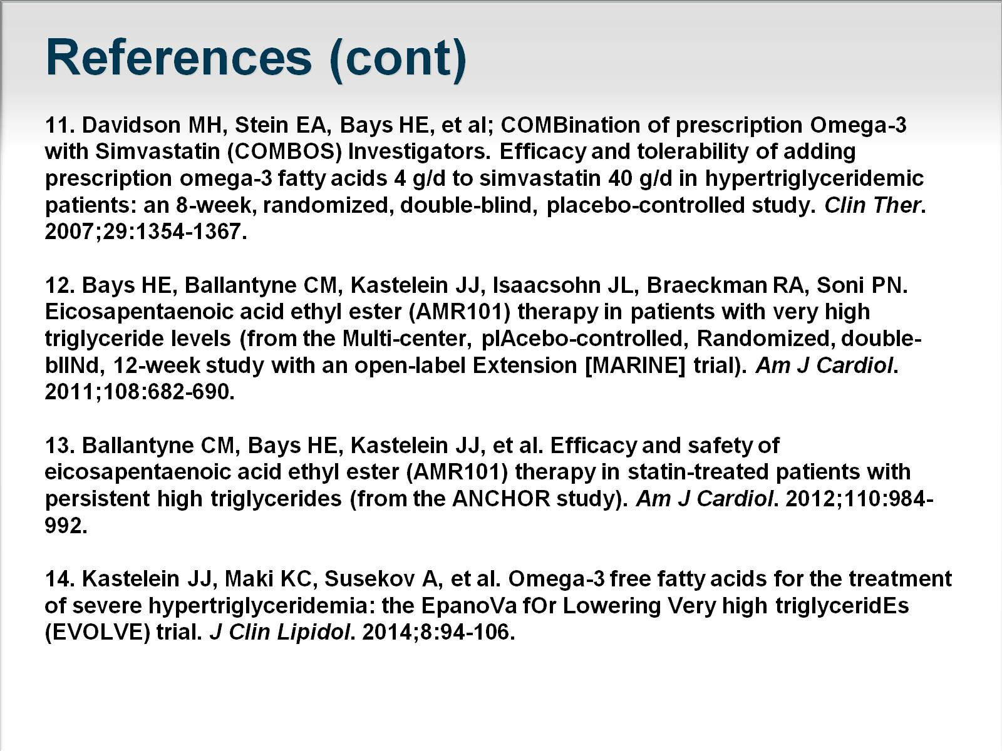
References (cont)

Slide 27
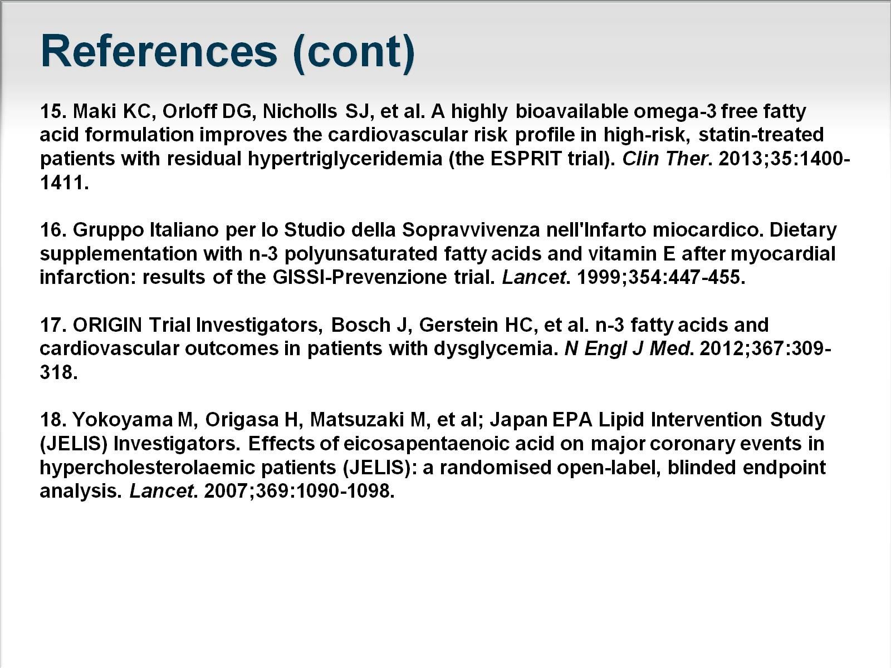
References (cont)

Slide 28
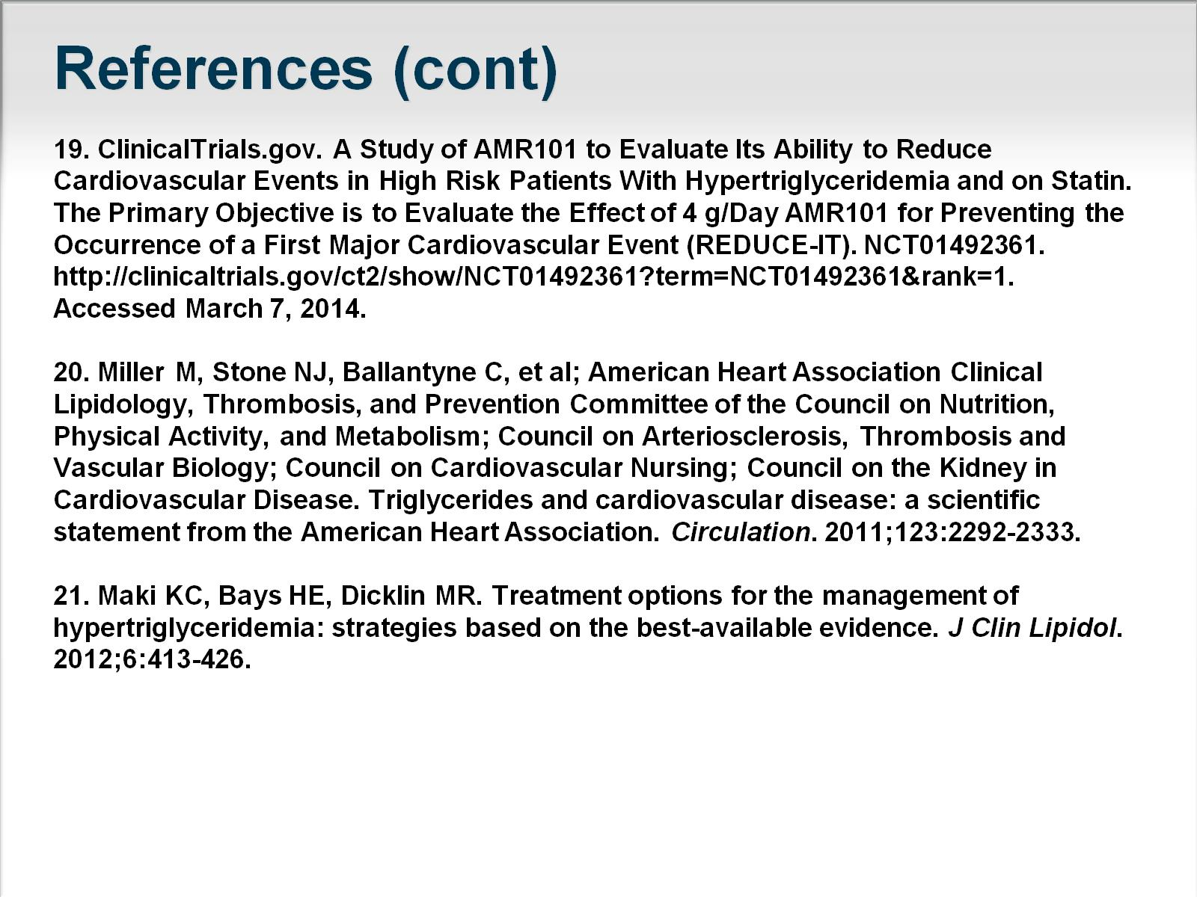
References (cont)

