Slide 2
Program Goals

Slide 3
Introduction

Slide 4
Program Outline

Slide 5
Patient-reported End-of-life Cancer Symptoms

Slide 6
Loss of Appetite Affects Survival

Slide 7
Effect of Weight Loss on Survival

Slide 8
Body Composition Changes in Cancer

Slide 9
Consequences of Cachexia

Slide 10
Definition and Classification of Cancer Cachexia An International Consensus

Slide 11
Ubiquitin-Proteasome System

Slide 12
Cachexia is Not Starvation

Slide 13
Program Outline

Slide 14
Parenteral Nutrition

Slide 15
Meta-analysis TPN for Cancer Patients Receiving Chemotherapy

Slide 16
Effect on Survival Oral Feeding for Malnourished Cancer Patients

Slide 17
Approach to the Patient With Cachexia

Slide 18
Megestrol Acetate Dosing

Slide 19
Megestrol Acetate vs Placebo Effect on Appetite

Slide 20
Megestrol Acetate Limitations

Slide 21
Despite Improvements in Appetite, Quality of Life Is Not Always Improved

Slide 22
Program Outline

Slide 23
New Avenues of Investigation for Treatment of Cancer-related Cachexia

Slide 24
Antimyostatin Agents

Slide 25
Antimyostatin Therapy Improvements in Body Weight and Survival

Slide 26
Example of Natural Myostatin Deficiency

Slide 27
Example of Natural Myostatin Deficiency (cont)

Slide 28
JAK Inhibition Associated With Weight Gain in Myelofibrosis Patients

Slide 29
Ruxolitinib for Treatment of Metastatic Pancreatic Cancer

Slide 30
Ghrelin Analogues Anamorelin for Treatment of Cancer Cachexia

Slide 31
Treatment With Anamorelin Improves Patient-reported Symptoms

Slide 32
Summary

Slide 33
Abbreviations

Slide 34
References

Slide 35
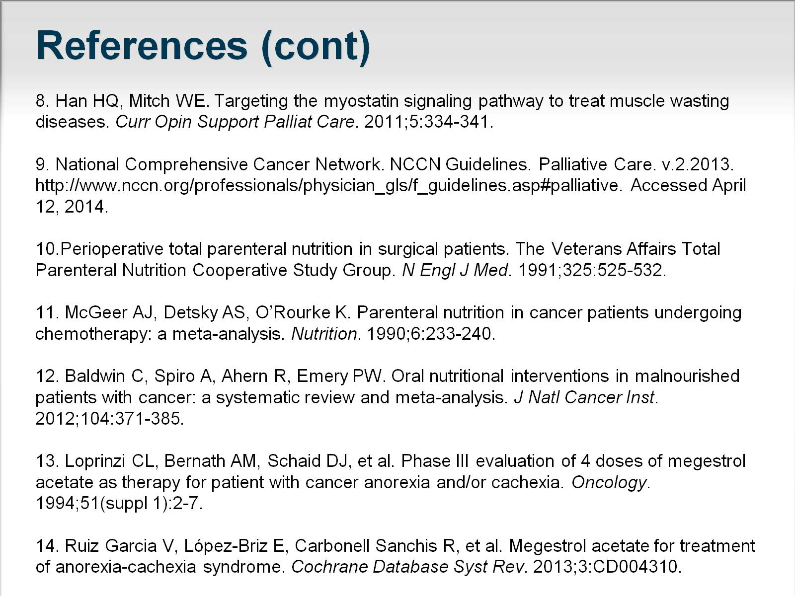
References (cont)

Slide 36
References (cont)

Slide 37
References (cont)

Slide 38
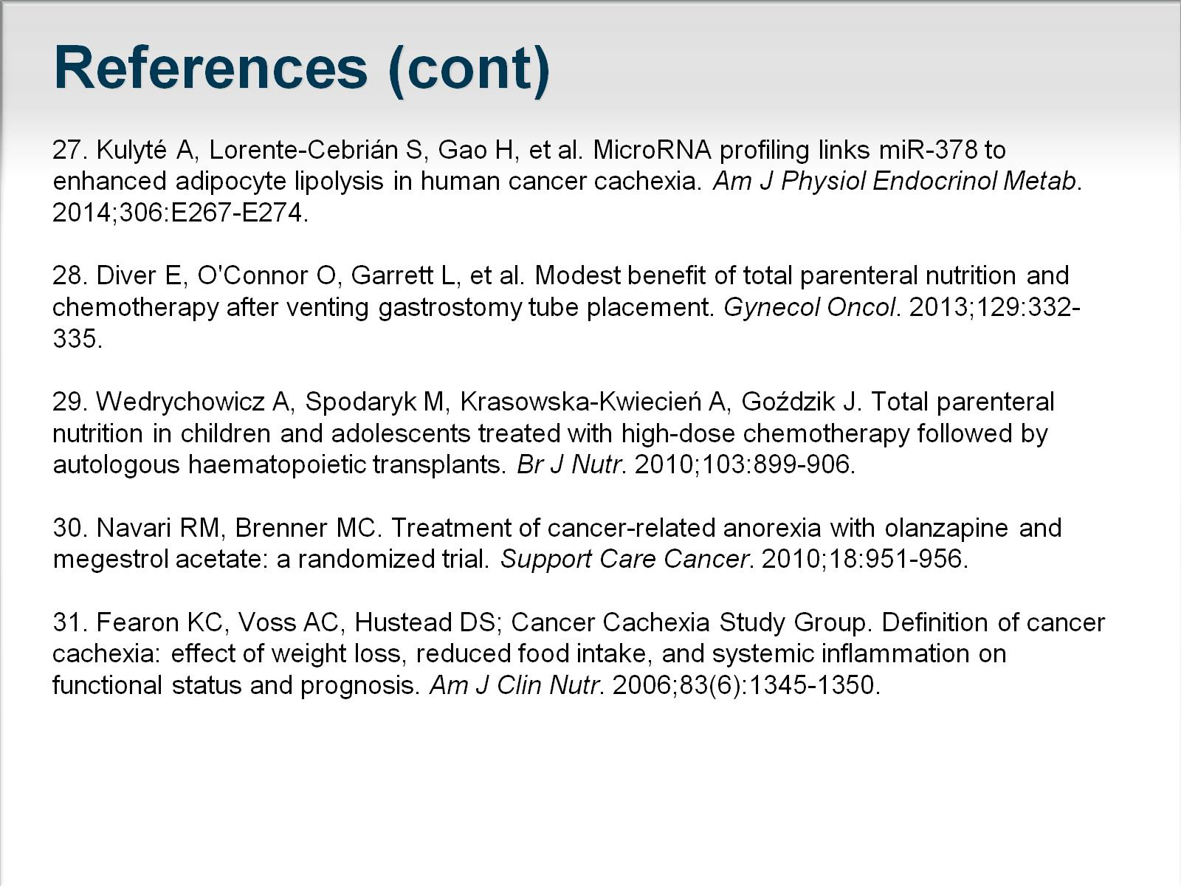
References (cont)

