Slide 2
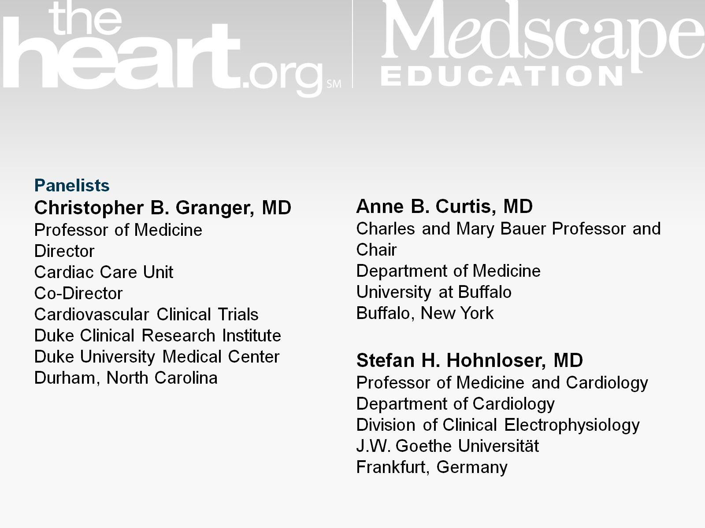

Slide 3
Atrial Fibrillation and Stroke

Slide 6
Overview of NOACs

Slide 7
Potential for Drug-Drug Interactions All NOACs Are Substrates for P-glycoprotein

Slide 8
Drug-Drug Interactions Effect on NOAC Plasma Levels

Slide 10
Myocardial Infarction in NOAC Trials

Slide 11
All NOACs Stroke or Systemic Embolic Event

Slide 12
Secondary Efficacy Outcomes

Slide 13
Baseline Characteristics

Slide 14
All NOACs Major Bleeding

Slide 15
Role for Warfarin Still Persists

Slide 16
NOAC Antidotes in Clinical Trials

