Slide 3
Monitoring Continuum

Slide 4
ISSUE-3

Slide 5
Atrial Fibrillation Classification

Slide 6
Cryptogenic Stroke and Atrial Fibrillation

Slide 7
AF Management Guidelines Considerations for Anticoagulant Selection

Slide 8
SURPRISE TRIAL

Slide 9
Time from Cryptogenic Stroke to AF Detection by ICM Results from SURPRISE study

Slide 10
CRYSTAL AF

Slide 11
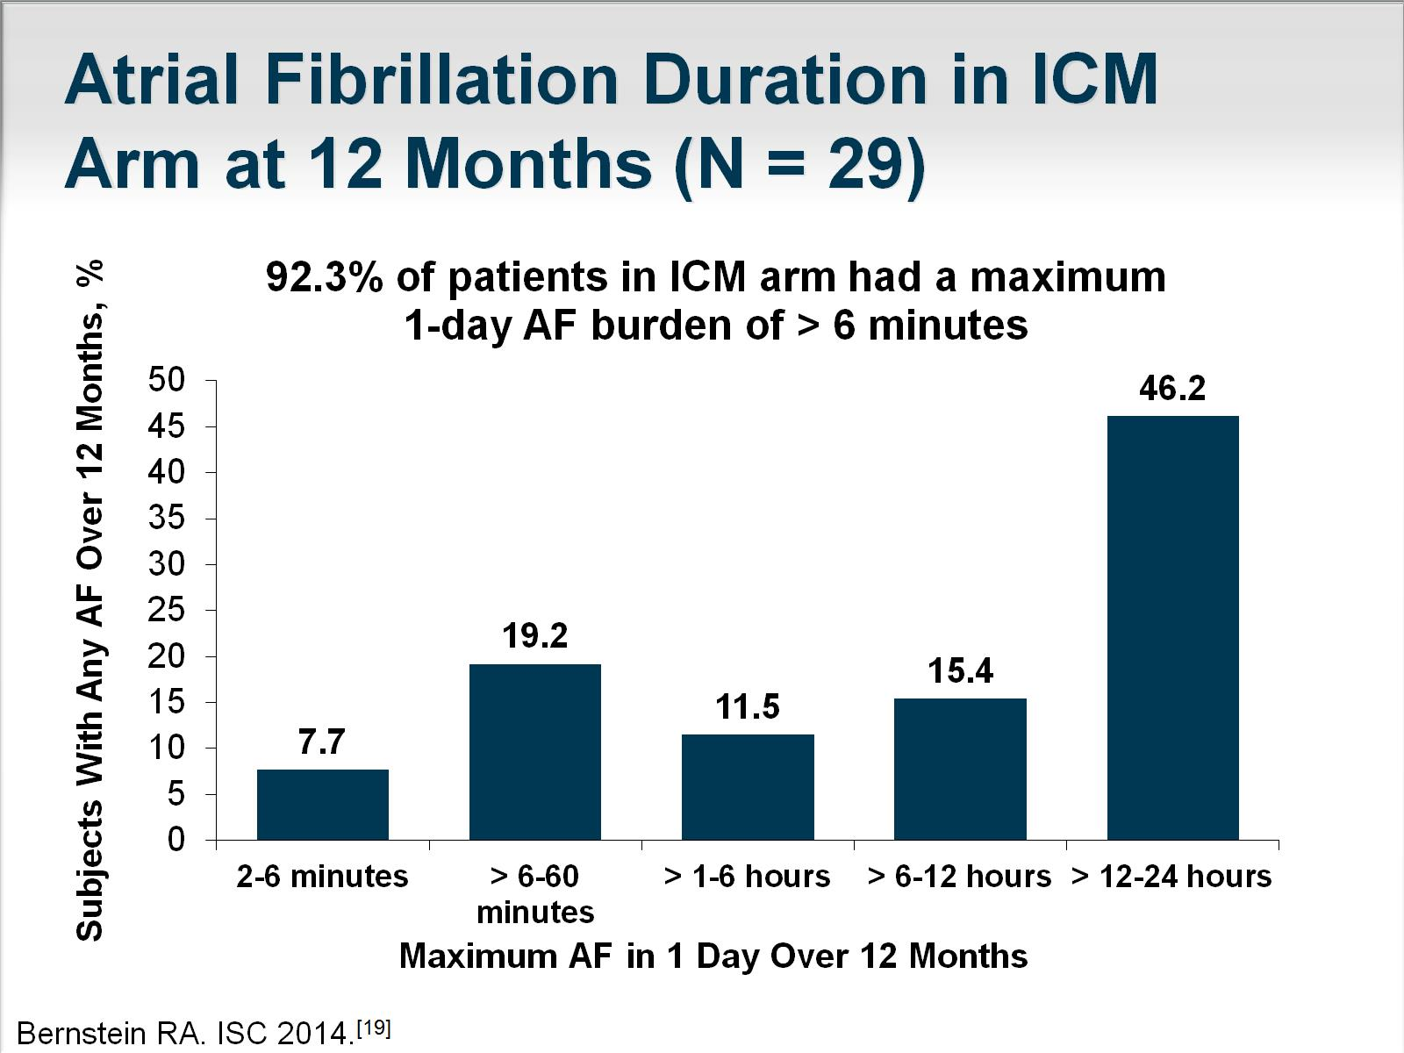
Atrial Fibrillation Duration in ICM Arm at 12 Months (N = 29)

Slide 12
Feedback Loop for Care Team

Slide 13
Clinical Scenario Presentation and Work-up

Slide 14
Evaluation for Cryptogenic Stroke

Slide 15
Clinical Scenario Continuous Monitoring

Slide 16
Current and Emerging Indications for Implantable Cardiac Monitoring

Slide 17
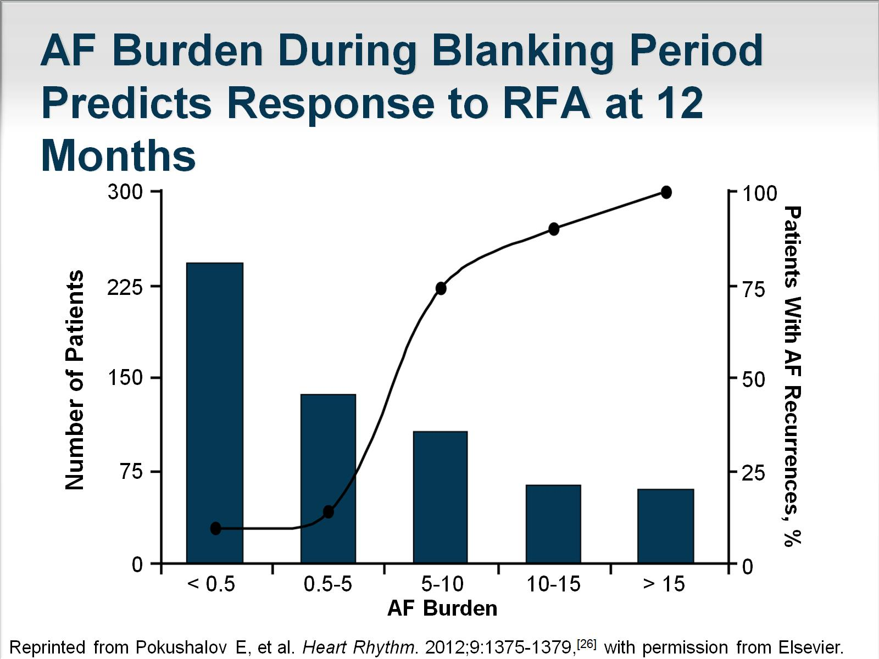
AF Burden During Blanking Period Predicts Response to RFA at 12 Months

Slide 18
DISCERN AF Prospective Multicenter Study

Slide 19
Abbreviations

Slide 20
Abbreviations (cont)

Slide 21
References

Slide 22
References (cont)

Slide 23
References (cont)

Slide 24
References (cont)

Slide 25
References (cont)

Slide 26
References (cont)

Slide 27
References (cont)

Slide 28
References (cont)

