Slide 1
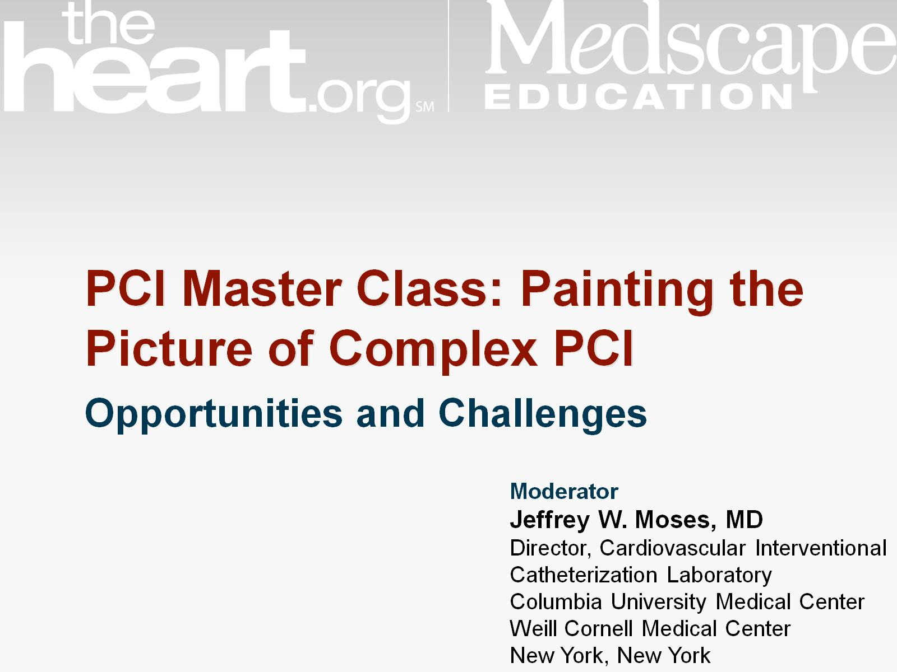

Slide 2
Trends in Coronary Procedures per 1000 Medicare Beneficiaries

Slide 3
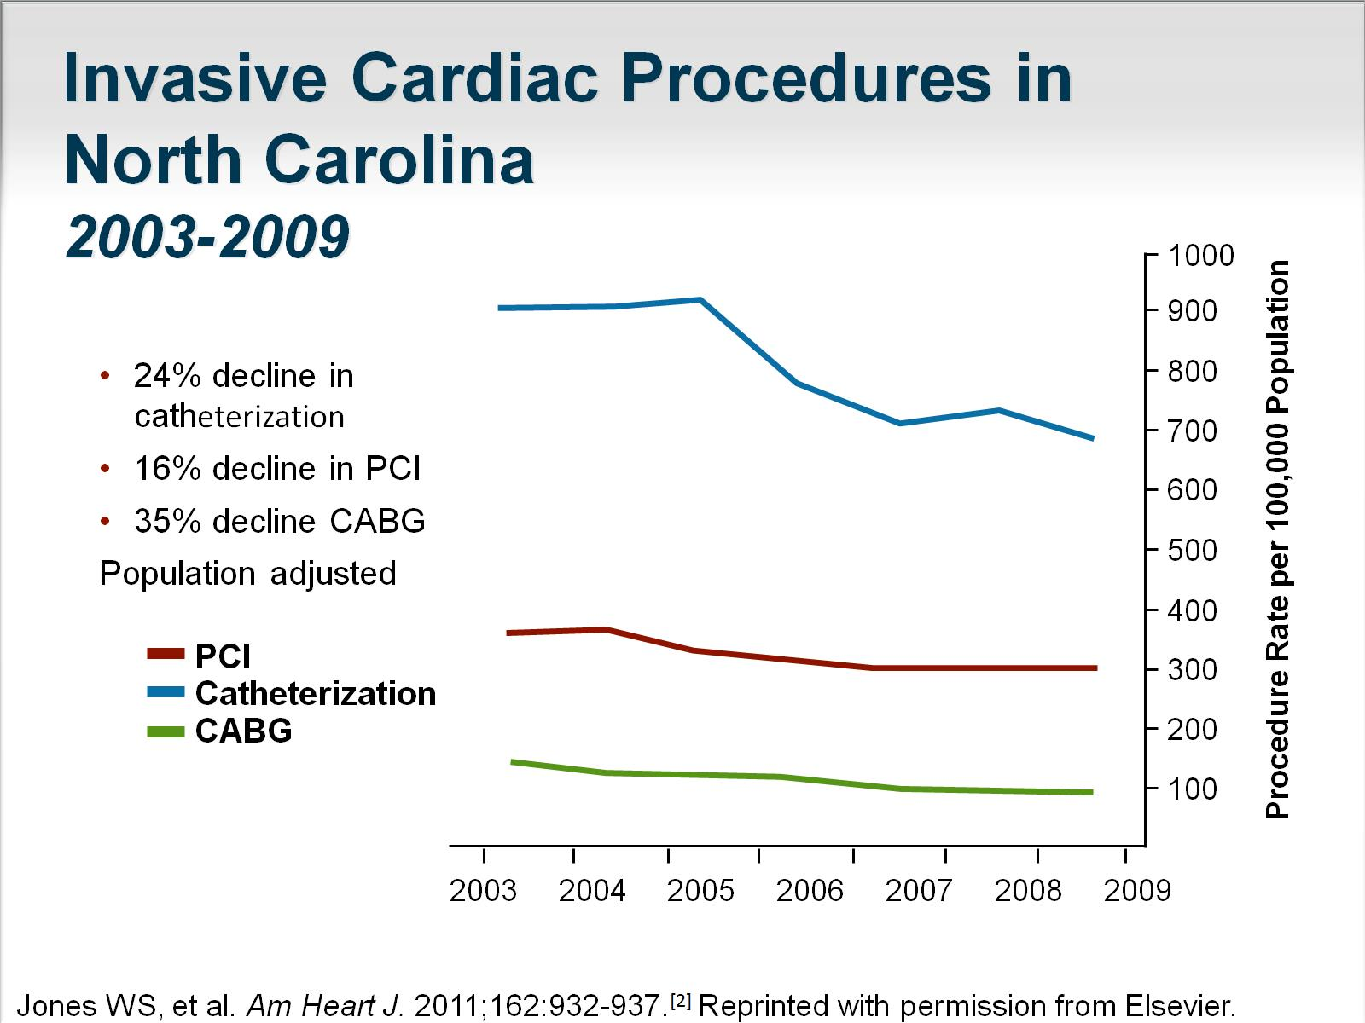
Invasive Cardiac Procedures in North Carolina 2003-2009

Slide 6
Aging of the PCI Population 2000 to 2008

Slide 7
Coronary Disease Characteristics in Patients Aged < 80 y

Slide 8
Coronary Disease Characteristics in Octogenarians

Slide 9
SYNTAX High-Risk Registry, 3-y Outcomes

Slide 10
Unprotected LM PCI in the US

Slide 11
PROTECT II Study Baseline Patient Characteristics

Slide 12
Underuse and Adverse Outcomes

Slide 13
Risk-Treatment Paradox in ACS

Slide 14
Despite Increasing Complexity, Outcomes Continue to Improve

Slide 15
What Do These Sets of Facts Mean?

Slide 16
Key Issues to Approach Goals of Care

Slide 17
Advanced CAD -- Method of Revascularization

Slide 18
SYNTAX II Integrating Clinical and Anatomical Factors

Slide 19
Complete Revascularization vs Incomplete Revascularization in SYNTAX

Slide 21
COURAGE Rates of Death or MI by Residual Ischemia on 6-18 m MPS

Slide 22
SYNTAX Score and Mortality in LM Stenting

Slide 23
Complete Revascularization and SYNTAX Score in LM Stenting

Slide 24
LM and Complete Revascularization

Slide 25
PCI Initial Success Rate

Slide 26
LM and Complete Revascularization: Cardiac Death

Slide 28
Complex Case Example

Slide 29
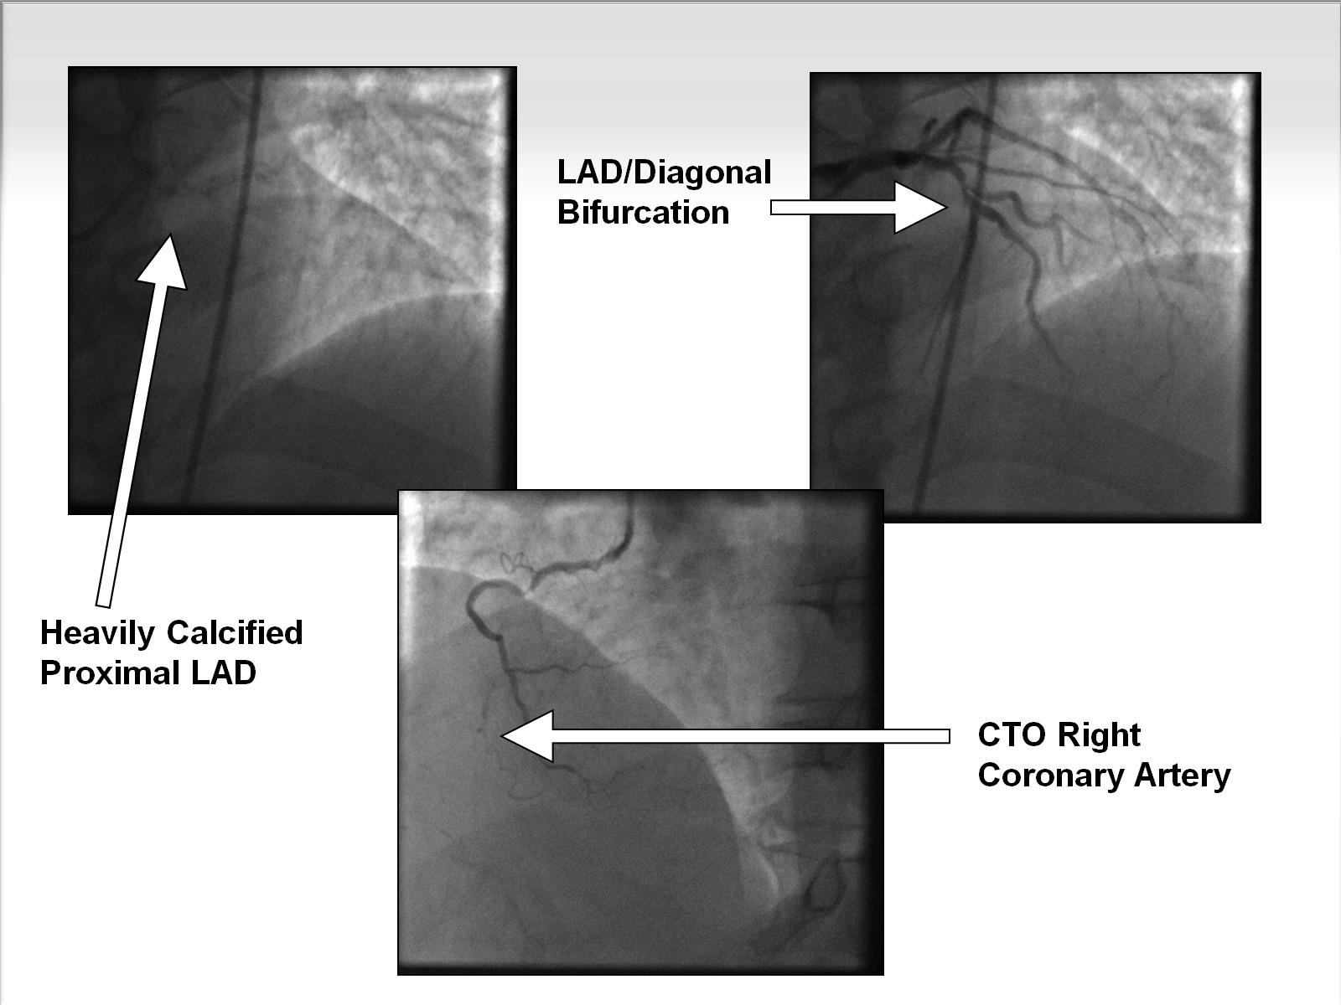

Slide 30
Advanced CAD -- Method of Revascularization

Slide 31
These Patients Present Complex Issues to the Interventional Cardiologist

Slide 32
Rotablator TM Catheter Components

Slide 33
Console

Slide 34
ROTAXUS

Slide 35
ROTAXUS 9-mo Follow-up

Slide 36
ROTAXUS Procedural Outcomes

Slide 37
Coronary OAS Mechanism of Action

Slide 39
Retrograde Approach

Slide 40
Corsair® Microcatheter

Slide 41
Cutting Balloons

Slide 42
AngioSculpt®

Slide 43
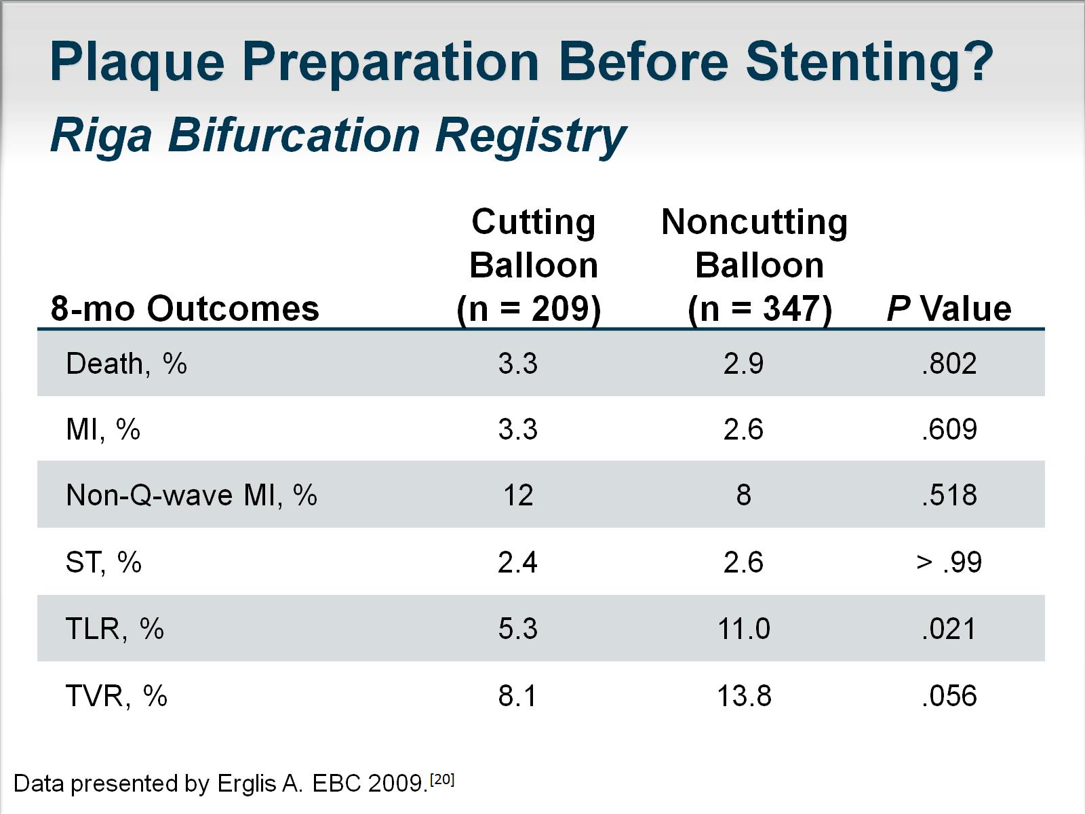
Plaque Preparation Before Stenting?

Slide 45
Use of IVUS During LM Stenting Associated With a Trend Toward Decreased Mortality

Slide 46
Summary

Slide 47
Abbreviations

Slide 48
Abbreviations (cont)

Slide 49
References

Slide 50
References (cont)

Slide 51
References (cont)

Slide 52
References (cont)

Slide 53
References (cont)

