Slide 1
Detecting and Treating Asparaginase-Related Toxicities in Acute Lymphoblastic Leukemia

Slide 3
Activity Goals

Slide 4
Acute Lymphoblastic Leukemia (ALL)

Slide 5
Outcome: Adults vs Childhood ALL

Slide 6
PEG-asparaginase for Pediatric Patients

Slide 7
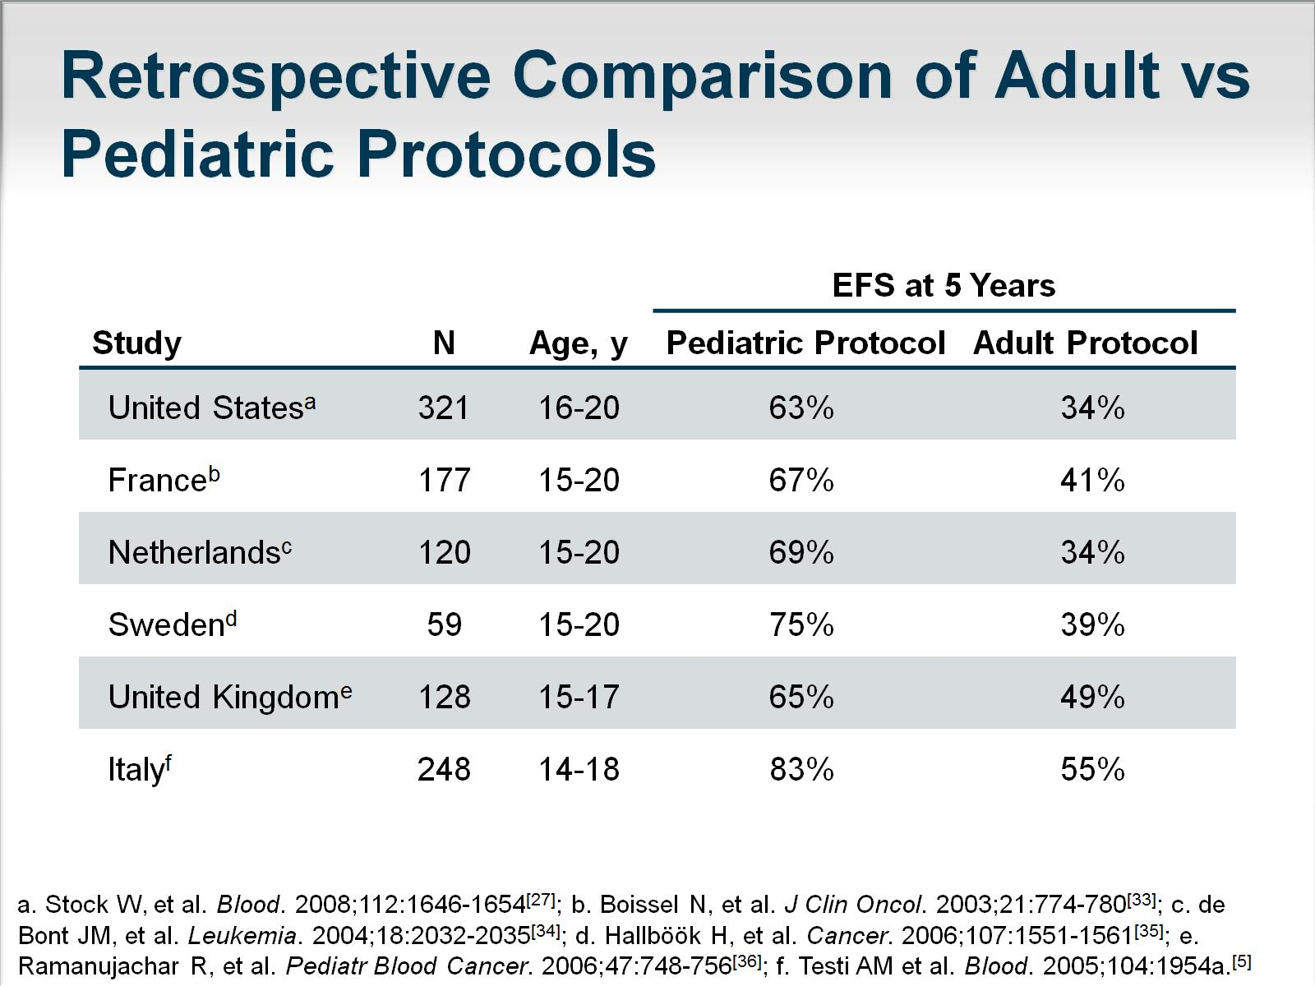
Retrospective Comparison of Adult vs Pediatric Protocols

Slide 8
Comparison of Adverse Events During Induction

Slide 9
Serum Asparaginase Concentrations

Slide 10
Grades 2-4 PEG-asparaginase-Related Adverse Events in Adults

Slide 12
PEG-asparaginase in Modified Pediatric Protocol

Slide 13
PK of Dex and Asparaginase Activity

Slide 14
Asparaginase Formulations and Half-life

Slide 15
PEGylated Asparaginase

Slide 16
Asparaginase

Slide 17
Current Dosing of Asparaginase

Slide 18
AEs From PEG-asparaginase From the CCG-Augmented Pediatric BFM Protocol

Slide 19
Asparaginase Hypersensitivity

Slide 20
AEs to PEG-asparaginase in Adults

Slide 21
Thrombosis

Slide 22
Antibodies to PEG-asparaginase

Slide 23
Measuring Asparaginase Activity

Slide 24
Monitoring Serum Asparaginase Activity

Slide 25
Dosing Asparaginase based on Serum Levels

Slide 26
Presence of Neutralizing Antibody: Switch to Erwinia Asparaginase

Slide 27
Why Use Asparaginase?

Slide 28
Using Pediatric-inspired Approaches in Adult ALL

Slide 29
The Importance of Asparaginase for ALL

Slide 30
Management of Asparaginase Toxicity in Adults

Slide 31
Conclusions

Slide 32
Abbreviations

Slide 33
Abbreviations (cont)

Slide 34
References

Slide 35
References (cont)

Slide 36
References (cont)

Slide 37
References (cont)

Slide 38
References (cont)

Slide 39
References (cont)

Slide 40
References (cont)

Slide 41
References (cont)

Slide 42
References (cont)

Slide 43
References (cont)

