Slide 3
Natural History of Atherothrombosis

Slide 4
Finding the Right Risk-Benefit Balance

Slide 5
Outcomes in Patients With Atherosclerotic Vascular Disease

Slide 6
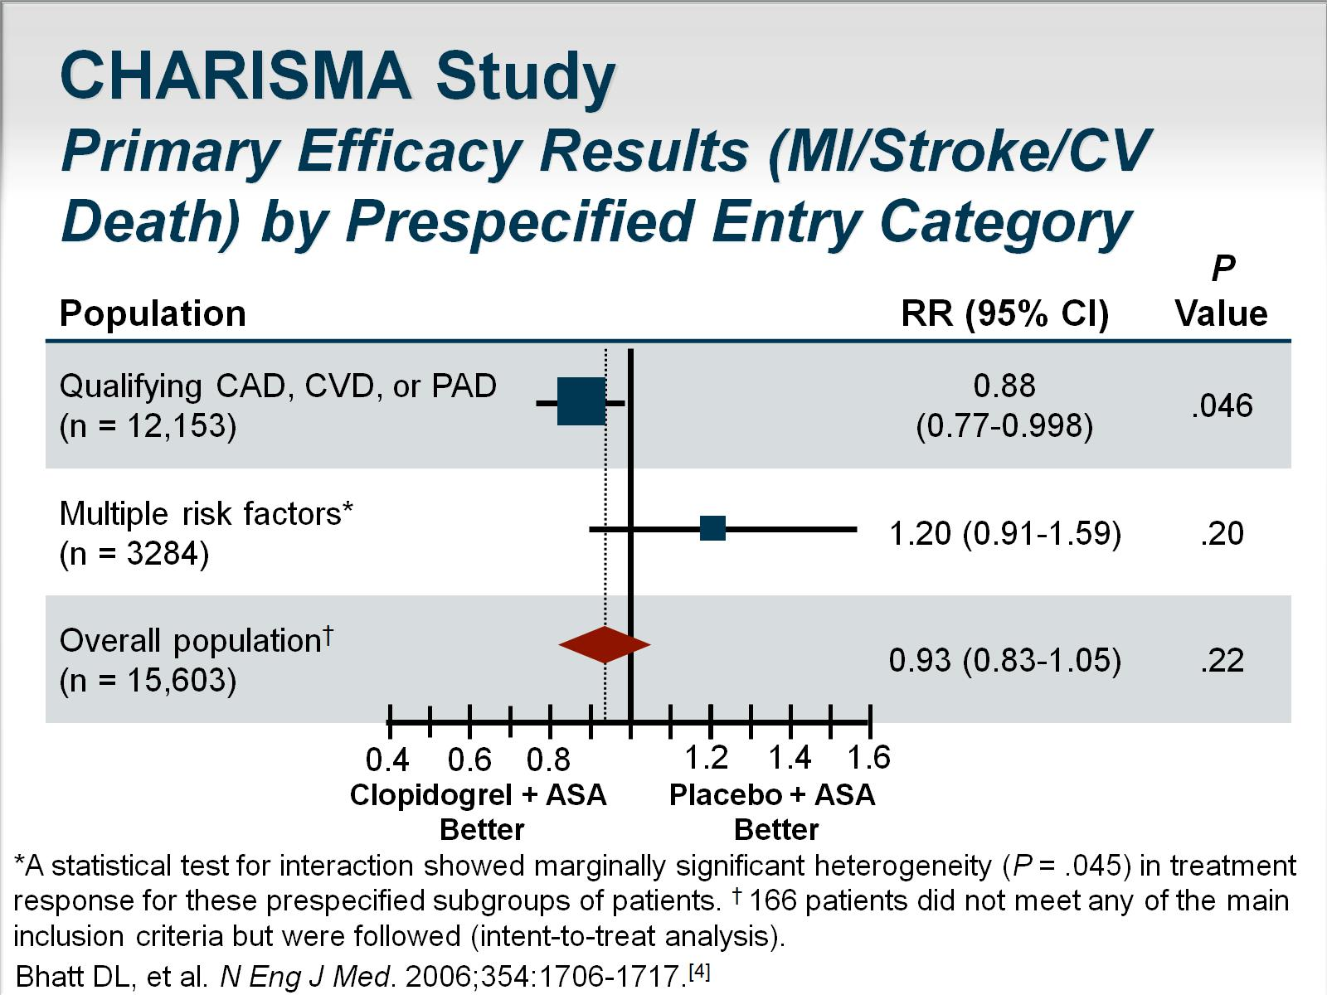
CHARISMA Study Primary Efficacy Results (MI/Stroke/CV Death) by Prespecified Entry Category

Slide 7
Monotherapy Clopidogrel vs Aspirin in Patients at Risk for Ischemic Events (CAPRIE)

Slide 8
REACH Data

Slide 9
Long-Term Dual Antiplatelet Therapy After MI?

Slide 10
TRILOGY ACS Post Hoc Analysis

Slide 11
Why Not Treat Everyone With Long-Term Thienopyridine Therapy?

Slide 12
Central Role of Thrombin as a Mediator of Coagulation and Platelet Thrombosis

Slide 13
PAR-1 Antagonists

Slide 14
TRA (Vorapaxar) Program Evaluation of Efficacy and Safety in Acute and Chronic Atherothrombosis

Slide 15
TRA-CER Trial Vorapaxar in ACS

Slide 16
TRA 2◦P-TIMI 50 Safety and Efficacy at 3 Years

Slide 17
TRA 2◦P-TIMI 50 MI Subgroup at 3 Years

Slide 18
Patients Considered for Long-Term, Higher Potency Antiplatelet Therapy

Slide 19
Addition of Vorapaxar

Slide 20
TRA◦2P-TIMI 50 Peripheral Artery Disease Cohort

Slide 21
DAPT Study Design

Slide 22
PEGASUS-TIMI 54 Trial

Slide 23
Take-home Points and Summary

Slide 24
Abbreviations

Slide 25
Abbreviations (cont)

Slide 26
References

Slide 27
References (cont)

Slide 28
References (cont)

Slide 29
References (cont)

