Slide 1
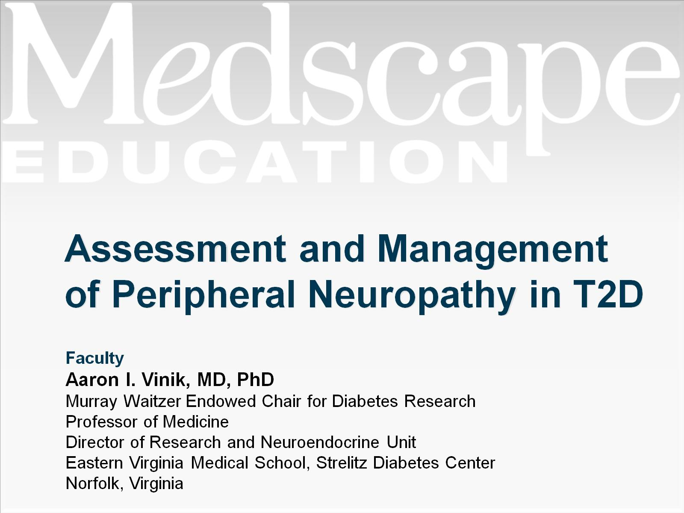
Assessment and Management of Peripheral Neuropathy in T2D

Slide 2
Program Goals

Slide 3
Neuropathy in Diabetes

Slide 4
Prevalence of Polyneuropathy and Neuropathic Pain

Slide 6
Neuropathy Is Commonly Underdiagnosed

Slide 10
Assessing Neuropathy

Slide 12
Field Testing of Vibration Detection Threshold (10 Seconds)

Slide 15
