Slide 1
Chronic Myelogenous Leukemia Diagnosis and Treatment

Slide 3
Survival in Early CP CML

Slide 4
OS, PFS, and Probability of Remaining in CHR and EFS by ITT Analysis

Slide 5
Outcomes: ENESTnd and DASISION

Slide 6
DASISION: 4-Year Rates of MMR

Slide 7
ENESTnd: Cumulative Incidence of MMR

Slide 8
Progression to AP/BC on Study According to Sokal Risk Score

Slide 9
DASISION: Transformation to AP/BP

Slide 10
ENESTnd: Progression to AP/BC

Slide 11
DASISION: OS and PFS

Slide 12
ENESTnd: 5-Year EFS and PFS

Slide 13
Compliance to Imatinib: ADAGIO Study

Slide 14
Adherence and Molecular Response

Slide 15
Cumulative Incidence of MMR According to BCR-ABL Level at 3 Months

Slide 16
When to Consider Mutational Analysis

Slide 17
Response and PFS With 2G-TKIs in Imatinib-Resistant CP-CML

Slide 18
Newly Approved Agents for CML Patients Resistant or Intolerant to Prior Therapy

Slide 19
Bosutinib Third Line: Best Cumulative Response

Slide 20
PACE: Response to Ponatinib by Previous CP CML Therapy

Slide 21
CCyR Rates After 2G-TKI Failure

Slide 22
ENESTnd: Cardiovascular Events by 5 Years

Slide 23
DASISION: Arterial Occlusive Events

Slide 24
Take-Home Message

Slide 25
IS TKI Therapy Forever? The STIM Trial

Slide 26
Complete Molecular Remission After Discontinuation of Imatinib

Slide 27
Abbreviations

Slide 28
Abbreviations

Slide 29
References

Slide 30
References (cont)

Slide 31
References (cont)

Slide 32
References (cont)

Slide 33
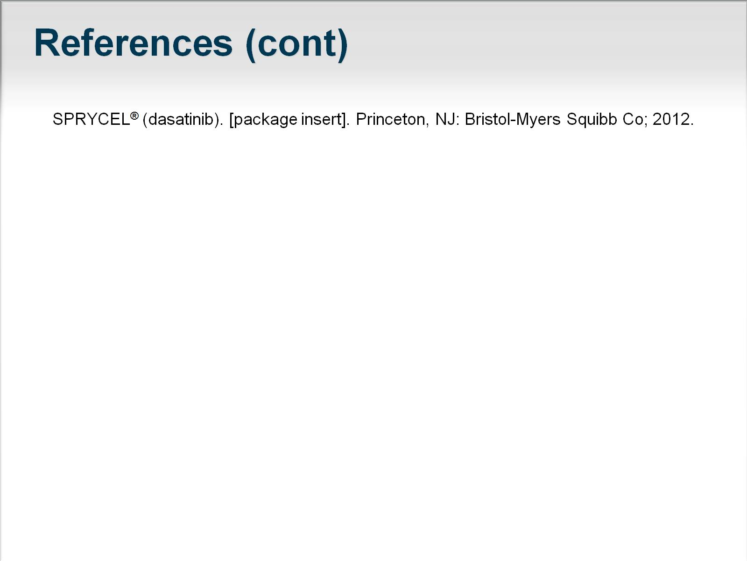
References (cont)

