Slide 1
Stroke Prevention in Atrial Fibrillation:

Slide 2
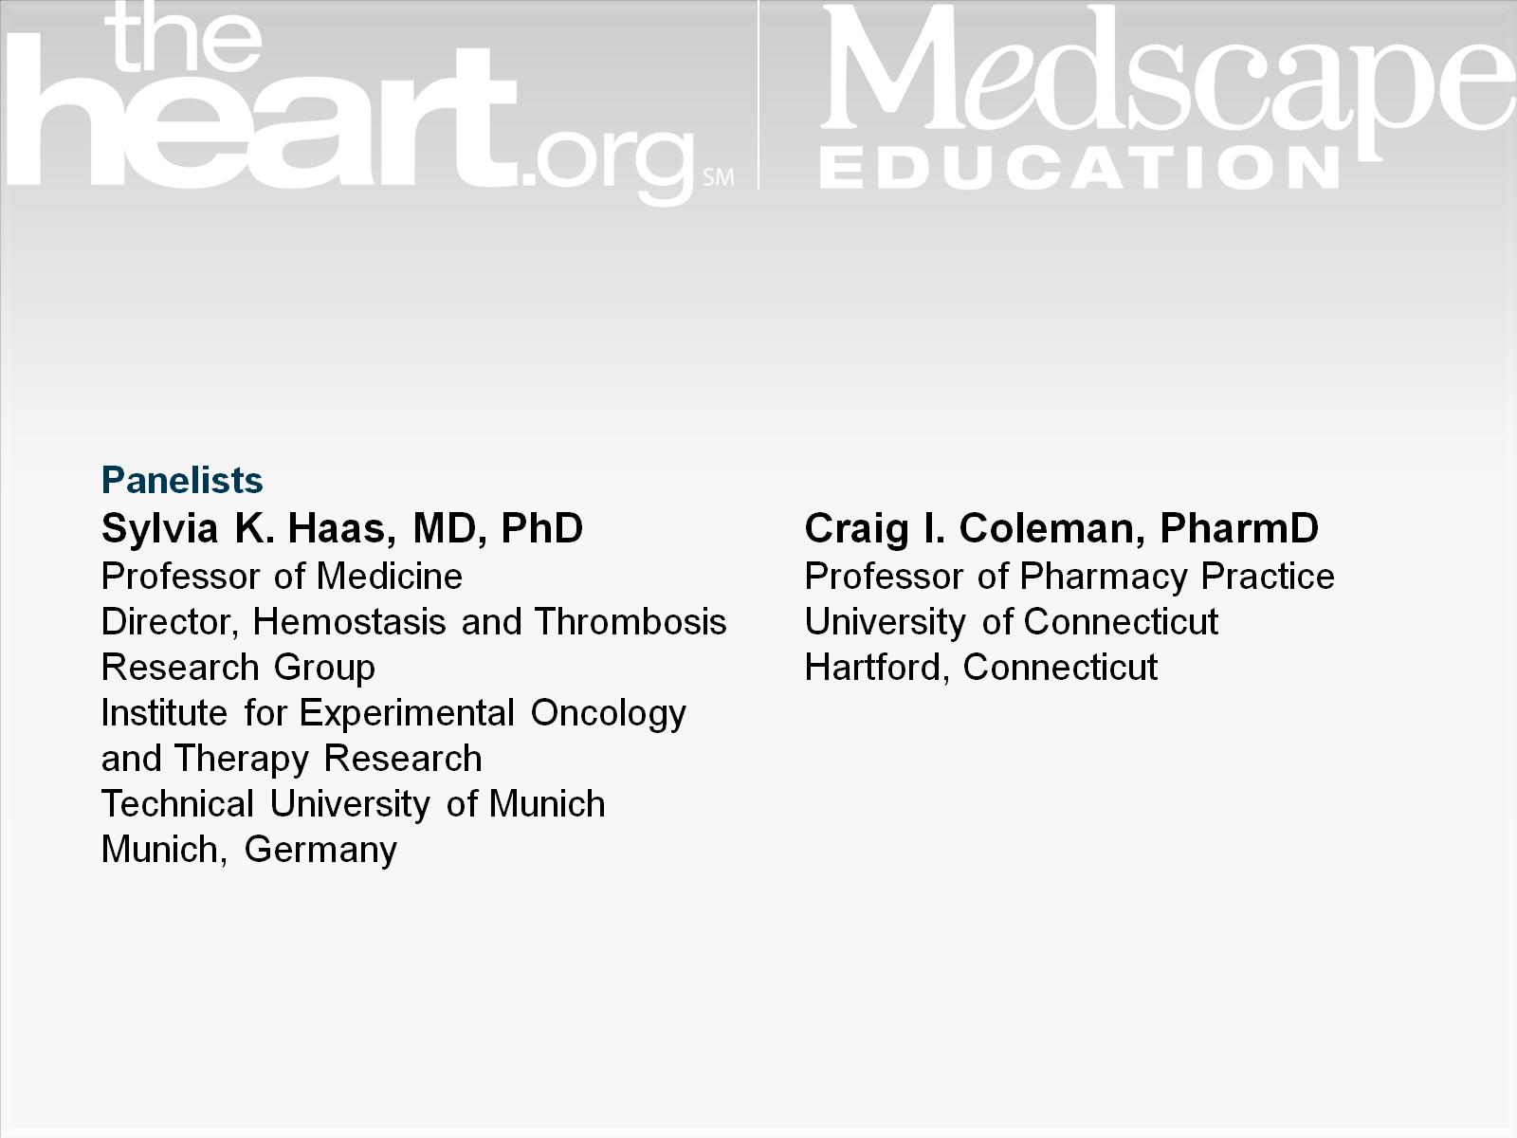

Slide 3
CHA₂DS₂-VASc Score

Slide 7
ENGAGE Subgroup Analysis

Slide 10
GARFIELD Registry

Slide 11
Physician Reasons for Not Prescribing VKAs in Patients With CHADS₂ Score ≥ 2

Slide 12
Medication Adherence

Slide 13
Medication Adherence (cont)

Slide 14
Chronic Cardiovascular Medication Adherence

Slide 15
Patient Preference for Dose Regimen

Slide 16
Patient Are Willing to Pay More for Once-Daily OACs

Slide 17
Nonadherence to Dabigatran Is Associated With Worse Outcomes

