Slide 1
SATELLITE SYMPOSIUM
Evolving Insights Into MS Pathology:
Can We Ever Stop Disease Worsening? CME
Thursday, September 11, 2014 | 6:00 pm – 7:00 pm
A live educational event from
Supported by an independent educational grant from
Teva Pharmaceuticals

Slide 2
Disclosures
Ludwig Kappos, MD, has disclosed the following relevant financial relationships:
Served as an advisor or a consultant for or received grants for clinical research from:
Actelion Pharmaceuticals, Ltd.; Addex Therapeutics; Bayer HealthCare Pharmaceuticals; Bayer Schering Pharma; Biogen Idec Inc.; CLC Behring; GeNeuro SA; Genzyme Corporation; Merck Serono; Mitsubishi Pharma America, Inc.; Novartis Pharmaceuticals Corporation; Octapharma; Praxicon; Roche; sanofi-aventis; Santhera Pharmaceuticals; Siemens AG; Teva Neuroscience, Inc.

Slide 3
SATELLITE SYMPOSIUM
Introduction and Overview
Ludwig Kappos, MD
Professor and Chair, University Hospital Basel, Basel, Switzerland
A live educational event from

Slide 4
Learning Objectives
Upon completion of this activity, participants will be able to:
Discuss the neuropathological changes of MS that contribute to disease worsening
Review the mechanisms of action of current and emerging MS disease-modifying therapies and their effects on disease worsening, neurodegeneration, and brain atrophy
Develop individualized management strategies to assess and target disease worsening in progressive MS

Slide 5
SATELLITE SYMPOSIUM
Do We Understand the Pathological Basis of Progressive MS?
Wolfgang Brück, MD
Professor of Neuropathology, University Medical Center Göttingen, Göttingen, Germany
A live educational event from

Slide 6
Disclosures
Wolfgang Brück, MD, has disclosed the following relevant financial relationships:
Served as an advisor or a consultant for:
Biogen Idec Inc.; Genzyme Corporation; Novartis Pharmaceuticals Corporation; Teva Pharmaceuticals USA
Served as a speaker or a member of a speakers bureau for:
Bayer AG; Biogen Idec Inc.; Genzyme Corporation; Merck-Serono; Novartis Pharmaceuticals Corporation; Teva Pharmaceuticals USA

Slide 7
Pathological Correlates of Disease Progression
White matter lesion type
Nature of inflammation
Remyelination failure
Gray matter involvement
Diffuse pathological changes
Axonal/neuronal loss
Compartmentalized inflammation

Slide 8
White Matter Lesion Type
MS focal white matter lesion characteristics depend on the age of the lesion:
Active demyelinating lesions (early MS)
Slowly expanding lesions (progressive MS)

Slide 9
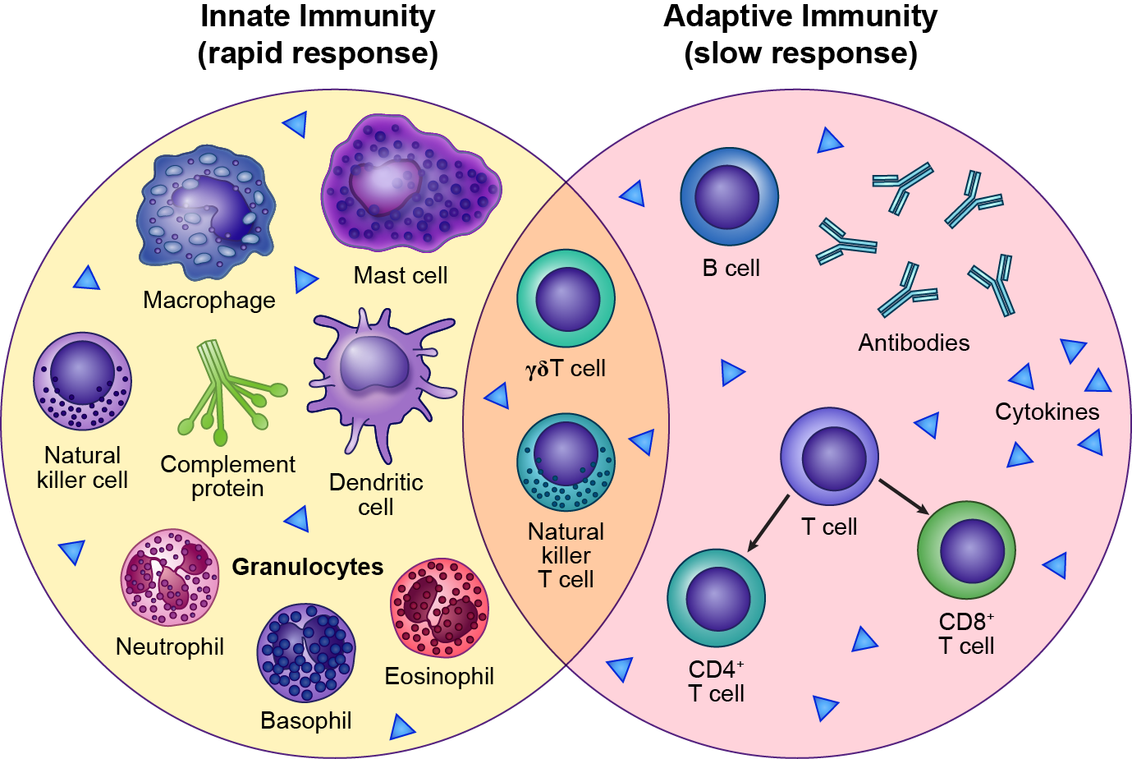
White Matter Lesion Type (cont)
Innate vs adaptive immunity
Alemtuzumab
Β-interferon
Dimethyl fumarate
Fingolimod
Glatiramer acetate
Mitoxantrone
Natalizumab
Teriflunomide
Laquinimod
Dranoff G. Nat Rev Cancer. 2004;4:11-22.^{[1]}
Notes:
BD/GS: Giovanna will redraw
RS: Redraw notes: The purpose of the image is to show the overlap between the immune cells involved in innate immune response to inflammation and the cells involved in the slower adaptive immune response. The redrawn version should reflect the variety of immune cells involved; it’s less important to preserve the various components of a certain cell. (For example, the neutrophil doesn’t need to have the red circles connected with a red line; it’s more important that it have a shape different from the others. The basophil and eosinophil could also have less detail. ) Colors can change, so long as they’re consistent (eg, T cell and gamma 6 T cell should have the same color; the CD4+ and CD8+ cells could be different shades of that same color.) I’m not sure what the “bracket” represents, connecting basophil, eosinophil, and neutrophil; that could be eliminated.

Slide 10
Adaptive vs Innate Immunity in MS
Adaptive Immunity
Slow but specific to pathogen
RRMS thought to be driven primarily by adaptive immunity
Most MS treatments are directed toward adaptive immunity targets (B-cells, T-cells, antibodies)
Innate Immunity
Nonspecific, rapid response to pathogen
More relevant in progressive MS
Few therapies target innate immunity (macrophages, dendritic cells, granulocytes)
Laquinimod has primary effect on innate immunity
Modulates myeloid antigen presenting cells that then downregulate proinflammatory T-cell responses
Acts within the CNS to reduce demyelination and axonal damage
Varrin-Doyer M, et al. Exper Neurol. 2014; Apr 13.^{[2]} [Epub ahead of print]

Slide 11
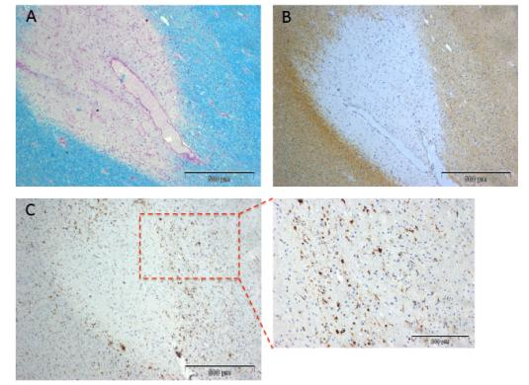
White Matter Lesion Type (cont)
“…[S]lowly expanding lesions (progressive plaques), in which ongoing myelin breakdown occurs in the absence of … acute inflammation, contribute to disease progression in cases of secondary-progressive multiple sclerosis.”
LFB/PAS
MBP
KiM-1P
Prineas JW, et al. Ann Neurol. 2001;50:646-657.^{[3]}
Notes:
The citation is still from the Prineas paper, I replaced the figure by one of my own which is not yet published

Slide 12
White Matter Lesion Type (cont)
Remyelination in early and chronic MS
IMAGE IS NO LONGER AVAILABLE
Goldschmidt T, et al. Remyelination capacity of the MS brain decreases with disease chronicity. Neurology. 2009;72:1914-1921. Reprinted with permission.^{[4]}
Notes:
I changed the figure to the original one from the manuscript where I am co-author. I also changed the title of the slide

Slide 13
White Matter Lesion Type (cont)
Remyelination is frequent in early MS
but often incomplete in chronic MS
IMAGE IS NO LONGER AVAILABLE
Goldschmidt T, et al. Remyelination capacity of the MS brain decreases with disease chronicity. Neurology. 2009;72:1914-1921. Reprinted with permission.^{[4]}
Notes:
I changed the slide and inserted the original figures from the manuscript where I am co-author. The slide is animated.

Slide 14
Gray Matter Involvement
Cortical lesion types
Type I
Type II
Type III
Dutta R, Trapp BD. Prog Neurobiol. 2011;93:1-12.^{[5]}
Notes:
BD/GS: Giovanna will redraw this.
RS: Focus of the slide is to show 3 types of gray matter lesions: Type 1, localized to a certain part of the fold and overlapping the white matter; Type 2, small lesions scattered along (and contained within) the fold ; Type 3, long lesion occupying a stretch of territory on (and contained within) the fold. The redraw could use a completely different fold shape (so long as it reflects a typical gray matter fold), and could use a different color to indicate lesions.

Slide 15
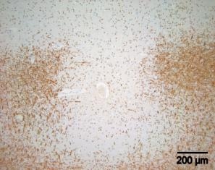
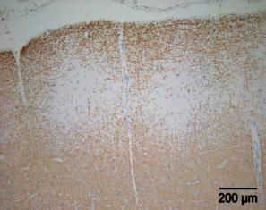
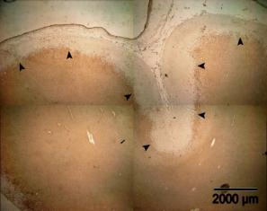
Gray Matter Involvement (cont)
Cortical lesion types
GM
WM
Type I
Type II
Type III
Images courtesy of Wolfgang Brück, MD.
Notes:
This is a figure of my own, not yet published, I replaced it by the one from Bö et al.

Slide 16
Gray Matter Involvement (cont)
Cortical demyelination is present in early MS
IMAGE IS NO LONGER AVAILABLE
From New England J Med, Lucchinetti CF, et al. Inflammatory cortical demyelination in early multiple sclerosis. 2011;365:2188-2197.^{[6]} Copyright © 2011 Massachusetts Medical Society. Reprinted with permission from Massachusetts Medical Society.
Notes:
I am co-author on this paper, this is the original figure. Should not be a problem

Slide 17
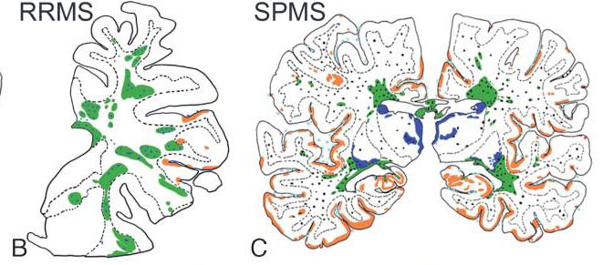
Gray Matter Involvement (cont)
Cortical demyelination is extensive in progressive MS
 | Cortical lesion area forebrain, % | White matter lesion area, %
RRMS | 2.96 | 10.3
PPMS | 12.54 | 6.54
SPMS | 13.29 | 24.13
Kutzelnigg A, et al., Cortical demyelination and diffuse white matter injury in multiple sclerosis, Brain. 2005;128:2705-2712,^{[7]} by permission of Oxford University Press.
Notes:
I replaced the figure by the original one from the manuscript. I am co-author on this manuscript.

Slide 18
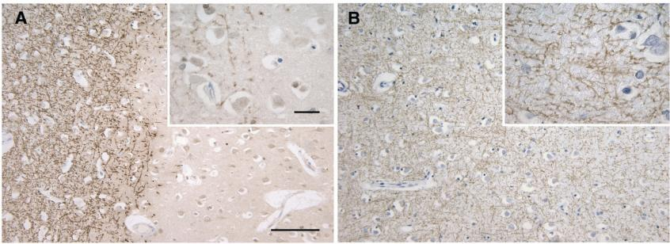
Gray Matter Involvement (cont)
Cortical demyelination increases with disease duration
Demyelinated MS cortex
Control non-MS cortex
Demyelinated area
Disease duration > 10 y: 20.1 ± 16.1%
Disease duration < 10 y: 4.8 ± 4.2%
Albert M, et al. Extensive cortical remyelination in patients with chronic multiple sclerosis. Brain Pathol. 2007;17:129-138.^{[8]} © 2007 International Society of Neuropathology.
Notes:
This is the original figure from the Albert et al paper, I am co-author

Slide 19
Gray Matter Involvement (cont)
Neuronal loss in lesional and nonlesional deep gray matter in MS
Region | Control | MS normal-appearing gray matter | MS lesional gray matter
Caudate nucleus | 95.5 ± 37.6 | 64.0 ± 31.2 | 41.3 ± 21.4
Thalamic mediodorsal nucleus | 67.3 ± 31.5 | 44.6 ± 25.3 | 35.5 ± 25.7
⇒ Significant neuronal loss in normal-appearing and demyelinated deep gray matter
Vercellino M, et al. J Neuropathol Exp Neurol. 2009;68:489-502.^{[9]}

Slide 20
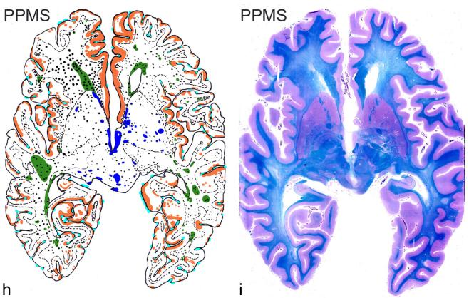
Diffuse Pathological Changes
Diffuse white matter inflammation in progressive MS
Kutzelnigg A, et al., Cortical demyelination and diffuse white matter injury in multiple sclerosis, Brain. 2005;128:2705-2712,^{[7]} by permission of Oxford University Press.
Notes:
I am co-author on this manuscript, so I think we can leave it as is

Slide 21
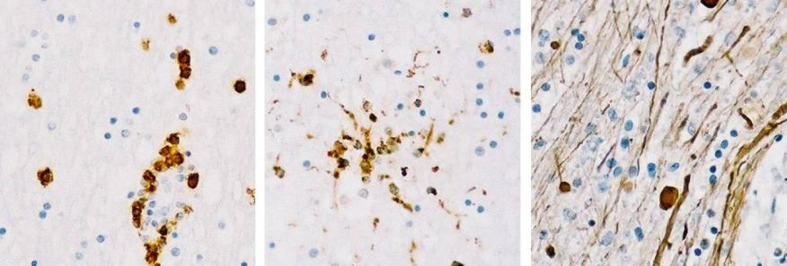
Diffuse Pathological Changes (cont)
Diffuse axonal damage in NAWM of MS patients
NAWM = normal-appearing white matter.
Kutzelnigg A, et al. Cortical demyelination and diffuse white matter injury in multiple sclerosis, Brain. 2005;128:2705-2712,^{[7]} by permission of Oxford University Press.
Notes:
I am co-author on this manuscript, so I think we can leave it as is

Slide 22
Diffuse Pathological Changes (cont)
Axonal loss in MS NAWM
Spinal cord NAWM (reduced nerve fiber density 19% to 42% in pyramidal tracts; predominantly small fibers affectedª
Corpus callosum NAWM (axonal density reduction 34%); ~ 50% of total axons are lost^{b}
Spinal cord NAWM (ventral column 22%); empty myelin sheaths, indicative of Wallerian degeneration^{c}
a. Ganter P, et al. Neuropathol Appl Neurobiol. 1999;25;459-467^{[10]}; b. Evangelou N, et al. Ann Neurol. 2000;47:391-395^{[11]}; c. Bjartmar C, et al. Neurology. 2001;57:1248-1252.^{[12]}
Notes:
I replaced the figure by a text slide, is this ok?

Slide 23
Pathological Correlates of Disease
Progression – Conclusions
The exact pathological correlates of disease progression in MS are not yet defined.
Different factors may contribute to progression including:
White matter lesion type
Gray matter (cortical) involvement
NAWM involvement
Remyelination failure
Axonal/neuronal loss
Compartmentalized inflammation
Specific mechanisms (oxidative stress, iron, mitochondria)

Slide 24
SATELLITE SYMPOSIUM
Measuring Disease Progression in MS: Role of Clinical and MRI Outcomes
Bruce Cree, MD, PhD, MCR
University of California San Francisco
A live educational event from

Slide 25
Disclosures
Bruce Cree, MD, PhD, MCR, has disclosed the following relevant financial relationships:
Served as a consultant for:
AbbVie; Biogen Idec Inc.; EMD Serono; Genzyme/sanofi-aventis; MedImmune; Novartis; Teva Pharmaceuticals
Received contracted research support (clinical trials):
Acorda Therapeutics; Avanir; Hoffman La Roche; Novartis

Slide 26
Progressive MS Phenotypes
Progressive disease definitions
Steadily worsening neurologic dysfunction without unequivocal recovery (fluctuations and phases of stability may occur)
Worsening disease
Documented increase in neurologic dysfunction as a result of relapses or progressive disease, reserving the term “disease progression” for those solely in a progressive phase of the illness
Confirmed progression or worsening
Increase of neurologic dysfunction confirmed throughout a defined time interval (guidelines suggest 3, 6, or 12 months)
Because neurologic dysfunction may still improve (especially in relapsing disease), even if progression is confirmed over 6 or 12 months, the term “sustained” is avoided.
Lublin FD, et al. Neurology. 2014;83:1-9.^{[13]}

Slide 27
Progressive MS: 2014 Definitions
2014 - MS Clinical Description Subtypes
Progressive accumulation of disability from onset
Active and with progression
(PP)
Active but without progression
Progressive
Disease
Not active but with progression
(SP)
Progressive accumulation of disability after initial relapsing course
Not active and without progression
(stable disease)
Progressive relapsing MS is no longer considered a distinct disease course .
Lublin FD, et al. Neurology. 2014;83:1-9.^{[13]}

Slide 28
Key Parameters in MS Management: Disability
Expanded Disability Status Scale (EDSS):
Rating system to follow the progression of disability in MS
Death
Normal neurologic exam
Minimal disability
Increased limitation in walking ability
Need for walking assistance
Wheelchair
restriction
Bed-bound patient
10.0
9.0
9.5
7.5
8.0
8.5
6.5
7.0
6.0
4.0
4.5
5.0
5.5
3.0
3.5
1.5
2.0
2.5
0
1.0
Patient Disability Classification
Kurtzke J. Neurology. 1983;33:1444-1452.^{[14]}

Slide 29
Disability Accumulation in MS
In relapsing MS, disability is initially accrued as a consequence of relapses
Good correlation of relapses and relapse-related disability with macroscopic inflammation as measured by contrast-enhancing lesions or new T2 lesions
In progressive MS, disability accrues independently from relapses
Poor correlation with radiographic measures of focal macroscopic inflammation
Radiographic correlates of diffuse tissue injury include loss of brain and spinal cord volume (atrophy)
Quantitative MRI measures of diffuse injury that are sensitive to change and have predictive value for accrual of disability have not been validated but could include MR diffusion and spectroscopy
Ongoing neural Inflammation likely still plays a role

Slide 30
RRMS and SPMS
The majority of MS patients will present with bout-onset or RRMS.
Frequency of relapses is highly variable but tends to decline over the course of the illness.
Relapses contribute to disability.
Many RRMS patients (32% to 58%) eventually develop secondary progressive disease.
The time from disease onset to secondary progression is ~ 19 years.
The time from disease onset to cane dependency is ~20 to 30 years, depending on the cohort.
Tremlett H, et al. Neurology. 2010;74:2004-2015.^{[15]}

Slide 31
Primary Progressive MS
MS characterized by progression from onset without relapses
Older age of onset
Gender dimorphism is less apparent
Much less common presentation of MS
6% to 20% of patients, depending on the study
Typical presentation is insidiously progressive, asymmetric, ascending myelopathy
Age of onset of PPMS is similar to age of onset of SPMS in most, but not all, studies.
Ages of disability milestones between PPMS and SPMS are similar.
Time to disability progression is shorter for PPMS but the age of onset is later than for relapsing MS.
Confavreux C, Vukusic S. Brain. 2006;129:606-616^{[16]}; Kremenchutzky M, et al. Brain. 2006;129:584-594^{[17]};Minderhoud JM, et al. Acta Neurol Scand. 1988;78:10-15^{[18]}; Koch M, et al. J Neurol Sci. 2007;255:35-41^{[19]}; Tremlett H, et al. Neurology. 2009;256-374-381.^{[20]}

Slide 32
Is There > 1 Form of Progressive MS?
No clear genetic or immunologic differences between SPMS and PPMS
No obvious histopathologic difference between SPMS and PPMS
No difference in progression rates between SPMS and PPMS after EDSS = 4
“Progressive relapsing” patients are now considered to have PPMS with active disease.
Does it make sense to think of SPMS and PPMS as fundamentally the same disease process?
Grouping SPMS and PPMS is reminiscent of the pre-1996 classification “chronic progressive MS.”
However: no convincing explanation for the differences in gender dimorphism
Should trials be designed to target “progressive forms of MS” rather than separate studies for PPMS and SPMS?

Slide 33
Use and Limitations of EDSS in Progressive MS Trials
Confirmed change in EDSS is the primary outcome for almost all progressive MS trials
Subjective scoring of neurologic examination
Poor interrater and intrarater reliability
Low-range scores dependent on functional scale scores
Mid-range scores dependent on ambulation
Clinical significance of change depends on baseline score
Rate of progression differs by baseline score
Time spent at different EDSS scores varies widely

Slide 34
Alternatives to EDSS
Multiple Sclerosis Functional Composite (MSFC)ª
Normalized, averaged score (Z-score) from 3 subscales
Timed 25-foot walk (T25W)
9-hole peg test (9HPT)
Paced auditory serial addition test (PASAT)
Used in the IMPACT trial of IFNβ-1a in SPMS^{b}
Mean change in Z-scores (P = .033):
Placebo: -0.495
Interferon: -3.62
Performance on 9HPT (and, to a lesser extent, PASAT-3) led to the MSFC Z score difference.
There was no difference in T25W or EDSS.
Highlights difficulty in interpretation of a composite end point
a. Cutter GR, et al. Brain. 1999;122:871-882^{[21]}; b. Cohen JA. Neurology. 2002;59:679-687.^{[22]}

Slide 35
MSFC and Composite End Points
Potential advantages of the MSFC
20% changes in the T25W or the 9HPT from baseline are thought to be clinically meaningfulª
9HPT could be used to measure disability progression in non-ambulatory patients (currently excluded from all studies)ª
One study found that T25W has a higher event rate than EDSS^{b}
1 year: 34% vs 17%
2 years: 46% vs 32%
Suggests that combining either a 20% impact on the T25W or 1-point change in EDSS is a more sensitive outcome for progressive MS registration trials than a single end point
The natalizumab trial in SPMS and the fingolimod trial in PPMS use a composite end point of worsening on the T25W or EDSS or 9HPT (the only such studies to date)
a. Kragt JJ, et al. Mult Scler. 2006;12:594-598^{[23]}; b. Bosma LV, et al. Mult Scler. 2009;15:715-720.^{[24]}

Slide 36
Cognitive Disability in Progressive MS
PASAT
Evaluates processing speed and immediate memory recall
Perform serial addition under time pressure and supervision
Confronts patients with errors by design
Provokes anxiety and frustration
Prominent learning effect
Symbol Digit Modality Test (SDMT)
Matches numbers with abstract figure
Usually does not provoke anxiety
Capture about 50% of the variance in cognitive performance in MS
Decline in 4 points associated with loss of vocation (disability)
Underused in progressive MS trials
Morrow SA, et al. Clin Neuropsychol. 2010;24:1131-1145.^{[25]}

Slide 37
Imaging Progressive MS
Need for a surrogate end point
Trials in RMS transformed by use of Q4- or Q6-week serial brain MRI scans performed over a 24- to 36-week duration to assess the impact of treatment on relapsing MS disease activity in phase 2 studies
A robust impact on the cumulative number of Gd-enhancing lesions correlates with an impact on relapses and relapse related accrual of neurologic impairments in phase 3 trials.
No such imaging biomarker has been developed for progressive MS.

Slide 38
Conventional MRI Limitations in Progressive MS
In SPMS, T2 lesion volume does not correlate well with clinical outcomes.
Contributes to < 5% of end-of-trial disabilityª
Gd-enhancing lesions are less common in progressive MS than in RRMS and have no correlation with disability.
Gray matter lesion pathology cannot be reliably assessed.
Radiographic outcomes that reflect diffuse injury include:
Measures of whole brain volume
Gray matter volume (eg, cortical or thalami)
Magnetic resonance spectroscopy for axonal integrity (eg, NAA)
Diffusion imaging metrics such as mean diffusivity or anisotropy
Positron emission tomography could provide insight into microglial activation, a pathologic hallmark of progressive MS.
a. Daumer M, et al. Neurology. 2009;72:705-711.^{[26]}
Notes:
(A–F) Axial 2-dimensional phase-sensitive inversion images at the C2/C3 disk level of patients with relapsing–remitting multiple sclerosis (MS) and Expanded Disability Status Score < 2.0 (A, C, E) and patients with primary progressive (B) and secondary progressive MS (D, F) illustrating gray matter (GM) atrophy in progressive MS. Notice the selective atrophy of the spinal cord GM in the patient with progressive MS and moderate disability (EDSS = 4.0; B) and both white matter and GM atrophy in severely disabled secondary progressive MS of long disease duration (F).

Slide 39
SPMS Radiographic Predictors
Thalamic atrophyª
N = 73 (20 CIS, 34 RRMS, 19 SPMS)
MRI at baseline and 12 months, follow-up at 8 years
Baseline thalamic fraction correlated with Δ EDSS at 8-year follow-up (OR = 0.60, 95% CI 0.41 to 0.87, P = .007)
Gray matter atrophy^{b}
N = 87 (15 CIS, 35 RRMS, 19 SPMS)
MRI assessed over 4 years
Δ Gray matter fraction greatest in SPMS and RRMS → SPMS
Δ GMF correlated with Δ MSFC but not Δ EDSS^{c}
Cerebral volume was impacted in a phase 2 trial of simvastatin in SPMS, suggesting that measuring brain volume may be a useful surrogate for progressive MS studies.^{d}
The phase 2 trial of laquinimod in PPMS will use brain volume as the primary surrogate endpoint
a. Rocca MA, et al. Radiology. 2010;257:463-469^{[27]}; b. Fisher E, et al. Ann Neurol. 2008;64:255-265^{[28]}; c. Rudick R, et al. J Neurol Sci. 2009;282:106-111^{[29]}; d. Chataway J, et al. Lancet. 2014;383:2213-2221.^{[30]}

Slide 40
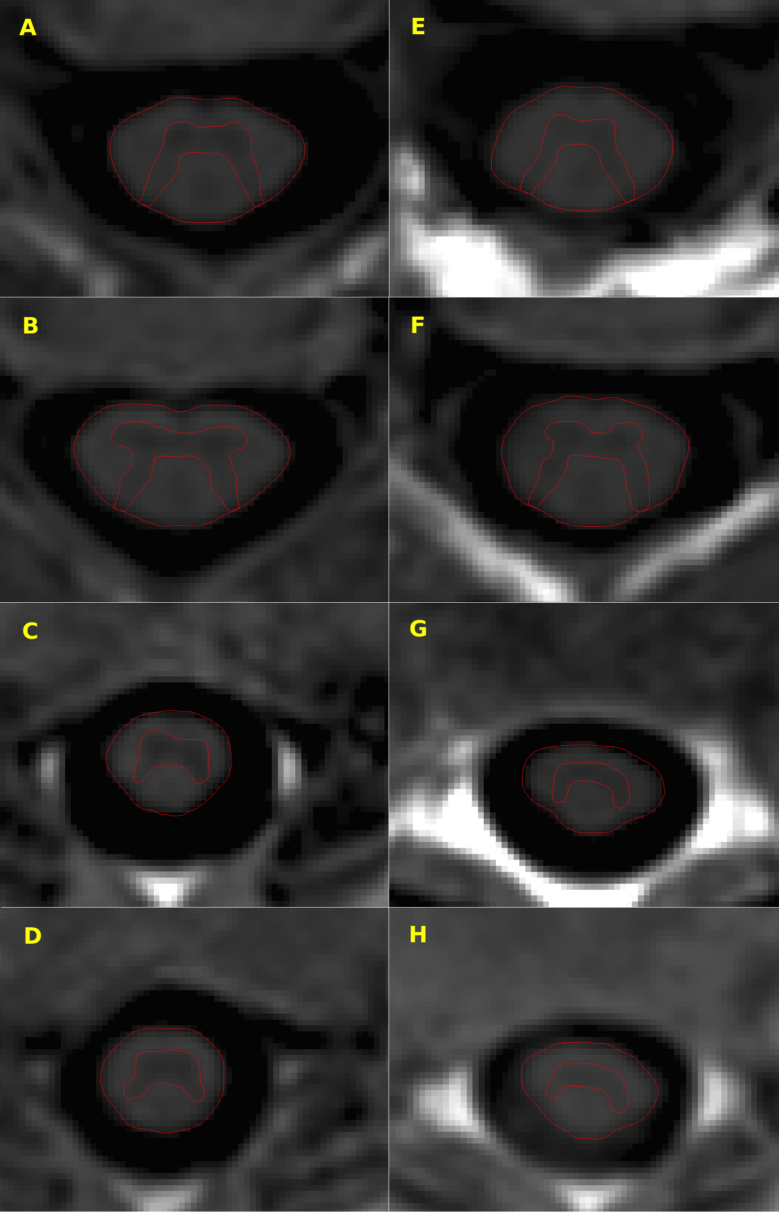
Spinal Cord Gray Matter Atrophy Correlates With MS Disability
RMS
PMS
C2/C3
Spearman rank correlations
Gray matter atrophy of the spinal cord using phase susceptibility inversion
recovery imaging
GM | EDSS | 9HPT | T25W
C2-3 | -.64 | -.41 | -.56
C3-4 | -.63 | -.47 | -.50
T8-9 | -.47 | -.23 | -.37
T9-10 | -.48 | -.13 (NS) | -.54
C3/C4
T8/T9
T9/T10
Schlaeger R, et al. Ann Neurol. 2014;
epub ahead of print.^{[31]}
Schlaeger R, et al. Personal communication.

Slide 41
Are There Biomarkers for Progressive MS?
Increased CSF levels of neurofilament light correlate with the MSSSª
99 MS patients underwent diagnostic LP
Neurofilament light levels measured 14 years later
Neurofilament light levels correlated with MSSS (r = .30, P = .005)
Levels of neurofilament light chain and other CSF markers of inflammation decrease following natalizumab treatment in SPMS^{b}
Uric acid inversely correlates with disability^{c}
r = -.15, P = .001
Proteomic^{d} and metabolomic^{e} methods might be revealing.
a. Salzer J, et al. Mult Scler. 2010;16:287-292^{[32]}; b. Romme Christensen J, et al. Neurology. 2014;82:1499-1507^{[33]}; c. Guerrero AL, et al. Neurol Sci. 2011;32:347-350^{[34]}; d. De Masi R, et al. BMC Neurol. 2013;13:45-52^{[35]}; e. Reinke S, et al. Mult Scler. 2014;1396-1400.^{[36]}

Slide 42
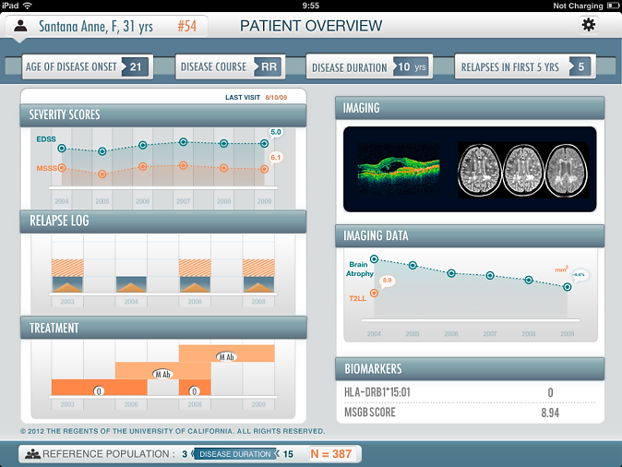
Integrating Clinical, Radiographic, and Biomarker Data to Visualize MS Progression: The MS Bioscreen
Front-end Application
Data Usage
Database
MRI
Databases
Cases Databases
Reference
Databases
Cloud-based
Database Infrastructure
and
Computations Server
Gourraud PA, et al. In press.^{[37]}

Slide 43
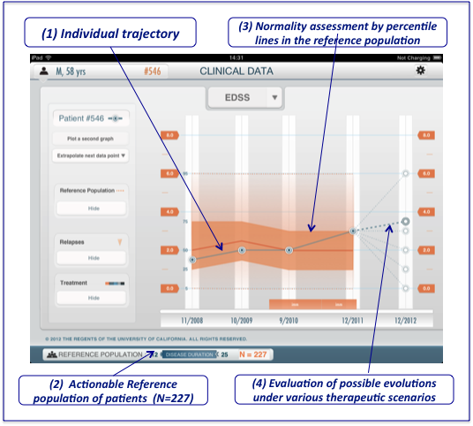
Visualizing Per-subject Data in Context
(1) Individual trajectory
(3) Normality assessment by percentile lines in the reference population
(2) Actionable reference population of patients (N = 227)
(4) Evaluation of possible evolutions under various therapeutic scenarios

Slide 44
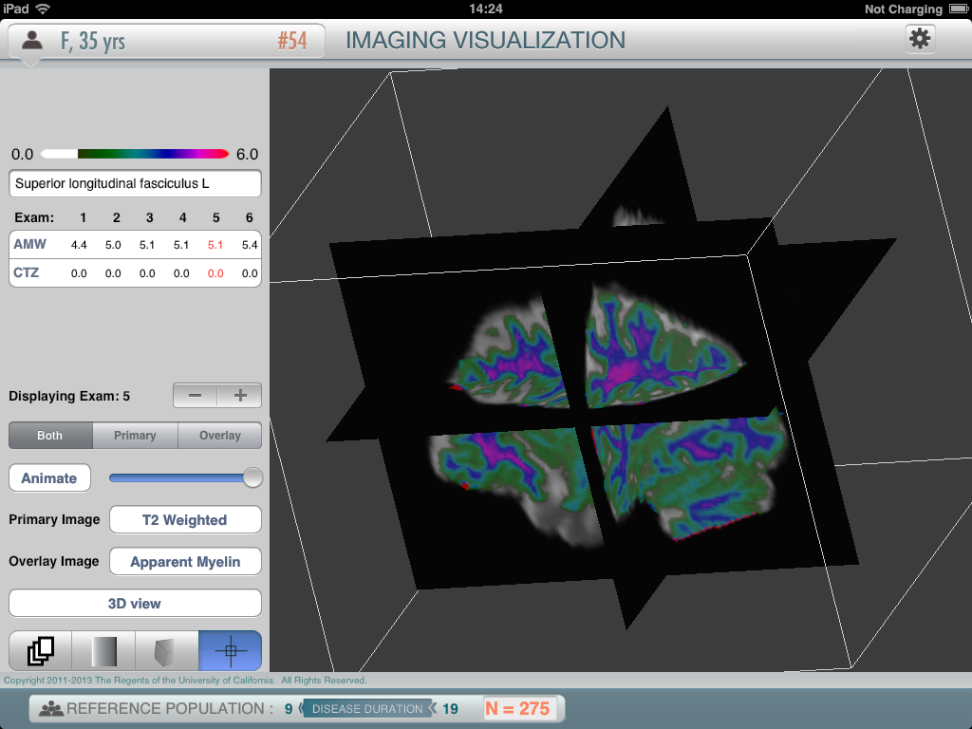
3D Serial MR Brain Imaging

Slide 45
Can an App Help Stop Progressive MS?
Currently, the MS Bioscreen can only be used to contextualize subjects who have undergone systematic serial assessments in a limited cohort of ~ 600 subjects from a single center.
Effort is under way to integrate prospective data from multiple centers.
With sufficient data, there is the potential to understand individual trajectories and to prognosticate.
This could be very useful for understanding the impact of switching treatments and the use of induction therapies, combination treatments, and other clinical strategies that are being considered as ways to mitigate the risk of progressive MS.

Slide 46
Conclusions
For now, change in EDSS remains the primary end point in progressive MS trials.
Combination end points may increase sensitivity to change.
It remains to be seen how regulatory agencies will assess use of combination end points if benefit is found only on the 9HPT.
A sensitive MRI biomarker for progressive MS needs to be developed that can be effectively used in phase 2 pilots to reduce the overall time and size of phase 3 studies.
The molecular mechanisms underlying progressive MS remain unknown…
…So identifying serological or CSF biomarkers of the underlying pathological process has been elusive.

Slide 47
SATELLITE SYMPOSIUM
New Treatment Targets for MS
Gavin Giovannoni, MBBCh, PhD
Barts and the London School of Medicine and Surgery
A live educational event from

Slide 48
Disclosures
Gavin Giovannoni, MBBCh, PhD, has disclosed the following relevant financial relationships:
Served as an advisor or a consultant for:
FivePrime Therapeutics; Genzyme Corporation; GW Pharmaceuticals; Ironwood Pharmaceuticals, Inc.; Merck Serono; Novartis Pharmaceuticals Corporation; Sanofi; Synthon BV; Vertex Pharmaceuticals Incorporated
Served as a steering committee member for:
AbbVie Inc.; Biogen Idec Inc.; Novartis Pharmaceuticals Corporation; Roche; Teva Pharmaceuticals USA

Slide 49
Overview
Treat-2-target: a moving target
NEDA (no evident disease activity)
End-organ damage (the new goal posts)
Early effective treatment prevents end-organ damage
Combination therapies (the next logical thing)
Need for both anti-inflammatory and neuroprotective strategies
Progressive MS
Therapeutic lag
Asynchronous progressive MS hypothesis
Therapeutic pyramid
Acute neuroprotection
Slow-burn neuroprotection
Remyelination strategies
Proof-of-concept studies
The black swan or viral hypothesis

Slide 50
NEDA – No Evident Disease Activity
Treat-2-target
No evidence of disease activity defined as^{a,b}:
× No relapses
× No sustained disability progression
× No MRI activity
× No new or enlarging T2 lesions
× No Gd-enhancing lesions
Gd = gadolinium.
a. Havrdova E, et al. Lancet Neurol. 2009;8:254-260.^{[38]}
b. Giovannoni G, et al. Lancet Neurol. 2011;10:329-337.^{[39]}

Slide 51
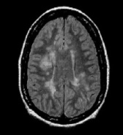
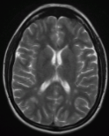
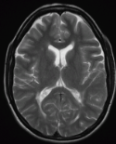
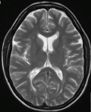
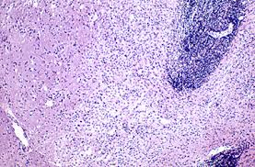
MS Iceberg
Relapses
Brain atrophy
Unreported relapses
Subclinical relapses: focal MRI activity
Focal gray and white matter lesions not detected by MRI
Clinical disease progression
Spinal fluid neurofilament levels
Clinical activity
NEDA
Focal MRI activity
Hidden focal and diffuse MRI activity
END-ORGAN DAMAGE
Microscopic or biochemical pathology

Slide 52
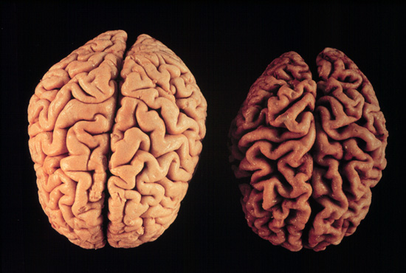
End-organ Damage
Control
MS
Image courtesy of Klaus Schmierer, MBBS, PhD, FRCP.

Slide 53
Brain Atrophy as a Marker of End-organ Damage
Global marker of neuroaxonal loss, or end-organ damage, in MS^{a,b}
Occurs in all clinical stages of MS at a rate of 0.5% to 1.0%/year vs 0.1% to 0.3%/year in healthy subjects^{a-c}
Generally measured on 2D/3D T1-weighted images and analyzed using:
Cross-sectional methods (eg, BPF, SIENAx, VBM)^{b}
Longitudinal methods (eg, SIENA)^{b}
Measures of global brain atrophy are robust, sensitive, and relatively easy to standardize^{b}
Brain atrophy correlates with cognitive and other disability outcomes
Month 0
Month 18
BPF = brain parenchymal fraction; SIENA = structural image evaluation, using normalization, of atrophy; VBM = voxel-based morphometry.
a. Filippi M, Agosta F. J Magn Reson Imaging. 2010;31:770-788^{[40]}; b. Giorgio A, et al. Neuroimaging Clin N Am. 2008;18:675–686^{[41]}; c. De Stefano N, et al. Neurology. 2010;74:1868-1876.^{[42]}

Slide 54
Treatment Effect on Disability Is Predicted by Effect on T2 Lesion Load and Brain Atrophy
Meta-analysis of treatment effect on EDSS worsening (y) vs effects on MRI lesions and brain atrophy, individually or combined, in 13 placebo-controlled RRMS trials (13,500 patients)
EDSS
Focal inflammation
T2
Neurodegeneration
BVL
M0
M12
M24
T2 ~ EDSS R² = 0.61, P < .001
Atrophy ~ EDSS R² = 0.48, P < .001
T2 + atrophy ~ EDSS R² = 0.75, P < .001
BVL = brain volume loss.
Sormani MP, et al. Ann Neurol. 2014;75:43-49.^{[43]}

Slide 55
NEDA – No Evident Disease Activity
Treat-2-target
No evidence of disease activity defined as^{a,b}:
× No relapses
× No sustained disability progression
× No MRI activity
× No new or enlarging T2 lesions
× No Gd-enhancing lesions
✓ Normalization of brain atrophy rates on MRI
a. Havrdova E, et al. Lancet Neurol. 2009;8:254-260.^{[38]}
b. Giovannoni G, et al. Lancet Neurol. 2011;10:329-337.^{[39]}

Slide 56
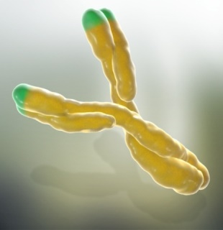
Window of Therapeutic Efficacy
RIS
CIS
RRMS
R-SPMS
SPMS
Inflammation
Subclinical
disease
Neuroaxonal loss
Disease Severity
First clinical attack
Brain volume loss
Relapses
First MRI lesion
MRI Events
Time, y
RRMS
R-SPMS
?
×
Placebo
~¼
Alemtuzumab
RIS = radiologically isolated syndrome; CIS = clinically isolated syndrome; RRMS = relapsing-remitting MS; R-SPMS = relapsing secondary progressive MS; SPMS = secondary progressive MS; PPMS = primary progressive MS.
Coles AJ, et al. J Neurol. 2006;253:98-108.^{[44]}

Slide 57
Therapeutic Lag
Progression from inflammation in years -2 and -1
Delayed effect on disability progression from IFNβ treatment in years +1 and +2
Progression from inflammation in years +1 and +2
Note: PPMSers treated with IFNβ in years +1 and +2 do better in years +3 and +4 due to delayed effect of suppressing inflammation
Progression from inflammation in years +3
Note: Slopes are parallel because IFNβ was stopped after year +2
EDSS / MSFC / Cognition / Brain Atrophy
Year -2
Year -1
Year +1
Year +2
Year +3
Year +4
Year +5
No treatment
IFNβ-1b
No treatment
Placebo
Tur C, et al. Arch Neurol. 2011;68:1421-1427.^{[45]}

Slide 58
The Asynchronous Progressive MS Hypothesis
Diagnosis of Progressive MS
Therapeutic window 1
Bladder
Therapeutic window 2
Motor system to legs
Therapeutic window 3
Cerebellar or balance systems
Therapeutic window 4
Sensory
Therapeutic window 5
Upper limbs
Therapeutic window 6
Cognition
Therapeutic window 7
Vision
Therapeutic window 8, etc….
Etc
Effective disease-modifying therapies could still target the remaining windows of therapeutic opportunity for individual neurological systems

Slide 59
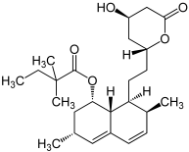
Simvastatin Effects on Rate of Brain Atrophy
EDSS
BVL
M0
M12
M24
MSIS = Multiple Sclerosis Impact Scale.
QoL - MSIS & MSIS - physical, P < .05
Chataway J, et al. Lancet. 2014;383:2213-2221.^{[30]}

Slide 60
Therapeutic Hierarchy
Therapeutic Pyramid
Neurorestoration
Remyelination
Anti-inflammatory
Neuroprotection
Smoking
Exercise
Diet
Sleep
Comorbidities
Infections
Concomitant medications
Brain Health Initiative
Antiaging

Slide 61
MS Dogma
✗
“Autoimmune endophenotype”
T2 and T1 lesions
Gd enhancement
Immune activation innate and adaptive responses
✗
Blood-brain barrier breakdown
Focal inflammation
Clinical attack
Clinical recovery
✗
Axonal plasticity and remyelination
Oligodendrocyte toxicity and demyelination
Acute axonal transection and loss
✗
✗
Biology
Release of soluble markers
✗
Delayed neuroaxonal loss and gliosis
✗
Clinical outcomes
Biomarkers
Brain and spinal cord atrophy
Disease progression
Banwell B, et al. Mult Scler Relat Disord. 2013;2:153.^{[46]}

Slide 62
Acute Neuroprotection: “The Inflammatory Penumbra”
CFMA Induces Neuroprotection in Experimental Autoimmune Encephalitis
Period of Daily Treatment
Hindlimb
No Immunosuppression Evident
Vehicle
CFMA D33-D4
4.0
Paralysis
3.5
3.0
Hindlimb
Paresis
2.5
Mean Neurological Score ± SEM
ROTAROD ACTIVITY
2.0
Impaired
300
Right
Measure of Motor Coordination
***
Reflex
250
1.5
200
Neuroprotection
Tail
150
Neuroprotection
1.0
Paralysis
Time of on Accelerating RotaRod (s)
100
0.5
50
Tail Paresis
0
0.0
Pre-Treatment (Day 27)
Post- Relapse (Day 48)
32
33
34
35
36
37
38
39
40
41
42
43
44
45
46
47
48
Therapeutic
window
for drug onset
Time Post-disease Induction, d
Phenytoin: Acute optic neuritis
ClinicalTrials.gov ID: NCT01451593
Courtesy of David Baker and Gavin Giovannoni.

Slide 63
Slow-burn Neuroprotection: Protective Role of Oxcarbazepine in MS Study (PROXIMUS)
An exploratory phase IIa study to evaluate Drug X as a neuroprotective strategy in secondary progressive MS
Secondary Progressive MS
Clinically definitive MS
EDSS 5.5 or less
On a standard DMT
Informed consent
MRI, bloodwork etc.
LP and CSF analysis
IMAGE IS NO LONGER AVAILABLE
Raised CSF NFL
>775 ng/mL
No
Exclusion
Yes
Randomization
Placebo vs. low dose Drug X vs. high dose Drug X
Primary outcome at 24 weeks
Reduction in CSF NF levels to within 30% of normal (< 450 ng/L)
Secondary outcomes at 48 weeks
MRI atrophy
Clinical
Safety profile
Estimated power calculations:
Two-tailed
Power 84%
Alpha 5%
N = 27 subjects per arm
Oxcarbazepine: SPMS (PROXIMUS Study)
ClinicalTrials.gov ID: NCT02104661
Reproduced from Petzold A, et al. J Neurol Neurosurg Psychiatry. 2005;76:206-211^{[47]} with permission from BMJ Publishing Group Ltd.

Slide 64
Phase 2A Study of Natalizumab in Progressive MS
CSF markers of axonal damage and demyelination (secondary end point)
P = .03
P = .048
CSF Neurofilament Light Chain, ng/L
CSF Myelin Basic Protein ng/mL
NIND Mean ± 95% CI
NIND Mean ± 95% CI
Natalizumab → SPMS ASCEND Study)
ClinicalTrials.gov ID: NCT01416181
Slide courtesy of Romme Christensen, ECTRIMS 2012. Oral presentation 170.^{[48]} Used with permission.

Slide 65
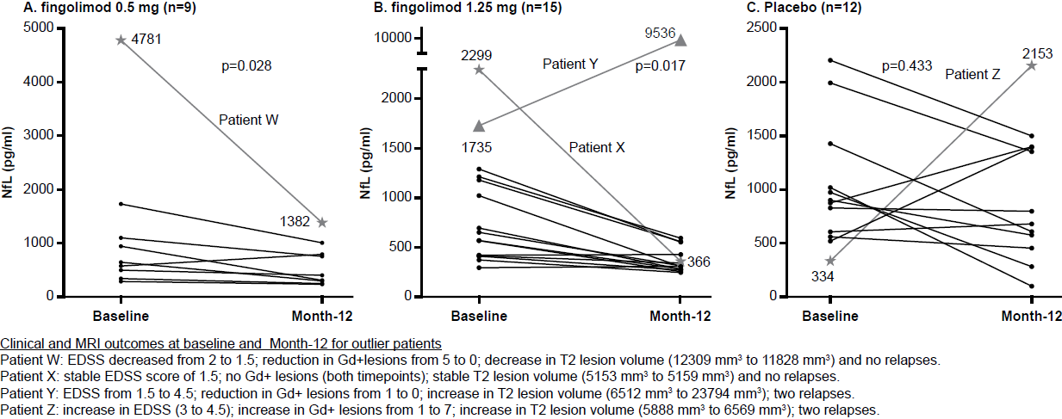
Fingolimod and CSF Neurofilament Light Chain Levels in RRMS
P = .028
P = .433
1735
Fingolimod → PPMS (INFORMS Study)
ClinicalTrials.gov ID: NCT00731692
Siponimod → SPMS (EXPAND Study)
ClinicalTrials.gov ID: NCT01665144
Kuhle J, et al. In press.^{[49]}

Slide 66
Rituximab in Progressive MS
EDSS
BVL
W0/W2
W24/W26
W48/W50
W72/W74
W96
W122
Anti-CD20
Natalizumab
Alemtuzumab
Fingolimod
Mitoxantrone
BMT
Cladribine
 | n | HR | 95% CI | P value
Overall | 439 | 0.77 | 0.55-1.09 | .1442
Subgroups
Age ≥ 51 / Gd lesion = 0 | 187 | 1.27 | 0.71-2.27 | .4256
Age ≥ 51 / Gd lesion ≥ 1 | 37 | 0.52 | 0.18-1.52 | .2243
Age < 51 / Gd lesion = 0 | 143 | 0.63 | 0.34-1.18 | .1427
Age < 51 / Gd lesion ≥ 1 | 72 | 0.33 | 0.14-0.79 | .0088
Ocrelizumab → PPMS (ORATORIO Study)
ClinicalTrials.gov ID: NCT01194570
Hawker, et al. Ann Neurol. 2009;66:460-471.^{[50]}

Slide 67
Innate Immunity: Microglia and Astrocytes
“Autoimmune endophenotype”
T2 and T1 lesions
Immune activation innate and adaptive responses
Gd enhancement
Blood-brain barrier breakdown
Focal inflammation
Clinical attack
Clinical recovery
Axonal plasticity & remyelination
Oligodendrocyte toxicity and demyelination
Acute axonal transection and loss
Ibudilastª
Laquinimod^{b}
✗
Biology
Clinical outcomes
Biomarkers
Release of soluble markers
✗
Delayed neuroaxonal loss and gliosis
✗
Brain and spinal cord atrophy
Disease progression
Ibudilast → Progressive MS (SPMS or PPMS)
ClinicalTrials.gov ID: NCT01982942
Laquinimod → PPMS (ARPEGGIO Study)
a. Barkhof F, et al. Neurology. 2010;74:1033-1040.^{[51]}
b. Filippi M, et al. J Neurol Neurosurg Psychiatry. 2014;85:851-858.^{[52]}

Slide 68
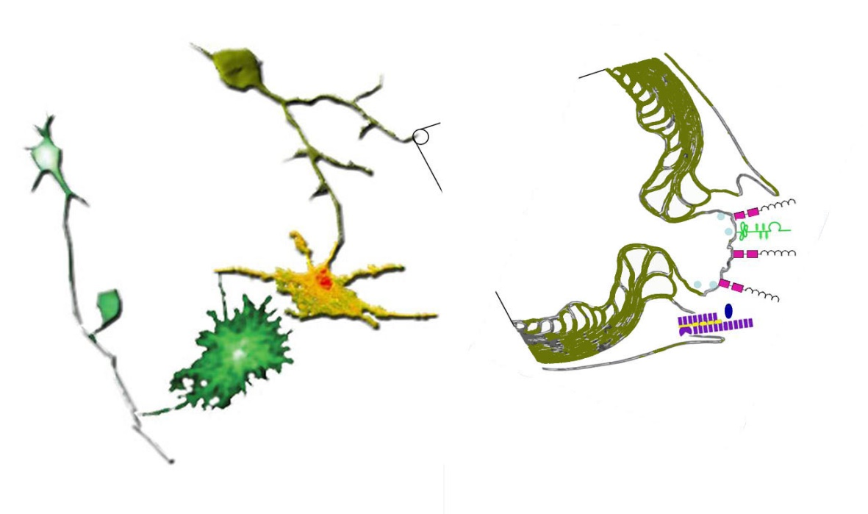
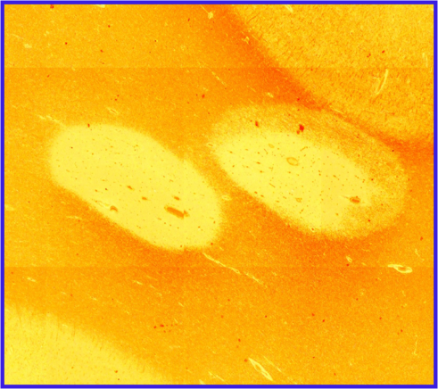
Remyelination
a.
Nogo, MAG, OMgP
Lingo-1-NgR-p75^{NTR}
GAP-43
NCAM
Neuregulin
Agents in trial:
Benztropine: anticholinergic
BIIB033: anti-LINGO-1
Clemastine: antihistamine
GSK239512: histamine H(3) receptor antagonist
IRX4204 and Bexarotene: RXR-agonist
rHIgM22: oligodendrocyte target
VX15: anti-SEMA4D
c. Visual evoked potentials
b.
VEPs
P100 = 144 msec
Left eye
P100 = 111 msec
Right eye
An intraocular conduction delay of 33 msec is indicative of demyelination
a. Courtesy of Sharmilee Gnanapavan, MBBS, BmedSci, PhD. b. Courtesy of Klaus Schmierer, MBBS, PhD, FRCP. c. Courtesy of Gavin Giovannoni, MBBCh, PhD

Slide 69
Trial Activity Targeting Progressive Pathology
PPMS
RIS
CIS
RRMS
R-SPMS
SPMS
Inflammation
Neuroaxonal loss
Subclinical
disease
Disease Severity
Brain volume loss
First clinical attack
Relapses
First MRI lesion
MRI Events
Time (Years)
PPMS: fingolimod, ocrelizumab, laquinimod
SPMS and PPMS: ibudilast
SPMS: natalizumab, siponimod, DMF
CIS: PHENYTOIN
RRMS: ? DE-FLAMES Study
Early SPMS:
oxcarbazepine
Late SPMS: SMART Study
fluoxetine, amiloride, riluzole

Slide 70
Conclusions
Treat-2-target: a moving target
NEDA (no evident disease activity)
End-organ damage (the new goal posts)
Early effective treatment prevents end-organ damage
Combination therapies (the next logical thing)
Need for both anti-inflammatory and neuroprotective strategies
Progressive MS
Therapeutic lag
Asynchronous progressive MS hypothesis
Therapeutic pyramid
Acute neuroprotection
Slow-burn neuroprotection
Remyelination strategies
Proof-of-concept studies
Viral hypothesis
The black swan
EBV and HERVs

Slide 71
SATELLITE SYMPOSIUM
Q & A
A live educational event from

Slide 72
Q&A Summary
For progressive MS, we need therapies that address remyelination, CNS inflammatory process, and axonal loss
Laquinimod, fingolimod, dimethyl fumarate cross the blood brain barrier to target CNS inflammation
Trials of potential remyelinating drugs are underway
Benefit of statins likely related to effects on age-related comorbid conditions; no phase 3 trials ongoing at present; the MS community probably should conduct such a trial
Progressive MS is driven by both inflammation and neurodegeneration. For progressive MS, the ideal is to target inflammation and demyelination in tandem
For progressive MS, brain volume, spinal cord atrophy may be more useful markers of disability progression/burden of disease and treatment efficacy than T2 lesion volume, but we need more data

Slide 73
Thank You for Participating
You may now revisit those questions presented at the beginning of the activity to see what you’ve learned by clicking on the Earn CME Credit link. The CME posttest will follow. Please also take a moment to complete the program evaluation at the end.

