Slide 2
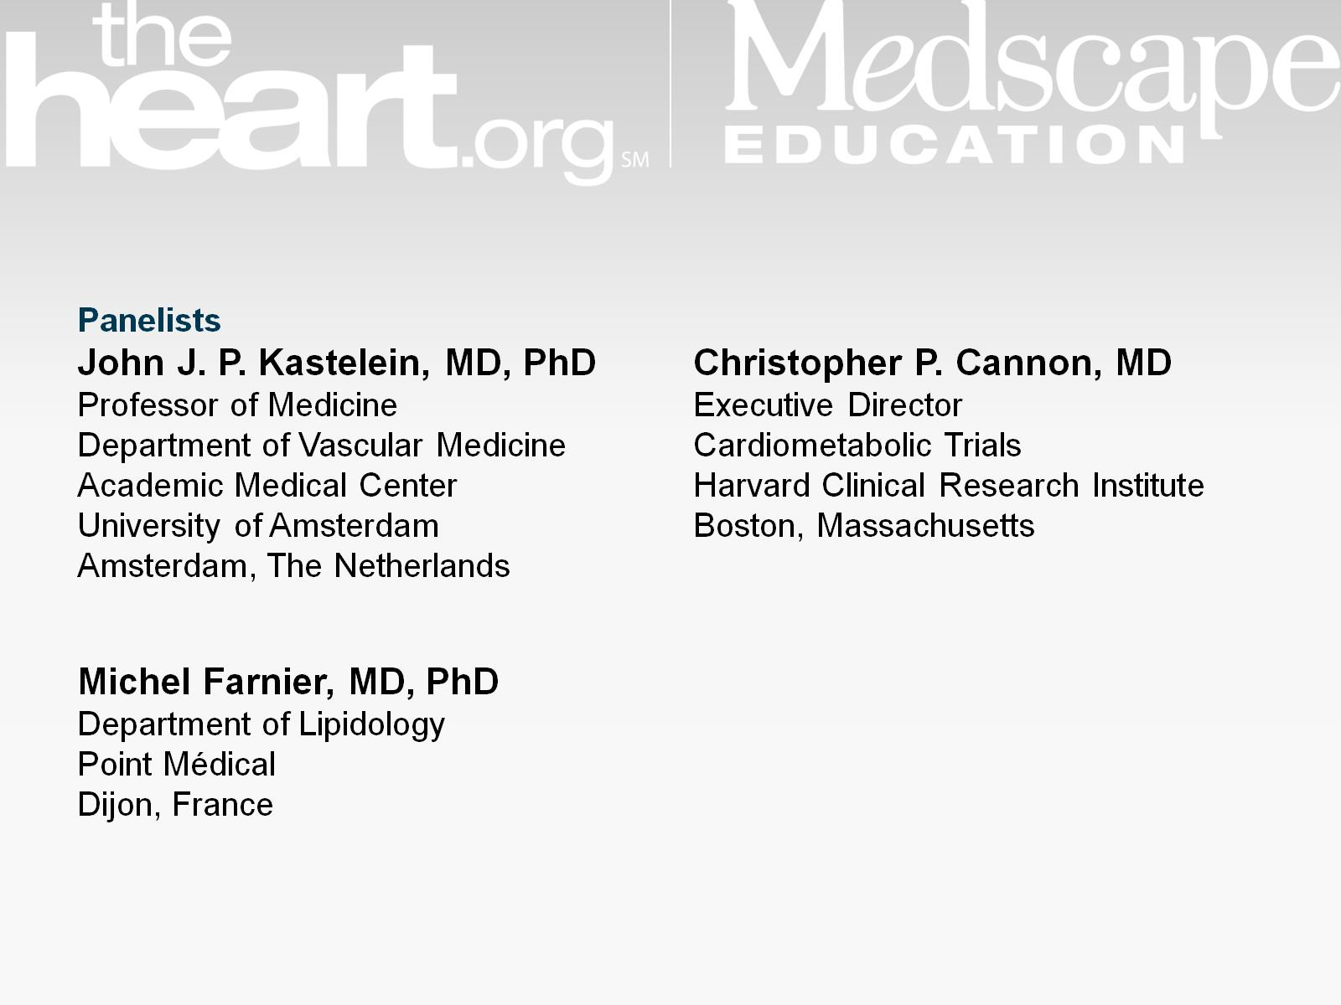

Slide 3
Current Dyslipidemia Management Guidelines

Slide 4
Residual Risk

Slide 5
PCSK9 and Hypercholesterolemia

Slide 6
PCSK9 Inhibitors Monoclonal Antibodies

Slide 7
Dramatic LDL-C Lowering Who Will Benefit Most?

Slide 8
Alirocumab Trials ODYSSEY FH I and FH II Studies

Slide 9
FH I and FH II Baseline Characteristics

Slide 10
FH I and FH II Results at W24

Slide 11
FH I and FH II Results Over 52 Weeks

Slide 12
FH I and FH II Percentage Reaching LDL-C Goals at W24

Slide 13
Looking Ahead

Slide 14
ODYSSEY Combo II Study

Slide 15
Combo II Baseline Characteristics

Slide 16
Combo II Results Over 52 Weeks

Slide 17
FH I, FH II, Combo II AEs Occurring in ≥ 5% of Patients

Slide 18
Take-home Messages From FH I/II and Combo II

Slide 19
ODYSSEY Long-term Study Design

Slide 20
ODYSSEY Long-term Study AE

Slide 21
ODYSSEY Long-term Study TEAEs

Slide 22
ODYSSEY Long-term Study LDL-C Reduction

Slide 23
ODYSSEY Long-term Study CV Death

Slide 24
Trials of Other PCSK9 Inhibitors

Slide 25
Ongoing Trials of PCSK-9 Inhibitors CV Outcomes

Slide 26
PCSK-9 Inhibitors The Path to Clinical Practice

Slide 27
Abbreviations

Slide 28
Abbreviations (cont)

Slide 29
Abbreviations (cont)

Slide 30
Abbreviations (cont)

Slide 31
References

Slide 32
References (cont)

Slide 33
References (cont)

Slide 34
References (cont)

Slide 35
References (cont)

Slide 36
References (cont)

Slide 37
References (cont)

