Slide 1
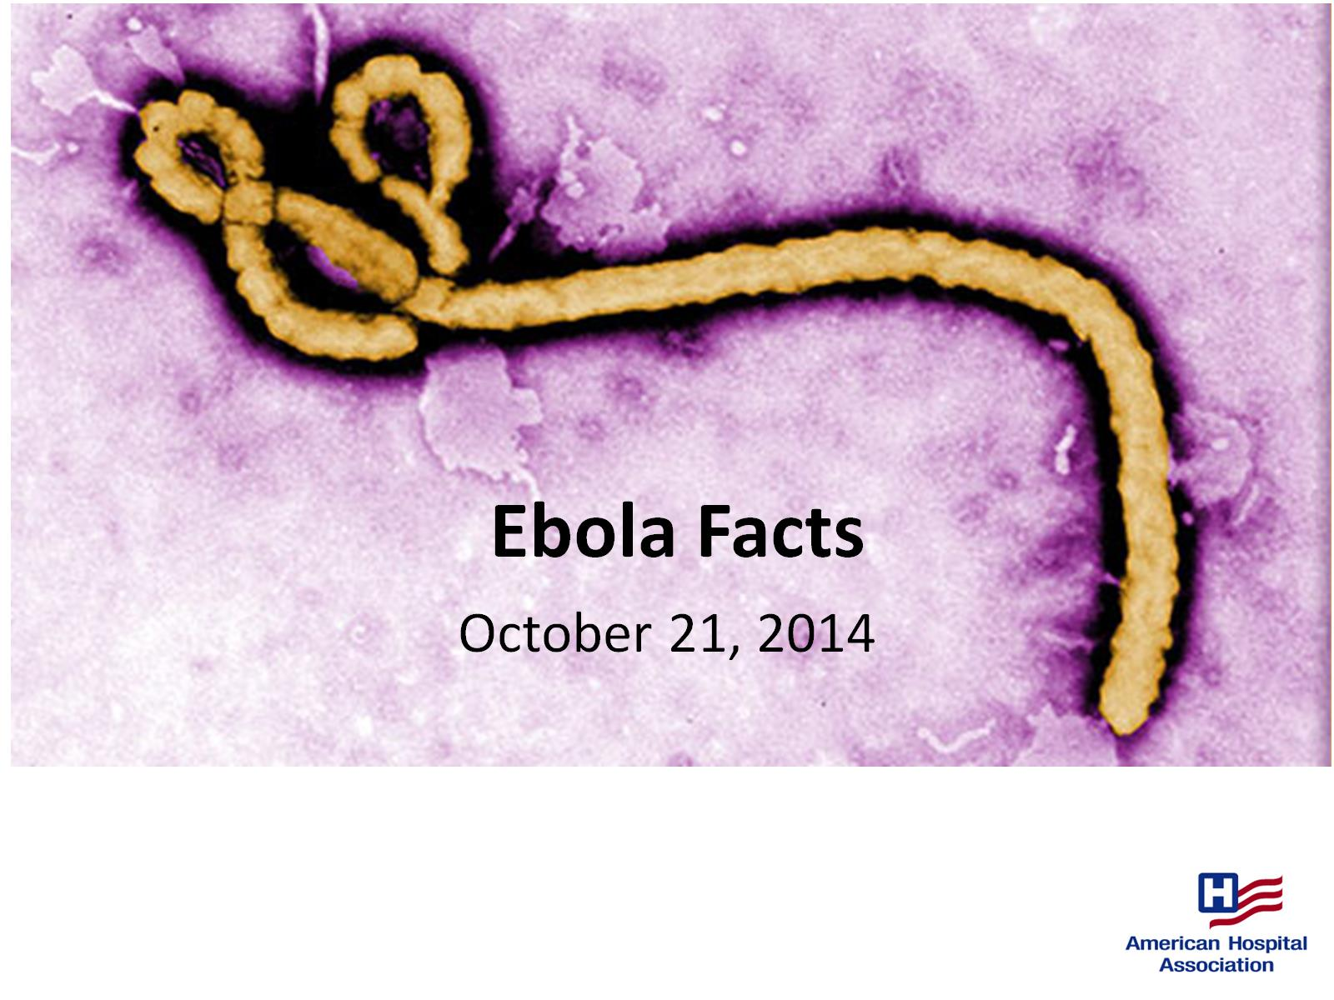
Ebola Facts

Slide 2
Symptoms of Ebola

Slide 3
Diagnosis of Ebola

Slide 5
Treatment of Ebola

Slide 6
Revised Guidance on PPE for Healthcare Workers

Slide 7
Recommended Administrative and Environmental Controls for Healthcare Facilities

Slide 8
Recommended Administrative and Environmental Controls for Healthcare Facilities (cont)

Slide 9
Recommended PPE

Slide 11
External (Non-CDC) Resources on PPE

Slide 12
References

