Slide 1
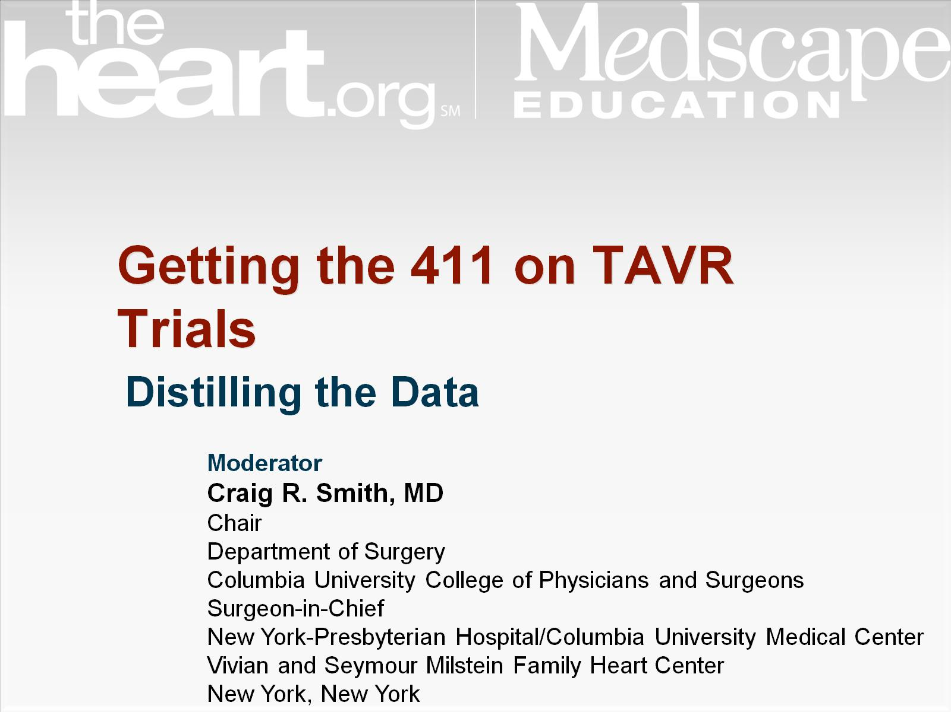
Getting the 411 on TAVR Trials

Slide 2


Slide 3
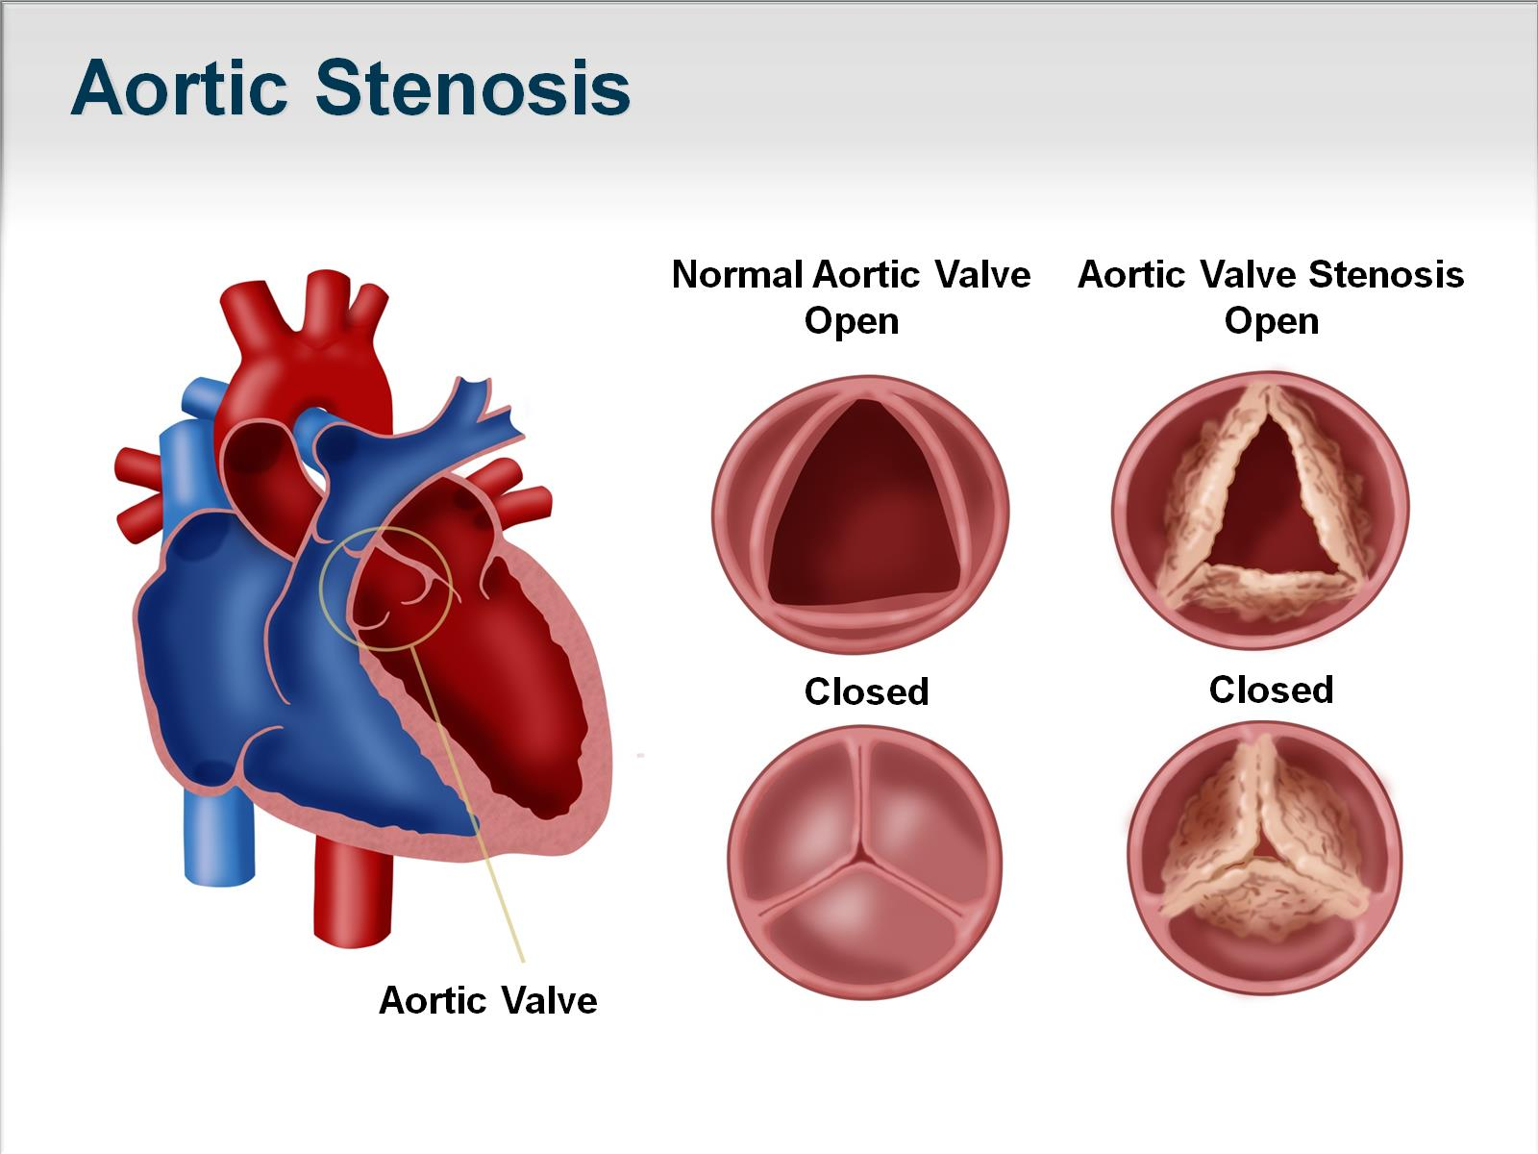
Aortic Stenosis

Slide 4
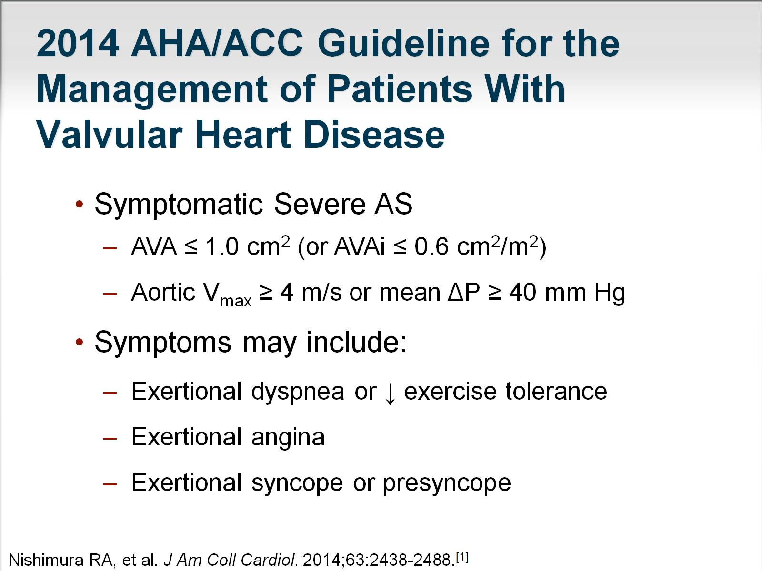
2014 AHA/ACC Guideline for the Management of Patients With Valvular Heart Disease

Slide 5
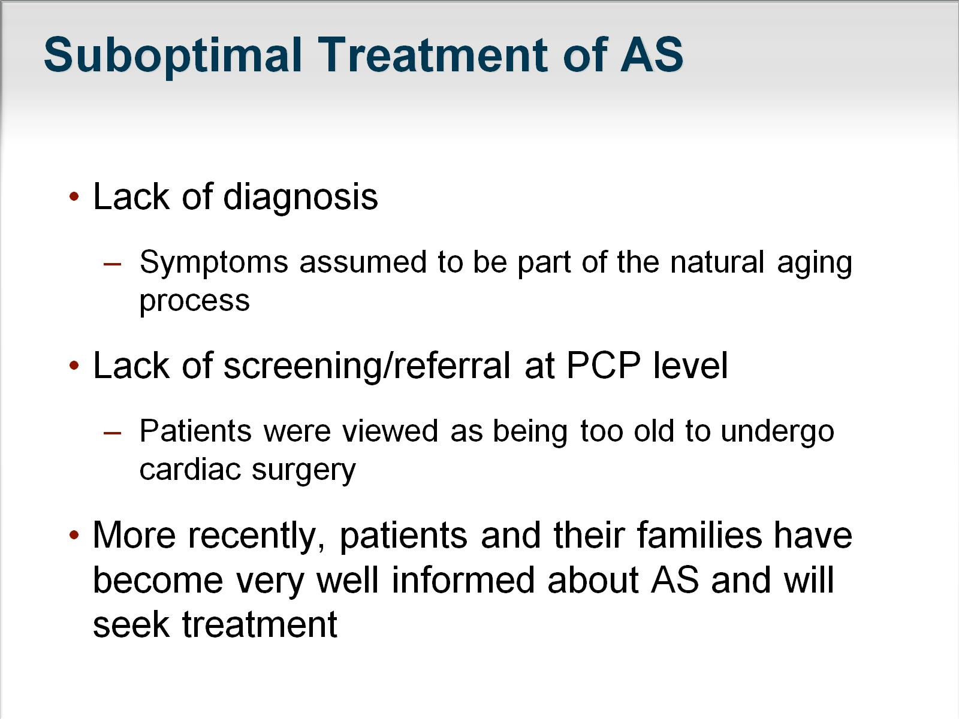
Suboptimal Treatment of AS

Slide 6
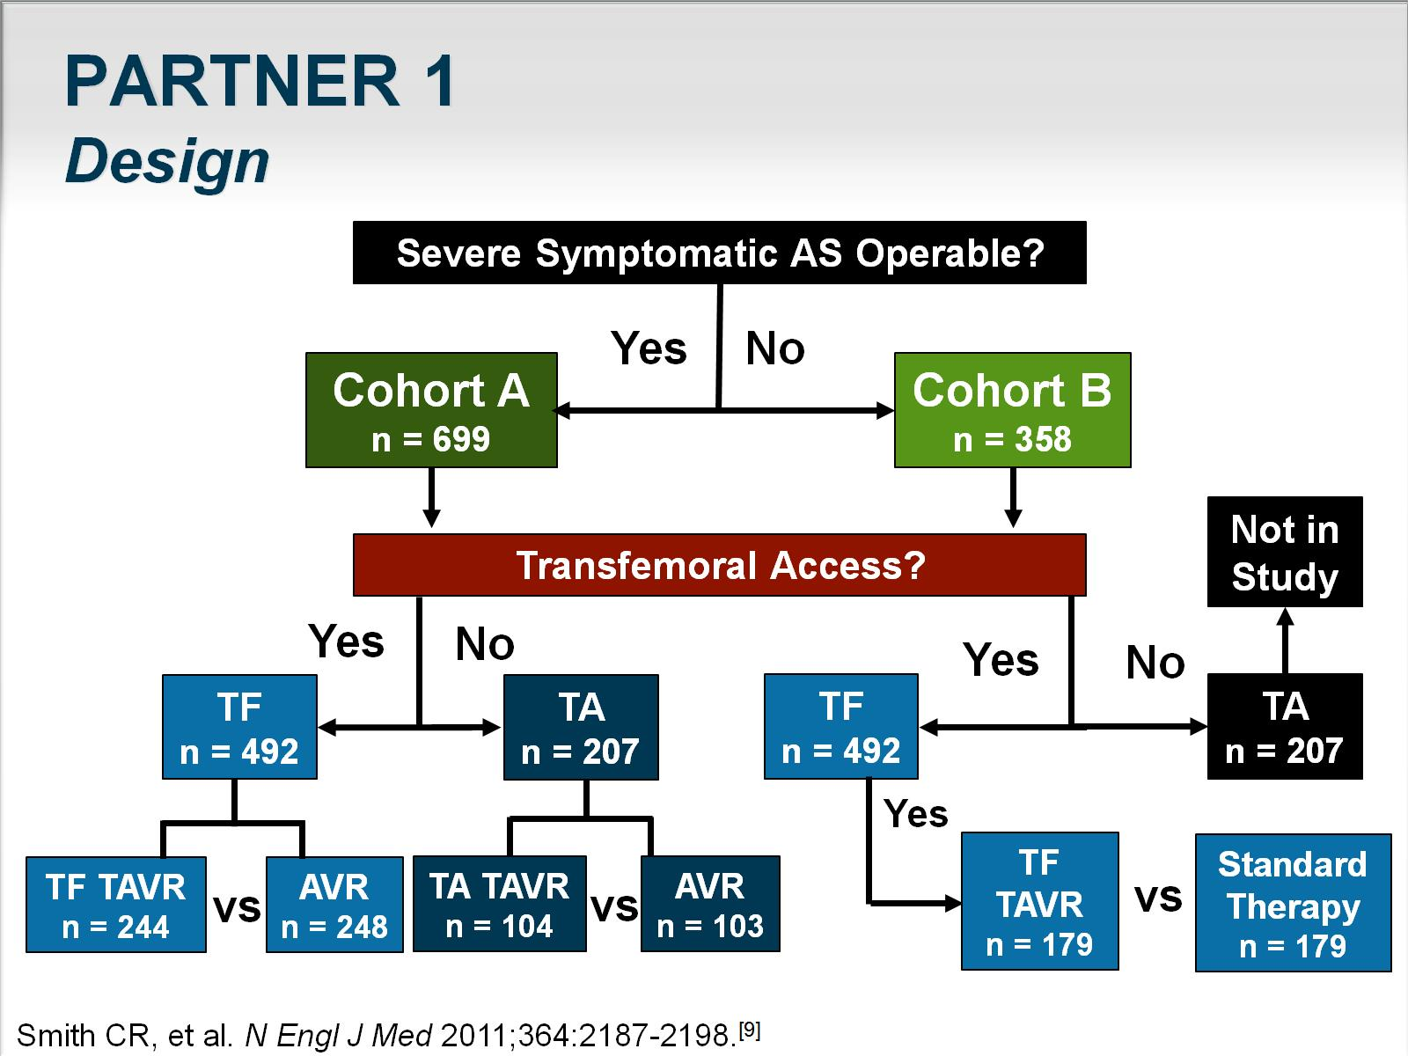
PARTNER 1
Design

Slide 7
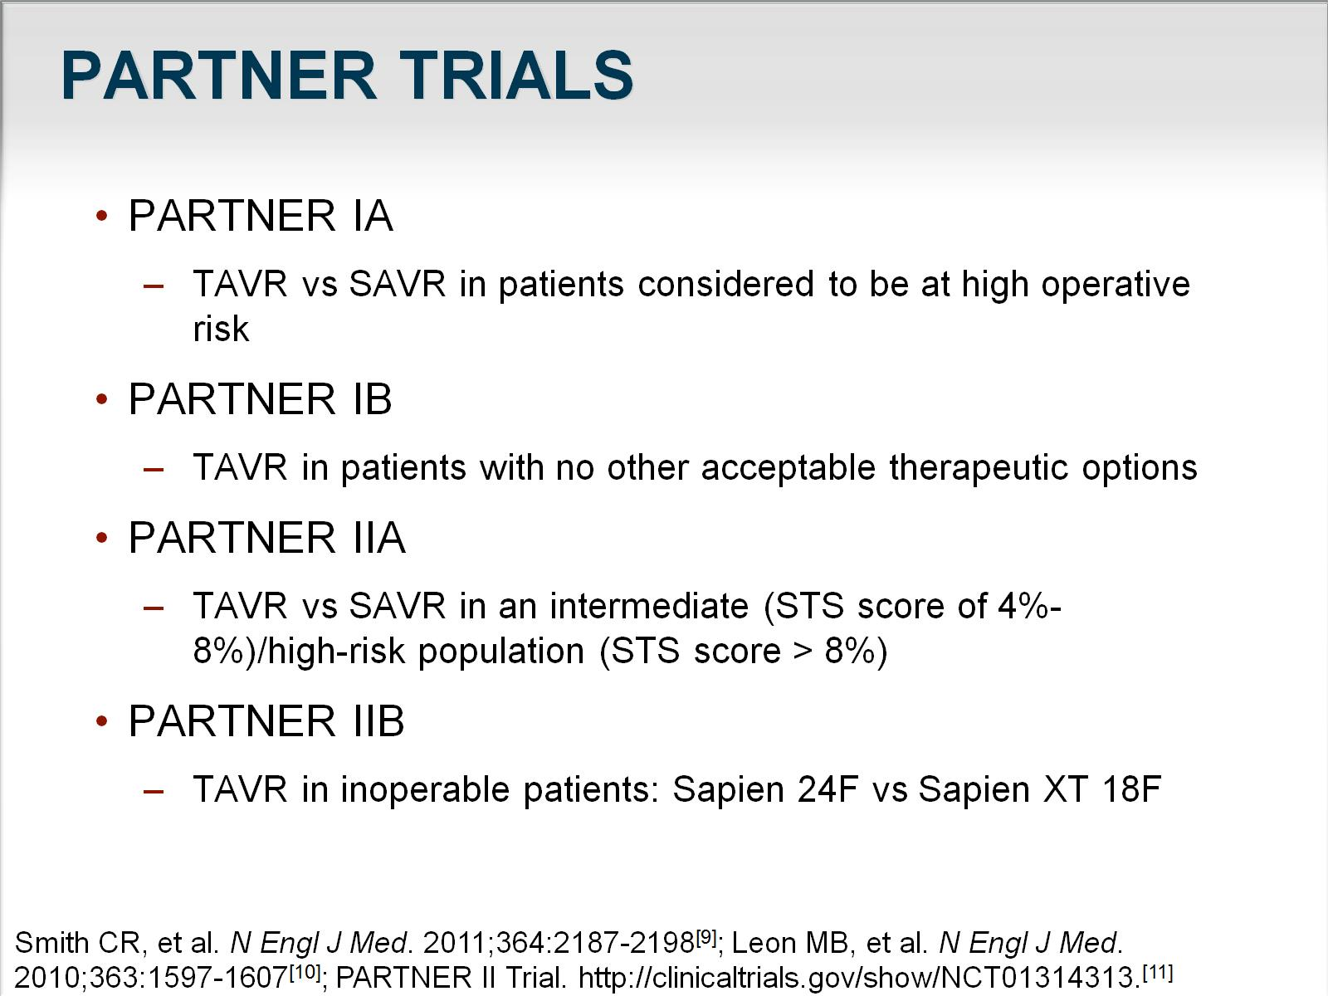
PARTNER TRIALS

Slide 8
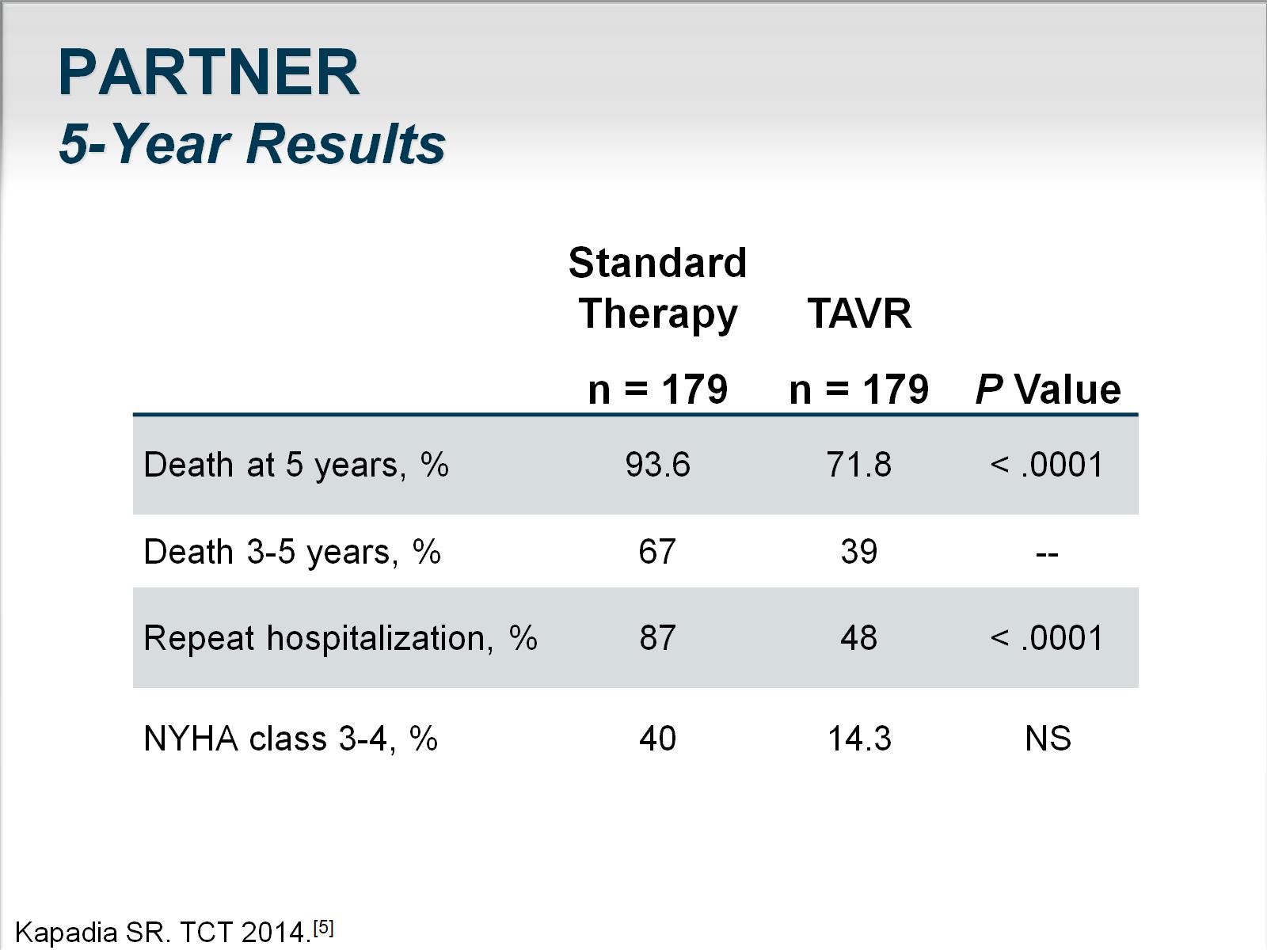
PARTNER
5-Year Results

Slide 9
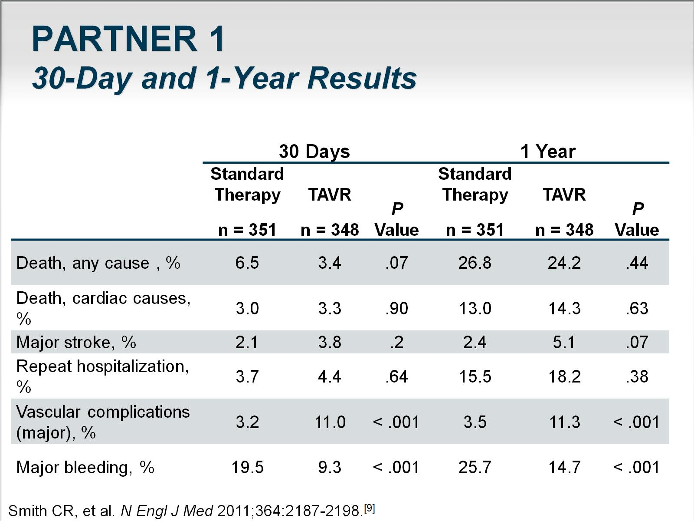
PARTNER 1
30-Day and 1-Year Results

Slide 10
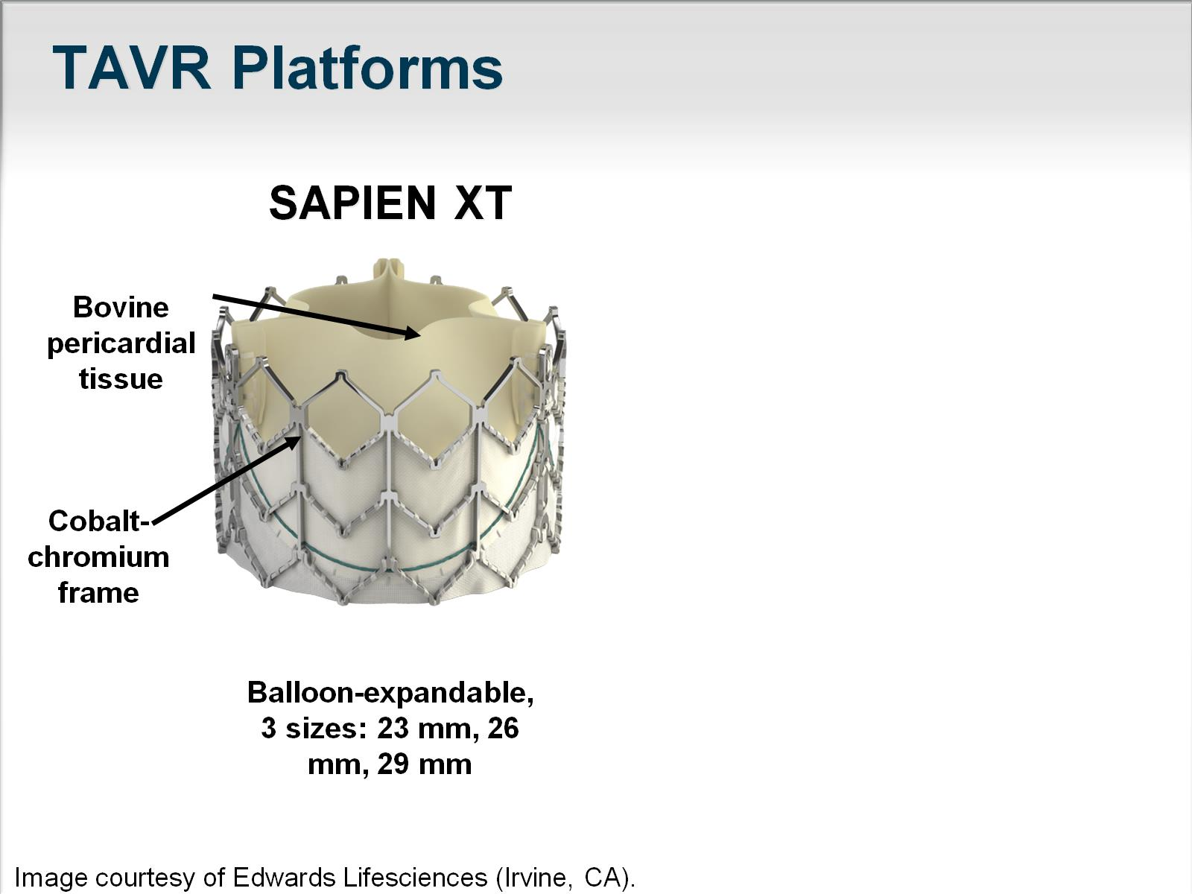
TAVR Platforms

Slide 11
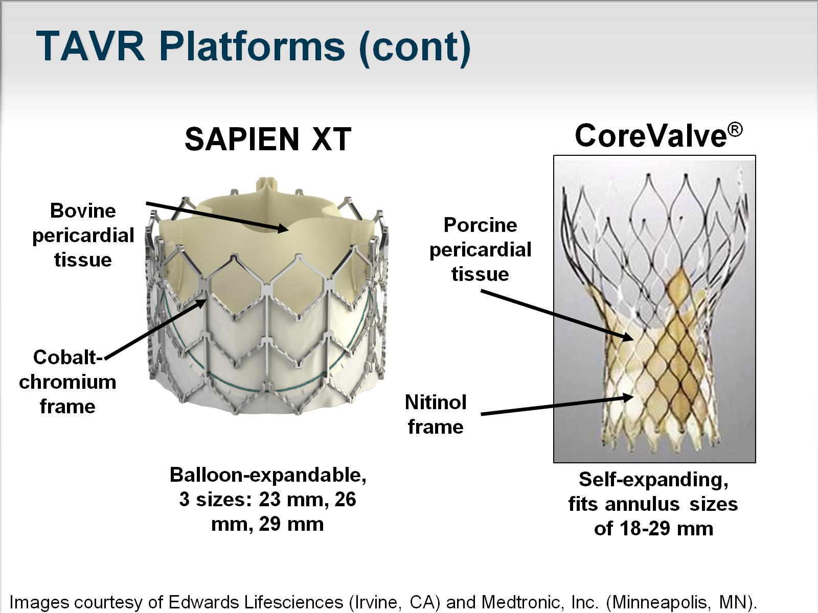

Slide 12
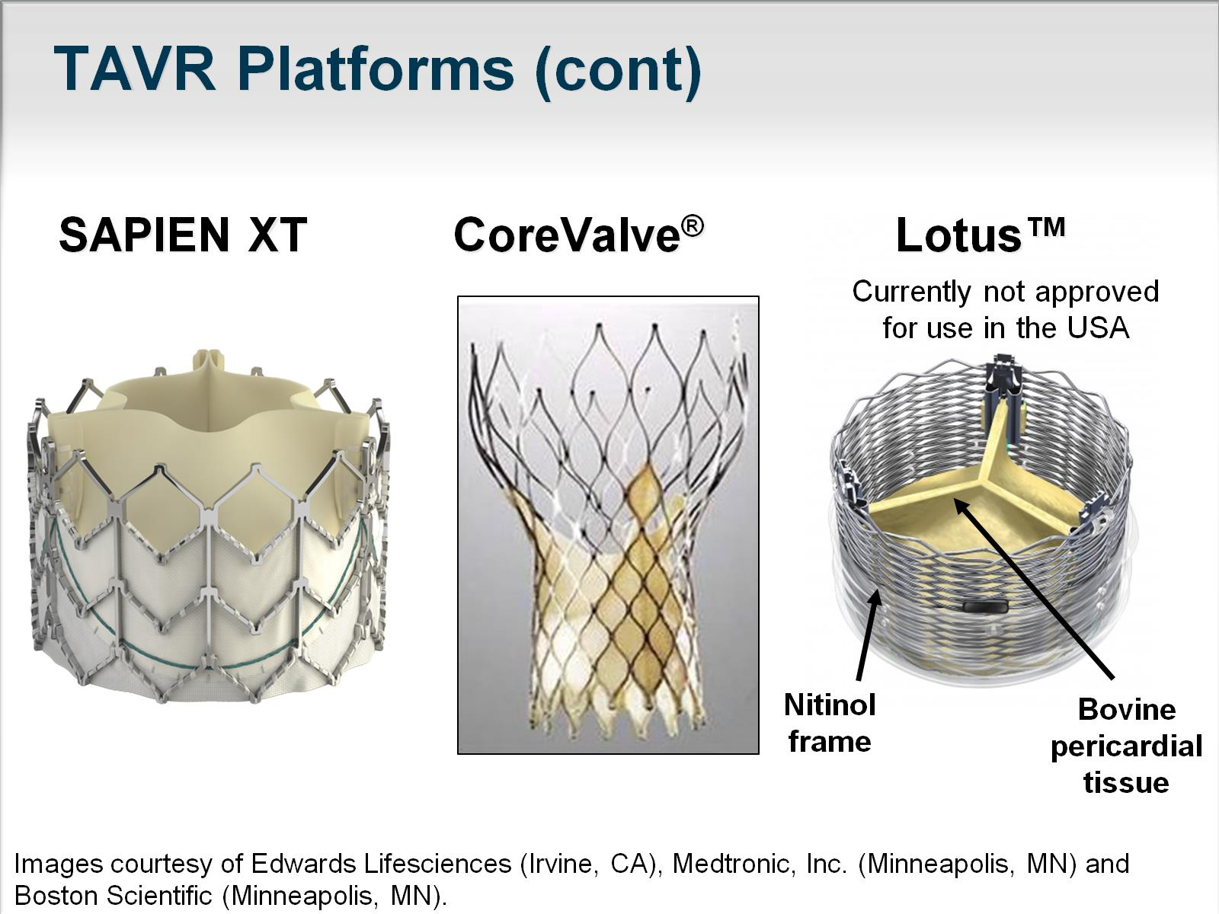
SAPIEN XT CoreValve® Lotus™

Slide 13
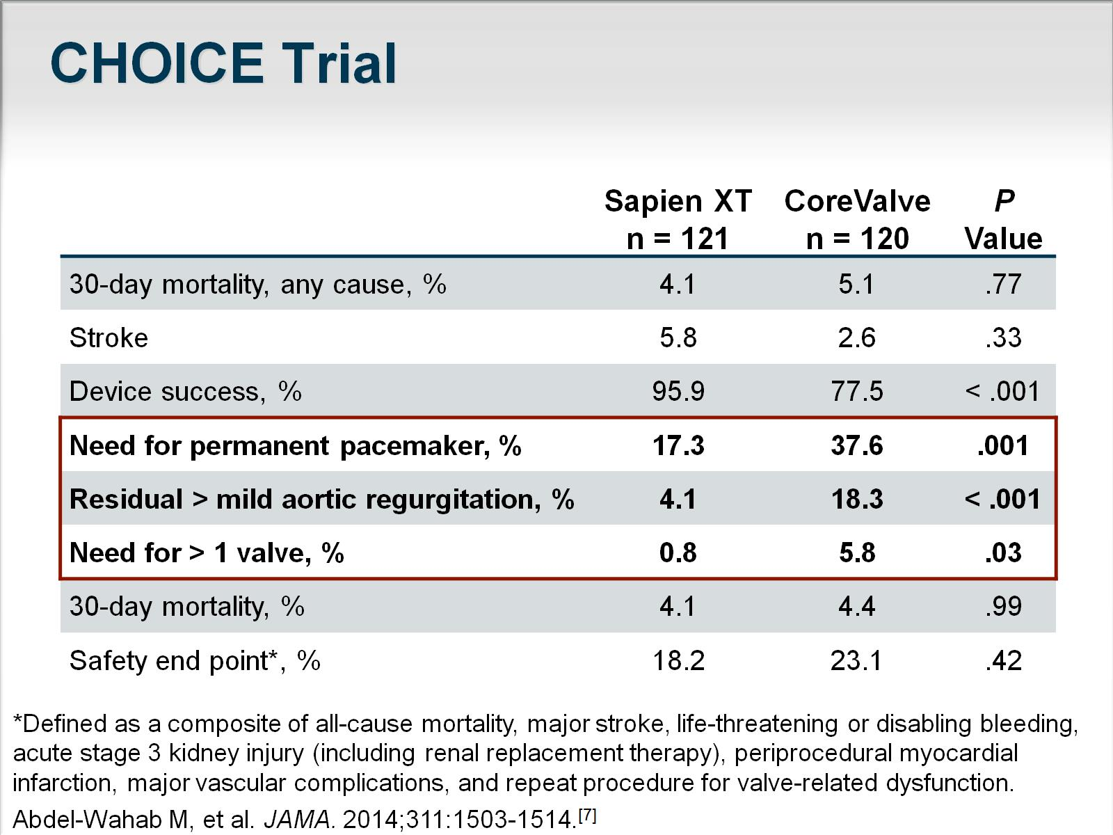
CHOICE Trial

Slide 14
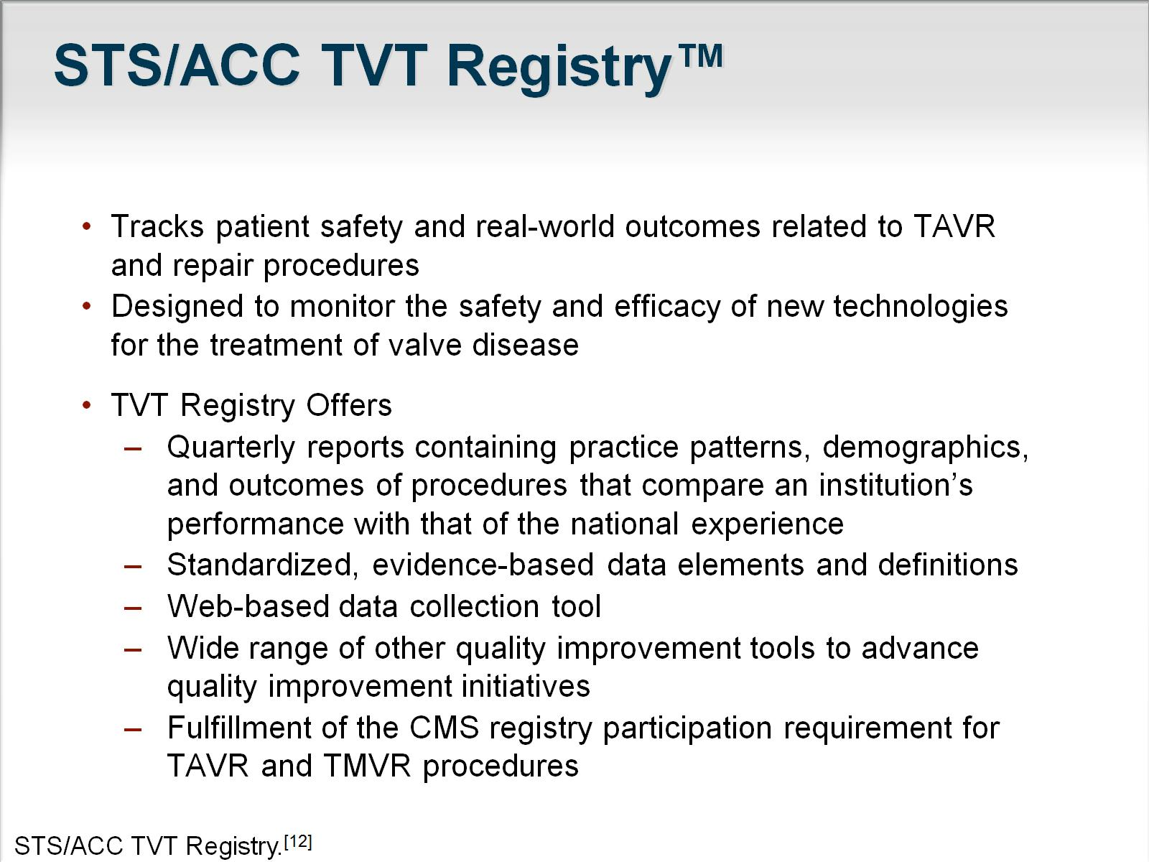
STS/ACC TVT Registry™

Slide 15
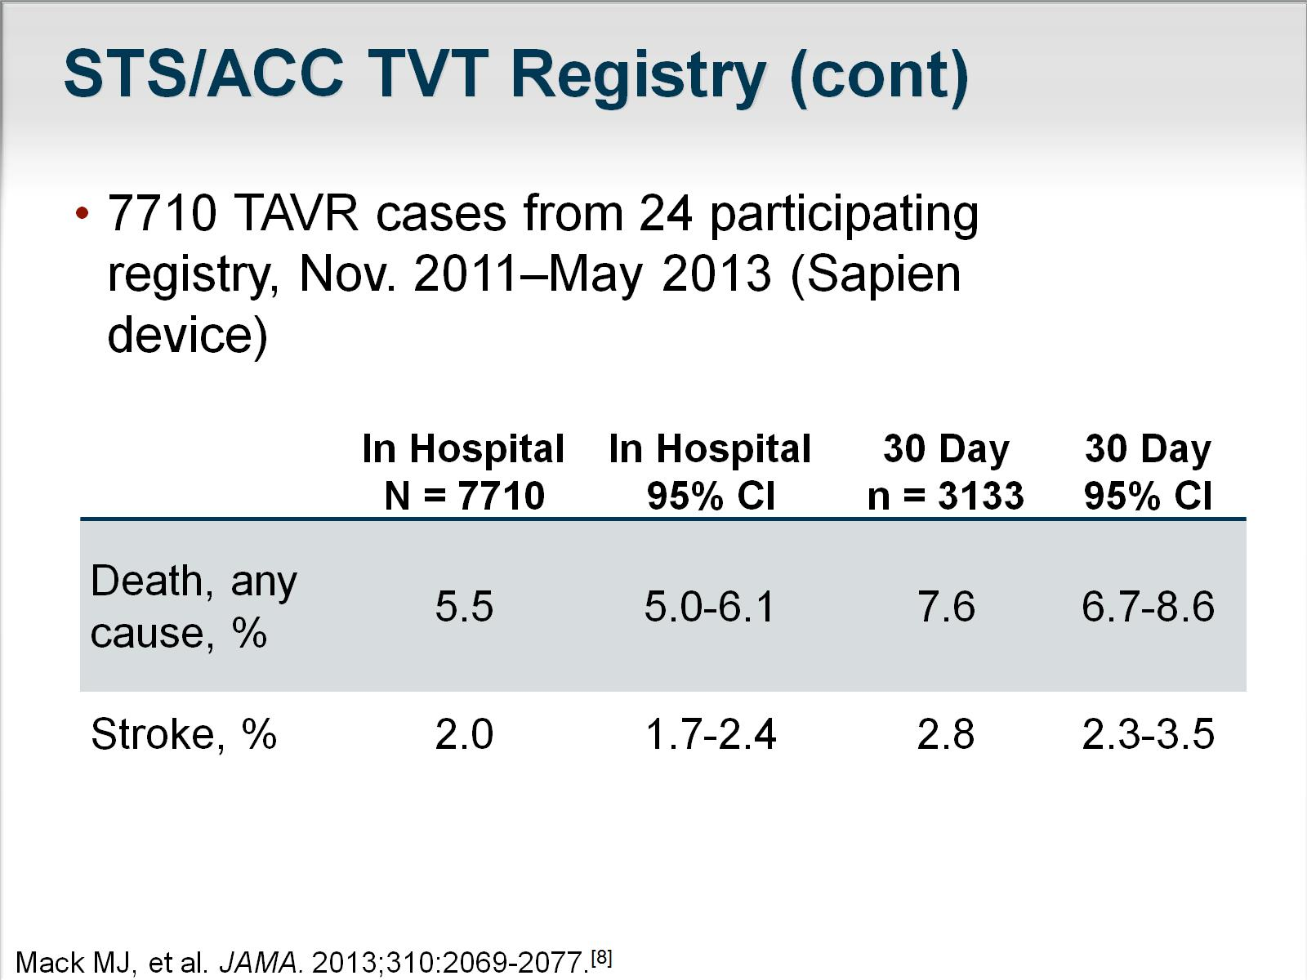
STS/ACC TVT Registry (cont)

Slide 16
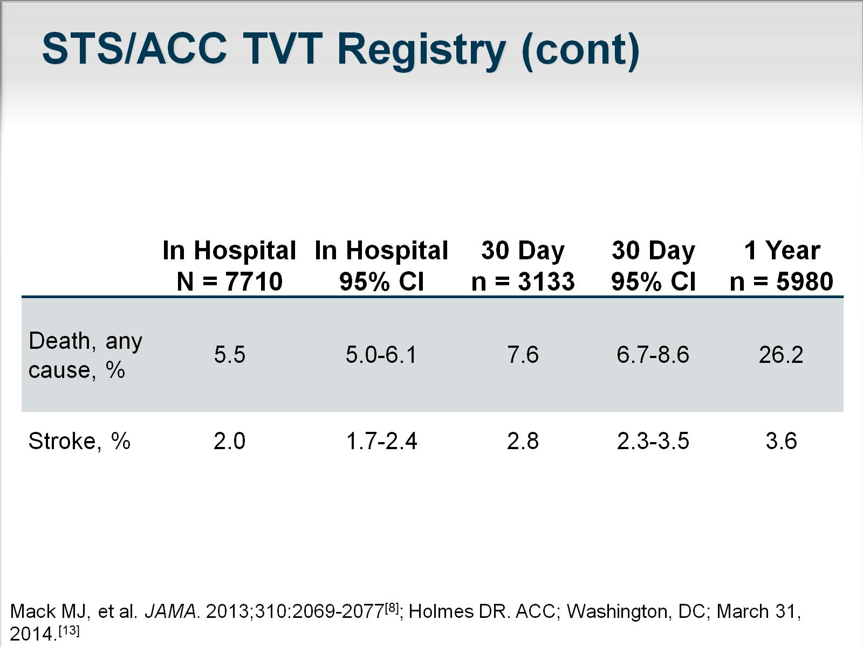
STS/ACC TVT Registry (cont)

Slide 17
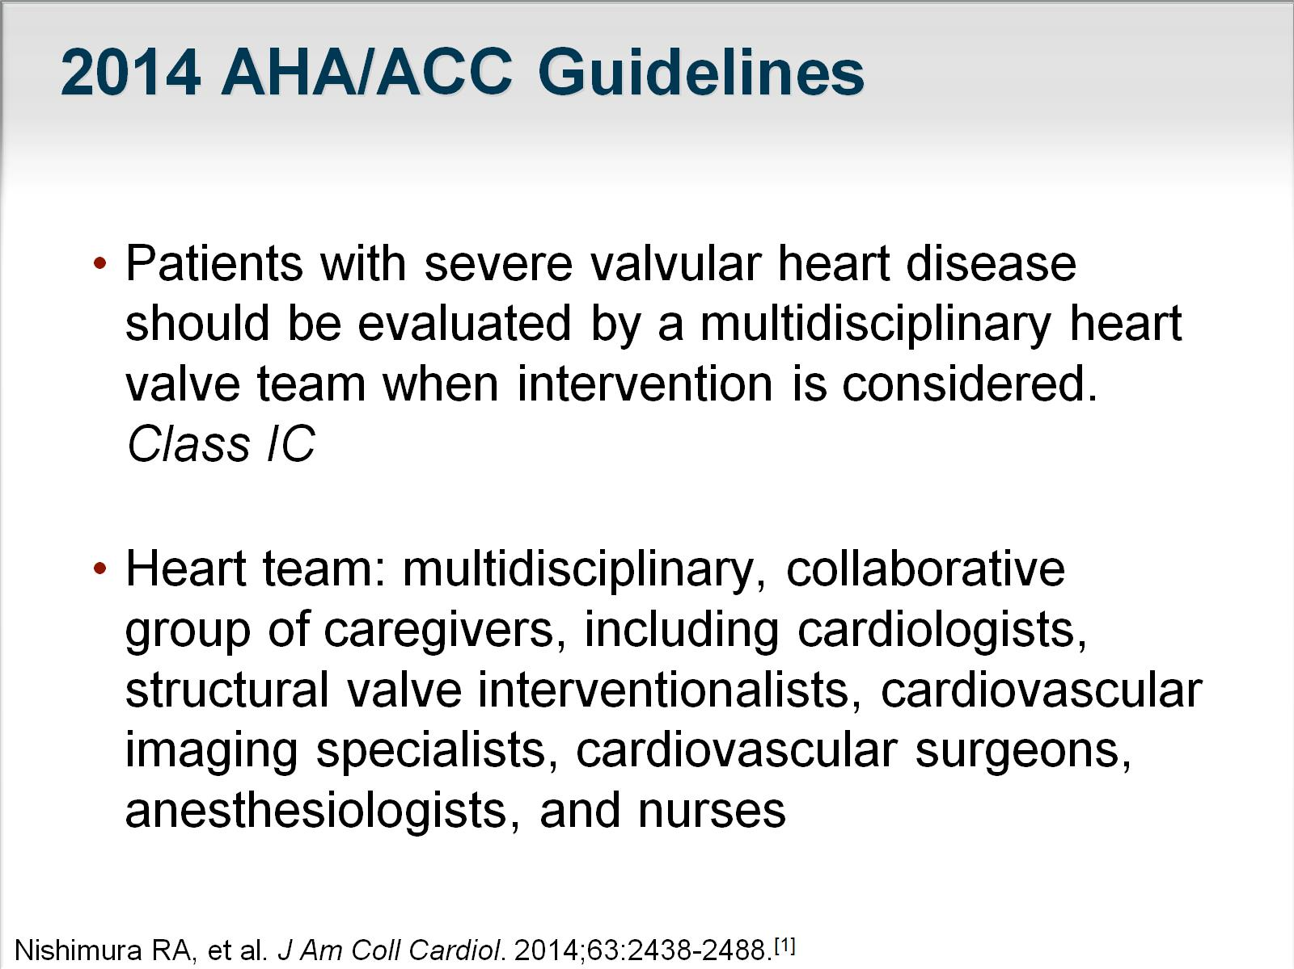
2014 AHA/ACC Guidelines

Slide 18
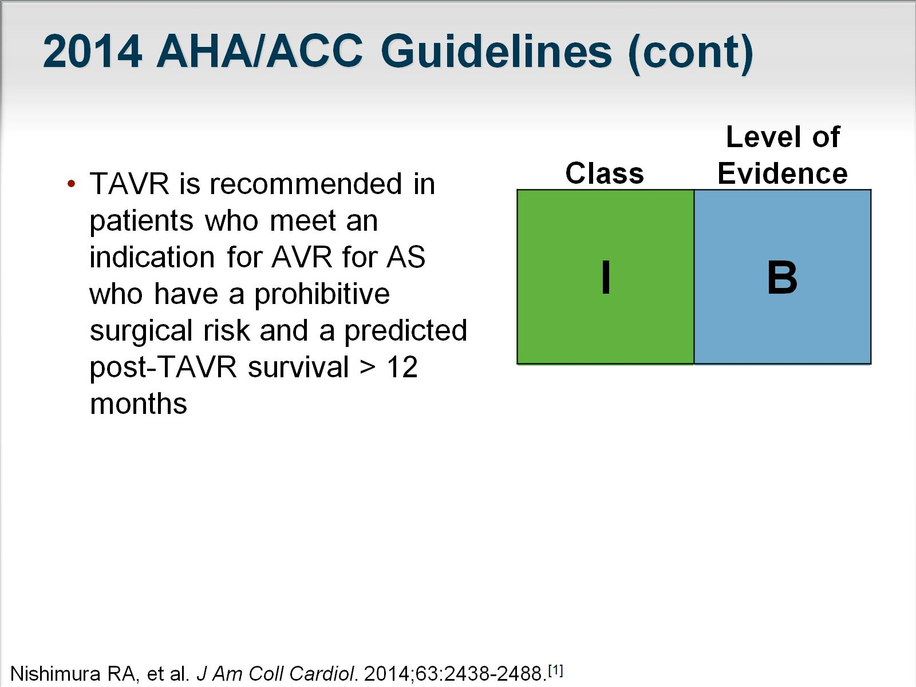
2014 AHA/ACC Guidelines (cont)

Slide 19
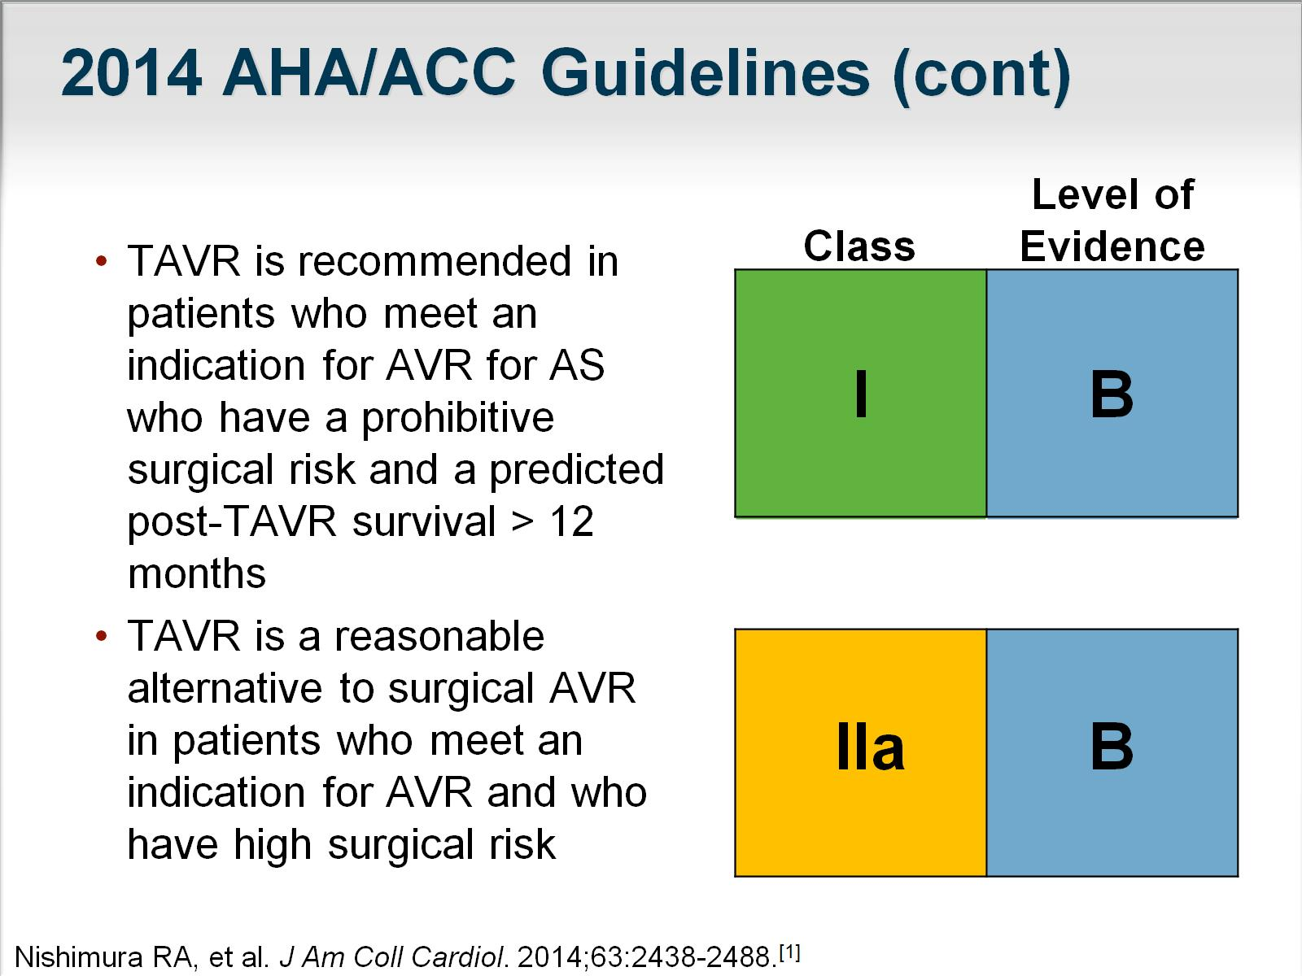
2014 AHA/ACC Guidelines (cont)

Slide 20
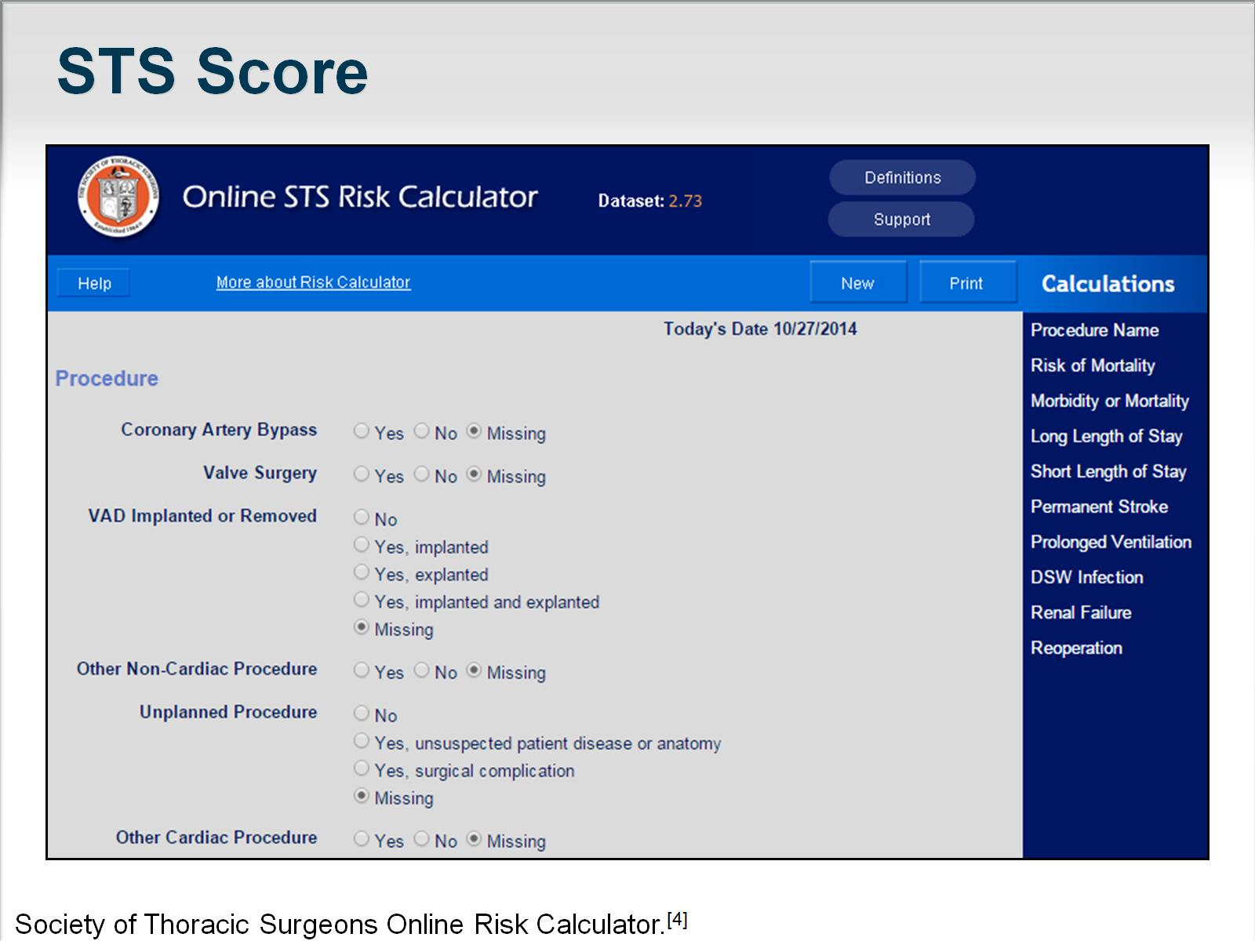
STS Score

Slide 21
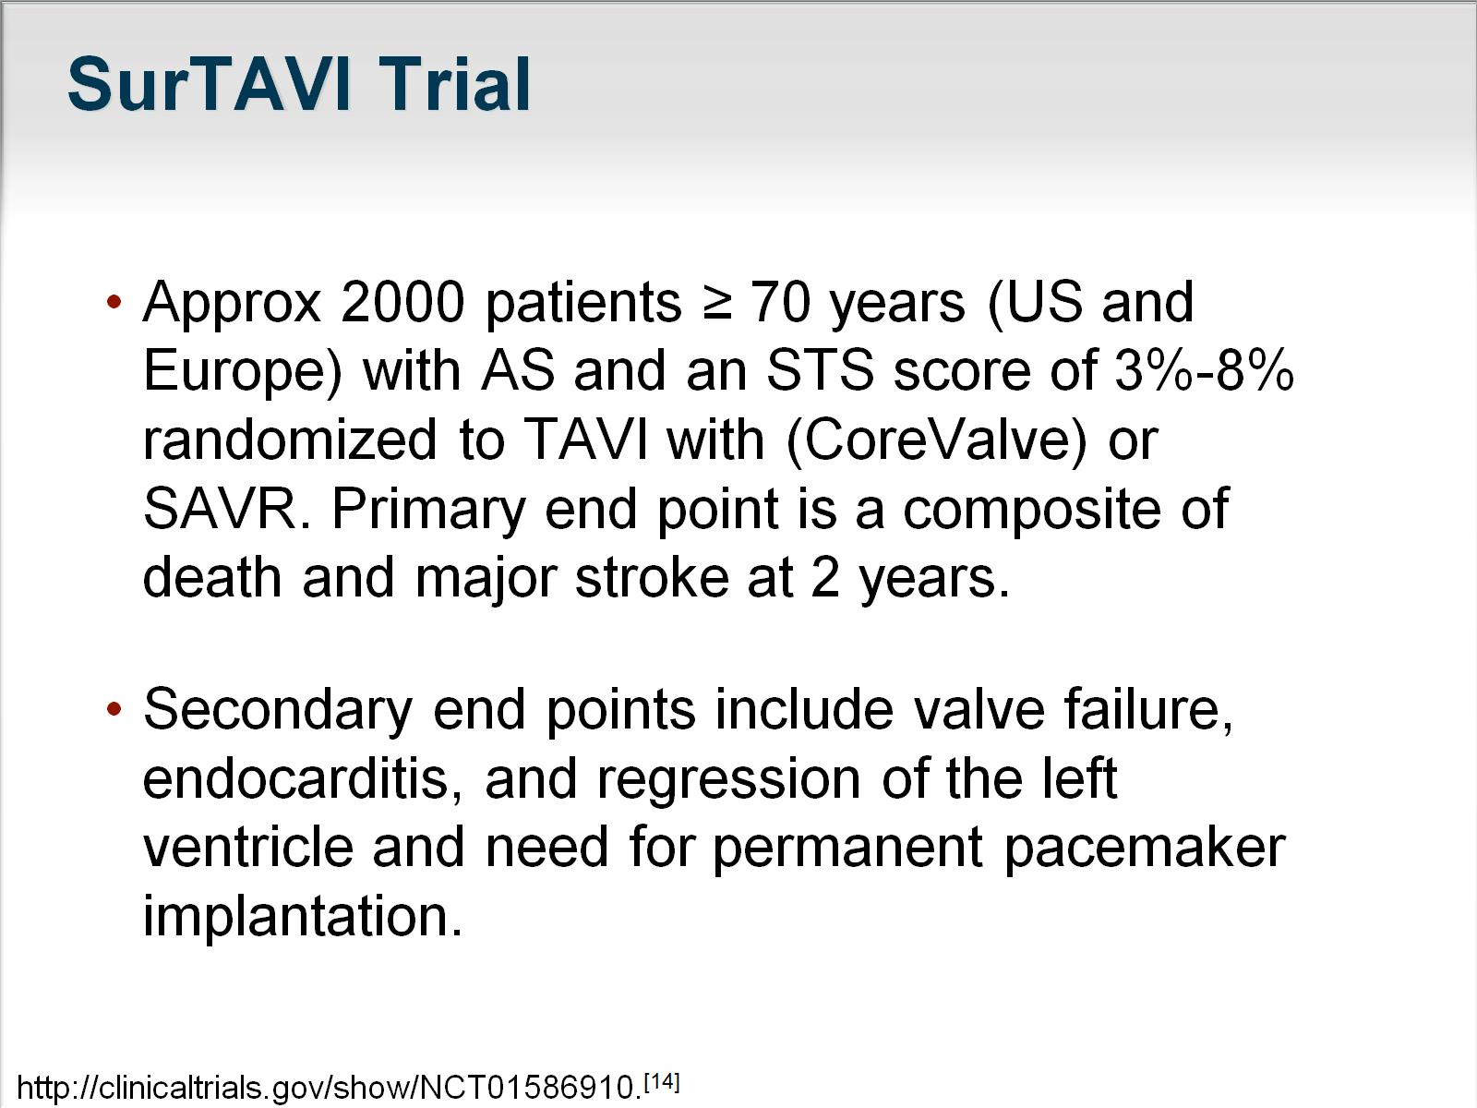
SurTAVI Trial

Slide 22
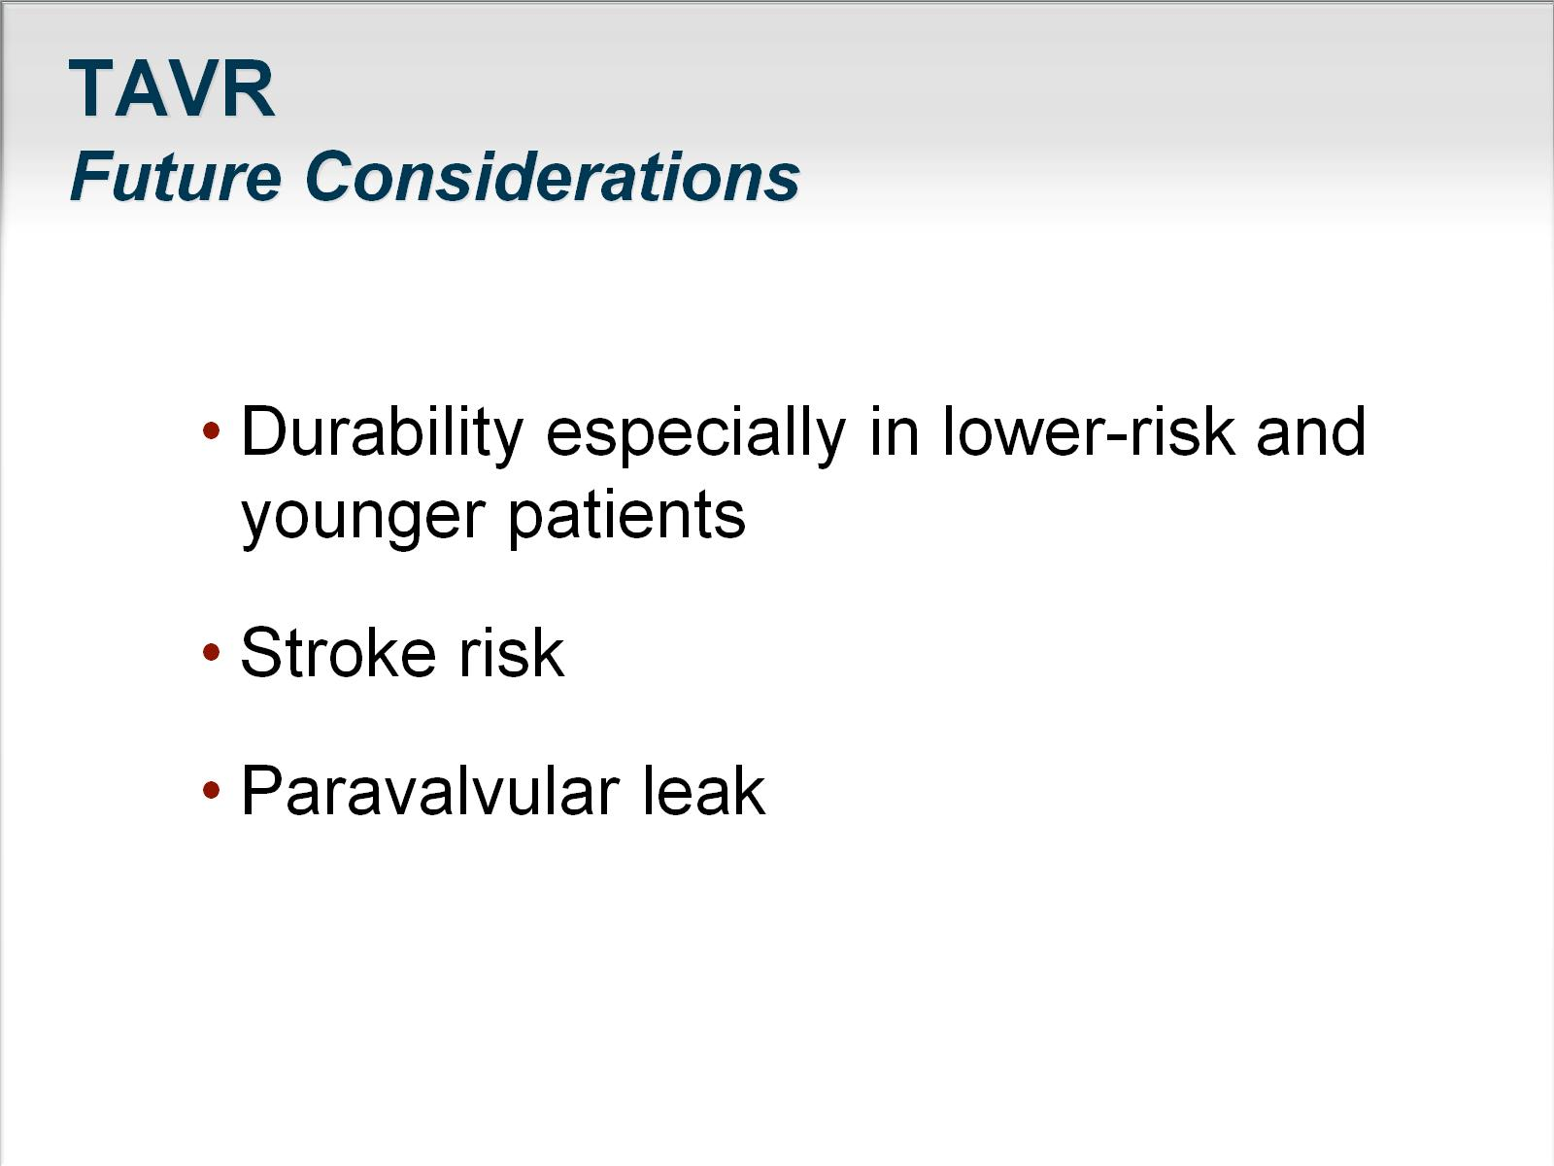
TAVR
Future Considerations

Slide 23
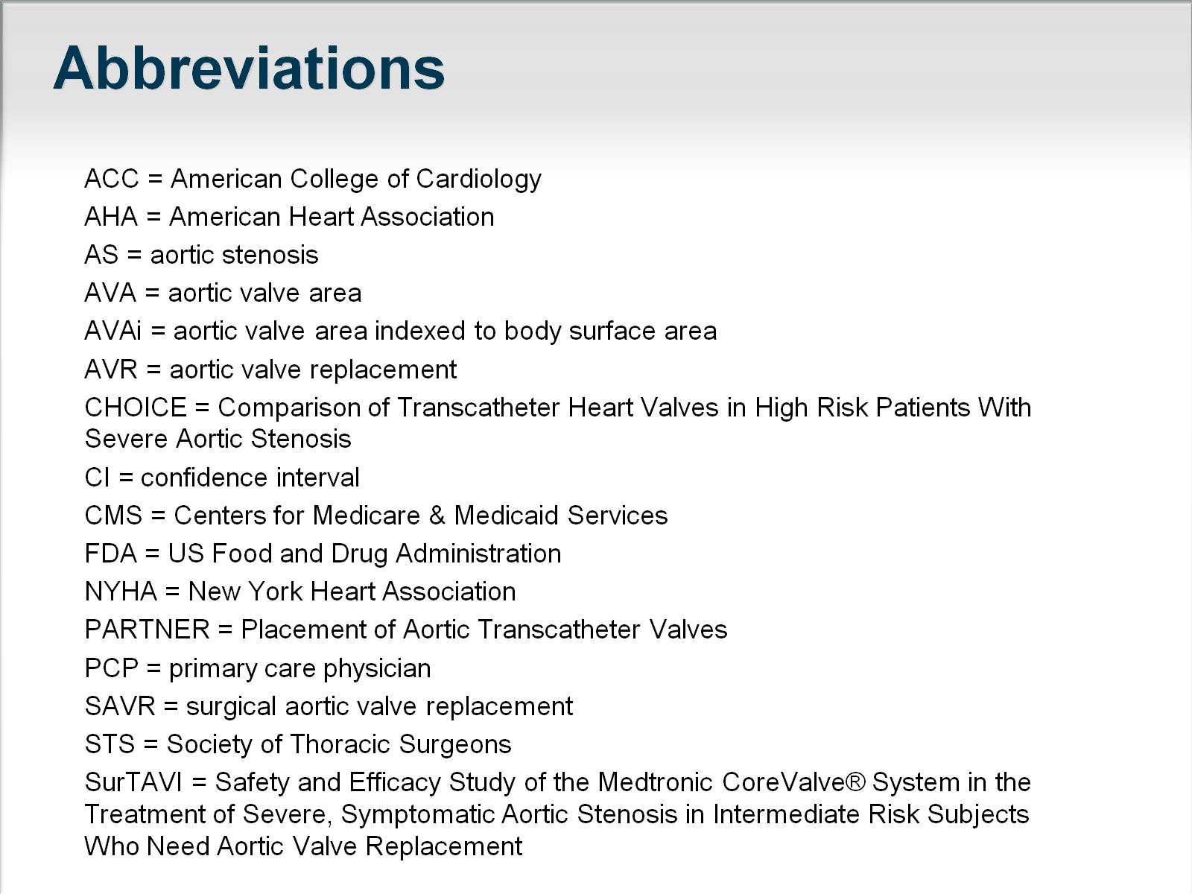
Abbreviations

Slide 24
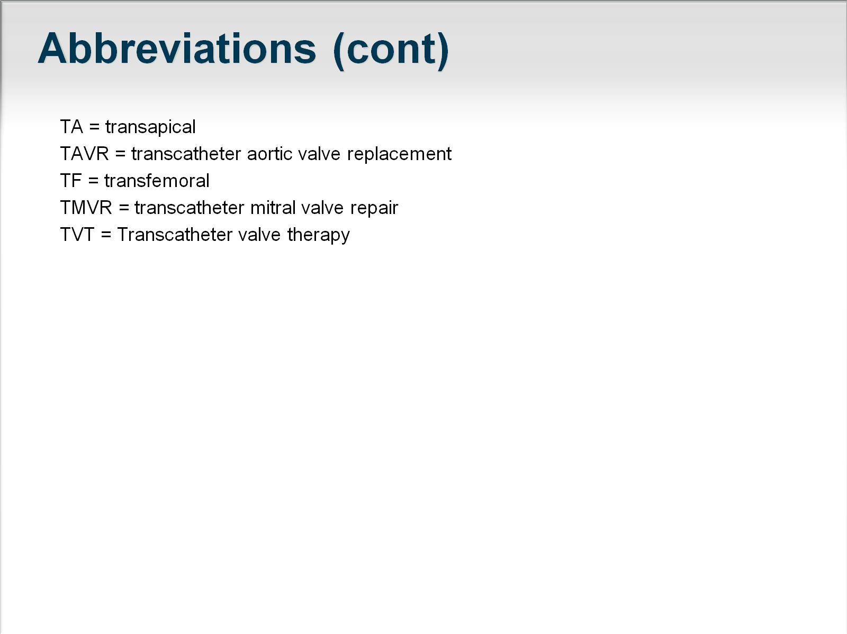
Abbreviations (cont)

Slide 25
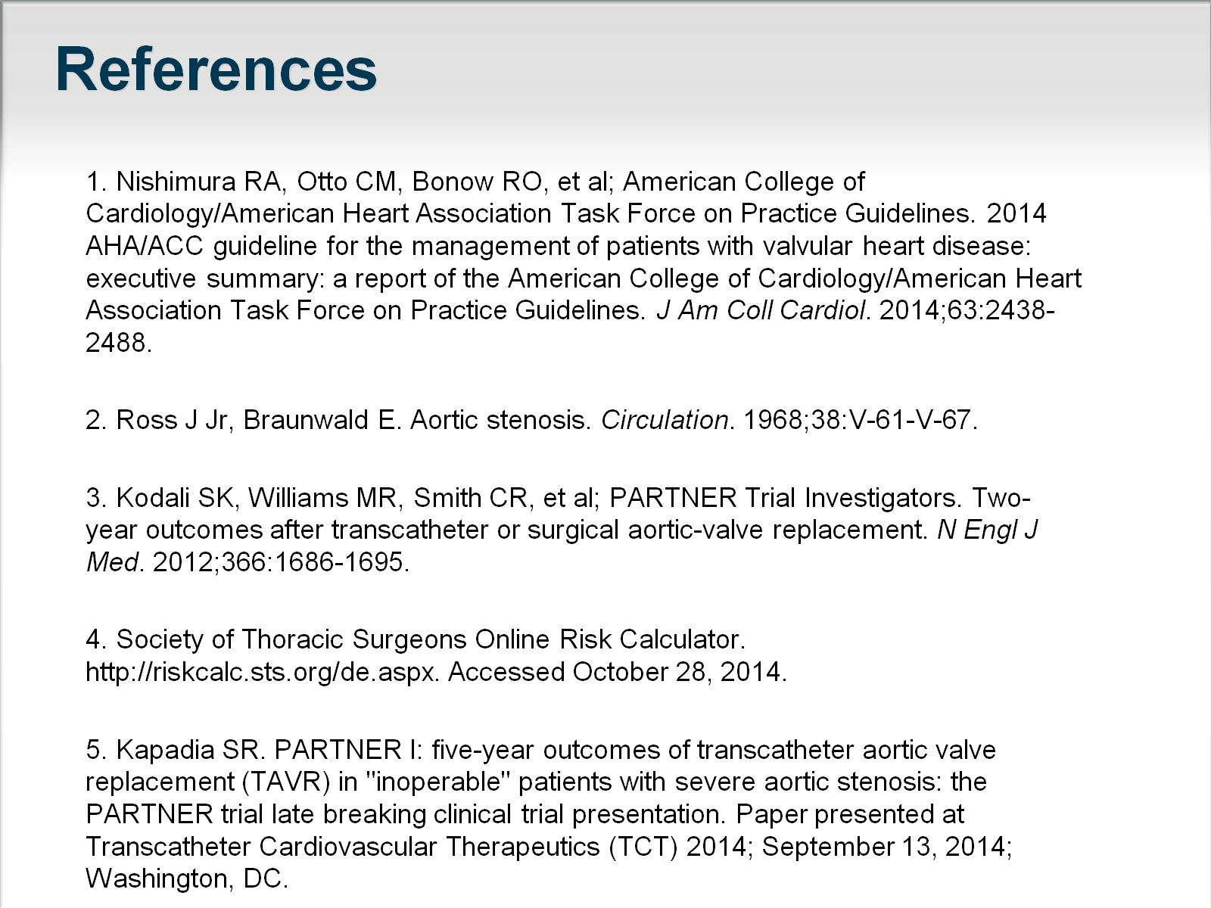
References

Slide 26
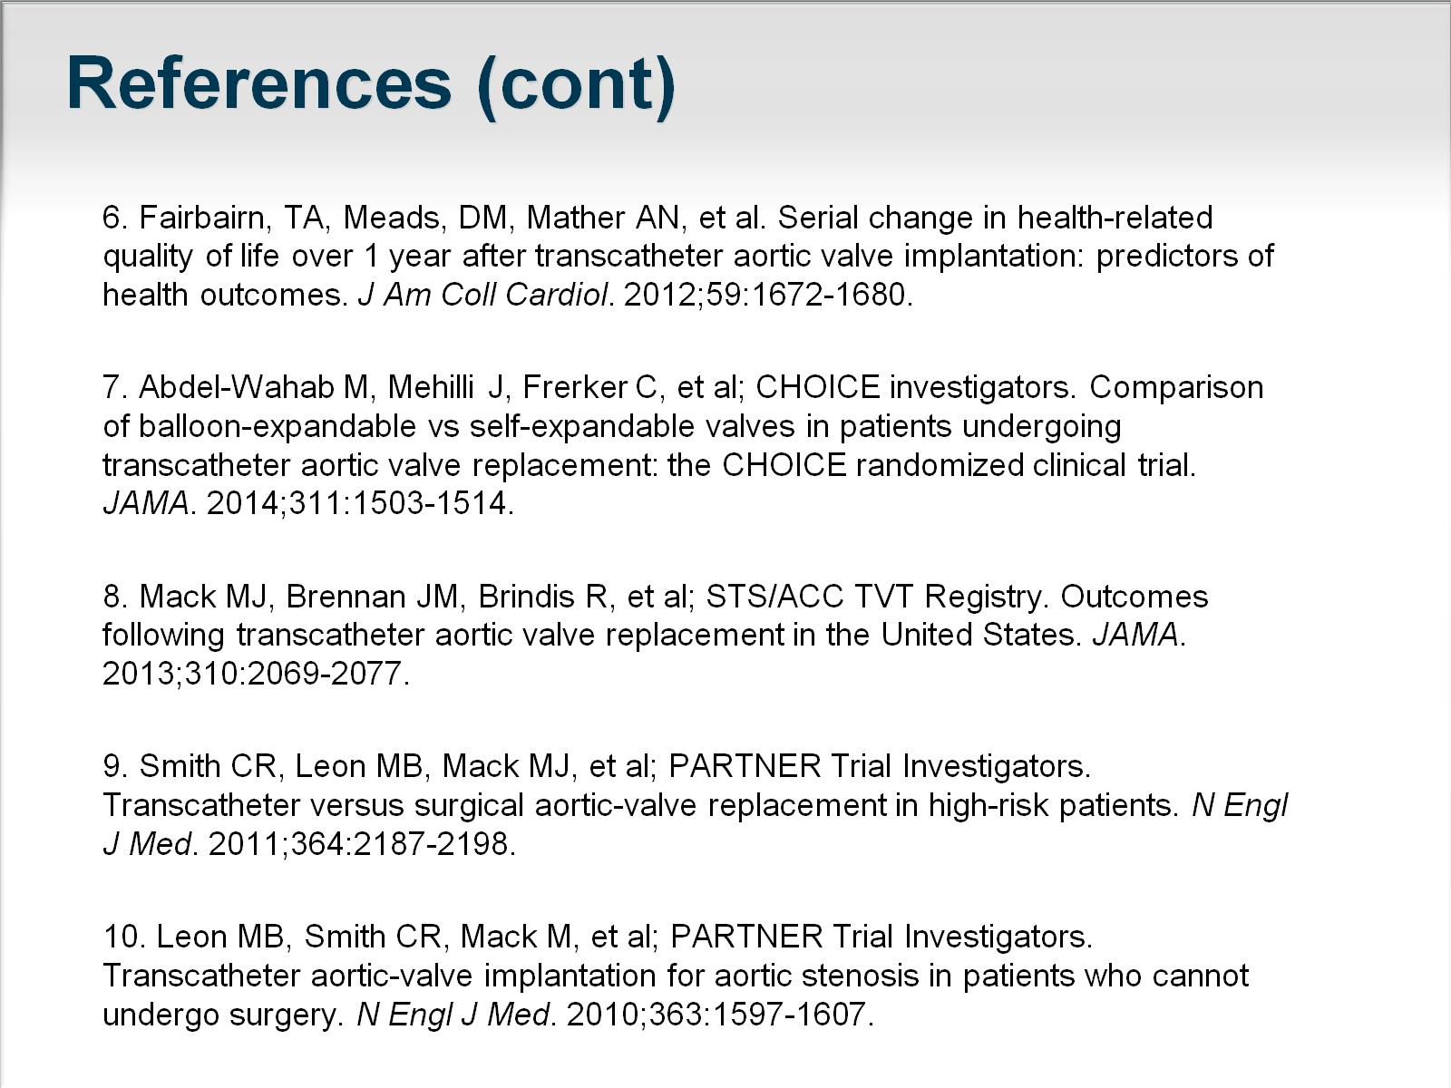
References (cont)

Slide 27
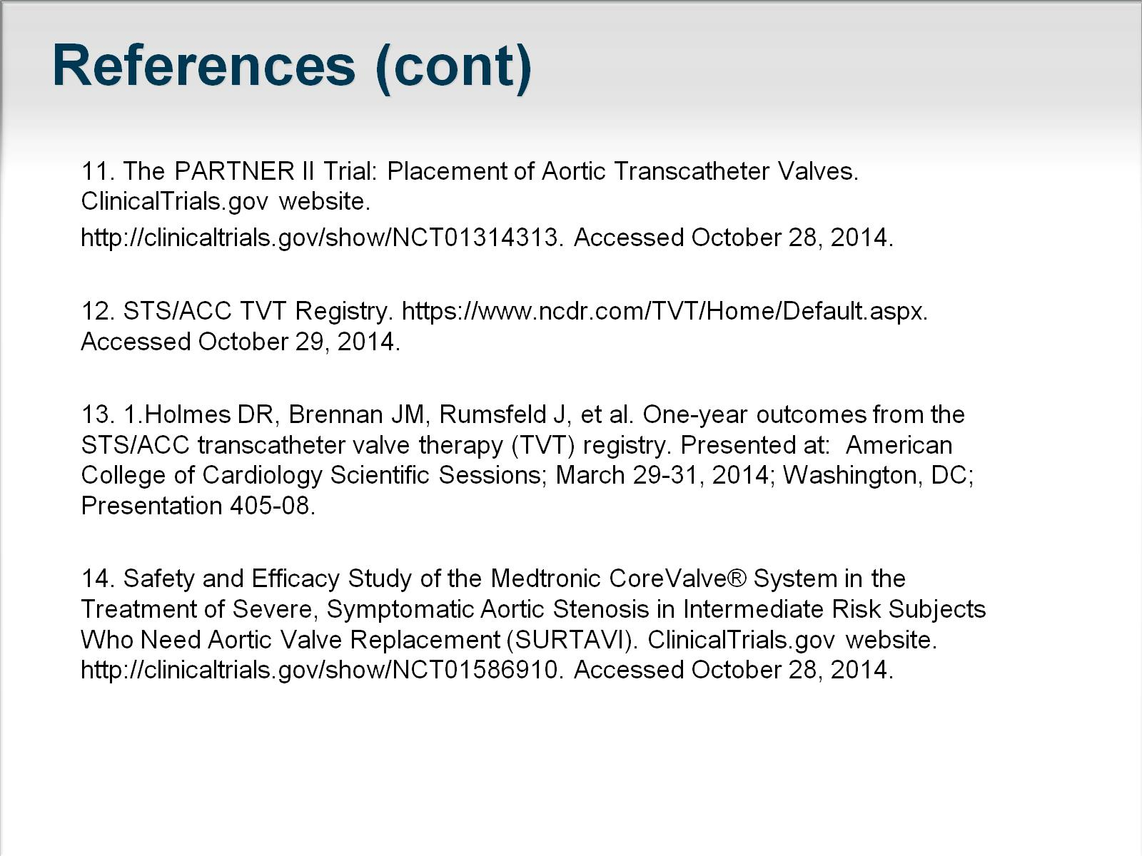
References (cont)

