Slide 1
Assessing and Modifying Risks for Older Drivers

Slide 2
Objectives

Slide 3
Older Drivers: Is There a Problem?

Slide 4
Why Are Older Drivers a Concern?

Slide 5
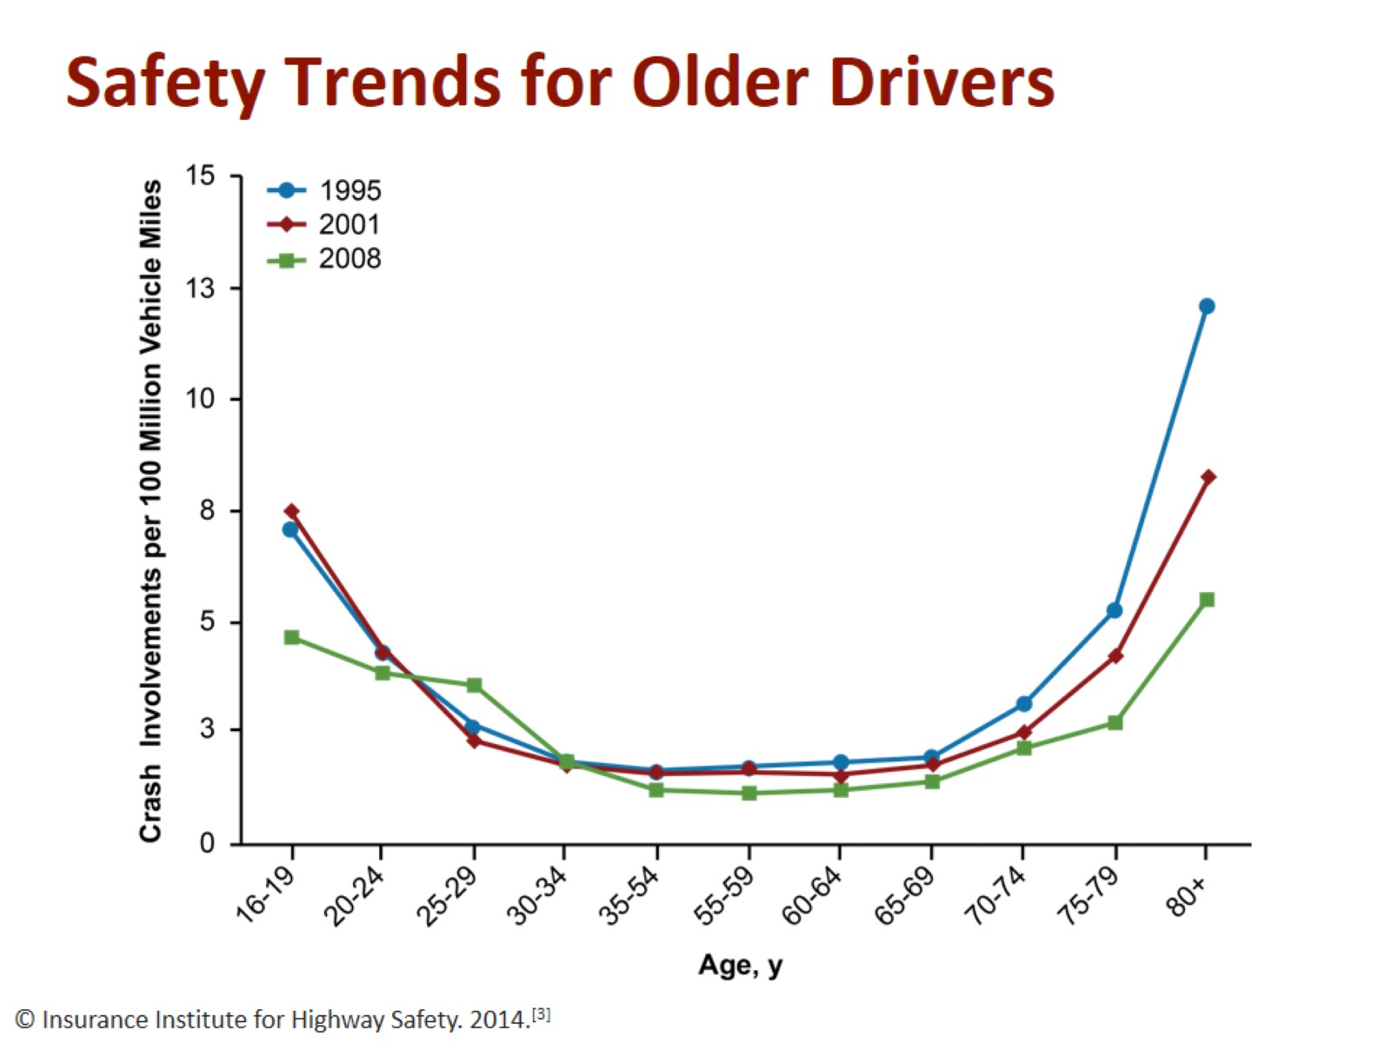
Safety Trends for Older Drivers

Slide 6
Older Drivers: Is There a Problem?

Slide 7
Aging Brings Changes That Affect Driving

Slide 8
Major Vision Conditions Affecting Driving

Slide 9
Physical Aging: Speed

Slide 10
Major Physical Conditions Affecting Driving

Slide 11
Neurologic Conditions Affecting Motor Function: Parkinson Disease

Slide 12
Major Medical Conditions Affecting Alertness

Slide 13
Medications of Particular Concern

Slide 14
Good Cognition Is Critical Too!

Slide 15
Driving Under the Influence of Dementia

Slide 16
Common Driving Errors in Alzheimer Disease

Slide 17
Time to Driving Restriction Due to Failed Road Test, At-Fault MVA, or Dementia Progression

Slide 18
Principles of Assessment

Slide 19
Physician’s Plan for Older Driver’s Safety

Slide 20
Assessment of Driving-related Skills

Slide 21
Assessment of Driving-related Skills

Slide 22
Maryland Pilot Older Driver Study

Slide 23
2010 AAN Practice Parameters for Drivers With Dementia

Slide 24
Evidenced-based Algorithm for Assessing Older Adult Drivers with Cognitive Impairment/Dementia

Slide 25
The Road Test

Slide 26
Risk Reduction: Physician Role

Slide 27
Steps to Driving Cessation

Slide 28
Enforcement of Decision

Slide 29
Enforcement of Decision (cont)

Slide 30
Monitoring Safety

Slide 31
Key Messages

Slide 32
Resources

Slide 33
Abbreviations

