Slide 1
Metastatic Renal Cell Carcinoma

Slide 2
Program Goals

Slide 3
Incidence of RCC in the United States

Slide 4
Survival

Slide 5
Current Treatment

Slide 6
Toxicities to Treatment

Slide 7
IL-2: Function

Slide 8
Challenges in Clinical Outcome With Targeted Drugs

Slide 9
Nivolumab Mechanism of Action

Slide 10
Nivolumab Monotherapy Phase 2 Study Design

Slide 11
Prior Therapy in Metastatic Setting

Slide 12
PFS Doses of Nivolumab

Slide 13
Objective Responses With Nivolumab

Slide 14
Duration of Response By Nivolumab Dose (Responding Patients)

Slide 15
Nivolumab Monotherapy Treatment-Related AEs

Slide 16
Overall Survival

Slide 17
Response According to PD-L1 Status by IHC

Slide 18
Nivolumab + Sunitinib or Pazopanib

Slide 19
Baseline Patient Characteristics

Slide 20
Antitumor Activity (per RECIST 1.1)

Slide 21
Grade 3-4 Treatment-Related AEs in ≥ 10% of Patients

Slide 22
Nivolumab plus Ipilimumab Mechanism of Action

Slide 23
CA209-016 (NCT01472081): Phase I Study Design (N + I cohort)

Slide 24
Nivolumab + Ipilimumab Dosing schedule

Slide 25
Nivolumab + Ipilimumab Baseline Patient Characteristics

Slide 26
MPDL3280A Phase 1a Baseline Demographics RCC Patients in Dose-escalation and Dose-expansion Cohorts

Slide 27
Nivolumab + Ipilimumab Antitumor Activity

Slide 28
Nivolumab + Ipilimumab Time to Response and DOR

Slide 29
Nivolumab + Ipilimumab Treatment-Related AEs

Slide 30
Nivolumab Next Steps

Slide 32
MPDL3280A Phase 1a Safety Overview (RCC)

Slide 33
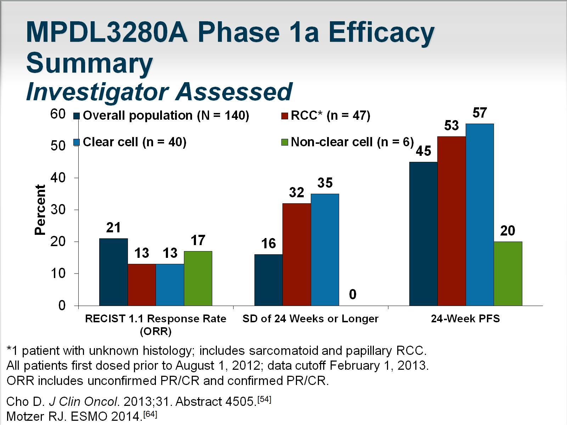
MPDL3280A Phase 1a Efficacy Summary Investigator Assessed

Slide 34
Other Checkpoint Inhibitor Trials to Watch

Slide 35
Conclusions

Slide 36
Abbreviations

Slide 37
Abbreviations (cont)

Slide 38
Abbreviations (cont)

Slide 39
References

Slide 40
References (cont)

Slide 41
References (cont)

Slide 42
References (cont)

Slide 43
References (cont)

Slide 44
References (cont)

Slide 45
References (cont)

Slide 46
References (cont)

Slide 47
References (cont)

Slide 48
References (cont)

Slide 49
References (cont)

Slide 50
References (cont)

Slide 51
References (cont)

