Slide 1

Organizational Culture in the Oncology Medical Home

Slide 2
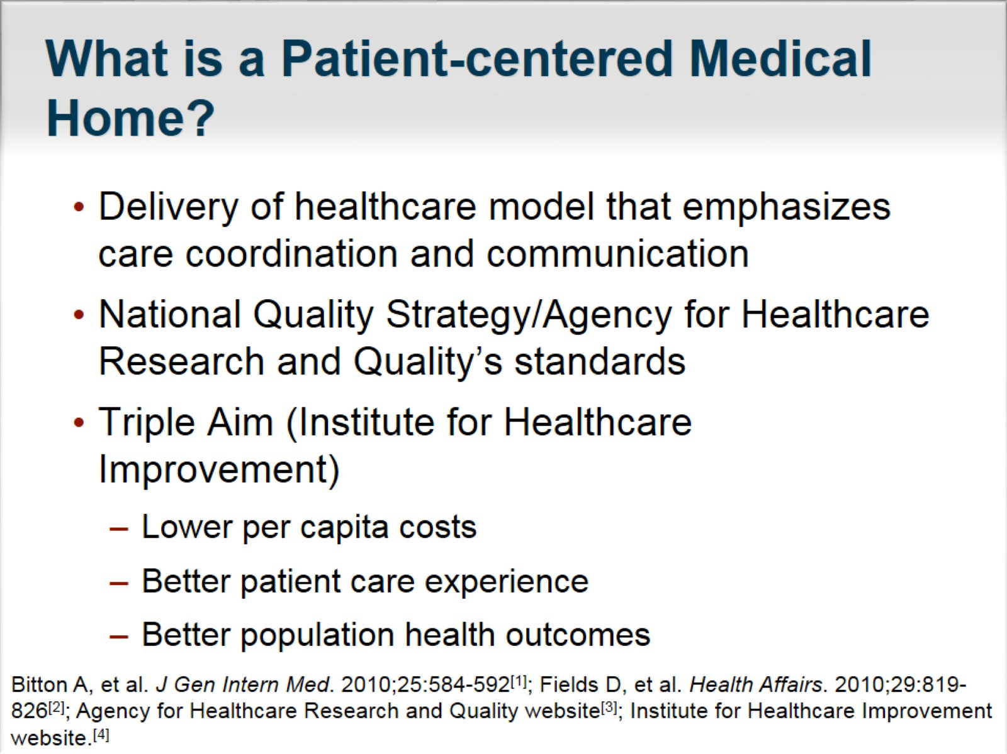
What is a Patient-centered Medical Home?

Slide 3
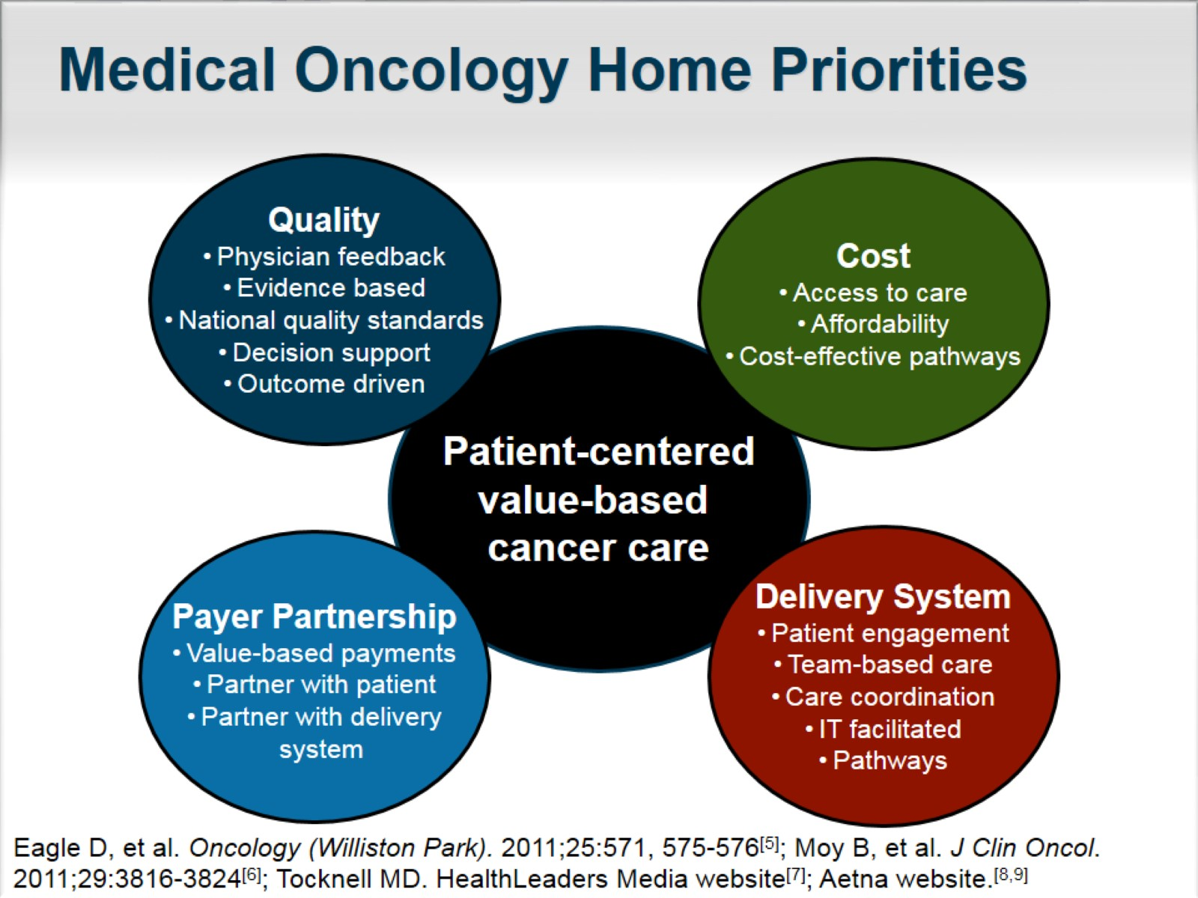
Medical Oncology Home Priorities

Slide 4
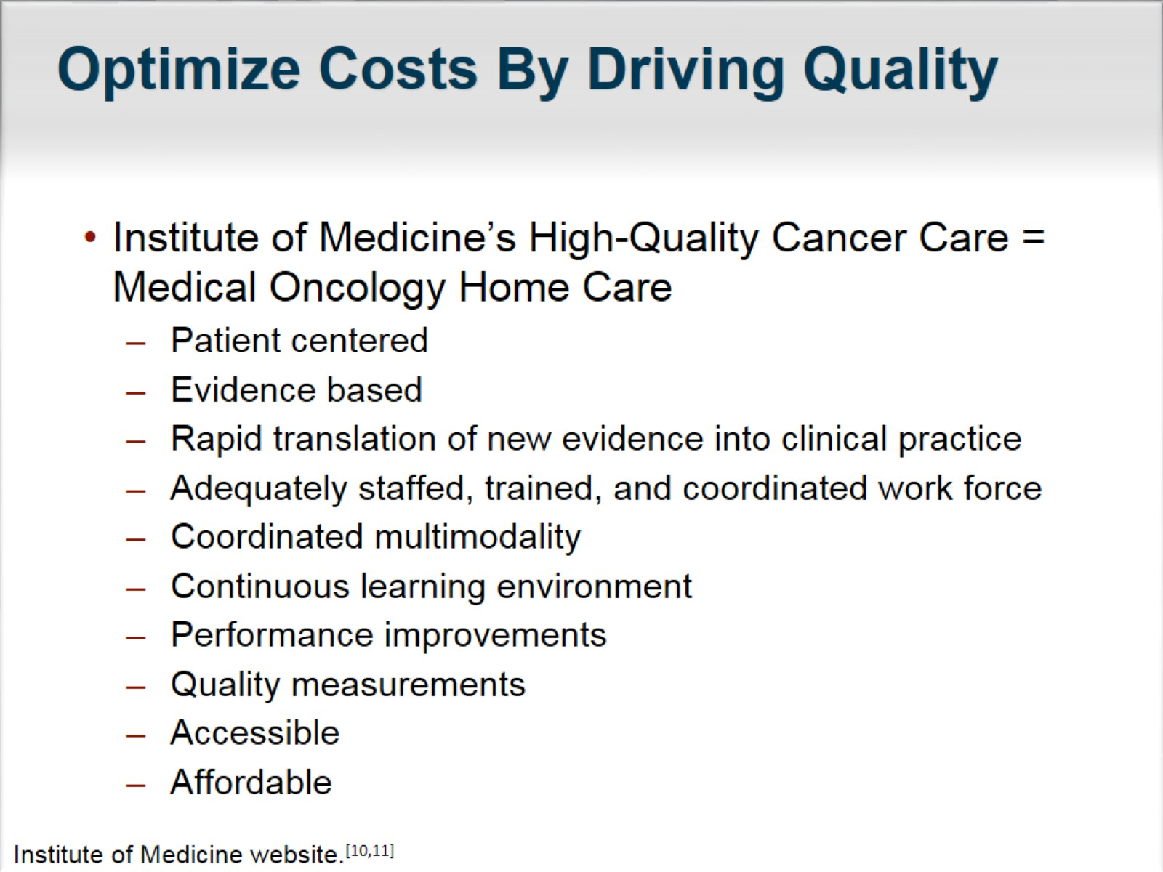
Optimize Costs By Driving Quality

Slide 5
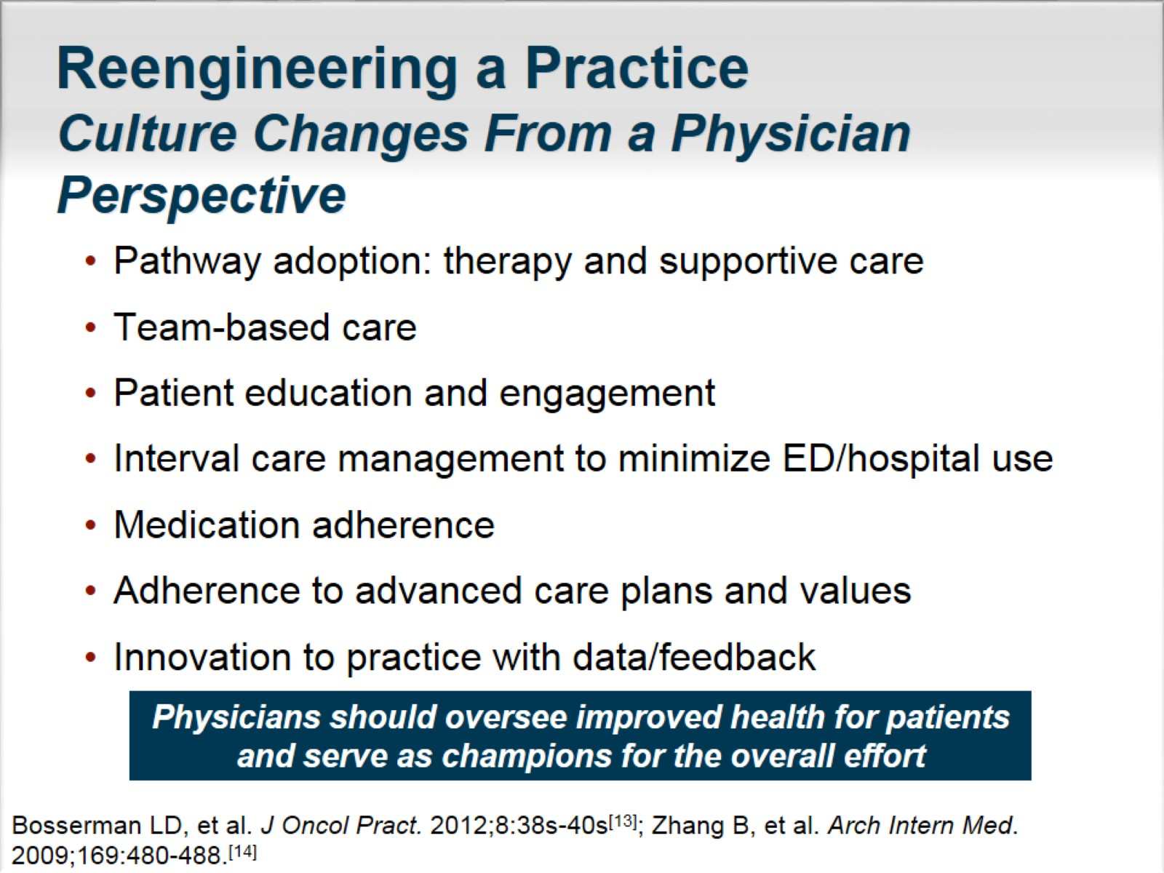
Reengineering a Practice
Culture Changes From a Physician Perspective

Slide 6
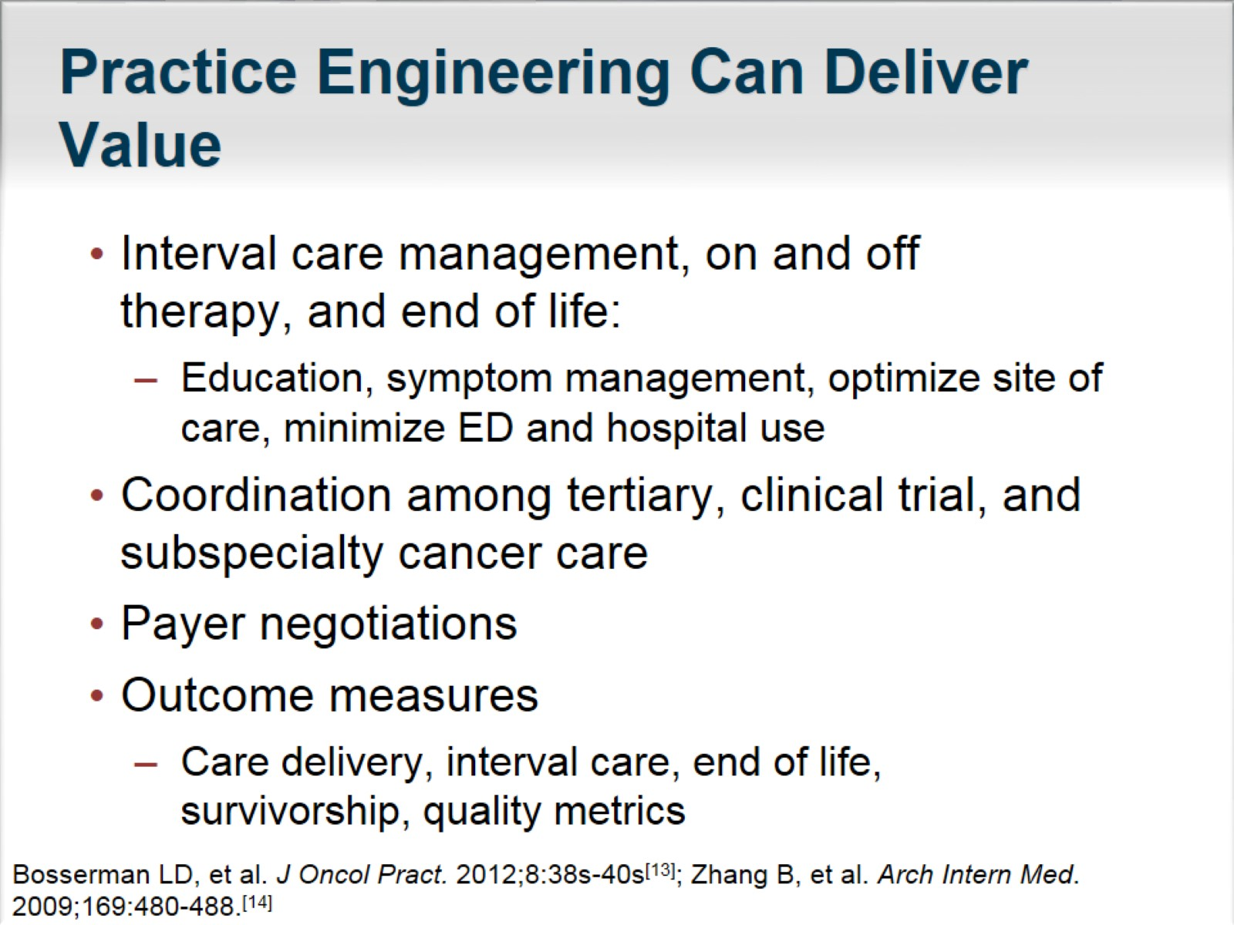
Practice Engineering Can Deliver Value

Slide 7
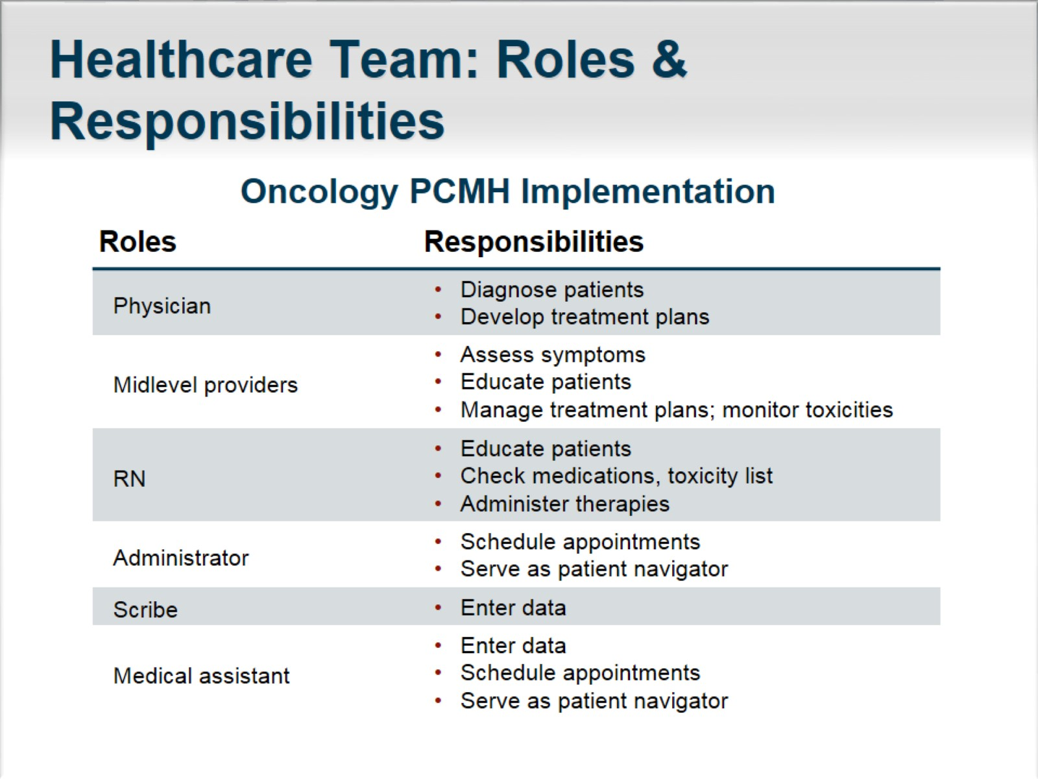
Healthcare Team: Roles & Responsibilities

Slide 8
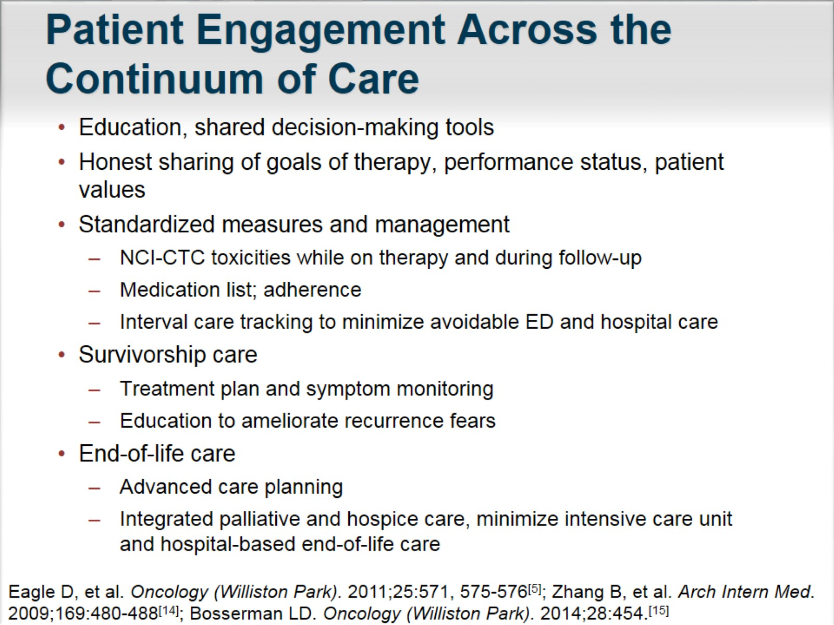
Patient Engagement Across the Continuum of Care

Slide 9
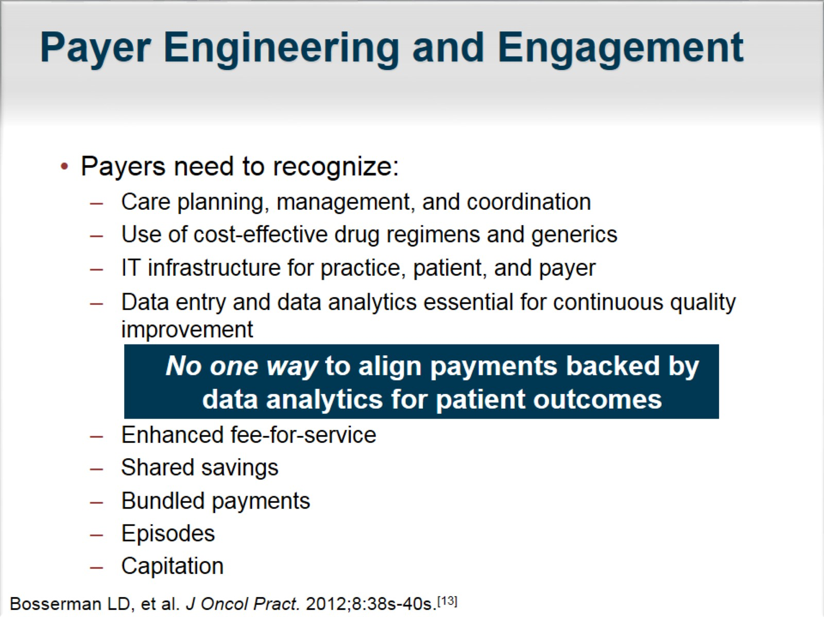
Payer Engineering and Engagement

Slide 10
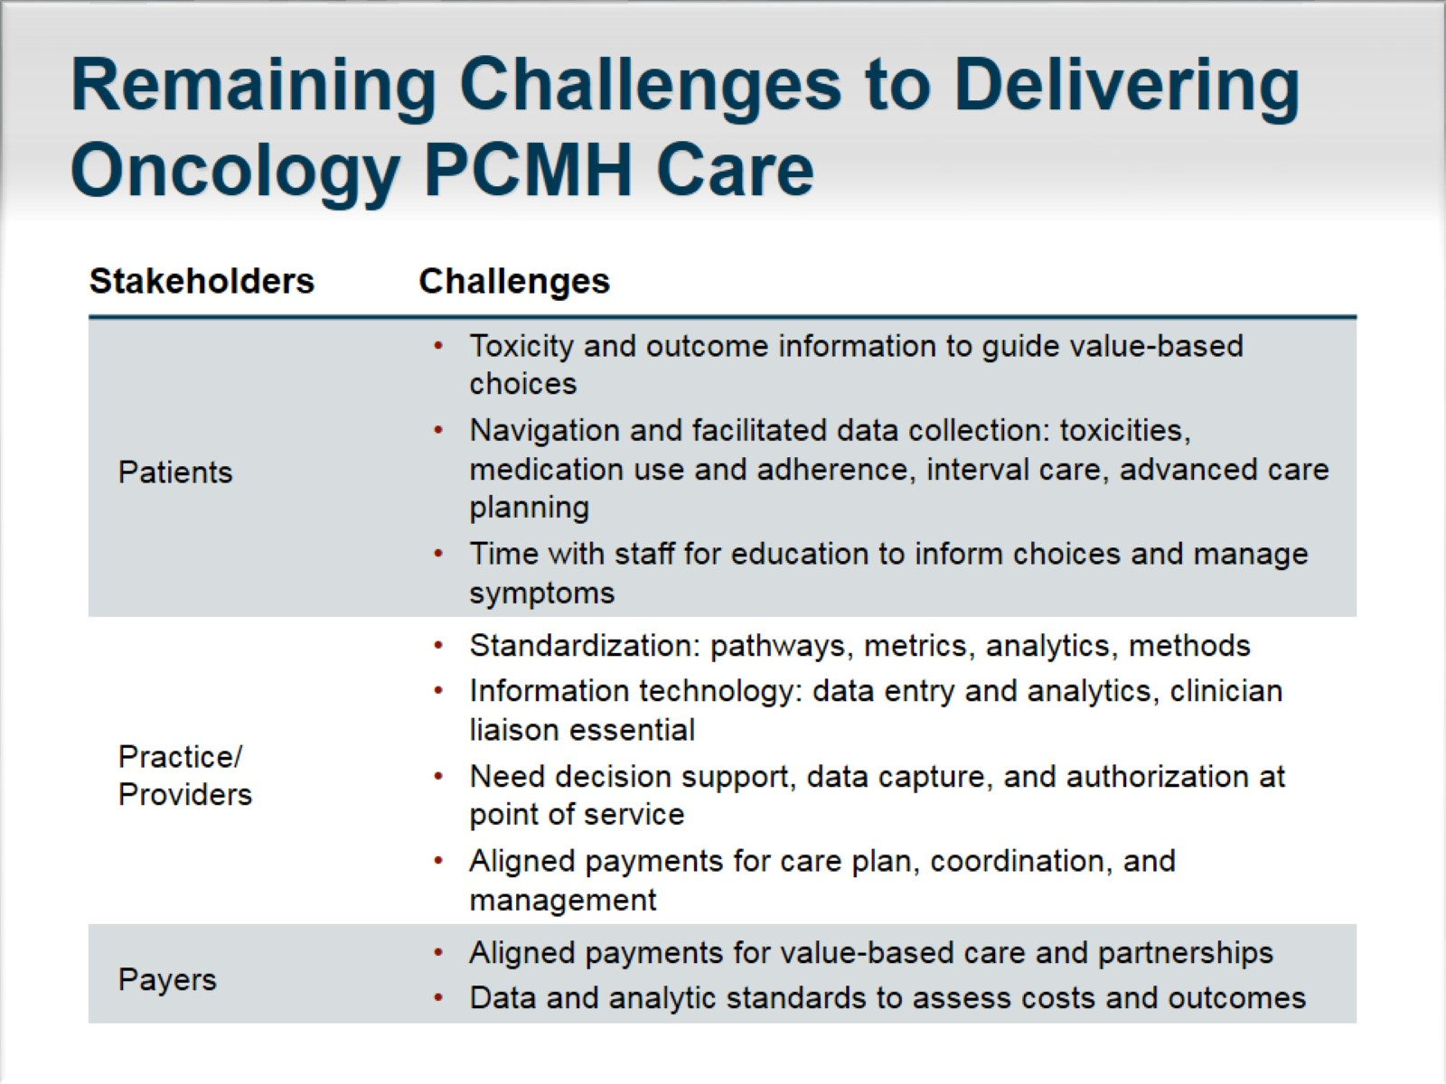
Remaining Challenges to Delivering Oncology PCMH Care

Slide 11
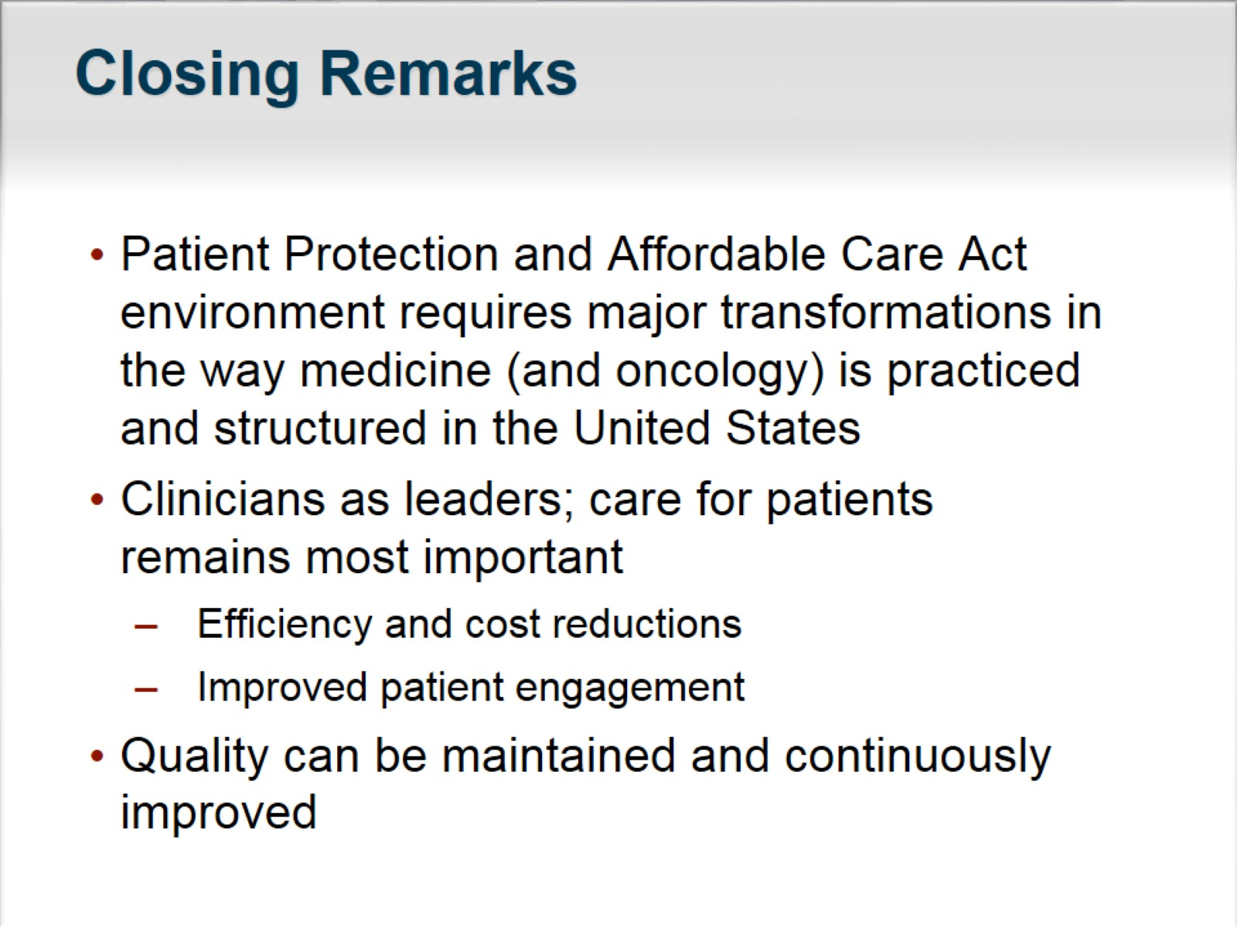
Closing Remarks

Slide 12
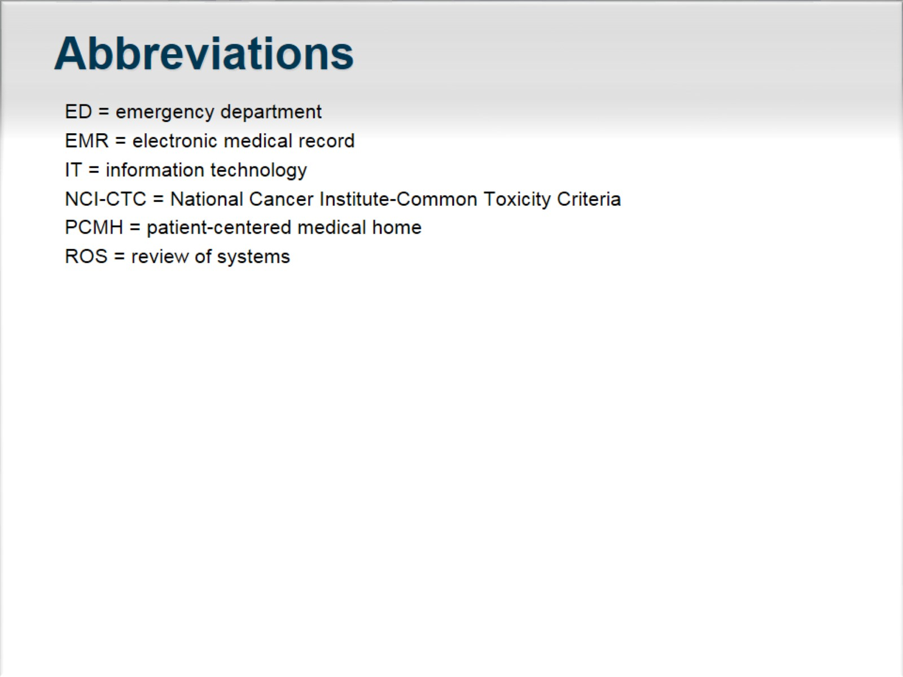
Abbreviations

Slide 13
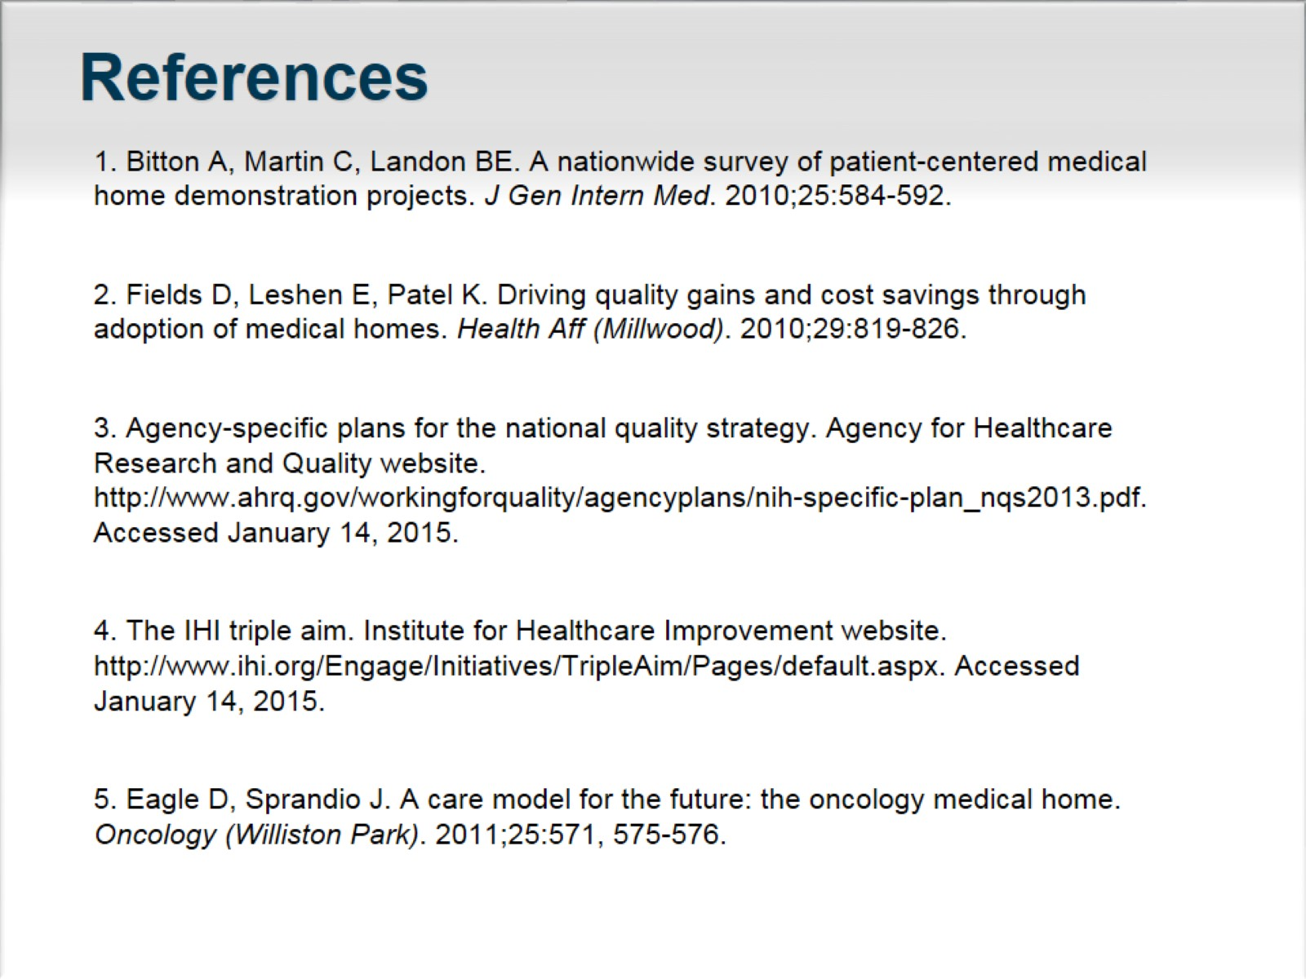
References

Slide 14
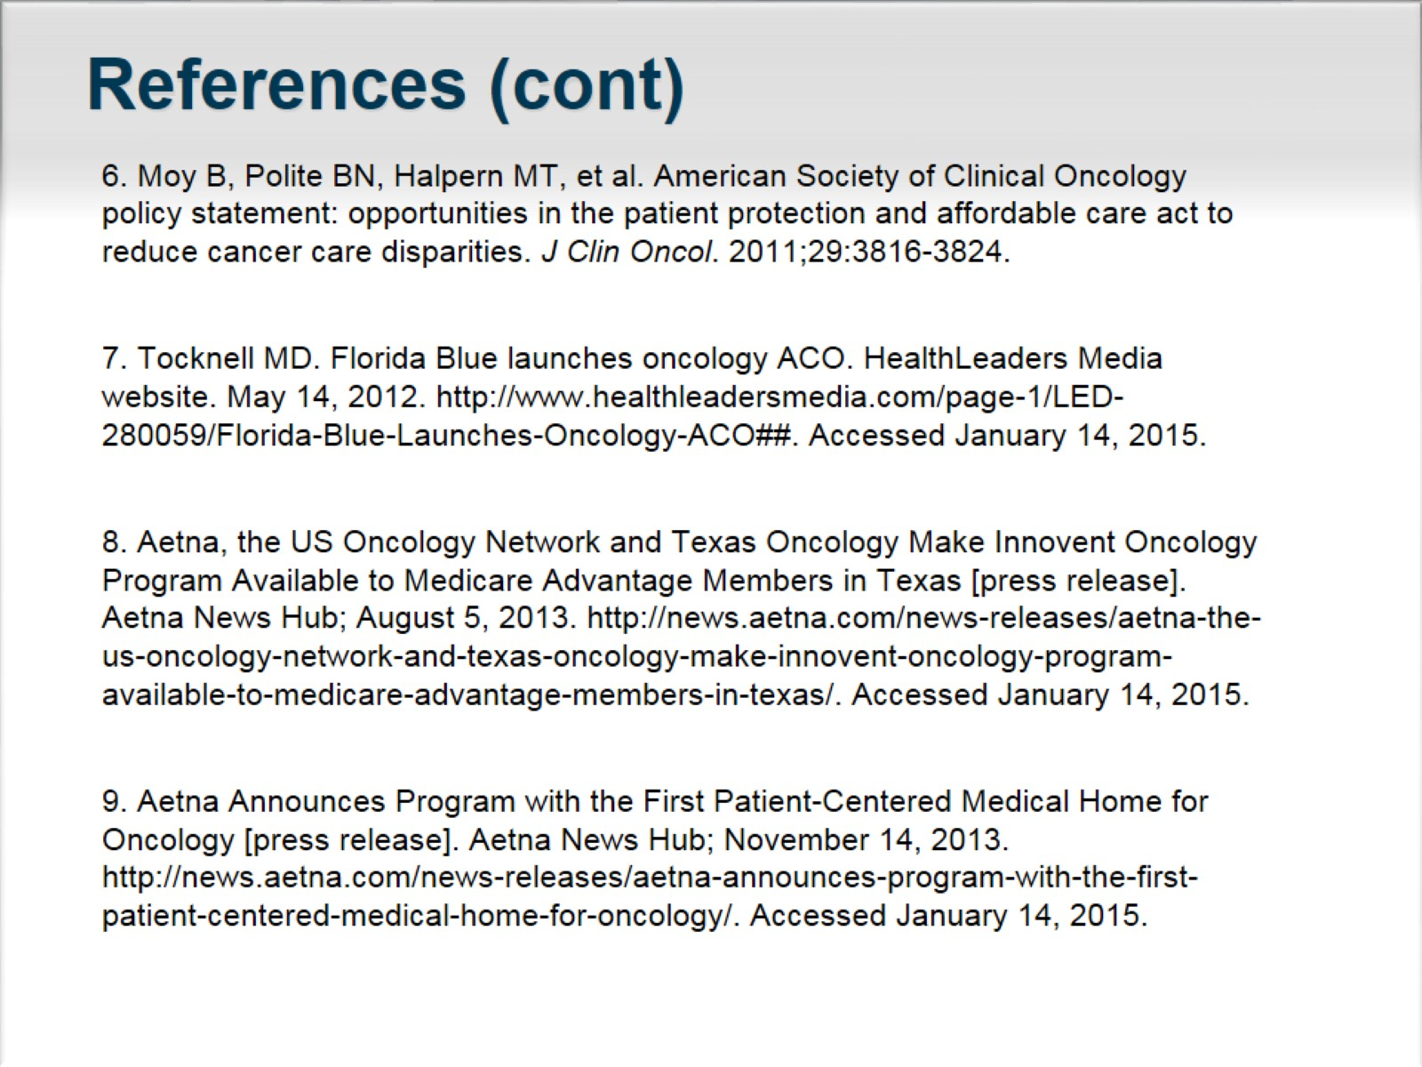
References (cont)

Slide 15
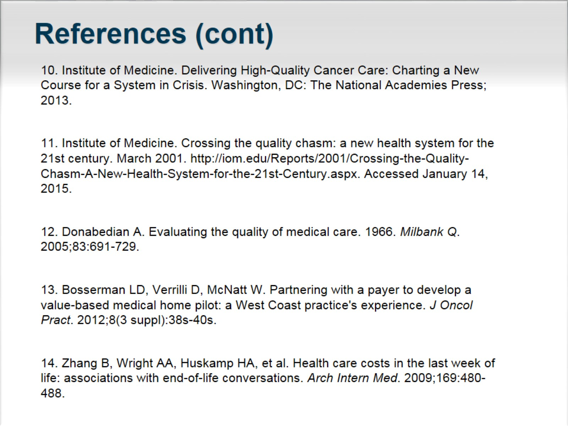
References (cont)

Slide 16
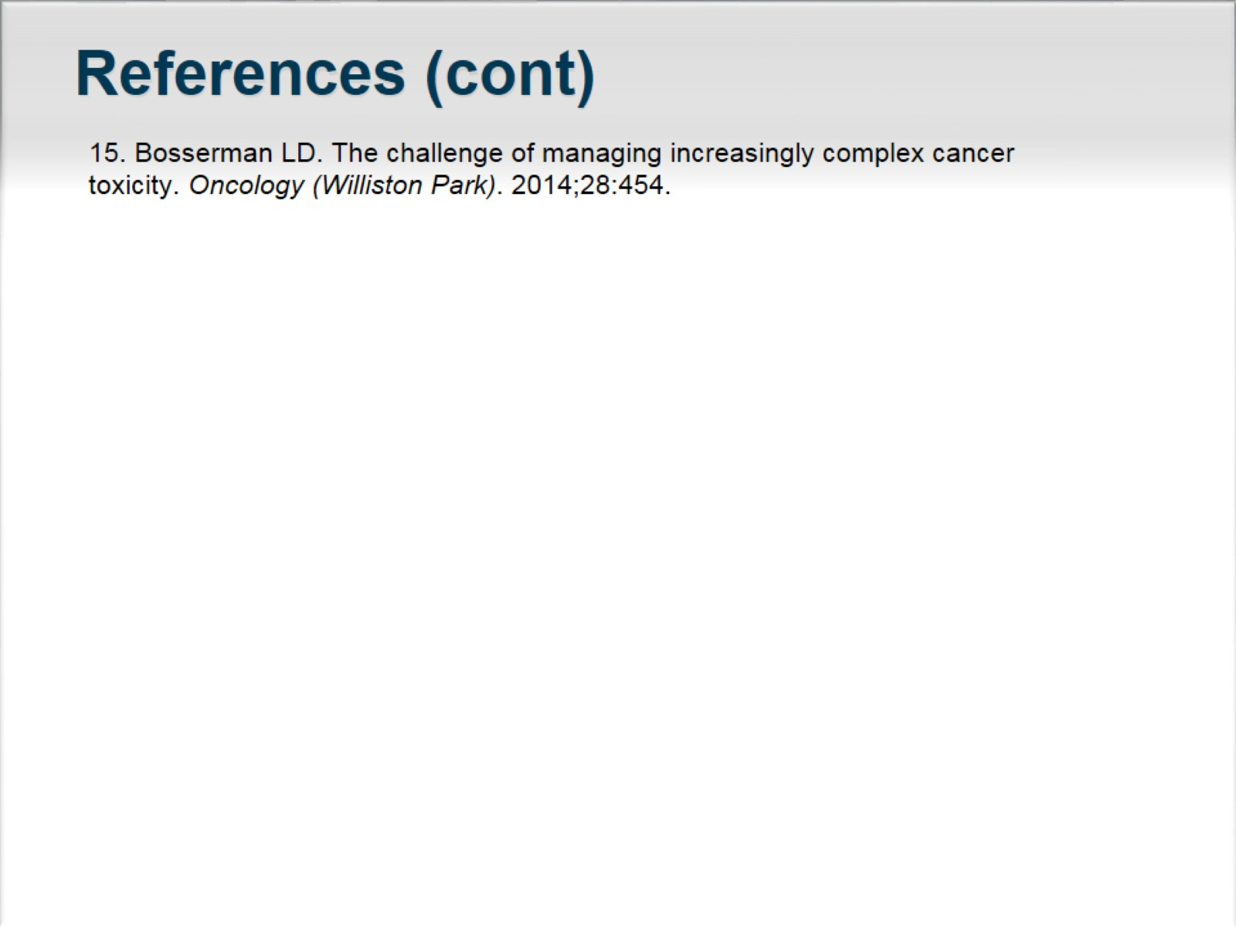
References (cont)

