Slide 1
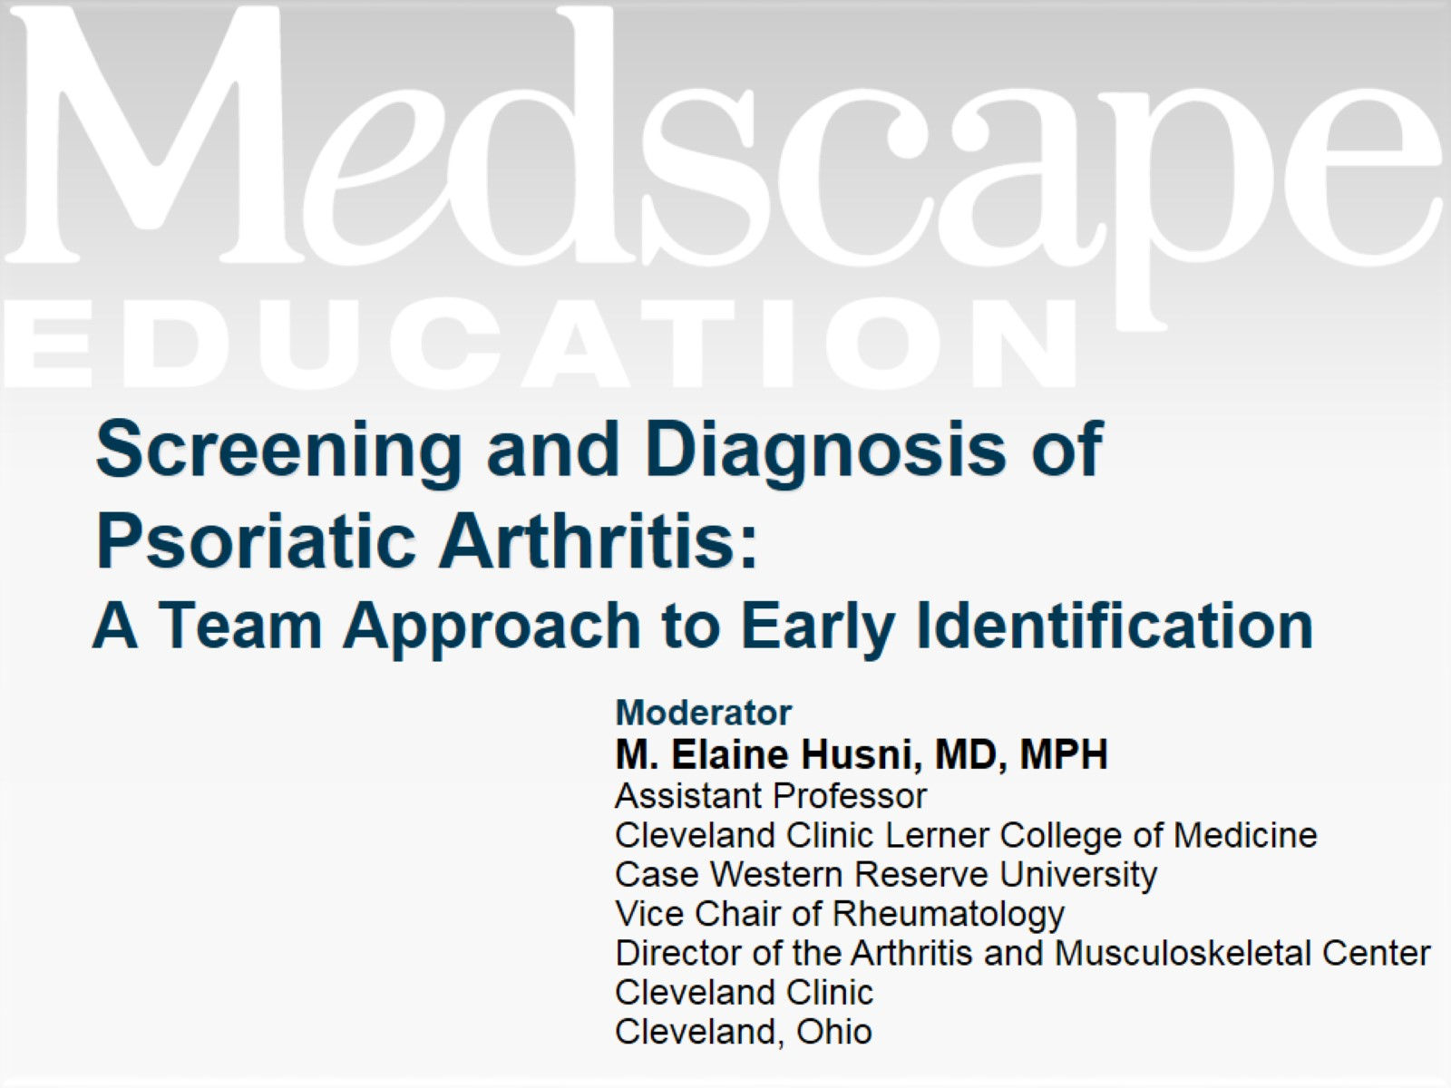
Screening and Diagnosis of Psoriatic Arthritis:

Slide 2
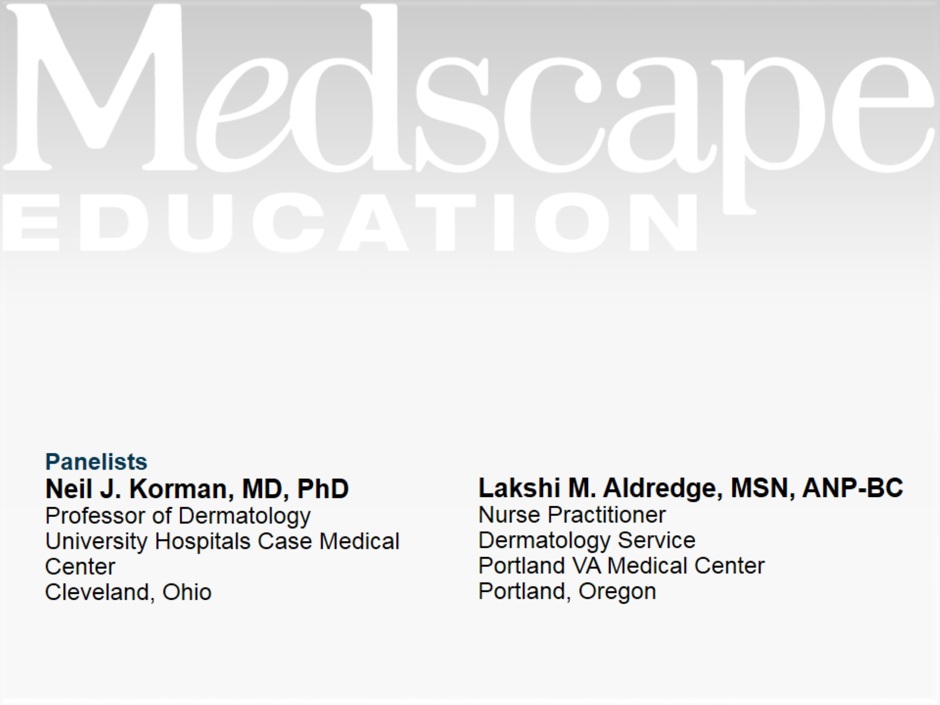

Slide 3
Psoriatic Arthritis: Overview

Slide 4
Burden of Psoriatic Arthritis

Slide 5
Burden of Psoriatic Arthritis (cont)

Slide 6
Psoriatic Arthritis: Symptom Recognition

Slide 7
Psoriatic Arthritis: Challenges in Diagnosis

Slide 8
Diagnosis of Arthritis in Patients with PsO and Joint Pain Dermatology/Rheumatology Clinic Experience

Slide 9
PsA Compared with Other Arthropathies

Slide 10
Heterogeneous Nature of PsA

Slide 11
CASPAR Classification Criteria for PsA

Slide 12
Screening Tools

Slide 13
PASE: Screening PsO Patients for Inflammatory Arthritis

Slide 14
Benefits of Screening

Slide 15
Clinical Predictors of Early Onset PsA

Slide 16
Multidisciplinary Approach to PsA Screening and Diagnosis Role of Team Members

Slide 17
Multidisciplinary Approach to PsA Screening and Diagnosis Role of Team Members (cont)

Slide 18
Multidisciplinary Approach to PsA Screening and Diagnosis Role of Team Members (cont)

Slide 19
Summary

Slide 20
Abbreviations

Slide 21
Abbreviations (cont)

Slide 22
References

Slide 23
References (cont)

Slide 24
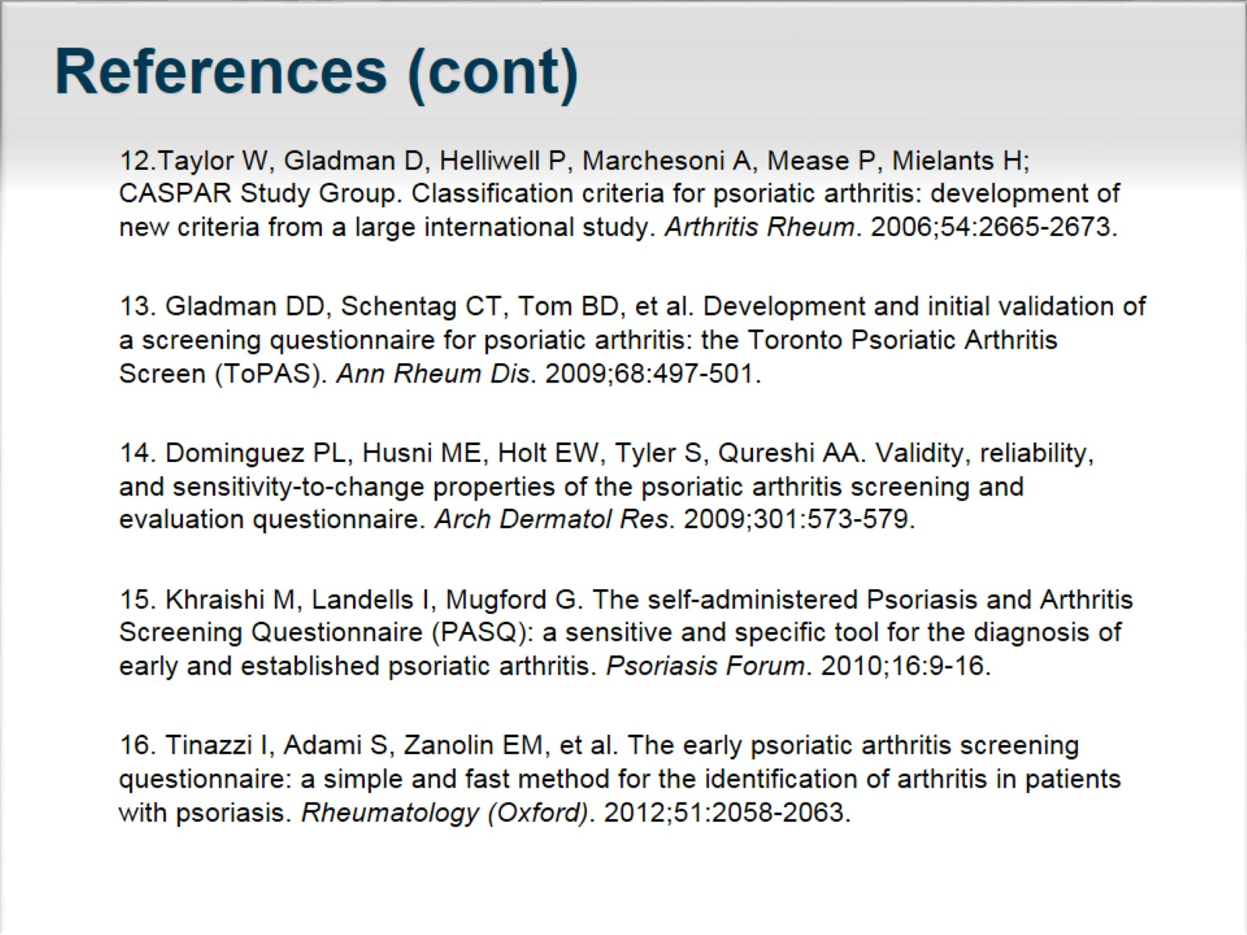
References (cont)

Slide 25
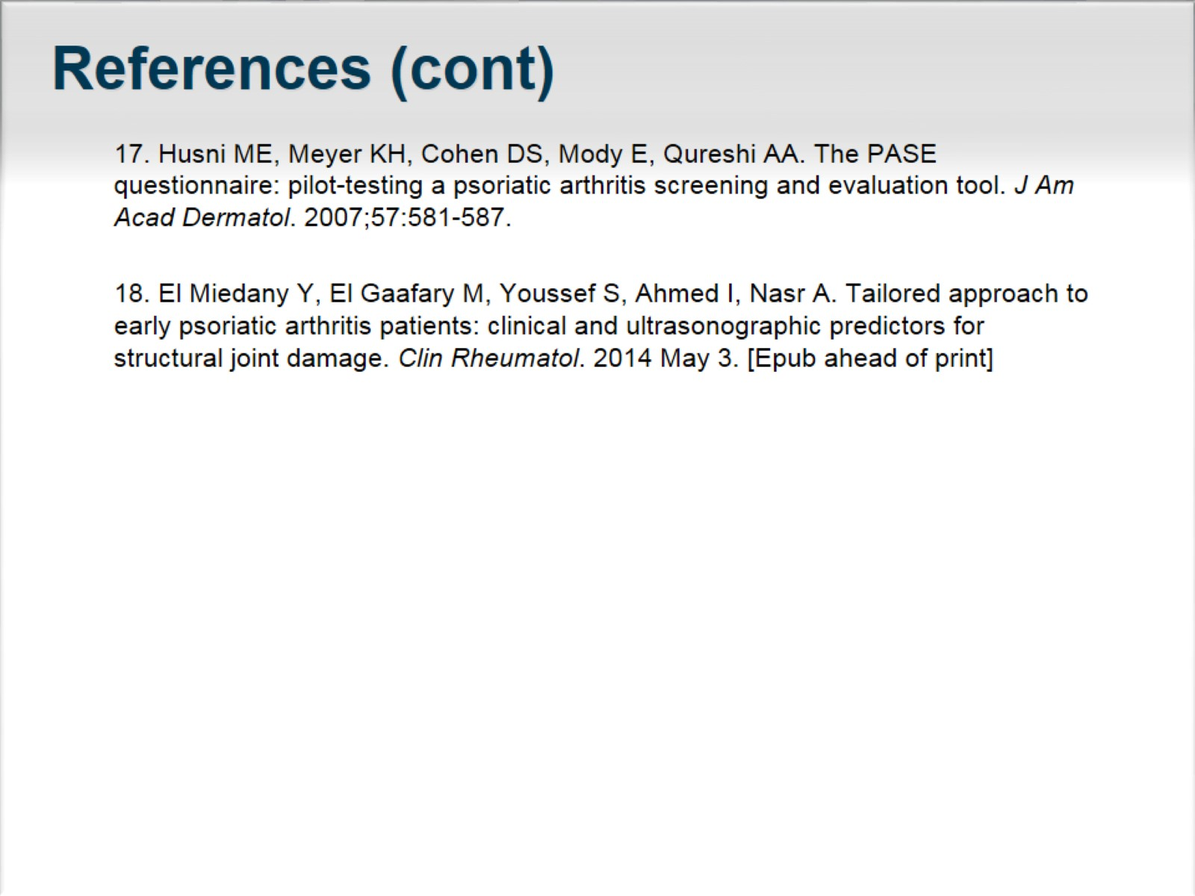
References (cont)

