Slide 1
Remote Patient Management:

Slide 2
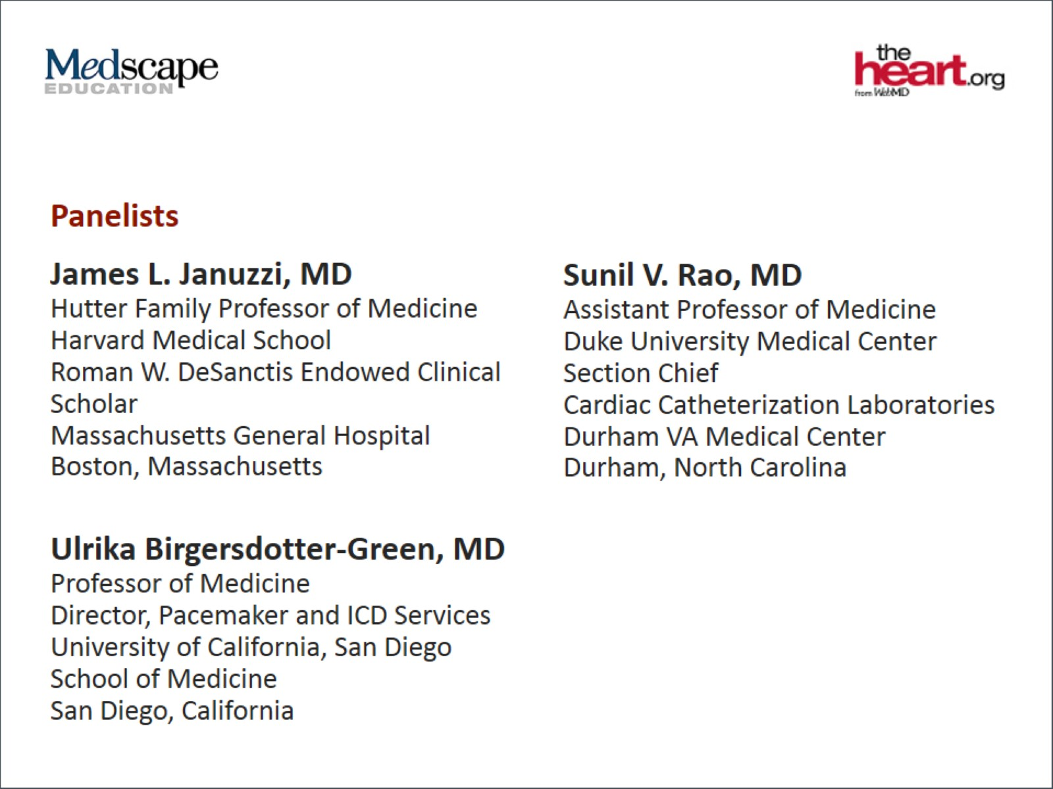

Slide 3
Learning Objectives

Slide 4
Characteristics of Patients After MI Coming to the Catheterization Lab

Slide 5
Cleveland Clinic Post-PCI Registry WCD Use Associated With Improved Survival

Slide 6
VALIANT Trial High Early Risk of SCA

Slide 7
CADILLAC Risk Score

Slide 8
Use of Evidence-based Therapies in HF After an MI

Slide 11
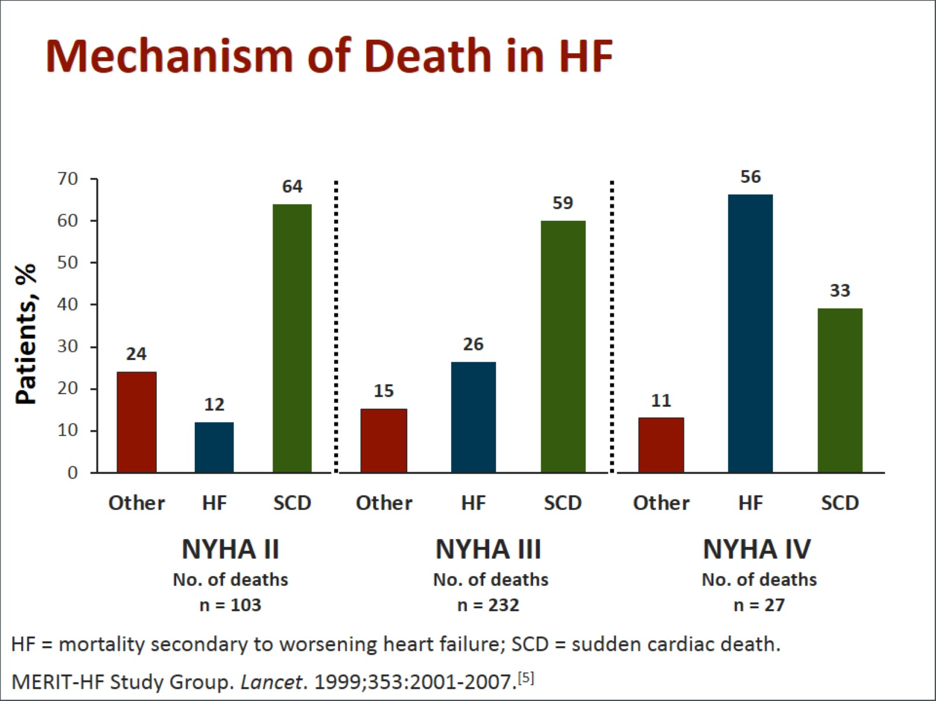
Mechanism of Death in HF

Slide 14
Use of the WCD in Peripartum CMP

Slide 15
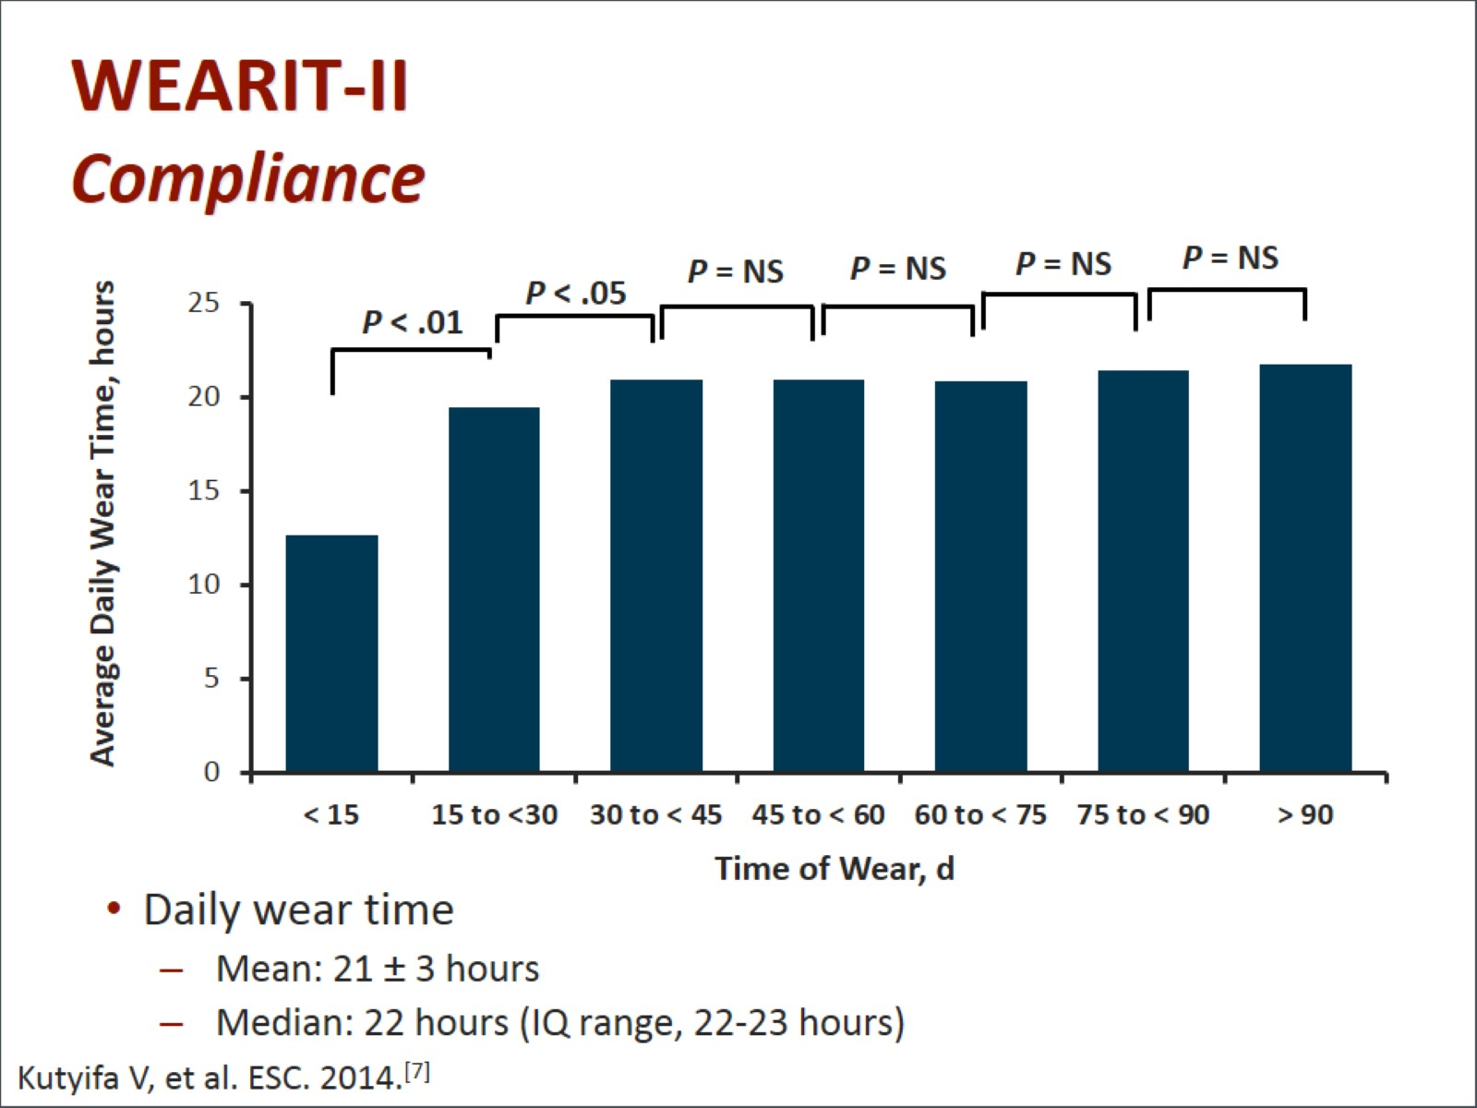
WEARIT-II Compliance

Slide 16
WEARIT-II Study Population

Slide 17
WEARIT-II ICD Implantation Rate by Disease Etiology

Slide 18
The WCD A Tool for Therapy and Diagnosis

Slide 21
Patients After PCI Avoiding Readmission

Slide 22
Abbreviations

Slide 23
Abbreviations (cont)

Slide 24
Abbreviations (cont)

Slide 25
References

Slide 26
References (cont)

