Slide 1
THE TRUTH ABOUT MODERN OBESITY AGENTS: ARE THEY REALLY SAFE AND EFFECTIVE?

Slide 2
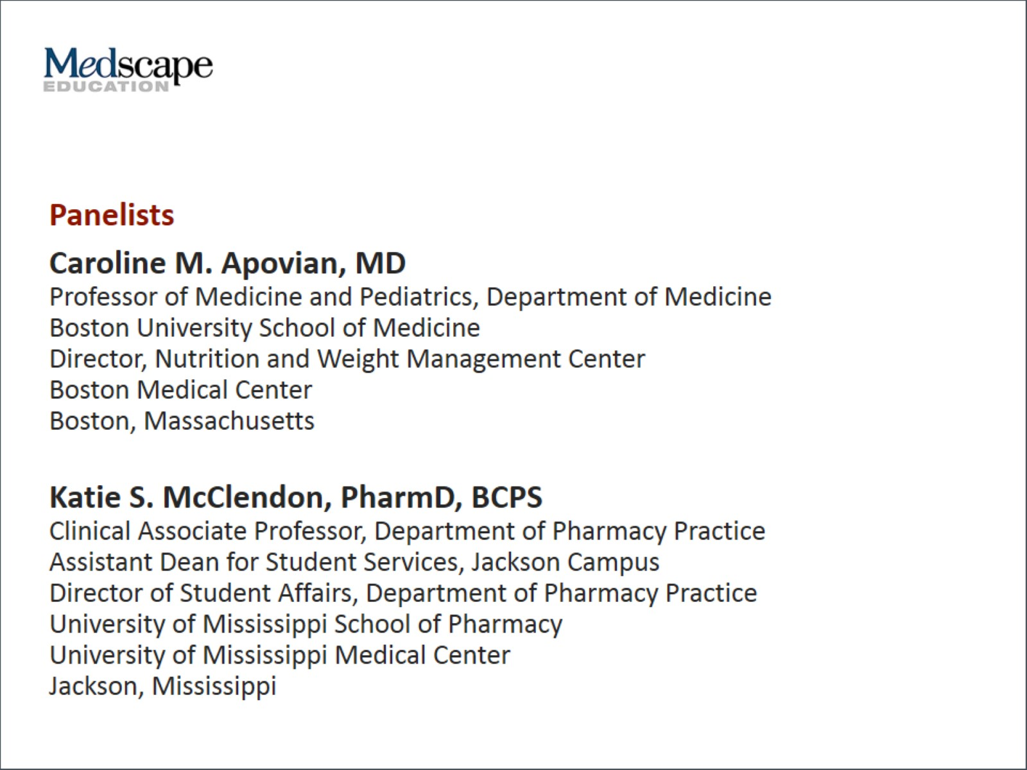

Slide 3
Program Goals

Slide 4
Introduction

Slide 5
Older Antiobesity Medications

Slide 6
Older Obesity Medications (Available Prior to 2012)

Slide 7
Managing Obesity as a Chronic Disease

Slide 8
Orlistat

Slide 9
Newer Antiobesity Medications

Slide 12
Choosing the Appropriate Medication

Slide 13
Drug Tolerability

Slide 14
How Much Weight Can a Patient Expect to Lose?

Slide 15
Obesity in Patients With T2D

Slide 16
Stopping Rules

Slide 17
Health Benefits of Weight Loss

Slide 18
Closing Comments

Slide 19
Abbreviations

Slide 20
Abbreviations (cont)

Slide 21
References

Slide 22
References (cont)

Slide 23
References (cont)

Slide 24
References (cont)

Slide 25
References (cont)

