Slide 1
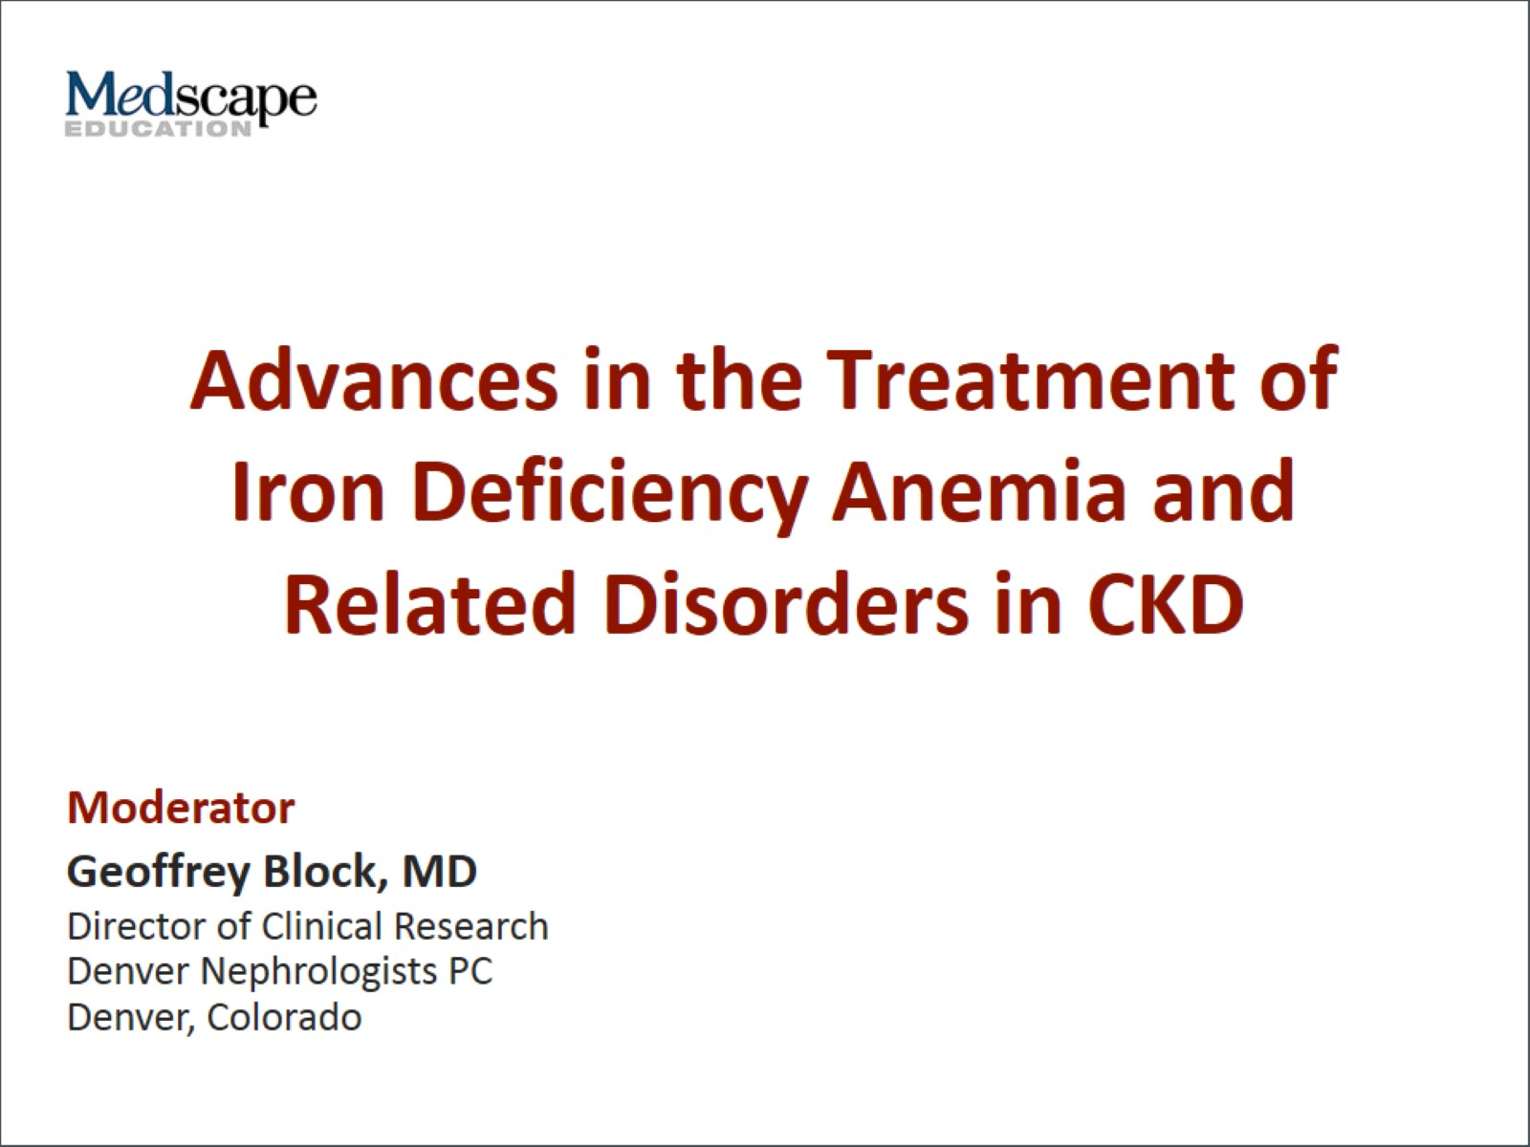
Advances in the Treatment of Iron Deficiency Anemia and Related Disorders in CKD

Slide 2


Slide 3
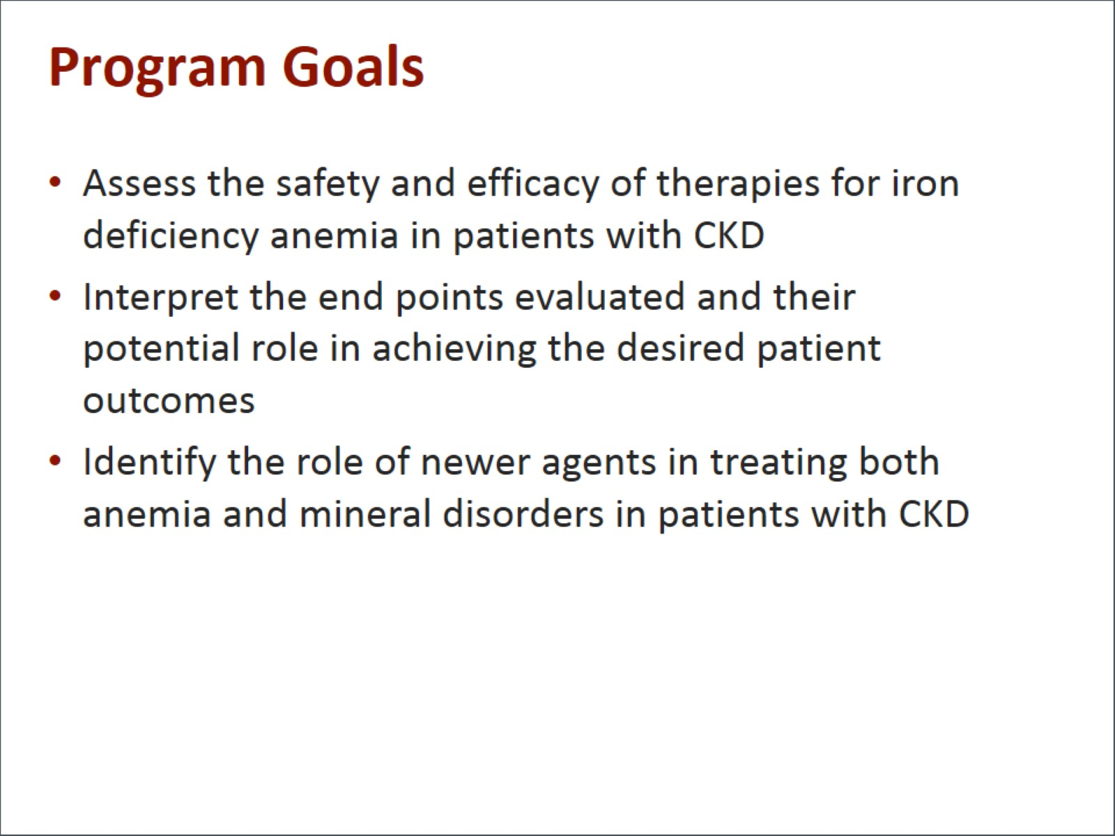
Program Goals

Slide 4
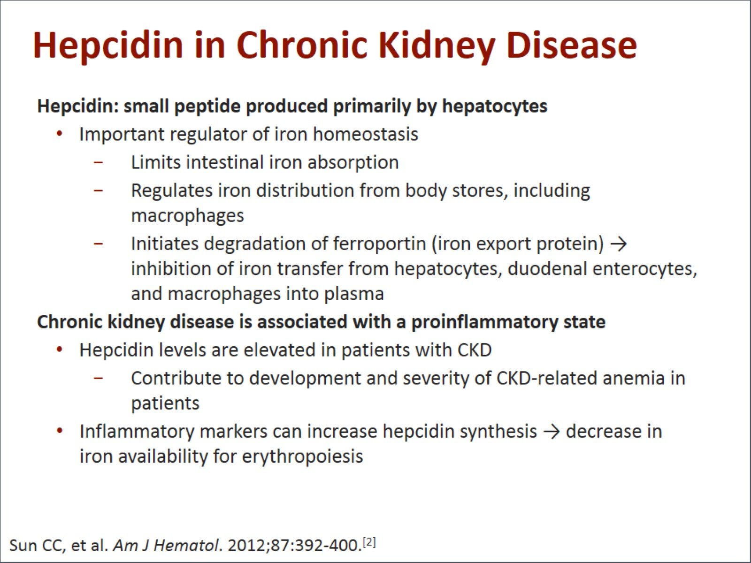
Hepcidin in Chronic Kidney Disease

Slide 5
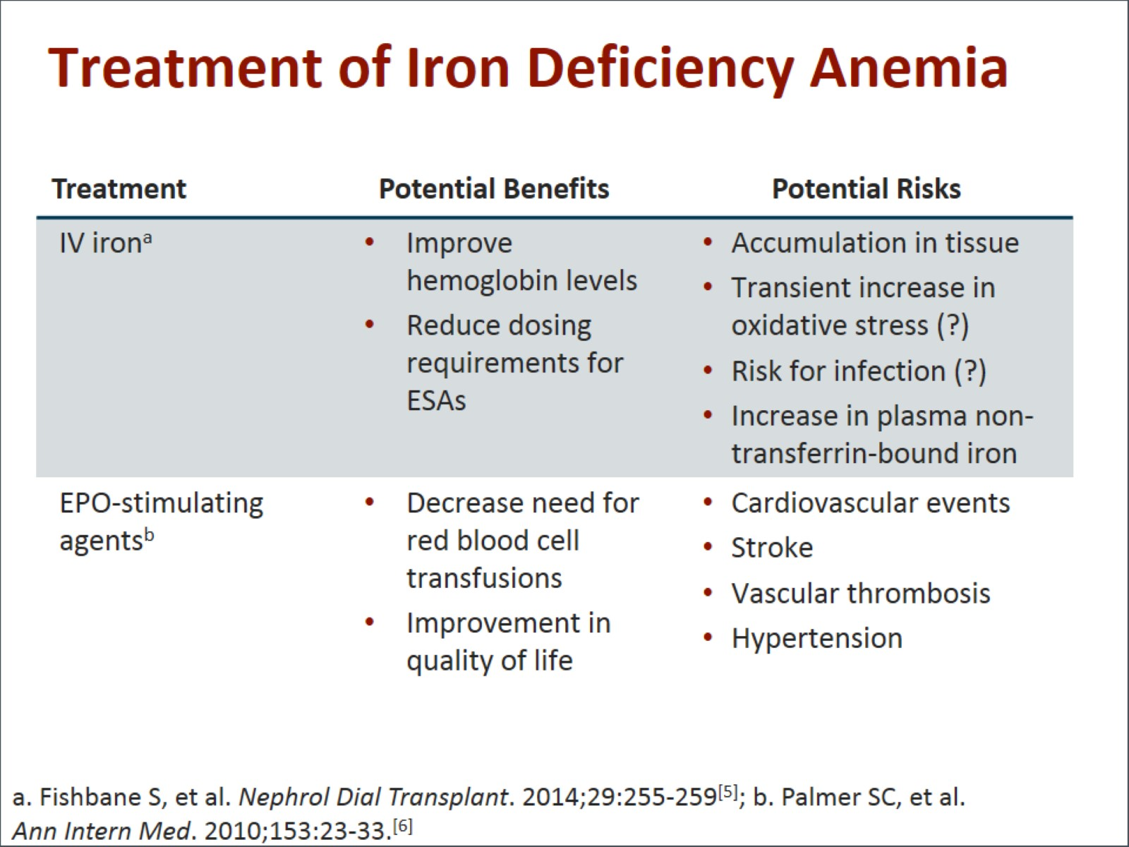
Treatment of Iron Deficiency Anemia

Slide 6
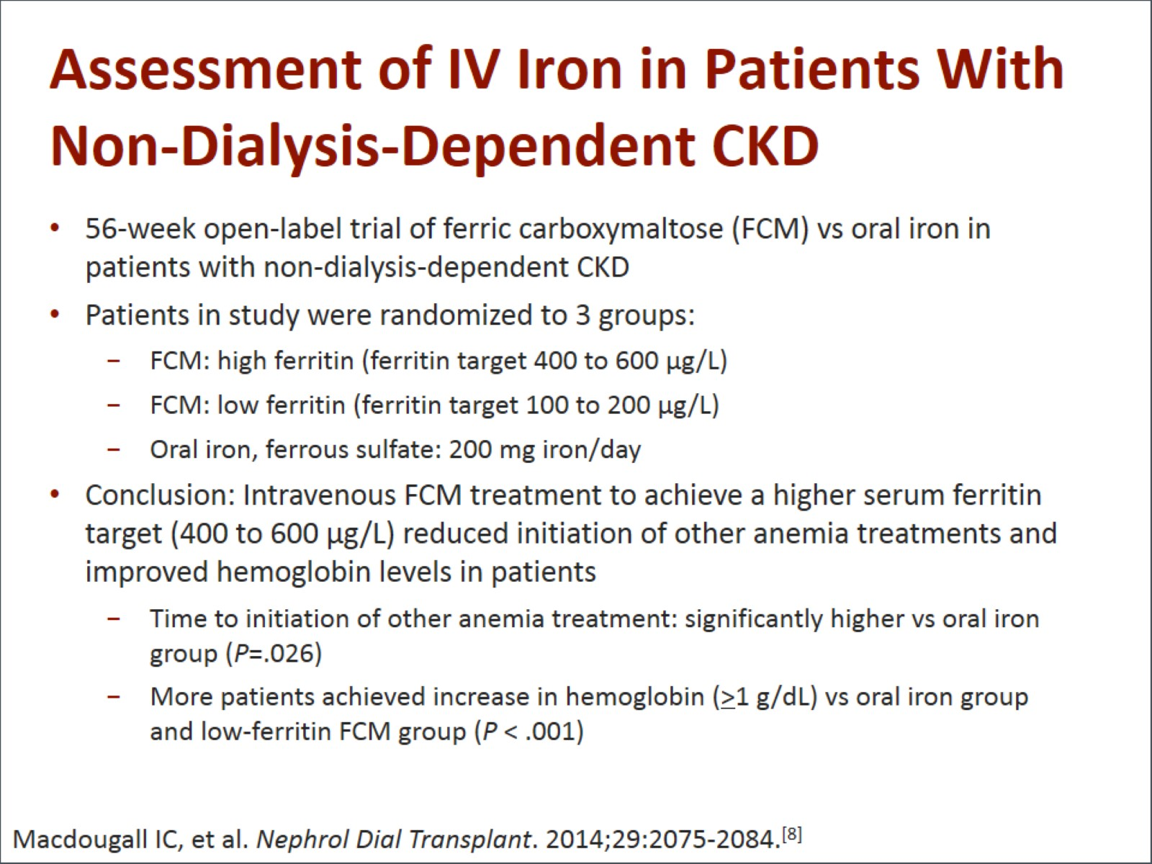
Assessment of IV Iron in Patients With Non-Dialysis-Dependent CKD

Slide 7
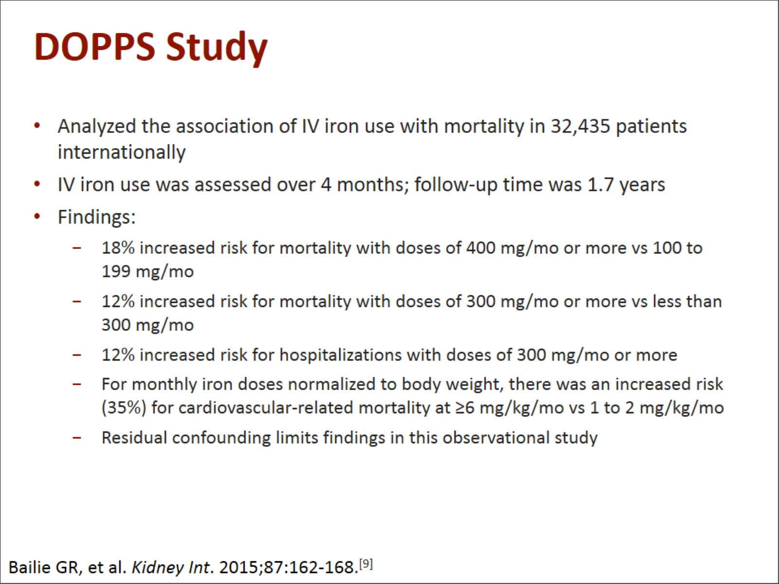
DOPPS Study

Slide 8
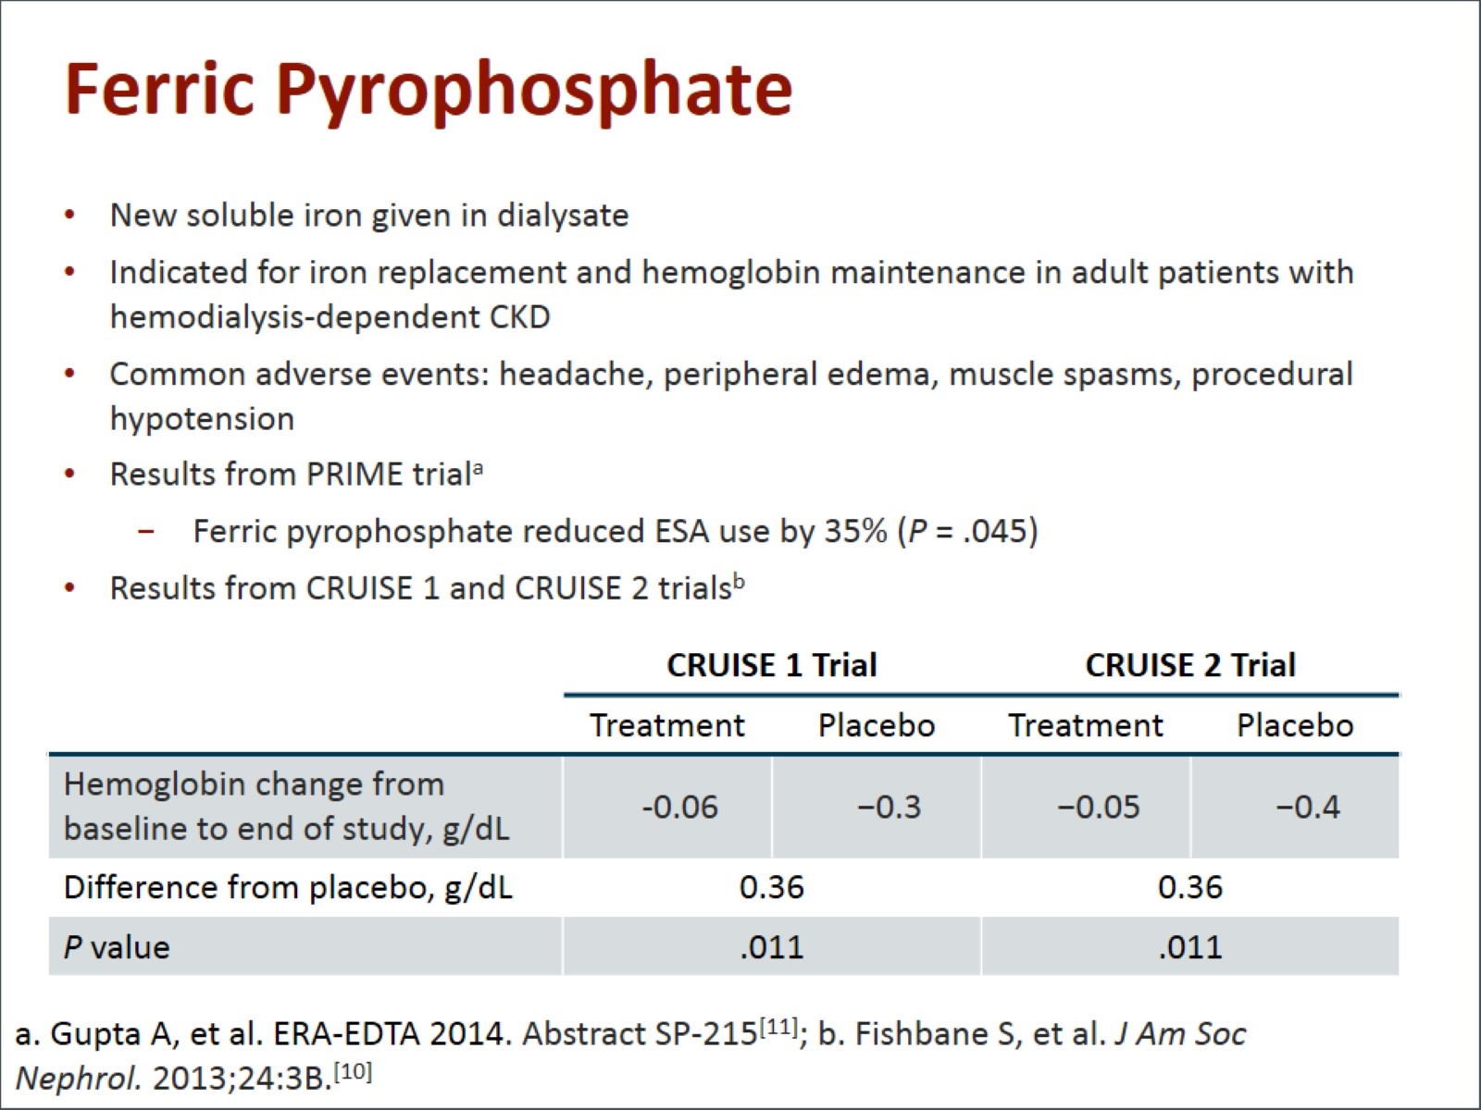
Ferric Pyrophosphate

Slide 9
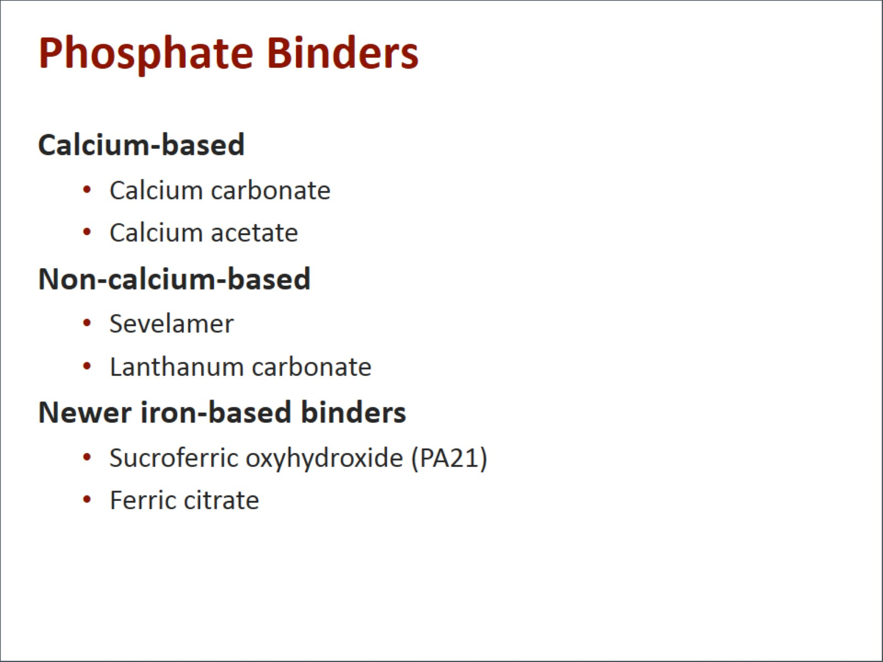
Phosphate Binders

Slide 10
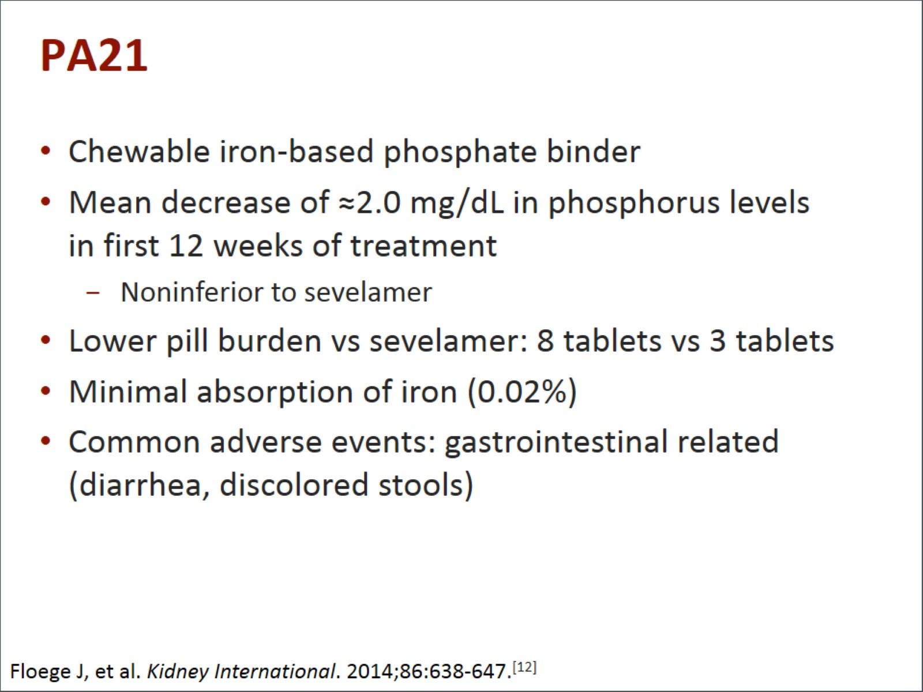
PA21

Slide 11
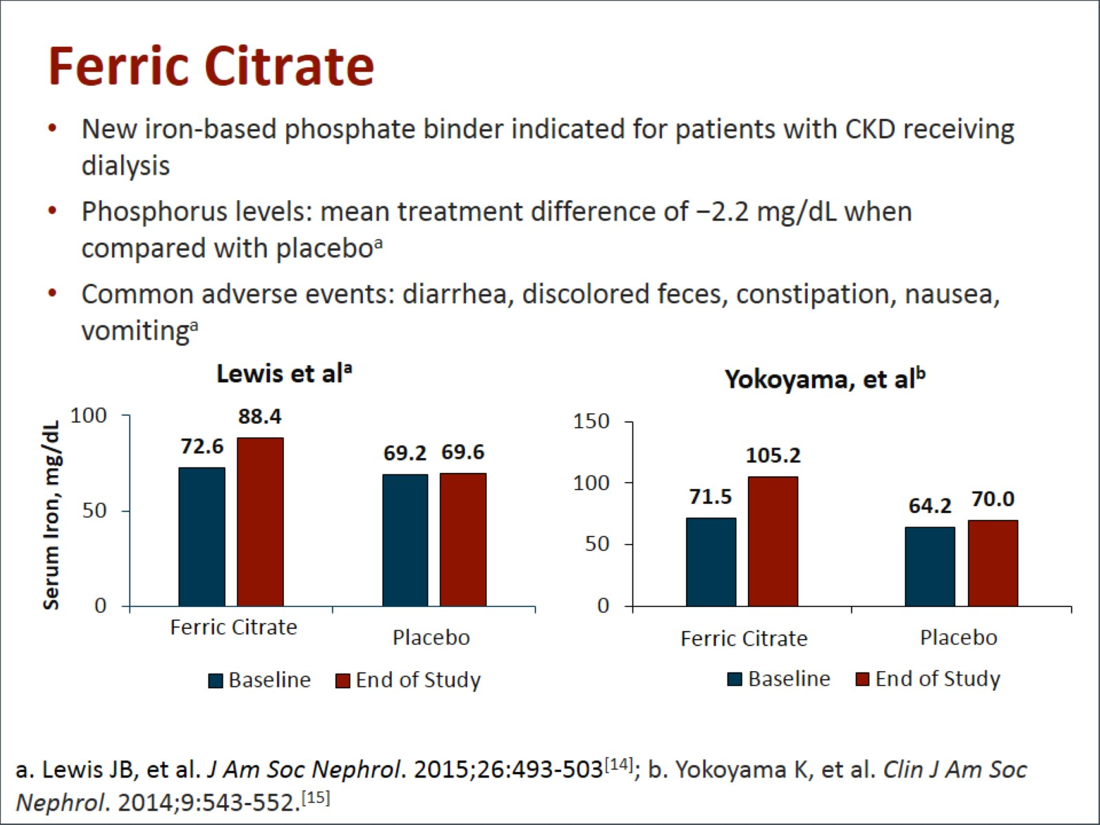
Ferric Citrate

Slide 12
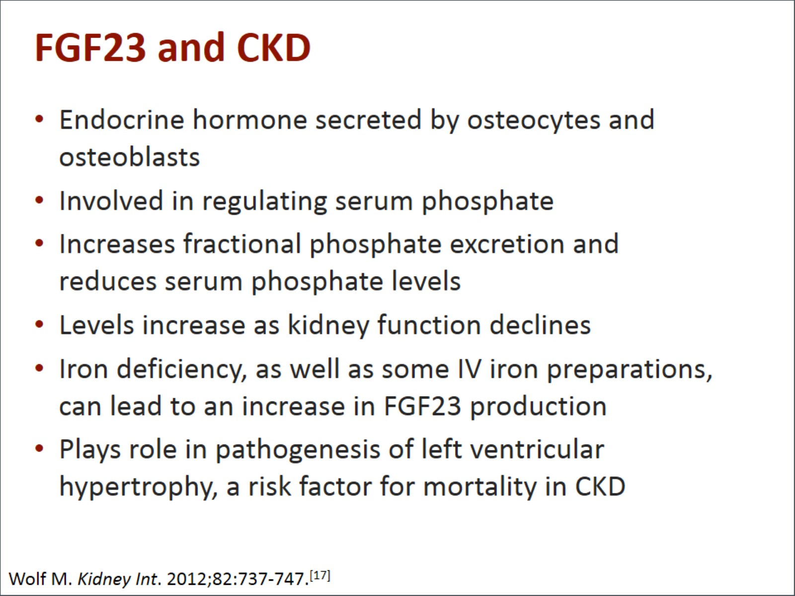
FGF23 and CKD

Slide 13
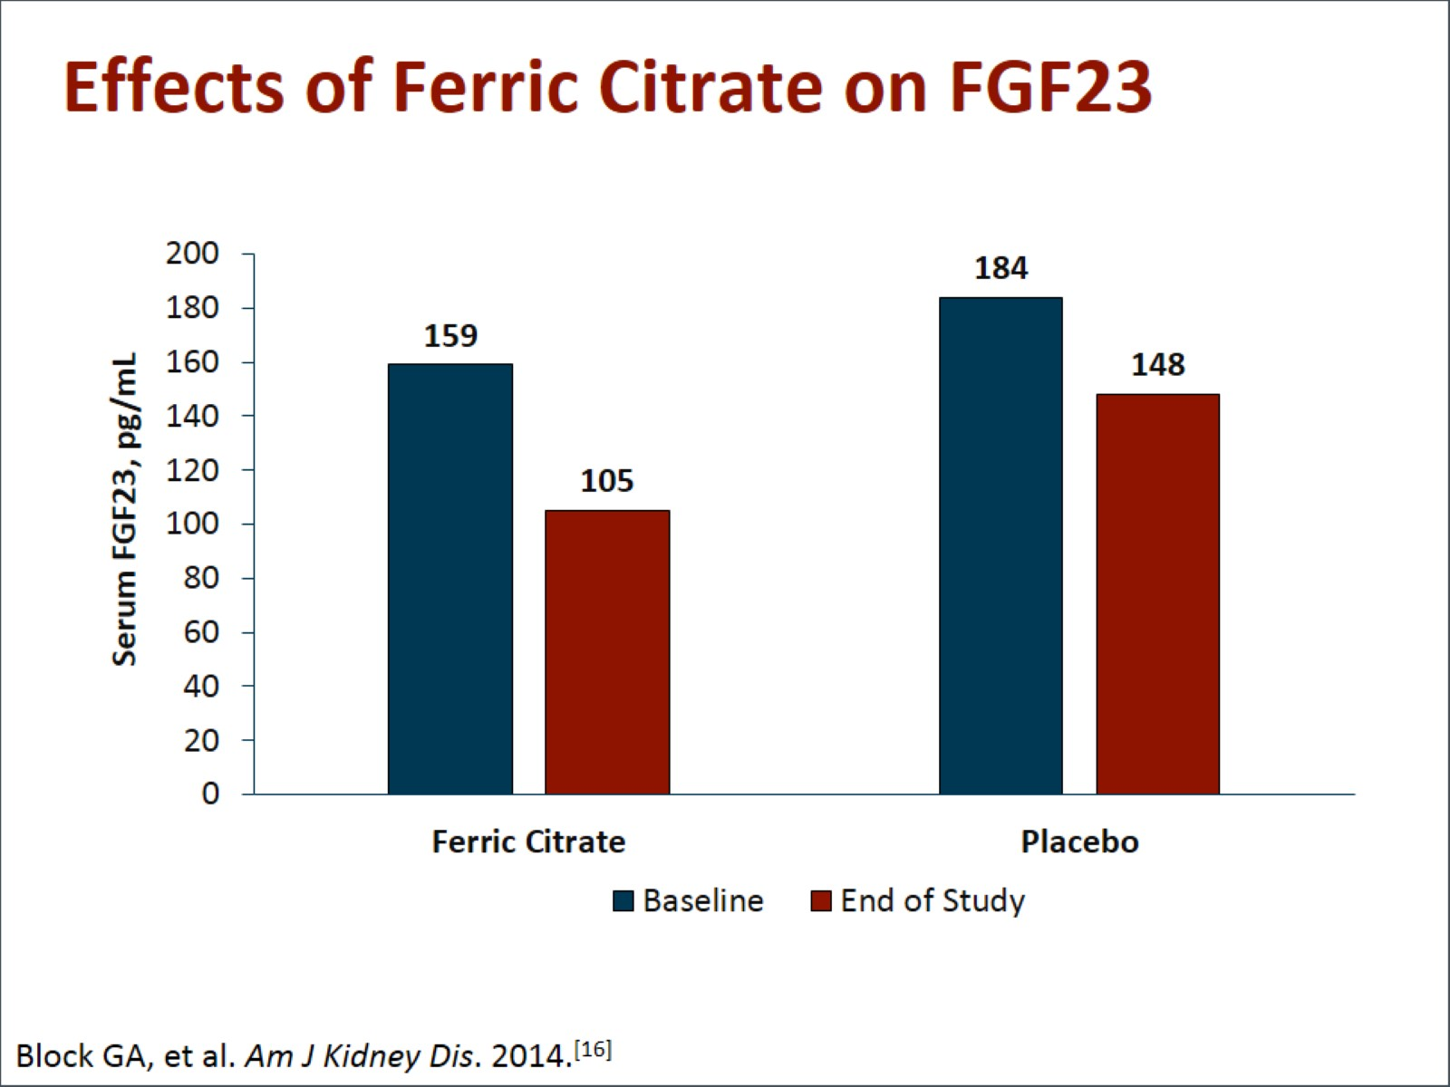
Effects of Ferric Citrate on FGF23

Slide 14
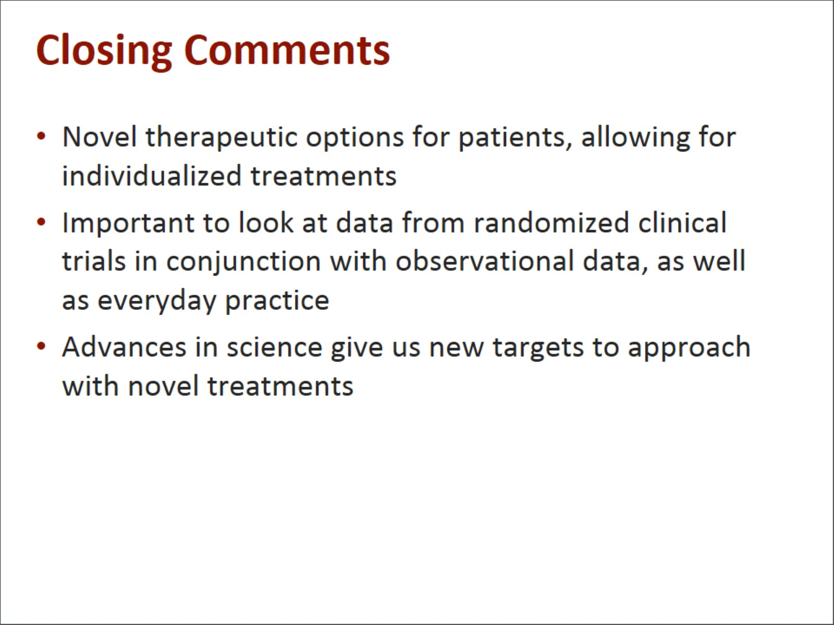
Closing Comments

Slide 15
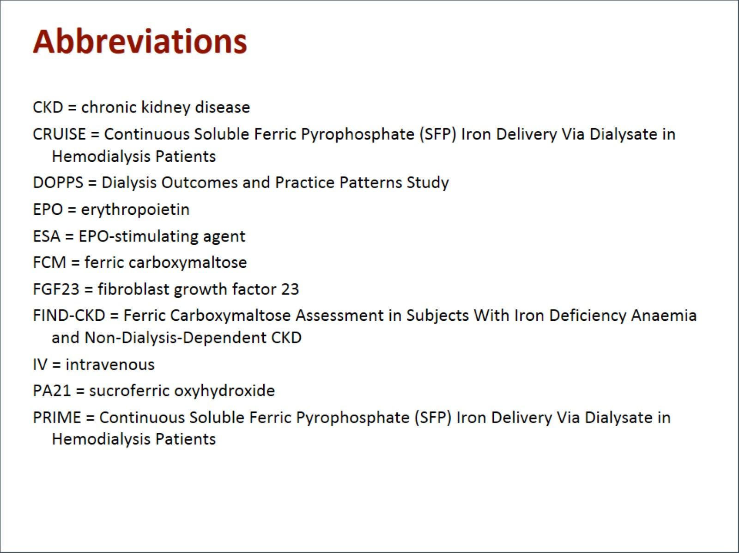
Abbreviations

Slide 16
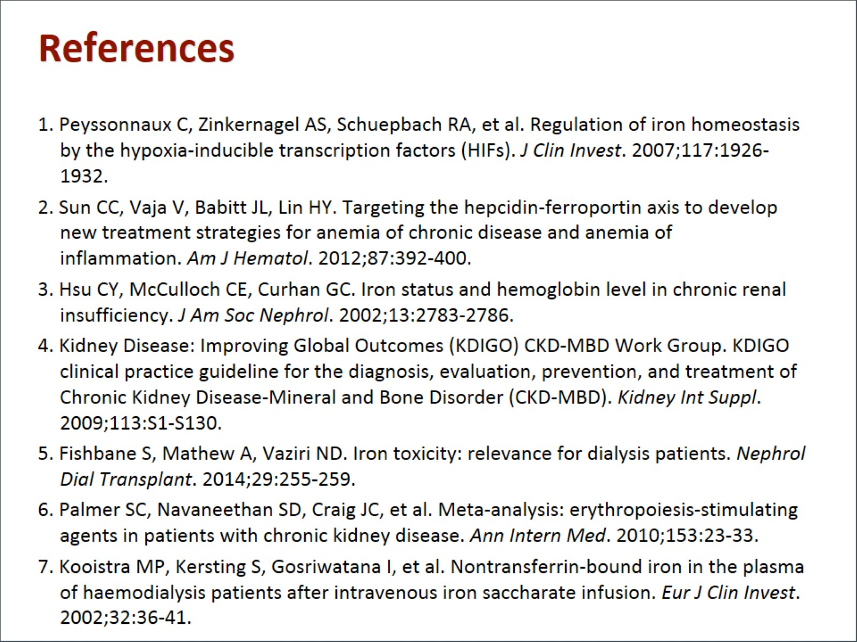
References

Slide 17
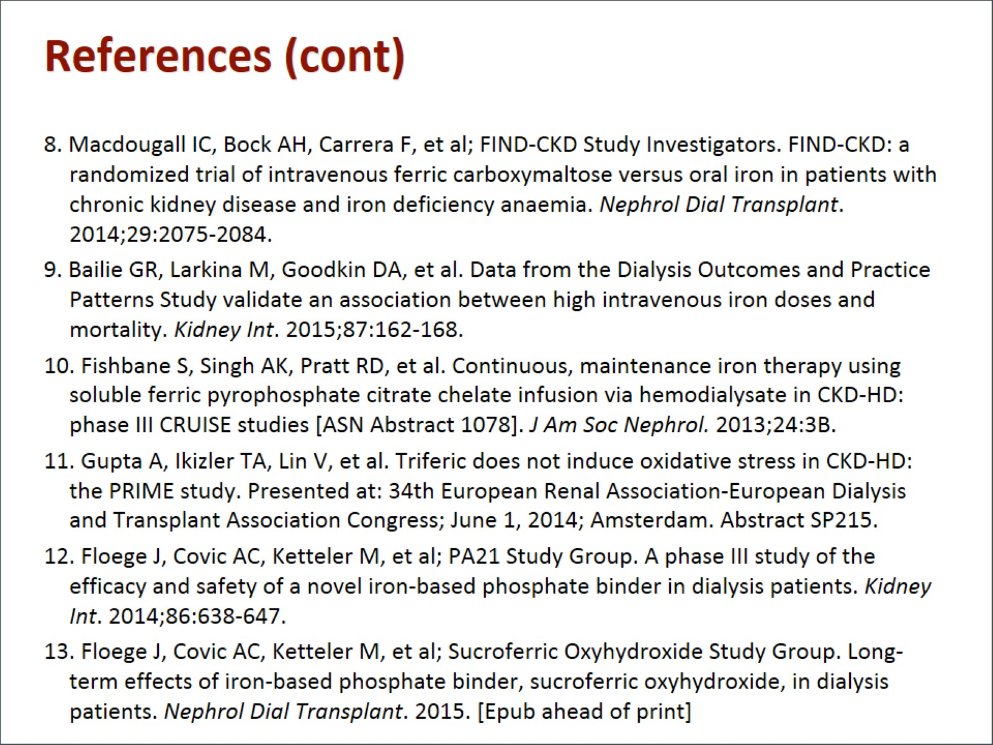
References (cont)

Slide 18
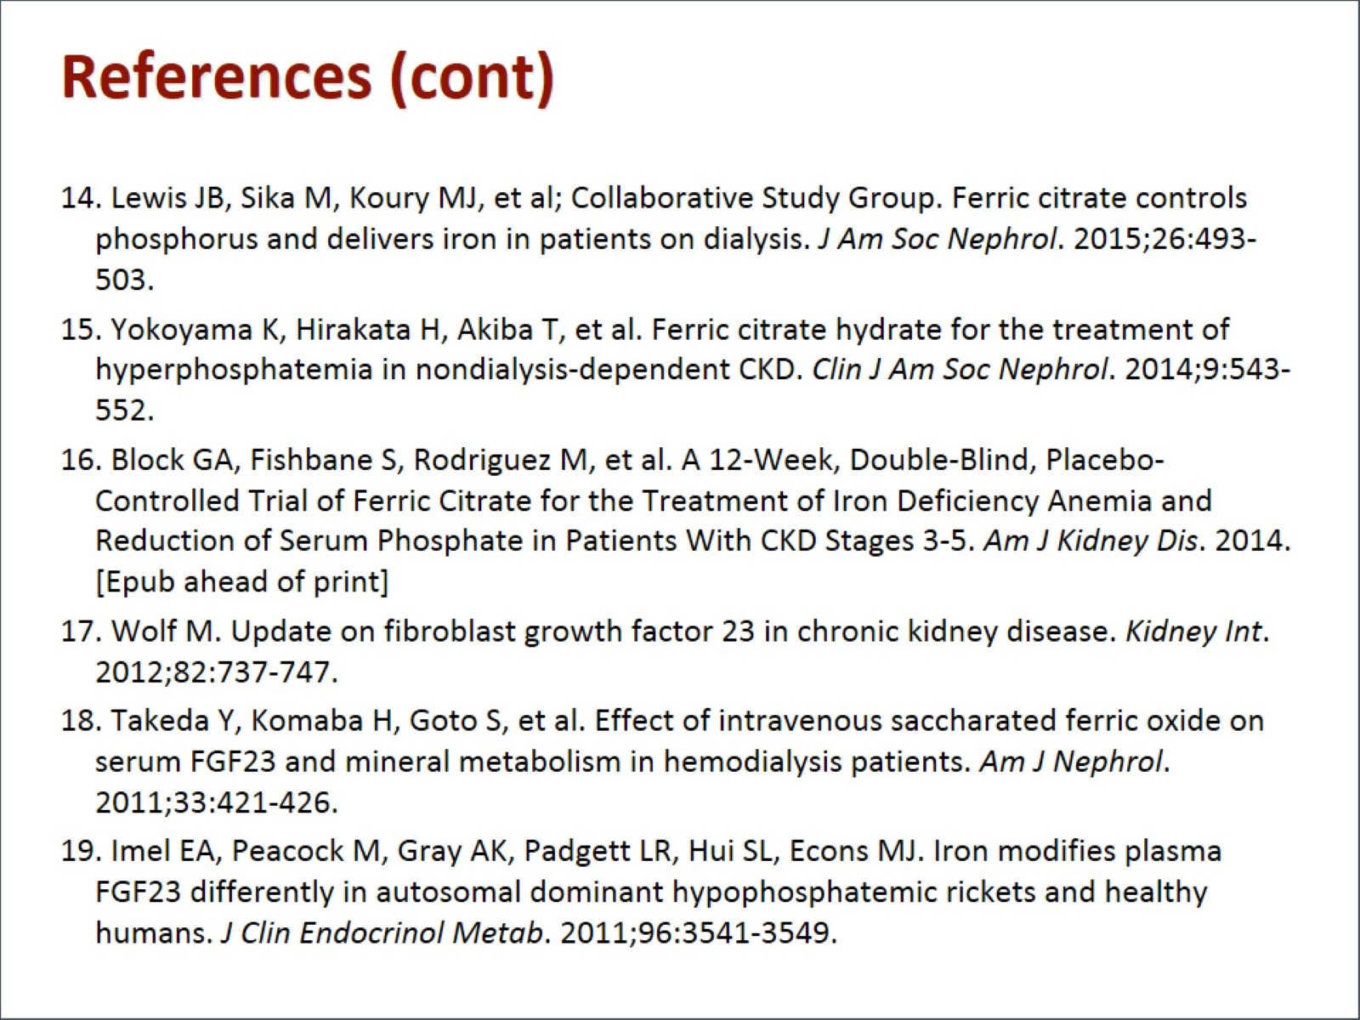
References (cont)

Slide 19
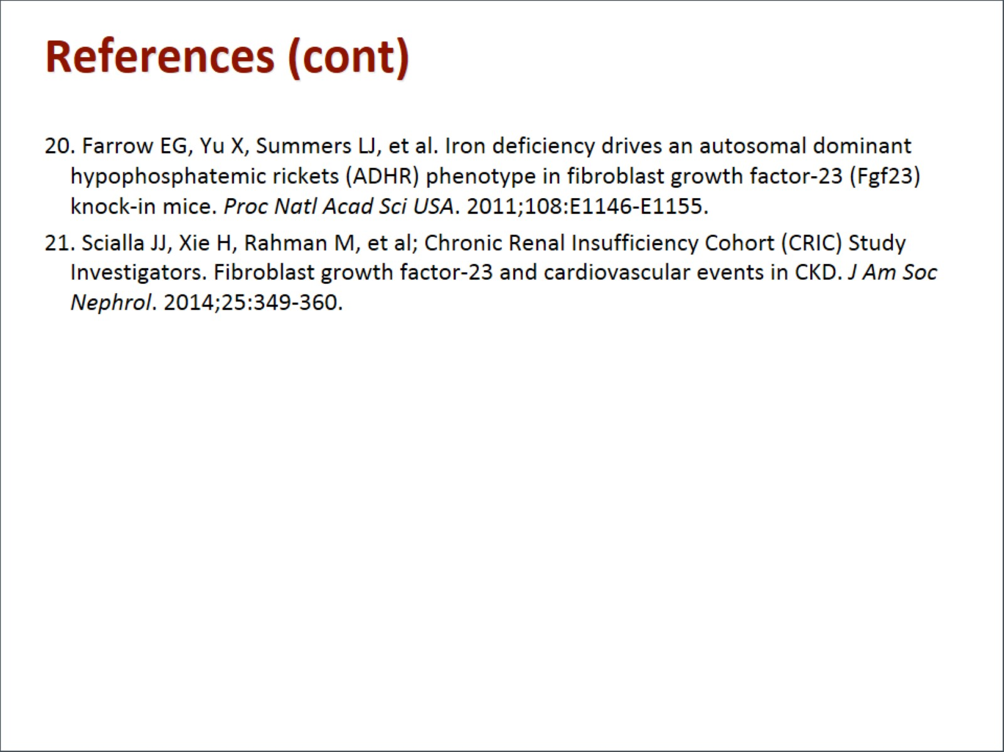
References (cont)

