Slide 1
Mycosis Fungoides-Cutaneous T-cell Lymphoma

Slide 2
Program Goal

Slide 3
Classification and Pathogenesis of CTCL

Slide 4
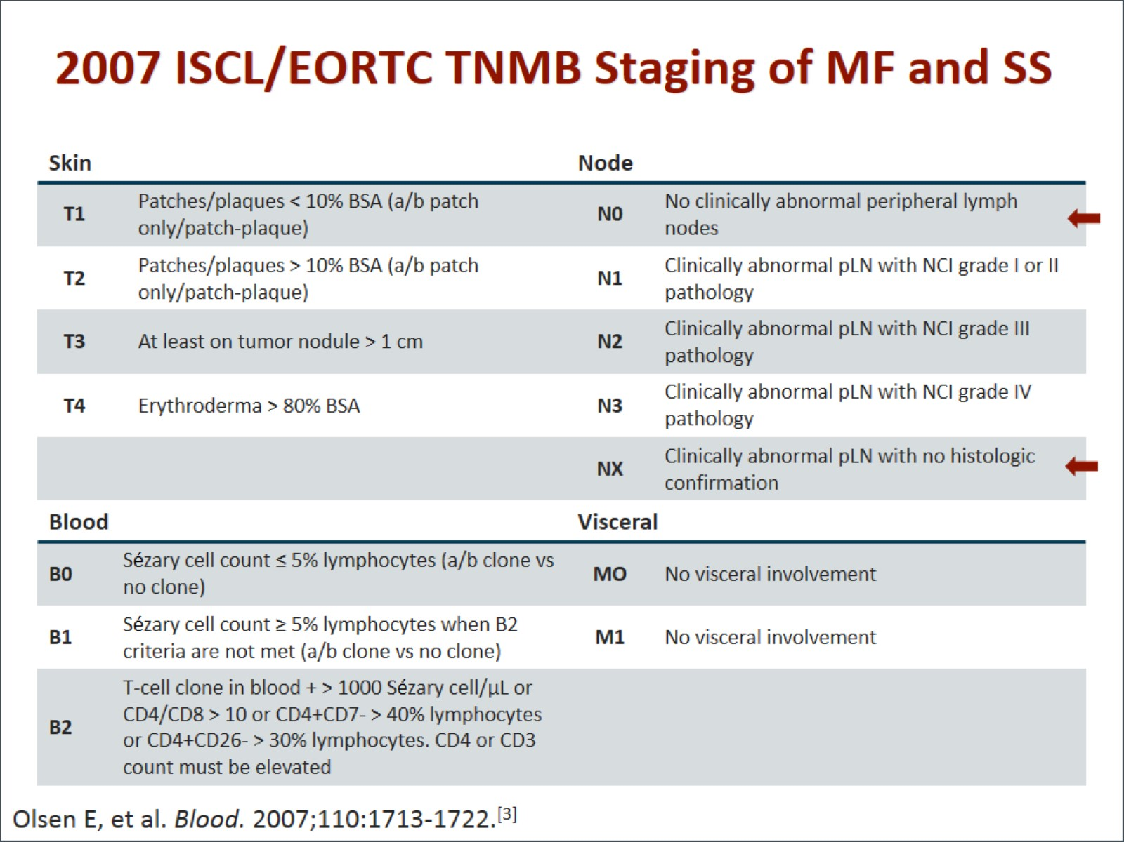
2007 ISCL/EORTC TNMB Staging of MF and SS

Slide 5
Staging of MF and SS

Slide 6
Diagnosis of CTCL

Slide 7
Histopathology of CTCL

Slide 8
Case #1: History

Slide 9
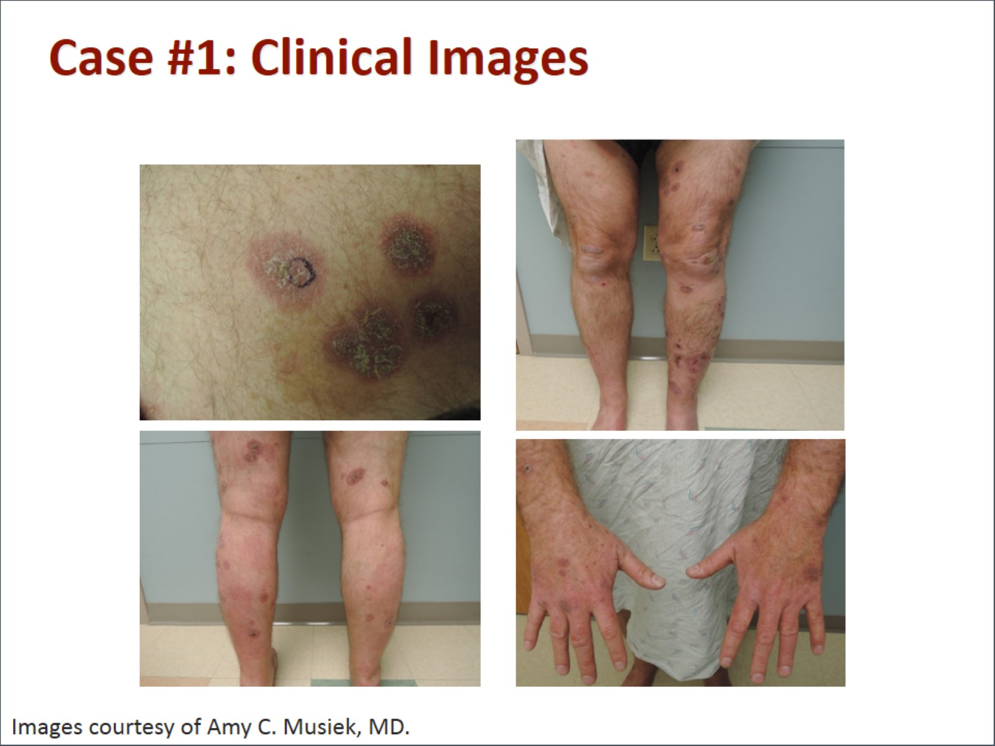
Case #1: Clinical Images

Slide 10
Case #1: Histopathology

Slide 11
Case #1: Staging and Diagnosis

Slide 12
Skin-Directed Therapy for Early-stage CTCL

Slide 13
Topical Treatments for Early-stage MF

Slide 14
Topical Treatments for Early-stage MF (cont)

Slide 15
Phototherapy

Slide 16
Localized Electron Beam — Low Dose

Slide 17
Case #2: History

Slide 18
Case #2: Clinical Images

Slide 19
Case #2: Diagnostic Workup

Slide 20
Case #2: Treatment

Slide 21
IFN-alfa for the Treatment of CTCL

Slide 22
Bexarotene for the Treatment of CTCL

Slide 23
HDAC Inhibitors for the Treatment of CTCL

Slide 24
Other Systemic Treatment Options

Slide 25
Estimating Prognosis in CTCL

Slide 26
Summary: CTCL

Slide 27
Abbreviations

Slide 28
Abbreviations (cont)

Slide 29
Abbreviations (cont)

Slide 30
References

Slide 31
References (cont)

Slide 32
References (cont)

Slide 33
References (cont)

Slide 34
References (cont)

Slide 35
References (cont)

Slide 36
References (cont)

