Slide 1
Removing the Escape Hatch
Restoring Immune System Activation and Memory in Cancer
Michael A. Postow, MD
Assistant Attending Physician
Melanoma and Immunotherapeutics Service
Memorial Sloan Kettering Cancer Center
New York, New York
Notes:
Title Slide Layout

Slide 2
Program Goals
Explain key mechanisms of immune escape and their role in cancer disease progression
Explain how the immune system can be harnessed to induce a tumor-specific response that results in a clinical response and reduction in overall tumor burden

Slide 3
Cancer Immunotherapy
Cancer immunotherapy was designated scientific breakthrough of the year by Science in 2013
Cancer immunotherapy is now demonstrating impressive tumor responses in patients with many different cancers
Couzin-Frankel J. Science. 2013;342:1432-1433.^{[1]}

Slide 4
Cancer Immunotherapy: Key Questions
How does the normal immune system function?
How do tumors escape the immune system?
How does immunotherapy restore the immune system’s control of cancer?

Slide 5
Normal Immune System Function
2 components of the immune system
Innate immune system: first line of defense
Macrophages, natural killer cells, dendritic cells
Recognizes conserved molecular patterns
Kills pathogens and processes antigen to initiate adaptive immunity
Adaptive immune system: specialized/memory
T cells (cellular) and B cells (humoral/antibody)
T-cell receptor and B-cell receptor for specificity

Slide 6
Innate and Adaptive Immunity
Pathogen
Innate immunity
Macrophage
Natural killer cell
Neutrophil
Dendritic cell (antigen-presenting cell [APC])
Pathogen-specific attack
Initial attack on pathogen
Antigen + MHC
B7
Dendritic APC -- Movement to lymph node
Adaptive immunity
Dendritic APC
T Cell
B Cell
T-cell receptor
Killer T cells (cellular immunity)
CD28
Antibody (humoral immunity)
Akira S. Philos Trans R Soc Lond B Biol Sci. 2011;366:2748-2755.^{[3]}

Slide 7
2 Signals for T-Cell Activation
Lymph node
Activated T cell
T-cell receptor
CD28
Signal 1
Signal 2
MHC with antigen
B7
Dendritic cell
Postow MA, et al. J Clin Oncol. 2015 Jan 20. [Epub ahead of print]^{[4]}

Slide 8
CTLA4 in Immune Cell Deactivation
Lymph node
Inhibited T cell
T-cell receptor
CD28
CTLA4
Signal 2 is blocked*
Signal 1
MHC with antigen
B7
Dendritic cell
*Antibody to CTLA4 blocks its interaction with B7, restoring the ability of B7 to interact with CD28.
Postow MA, et al. J Clin Oncol. 2015 Jan 20. [Epub ahead of print]^{[4]}

Slide 9
Immune System Interaction With Cancer
Tumor Elimination
Tumor Equilibrium
Tumor Escape
Tumor heterogeneity and time under immune selective pressure
Immune cell
Dead tumor cell
Cytokine
Immune-mediated tumor cell death
Resistant tumor cell
Tumor cell
Stromal cell
Dunn GP, et al. Nat Immunol. 2002;3:991-998^{[5]}; Schreiber R, et al. Science. 2011;331:1565-1570^{[6]};
Mittal D, et al. Curr Opin Immunol. 2014;27:16-25.^{[7]}

Slide 10
Control of the T Cell
T-cell activating receptors
CD28
OX40
GITR
CD137
CD27
HVEM
Agonistic antibodies to T-cell activating receptors stimulate the immune system by turning up the activation
T-cell inhibitory receptors
CTLA4
PD-1
TIM-3
BTLA
VISTA
LAG3
Antibodies that block T-cell inhibitory receptors stimulate the immune system by blocking this inhibition
Mellman I, et al. Nature. 2011;21:480-489.^{[9]}

Slide 11
Immunity in Tumor Control
Lymph node
MHC-antigen complex
T cells
NK
NK
Dendritic cells
T-cell infiltration and killing of tumor cells
Tumor antigen uptake and processing
T
MHC-antigen complex
Antigen presentation and T-cell activation
PD-L1
NK
Tumor antigen
T
PD-1
Immunosuppression
PD-L1
B
NK
B
Tumor
Adapted from Mellman I, et al. Nature. 2011;21:480-489.^{[9]}

Slide 12
Immunotherapy in Tumor Control
Vaccines
Cytokines
Adoptive cell transfer
Immunomodulatory antibodies

Slide 13
“Driving” an Immune Response
T-cell receptor: Antigen-MHC
CD28: B7
CTLA4: B7
PD-1: PD-L1
Signal 1
Signal 2
Blockade of Signal 2

Slide 14
Therapies to “Drive” Immune Response
Vaccines
Adoptive T-cell therapies
CAR-T
Raval RR, et al. J Immunother Cancer. 2014;2:14.^{[2]}

Slide 15
2 Signals for T-Cell Activation
Lymph node
Activated T cell
T-cell receptor
CD28
Signal 1
Signal 2
MHC with antigen
B7
Dendritic cell
Postow MA, et al. J Clin Oncol. 2015 Jan 20. [Epub ahead of print]^{[4]}

Slide 16
Sipuleucel-T Vaccine Improves Survival in Men With Metastatic Prostate Cancer
Therapeutic cancer vaccines involve the delivery of unique antigens present on malignant cells along with immunostimulants
The sipuleucel-T vaccine consists of autologous peripheral-blood mononuclear cells (including APCs) that were activated ex vivo
OS was improved for patients receiving sipuleucel-T vs placebo in a randomized, placebo-controlled trial of 512 patients with metastatic castration-resistant prostate cancer
Sipuleucel-T arm (n = 341): median OS = 25.8 months
Placebo arm (n = 171): median OS = 21.7 months
Median OS benefit: 4.1 months
HR : 0.78 (95% CI, 0.61-0.98; P = .03)
36-month survival probability: 31.7% (sipuleucel-T) vs 23.0% (placebo)
Kantoff PW, et al. N Engl J Med. 2010;363:411-422.^{[10]}

Slide 17
What Is a CAR T cell?
CAR T cells are a form of adoptive T cell therapy where externally manipulated T cells are infused.
Signal 1
Signal 2
An antibody targeting a tumor-specific protein is substituted for the T-cell receptor
T cells are manipulated to express costimulatory signaling domains to prevent development of immune tolerance
Raval RR, et al. J Immunother Cancer. 2014;2:14.^{[2]}

Slide 18
Therapies to “Drive” an Immune Response
Vaccines
Adoptive T-cell therapies
CAR-T
Cytokines
Agonist antibodies (4-1BB, GITR)

Slide 19
IL-2 Therapy
IL-2 is a cytokine that functions as a T-cell growth factor
High-dose IL-2 produces durable responses in 6%-10% of patients with advanced melanomaª or RCC/mRCC^{b}
In 270 patients with metastatic melanoma receiving high-dose IL-2, ORR = 16% (CR = 6%; PR = 10%); median PFS for patients achieving CR ≥ 54 monthsª
In 7 phase 2 studies of patients with metastatic renal cell carcinoma (255 patients total), ORR = 15% (CR = 7%; PR = 8%); median duration of response (all responders) = 54 months^{b}
Approved by the US FDA for use in advanced melanoma and metastatic renal cell carcinoma^{c}
a. Atkins MB, et al. J Clin Oncol. 1999;17:2105-2116^{[18]}; b. McDermott DF, Atkins MB. Expert Opin Biol Ther. 2004;4:455-468^{[19]}; c. Proleukin® PI 2012.^{[17]}

Slide 20
Therapies to “Drive” an Immune Response
Vaccines
Adoptive T-cell therapies
CAR-T
Cytokines
Agonist antibodies (4-1BB, GITR)
Checkpoint blockade (CTLA4, PD-1, PD-L1)

Slide 21
Control of the T Cell
T-cell activating receptors
CD28
OX40
GITR
CD137
CD27
HVEM
Agonistic antibodies to T-cell activating receptors stimulate the immune system by turning up the activation
T-cell inhibitory receptors
CTLA4
PD-1
TIM-3
BTLA
VISTA
LAG3
Antibodies that block T-cell inhibitory receptors stimulate the immune system by blocking this inhibition
Mellman I, et al. Nature. 2011;21:480-489.^{[9]}

Slide 22
CTLA4 in Immune Cell Deactivation
Lymph node
Inhibited T cell
T-cell receptor
CD28
CTLA4
Signal 2 is blocked*
Signal 1
MHC with antigen
B7
Dendritic cell
*Antibody to CTLA4 blocks its interaction with B7, restoring the ability of B7 to interact with CD28.
Postow MA, et al. J Clin Oncol. 2015 Jan 20. [Epub ahead of print]^{[4]}

Slide 23
Anti-CTLA4 Antibody in Immune Cell Activation
Lymph node
Activated T cell
CTLA4
T-cell receptor
CD28
Signal 1
Signal 2
MHC with antigen
B7
Antibody to CTLA4 blocks binding of B7 to CTLA4, allowing costimulation through signal 2 to be restored
Dendritic cell
Postow MA, et al. J Clin Oncol. 2015 Jan 20. [Epub ahead of print]^{[4]}

Slide 24
Antibodies That Block CTLA4
Target | Agent | Class | Regulatory Status in US (March 2015)
CTLA-4 | Ipilimumabª | Fully human IgG1 | Approved in advanced melanoma
 | Tremelimumab | Fully human IgG2 | In development/ investigational
a. Yervoy® PI 2013.^{[25]}

Slide 25
Ipilimumab + gp100 Vaccine
Phase 3 randomized controlled trial of 676 patients with HLA-A*0201-positive, previously treated advanced melanoma
Patients were randomly assigned in a 3:1:1 ratio to ipilimumab + the vaccine, gp100†; ipilimumab alone; and gp100 alone
Median OS
Ipilimumab + gp100 arm = 10.0 months
Ipilimumab-alone arm = 10.1 months
Gp100-alone arm = 6.4 months
2-year OS rate
Ipilimumab + gp100 arm = 21.6%
Ipilimumab-alone arm = 23.5%
Gp100-alone arm = 13.7%
ORR in ipilimumab alone arm = 10.9%
†HLA-A*021-restricted peptides derived from the melanosomal protein, glycoprotein 100.
Hodi FS, et al. N Engl J Med. 2010;363:711-723.^{[27]}

Slide 26
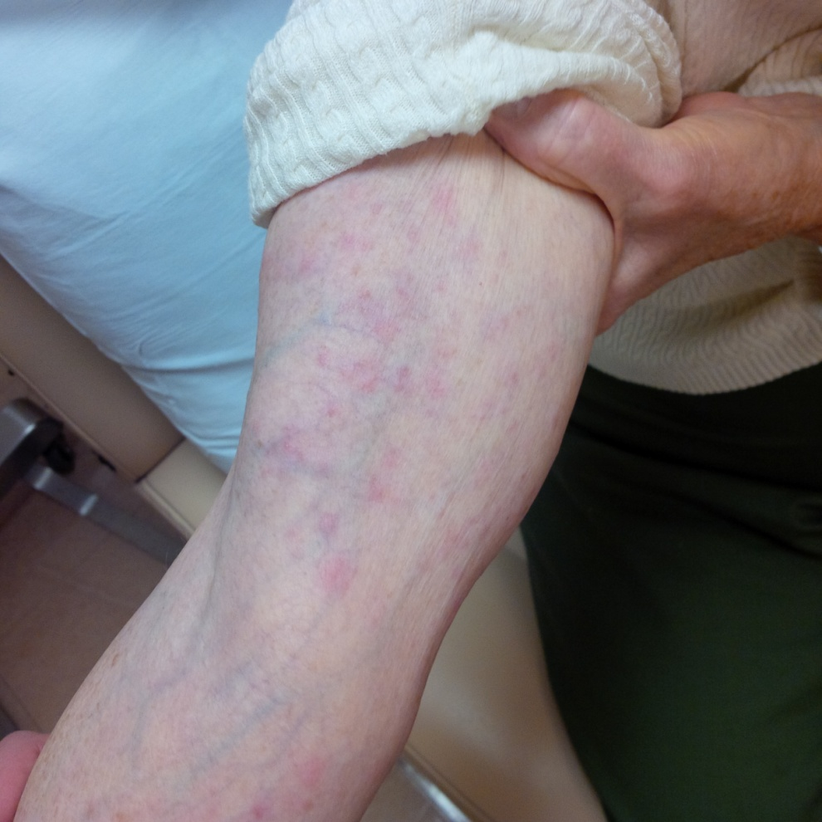
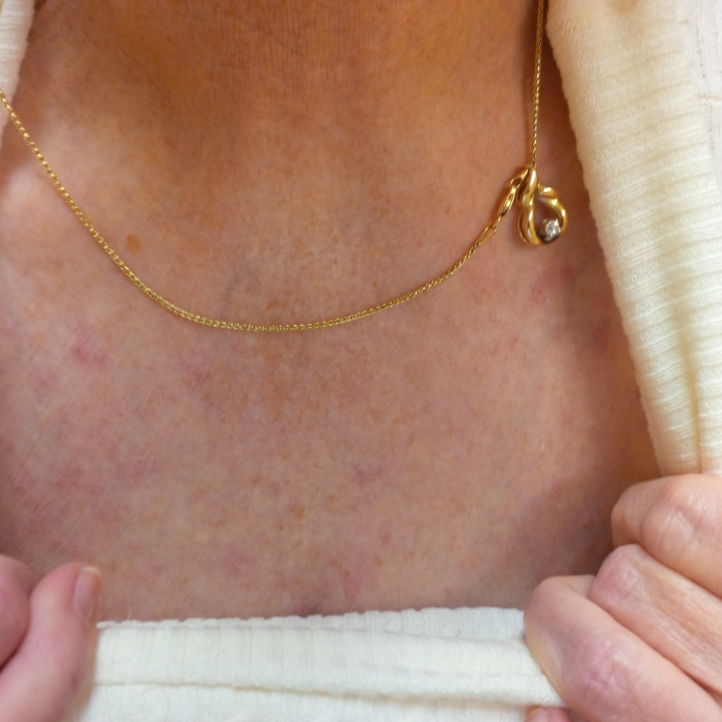
Ipilimumab Rashes
Can be treated with topical corticosteroids
Slide courtesy of Michael A. Postow, MD.

Slide 27
Diarrhea and Colitis Associated With Ipilimumab Use
Ileocolitis, characterized by deep-confluent, Crohn-like ulcerations and diffuse thickening of the wall of the colon, can be an adverse effect of ipilimumab therapy
Corticosteroids most often prescribed as first-line treatment of this adverse effect
Slangen RM, et al. Gastrointest Pharmacol Ther. 2013;4:80-82.^{[31]}

Slide 28
PD-1/PD-L1 in the Immune Response
Binding of PD-L1 to PD-1 receptor downregulates T-cell effector functions
Antibody-mediated blockage of the binding of PD-L1 protein to PD-1 receptor restores T-cell effector functions
Inhibited T cell
Inhibited T cell
Inhibited T cell
T-cell receptor
Antibody to PD-L1
PD-1
PD-1
Signal 1
Signal 2
MHC with antigen
PD-L1
Antibody to PD-1
PD-1
PD-L1
PD-L1
Tumor cell
Tumor cell
Tumor cell
Sznol M, Chen L. Clin Cancer Res. 2013;19:1021-1034.^{[47]}
Notes:
Permission not needed.

Slide 29
Antibodies That Block PD-1 or PD-L1
Target | Agent | Class | US Regulatory Status (as of March 2015)
PD-1 | Nivolumabª | IgG4 fully human Ab | FDA approved in advanced melanoma and metastatic squamous NSCLC
 | Pembrolizumab^{b} (MK-3475) | IgG4 engineered humanized Ab | FDA approved in advanced melanoma
 | Pidilizumab (CT‑011) | IgG1 humanized Ab | In development/investigational
 | AMP‑224 | Fc of human IgG-PD-L2 fusion | In development/investigational
PD-L1 | MPDL3280A | IgG1 engineered fully human Ab | In development/investigational
 | MEDI4736 | IgG1 engineered fully human Ab | In development/investigational
 | MSB0010718C | IgG1 fully human Ab | In development/investigational
Opdivo® PI 2015^{[24]}; Keytruda® PI 2014.^{[23]}

Slide 30
Anti-PD-L1 Antibodies
MEDI4736
A multi-arm expansion study of MEDI4736 monotherapy was carried out in patients with advanced disease of different tumor typesª
Early evidence of efficacy was observed in melanoma, pancreatic, gastroesophageal, head and neck squamous cell carcinoma (HNSCC)
1 case involved a 96-year old woman with HPV-negative, PD-L1-positive, advanced HNSCC characterized by a very large submandibular exophytic mass -- she had previously experienced disease progression on cetuximab therapy
A dramatic reduction in tumor size was observed following only 2 doses of study drug
MPDL3280A
Phase 1 trials of MPDL3280A monotherapy in pretreated patients with advanced NSCLC and metastatic urothelial bladder cancer have showed response rates in patients with high levels of PD-L1 expression^{b,c}
Preliminary data suggest that the safety of these 2 agents is acceptable
a. Segal NH, et al. J Clin Oncol. 2014;32. Abstract 3002^{[33]}; b. Horn L, et al. J Thorac Oncol. 2013;8:S364^{[48]}; c. Kim JW, et al. J Clin Oncol. 2015;33. Abstract 297.^{[49]}

Slide 31
Anti-PD-1 Antibody, Pembrolizumab, in Advanced Melanoma
 | Overall* | Ipilimumab naive | Ipilimumab treated
N† | 411* | 190 | 221
ORR‡ , % | 34 | 40 | 28
Median PFS, wk |  | 24 | 23
1-year survival rate, % | 69
*162 patients treated at 2 mg/kg 3 times weekly; 192 patients treated at 10 mg/kg 3 times weekly; †365 patients with measurable disease at baseline (n = 168, ipi naive; n = 197, ipi treated); 270 patients treated at 2 mg/kg 3 times weekly; ‡According to RECIST v1.1.
12% of patients experienced a drug-related AE; no drug-related deaths.
Ribas A, et al. J Clin Oncol. 2014;32. Abstract LBA9000.^{[34]}

Slide 32
Nivolumab Improves OS of Patients With Advanced Melanoma
Phase 3 Study
Nivolumab (3 mg/kg) every 2 wk + placebo every 3 wk; n = 210
Patients with treatment-naive advanced BRAF wild- type melanoma
R
Dacarbazine (1000 mg/m²) every 3 wk + placebo every 2 wk; n = 208
Primary Endpoint: OS
Outcome | Nivolumab Arm | Dacarbazine Arm
1-year survival rate | 73 | 42
Median OS, mo | NR | 10.8 (HR = 0.42; 99.79% CI, 0.25-0.73; P < .0001)
Median PFS, mo | 5.1 | 2.2 (HR for death or progression = 0.43; 95% CI, 0.34-0.56; P < .0001)
ORR, % | 40 | 14
Median duration of response, mo | NR | 6
Long GV, et al. J Transl Med. 2015;13:2063.^{[35]}

Slide 33
Pneumonitis Associated With Ipilimumab Followed by Nivolumab Therapy
2/21/2011
3/30/2011
2 doses of ipilimumab and 4 of nivolumab
Slide courtesy of Michael A. Postow, MD.

Slide 34
Immunotherapy Combinations
Chemotherapy
Carboplatin/Paclitaxelª (NSCLC)
Antiangiogenic agents
Bevacizumab^{b} (melanoma)
Hormonal therapy
Exemestane^{c} (breast cancer)
Androgen deprivation^{d} (prostate cancer)
Targeted therapy
Vemurafenib^{e} (melanoma)
Other immunotherapy
GM-CSF^{f}
Ipilimumab + nivolumab^{g}
Radiotherapy^{h}
a. Lynch TJ, et al. J Clin Oncol. 2012;30:2046-2054^{[38]}; b. Hodi FS, et al. Cancer Immunol Res. 2014;2:632-642^{[39]}; c. Vonderheide RH, et al. Clin Cancer Res. 2010;16:3485-3494^{[40]}; d. Subudhi SK, et al. ESMO 2014. Abstract 1053PD^{[41]}; e. Ribas A, et al. N Engl J Med. 2013;368:1365-1366^{[42]}; f. Hodi FS, et al. JAMA. 2014;312:1744-1753^{[43]}; g. Wolchok JD, et al. N Engl J Med. 2013;369:122-133^{[44]}; h. Postow MA, et al. N Engl J Med. 2012;366:925-931.^{[45]}

Slide 35
Ipilimumab + Nivolumab in Advanced Melanoma
Phase 1 study of 86 patients with advanced melanoma
Concurrent group (n = 53): Received nivolumab + ipilimumab every 3 wk for 4 doses followed by nivolumab alone every 3 wk for 4 doses
Combined treatment subsequently administered every 12 wk for up to 8 doses
ORR*
40% (concurrent group)
Deep, rapid tumor regression in a substantial proportion of patients†
Grade 3/4 AEs
53% (concurrent group)
Qualitatively similar between groups; generally reversible
Generally reversible
* At doses of 1 mg/kg (nivolumab); 3 mg/kg (ipilimumb).
†Majority of patients experiencing response had tumor regression ≥ 80% at initial tumor assessment.
Wolchok JD, et al. N Engl J Med. 2013;369:122-133.^{[44]}
Notes:
ORR, overall response rate.

Slide 36
Summary and Ongoing Questions
Innate and adaptive immunity can be manipulated to enhance antitumor immunity
How is balance between efficacy and adverse effects maintained?
Responses seen in many different cancers
Are some cancers more likely to be responsive?
What are predictors of response?
Combination immunotherapy + standard anticancer agents may increase the number of patients who benefit
Is concurrent better than sequential treatment?

Slide 37
Thank you for participating in this activity.
You may now revisit those questions presented at the beginning of the activity to see what you’ve learned by clicking on the Earn CME Credit link. The CME posttest will follow. Please also take a moment to complete the program evaluation at the end.

