Slide 1
Diabetes and Dyslipidemia

Slide 2
2013 ACC/AHA Guideline on the Treatment of Blood Cholesterol to Reduce Atherosclerotic Cardiovascular Risk in Adults

Slide 3
IMPROVE-IT

Slide 4
2012 Update of the Canadian Cardiovascular Society Guidelines for the Diagnosis and Treatment of Dyslipidemia

Slide 5
Achieved LDL < 50 mg/dL Has a Greater Relative Risk Reduction Than Higher Levels

Slide 6
ACCORD Primary Outcome Event Rate

Slide 7
IMPROVE-IT Diabetes

Slide 8
ODYSSEY LONG TERM LDL lowering

Slide 9
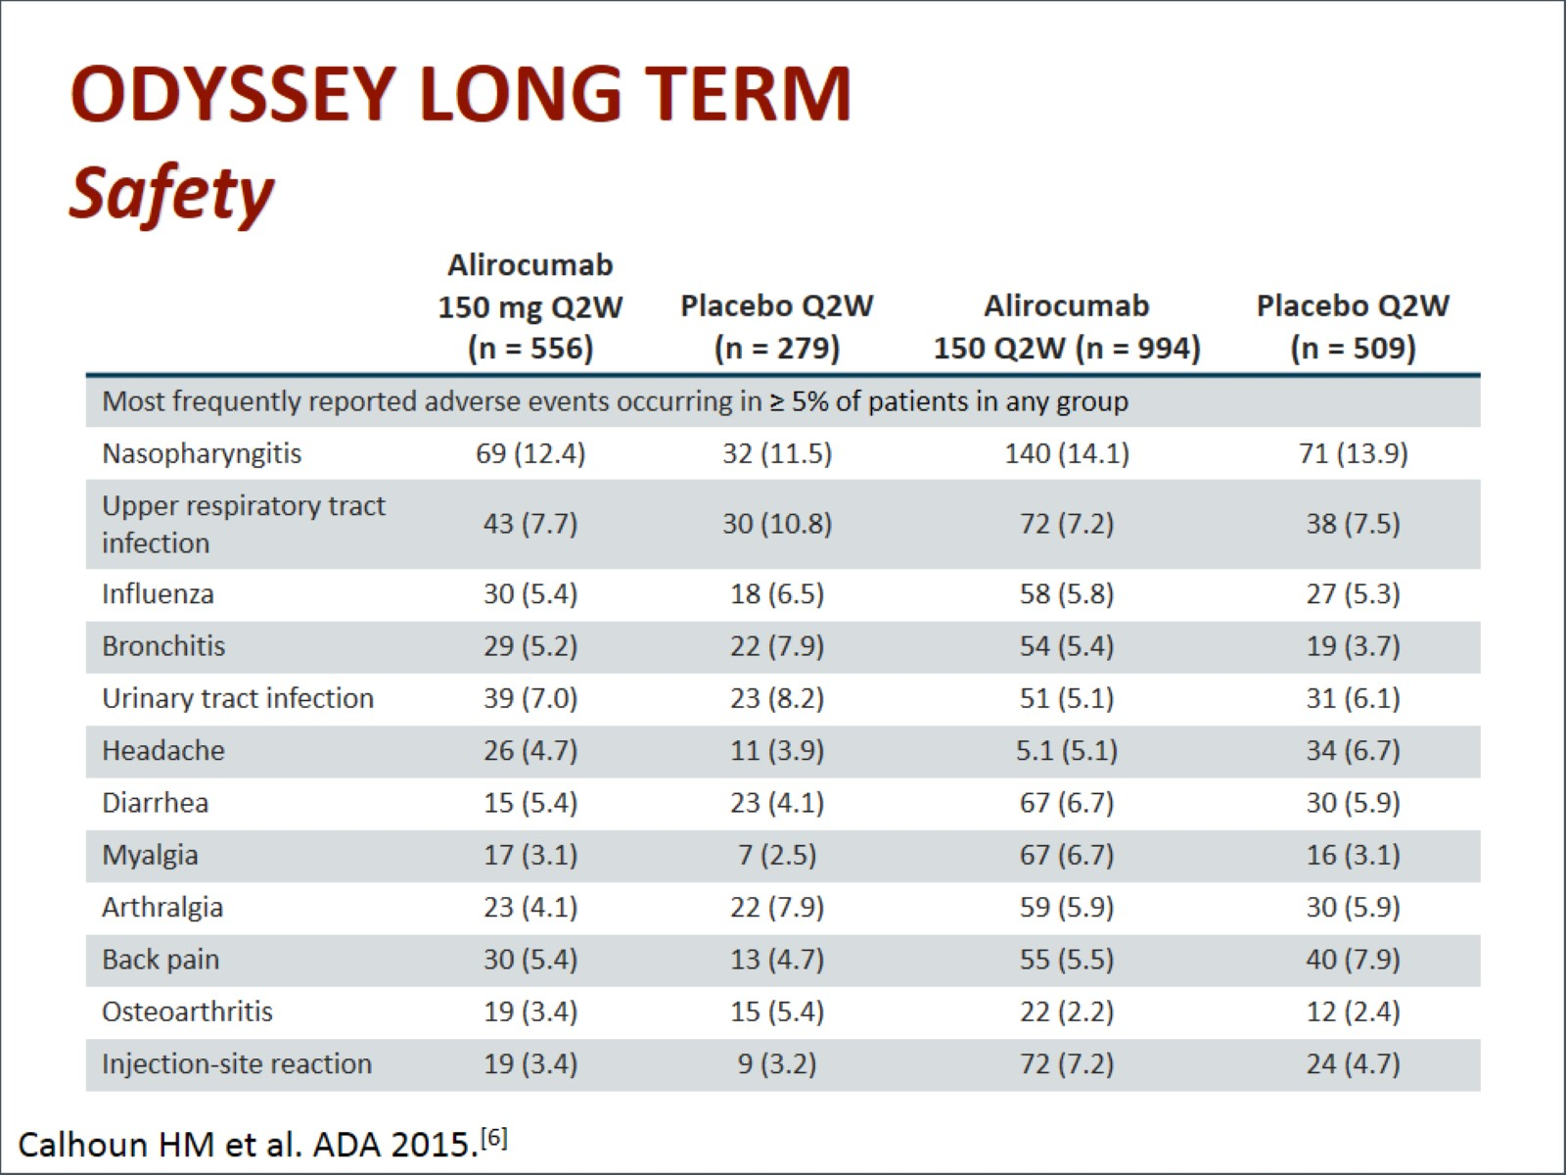
ODYSSEY LONG TERM Safety

Slide 10
Coronary Atheroma Regression as a Function of LDL Lowering

Slide 11
Management of a Patient With SAMS Step V: Rechallenge the patient repetitively

Slide 12
ODYSSEY Alternative Study Design

Slide 13
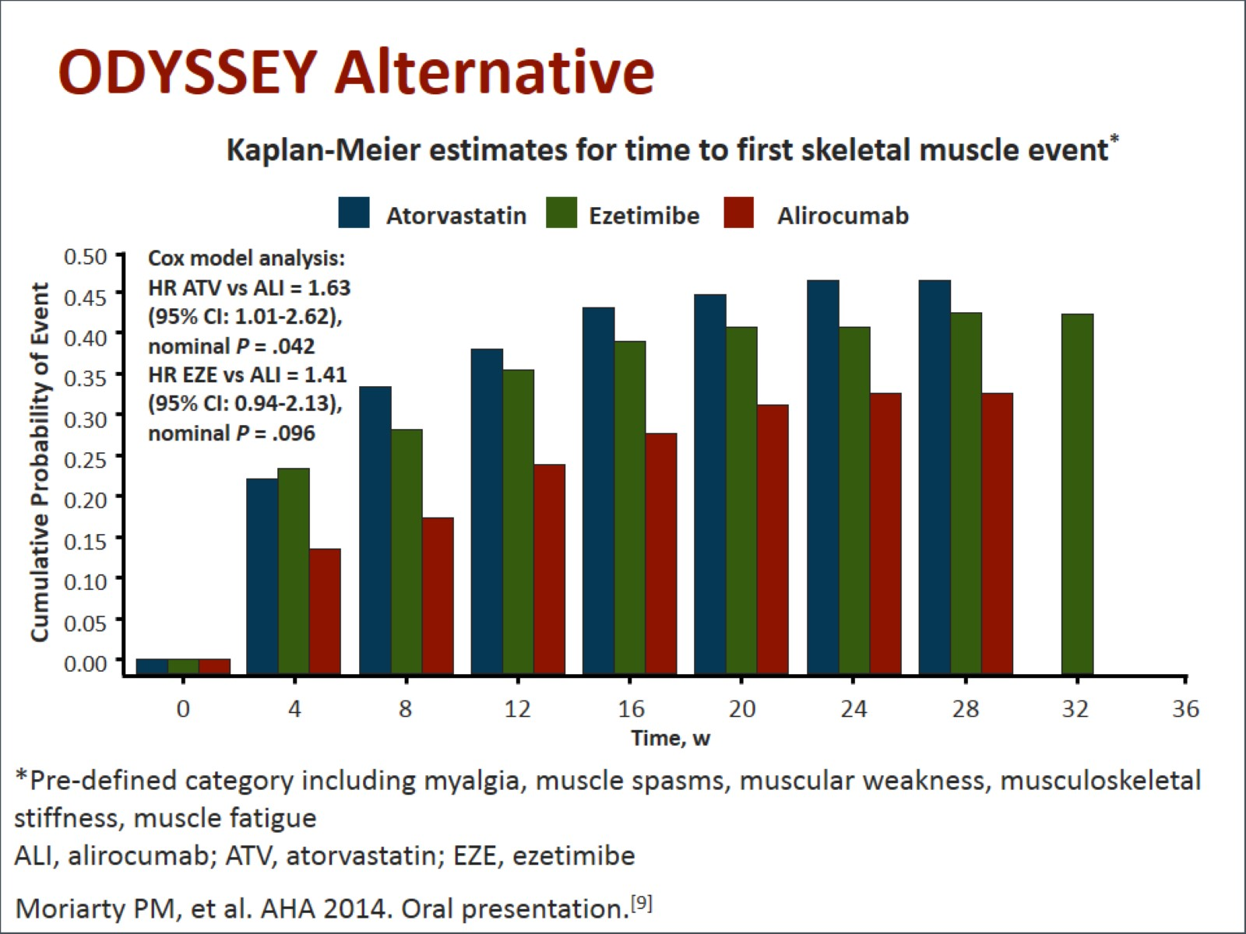
ODYSSEY Alternative

Slide 14
ONGOING LIPID Lowering Trials

Slide 15
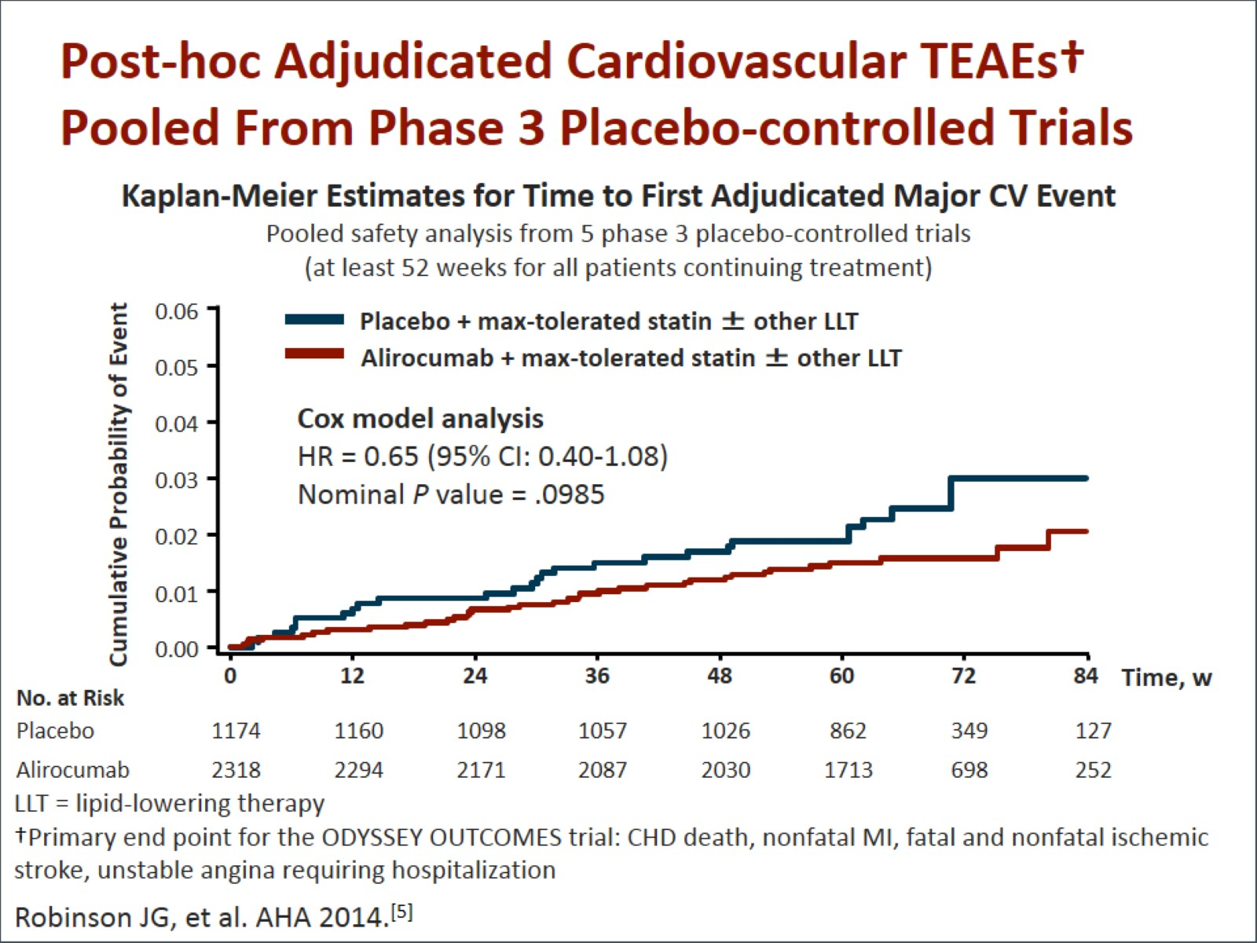
Post-hoc Adjudicated Cardiovascular TEAEs† Pooled From Phase 3 Placebo-controlled Trials

Slide 16
Cholesteryl Ester Transfer Protein Inhibitors A Note of Caution

Slide 17
Abbreviations

Slide 18
Abbreviations (cont)

Slide 19
References

Slide 20
References (cont)

Slide 21
References (cont)

