Slide 1
Challenges in Managing Progressive Multiple Sclerosis

Slide 2
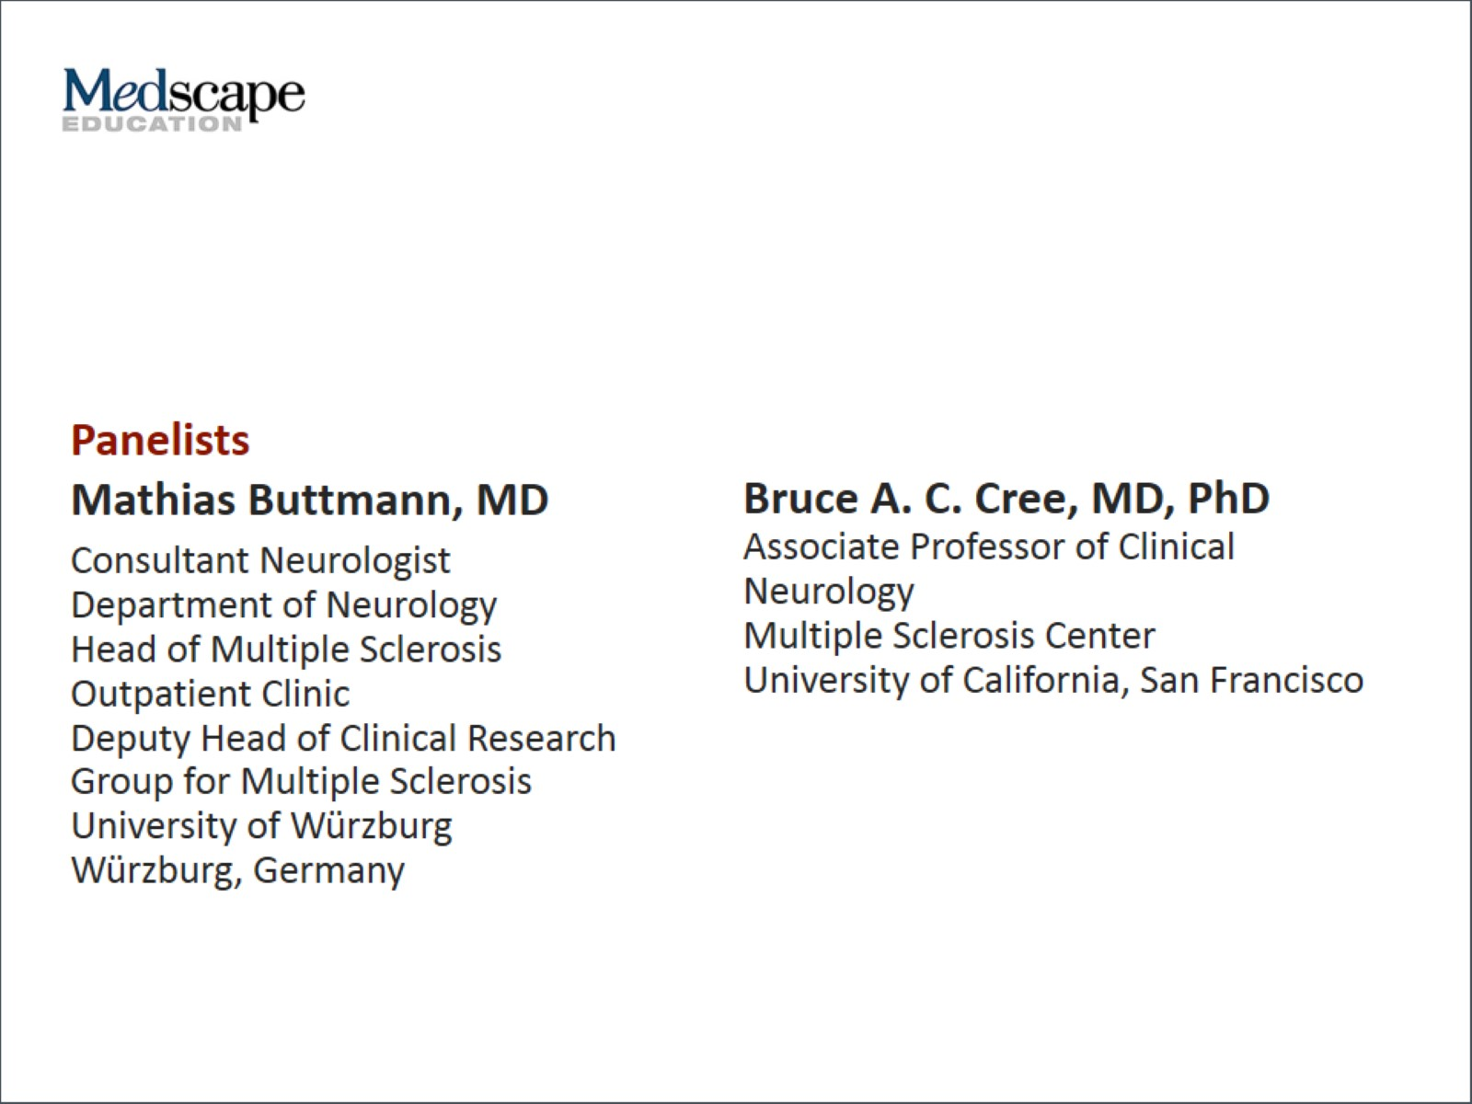

Slide 3
Program Goals

Slide 4
Disclaimers

Slide 5
Overview

Slide 6
Progressive MS Onset, Mechanisms

Slide 7
Inflammation: A Target in Progressive MS?

Slide 8
Inflammation as a Target in Progressive MS: Therapeutic Lag?

Slide 9
PPMS Trials: Too Short or Too Late? UCSF Experience

Slide 10
Predicting Progression

Slide 11
Prognostic Profiling Possible Clinical Trial End Points

Slide 12
Clinical Trials in Progressive MS

Slide 13
Is There a Role for Rituximab? UCSF Experience

Slide 14
Is There a Role for Statins?

Slide 15
INFORMS -- What Did We Learn?

Slide 16
INFORMS -- What Did We Learn? (cont)

Slide 17
Laquinimod

Slide 18
B-Cell Therapies

Slide 19
Triamcinolone

Slide 20
Combination Therapy and Remyelination

Slide 21
Remyelination

Slide 22
Phenytoin in Optic Neuritis Proof-of-Concept Trial

Slide 23
Biotin in SPMS

Slide 24
Summary and Key Points

Slide 25
Abbreviations

Slide 26
Abbreviations (cont)

Slide 27
References

Slide 28
References (cont)

Slide 29
References (cont)

Slide 30
References (cont)

Slide 31
References (cont)

Slide 32
References (cont)

