Slide 1
Advances in Multiple Myeloma: Data Highlights and Analysis from the 2015 Hematology/Oncology Conferences

Slide 2
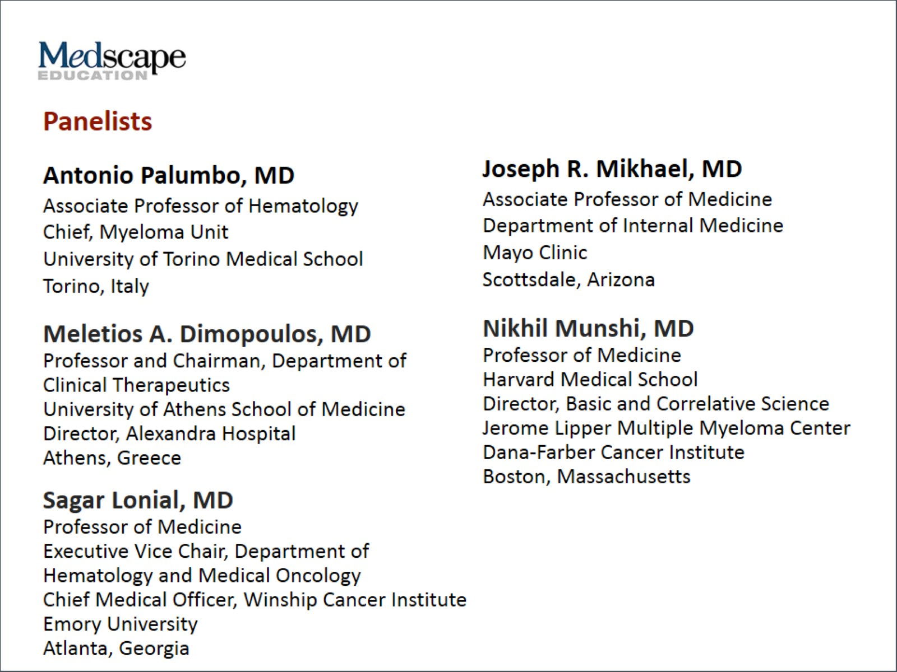

Slide 3
Program Goals

Slide 4
Newly Diagnosed Multiple Myeloma

Slide 5
Current Approaches for Newly Diagnosed Multiple Myeloma (MM)

Slide 6
Importance of Fitness in Older Patients With MM

Slide 7
Future Directions in Treatment of Newly Diagnosed MM

Slide 8
Relapsed/Refractory Multiple Myeloma (R/R MM)

Slide 9
PANORAMA 1 Bortezomib/Dexamethasone ± Panobinostat

Slide 10
ASPIRE Carfilzomib, Lenalidomide, Dexamethasone (KRd) vs Len/Dex (Rd)

Slide 11
ENDEAVOR Carfilzomib/Dexamethasone (Kd) vs Bortezomib/Dexamethasone (Vd) in Patients With 1-3 Prior Lines of Therapy

Slide 12
Monoclonal Antibodies in Multiple Myeloma

Slide 13
ELOQUENT-2 Len/Dex ± Elotuzumab (anti-SLAMF7) in Relapsed/Refractory MM

Slide 14
SIRIUS Phase 2 Study of Daratumumab (anti-CD38) in Heavily Pretreated MM

Slide 15
Monoclonal Antibodies in MM Future Directions

Slide 16
New Targets in Multiple Myeloma

Slide 17
Novel Proteasome Inhibitors in Development

Slide 18
Novel Targeted Therapy Approaches in MM

Slide 19
Novel Approaches to MM Therapy

Slide 20
Biological Profiling of Multiple Myeloma

Slide 21
Current Role of Cytogenetics Prognostic Information

Slide 22
Measuring MRD in MM

Slide 23
MM is Heterogeneous in its Genetics

Slide 24
Summary Multiple Myeloma in 2015

Slide 25
Abbreviations

Slide 26
Abbreviations (cont)

Slide 27
Abbreviations (cont)

Slide 28
References

Slide 29
References (cont)

Slide 30
References (cont)

Slide 31
References (cont)

Slide 32
References (cont)

Slide 33
References (cont)

Slide 34
References (cont)

Slide 35
References (cont)

Slide 36
References (cont)

Slide 37
References (cont)

Slide 38
References (cont)

Slide 39
References (cont)

Slide 40
References (cont)

