Slide 1
Managing Patients With Bipolar Disorder and Mixed Features

Slide 3
Program Goals

Slide 4
Outline

Slide 5
Moving From a Categorical to a Dimensional Approach

Slide 6
Kraepelin’s Classification (1913)

Slide 7
History of Mixed States

Slide 8
DSM-IV Criteria for Mixed Episode

Slide 9
Reasons for the Change

Slide 10
Consequences of Ad Hoc Definitions Currently in Use

Slide 11
Rates of Mixed Hypomania

Slide 12
Prevalence of Mixed Hypomania N = 14,328 Visits with 908 Patients

Slide 13
Prevalence of Mixed Depression N = 14,328 Visits with 908 Patients

Slide 14
DSM-IV Mood Elevation Symptoms Present in Most STEP-BD Baseline Bipolar Depressive Episodes

Slide 15
Additional Studies on Mixed Symptoms

Slide 16
Features and Psychiatric History Associated With Mixed States

Slide 17
Features and Psychiatric History Associated With Mixed States (cont)

Slide 19
A Spectrum of Presentation

Slide 20
Mixed Features Specifier in DSM-5 New Nomenclature for Mixed States

Slide 21
Mania/Hypomania With Mixed Features

Slide 22
Mixed Depression

Slide 23
Bipolar Depression with Mixed Features Specifier With Hypomanic Features

Slide 24
Mixed Specifier With Hypomanic Features

Slide 25
Not Included in Mixed Specifier—But These Are Red Flags

Slide 26
Role of Antidepressants

Slide 27
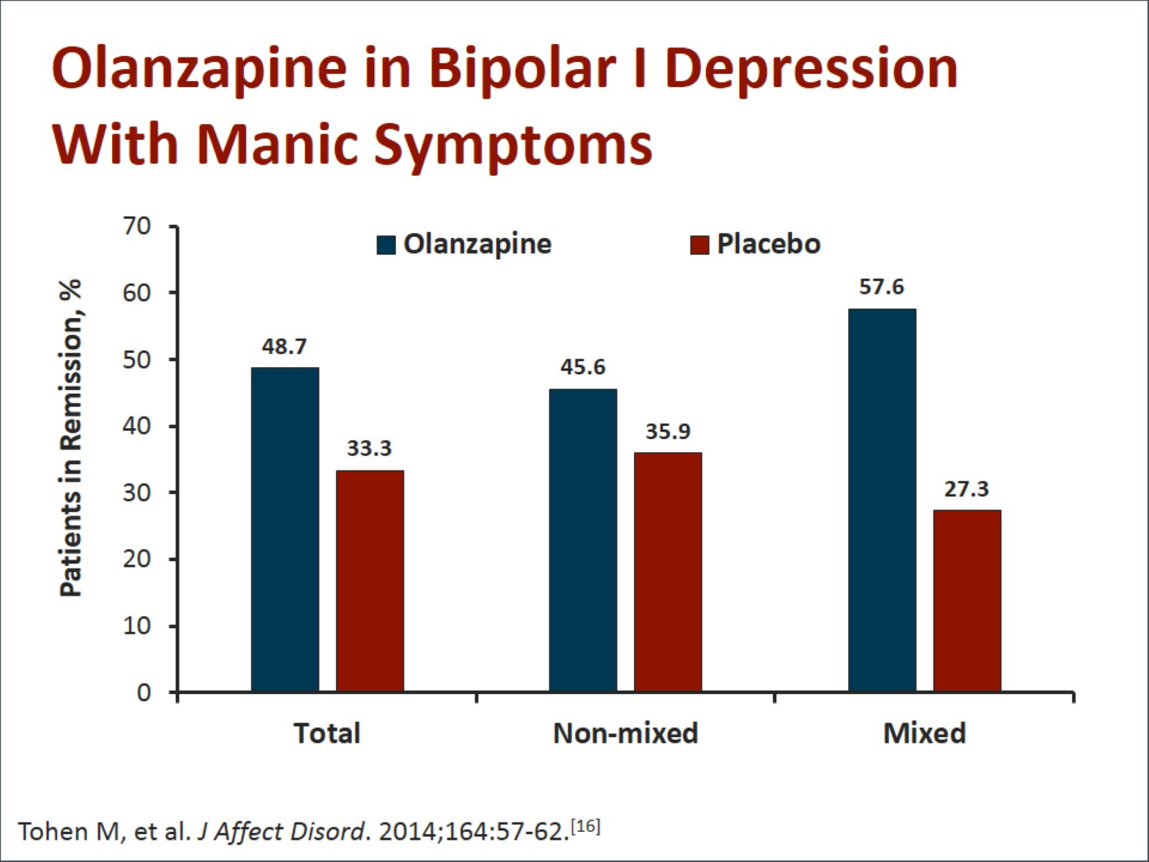
Olanzapine in Bipolar I Depression With Manic Symptoms

Slide 28
Lurasidone in Bipolar Depression With Subsyndromal Hypomania

Slide 29
Other Treatment Options

Slide 30
Conclusions

Slide 31
Abbreviations

Slide 32
References

Slide 33
References (cont)

Slide 34
References (cont)

Slide 35
References (cont)

Slide 36
References (cont)

