Slide 1
Individualizing Therapy for Patients With Chronic Hepatitis C Infection

Slide 3
Current HCV Infection Landscape We Have Come a Long Way: Advances in Therapy and New Treatment Challenges

Slide 4
General Recommendations for Initial Treatment of Chronic HCV Infection*

Slide 5
Extrahepatic Manifestations of HCV Focus on Kidney Disease

Slide 6
Treating HCV Infection in Patients With CKD An Important Unmet Need

Slide 7
RUBY-1 3D Regimen for Patients With HCV GT1 Infection and CKD: Small Study With Impressive Results

Slide 8
RUBY-1 (cont) Safety

Slide 9
C-SURFER Grazoprevir/Elbasvir in Patients With Advanced CKD

Slide 10
C-SURFER (cont) Notable Results in Patients with CKD

Slide 11
GT3: The New GT1

Slide 12
VALENCE Study SOF + RBV in Patients With HCV GT2 or GT3 Infection

Slide 13
ALLY-3 Study Daclatasvir + SOF in Patients With HCV GT3 Infection

Slide 14
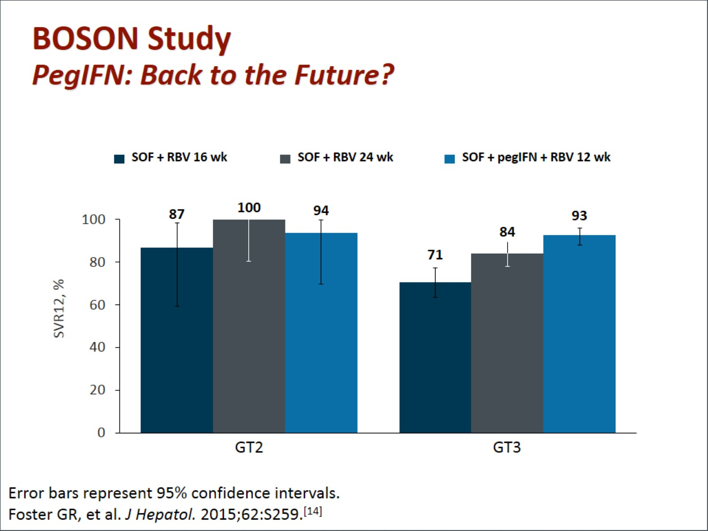
BOSON Study PegIFN: Back to the Future?

Slide 15
ELECTRON-2 Study LDV/SOF ± RBV for 12 wk in Patients With GT3 HCV: SVR12

Slide 16
NS5A RAVs

Slide 17
NS5A RAVs in Patients With Compensated Cirrhosis Who Were Treated With LDV/SOF in Phase 2 and 3 Studies*

Slide 18
Advocacy for HCV Treatment Access

Slide 19
PROs Blending Quantitative and Qualitative Data to Tell the Entire Story

Slide 20
Virologic Cure and Beyond Benefits of Treating HCV Infection

Slide 21
The HCV and Diabetes Connection

Slide 22
The SIRIUS Study PROs in Patients With Cirrhosis Who Were Re-treated With LDV/SOF After Not Responding to PegIFN Plus RBV

Slide 23
TURQUOISE-III 3D Regimen Without RBV in Patients With GT1b Infection

Slide 24
Summary

Slide 25
Abbreviations

Slide 26
Abbreviations (cont)

Slide 27
References

Slide 28
References (cont)

Slide 29
References (cont)

Slide 30
References (cont)

Slide 31
References (cont)

Slide 32
References (cont)

