Slide 1
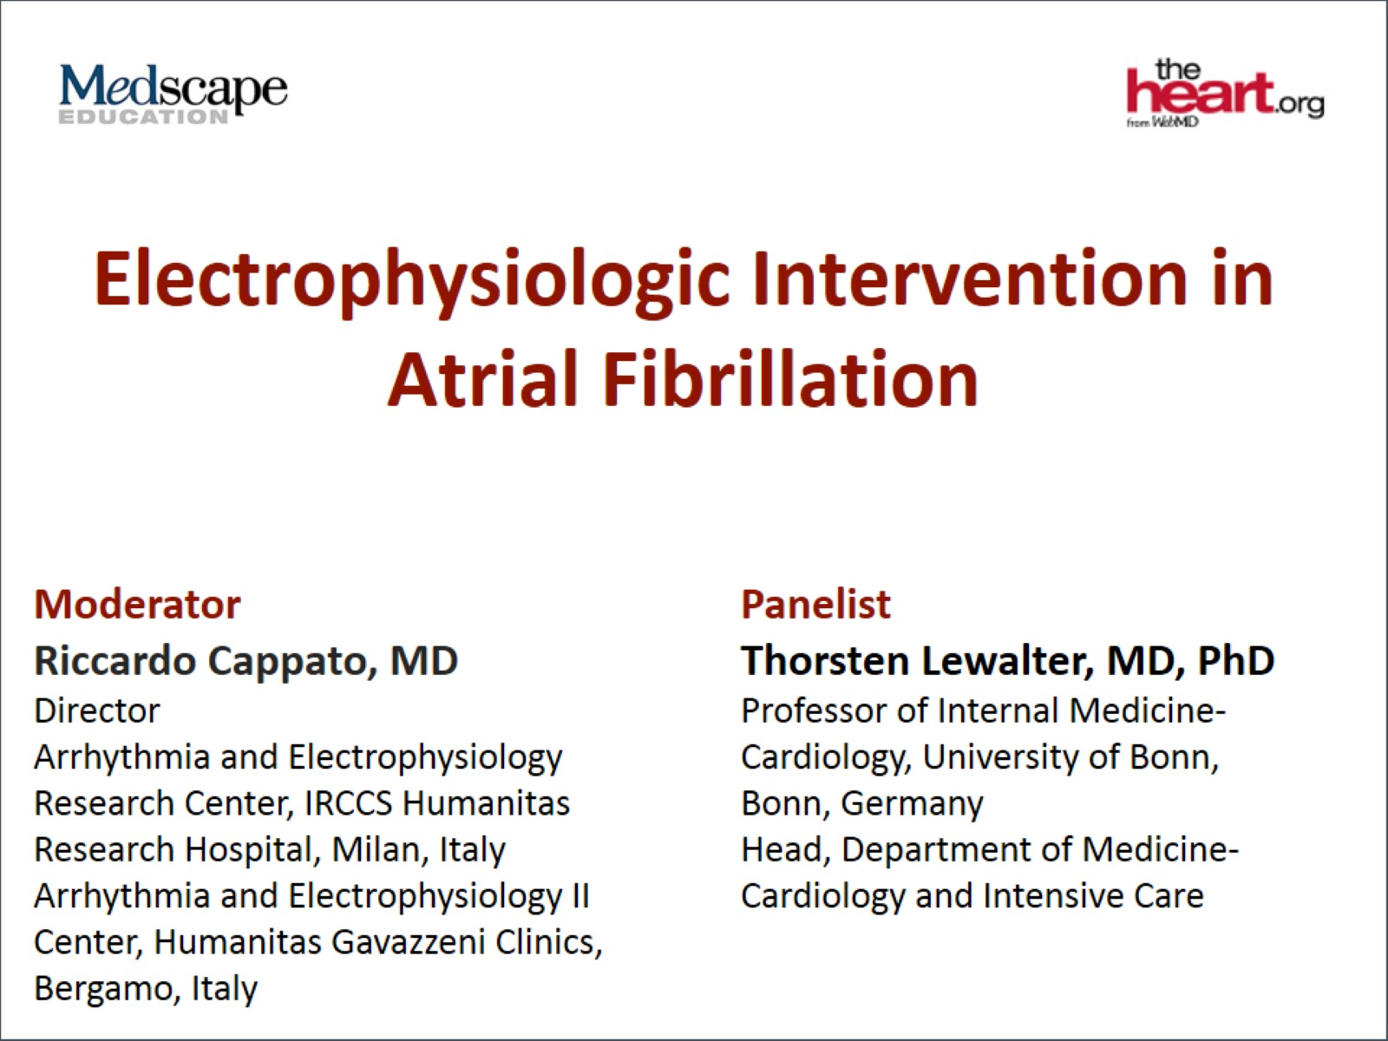
Electrophysiologic Intervention in Atrial Fibrillation

Slide 2
Meta-analysis of Rivaroxaban and Dabigatran in Ablation

Slide 3
VENTURE-AF Study Design

Slide 4
VENTURE-AF

Slide 5
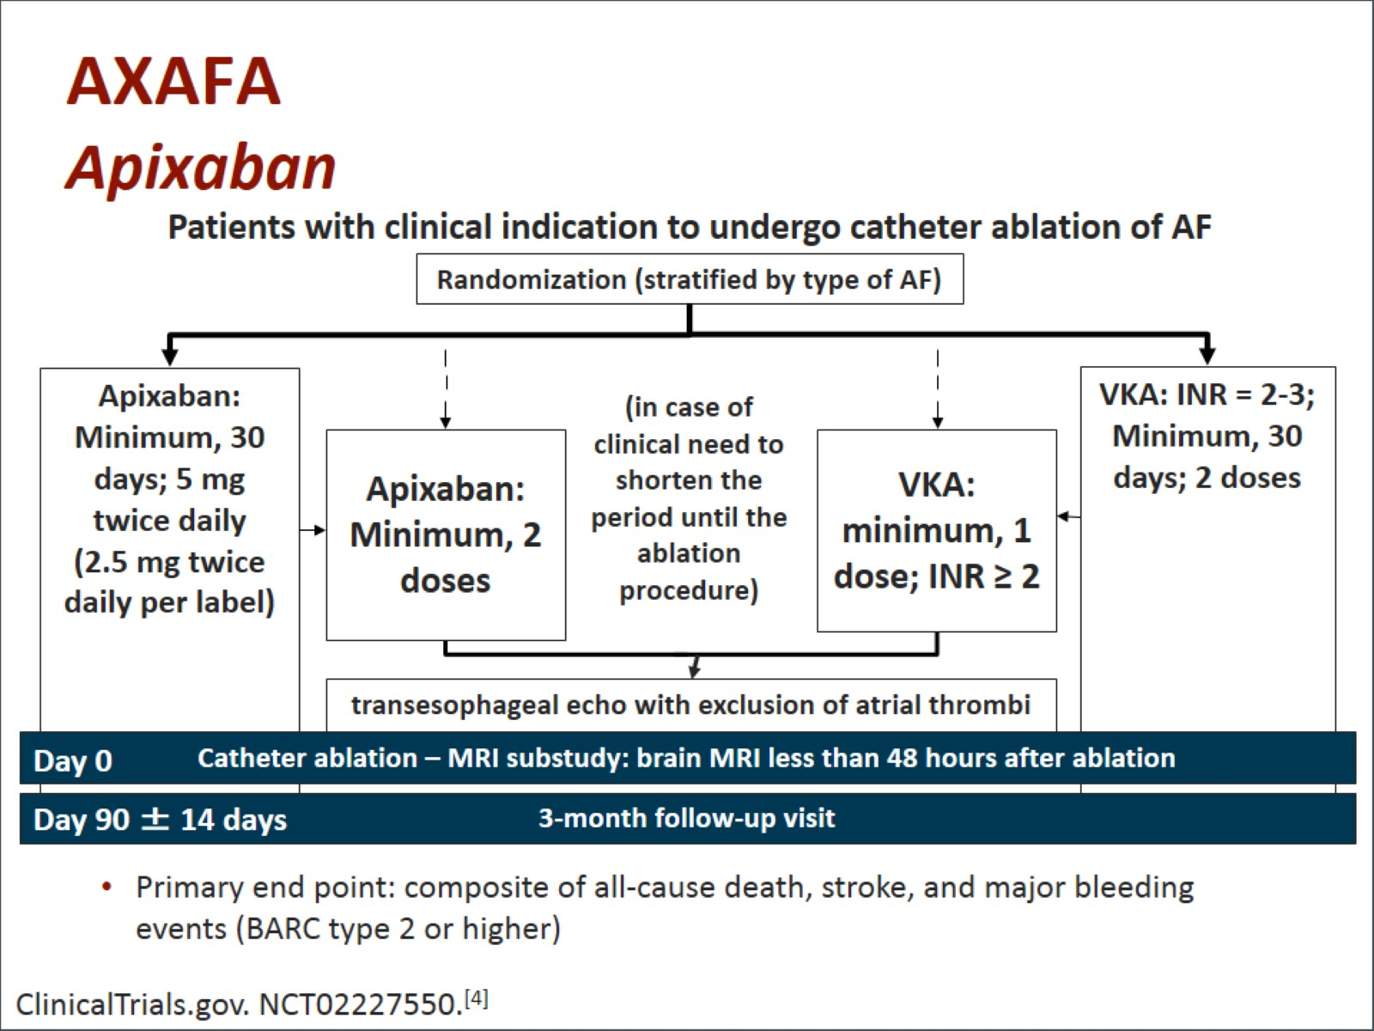
AXAFA Apixaban

Slide 6
DAPPAR AF Dabigatran Ablation Study

Slide 7
AF Trials Cardioversion Subgroup Analyses

Slide 8
X-VERT Design

Slide 9
X-VERT Primary Efficacy

Slide 10
X-VERT: Safety Outcomes

Slide 11
Summary

Slide 12
Summary (cont)

Slide 13
Abbreviations

Slide 14
Abbreviations (cont)

Slide 15
References

Slide 16
References (cont)

Slide 17
References (cont)

