Slide 1
A Practical Guide to the Prevention of Surgical Adhesions

Slide 4
Fibrinolytic System Inhibitors vs Activators

Slide 5
Pathogenesis of Adhesions

Slide 6
Etiology of Adhesion Formation

Slide 7
Prevalence of Adhesions Following Surgical Procedures

Slide 8
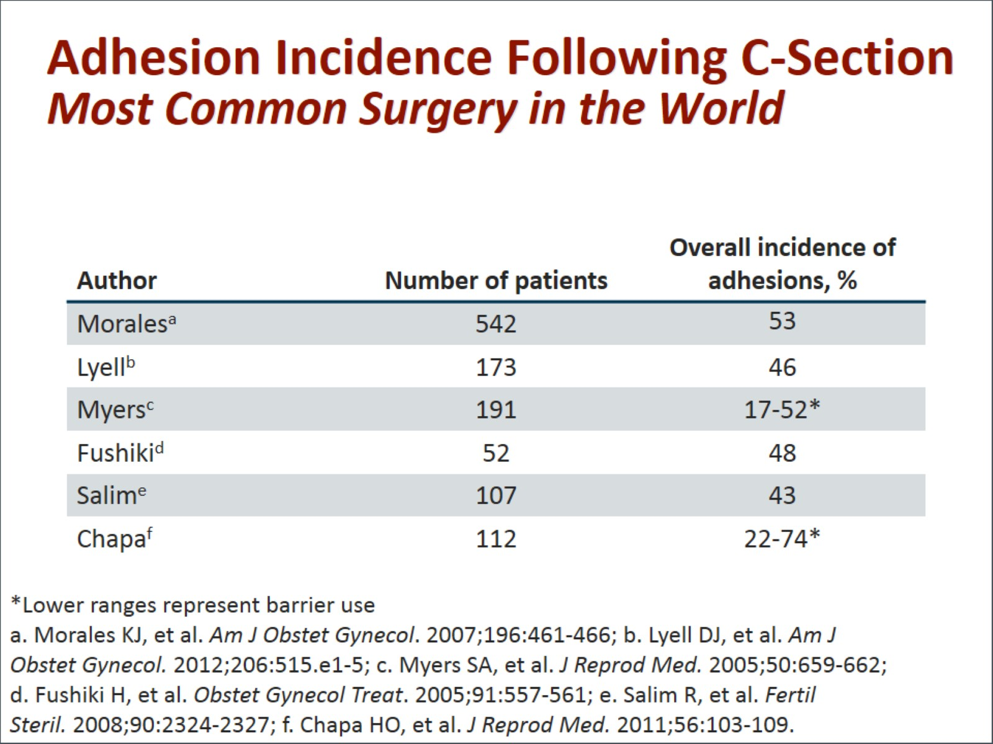
Adhesion Incidence Following C-Section Most Common Surgery in the World

Slide 9
Prevalence of Adhesions Following Laparoscopic Procedures

Slide 10
Predicting Adhesion Formation

Slide 11
Burden of Adhesions

Slide 12
Sequelae of Adhesions

Slide 13
Adhesion Prevention Strategies

Slide 14
Adhesion Prevention Strategies Pharmacologic Interventions

Slide 15
Adhesion Prevention Solutions/Gels

Slide 16
P.O.P.A. Study Icodextrin 4% Solution

Slide 17
Adhesion Prevention Barrier Devices

Slide 18
Oxidized Regenerated Cellulose

Slide 19
Oxidized Regenerated Cellulose 10-study Meta-analysis

Slide 20
Oxidized Regenerated Cellulose Usage Caveats

Slide 21
HA/CMC Abdominal Study

Slide 22
HA/CMC Safety in Abdominal Surgery

Slide 23
HA/CMC Myomectomy Study Percentage of Patients with No Adhesions

Slide 24
HA/CMC Limitations

Slide 25
Barrier Agents’ Efficacy Review of 18 Randomized Controlled Trials

Slide 26
Future Directions

Slide 27
Summary

Slide 28
Abbreviations

Slide 29
References

Slide 30
References (cont)

Slide 31
References (cont)

Slide 32
References (cont)

Slide 33
References (cont)

Slide 34
References (cont)

