Slide 1
Strategies for Improving Infection Control During Cancer Care
Moderator
Douglas W. Blayney, MD
Professor of Medicine (Oncology)
Stanford University Medical Center
Member, Stanford Cancer Institute
Stanford, California

Slide 2
Panelists
Janet Eagan, RN, MPH, CIC
Infection Control Manager
Memorial Sloan Kettering Cancer Center
New York, New York
Lisa C. Richardson, MD, MPH
Director, Division of Cancer Prevention and Control
Centers for Disease Control and Prevention
Atlanta, Georgia
Michele E. Gaguski, MSN, RN, AOCN, CHPN, APN-C
Clinical Director, Medical Oncology/Infusion Services
Atlanticare Cancer Care Institute
Egg Harbor Township, New Jersey

Slide 3
Program Goals
Describe risk factors for neutropenia and infection in people with cancer
Discuss the policies and procedures that an outpatient oncology facility must follow to meet minimal expectations for protecting patients from infection as described in the CDC's Basic Infection Control and Prevention Plan for Outpatient Oncology Settings (BICAPP)
Identify educational tools and resources that can help facilities implement infection control recommendations

Slide 4
Risk Factors for Neutropenia and Infection in Patients With Cancer
Neutropenia and subsequent infections are a major cause of morbidity and mortality in patients with cancer.^{a-c}
Risk Factors for Neutropenia in Cancer Patients^{a-d}
Chemotherapy | Poor nutrition
Comorbidities | Prior splenectomy
Compromised physical barriers (eg, mucosal, skin, or hair) | Radiotherapy
Indwelling vascular catheter | Stem cell or bone marrow transplant
Malignancy-related immunodeficiency | Surgical procedures
Newer treatment modalities | Tumor type
a. Zembower TR. Cancer Treat Res. 2014;161:43-89^{[2]}; b. Maschmeyer G, et al. Int Antimicrob Agents. 2008;31:193-197^{[3]}; c. Thirumala R, et al. Crit Care Clin. 2010;26:59-91^{[4]}; d. American Cancer Society website.^{[5]}

Slide 5
Neutropenia
Neutropenia is a reduction in neutrophils (WBCs).
Neutropenia occurs in about 50% of patients who receive myelosuppressive therapy.
Chemotherapy-induced neutropenia increases infection risk and results inª
~60,000 cancer patients in the US hospitalized each year
1 in 14 will die from this complication.
Category^{b} | ANC Level^{b} | Significance^{c}
Neutropenia | 1000/µL | Immune system is weak
Severe neutropenia | 500/µL | High risk of infection if this ANC level persists for a few days
Profound neutropenia | ≤ 100/µL | Very high risk of serious infection if level persists for 1 week
a. Caggiano V, et al. Cancer. 2005;103:1916-1924^{[6]}; b. Flowers CR, et al. J Clin Oncol. 2013;31:794-810^{[7]}; c. American Cancer Society website.^{[8]}

Slide 6
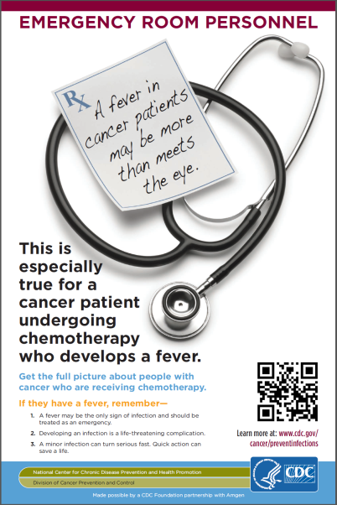
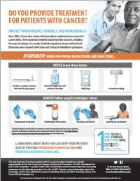
Preventing Infections in Cancer Patients (PICP)
A comprehensive initiative led by the CDC and the CDC Foundation to reduce infections in people with cancer
PICP was developed to empower people with cancer, their caregivers, and healthcare providers, to arm themselves with the right information and tools that will help them reduce the risk of life-threatening infections during chemotherapy.

Slide 7
PICP Tools
PreventCancerInfections.org
Developed for patients, caregivers, and providers
A user can complete a brief questionnaire to assess risk level for neutropenia and then receive tailored infection control messages based on that risk level (high vs low) Or a user can simply explore the site and learn about neutropenia, the signs and symptoms of infections, and how to prevent or control them Topics include Basic Hygiene Practices, Signs and Symptoms of an Infection, Caring for your Catheter, Food and Kitchen Safety, etc
Basic Infection Control and Prevention Plan (BICAPP)
Developed for outpatient oncology facilities
Outlines infection control policies and procedures that can be customized for use at any oncology clinic

Slide 8
Overview of CDC’s BICAPP
Contains policies and procedures to meet minimal expectations of patient protections as found in CDC's “Guide to Infection Prevention in Outpatient Settings”
Focuses on core infection prevention measures
Suitable for use by any outpatient oncology clinic
Can be used to enhance or establish processes, policies, and procedures for infection control
Does not replace the need for regular access to an individual with training in infection prevention
Core principles of infection prevention
Surveillance and reporting
Education and training
BICAPP
Resources
CDC website.^{[1]}

Slide 9
BICAPP: Standard Precautions
Standard precautions: minimum measures to prevent infection when caring for patients in a healthcare setting:
Hand hygiene
Use of personal protective equipment (PPE) appropriate to exposure risk
Respiratory hygiene and cough etiquette
Injection safety
Medication storage and handling
Cleaning and disinfection of devices and environmental surfaces
Standard precautions are designed to protect patients, visitors, and healthcare personnel.
CDC website.^{[1]}

Slide 10
BICAPP: Transmission-Based Precautions
Transmission-based precautions: supplement standard precautions when managing potentially infectious patients:
Identifying potentially infectious patients
Contact precautions
Droplet precautions
Airborne precautions
Example: Practices for Patients With Respiratory Symptoms
Triage immediately
Provide masks for the patient and staff
Place the patient in a private exam room with the door closed
Perform hand hygiene before and after contact
Transmission-based precautions are designed to be used in addition to standard precautions when warranted.
CDC website.^{[1]}

Slide 11
Implementing CDC’s BICAPP and Resources
Use the CDC Infection Prevention Checklist to assess your facility's current practices. Is your facility meeting the minimum expectations for safe care?
Use other resources in the BICAPP to:
Develop a list of contact persons with their roles, responsibilities, and contact information
Create and regularly update a list of reportable diseases/conditions and make available to all personnel.
Review other CDC resources relevant to your facility’s practices.
Make changes to policy and processes as needed.
CDC website.^{[1]}

Slide 12
Case 1: Mary Alice
Mary Alice is a 56-year-old woman with HER2-positive, hormone receptor-negative breast cancer.
She underwent lumpectomy with sentinel lymph node dissection before radiotherapy.
She is starting 1 year of adjuvant chemotherapy with doxorubicin, cyclophosphamide, docetaxel, and trastuzumab and may need a VAD.
Her husband and sister have accompanied her to the clinic for her first dose.
How would you educate Mary Alice and her family about chemotherapy-related infection?

Slide 13
Educating Patients With Cancer Neutropenia and Infection Risk
Patients who understand neutropenia and their risk for infection during chemotherapy can take steps to prevent it.
Explain myelosuppression, neutropenia, and nadir:
Nadir typically occurs 7 to 12 days after chemotherapy
Myelosuppression may last 1 week, depending on the drug.
PreventCancerInfections.org includes a a patient handout on neutropenia and infections that explains:
What neutropenia is
Signs and symptoms of infection
When to call the physician
Methods for preventing infection.
CDC website.^{[1]}

Slide 14
Educating Patients With Cancer (cont) Preventing Infection at Home
Empower patients to take steps at home to reduce their risk for infection during chemotherapy
Steps Patients Can Take to Prevent Infection
Avoid crowded places and sick people
Clean hands frequently
Do not share personal items
Get flu vaccination
Keep household surfaces clean
Practice good dental hygiene
Prepare food safely (eg, cook foods completely, wash produce)
Protect skin from damage (eg, cuts, scrapes)
CDC website.^{[1]}

Slide 15
Educating Patients With Cancer (cont) Central Venous Catheters
More than 5 million central venous catheters are inserted in the United States each year, resulting in
~80,000 catheter-related bloodstream infections
~28,000 catheter-related deaths
Infection risk varies depending on device, placement, use, duration, and patient's immune function.
Postoperative signs of infection include:
Redness, pain, or swelling at the surgical site
Drainage or pus coming from the surgical site or PICC line
Fever.
Instruct patients to contact their provider immediately if they notice any sign of infection or develop a fever.
Zembower TR. Cancer Treat Res. 2014;161:43-89.^{[2]}

Slide 16
Triage Protocols to Prevent Infection
Triage is an important way to reduce the risk of infection transmission at oncology centers.
Remain alert for patients (expected or unexpected) arriving with symptoms of infection:
Provide face masks to patients with respiratory symptoms
Quickly move symptomatic patients into an exam room
Have staff wear masks or other protective gear
Ask patients about travel to high-risk areas.
Use contact, droplet, or airborne precautions as needed.
Post signage in the waiting area:
Telling patients to self-report symptoms of infection
Detailing proper methods of hand hygiene, respiratory hygiene, and cough etiquette.
CDC website.^{[1]}

Slide 17
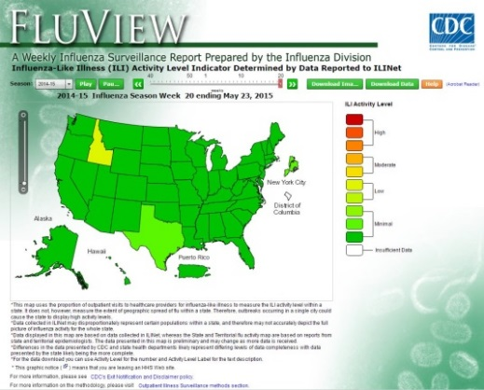
Extra Precautions During Outbreaks
Extra precautions are needed during influenza season or other outbreaks.
Federal and state resources can help you monitor for potential outbreaks.
Place posters, alcohol-based hand rub dispensers, and facemasks at entrances.
Have a separate triage area for people with respiratory symptoms.
Provide appropriate protective gear for staff members interacting with patients (eg, facemasks, gloves, and gowns).
Send out alerts to staff.
CDC website.^{[1]} Bottom image courtesy of CDC/James Gathany, 2008.

Slide 18
WHO Hand Hygiene Guidelines
 | Hand Wash | Hand Rub
When to Use | When hands are visibly soiled | When hands are not visibly soiled but need to be sanitized
What to Use | Soap and water | Alcohol-based cleanser
How to Dry | Dry hands with a single use towel, then use towel to turn off faucet | Continue rubbing hands together until they feel dry
Total Duration | 40-60 seconds | 20-30 seconds
WHO website.^{[10]} Images courtesy of CDC/Amanda Mills, 2011.

Slide 19
Injection Safety
Injection safety is the proper use and handling of supplies for administering injections and infusions.
Since 2001, CDC has documented more than 50 outbreaks associated with unsafe medical injection practices in the United States:
18 were viral hepatitis outbreaks
Some occurred at oncology clinics.
Each syringe, needle, and single-dose vial should be used only once per patient and per procedure.
CDC website.^{[11]}

Slide 20
Cleaning and Disinfection
Facilities should have a designated environmental services team and written procedures
When to Clean | What to Clean
At least once daily or if visibly soiled | Clean and disinfect triage area, patient-care areas, medication preparation areas, and bathrooms Empty trash and waste containers
Between patients | Disinfect bathrooms used by patients who have or may have infectious diarrhea Disinfect surfaces and devices in direct contact with nonintact skin, mucous membranes, or bodily fluids Clean medication preparation stations in exam rooms Clean chemotherapy suites Change exam table paper and take care of soiled linens
As soon as possible | Clean and decontaminate areas with spilled blood or infectious bodily substances
Always wear appropriate PPE
Use EPA-approved disinfectants as indicated and directed
Focus on high-touch areas when cleaning and disinfecting
CDC website.^{[1]}

Slide 21
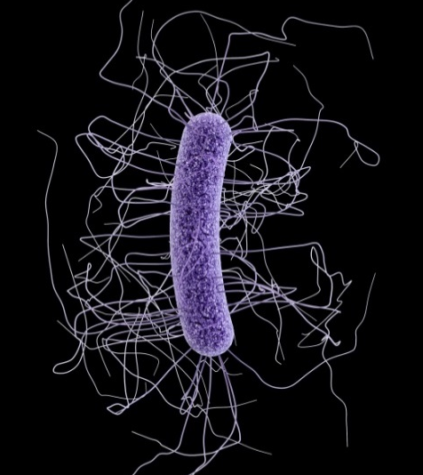
Preventing C difficile Transmission
A CDC study on the US incidence of Clostridium difficile infection (CDI) in 2011 reported ~450,000 infections and ~29,300 deaths.ª
66% of CDIs were linked to an inpatient healthcare facility stay, and 34% were community associatedª:
82% of patients with community-associated CDIs had prior outpatient healthcare exposures in the preceding 12 weeks
1 of every 3 CDIs affected someone 65 years or older.
When a patient has or may have CDI^{b}:
Wear gloves and gowns
Wash hands with soap and water
Use bleach to disinfect any areas the patient came into contact with (eg, toilet, examination room).
Clostridium difficile
a. Lessa FC, et al. N Engl J Med. 2015;372:825-834^{[12]}; b. CDC website.^{[1]}
Image courtesy of the CDC.

Slide 22
Case 2: Henry
Henry is a 65-year-old man who underwent surgical excision of primary colorectal cancer.
The oncology nurse instructed Henry on the signs and symptoms of infection to watch for during his recovery at home.
A week after surgery he called the oncology clinic to report that his abdominal incision site was red, tender, and oozing but he had no fever.
Henry was instructed to come in for evaluation.
How would you prepare for Henry's arrival at the oncology clinic?

Slide 23
Patients With Suspected Infection
If patients call ahead to report a possible infection, staff should take advantage of the opportunity to prepare
Infection Category | Procedures
All suspected infections | Notify staff to remain alert for patient's arrival Have staff who may be exposed perform hand hygiene (use soap and water for suspected CDI) before and after contact and don appropriate PPE Isolate patient in a prepared room ASAP
Additional precautions for suspected respiratory infection | Have patient come when the center is less busy Ask patient to reschedule if non-urgent Ask caregivers/family/friends to wait outside Tell patient to don a face mask on arrival
Additional precautions for suspected wound or other infection (eg, CDI, MRSA) | Put environmental services staff on alert Check patient for sepsis and/or culture wound, and If clinically warranted, transfer patient to the ED Use EPA-registered disinfectant with appropriate germicidal to clean/disinfect all areas the patient came into contact with, including bathrooms
CDC website.^{[1]}

Slide 24
CDC Infection Prevention Checklist
The checklist provides a tool to help a facility ensure it has appropriate infection prevention policies and procedures in place and supplies to allow healthcare personnel to provide safe care.
It systematically assesses personnel adherence to correct infection prevention practices.
Section 1 focuses on administrative policies and facility practices:
Facility policies
Education and training
Occupational health
Surveillance and disease reporting
Hand hygiene
Personal protective equipment (PPE)
Injection safety
Respiratory hygiene/cough etiquette
Environmental cleaning
Reprocessing of reusable medical devices
Sterilization and high-level disinfection of reusable instruments and devices
CDC website.^{[1]}

Slide 25
CDC Infection Prevention Checklist (cont)
Section 2 is an assessment of adherence to infection control practices that should be conducted by direct observation of healthcare personnel during the performance of the following duties:
Hand hygiene
PPE use
Injection safety
Point-of-care testing
If the auditor finds a practice is not being followed:
Determine why it was not followed
Seek to correct the problem, including educating staff
Assess whether the lapse put any patients at risk and take appropriate follow-up steps.
Environmental cleaning
Reprocessing of reusable instruments and devices
Sterilization and high-level disinfection of reusable instruments and devices.
CDC website.^{[1]}

Slide 26
Using PreventCancerInfections.org
Neutropenia and Infection Risk Assessment Tool for patients, caregivers, and providers
Videos
Health Tip Sheets
Prevent Infections During Chemotherapy
Cut-out Contact Card
News
Website can be accessed wherever there are computers available including clinic, hospital, or home
Variety of resources (eg, fact sheets, health tip sheets) can be included in a facility’s chemotherapy education material/binder
Useful tool for in-service patient education

Slide 27
Summary
Infection is a leading cause of death in patients with cancer.
CDC’s BICAPP is a valuable tool to help outpatient oncology facilities prevent infection.
PreventCancerInfections.org helps patients understand their risk for neutropenia and infection and what to do to prevent infections.
In addition to reducing mortality and morbidity, preventing infection reduces the consumption of limited healthcare resources.

Slide 28
Thank you for participating in this activity.
You may now revisit those questions presented at the beginning of the activity to see what you’ve learned by clicking on the Earn CME/CE Credit link. The CME/CE posttest will follow. Please also take a moment to complete the program evaluation at the end.

