Slide 1
Addressing Patients at High Risk for SCA

Slide 3
Learning Objectives

Slide 4
Burden of CVD and Risk of SCD

Slide 5
Heart Rhythm Society SCD Primary Prevention Protocols

Slide 6
VALIANT Study

Slide 7
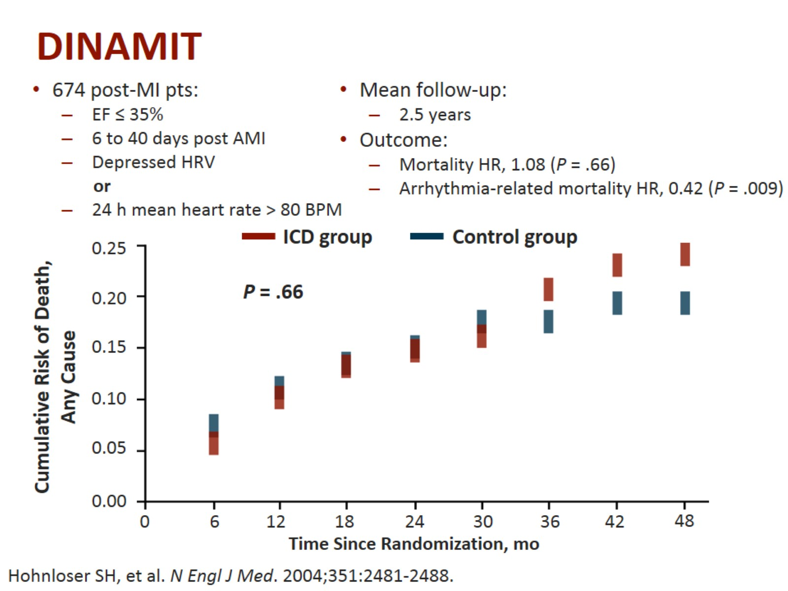
DINAMIT

Slide 8
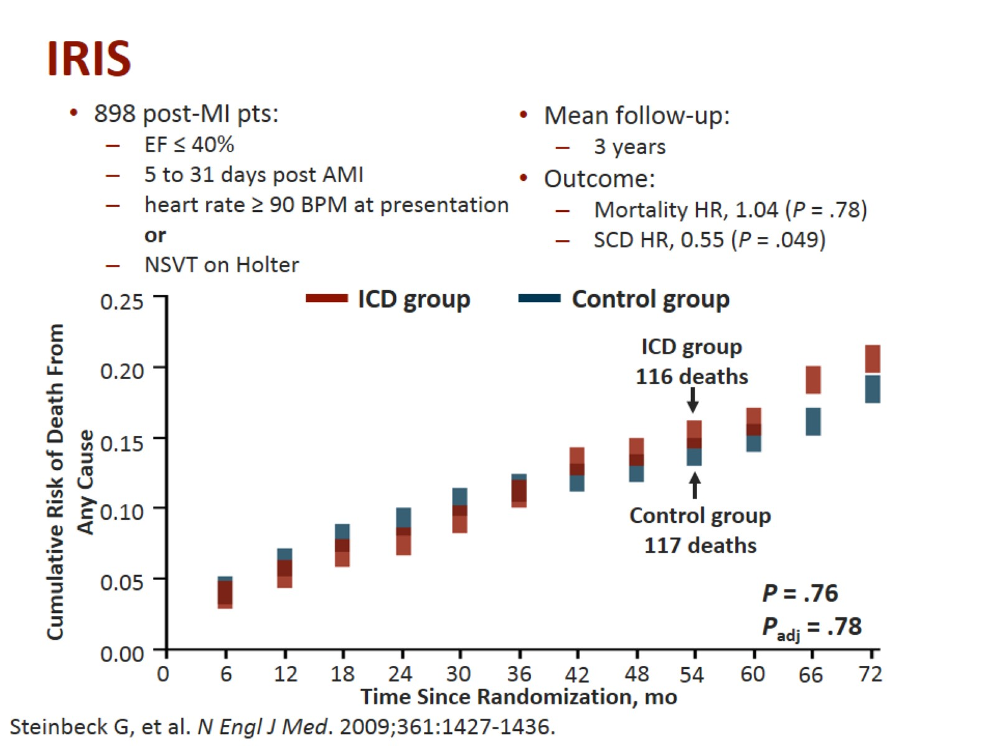
IRIS

Slide 11
LifeVest® Wearable Cardioverter Defibrillator (WCD)

Slide 12
WEARIT-II Characteristics of Patients

Slide 13
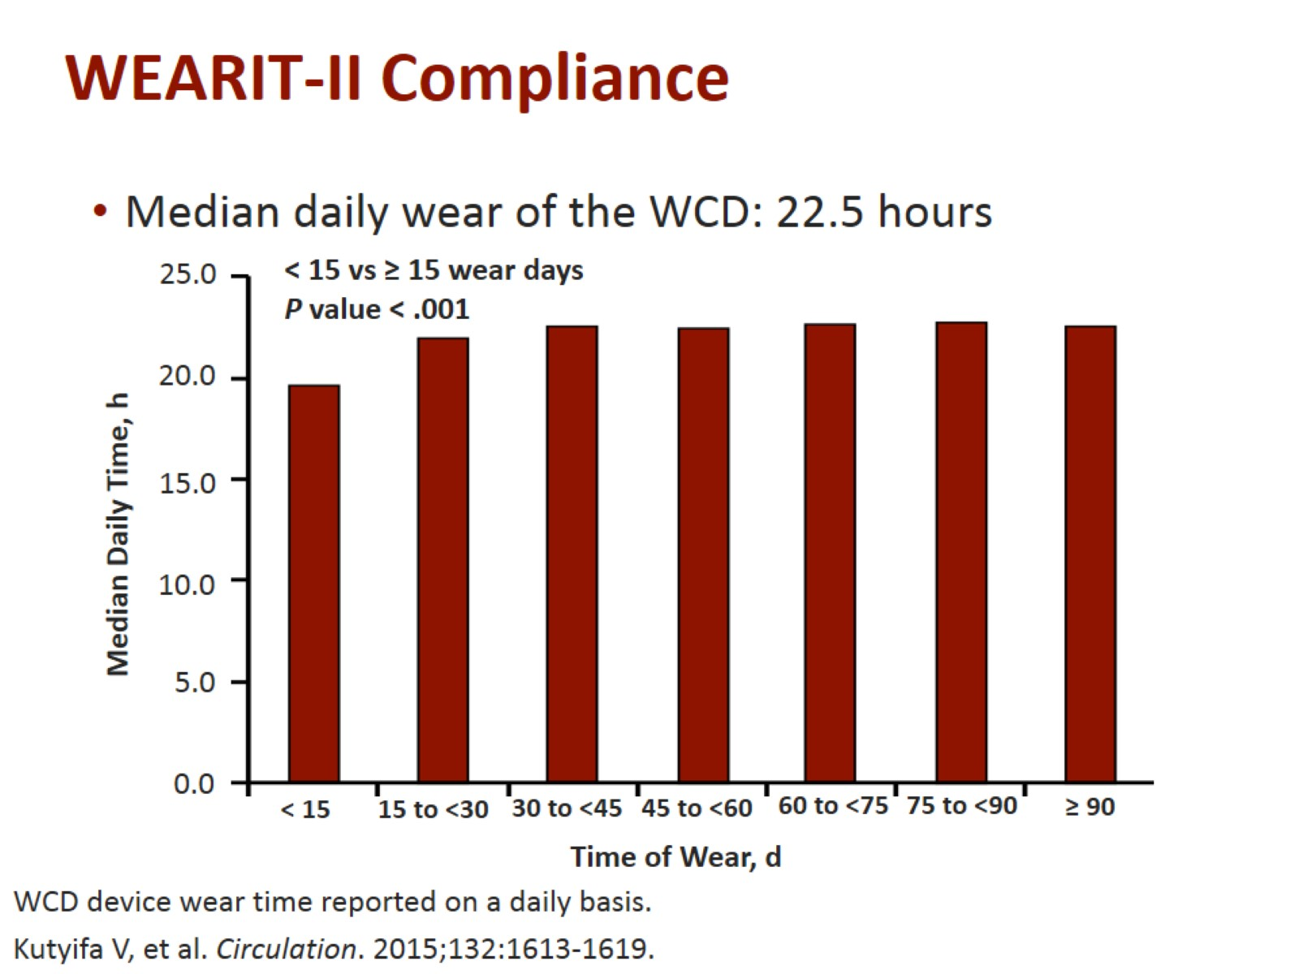

Slide 14
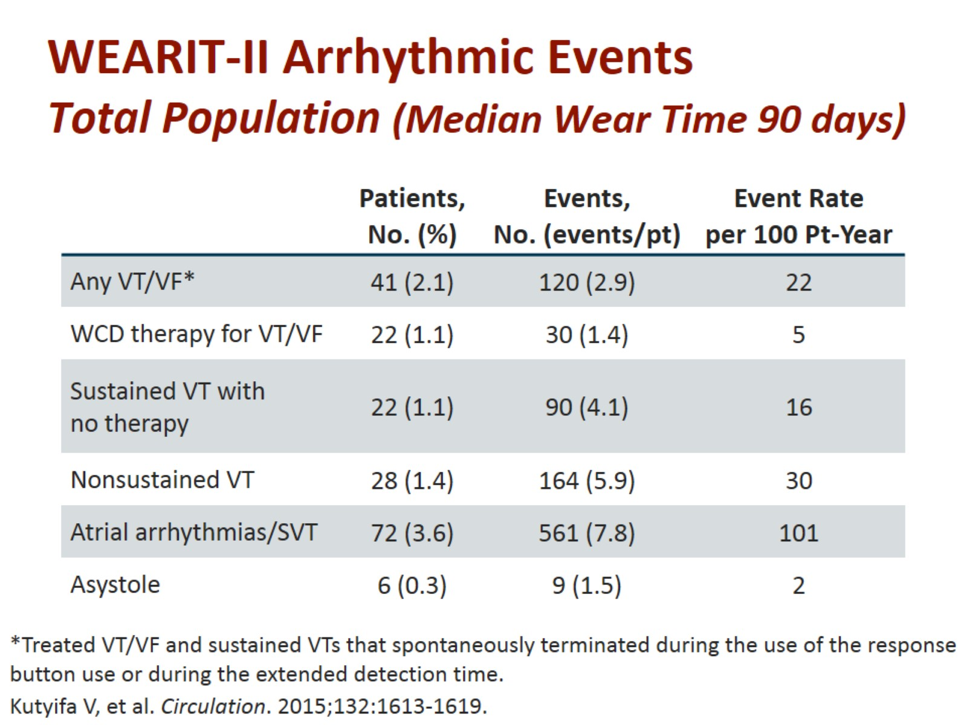
WEARIT-II Arrhythmic Events Total Population (Median Wear Time 90 days)

Slide 15
WEARIT-II Safety Endpoints

Slide 16
WEARIT-II Arrhythmic Events Total Population (Median Wear Time 90 days)

Slide 17
Arrhythmic Events WEARIT-II vs MADIT-RIT

Slide 18
WCD Use Early After Coronary Revascularization (CR)

Slide 19
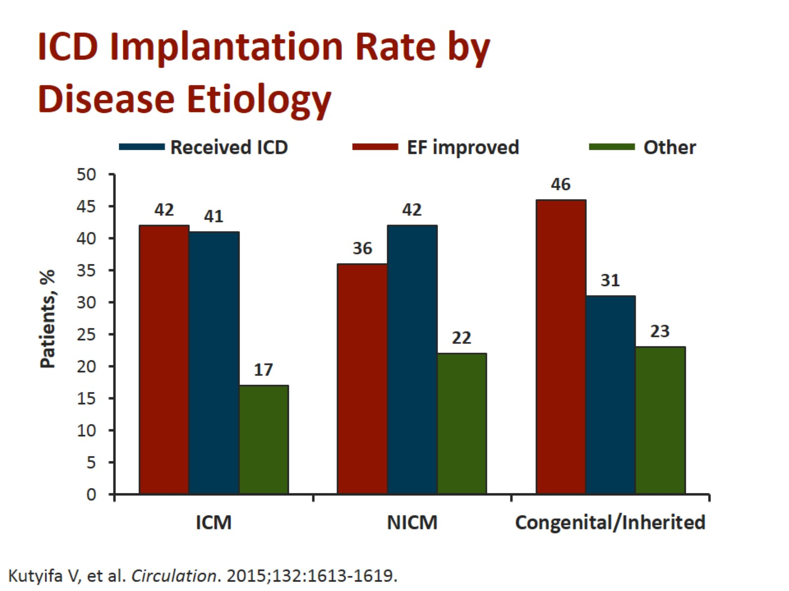

Slide 22
WEARIT-II Registry Probability of One-Year Mortality

Slide 23
Congenital, Inherited Heart Disease

Slide 24
Indications for WCD Use Bridging Period for ICD or Heart Transplantation

Slide 25
Recommendations for WCD Use Risk Stratification

Slide 26
LifeVest® Network

Slide 27
Summary

Slide 28
Abbreviations

Slide 29
Abbreviations (cont)

