Slide 1
Treatment of HR+ Breast Cancer: A Clinical Update

Slide 2
Treatment of HR+ Breast Cancer: A Clinical Update

Slide 3
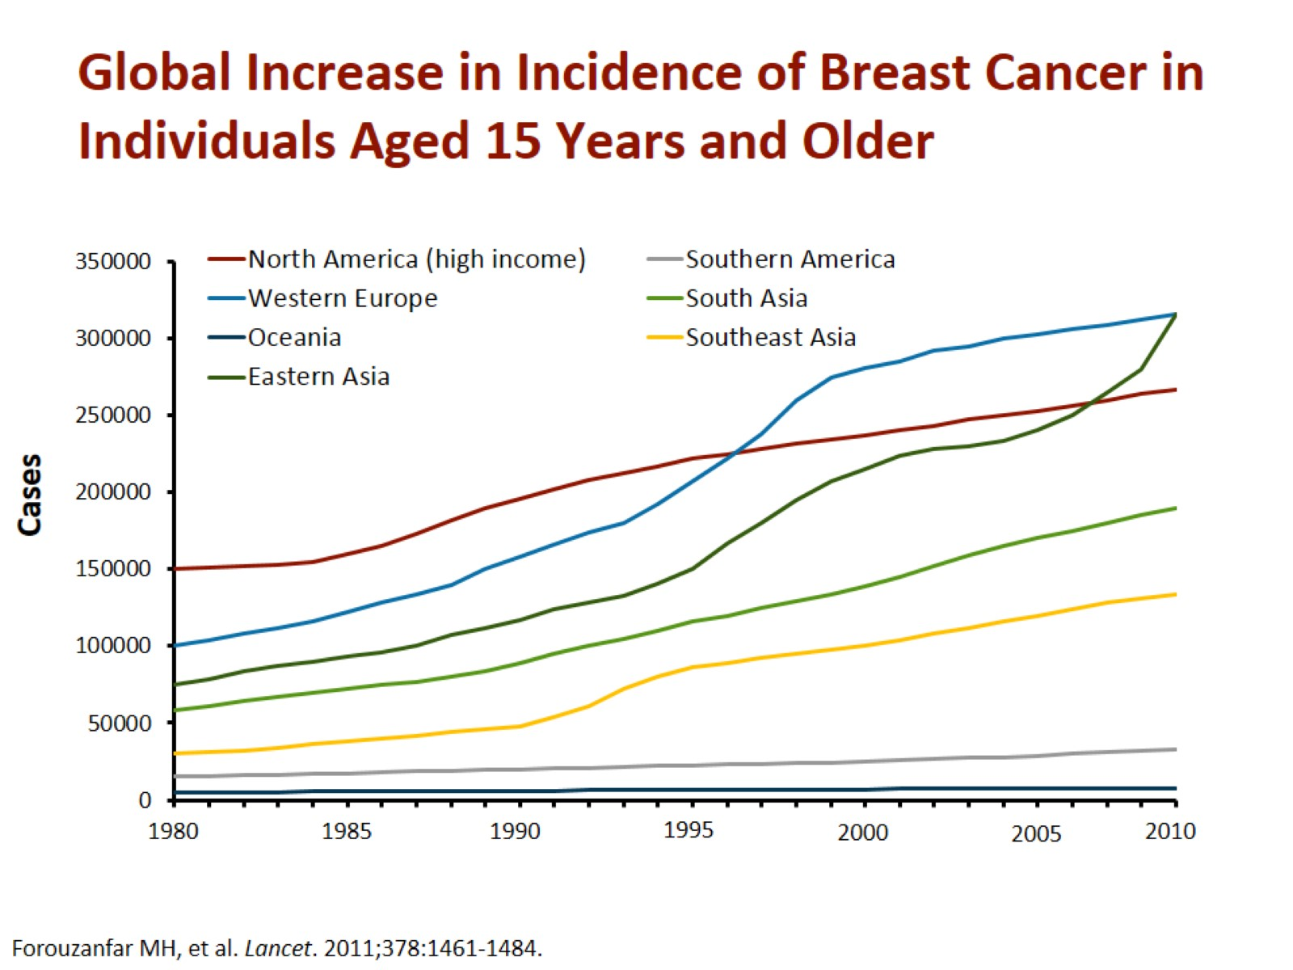
Global Increase in Incidence of Breast Cancer in Individuals Aged 15 Years and Older

Slide 4
Mortality From Breast Cancer, Age-Distributed Rate (World), All Ages

Slide 5
Breast Cancer Is a Heterogeneous Disease

Slide 6
Approach to Treatment of Breast Cancer

Slide 7
Systemic Drug Treatment Strategies in Breast Cancer

Slide 8
Current Therapies for HR+ Early Breast Cancer

Slide 9
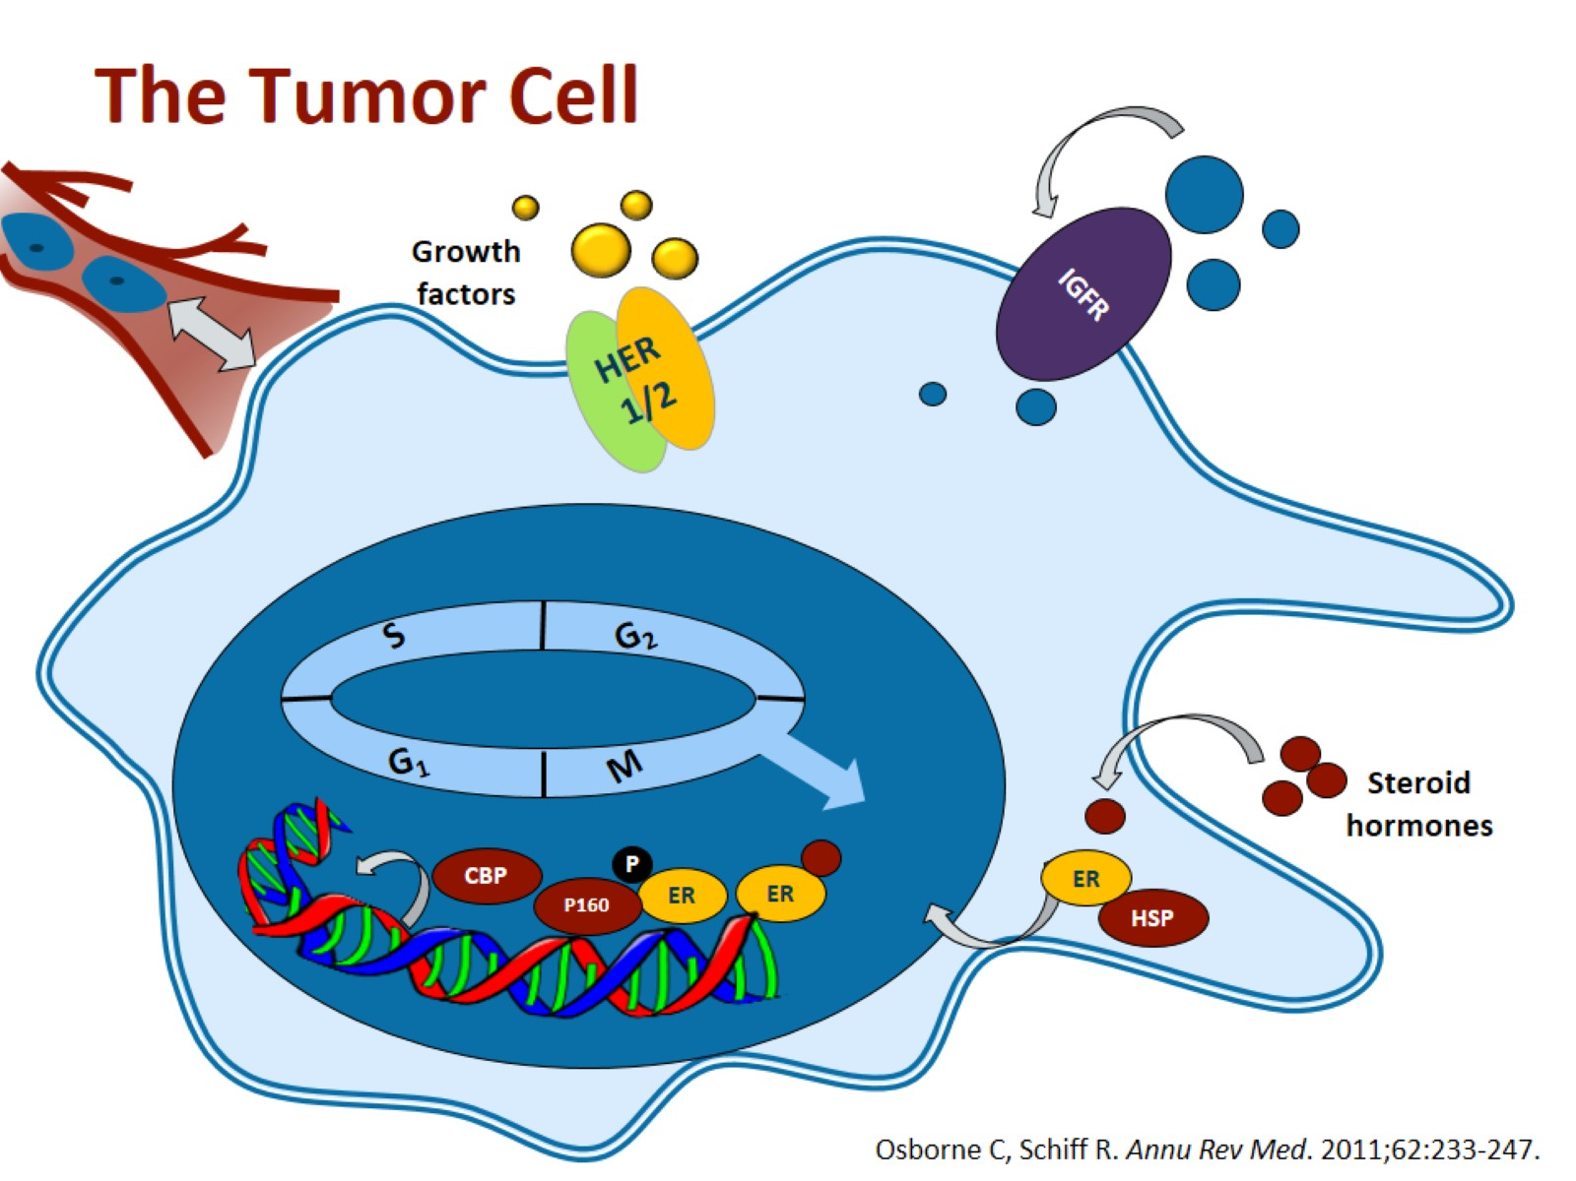
The Tumor Cell

Slide 10
Treatment Strategies for HR+ Breast Cancer in Postmenopausal Women

Slide 11
5 Years of Tamoxifen vs No Tamoxifen

Slide 12
Trials of Adjuvant Endocrine Therapy Strategies

Slide 13
5 Years of AI vs 5 Years of Tamoxifen

Slide 14
ATAC: Adverse Events

Slide 15
Patients Already on Adjuvant Therapy (2-3 Years of Tamoxifen)

Slide 16
Sequential Exemestane IES Trial: Disease-Free Survival

Slide 17
ATLAS: 6846 Women, ER+, 10 vs 5 Years of Tamoxifen

Slide 18
Breast Cancer Intrinsic Subtypes: A Spectrum

Slide 19
Adjuvant Endocrine Therapy in Early Breast Cancer

Slide 20
Available Therapies for HR+ MBC

Slide 21
NCCN Guidelines: Postmenopausal HR+ MBC

Slide 22
Goals in the Treatment of HR+ MBC

Slide 23
Approved Endocrine Therapy for HR+ MBC

Slide 24
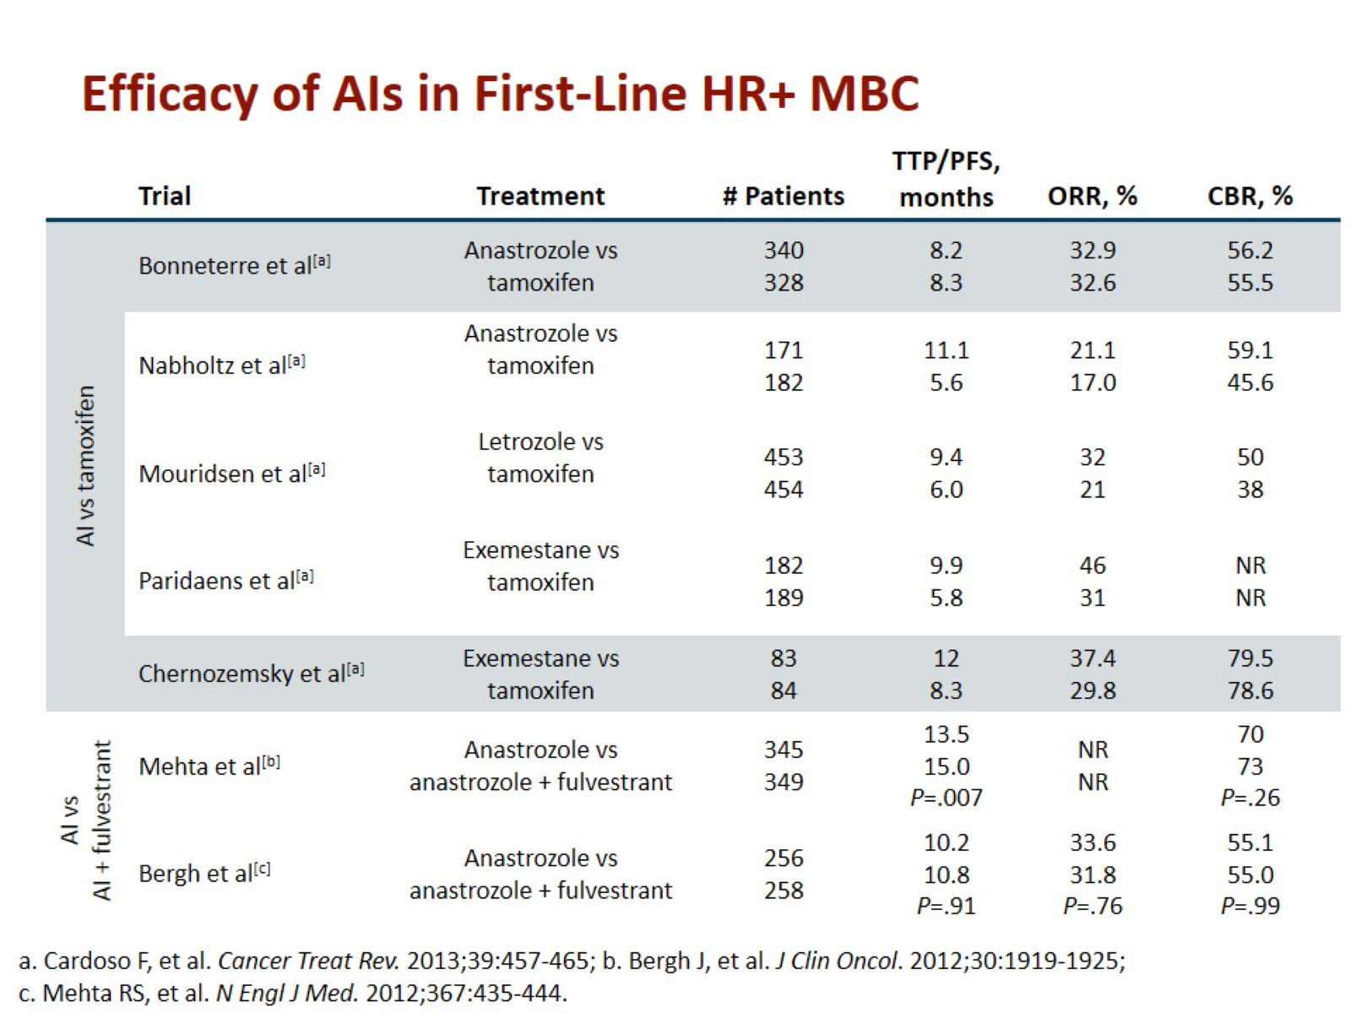
Efficacy of AIs in First-Line HR+ MBC

Slide 25
Fulvestrant MoA

Slide 26
Fulvestrant 250 mg + AI Combination as First-Line Treatment for ER+ MBC

Slide 28
CONFIRM: Fulvestrant 500 mg vs 250 mg in First/Second-Line Treatment

Slide 29
FALCON: Fulvestrant 500 mg vs Anastrozole in First-Line Endocrine Therapy-Naive ER+ MBC

Slide 30
Available Second-Line Options for ER+ MBC in Europe

Slide 31
EFECT and SoFEA Trials

Slide 32
Clinical Benefit From mTOR Inhibition in ER+ MBC

Slide 33
BOLERO-2: PFS

Slide 34
Treatment Challenges and Unmet Clinical Needs

Slide 35
Reversing Endocrine Resistance in MBC

Slide 36
Pathways Involved in Endocrine Resistance

Slide 37
Mutations in ESR1 Evolve in ER+ MBC

Slide 38
SoFEA Trial Results

Slide 39
Conclusions

Slide 40
Abbreviations

Slide 41
Abbreviations (cont)

Slide 42
Abbreviations (cont)

