Slide 1
The Nurse View: Updates in the Management of Metastatic Colorectal Cancer

Slide 2
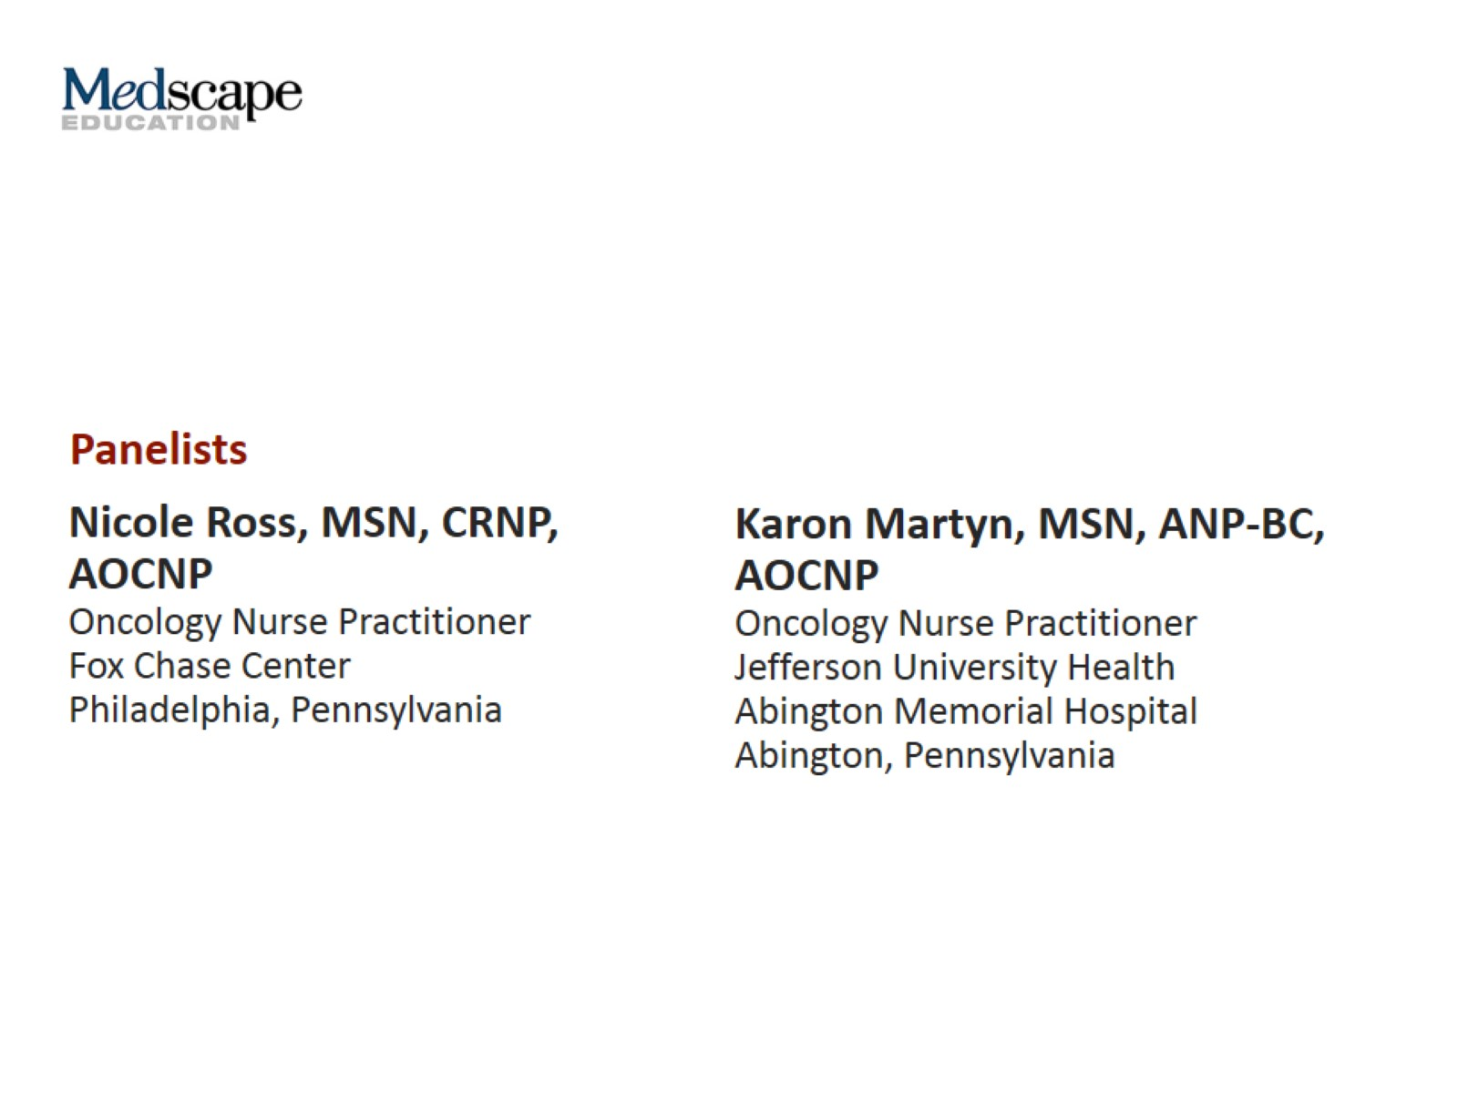

Slide 4
Colorectal Cancer

Slide 5
Management of Patients With mCRC Overview

Slide 6
Case Study: Mr M Background

Slide 7
Case Study: Mr M Treatment History

Slide 8
Considerations for Second-Line Therapy in mCRC

Slide 9
Strategies for Communicating With and Educating Patients

Slide 10
Including Patients and Caregivers in Treatment Decisions

Slide 11
Second-Line Treatment Options for mCRC

Slide 12
Guidelines for Second-Line mCRC Treatment

Slide 13
Guidelines for Second-Line mCRC Treatment (cont)

Slide 14
Case Study: Mr. M (cont)

Slide 16
Managing Chemotherapy-Related Diarrhea

Slide 17
Prevention of Chemotherapy-Induced Peripheral Neuropathy

Slide 18
Management of Chemotherapy-Induced Peripheral Neuropathy

Slide 19
Anti-VEGF-Associated Hypertension

Slide 21
Bevacizumab-Related AEs

Slide 23
Case Study: Mr M (cont) Review of Case

Slide 24
Case Study: Mr M (cont)

Slide 25
NCCN mCRC Treatment Guideline Third-Line Treatment

Slide 26
Regorafenib Overview

Slide 27
Regorafenib Dosing and Administration

Slide 28
Regorafenib Adverse Events

Slide 29
Hand-Foot Syndrome vs Hand-Foot Skin Reaction

Slide 30
Preventing and Managing HFSR

Slide 31
Trifluridine-Tipiracil Overview

Slide 32
Trifluridine-Tipiracil Dosing and Administration

Slide 33
Trifluridine-Tipiracil Adverse Events

Slide 34
Nivolumab and Pembrolizumab Overview

Slide 35
Nivolumab and Pembrolizumab Adverse Events

Slide 36
Abbreviations

Slide 37
Abbreviations (cont)

