Slide 1
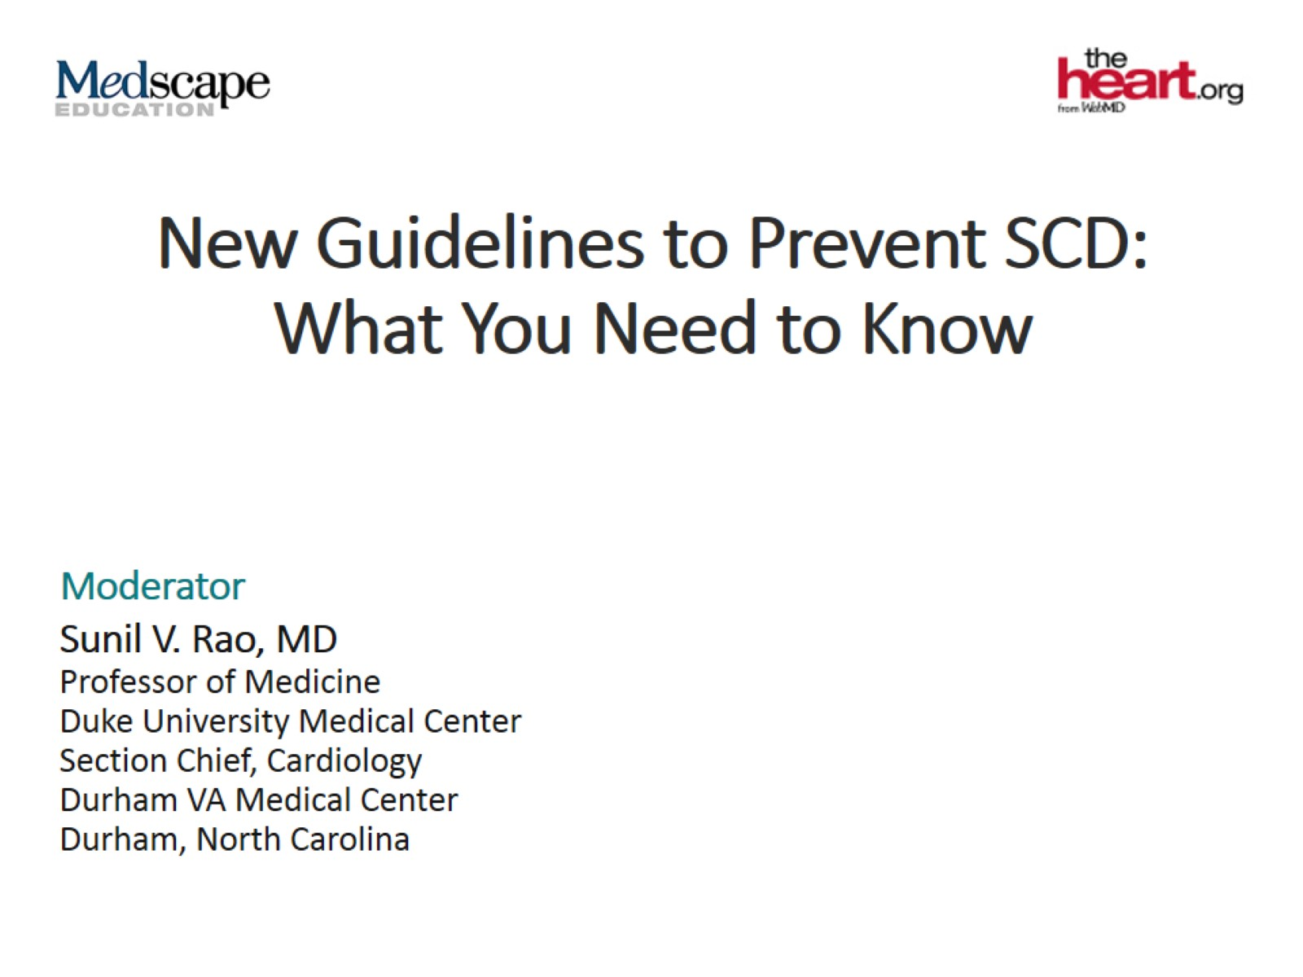
New Guidelines to Prevent SCD: What You Need to Know

Slide 3
Goals

Slide 4
SCD Death -- Hot Topic

Slide 5
Key Updates From the New Guidelines

Slide 6
Key Updates From the New Guidelines (cont)

Slide 7
Key Updates From the New Guidelines (cont)

Slide 8
Arrhythmia Suppression

Slide 9
Inadequate Vascular Access or at High Risk for Infection

Slide 10
First-Degree Relatives With SCD

Slide 11
Shared Decision-Making

Slide 12
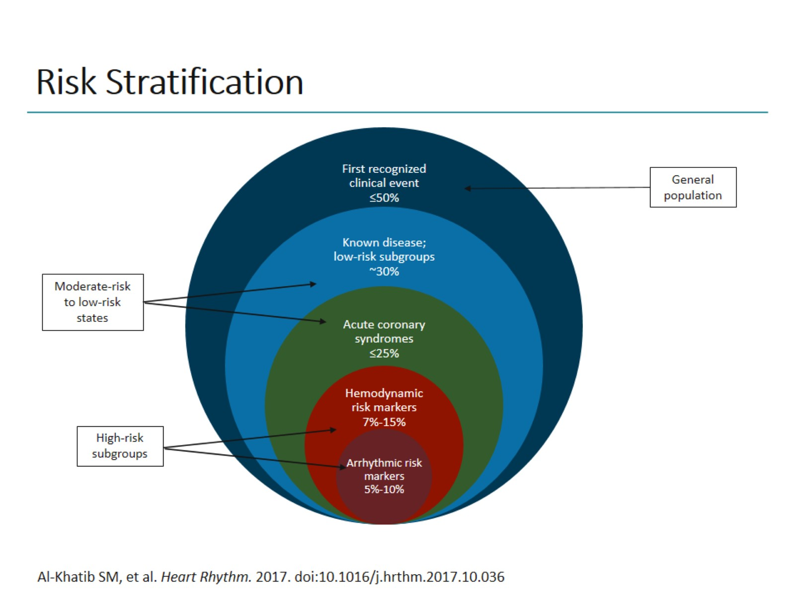
Risk Stratification

Slide 13
Risk Stratification and EF

Slide 14
SCD Is the First Recognized Clinical Event Vast Majority of Patients

Slide 15
Determining Risk for Ischemic vs Nonischemic Patients

Slide 16
2017 AHA/ACC/HRS Guidelines Risk for Ventricular Arrhythmias

Slide 17
Primary Prevention of SCD in Patients With NICM

Slide 18
Primary Prevention of SCD in Patients With Ischemic Heart Disease

Slide 19
When to Consider a WCD Patient Types

Slide 20
WCD Class IIb Recommendation

Slide 21
Well-Coordinated Multidisciplinary Teams

Slide 22
Shared Decision-Making

Slide 23
Key Takeaways

Slide 24
Abbreviations

Slide 25
Abbreviations (cont)

