Slide 1
WHAT’S NEW WITH THE TREATMENTS FOR HIGH-RISK DYSLIPIDEMIA?

Slide 2
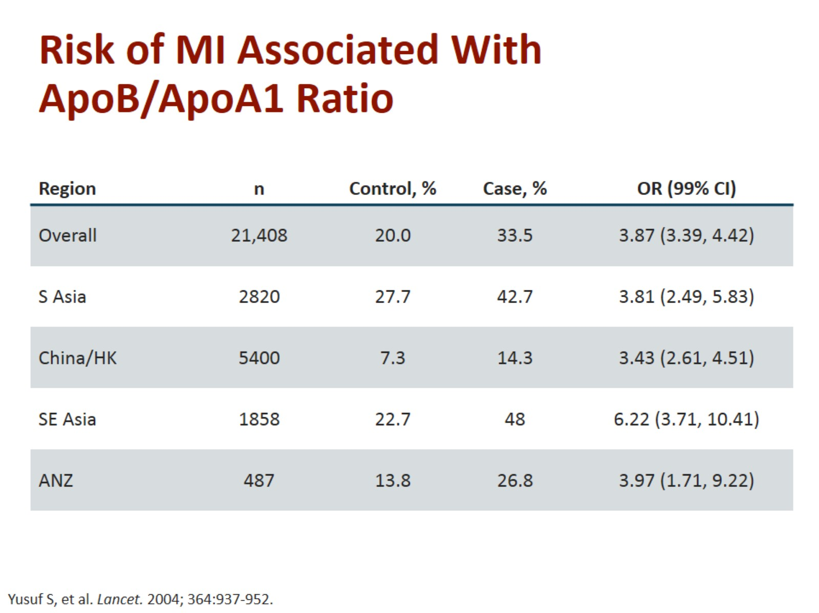
Risk of MI Associated With ApoB/ApoA1 Ratio

Slide 3
Statins Approximate LDL-C-Lowering Efficacy

Slide 4
Effect of Statins vs Placebo on CV Events

Slide 5
Lipid Goal Attainment in Asian Patients With ACS

Slide 6
PCSK9 Inhibition in Patients With Hypercholesterolemia Receiving Statin Therapy

Slide 7
PCSK9 CV Outcomes Trials

Slide 8
FOURIER Trial Design

Slide 9
FOURIER Endpoints

Slide 10
FOURIER Follow-Up

Slide 11
FOURIER: Baseline Characteristics

Slide 12
FOURIER: Lipid-Lowering Therapy and Lipid Levels at Baseline

Slide 13
FOURIER: Effect on LDL-C

Slide 14
FOURIER: Main CV Outcomes

Slide 15
FOURIER: Main CV Outcomes (cont)

Slide 16
FOURIER: Lower LDL-C Is Better

Slide 17
FOURIER: Safety

Slide 18
Summary of FOURIER

Slide 19
EBINGHAUS: Trial Design

Slide 20
Cognition and PCSK9 Inhibitors

Slide 21
EBINGHAUS Primary Endpoint: Spatial Working Memory Strategy Index

Slide 22
EBINGHAUS: Cognitive Assessments by Nadir Achieved LDL-C and Treatment

Slide 23
The SPIRE-1 and SPIRE-2 CV Outcome Trials

Slide 24
SPIRE-1 and SPIRE-2: Baseline Clinical Characteristics

Slide 25
SPIRE-1 and SPIRE-2: Confirmation of Attenuation in LDL-C Reduction Over Time

Slide 26
SPIRE-1 and SPIRE-2 Primary Prespecified Endpoint

Slide 27
SPIRE-1 and SPIRE-2: Incidence Rates of AEs per 100 P-Y of Exposure

Slide 28
ODYSSEY Outcomes Phase 3 Post-ACS With Alirocumab

Slide 29
PCSK9 CV Outcomes Trials

Slide 30
Abbreviations

Slide 31
Abbreviations (cont)

Slide 32
Abbreviations (cont)

