Slide 1
Trials and Tribulations in VTE: How Do Real-World Data Fit In?

Slide 3
Program Goals

Slide 4
VTE Is a Leading Cause of Death Worldwide

Slide 5
NOACs: VTE Clinical Trials

Slide 6
Real-World Data

Slide 7
XALIA A Prospective, Noninterventional Study

Slide 8
EINSTEIN-DVT and XALIA: Outcomes

Slide 9
Clinical Trials vs Real World

Slide 10
GARFIELD-VTE: A Prospective Global Disease Registry

Slide 11
GARFIELD-VTE: Patient Population

Slide 12
GARFIELD-VTE: Treatment Patterns of AC Therapy Within ±30 Days of Diagnosis

Slide 13
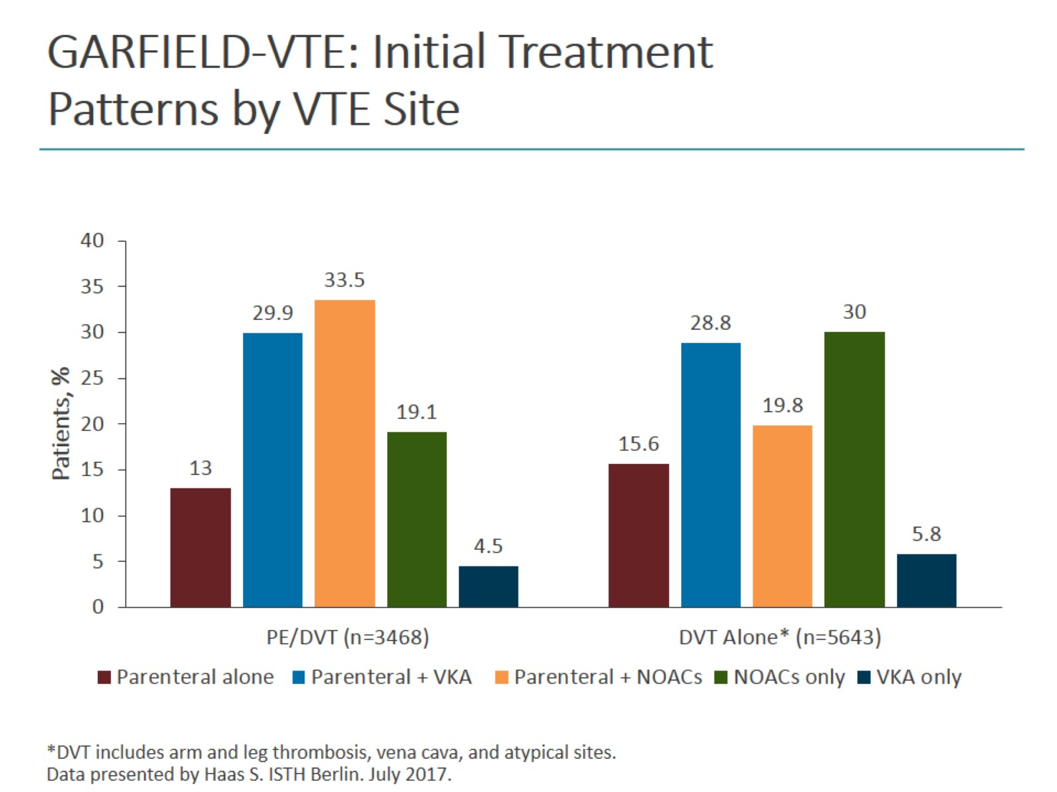
GARFIELD-VTE: Initial Treatment Patterns by VTE Site

Slide 14
GARFIELD-VTE: Baseline Characteristics

Slide 15
GARFIELD-VTE: 0- to 6-Month Outcomes

Slide 16
GARFIELD-VTE: Causes of Death During 6 Months After VTE

Slide 17
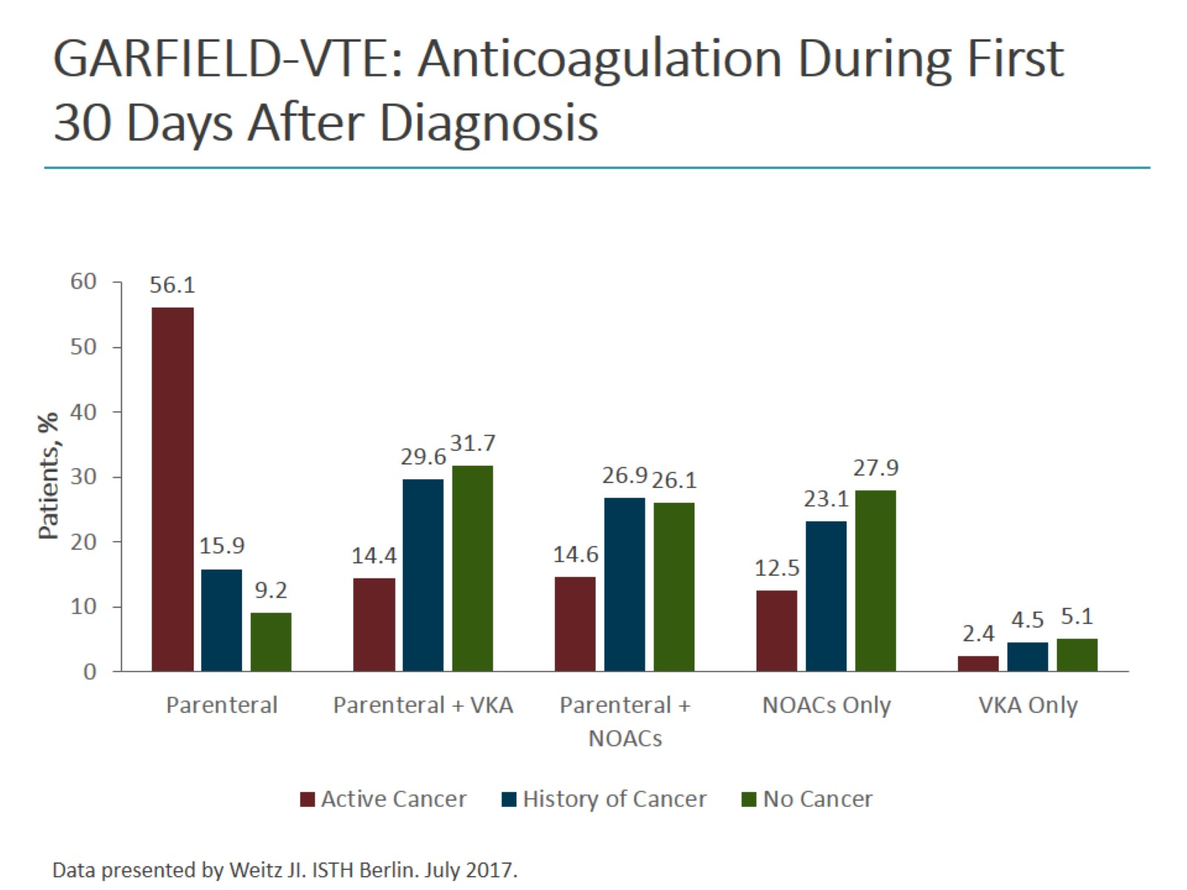
GARFIELD-VTE: Anticoagulation During First 30 Days After Diagnosis

Slide 18
Real-World Evidence With Rivaroxaban in VTE Treatment

Slide 19
Real-World Evidence With Rivaroxaban in VTE Treatment (cont)

Slide 20
Other Real-World Evidence

Slide 21
RE-COVERY: Design

Slide 22
ETNA-VTE

Slide 23
Summary

Slide 24
Abbreviations

