Slide 1
The Effect of Intra-Articular Steroids on Cartilage in Knee Osteoarthritis

Slide 2
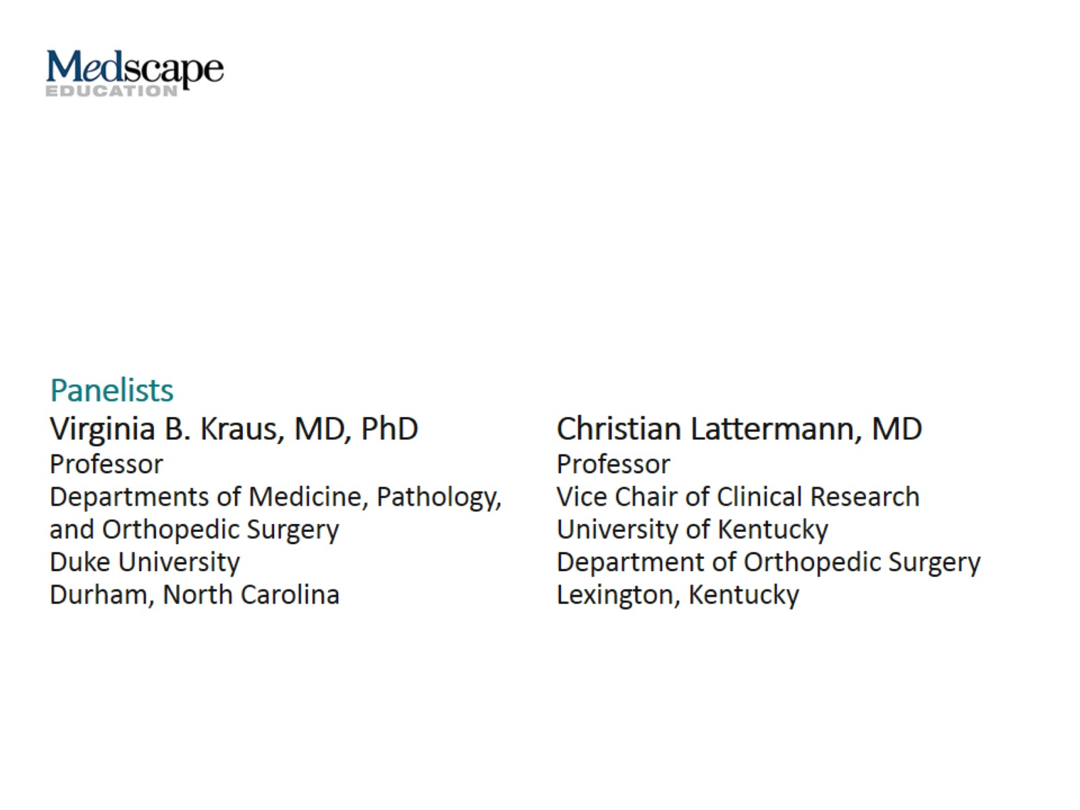

Slide 3
This program will include a discussion of investigational agents not approved by the FDA for use in the United States.

Slide 4
Goals of This Program

Slide 5
Background

Slide 6
Background (cont)

Slide 7
Historic Perspectives: Effect of IA Steroids on Knee Cartilage

Slide 8
Historic Perspectives: Effect of IA Steroids on Knee Cartilage (cont)

Slide 9
Effect of IA Steroids on Articular Cartilage

Slide 10
Effect of IA Steroids on Articular Cartilage: Panel’s Comments

Slide 11
Effect of IA Steroids on Articular Cartilage: Panel’s Comments (cont)

Slide 12
OA Is a Disease Process, Not a Condition

Slide 13
Early Anti-inflammatory Treatment in Patients With Acute ACL Tear

Slide 14
Early Anti-inflammatory Treatment: Methods

Slide 15
Early Anti-inflammatory Treatment: Results

Slide 16
Early Anti-inflammatory Treatment: Conclusions

Slide 17
Can IA Triamcinolone Modify OA Progression?

Slide 18
Can IA Triamcinolone Modify OA Progression? Results

Slide 19
Can IA Triamcinolone Modify OA Progression? Conflicting Conclusions

Slide 20
Can IA Triamcinolone Modify OA Progression? Panel’s Comments

Slide 21
Can IA Triamcinolone Modify OA Progression? Panel’s Comments (cont)

Slide 22
Analgesic Effect of ER Triamcinolone

Slide 23
Analgesic Effect of ER Triamcinolone: Results

Slide 24
Analgesic Effect of ER Triamcinolone: Implications

Slide 25
Analgesic Effect of ER Triamcinolone: Implications (cont)

Slide 26
Summary

Slide 27
Abbreviations

