Slide 1
New DOACs to Prevent PE and Stroke in HF and Other Hospitalized Patients
MODERATOR
  Samuel Z. Goldhaber, MD
    Professor of Medicine
    Harvard Medical School
    Section Head of Vascular Medicine
    Director of the Thrombosis Research Group
    Brigham and Women's Hospital
    Boston, Massachusetts
Tuesday, 29 August 2017

Slide 2
New DOACs to Prevent PE and Stroke in HF and Other Hospitalized Patients
Welcome and Introductions
  Samuel Z. Goldhaber, MD
The Critical Unmet Need for VTE Prophylaxis in Medically Ill Patients
  Samuel Z. Goldhaber, MD
DOACs to Prevent VTE and to Reduce the Risk of Stroke During Hospitalization and During the First Several Months After Hospital Discharge
  C. Michael Gibson, MD
Antidotes for DOACs
  Alexander T. Cohen, MBBS, MSc, MD, FRACP
Case Discussion With Faculty Panel
  Gregory Piazza, MD
Summary and Concluding Remarks
  Samuel Z. Goldhaber, MD

Slide 3
Learning Objectives
Upon completion of this activity, participants will:
  Have increased knowledge regarding
    The unmet need for VTE prophylaxis in the medically ill
  Have greater competence related to
    Optimal utilization of DOACs to prevent VTE and reduce risk of stroke during and after hospitalization
    Use of available antidotes for DOACs
Notes:
Abbreviations:
DOAC = direct oral anticoagulant
VTE = venous thromboembolism

Slide 4
The Critical Unmet Need for VTE Prophylaxis in Medically Ill Patients
Moderator
  Samuel Z. Goldhaber, MD
    Professor of Medicine
    Harvard Medical School
    Section Head of Vascular Medicine
    Director of the Thrombosis Research Group
    Brigham and Women's Hospital
    Boston, Massachusetts

Slide 5
Interactive Question
  Among patients with acute medical illnesses, the highest frequency of hospital-related DVT and PE occurs:
  During the first 5 days of hospitalization
  During the second 10 days of hospitalization
  During the first month after hospital discharge
  During the third month after hospital discharge
  During the sixth month after hospital discharge
Notes:
Abbreviation:
DVT = deep vein thrombosis
C) During the first month after hospital discharge

Slide 6
Interactive Question
  Among patients with acute medical illnesses, the highest frequency of hospital-related DVT and PE occurs:
  During the first 5 days of hospitalization 34%
  During the second 10 days of hospitalization 21%
  During the first month after hospital discharge 39%
  During the third month after hospital discharge 3%
  During the sixth month after hospital discharge 3%
Notes:
C) During the first month after hospital discharge

Slide 7
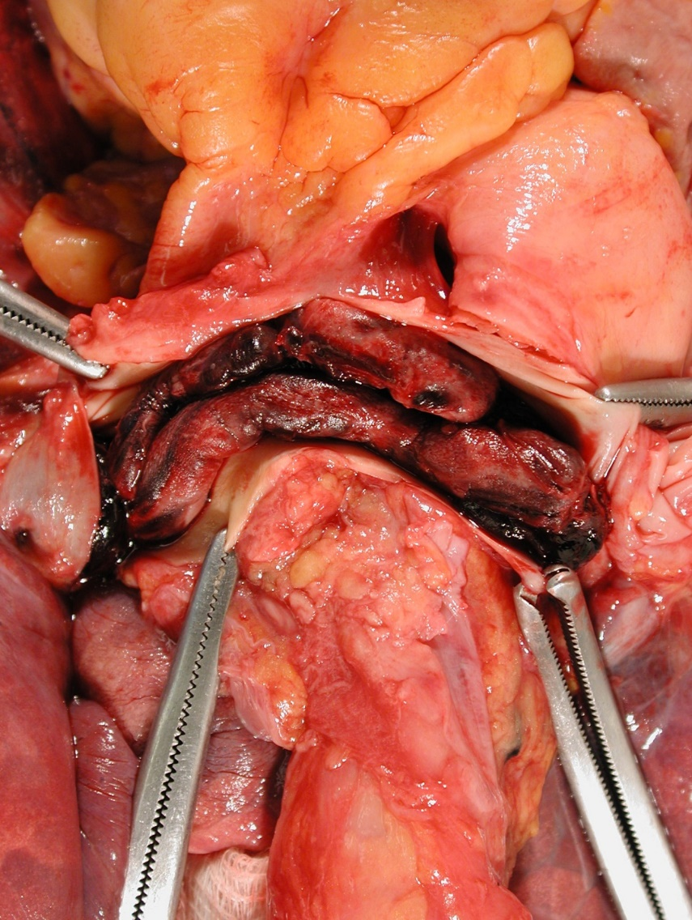
41-Year-Old Woman: Sudden Collapse
Image courtesy of Samuel Z. Goldhaber, MD.
Notes:
Courtesy of Dr G

Slide 8
CTEPH Pathophysiology
IMAGE NO LONGER AVAILABLE
From N Engl J Med, Piazza G, Goldhaber SZ, et al., Chronic Thromboembolic Pulmonary Hypertension, 364., 351-60. Copyright © 2011 Massachusetts Medical Society. Reprinted with permission from Massachusetts Medical Society.

Slide 9
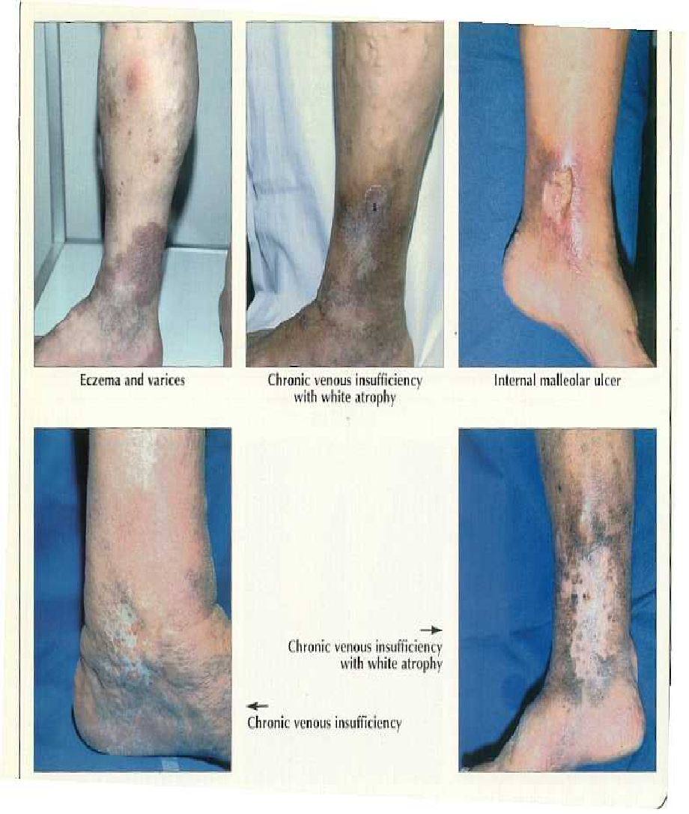
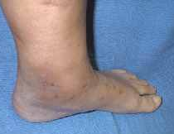
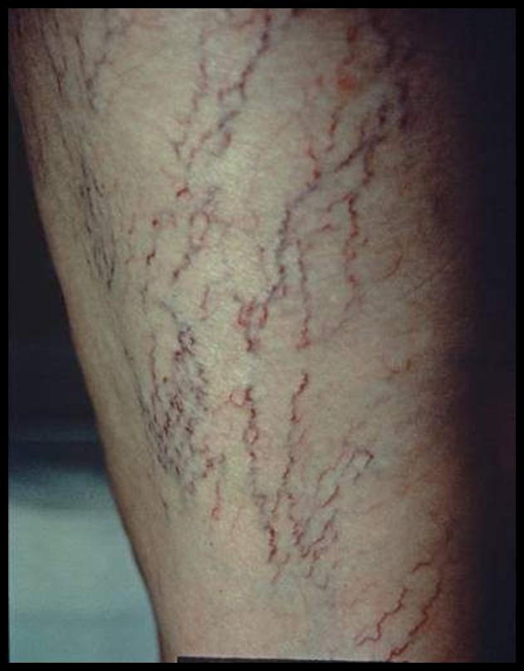

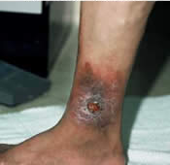
Post-Thrombotic Syndrome
Venous ectasia
Edema
Hyperpigmentation
Venous ulcer
Skin induration
Atrophie blanche
Images courtesy of Samuel Z. Goldhaber, MD.
Notes:
9
Courtesy of Dr G

Slide 10
Call to Action
  100,000 to 180,000 PE-related deaths annually in the United States alone
  PE is the most preventable cause of death among hospitalized patients
IMAGE NO LONGER AVAILABLE
Office of the Surgeon General (US). The Surgeon General's Call to Action to Prevent Deep Vein Thrombosis and Pulmonary Embolism. 2008.
Notes:
Abbreviation:
PE = pulmonary embolism
LO 1
https://www.ncbi.nlm.nih.gov/books/NBK44178/
Ref on PT: https://www.ncbi.nlm.nih.gov/books/NBK44178/

Slide 11

In G7 Countries, How Big Is the At-Risk Population of Acutely Ill Medical Patients?
  In G7 countries, which comprise the United States, Canada, France, Germany, Italy, Japan, and the United Kingdom, a substantial number of acutely ill medical patients are vulnerable to VTE
  In these countries:
    There are > 24 million hospitalized acutely ill medical patients
    An estimated 22.5 million of these patients are at risk of VTE events
    And > 1 million VTE events and 150,000 VTE-related deaths are reported annually
>24 million hospitalized acutely ill medical patients
~22.5 million at risk of VTE events
>1 million VTE events
>150,000 VTE deaths
Cohen AT, et al. Thromb Haemost. 2007;98:756-764.
Notes:
https://globenewswire.com/news-release/2017/06/23/1028665/0/en/U-S-FDA-Approves-Bevyxxa-betrixaban-First-and-Only-Anticoagulant-for-Hospital-and-Extended-Duration-Prevention-of-Venous-Thromboembolism-VTE-in-Acutely-Ill-Medical-Patients.html
In G7 countries, which include the United States, Canada, France, Germany, Italy, Japan, and the United Kingdom, a substantial number of acutely ill medical patients are vulnerable to VTE
In these countries:
There are more than 24 million hospitalized acutely ill medical patients
An estimated 22.5 million of these patients are at risk of VTE events
And more than 1 million VTE events and 150,000 VTE-related deaths are reported annually

Slide 12
Trials of VTE Prophylaxis in Hospitalized
Medical Patients
MEDENOX (enoxaparin 40 mg)^{[a]}
PREVENT
(dalteparin
5000 IU)^{[b]}
ARTEMIS (fondaparinux
2.5 mg)^{[c]}
a. Samama MM, et al. N Engl J Med. 1999;341:793-800.
b. Leizorovicz A, et al. Circulation. 2004;110:874-879.
c. Cohen AT, et al. BMJ. 2006; 332:325-329.

Slide 13
3 Pharmacologic Trials
Once-daily injected low-dose anticoagulant prophylaxis, in these 3 placebo-controlled trials, reduced DVT/ PE by > 50%, without increasing major bleeding
Samama MM, et al. New Engl J Med. 1999;341:793-800; Leizorovicz A, et al. Circulation. 2004;110:874-879;
Cohen AT, et al. BMJ. 2006; 332:325-329.

Slide 14
Randomization
VTE risk score > 4
No prophylaxis
N = 2506
INTERVENTION
Single alert
n = 1255
CONTROL
No alert
n = 1251
VTE Risk Factors | Score
Major Cancer, prior VTE, hypercoagulability | 3
Intermediate Major surgery | 2
Minor Advanced age, obesity, bed rest, hormone-replacement therapy or oral contraceptives | 1
Kucher N, et al. N Engl J Med. 2005;352:969-977.

Slide 15
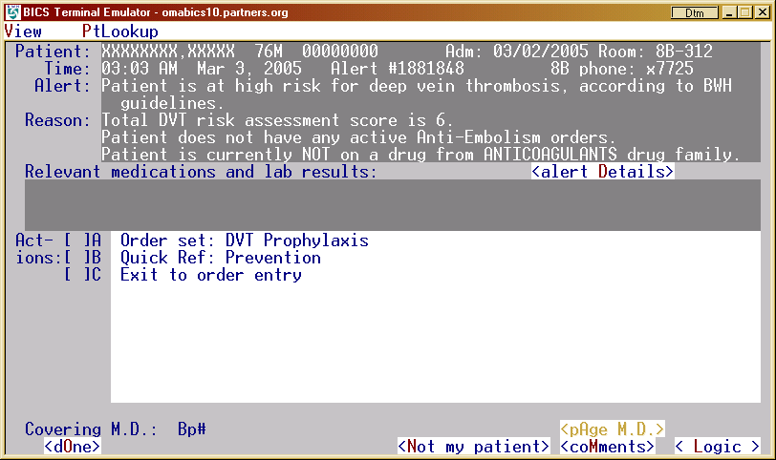
Patient Alerts
Image courtesy of Samuel Z. Goldhaber, MD.
Notes:
Courtesy of Dr G

Slide 16

Primary Endpoint
From N Engl J Med, Kucher N, et al., Electronic Alerts to Prevent Venous Thromboembolism among Hospitalized Patients, 352., 969-977. Copyright © 2005 Massachusetts Medical Society. Reprinted with permission from Massachusetts Medical Society.

Slide 17
VTE After Hospital Discharge
  Despite in-hospital VTE prophylaxis with UFH or LMWH, > 400,000 VTE events occur in this post-hospital discharge population annually in the United States alone
  About half occur within 5 to 6 weeks of discharge
Spencer FA, et al. Arch Intern Med. 2007;167:1471-1475.
Notes:
Abbreviations:
LMWH = low molecular weight heparin
UFH = unfractionated heparin

Slide 18
Out-of-Hospital VTE
  Despite in-hospital VTE prophylaxis, 75% of VTEs present out-of-hospital
  37% have been hospitalized within the 3 months preceding the diagnosis of VTE
IMAGE NO LONGER AVAILABLE
Reproduced with permission from Arch Intern Med. 2007. 167: 1471-1475. Copyright © 2007 American Medical Association. All rights reserved.

Slide 19
Risk of VTE Extends
Post-Hospital Discharge
Observational study of >11,000 hospitalized medical patients
IMAGE NO LONGER AVAILABLE
Amin AN, et al. J Hosp Med. 2012;7:231-238. Copyright © 2011 Society of Hospital Medicine.

Slide 20
Extended VTE Prophylaxis
Medical Patients
Study | Study Conclusion | Net Clinical Benefit
EXCLAIM -- LMWH (n = 5963) | VTE↓ Major bleeding ↑ | Marginal
MAGELLAN -- Rivaroxaban (n = 8101) | VTE↓ Major bleeding ↑ | No
ADOPT -- Apixaban (n = 6528) | VTE↔ Major bleeding ↑ | No
Hull RD, et al. Ann Intern Med. 2010;153:8-18.
Cohen AT, et al. N Engl J Med. 2013;368:513-523.
Goldhaber SZ, et al. N Engl J Med. 2011;365:2167-2177.
Notes:
Hull RD, et al. Ann Intern Med. 2010;153:8-18; Cohen AT, et al. N Engl J Med. 2013;368:513-523; Goldhaber SZ, et al. N Engl J Med. 2011;365:2167-2177.
EXCLAIM- enox vs. placebo
MAGELLAN- riva vs. enox
ADOPT- apix vs. enox
LIFENOX- enox/GCS vs. placebo/GCS

Slide 21

Post-Discharge VTE: Medical Patients
  The rate of symptomatic VTE more than doubles over 21 days post-discharge
  The risk of fatal VTE increases fivefold
MAGELLAN | VTE-Related Death, %
 | 10 d | 35 d
Enoxaparin 10 d | 0.2 | 1.0
Rivaroxaban 35 d | 0.1 | 0.6
From N Engl J Med, Goldhaber SZ, et al., Apixaban versus Enoxaparin for Thromboprophylaxis in Medically Ill Patients, 365., 2167-2177. Copyright © 2011 Massachusetts Medical Society. Reprinted with permission from Massachusetts Medical Society.
Cohen AT, et al. N Engl J Med. 2013;368:513-523; Goldhaber SZ, et al. N Engl J Med. 2011;365:2167-2177.
Notes:
Cohen AT, et al. N Engl J Med. 2013;368:513-523; Goldhaber SZ, et al. N Engl J Med. 2011;365:2167-2177
Here’s compelling data on the unmet need for preventing blood clots post hospitalization in acute medically ill patients
Each year in the United States an estimated 54,000 hospitalized patients with diseases such as CHF, stroke, infection, and cancer survive their medical condition but die of a pulmonary embolism this is tragic
If we look at recent data from large trials and specifically look at the post hospitalization period we see that after hospital therapy is stopped
The rate of symptomatic VTE > doubles over the first 21 days post discharge
The risk of fatal PE increases 5 fold between day 10 and 35 post hospital discharge
And there a no approved post hospital therapies
Other note:
MAGELLAN lovenox 35 day death rate, .6 % x 8.4 million High –risk Guideline patients
Surgeon General says 84,000 U.S. deaths each year due to PE and we know Acute medically iLL patients represent majority
21

Slide 22
Betrixaban
  Factor Xa inhibitor
  19- to 25-hour half-life
  Low peak-to-trough ratio
  7% to 17% renal clearance
  Antidote (Andexanet) in development
Chan NC, et al. Vasc Health Risk Manag. 2015;11:343-351
Chan NC, et al. Vasc Health Risk Manag. 2015;11:343-351.
Notes:
Chan NC, et al. Vasc Health Risk Manag. 2015;11:343-351

Slide 23
Properties of Betrixaban
  Rapid onset of action with Cmax achieved at 3 to 4 hours
  Stable plasma concentration and antithrombotic effect at steady state
  Long half-life
  Low renal clearance
  Lack of CYP interactions
 | Betrixaban | Rivaroxaban | Apixaban | Edoxaban | Enoxaparin
Half-Life, h | 19-25 | 5-9 | 9-13 | 8-10 | 4.5-7
Renal Excretion, % | 7 | 36 | 25 | 50 | > 40
CYP3A4 Interactions | No | Yes | Yes | No | No
Chan NC, et al. Vasc Health Risk Manag. 2015;11:343-351.
Notes:
Abbreviations:
Apix = apixaban
Betrix = betrixaban
C_{max} = maximum concentration
CYP = cytochrome P450
CYP3A4 = cytochrome P450, family 3, subfamily A, polypeptide 4
Edox = edoxaban
Enox = enoxaparin
Chan NC, et al. Vasc Health Risk Manag. 2015;11:343-351

Slide 24
Betrixaban: APEX Study Publication
The New England Journal of Medicine
Extended Thromboprophylaxis with Betrixaban in Acutely Ill Medical Patients
Cohen AT, Harrington RA, Goldhaber SZ, Hull RD, Wiens BL, Gold A, Hernandez AF, Gibson CM
Cohen AT, et al. N Engl J Med. 2016;375:534-544.

Slide 25
More Than Half of VTE Occurs After 10 Days of Prophylaxis
Cohen AT, et al. N Engl J Med. 2013;368:513-523; Cohen AT, et al. N Engl J Med. 2016;375:534-544;
Goldhaber SZ, et al. N Engl J Med. 2011;365:2167-2177.
Notes:
N Engl J Med 2013; 368: 513-523
N Engl J Med 2011; 365: 2167-2177
Cohen AT, et al. N Engl J Med. 2016;375:534-544.

Slide 26
DOACs to Prevent VTE and to Reduce the Risk of Stroke During Hospitalization and During the First Several Months After Hospital Discharge
Moderator
  C. Michael Gibson, MD
    Professor of Medicine
    Harvard Medical School
    Chairman
    PERFUSE Study Group
    Professor of Medicine
    Beth Israel Deaconess Medical Center
    Boston, Massachusetts

Slide 27
Previous Novel Oral Anticoagulant Trials of Extended Thromboprophylaxis in Acute Medically Ill Patients
ADOPT
Enoxaparin vs. Apixaban
MAGELLAN
Enoxaparin vs. Rivaroxaban
VTE Events
RRR = 22.8%
P = .02
6
RRR = 12.9%
P = .44
Incidence, %
0
More Major Bleeding
0.2%
0.5%
0.4%
1.1%
P = .04
P < .001
6
ADOPT: Goldhaber SZ, et al. N Engl J Med. 2011;365:2167-77.
MAGELLAN: Cohen AT, et al. N Engl J Med. 2013;368:513-523.
Gibson CM, et. al. ISTH 2016 . Abstract CA02.
Notes:
Abbreviation:
RRR = relative risk reduction

Slide 28
MARINER
Acute Medical Illness Patients Post-Hospital Discharge
Rivaroxaban once-daily compared with placebo
Switching after in-hospital parenteral thromboprophylaxis
Commencing rivaroxaban 10 mg on discharge
    Dose reduction (7.5 mg) for renal impairment
45 days after hospital discharge
12,000 patients in a global setting
Raskob GE, et al. Thromb Haemost. 2016.115:1240-1248.

Slide 29
Betrixaban
Oral factor Xa inhibitor
Renal clearance of administered dose (5%)
Renal clearance of absorbed dose (17%)
1 day half-life (19-25 h)
Not a substrate for major CYP450 enzymes
Rapid onset C_{max} achieved at 3 to 4 hours
Safety and efficacy of 80 mg daily dose of betrixaban previously described in approximately 1200 patients in phase 1 and 2 studies
Connolly SJ, et al. Eur Heart J. 2013;34:1498-1505.
Turpie AG, et al. Thromb Haemost. 2009;101:68-76.
Cohen AT, et al. Am Heart J. 2014;167:335-341.
Gibson CM, et al. ISTH 2016. Abstract CA02.

Slide 30
APEX Study Design
IMAGE NO LONGER AVAILABLE
Primary Efficacy Endpoint: Composite of asymptomatic proximal DVT (detected on ultrasound), symptomatic DVT (proximal or distal), non-fatal PE, and VTE-related death through Visit 3
Primary Safety Endpoint: ISTH Major bleeding through 7 days after drug discontinuation
Net Clinical Benefit: Composite of primary efficacy and primary safety endpoints
Dose adjustments in severe renal insufficiency (CrCl < 30 mL/min): Betrixaban 40 mg PO qd and Enoxaparin 20 mg SC qd
Gibson CM, et al. ISTH 2016. Abstract CA02.
Notes:
Abbreviation:
CrCl = creatinine clearance
ISTH = International Society on Thrombosis and Haemostasis
PO = by mouth
SC = subcutaneous

Slide 31
Study Design: Key Inclusion Criteria
Age/Risk Factors:
  ≥ 75 y OR
  60 - 74 y with D-dimer ≥ 2 x ULN OR
  40 - 59 y with D-dimer ≥ 2 x ULN and a history of either VTE, or cancer*
Anticipated to be severely immobilized for at least 24 hours after randomization with anticipated length of hospitalization ≥ 3 days
Hospitalized for one of the following acute presentation:
  Acute on chronic heart failure decompensation
  Acute on chronic respiratory failure
  Acute infection without septic shock
  Acute rheumatic disorders
  Acute ischemic stroke (w/ immobilization)
*Pre-amendment 3, other risk factors were allowed including: previous history of superficial VT, obesity, varicose veins of lower extremities, hormone therapy, thrombophilia, concomitant use of erythropoiesis stimulating agents
Gibson CM, et al. ISTH 2016. Abstract CA02.
Notes:
Abbreviations:
ULN = upper limit of normal
VT = ventricular tachycardia

Slide 32
Study Design: Key Exclusion Criteria
End-stage renal disease with CrCl < 15 mL/min, or requiring dialysis (first trial to enroll patients with CrCl < 30 mL/min)
Anticipated need for prolonged anticoagulation
Current intake of dual antiplatelet therapy
Anticipated major surgery
History of clinically significant bleeding within 6 months prior to enrollment
History of ICH, head trauma, or known intracranial lesions
History of significant GI, pulmonary or GU bleeding, ongoing chronic PUD or ongoing or acute gastritis within 2 years prior to enrollment
Hgb < 10 g/dL (pre-amendment 3); Hgb < 9.5 g/dL or unstable/declining hemoglobin (possible active bleed) (post-amendment 3)
Gibson CM, et al. ISTH 2016. Abstract CA02.
Notes:
Abbreviation:
GI = gastrointestinal
GU = genitourinary
Hgb = hemoglobin
ICH = intracranial hemorrhage
PUD = peptic ulcer disease

Slide 33
CONSORT Diagram
Enoxaparin
Randomly assigned
(n = 7513)
Betrixaban
n = 3754
Did not receive any dose of study drug
n = 3759
n = 34
n = 38
mITT
population
n = 3720
n = 3721
mITT
population
No ultrasound AND no symptomatic event
n = 546
n = 609
Cohort 3:
Overall
efficacy
population
n = 3174
n = 3112
Cohort 3:
Overall
efficacy
population
Cohort 2
n = 2893
n = 2842
Cohort 2
Cohort 1
n = 1956
n = 1914
Cohort 1
Cohen AT, et al. N Engl J Med. 2016;375:534-544.
Notes:
33
Abbreviation:
mITT = modified intention to treat

Slide 34
mITT Efficacy Analysis
Including All Patients Who Received Study Drug, Including Those With Missing Ultrasound As Included in US FDA Label
Cohort 1
D-dimer ≥ 2 x ULN
Cohort 2
D-dimer ≥ 2 x ULN
or age ≥ 75 y
Cohort 3
Overall efficacy
population
P = .038
RRR = 20.9%
P = .018
RRR = 21.6%
P = .003
RRR = 25.4%
7.18%
6.02%
5.99%
5.70%
4.70%
4.43%
Event rate, %
n=166
n=132
n=204
n=160
n=223
n=165
P-values reported using the Mantel-Haenszel test stratified for dosing criteria in Cohort 1 and dosing and entry criteria in Cohort 2 and mITT. mITT defined as patients who received at least one dose of study drug. Symptomatic events from Day 1 till Day 42 or the date of Visit 3, if Visit 3 occurred before Day 42; Asymptomatic DVT between Day 32 and 47.
Gibson CM, et al. ISTH 2016. Abstract CA02.
Notes:
Abbreviation:
FDA = US Food and Drug Administration

Slide 35
Subgroup Analysis -- Primary Efficacy
Overall Efficacy Population (Cohort 3)
Composite of Asymptomatic Proximal DVT, Symptomatic Proximal or Distal DVT, Nonfatal PE, or VTE-related Death
Event Rate
(Enoxaparin)
Event Rate
(Betrixaban)
(95% CI)
RR
Overall
223 / 3174
165 / 3112
0.76 (0.63, 0.92)
Age
152 / 2136
Age ≥ 75 years
Age < 75 years
115 / 2138
0.75 (0.60, 0.95)
71 / 1038
50 / 974
0.77 (0.54, 1.09)
Gender
102 / 1447
81 / 1406
0.82 (0.62, 1.09)
Male
Female
84 / 1706
121 / 1727
0.70 (0.54, 0.92)
Additional VTE Risk Factors
114 / 1253
77 / 1252
0.68 (0.51, 0.89)
≥ 2 VTE risk factors
< 2 VTE risk factors
88 / 1860
109 / 1921
0.84 (0.64, 1.10)
Dosing Criteria
180 / 2511
120 / 2426
0.70 (0.56, 0.87)
No dosing modification
P-gp inhibitor
Severe renal insufficiency
33 / 540
33 / 553
1.06 (0.67, 1.70)
10 / 110
12 / 146
0.88 (0.40, 1.94)
Reason for Hospital Admission
Acute decompensated HF
Acute infection
Acute respiratory failure
Acute ischemic stroke
Acute rheumatic disorders
83 / 1481
69 / 1428
0.85 (0.62, 1.16)
69 / 854
49 / 883
0.72 (0.50, 1.02)
29 / 375
24 / 353
0.89 (0.53, 1.49)
33 / 363
18 / 353
0.58 (0.34, 1.02)
9 / 101
5 / 94
0.63 (0.22, 1.78)
0.1
0.2
0.4
0.6
0.8
1
2
3
4
5
6
P value for interaction is nonsignificant for all analyses.
All analysis were stratified for dosing and entry criteria.
Betrixaban Better
Enoxaparin Better
Gibson CM, et al. ISTH 2016. Abstract CA02.
Notes:
35
Abbreviation:
HF = heart failure
RR = relative risk

Slide 36
Betrixaban vs Enoxaparin -- Thrombus Burden
Post Hoc Analysis, mITT Population
P = .012
Data on file PERFUSE Study Group

Slide 37
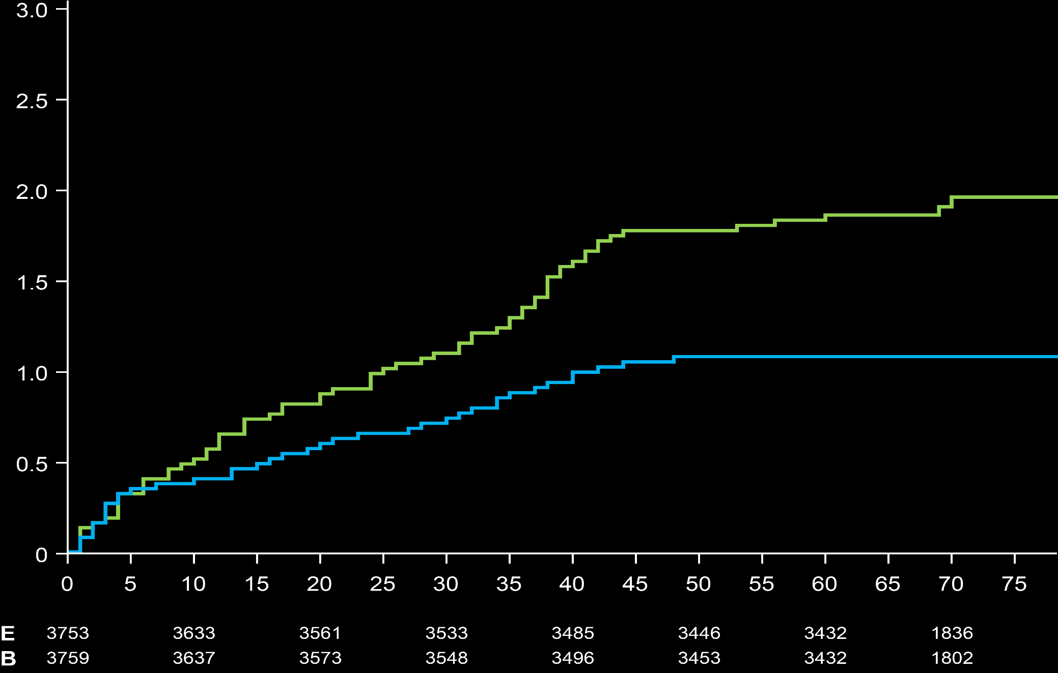
Symptomatic VTE
All Patients Randomized
Composite of Symptomatic Proximal or Distal DVT, Non-Fatal PE, or VTE-related Death
Through Visit 3
HR = 0.65 (0.42, 0.99)
ARR = 0.51%
NNT = 196
Through End of Trial*
HR = 0.56 (0.38, 0.84)
ARR = 0.80%
NNT = 125
1.84%
1.44%
Probability of Symptomatic Event, %
P = .004
P = .043
Parenteral
Therapy
Enoxaparin
1.04%
0.93%
Betrixaban
Visit 3
Time (Days)
*End of Trial defined as final follow-up visit (30 + 5 days after Visit 3)
Gibson CM, et al. ISTH 2016. Abstract CA02.
Notes:
37
Abbreviations:
ARR = annualized relapse rate
HR = hazard ratio
NNT = number needed to treat

Slide 38
Stroke or TIA
mITT Population
Stroke Type | Enoxaparin (N = 3716) | Betrixaban (N = 3716) | Relative Risk (95% CI) | P value
All-cause stroke | 0.97% (36) | 0.54% (20) | 0.56 (0.32, 0.96) | .032
Ischemic | 0.91% (34) | 0.48% (18) | 0.53 (0.30, 0.94) | .026
Hemorrhagic | 0.03% (1) | 0.03% (1) | 1.00 (0.06, 15.98) | 1.00
Uncertain type | 0.03% (1) | 0.03% (1) | 1.00 (0.06, 15.98) | 1.00
TIA | 0.13% (5) | 0.11% (4) | 0.80 (0.22, 2.98) | .74
All-cause stroke or TIA | 1.10% (41) | 0.65% (24) | 0.59 (0.35, 0.97) | .034
Gibson CM, et al. Circulation. 2017;135:648-655.
Notes:
Abbreviation:
TIA = transient ischemic attack

Slide 39
Time to Ischemic Stroke Among Subjects
With CHF or Ischemic Stroke at Entry
mITT Population
IMAGE NO LONGER AVAILABLE
Gibson CM, et al. Circulation. 2017;135:648-655.
Notes:
Abbreviation:
CHF = congestive heart failure

Slide 40
Primary Safety Endpoint -- ISTH Major Bleeding
Safety Population
IMAGE NO LONGER AVAILABLE
n=21
n=25
Cohen AT, et al. N Engl J Med. 2016;375:534-544.
Safety population defined as patients who received at least one dose of active study drug. Analysis by actual treatment. NNH not reported given P = NS.
Notes:
40
Abbreviation:
NS = not significant

Slide 41
Secondary Safety Endpoint
Safety Population
Major or clinically relevant nonmajor bleeding events (ISTH) through 7 days after drug discontinuation
ISTH major bleeding definition: fatal bleeding, and/or symptomatic bleeding in a critical area or organ such as
intracranial, intraspinal, intraocular, retroperitoneal, intra- articular or pericardial, or intramuscular with compartment syndrome, and/or bleeding causing a fall in hemoglobin level of ≥20 g/L (1.24 mmol/L), or leading to transfusion of ≥ 2units of whole blood or red cells.
3.12%
1.59%
p < 0.001
n=59
n=116
Cohen AT, et al. N Engl J Med. 2016;375:534-544.
Safety population defined as patients who received at least one dose of active study drug. Analysis by actual treatment.
Notes:
41

Slide 42
Fatal Bleeding and ICH
Safety Population
p = 0.18
0.19%
Event rate (%)
n=9
0.05%
0.03%
0.03%
n=1
n=1
n=7
n=2
Enoxaparin
(N=3,716)
Betrixaban
(N=3,716)
Enoxaparin
(N=3,716)
Betrixaban
(N=3,716)
Fatal Bleeding
ICH
Gibson CM, et al. Circulation. 2017;135:648-655.
Safety population defined as patients who received at least one dose of active study drug. Analysis by actual treatment.
Notes:
42

Slide 43
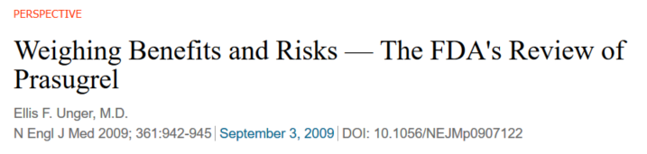
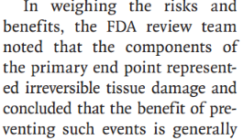
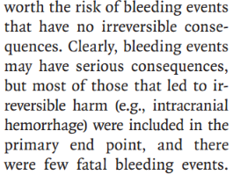
Unger et al of FDA suggests that net clinical outcome analyses include events that are clinically meaningful and are of similar clinical significance, such as fatal or irreversible events.
Benefit = Non-hemorrhage CV death + Nonfatal PE + MI + ischemic stroke
Harm = Fatal Bleeding + ICH
Gibson CM, et al. ISTH 2016. Abstract CA02.

Slide 44
Fatal or Irreversible Outcomes
All Patients Randomized
IMAGE NO LONGER AVAILABLE
*End of Trial defined as final follow-up visit (30 + 5 days after Visit 3)
Gibson CM, et al. J Am Heart Assoc. 2017;6.

Slide 45
VTE-Related Rehospitalization
Post Hoc Analysis, mITT Population, Actual Regimen Received
1.50
HR = 0.44 (0.25, 0.80)
ARR = 0.59%
NNT = 170
1.25
1.04%
1.00
0.75
P = .0055
0.50
0.45%
0.25
0.00
0
10
20
30
40
50
60
70
77
Betrixaban
3716
3646
3595
3572
3521
3478
3455
1835
263
Enoxaparin
3716
3660
3594
3557
3516
3472
3458
1854
228
Data on file PERFUSE Study Group

Slide 46
Primary Efficacy Endpoint
Central D-dimer ≥ 2 x ULN: MAGELLAN vs APEX
MAGELLAN
APEX
RRR = 29.0% (8.0, 46.0)
P < .001
RRR = 29.5% (11.6, 43.9)
P = .002
9.3%
9.30%
9.0%
HR = (95% CI)
%
6.50%
6.5%
6.4%
p=
%
n=
n=
n=125
n=84
n=165
n=118
MAGELLAN and APEX analyses through 35 days
Cohen A et al. J Throm Haemost. 2014;12:479-87
Gibson CM, et al. ISTH 2016. Abstract CA02.
Notes:
46

Slide 47

Comparison to Previous NOAC Trials of Extended Thromboprophylaxis in Acute Medically Ill Patients
ADOPT
Apixaban
MAGELLAN
Rivaroxaban
APEX
Betrixaban
8
RRR* = 24.0%
VTE Events
p<0.001
P* = .006
RRR = 22.8%
P = .02
RRR = 12.9%
4
P = .44
Incidence (%)
0
Major Bleeding
2
P = .04
P < .001
P = .55
Enoxaparin Apixaban Enoxaparin Rivaroxaban Enoxaparin Betrixaban
* Overall efficacy population analysis used for comparison purposes
Gibson CM, et al. ISTH 2016. Abstract CA02.
Notes:
Abbreviation:
NOAC = non-vitamin K antagonist oral anticoagulant

Slide 48
Summary
In an mITT analysis that includes all patients treated with study drug performed by the FDA in the label and pre-specified in the protocol, Betrixaban reduced the composite endpoint of symptomatic and asymptomatic events as well as symptomatic events
Betrixaban was not associated with a significant increase in major, ICH, or fatal bleeding, but was associated with more CRNM bleeding
Betrixaban reduced stroke
Betrixaban reduced fatal or irreversible events
Gibson CM, et al. ISTH 2016. Abstract CA02.
Notes:
Abbreviation:
CRNM = clinically relevant nonmajor

Slide 49
Antidotes for DOACs
  Alexander T. Cohen, MBBS, MSc, MD, FRACP
    Consultant Physician
    Guy's and St Thomas' NHS Foundation Trust
    London, United Kingdom

Slide 50
Interactive Question
  What was the mortality rate from intracranial haemorrhages in the DOAC phase III studies?
  10-15%
  15-30%
  30-40%
  40-50%

Slide 51
Interactive Question
  What was the mortality rate from intracranial haemorrhages in the DOAC phase III studies?
  10-15% 49%
  15-30% 21%
  30-40% 14%
  40-50% 15%

Slide 52
OAC-Related Bleeding
  The lack of antidotes for factor Xa inhibitors is a concern for patients and clinicians
  Many clinicians perceive VKAs and the heparins to be safer, as antidotes are available if bleeding occurs
  In clinical trials and clinical practice, however, major bleeding rates and bleeding case fatality rates are significantly lower with DOACs than with VKAs
Notes:
Abbreviations:
OAC = oral anticoagulant
VKA = vitamin K antagonist

Slide 53
Why Do We Need Antidotes ?
  OACs still top the list of medications most likely to cause harm
  DOACs are being used in patients with multiple morbidities
  PCC can reverse INR after FXa inhibitors (rivaroxaban, apixaban, edoxaban, betrixaban), but this is not proven to stop bleeding and is associated with thrombosis
Notes:
Abbreviations:
FXa = factor Xa
INR = international normalized ratio
PCC = prothrombin complex concentrate

Slide 54
Level 1A Evidence for Reversal Strategies for Direct Anticoagulants
This space intentionally left blank

Slide 55
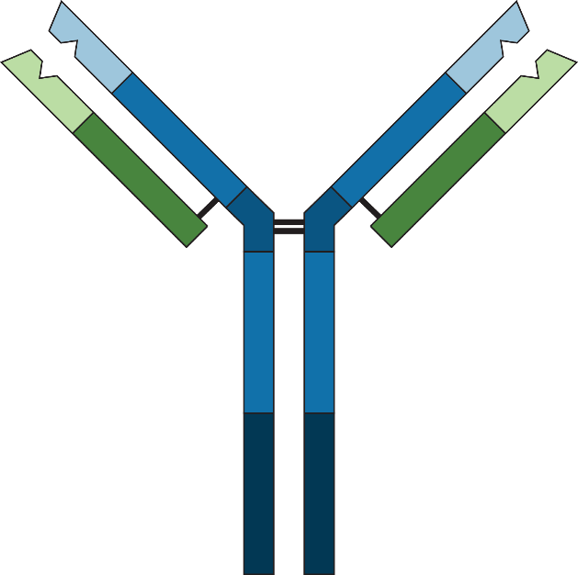
DOAC Antidote
Idarucizumab
  Idarucizumab
    Humanized monoclonal antibody fragment that binds dabigatran
    300 × higher affinity for dabigatran than dabigatran has for thrombin
    2.5-g IV x 2 bolus dose
    Approved for
      Emergency surgery/urgent procedures
      Life-threatening or uncontrolled bleeding
Fully humanized antibody fragment
Pollack CV, et al. N Engl J Med. 2017;377:431-441.
Notes:
Abbreviation:
IV = intravenous

Slide 56
RE-VERSE AD: Primary Endpoint -- Reversal of Dabigatran With Idarucizumab
IMAGE NO LONGER AVAILABLE
From N Engl J Med, Pollack CV, et al., Idarucizumab for Dabigatran Reversal, 373., 511-520. Copyright © 2015 Massachusetts Medical Society. Reprinted with permission from Massachusetts Medical Society.
Notes:
Abbreviations:
dTT = dilute thrombin time
ECT = ecarin clotting time
Activity restored in most patients for close to 24 hours.

Slide 57
Idarucizumab for Dabigatran Reversal
301 acute bleeding:
  98 (32.6%) presented with intracranial hemorrhage;
    Median time to the cessation of bleeding was 2.5 hours (in those assessable)
  At 90 days, thrombotic events 6.3%
    Mortality rate was 19%
  202 emergency surgery:
  Median time to the initiation of the intended procedure was 1.6 hours;
  Periprocedural hemostasis was assessed as normal in 93.4%
    Mildly abnormal in 5.1%, and moderately abnormal in 1.5%
  At 90 days, thrombotic events 7.4%
    Mortality rate was 19%
Pollack CV, et al. N Engl J Med. 2017;377:431-441.
57

Slide 58
DOAC Antidote
Andexanet Alfa
Andexanet alfa
  "Decoy" recombinant FXa molecule with mutation in catalytic site, lacks GLA domain
  "Universal" FXa inhibitor antidote
  Human volunteer studies demonstrate reversal of anticoagulation:
    Apixaban
    Betrixaban
    Edoxaban
    Rivaroxaban
    LMWH
  Not yet approved for use
Image courtesy of Alexander Cohen, MBBS, MSc, MD.
Notes:
Abbreviation:
GLA = γ-carboxyglutamic acid-rich
Universal—both direct Xai and those that work through antithrombin

Slide 59
ANNEXA-A and ANNEXA-R
Heathy Volunteers
IMAGE NO LONGER AVAILABLE
From N Engl J Med, Siegal DM, et al., Andexanet Alfa for the Reversal of Factor Xa Inhibitor Activity, 373., 2413-2424. Copyright © 2015 Massachusetts Medical Society. Reprinted with permission from Massachusetts Medical Society.

Slide 60
Andexanet Alfa: Interim Analysis of 67 Patients
The New England Journal of Medicine
Andexanet Alfa for Acute Major Bleeding Associated With Factor Xa Inhibitors
Connolly SJ, Milling TJ, Eikelboom JW, Gibson CM, Curnutte JT, Gold A, Bronson MD, Lu G, Conley PB, Verhamme P, Schmidt J, Middeldrop S, Cohen AT, Beyer-Westendorf J, Albaladejo P, Lopez-Sendon J, Goodman S, Leeds J, Wiens BL, Siegal DM, Zotova E, Meeks B, Nakamya J, Lim WT, Crowther M
Connolly SJ, et al. N Engl J Med. 2016;375:1131-1141.
60

Slide 61
Methods -- Hematoma Volumetric Analysis
Quantitative Tomography
User-assisted volumetric software featuring:
  Adjustment for slice thickness and gaps
  Study parameters saved to facilitate retrospective validation
IMAGE NO LONGER AVAILABLE
Image courtesy of Alexander T. Cohen, MBBS, MSc, MD.
Notes:
PREDICT 01-028 - Followup

Slide 62
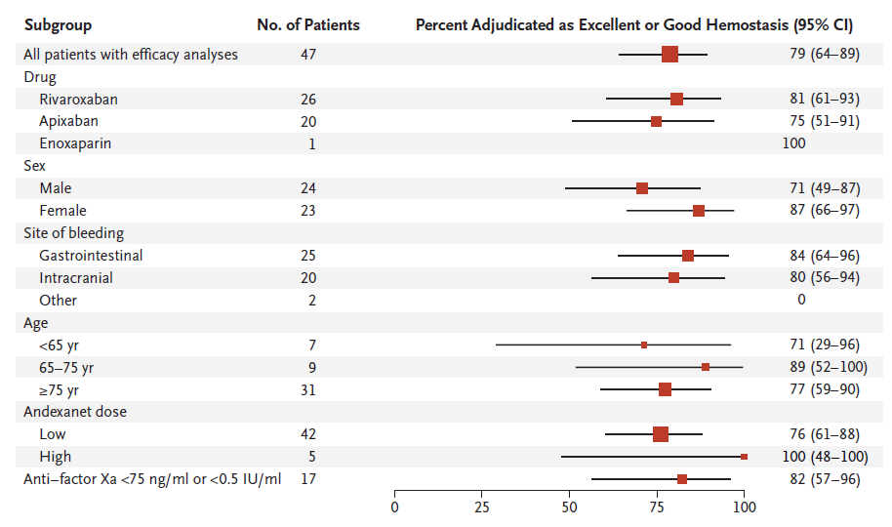
Clinical Hemostatic Efficacy
From N Engl J Med, Connolly SJ, et al., Andexanet Alfa for Acute Major Bleeding Associated with Factor Xa Inhibitors, 375., 1131-1141. Copyright © 2016 Massachusetts Medical Society. Reprinted with permission from Massachusetts Medical Society.

Slide 63
ANNEXA-4 Update: Thrombotic Event and Re-Anticoagulation Rates
Letter to New England Journal of Medicine, December 22, 2016
 | ANNEXA-4 N Engl J Med Publication August 2016 (n = 67) | ANNEXA-4 N Engl J Med Update December 2016 (n = 105)
30 day thrombotic event rate | 18% | 12%
 | Interval : 3% (1 of 38)
Re-anticoagulation rate (by day 30) | 27% | 40%
 | Interval : 63% (24 of 38)
Connolly SJ, et al. N Engl J Med 2016;375:1131-1141; Connolly SJ, et al. N Eng J Med 2016;375:2498-2500
Notes:
Connolly SJ, Gibson CM, Crothwer M. N Engl J Med. 2016 Dec 33:375(25):2499-500.
Thrombotic Rate was 12%

Slide 64
Conclusions
  Specific antidotes will be an important addition to the management of bleeding, and will lower the barrier for patient and clinician acceptance of prescribing DOACs
  Idarucizumab has been approved and is in use for dabigatran reversal
  Andexanet alfa is in the final stages of development

Slide 65
Case Discussion With Faculty Panel
Moderator
  Gregory Piazza, MD
    Assistant Professor of Medicine
    Harvard Medical School
    Boston, Massachusetts

Slide 66
Interactive Question: Case No. 1
  What is the appropriate duration of thromboprophylaxis for a 67-year-old woman with diabetes and obesity, who is admitted to the medical ward with urosepsis and discharged after 3 days?
  3 days
  7 days
  14 days
  42 days

Slide 67
Interactive Question: Case No. 1
  What is the appropriate duration of thromboprophylaxis for a 67-year-old woman with diabetes and obesity, who is admitted to the medical ward with urosepsis and discharged after 3 days?
  3 days 13%
  7 days 16%
  14 days 23%
  42 days 48%

Slide 68
Discussion Case No. 2
  A 76-year-old woman with chronic obstructive pulmonary disease is admitted for shortness of breath and cough
  A chest X-ray shows hyperinflation, dense right lower lobe consolidation, and a small right pleural effusion
  The patient is treated for community-acquired pneumonia and is discharged on the fourth hospital day

Slide 69
What Risk Factors Does This Patient Have For VTE Following Discharge?
  Infection (pneumonia)
  COPD
  Elderly age
  Immobilization after hospital discharge
Notes:
Abbreviation:
COPD = chronic obstructive pulmonary disease

Slide 70
How Would You Rate This Patient's Overall Risk for VTE Complicating Discharge From Hospitalization?
  High risk for VTE
    Risk increases after hospitalization
    Presence of inflammatory milieu activates coagulation system
    Immobilization after hospital discharge

Slide 71
What Is the Optimal Thromboprophylactic Regimen for This Patient During Hospitalization and After Discharge?
  Betrixaban
    160 mg loading dose
    80 mg once daily for 35 to 42 days

Slide 72
Summary and Concluding Remarks
  Betrixaban in the acutely ill medical patient provides physicians a new tool to
    Reduce symptomatic PE, symptomatic and asymptomatic DVT
    Reduce fatal irreversible events
    Reduce stroke
    Reduce thrombus burden
    Reduce rehospitalization

Slide 73
Thank you for participating in this activity.
To proceed to the online CME test, click on the Earn Credit link on this page.

