Slide 1
Identification of High-Risk Dyslipidemias

Slide 2
High-Risk Dyslipidemia in Asia

Slide 3
CV Death, MI, Stroke, UA, or Coronary Revascularization in the FOURIER trial

Slide 4
FOURIER : Safety

Slide 5
Program Topics

Slide 6
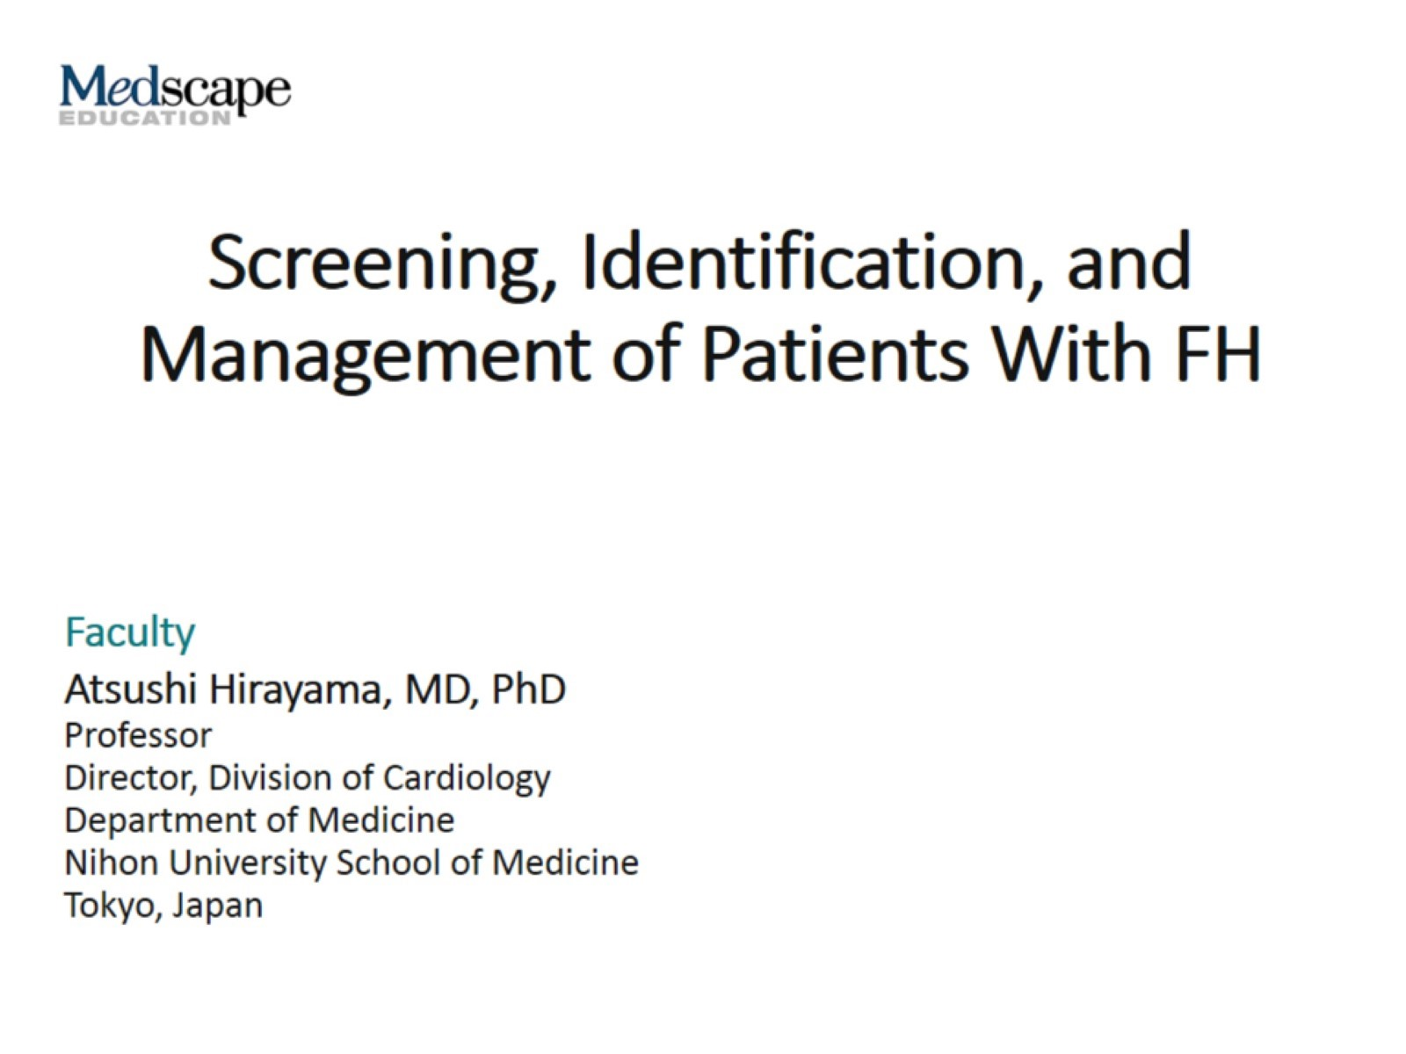
Screening, Identification, and Management of Patients With FH

Slide 7
Cause of Death and Age of Patients With HeFH

Slide 8
Acute Myocardial Infarction (HeFH)

Slide 9
FH Is More Common Than Other Genetic Diseases

Slide 10
Estimated Prevalence of FH Globally

Slide 11
LDL-C Burden in Individuals With or Without FH as a Function of the Age of Initiation of Statin Therapy

Slide 12
Reasons for Necessity of Early Diagnosis of FH

Slide 13
Estimated Percentage of Individuals Diagnosed With FH as a Fraction of Patients Theoretically Predicted

Slide 14
Distribution of LDL-C Level in Patients With and Without FH

Slide 15
Known Mechanisms Causing FH Linked to LDL-R Function

Slide 16
Prevalence of Genetic Variance Among Patients With FH (Hokuriku District in Japan)

Slide 17
Dutch Lipid Clinic Network Criteria for Diagnosis of HeFH in Adults

Slide 18
Diagnostic Criteria Used in Published FH Studies in Asia

Slide 19
Diagnostic Criteria for HeFH in Adults (Age ≥ 15 y)

Slide 20
Prevalence of FH in Patients With ACS in Japan

Slide 21
Treatment of Adult FH (age ≥ 15 y)

Slide 22
The Care Situation in 3 Asian Countries in MEDPED Program

Slide 23
Levels of Calculated LDL-C Over Time (ODYSSEY FH I and FH II)

Slide 24
Percentage Changes in LDL-CL From Baseline by Study Point (RUTHERFORD-2)

Slide 25
Percentage Changes in LDL-C From Baseline to 10/12 wk After Evolocumab Treatment in Patients With HeFH (YUKAWA-2 Study)

Slide 26
Key Messages

Slide 27
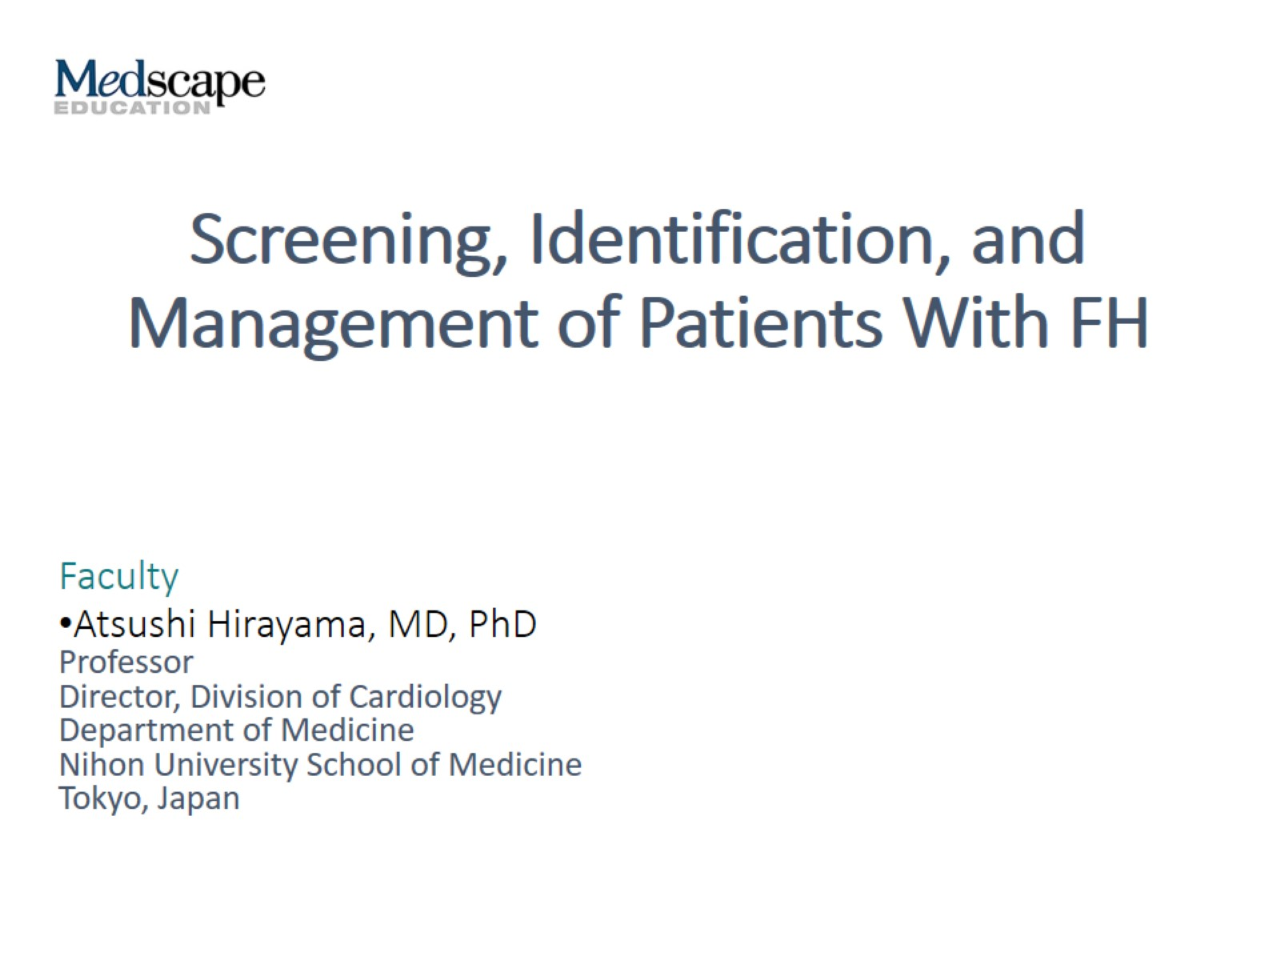
Screening, Identification, and Management of Patients With FH

Slide 28
Cause of Death and Age of Patients With HeFH

Slide 29
Acute Myocardial Infarction (HeFH)

Slide 30
FH Is More Common Than Other Genetic Diseases

Slide 31
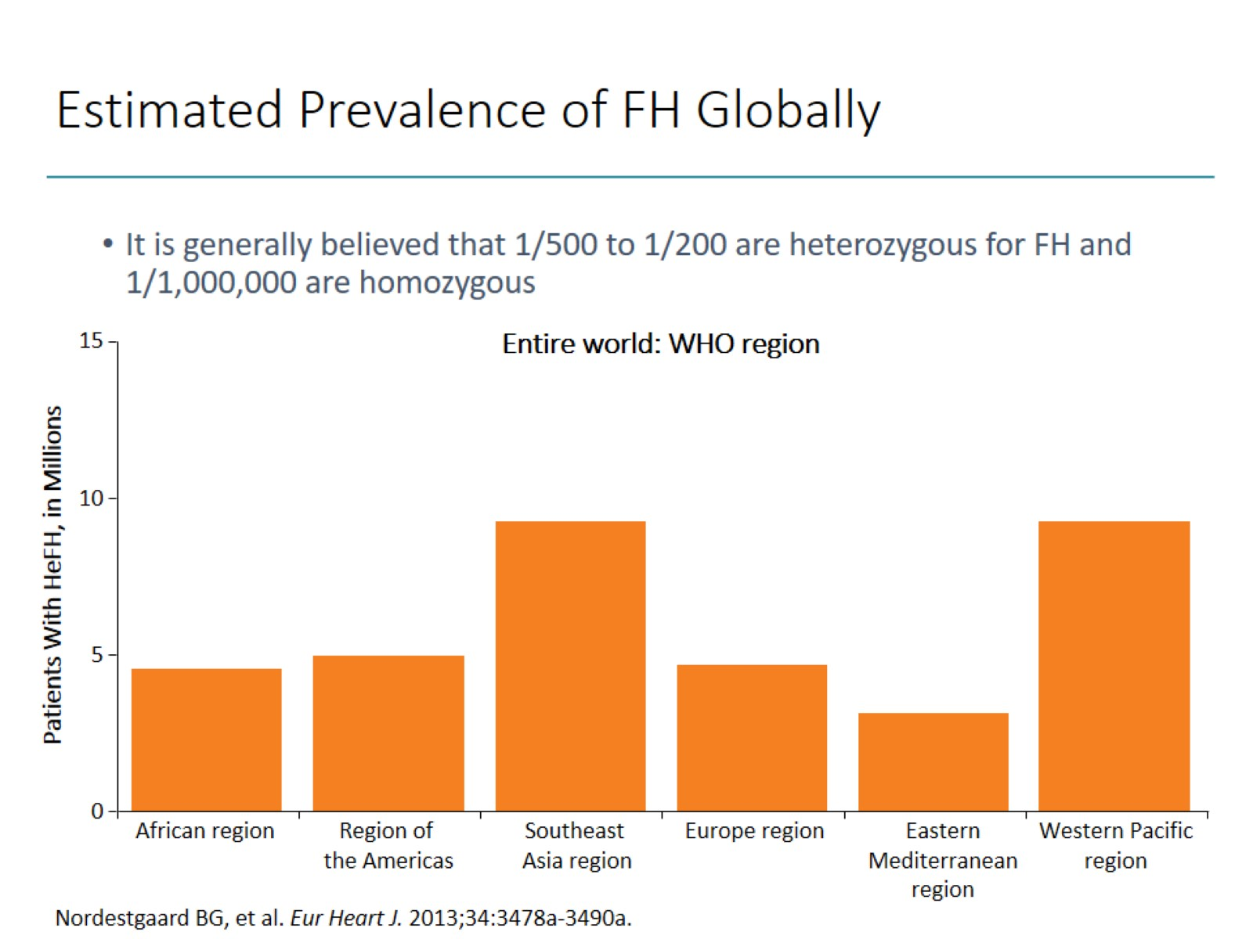
Estimated Prevalence of FH Globally

Slide 32
LDL-C Burden in Individuals With or Without FH as a Function of the Age of Initiation of Statin Therapy

Slide 33
Reasons for Necessity of Early Diagnosis of FH

Slide 34
Estimated Percentage of Individuals Diagnosed With FH as a Fraction of Patients Theoretically Predicted

Slide 35
Distribution of LDL-C Level in Patients With and Without FH

Slide 36
Known Mechanisms Causing FH Linked to LDL-R Function

Slide 37
Prevalence of Genetic Variance Among Patients With FH (Hokuriku District in Japan)

Slide 38
Dutch Lipid Clinic Network Criteria for Diagnosis of HeFH in Adults

Slide 39
Diagnostic Criteria Used in Published FH Studies in Asia

Slide 40
Diagnostic Criteria for HeFH in Adults (Age ≥ 15 y)

Slide 41
Prevalence of FH in Patients With ACS in Japan

Slide 42
Treatment of Adult FH (age ≥ 15 y)

Slide 43
The Care Situation in 3 Asian Countries in MEDPED Program

Slide 44
Levels of Calculated LDL-C Over Time (ODYSSEY FH I and FH II)

Slide 45
Percentage Changes in LDL-CL From Baseline by Study Point (RUTHERFORD-2)

Slide 46
Percentage Changes in LDL-C From Baseline to 10/12 wk After Evolocumab Treatment in Patients With HeFH (YUKAWA-2 Study)

Slide 47
Key Messages

Slide 48
Mixed Hyperlipidemia

Slide 49
Definition of Mixed Hyperlipidemia

Slide 50
Definition of Mixed Hyperlipidemia (cont)

Slide 51
Familial Combined Hyperlipidemia

Slide 52
Prevalence of Mixed Hyperlipidemia in Asia

Slide 53
Prevalence of Mixed Hyperlipidemia in Asia (cont)

Slide 54
Effect of Mixed Hyperlipidemia on Prognosis

Slide 55
TG-Mediated Pathways and Coronary Disease

Slide 56
TGs and CVD

Slide 57
Variants in ANGPTL4 and ANGPTL3 and TGs

Slide 58
Optional Therapeutic Strategies

Slide 59
Ezetimibe

Slide 60
Fenofibrate ACCORD—Patients With Elevated TGs and Low HDL-C

Slide 61
Niacin

Slide 62
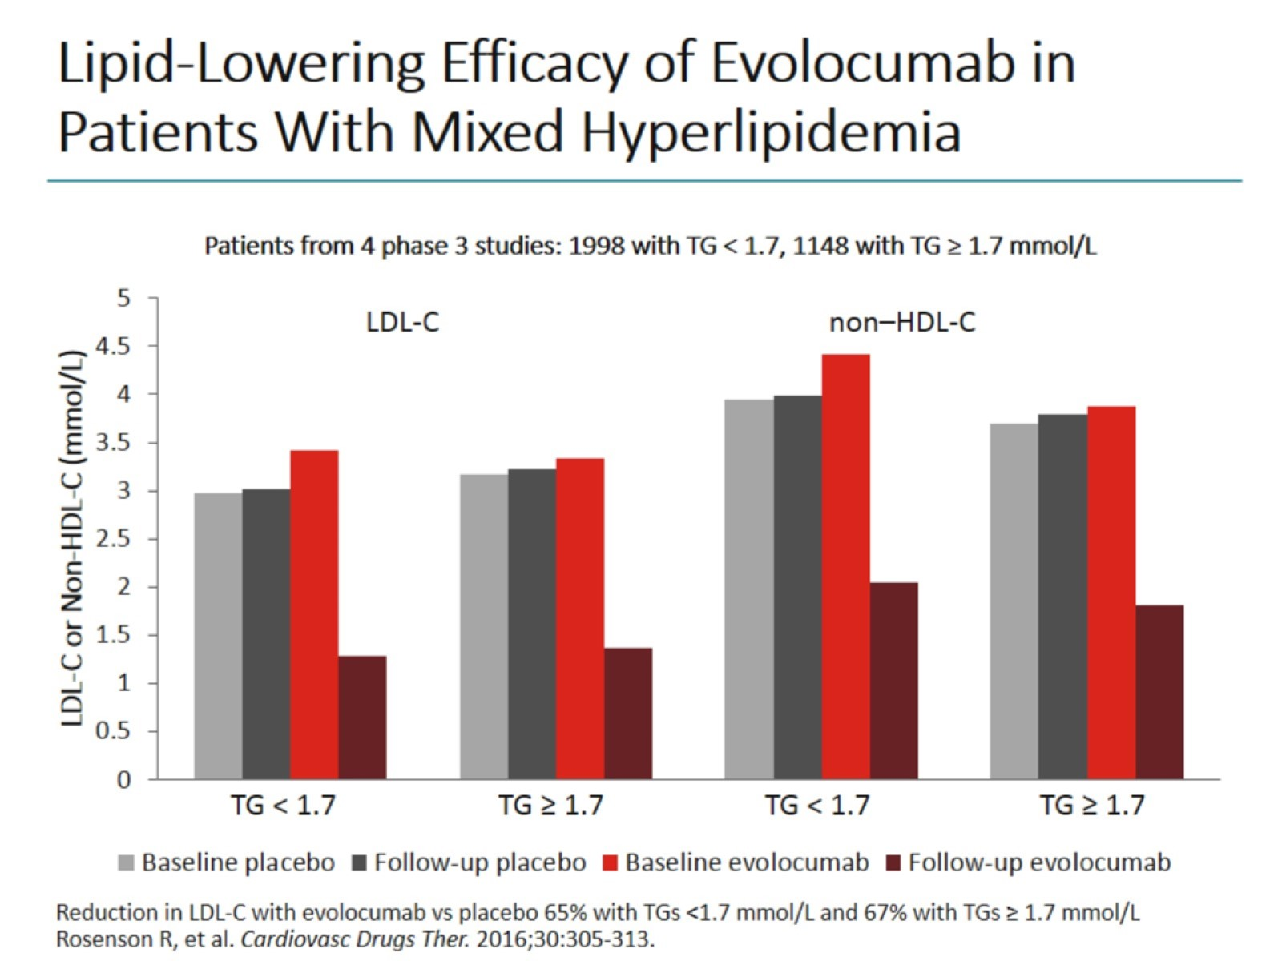
Lipid-Lowering Efficacy of Evolocumab in Patients With Mixed Hyperlipidemia

Slide 63
Lipid-Lowering Efficacy of Evolocumab in Patients With T2DM

Slide 64
ODYSSEY DM‑DYSLIPIDEMIA Trial Effect of Alirocumab

Slide 65
Conclusion

Slide 66
Statin Intolerance

Slide 67
Definition

Slide 68
Frequency of SI

Slide 69
The Lipid-Lowering Efficacy of Statins in Asians

Slide 70
Recent SI Research

Slide 71
Highlights From GAUSS-3

Slide 72
ODYSSEY ALTERNATIVE

Slide 73
CV Risk in Patients With SI

Slide 74
Risk Factors for Statin-Induced Myopathy

Slide 75
A Simplified Algorithm for Statin-Induced Myopathy

Slide 76
Therapeutic Strategies to Assist SI

Slide 77
Take-Home Message

Slide 78
From Screening to Effect of Treatment

Slide 79
High-Risk Dyslipidemia Treatment

Slide 80
FOURIER Trial Primary Efficacy Outcome

Slide 81
ODYSSEY Outcomes Phase 3 Post-ACS With Alirocumab

Slide 82
Abbreviations

Slide 83
Abbreviations (cont)

Slide 84
Abbreviations (cont)

Slide 85
Abbreviations (cont)

