Slide 1
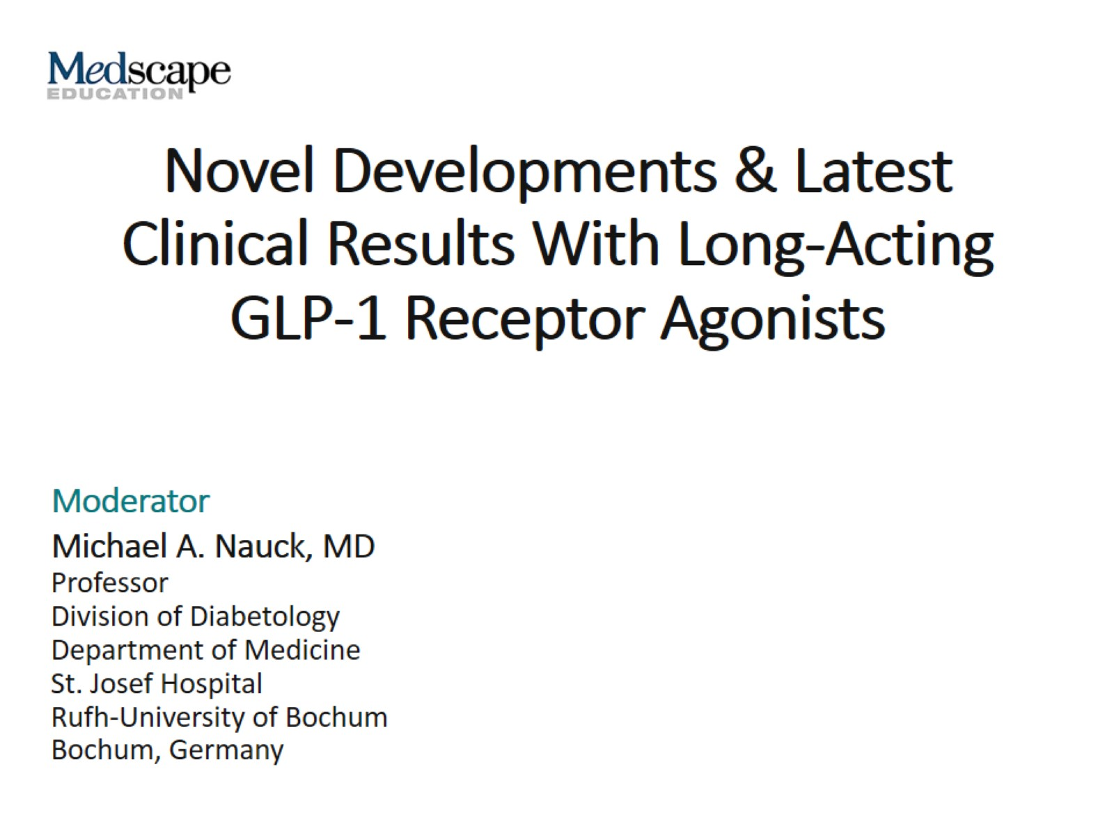
Novel Developments & Latest Clinical Results With Long-Acting GLP-1 Receptor Agonists

Slide 3
Introduction/Background

Slide 4
Diabetes Is an Independent Risk Factor for Micro- and Macrovascular Disease and Stroke

Slide 5
T2DM and Obesity Are Closely Interlinked

Slide 6
Managing a Multifactorial Condition (Like T2DM) Requires a Multifactorial Approach

Slide 7
Glycemic Control Alone Is Not Always Sufficient to Improve Diabetes Outcomes in the Long Term

Slide 8
Effects of a Multifactorial Therapeutic Approach in T2DM (STENO-2 Study)

Slide 9
Weight Effects of Glucose-Lowering Therapies

Slide 10
What Is GLP-1?

Slide 11
GLP-1 Secretion and Receptor Expression

Slide 12
Amino Acid Sequences of Exendin-4 and GLP-1

Slide 13
Liraglutide Is a Once-Daily Human GLP-1 Analogue

Slide 14
Molecular Structure: Dulaglutide and Albiglutide

Slide 15
Results From SUSTAIN 1-5: Change in HbA1c

Slide 16
Results From SUSTAIN 1-5: Change in Body Weight

Slide 17
SUSTAIN-7: Topline Results, HbA1c, Body Weight

Slide 18
LEADER: Primary Outcome Results*

Slide 19
SUSTAIN-6 (Semaglutide): Primary Outcome Results

Slide 20
Topline Results: EXSCEL

Slide 21
EMPA-REG: Primary Outcome (3-Point MACE) - CV Death, Nonfatal MI, or Nonfatal Stroke

Slide 22
Clear-Cut Clinical Roles for GLP-1 RAs and SGLT2 Inhibitors in T2DM

Slide 23
Pancreatitis in the LEADER Trial (Confirmed by Adjudication)

Slide 24
Explaining the Differences in CVOT Outcomes

Slide 25
Guidelines' Changes as a Result of CVOT Findings

Slide 26
Despite Proven Advantages, Uptake of Newer Glucose-Lowering Agents Remains Low

Slide 27
The Case for Using Newer Glucose-Lowering Agents

Slide 28
Summary and Conclusions

