Slide 1
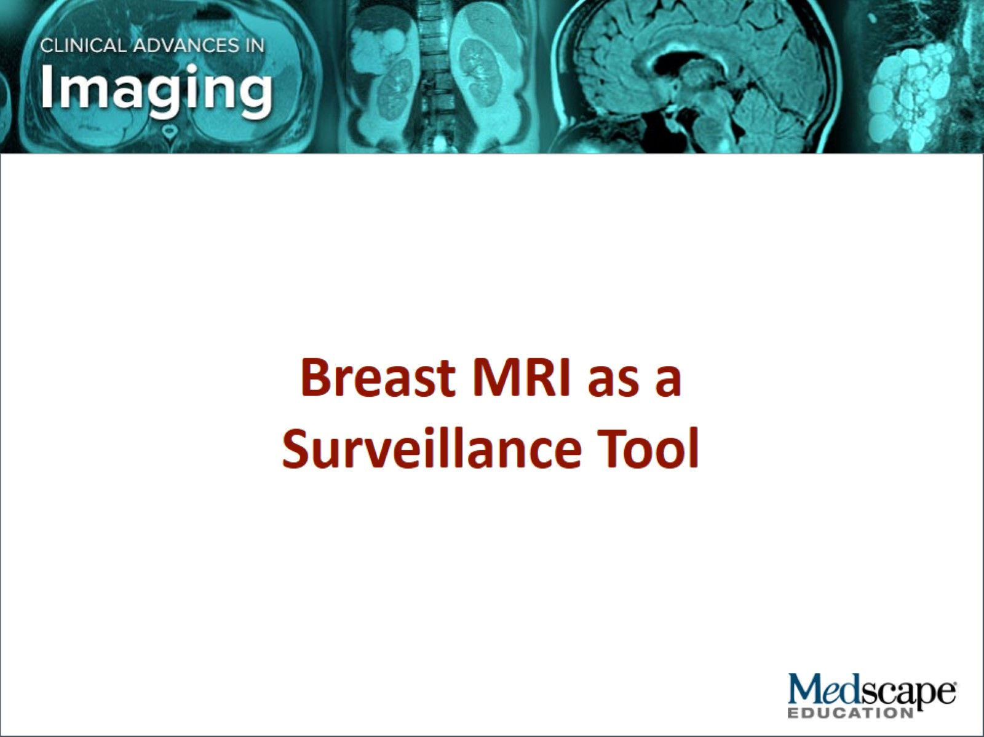

Slide 2
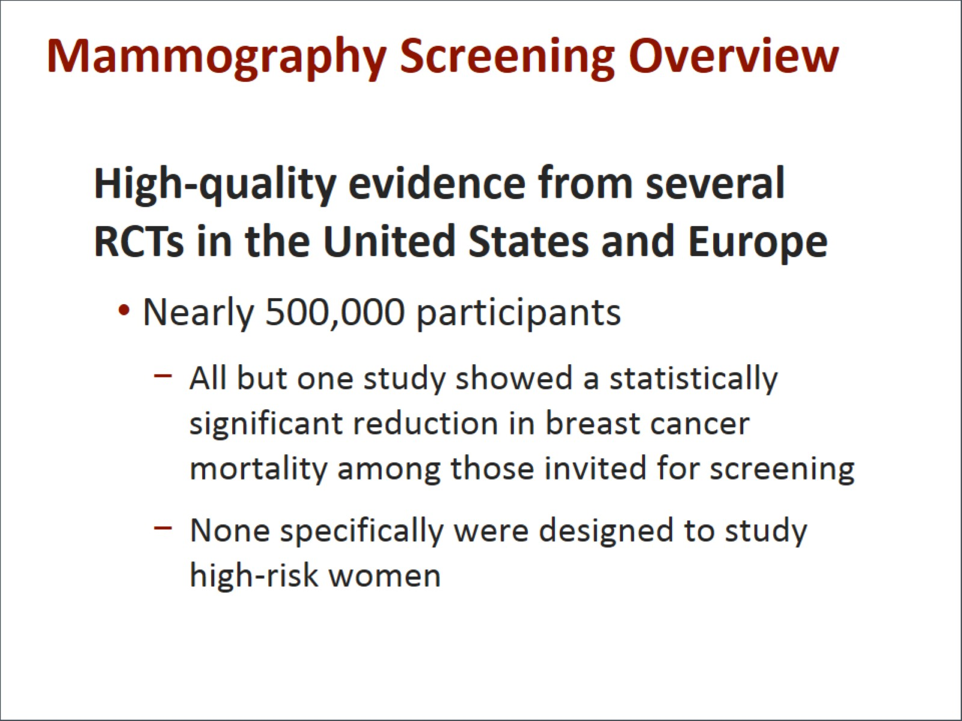
Mammography Screening Overview

Slide 3
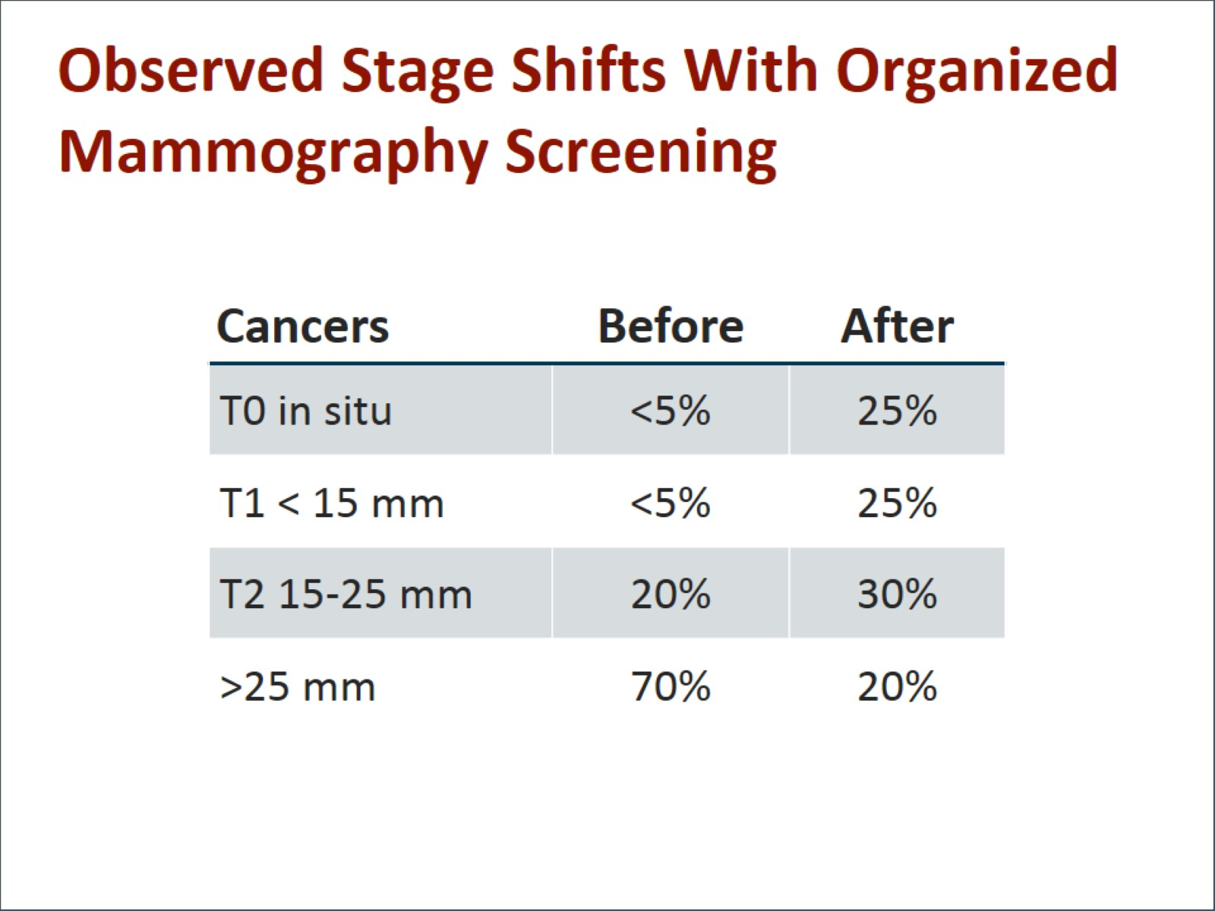
Observed Stage Shifts With Organized Mammography Screening

Slide 4
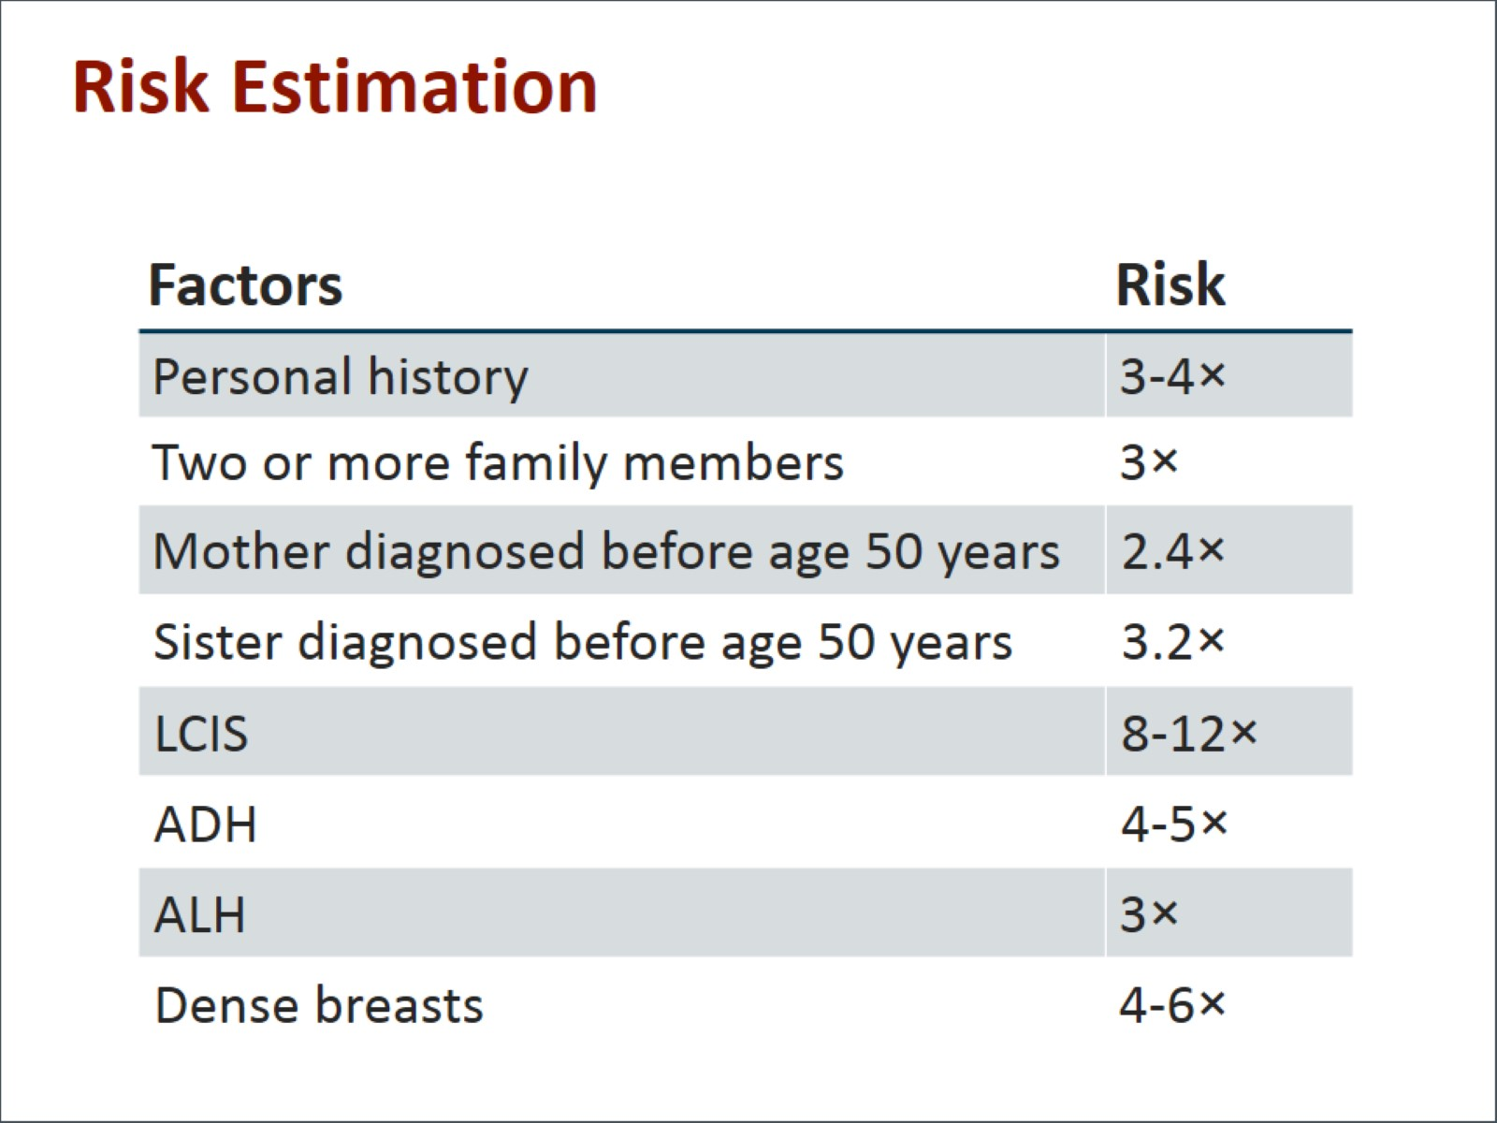
Risk Estimation

Slide 5
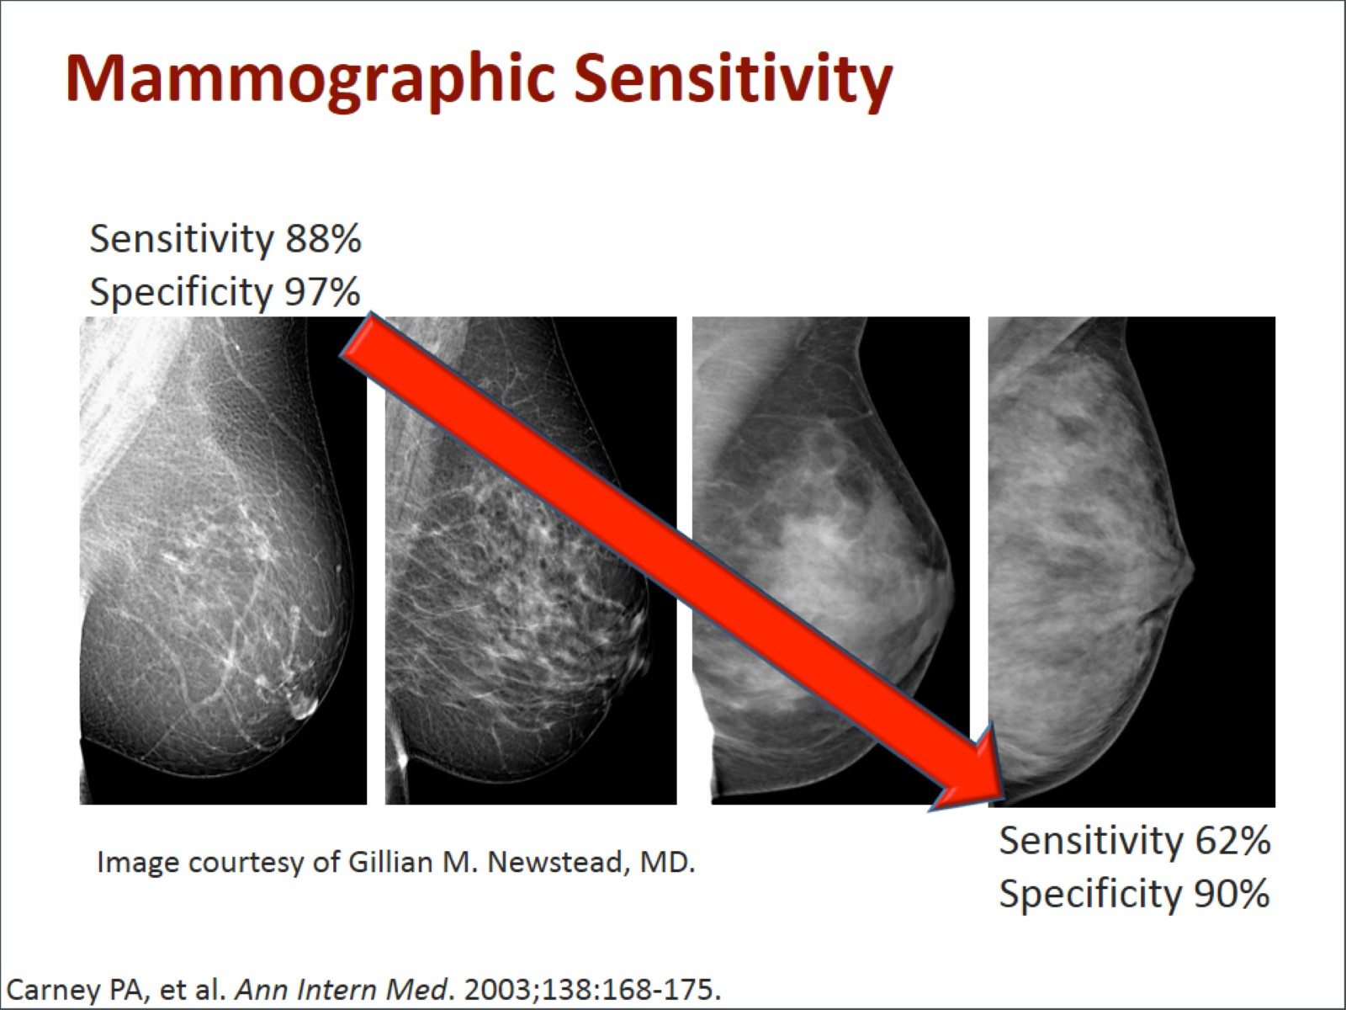
Mammographic Sensitivity

Slide 6
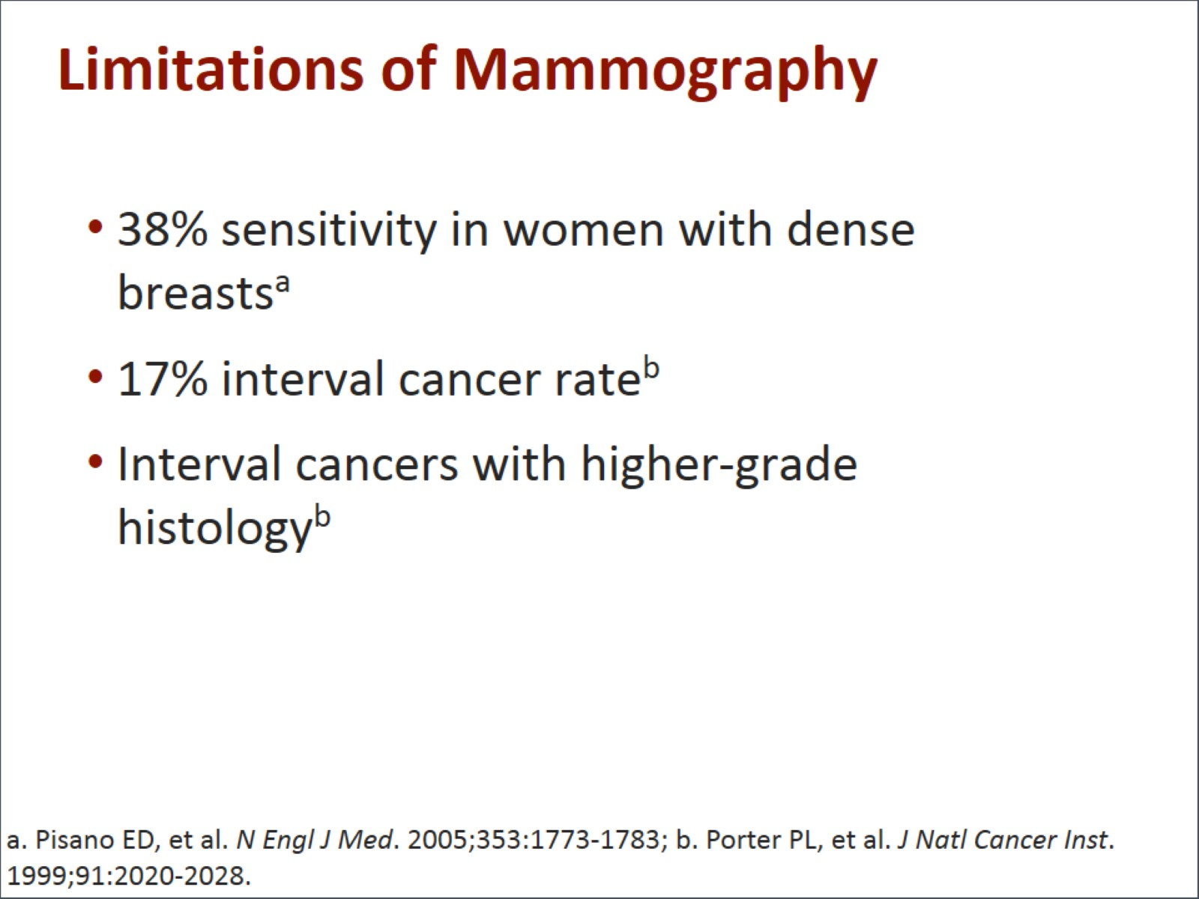
Limitations of Mammography

Slide 7
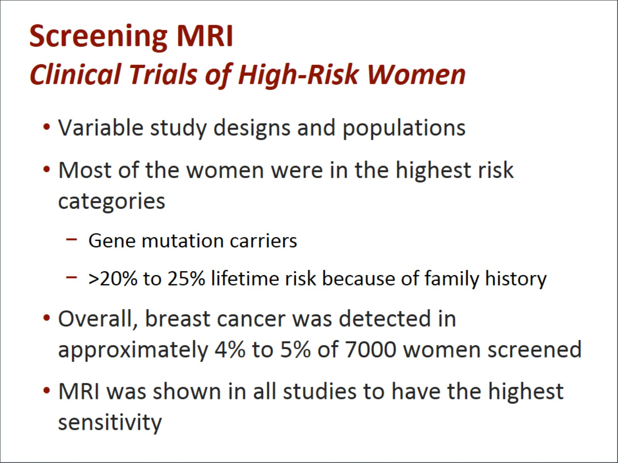
Screening MRI
Clinical Trials of High-Risk Women

Slide 8
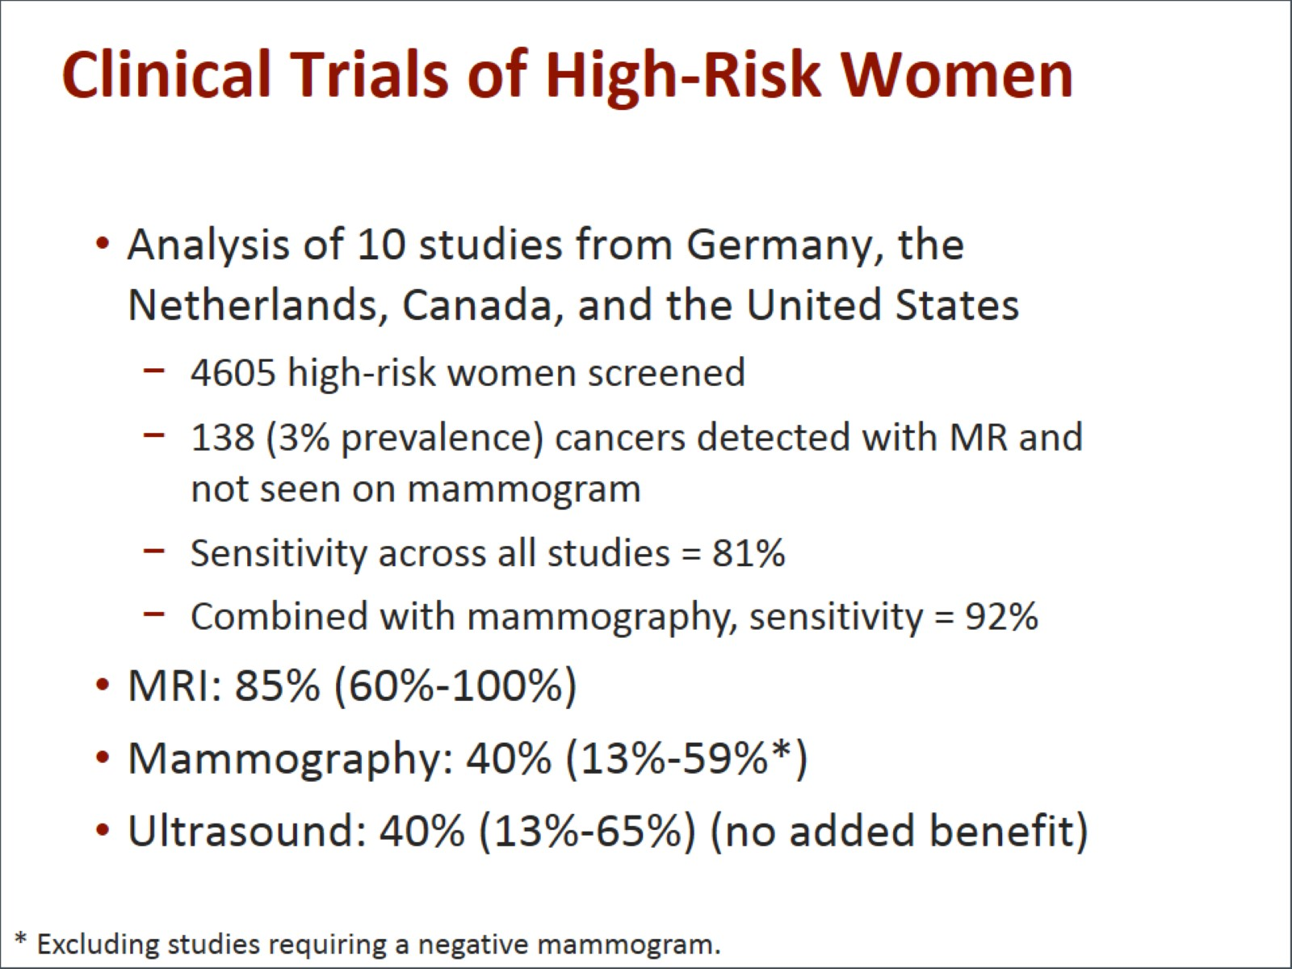
Clinical Trials of High-Risk Women

Slide 9
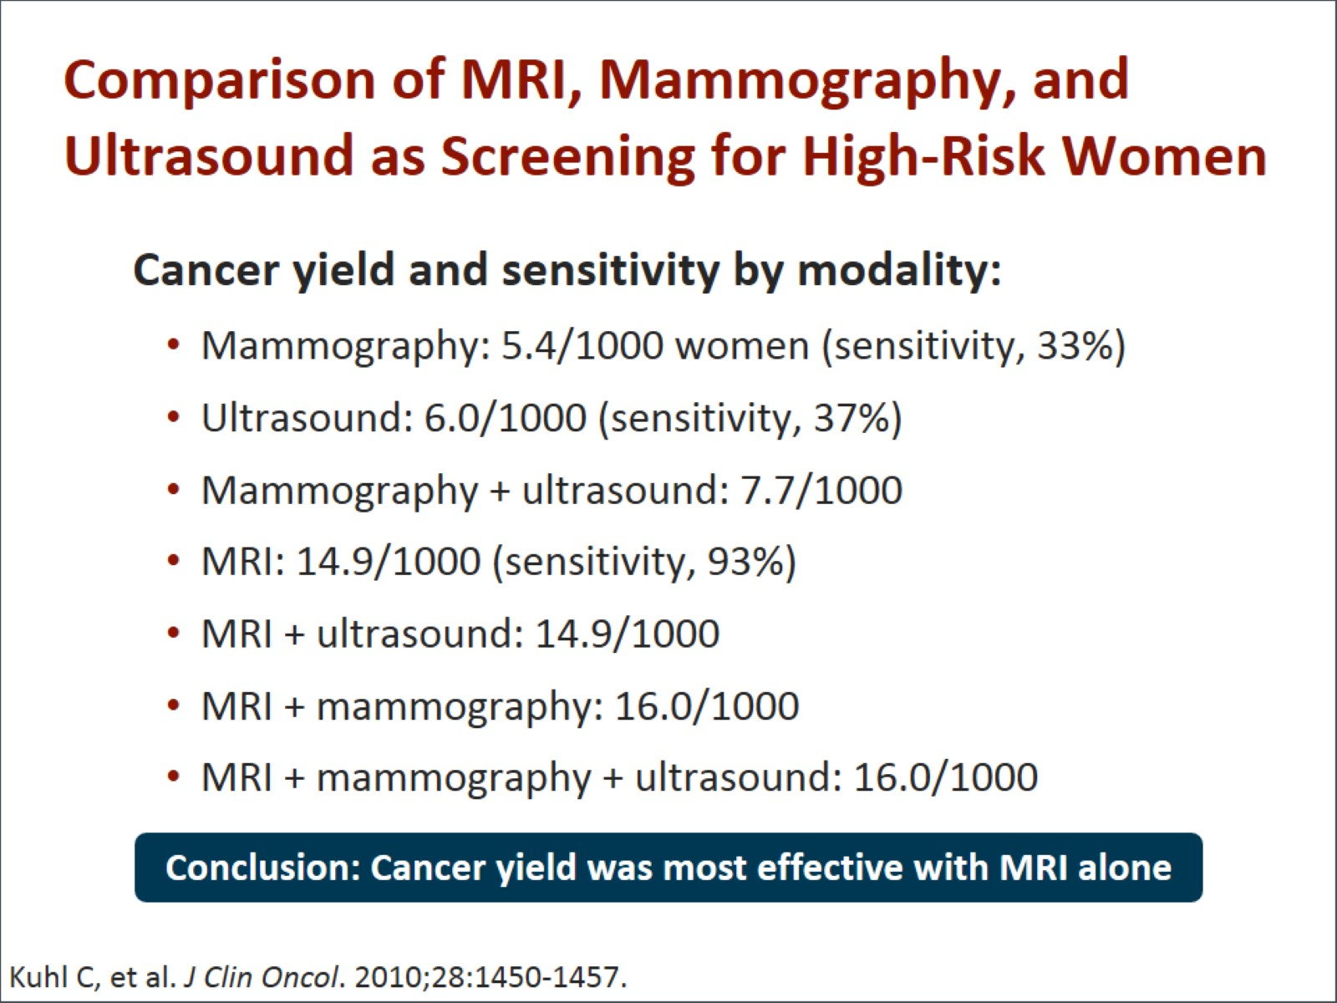
Comparison of MRI, Mammography, and Ultrasound as Screening for High-Risk Women

Slide 10
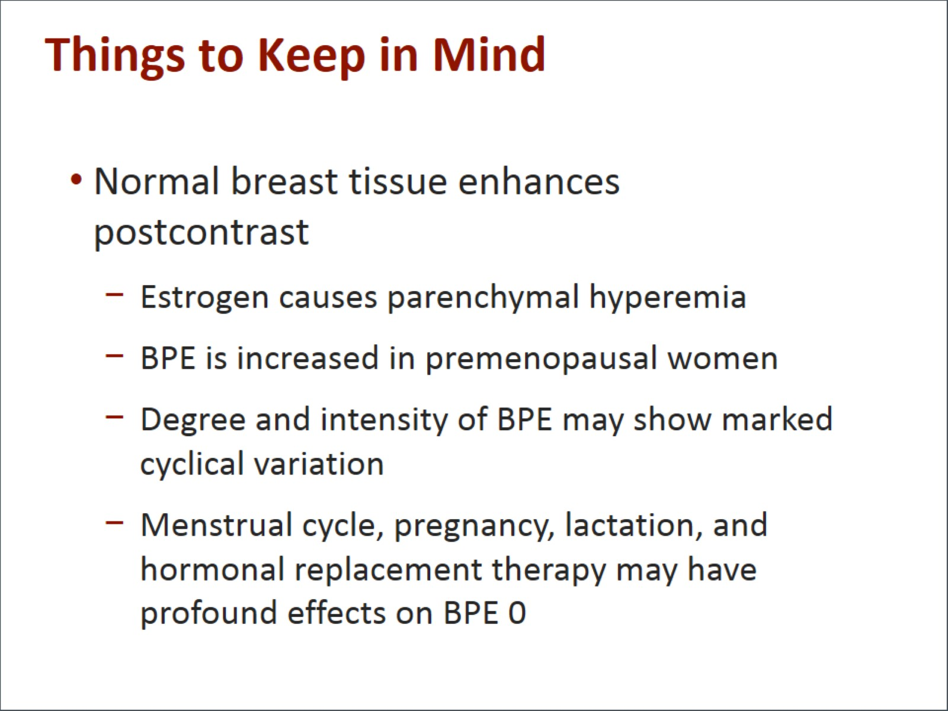
Things to Keep in Mind

Slide 11
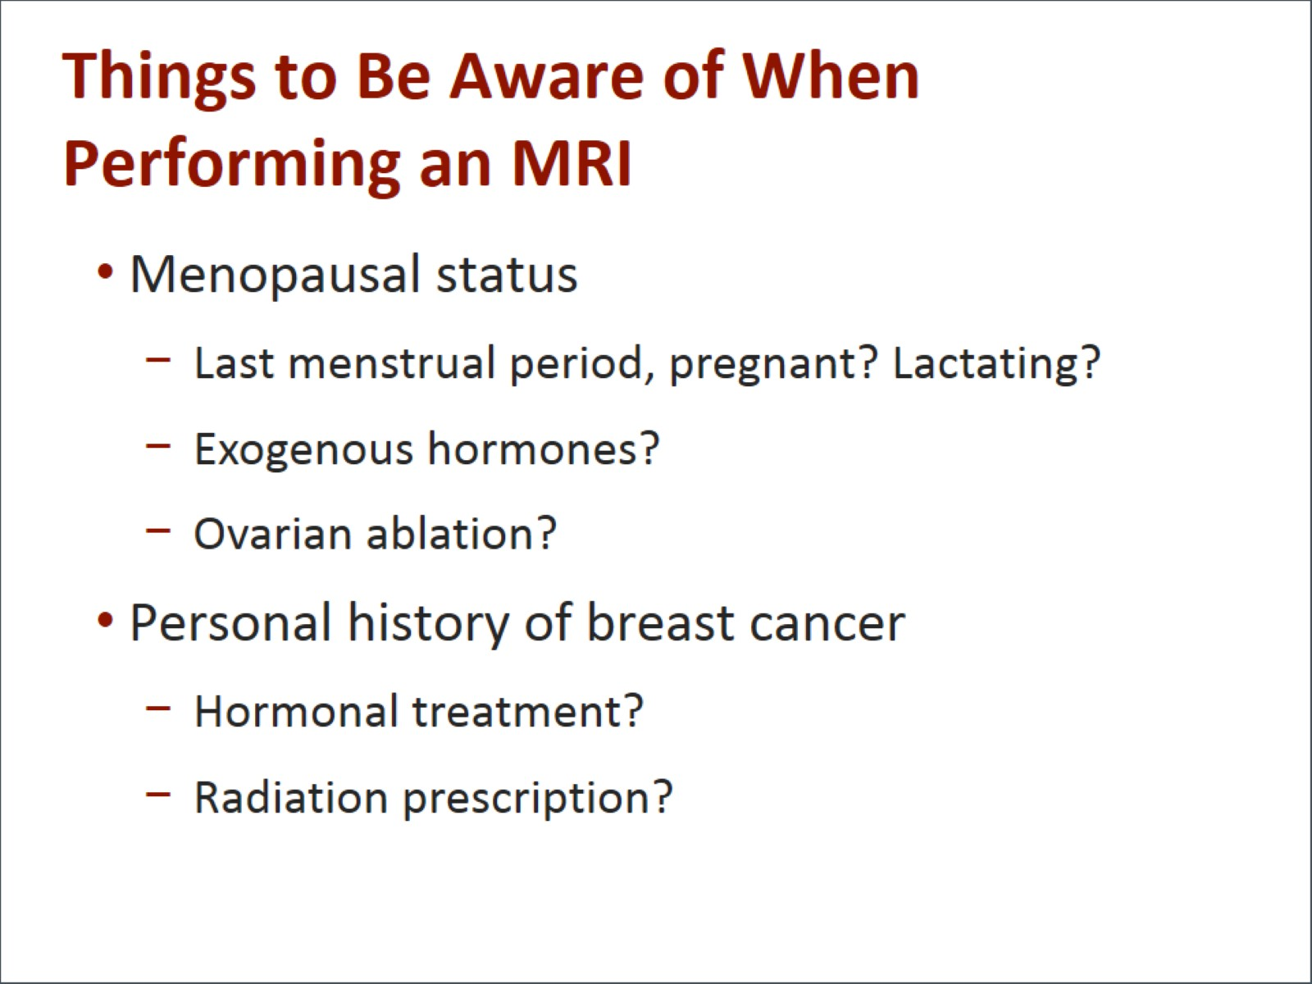
Things to Be Aware of When Performing an MRI

Slide 12
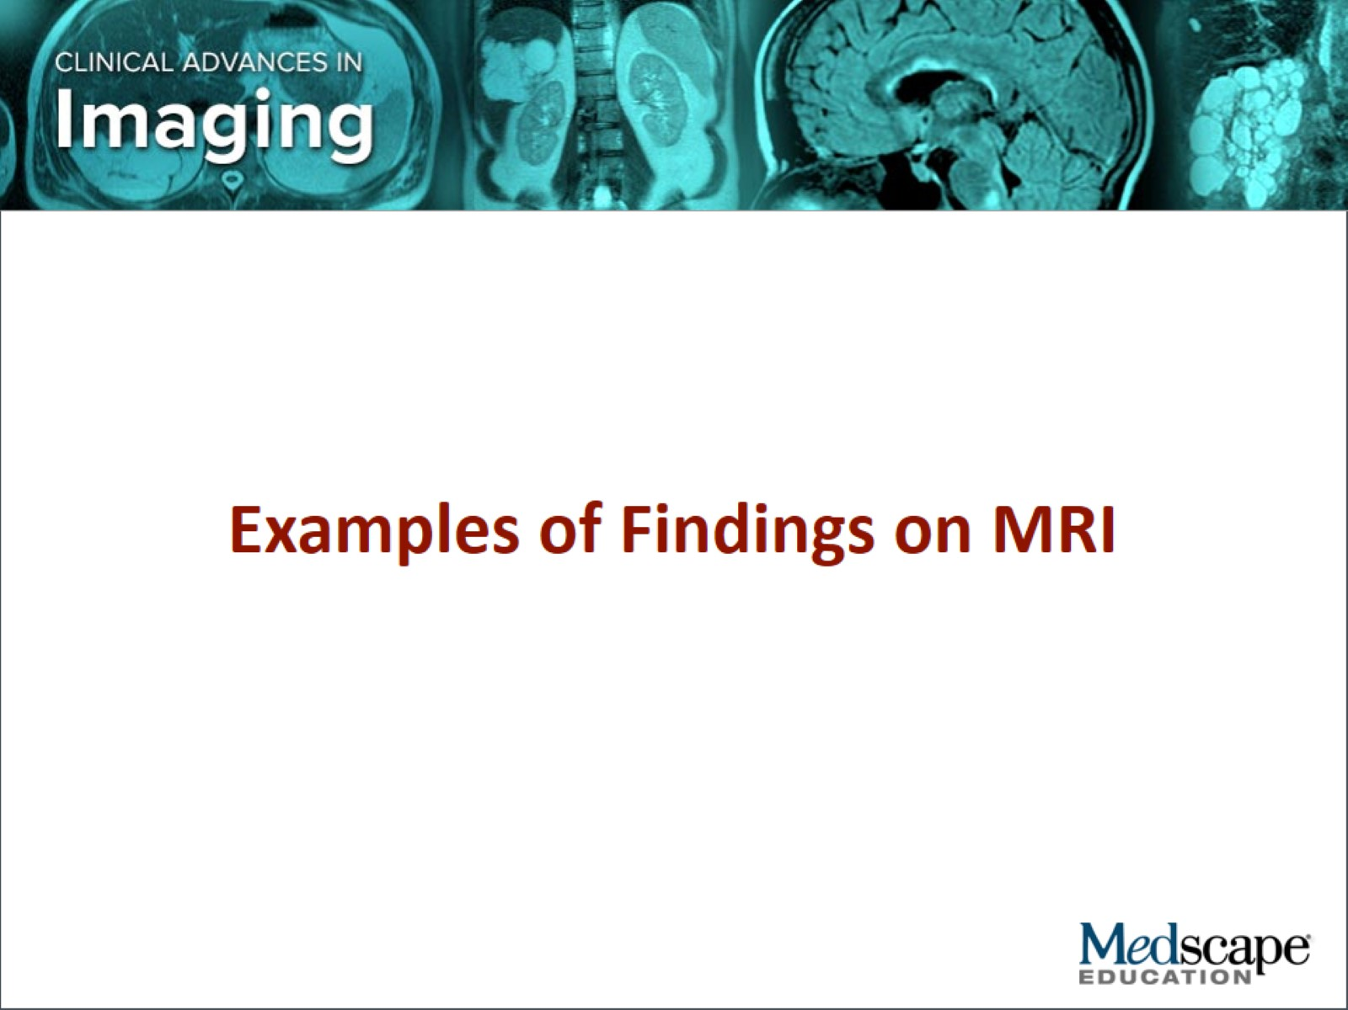

Slide 13
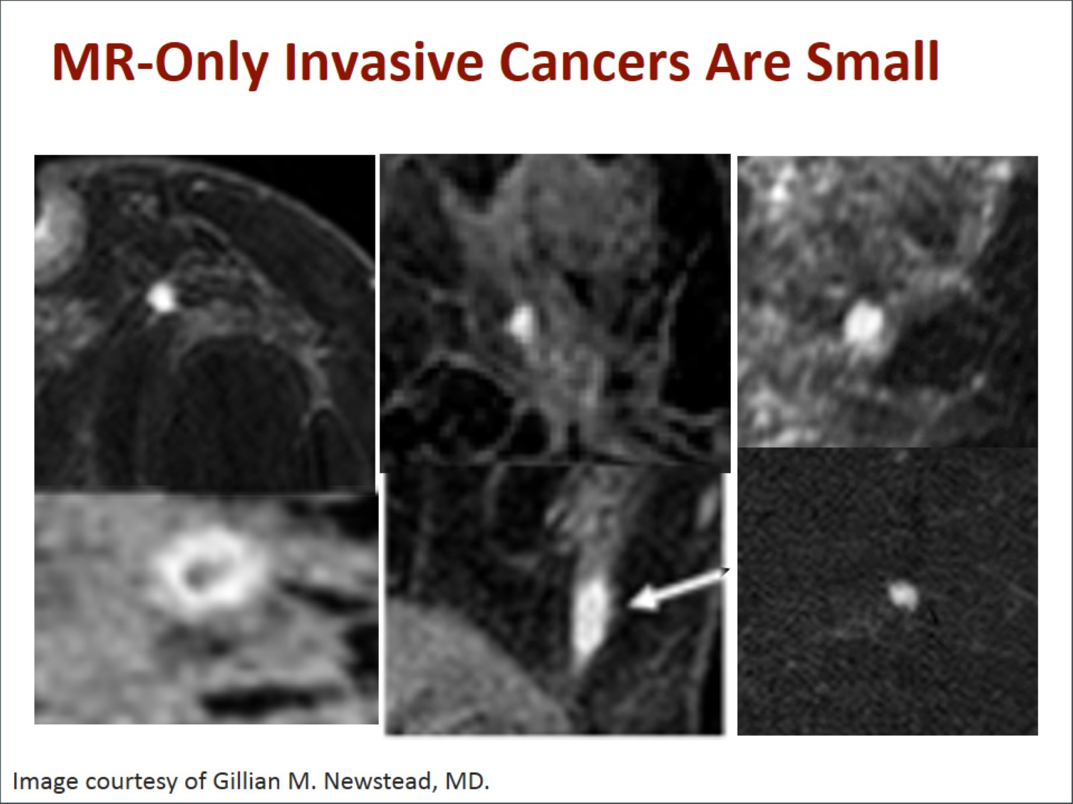
MR-Only Invasive Cancers Are Small

Slide 14
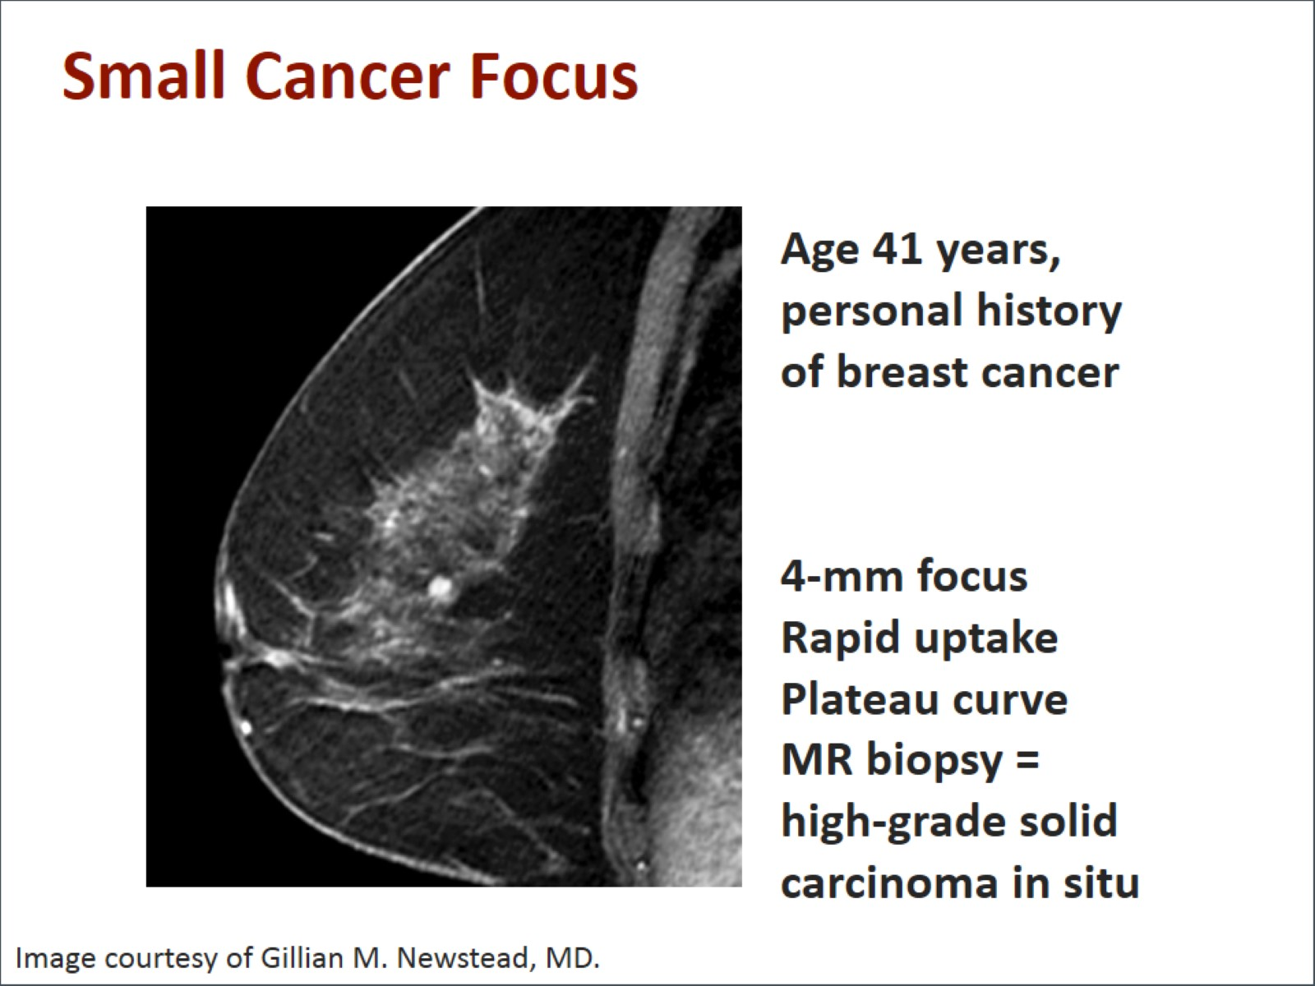
Small Cancer Focus

Slide 15
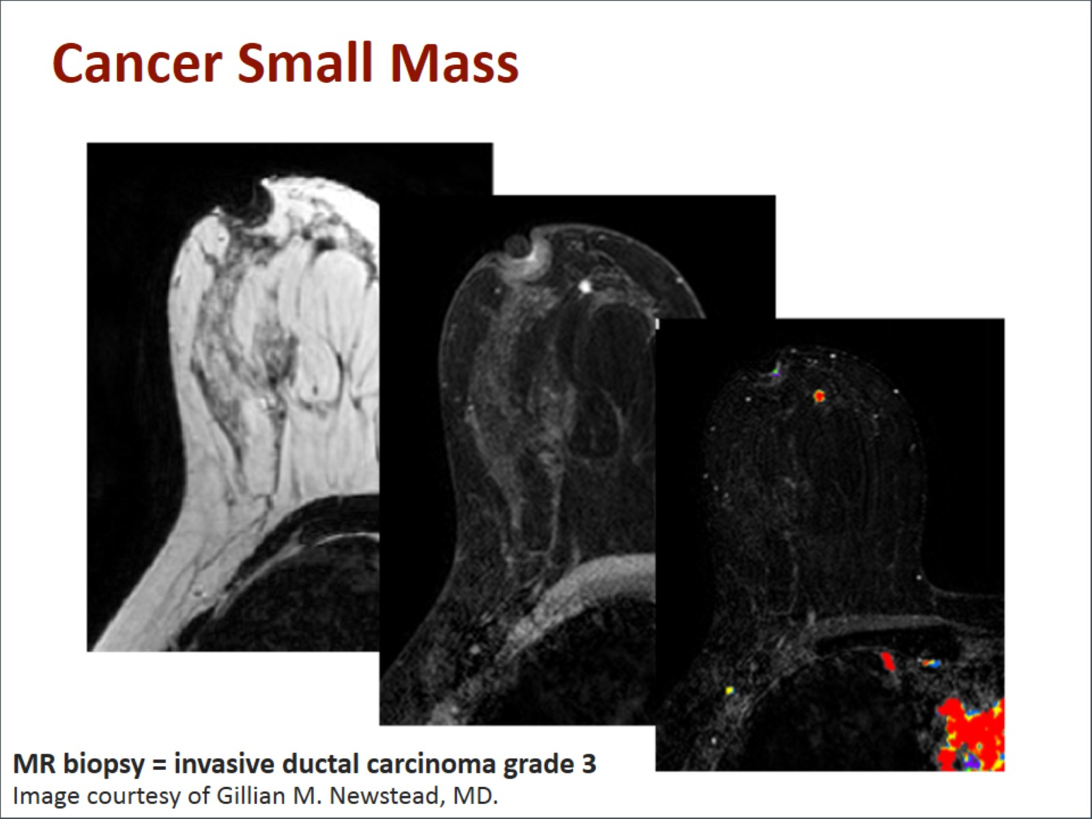
Cancer Small Mass

Slide 16
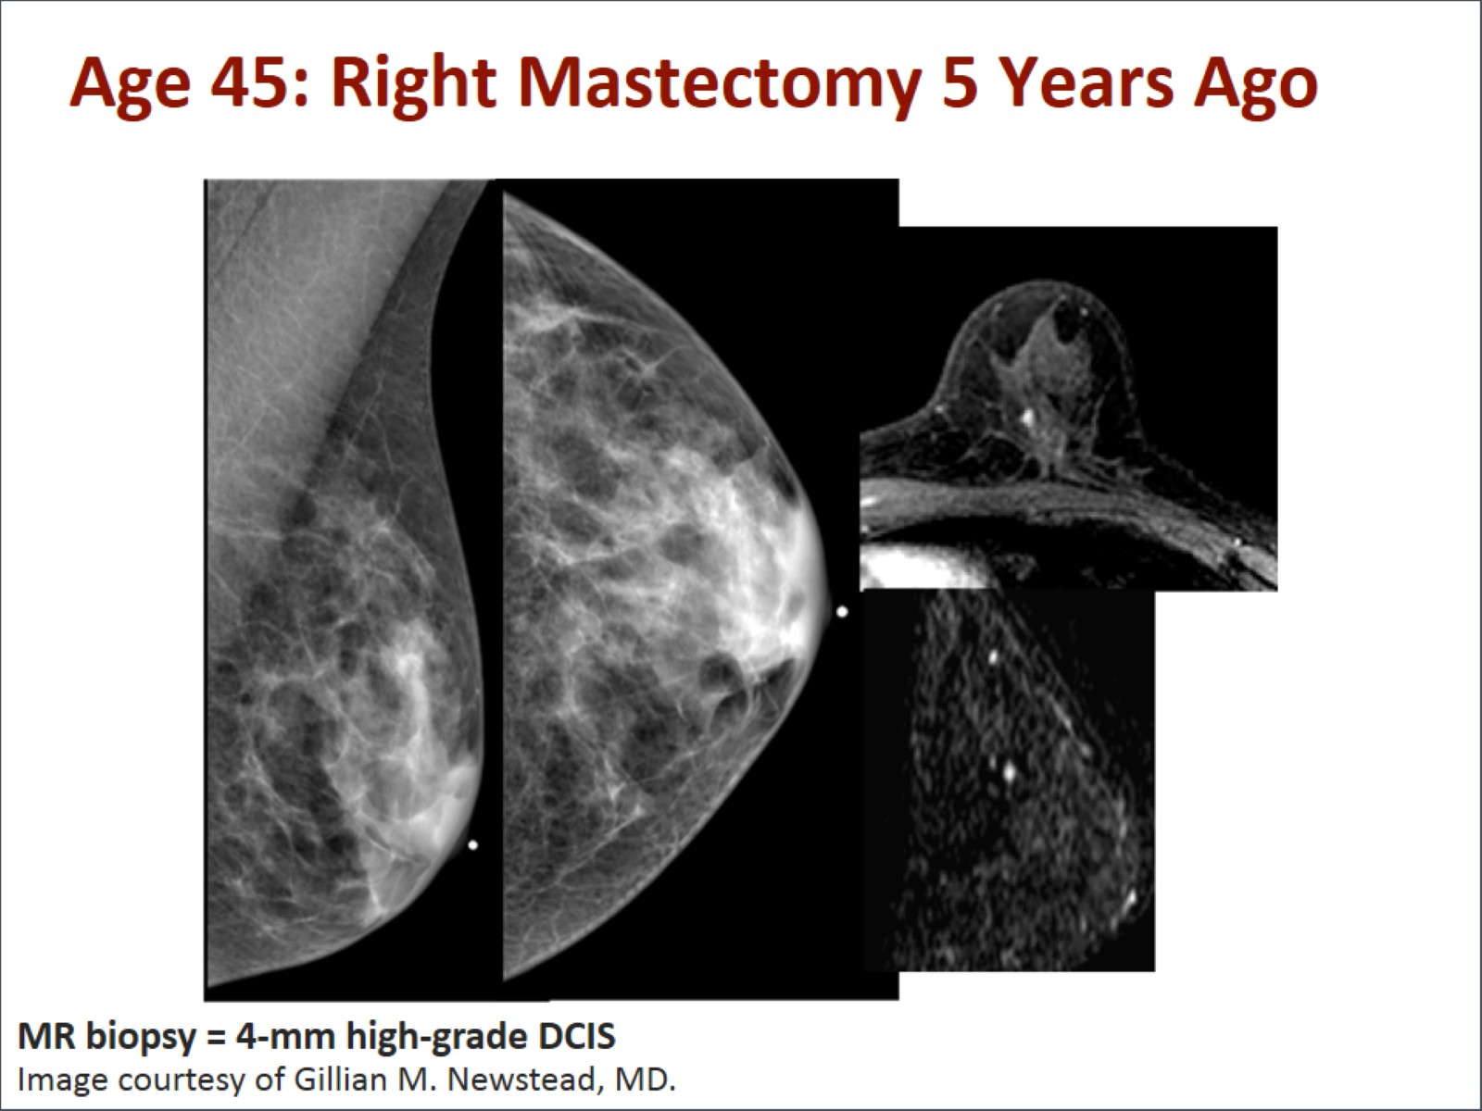
Age 45: Right Mastectomy 5 Years Ago

Slide 17
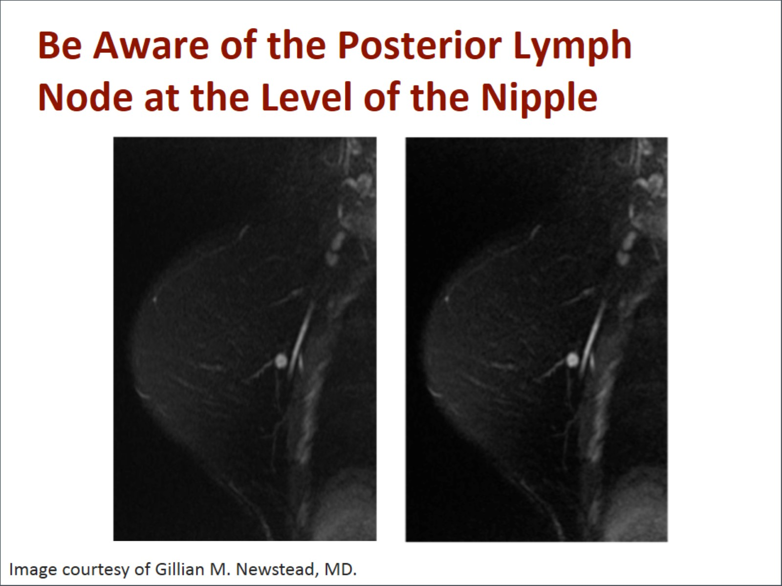
Be Aware of the Posterior Lymph Node at the Level of the Nipple

Slide 18
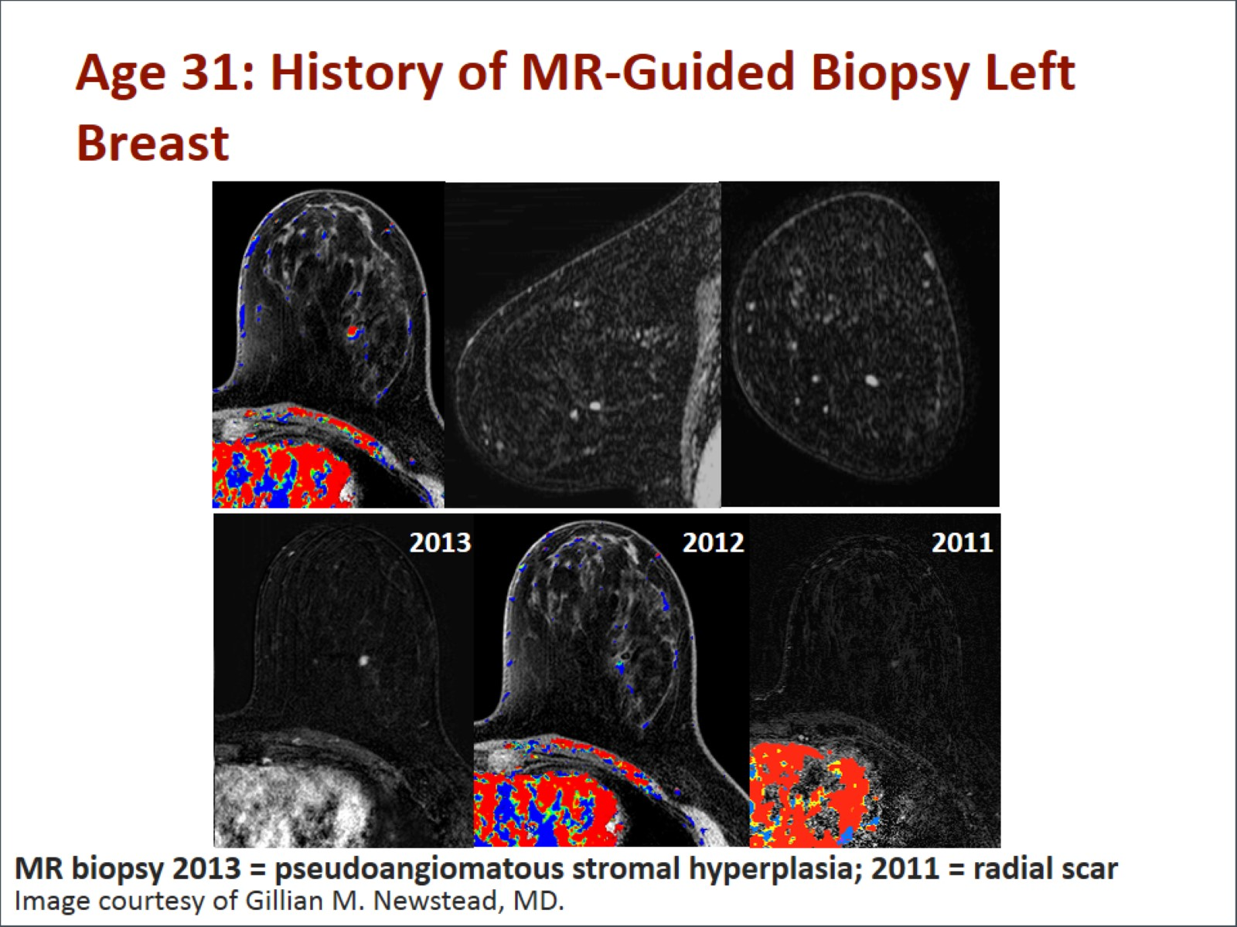
Age 31: History of MR-Guided Biopsy Left Breast

Slide 19
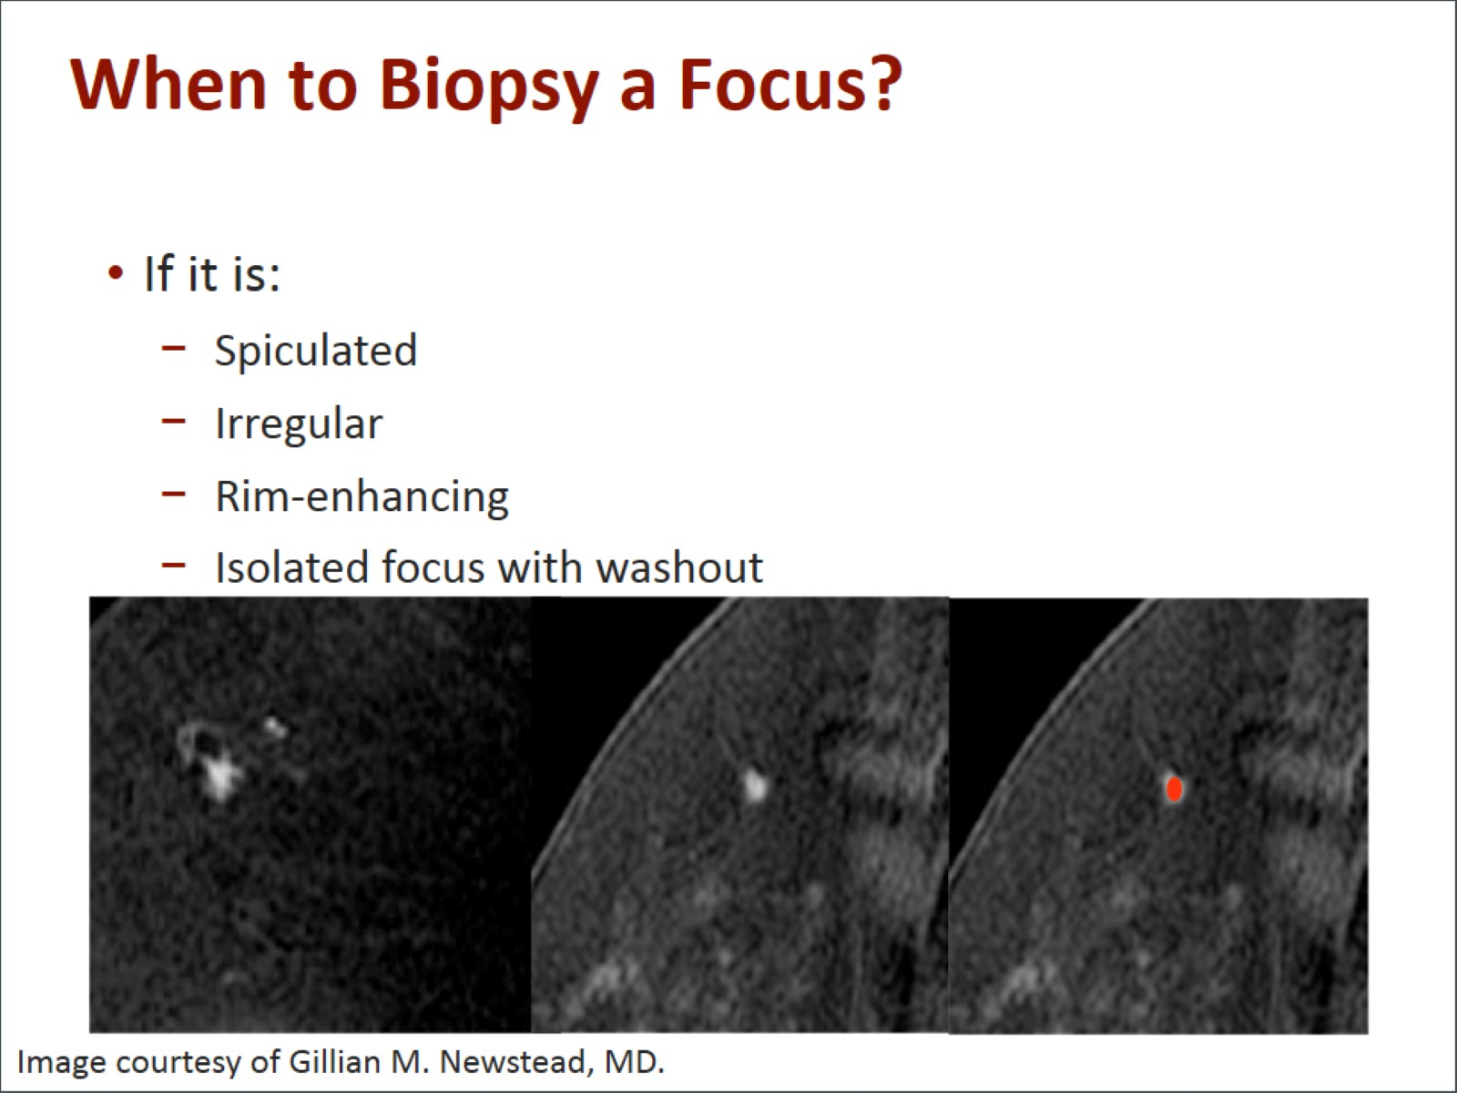
When to Biopsy a Focus?

Slide 20
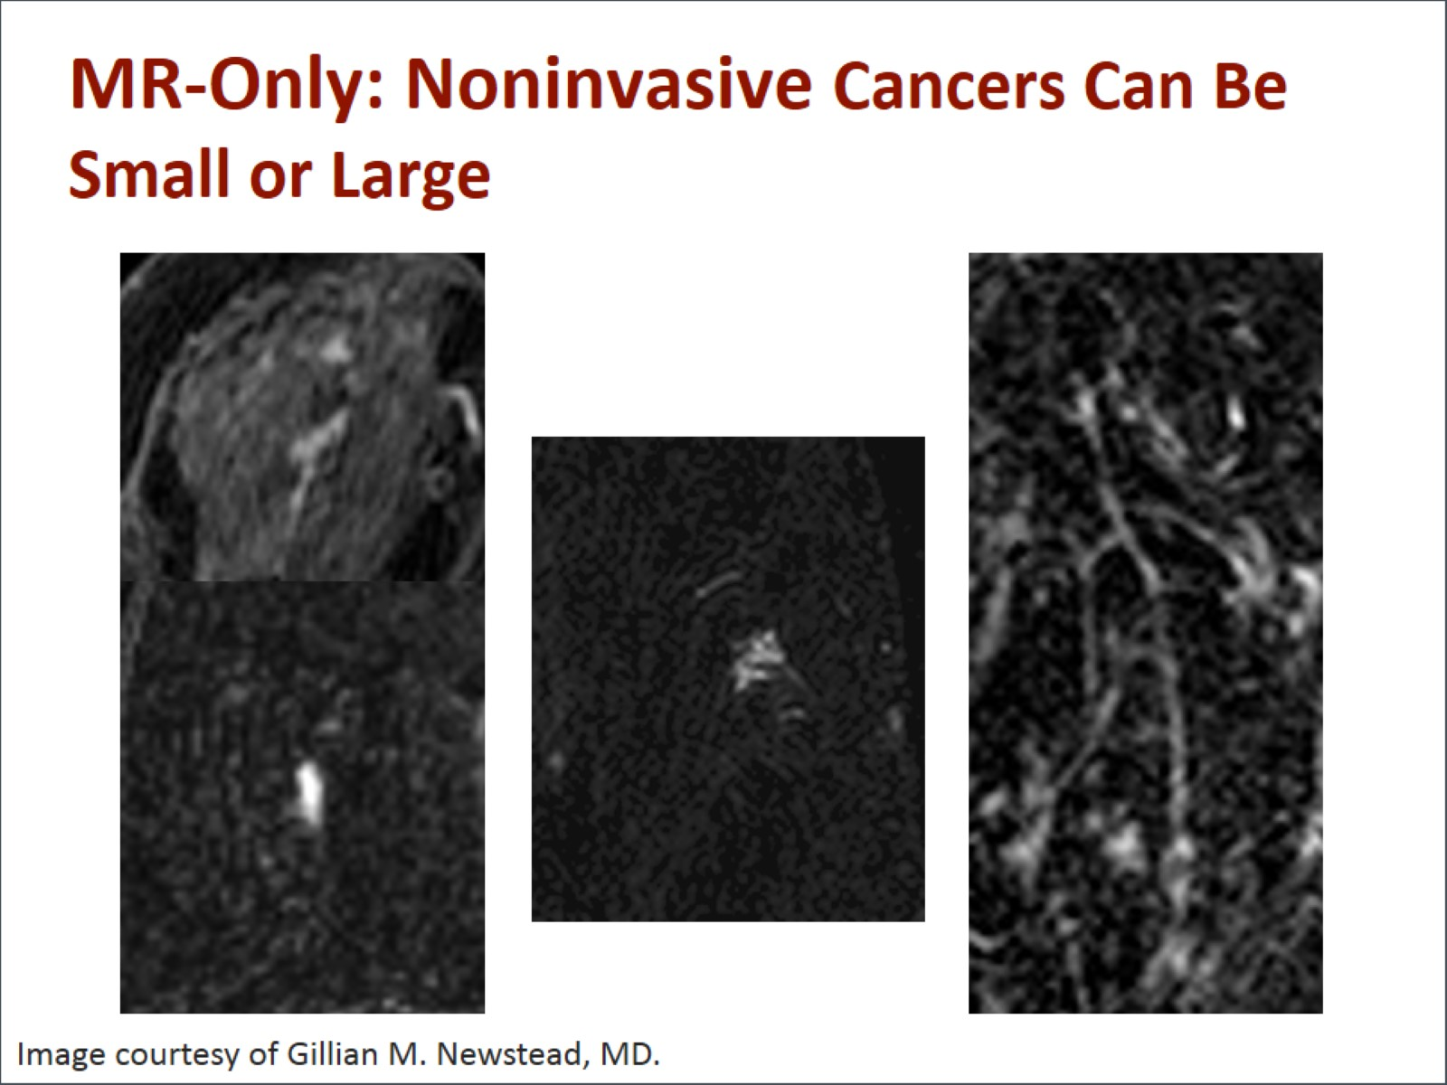
MR-Only: Noninvasive Cancers Can Be Small or Large

Slide 21
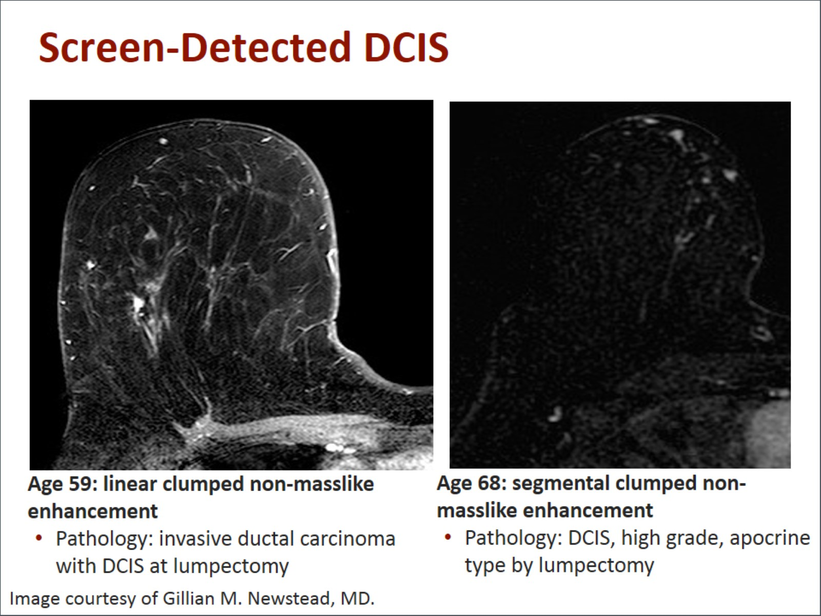
Screen-Detected DCIS

Slide 22
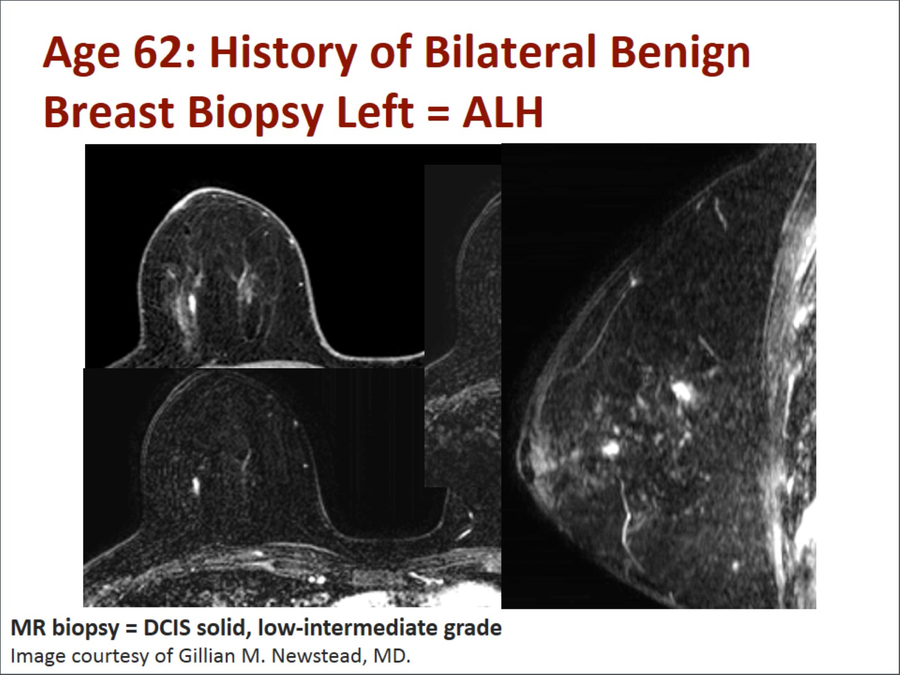
Age 62: History of Bilateral Benign Breast Biopsy Left = ALH

Slide 23
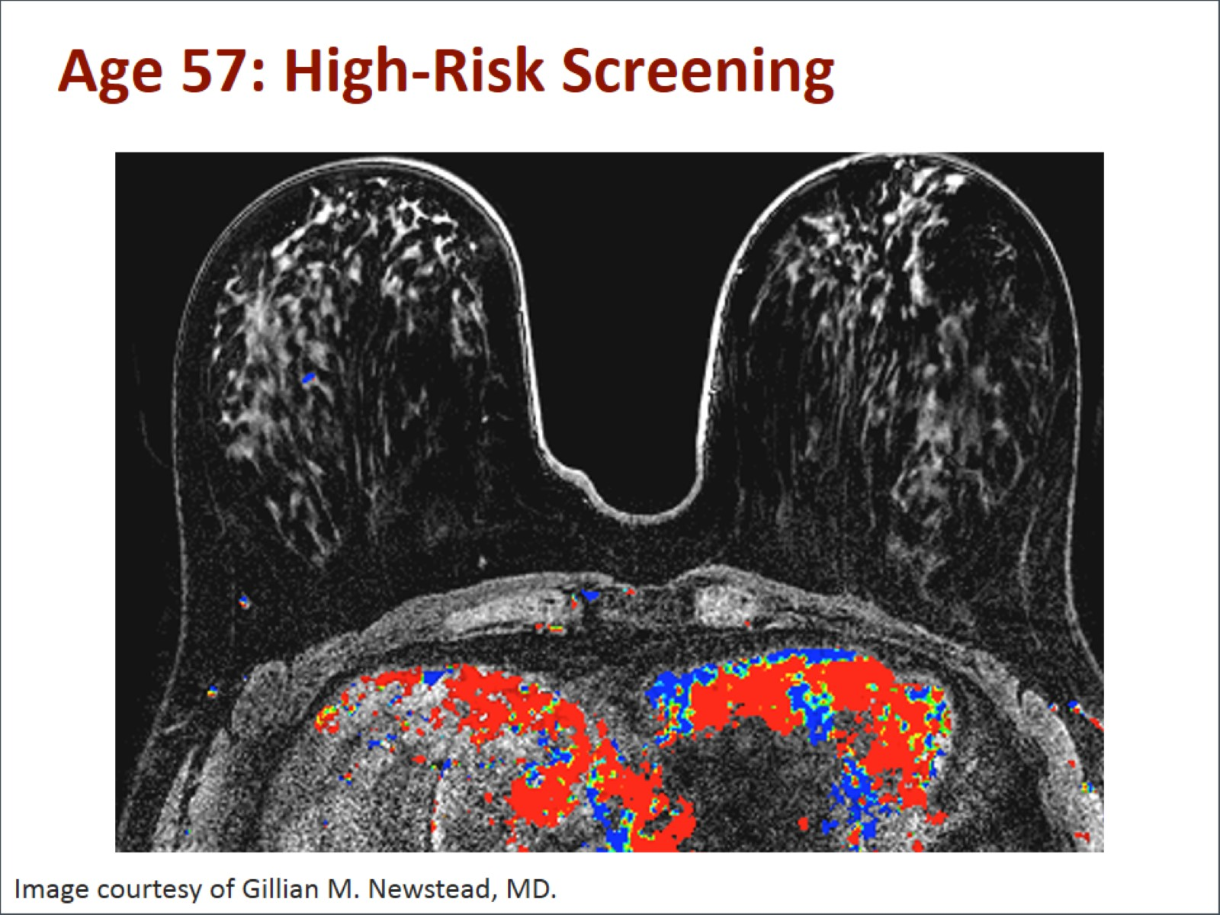
Age 57: High-Risk Screening

Slide 24
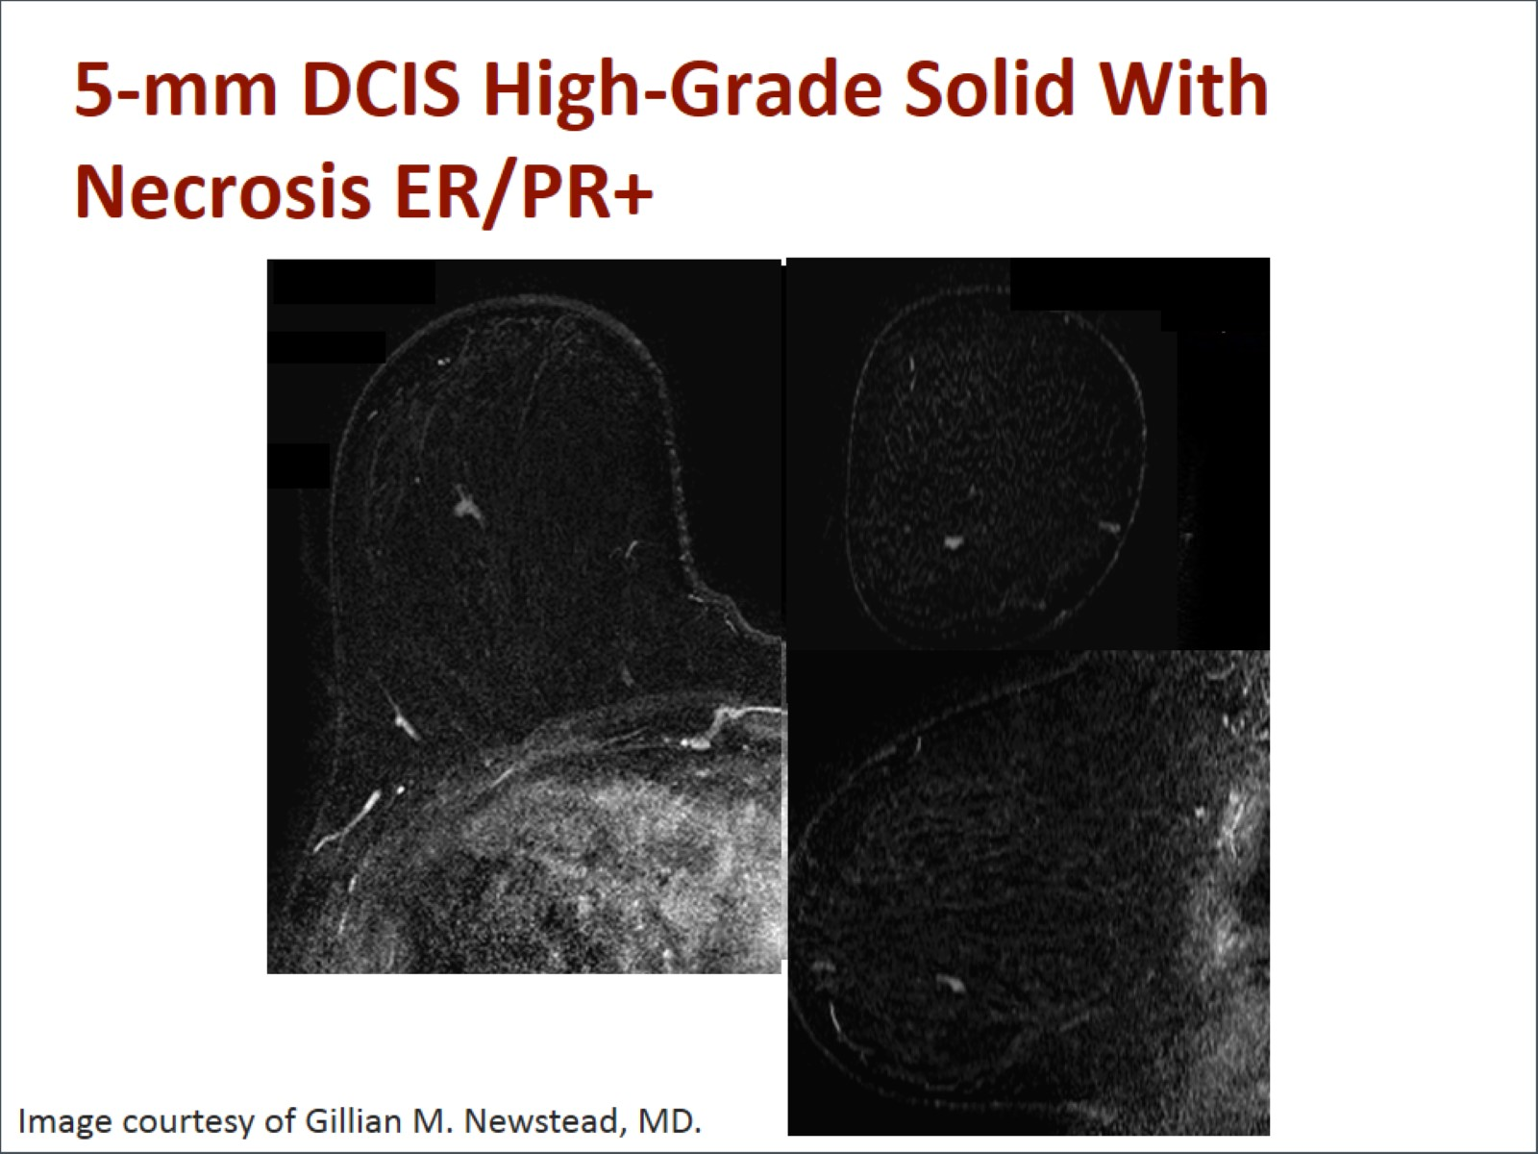
5-mm DCIS High-Grade Solid With Necrosis ER/PR+

Slide 25
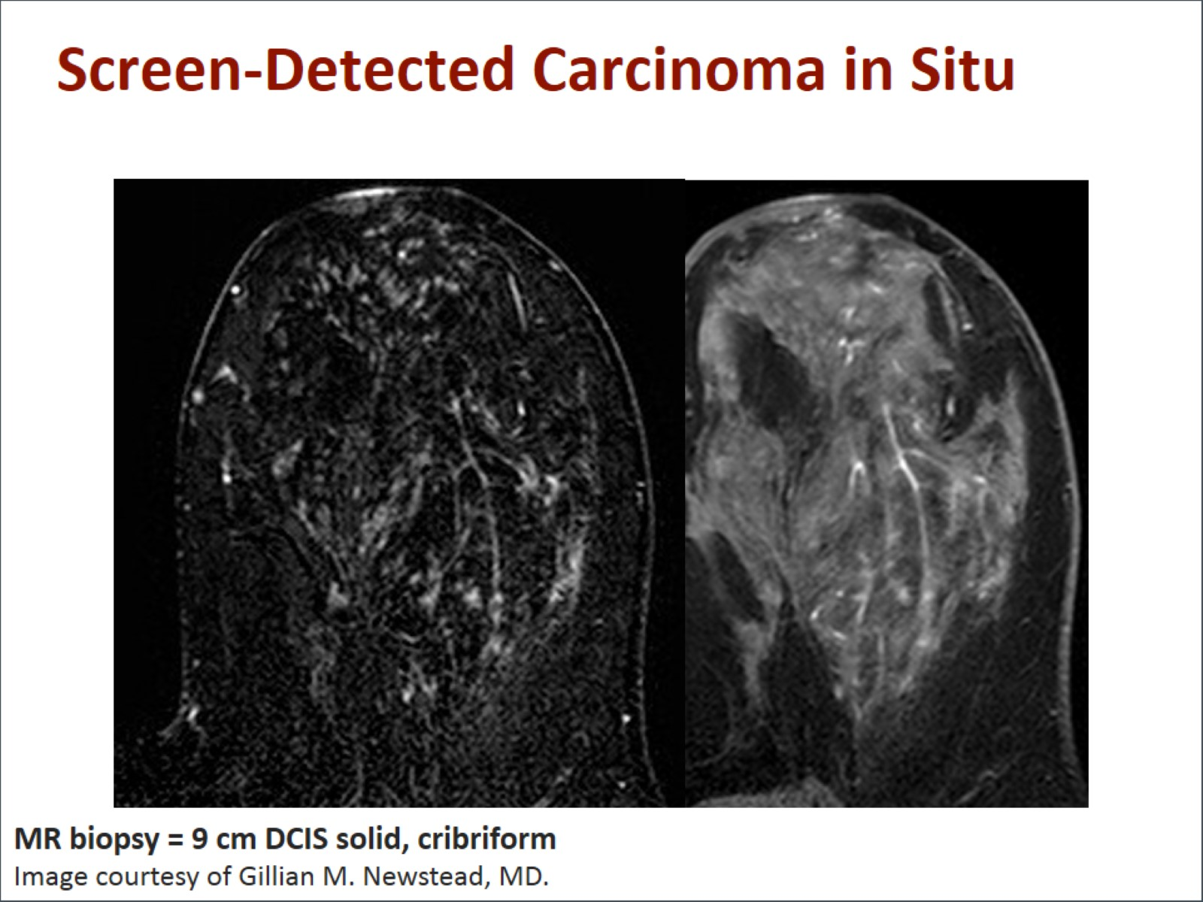
Screen-Detected Carcinoma in Situ

Slide 26
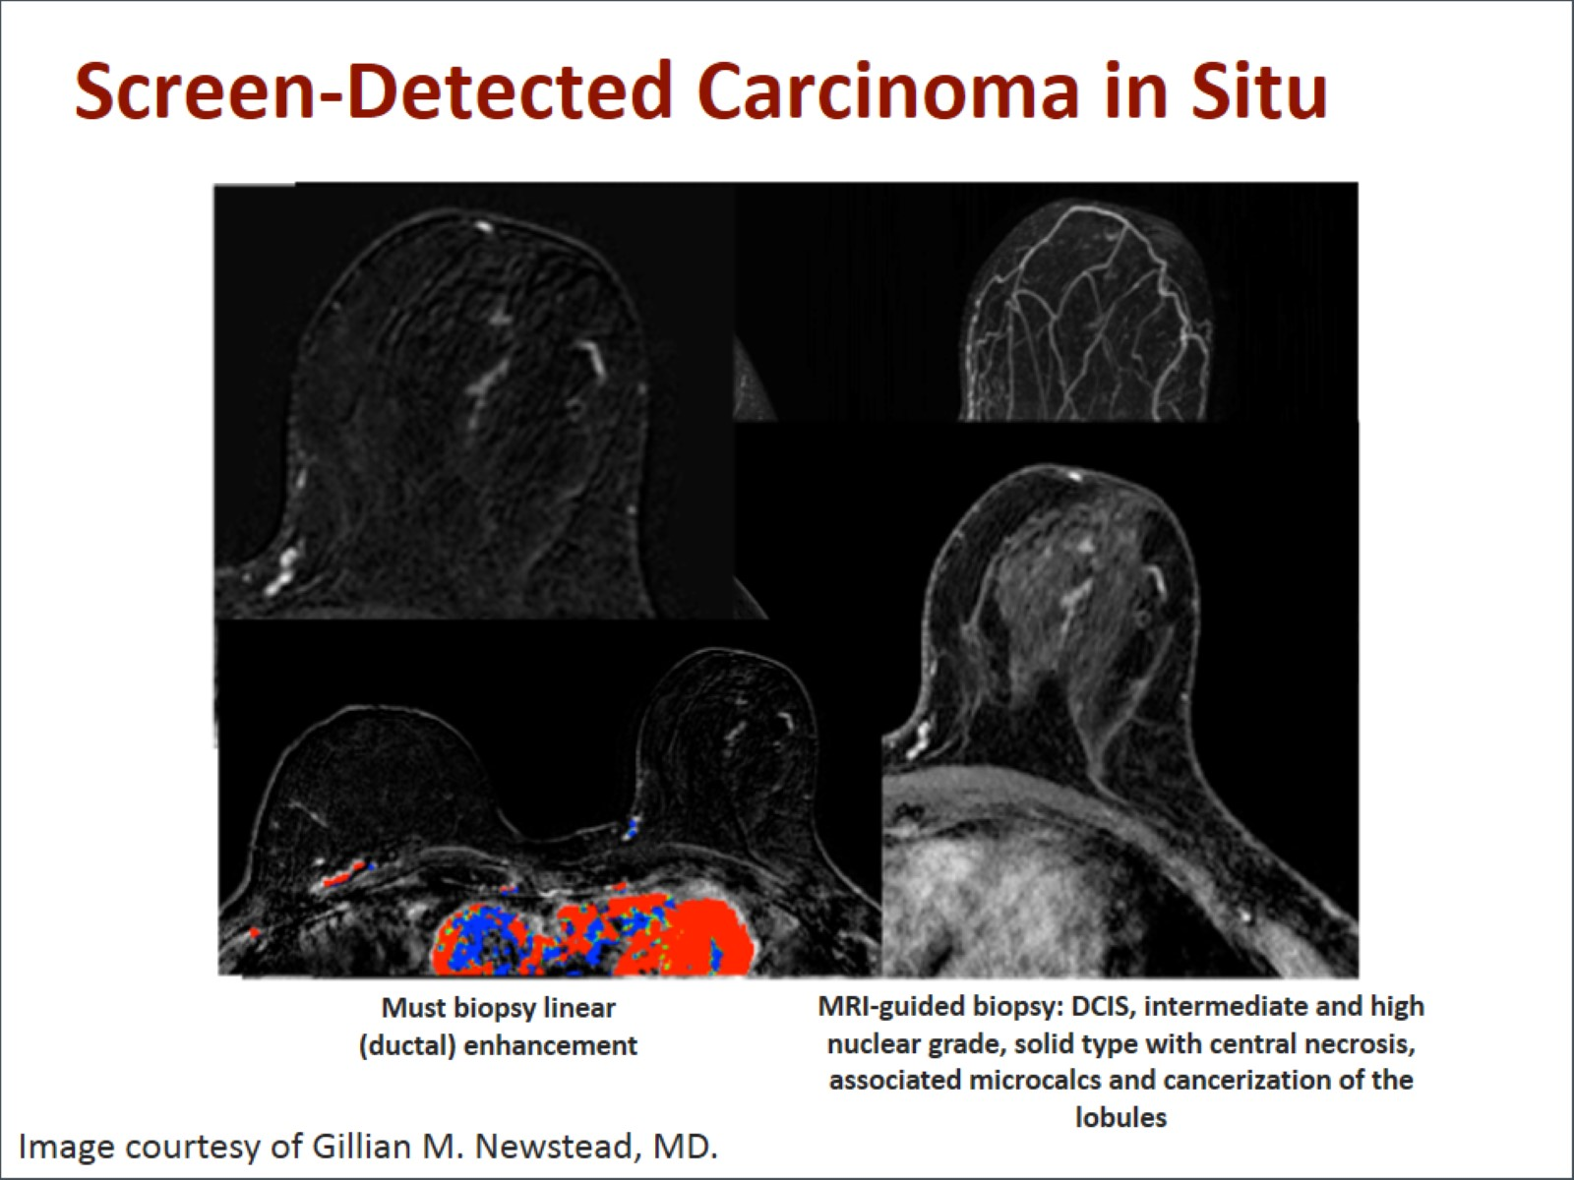
Screen-Detected Carcinoma in Situ

Slide 27
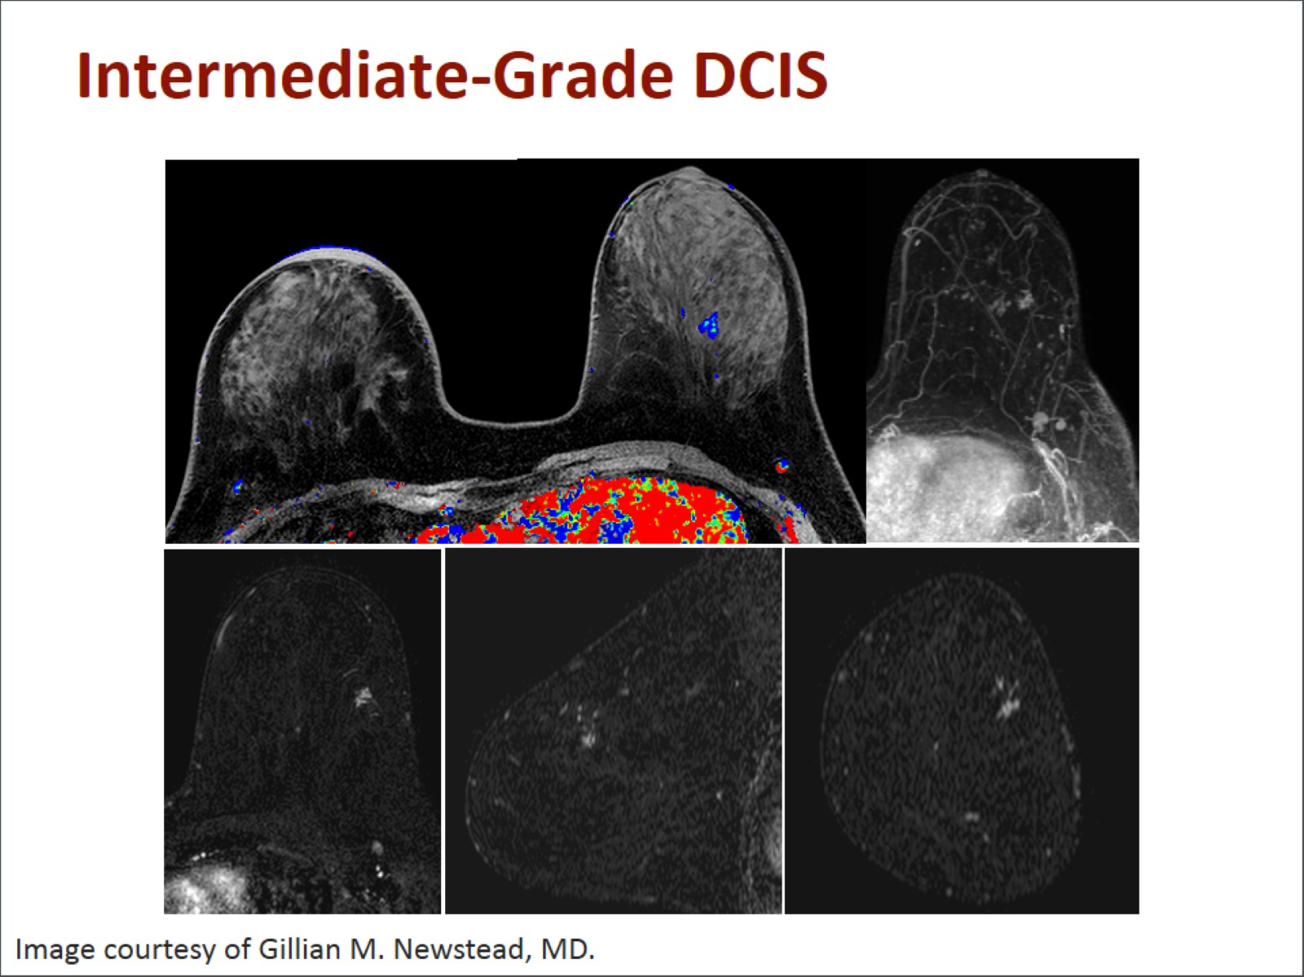
Intermediate-Grade DCIS

Slide 28
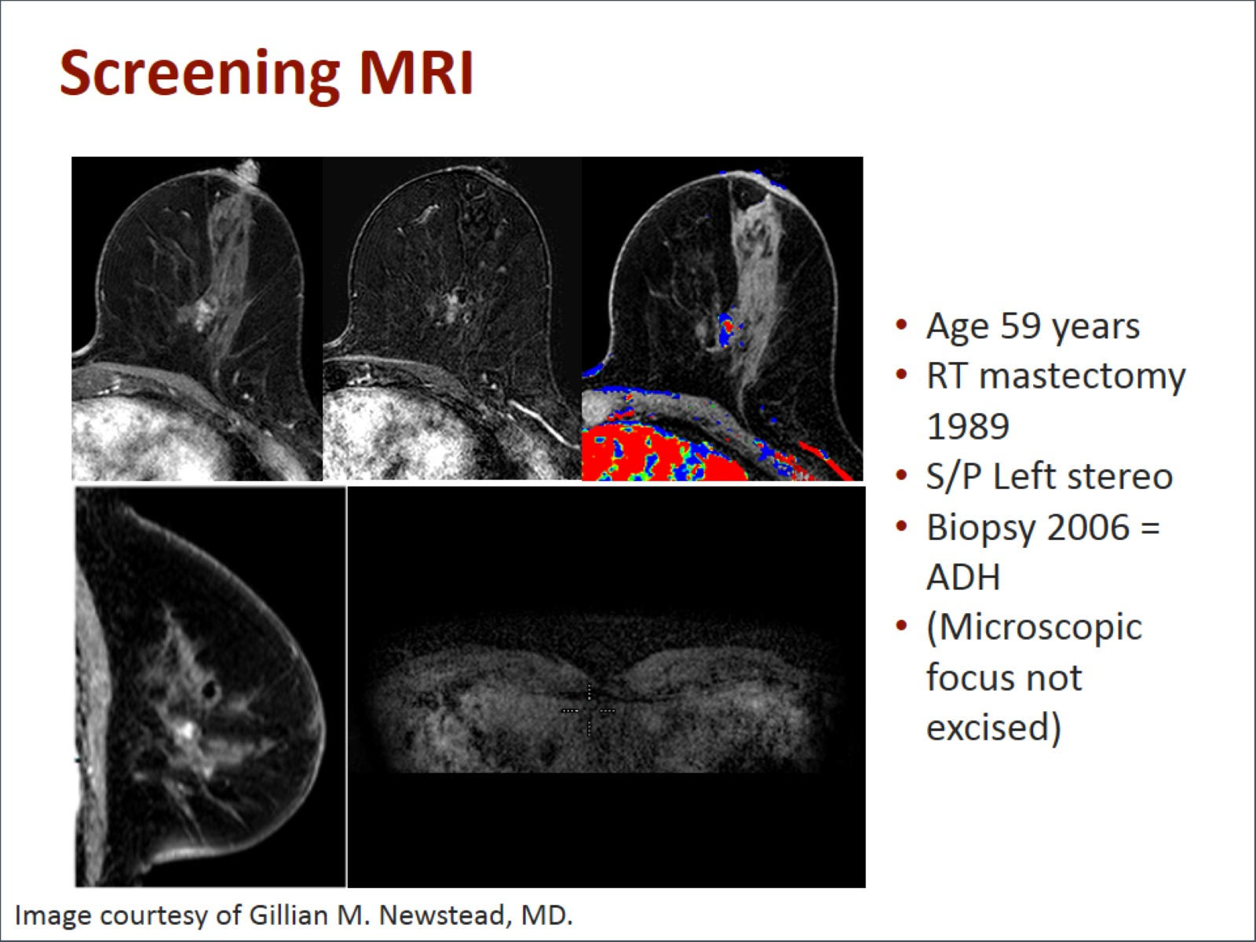
Screening MRI

Slide 29
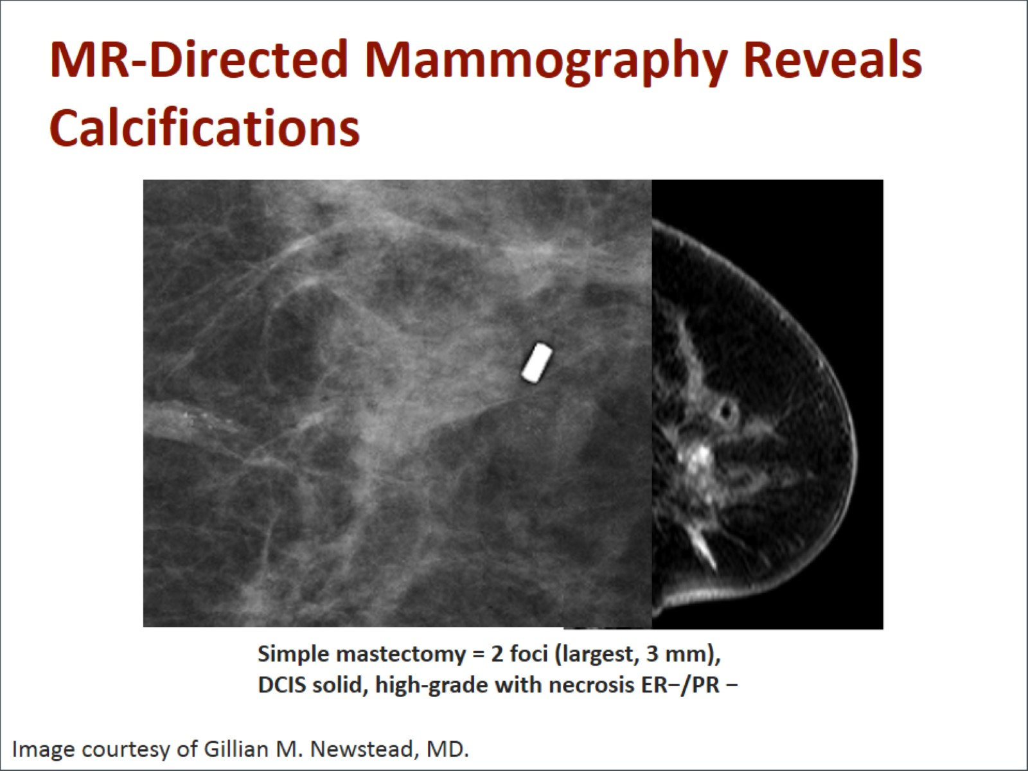
MR-Directed Mammography Reveals Calcifications

Slide 30
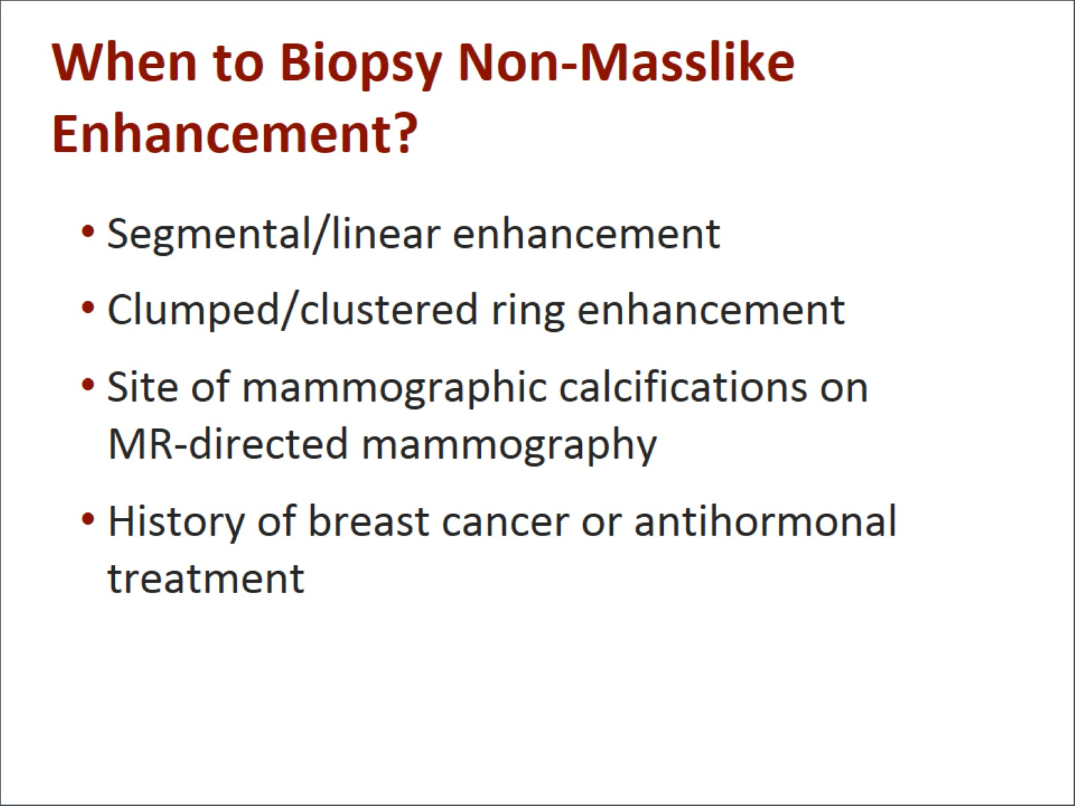
When to Biopsy Non-Masslike Enhancement?

Slide 31
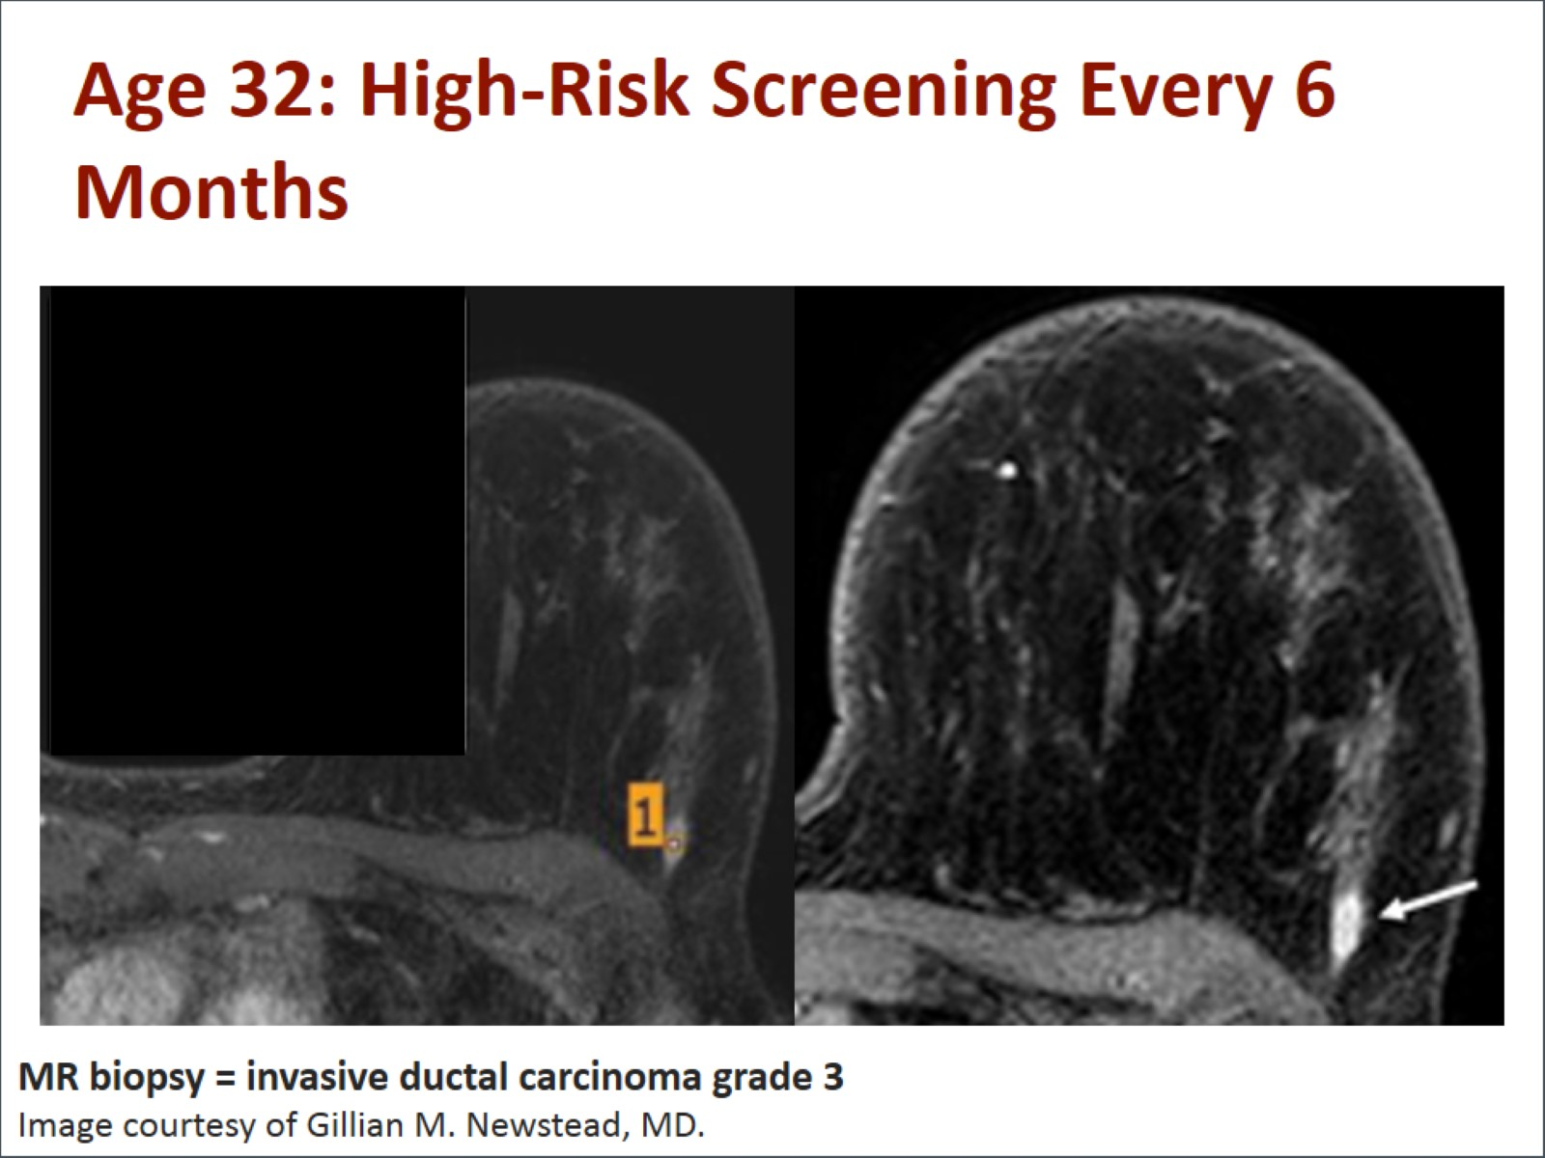
Age 32: High-Risk Screening Every 6 Months

Slide 32
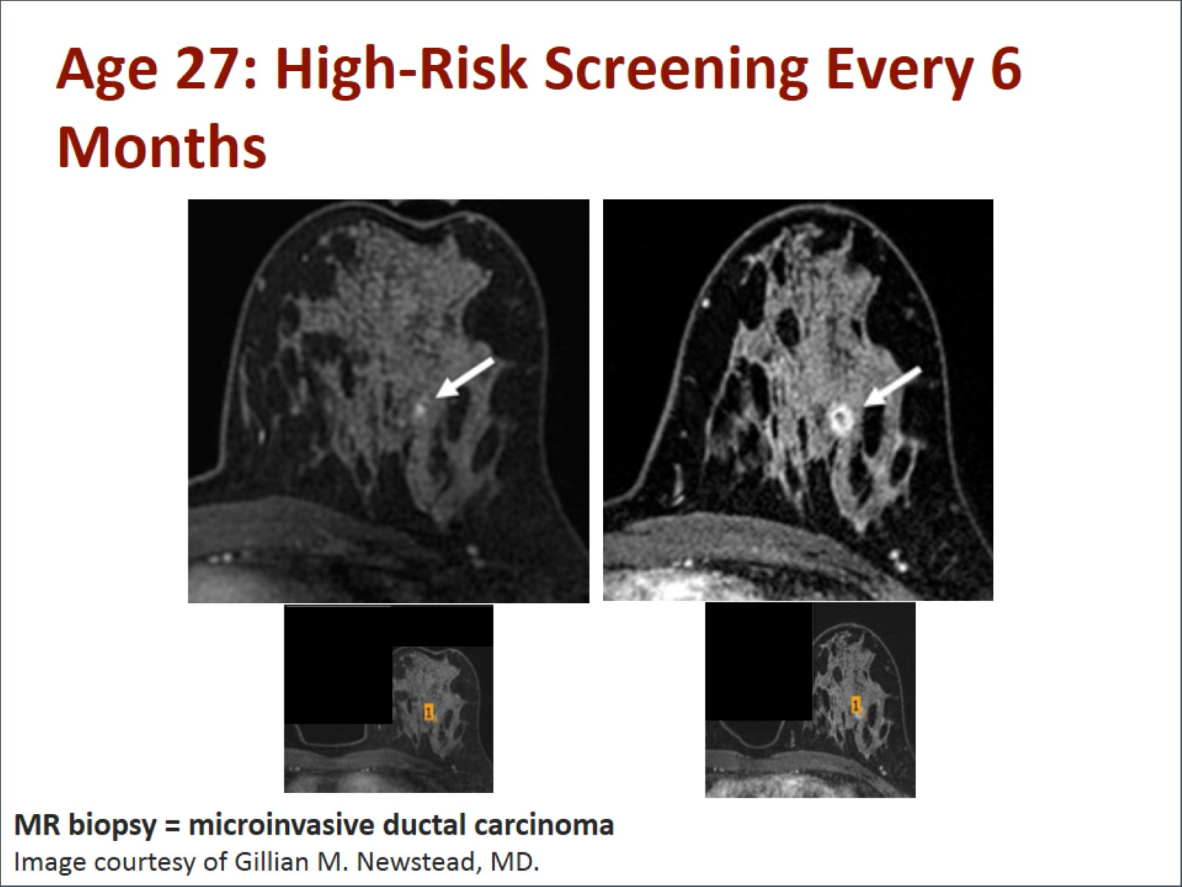
Age 27: High-Risk Screening Every 6 Months

Slide 33
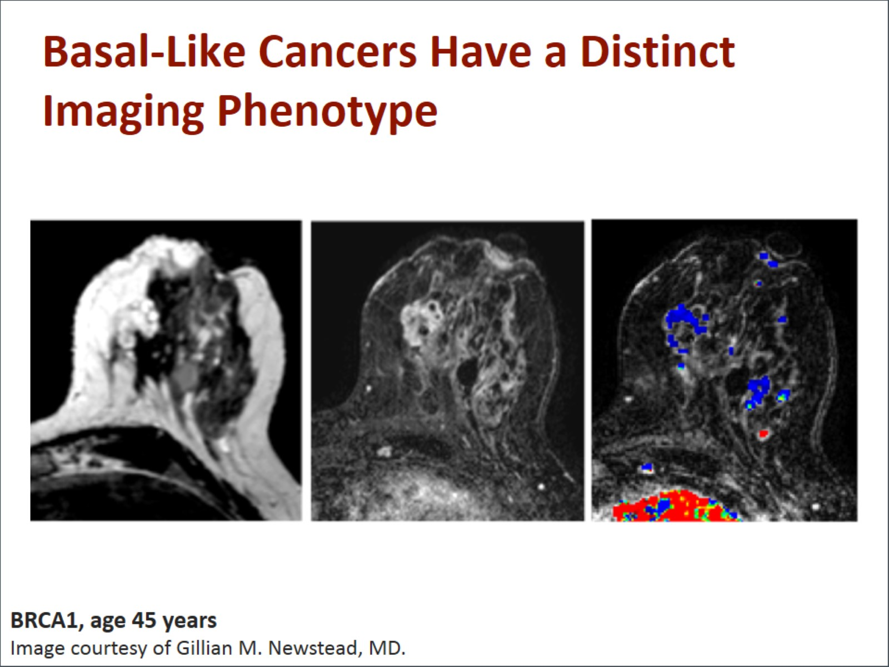
Basal-Like Cancers Have a Distinct Imaging Phenotype

Slide 34
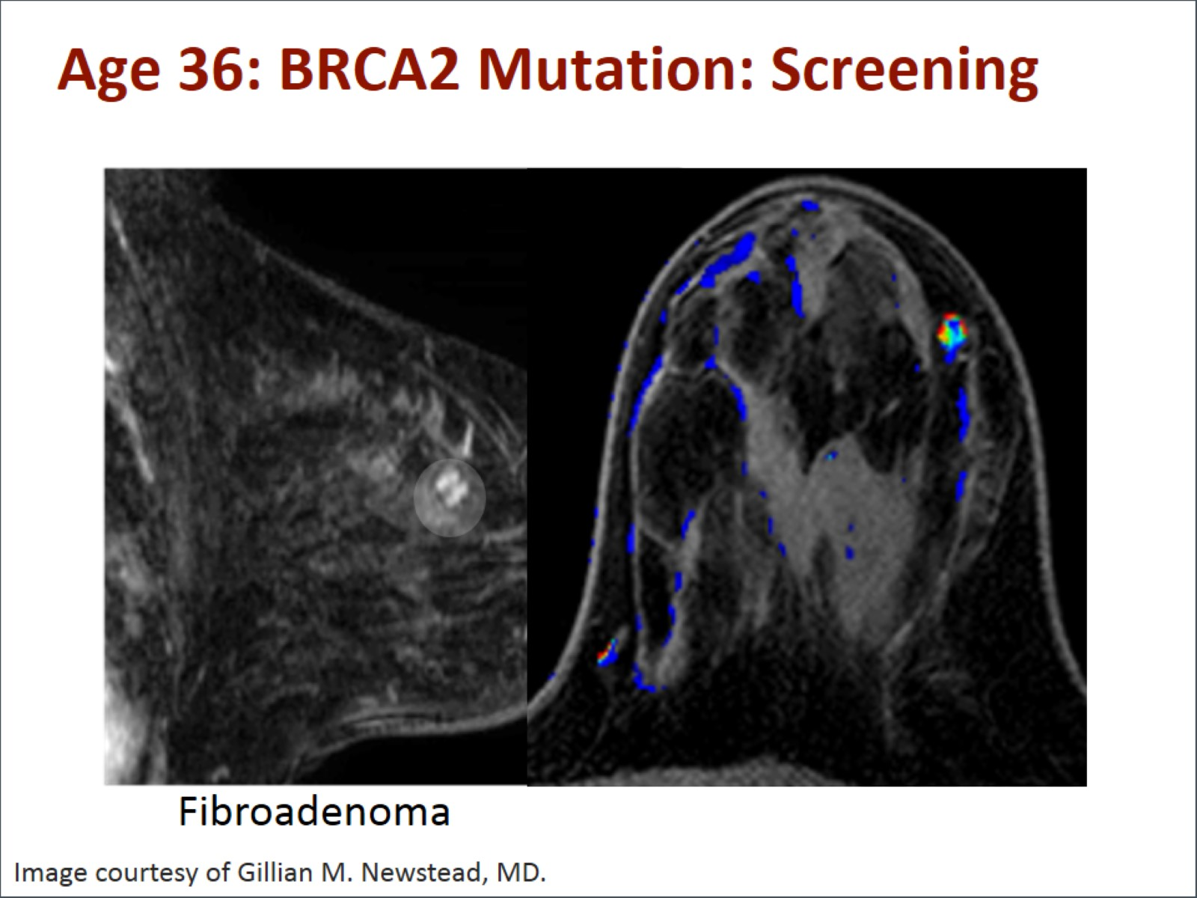
Age 36: BRCA2 Mutation: Screening

Slide 35
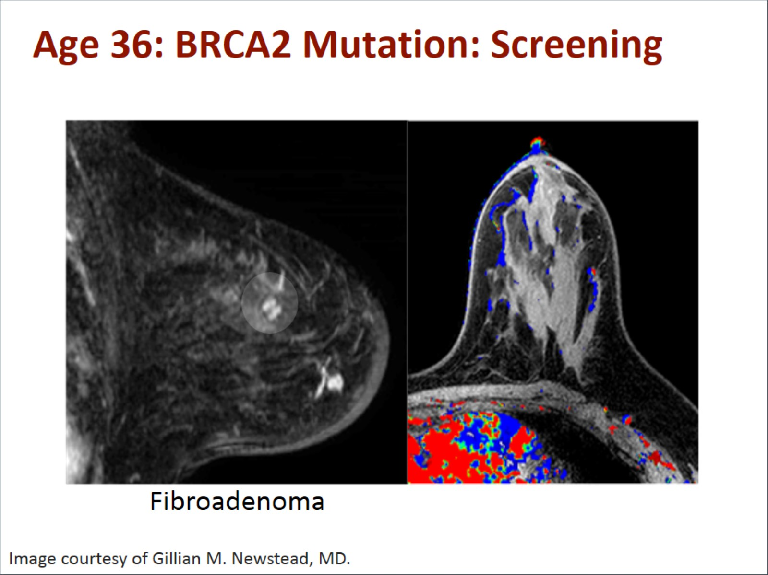
Age 36: BRCA2 Mutation: Screening

Slide 36
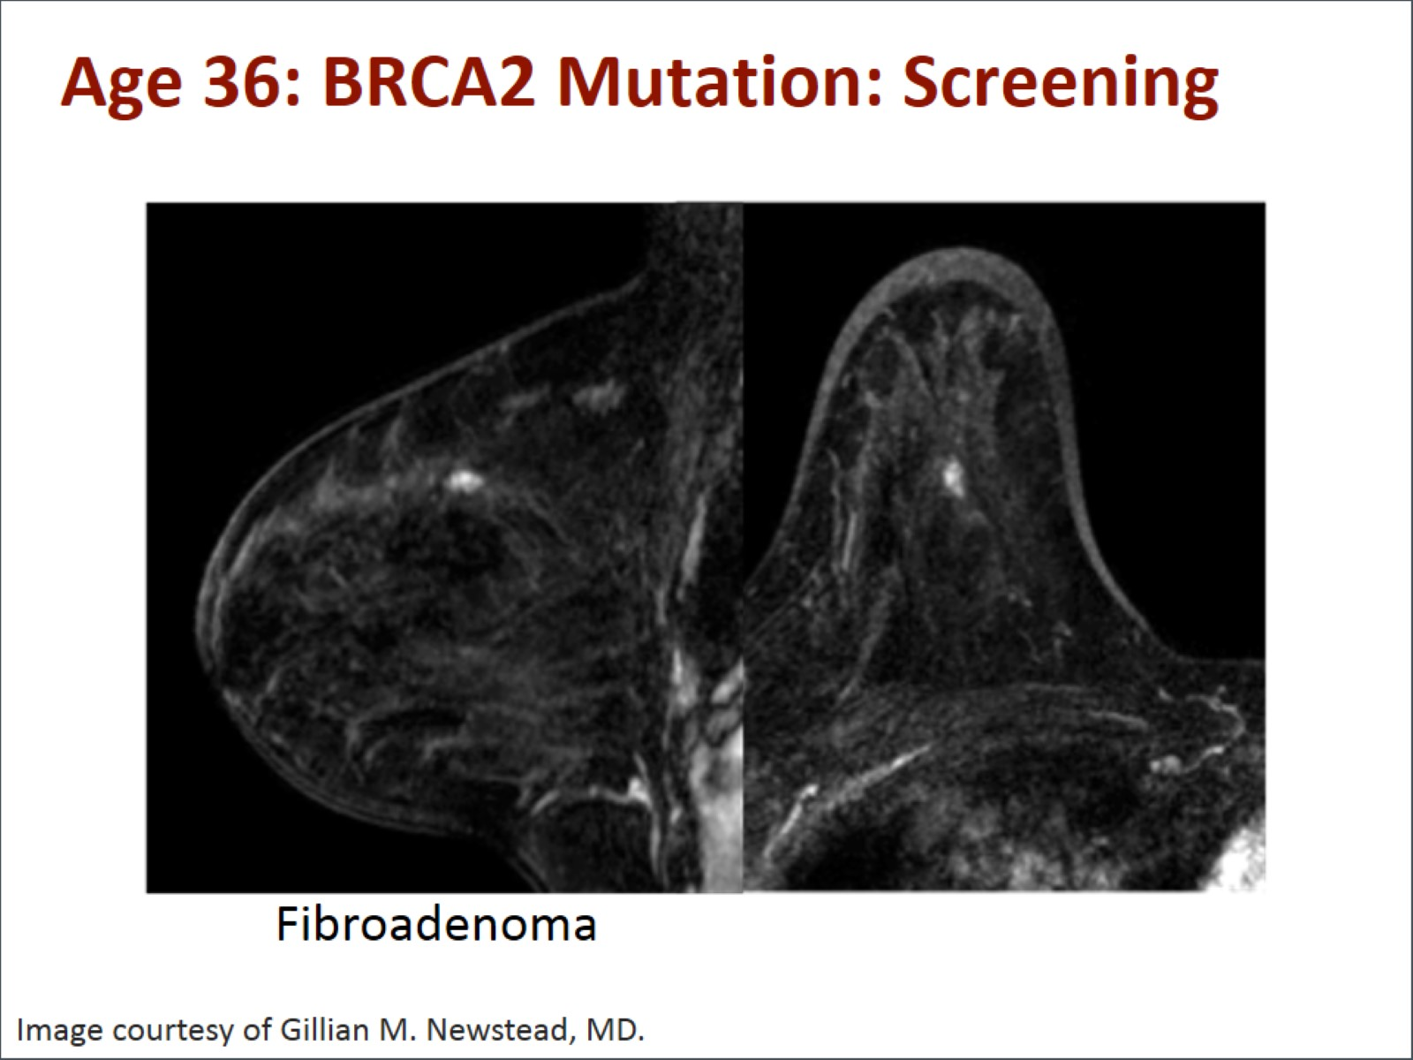
Age 36: BRCA2 Mutation: Screening

Slide 37
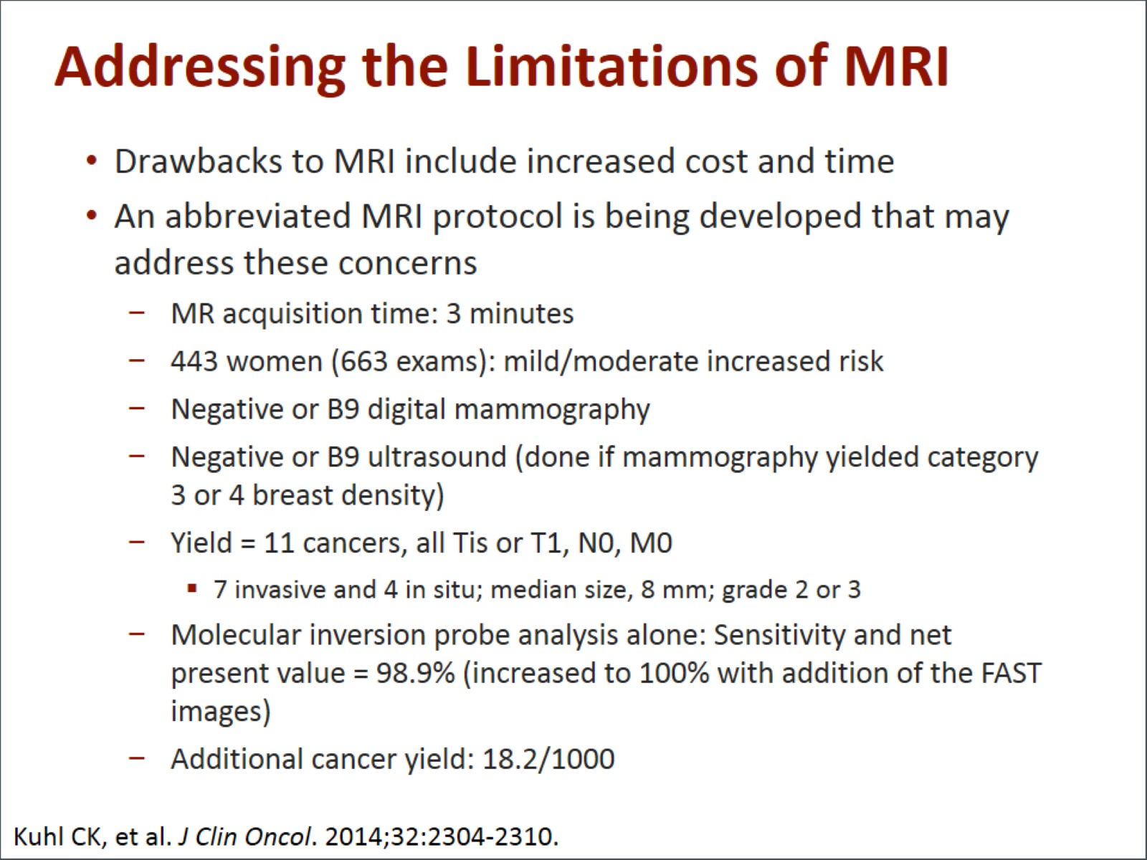
Addressing the Limitations of MRI

Slide 38
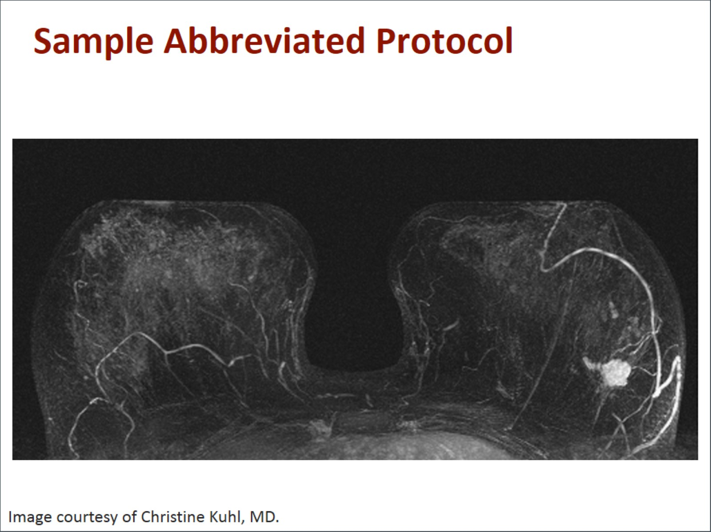
Sample Abbreviated Protocol

Slide 39
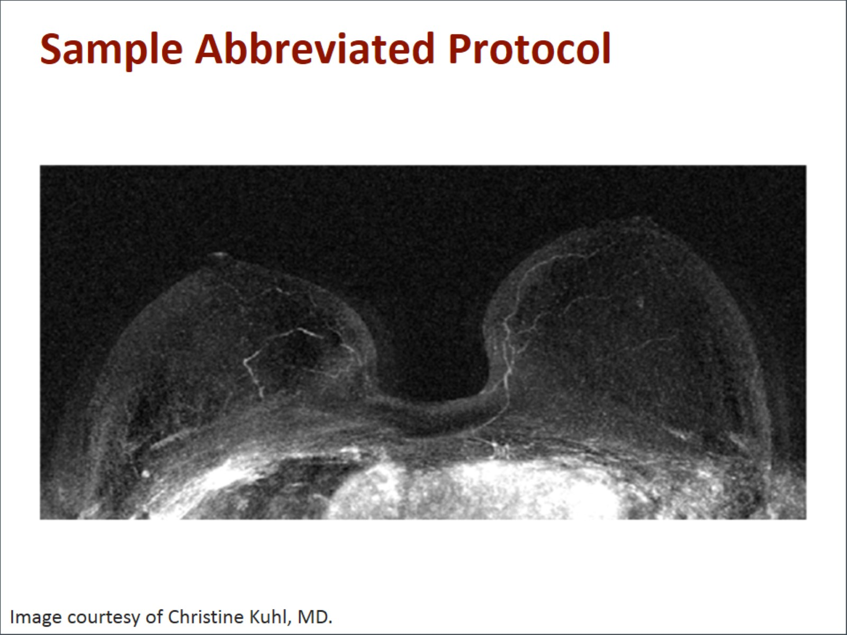
Sample Abbreviated Protocol

Slide 40
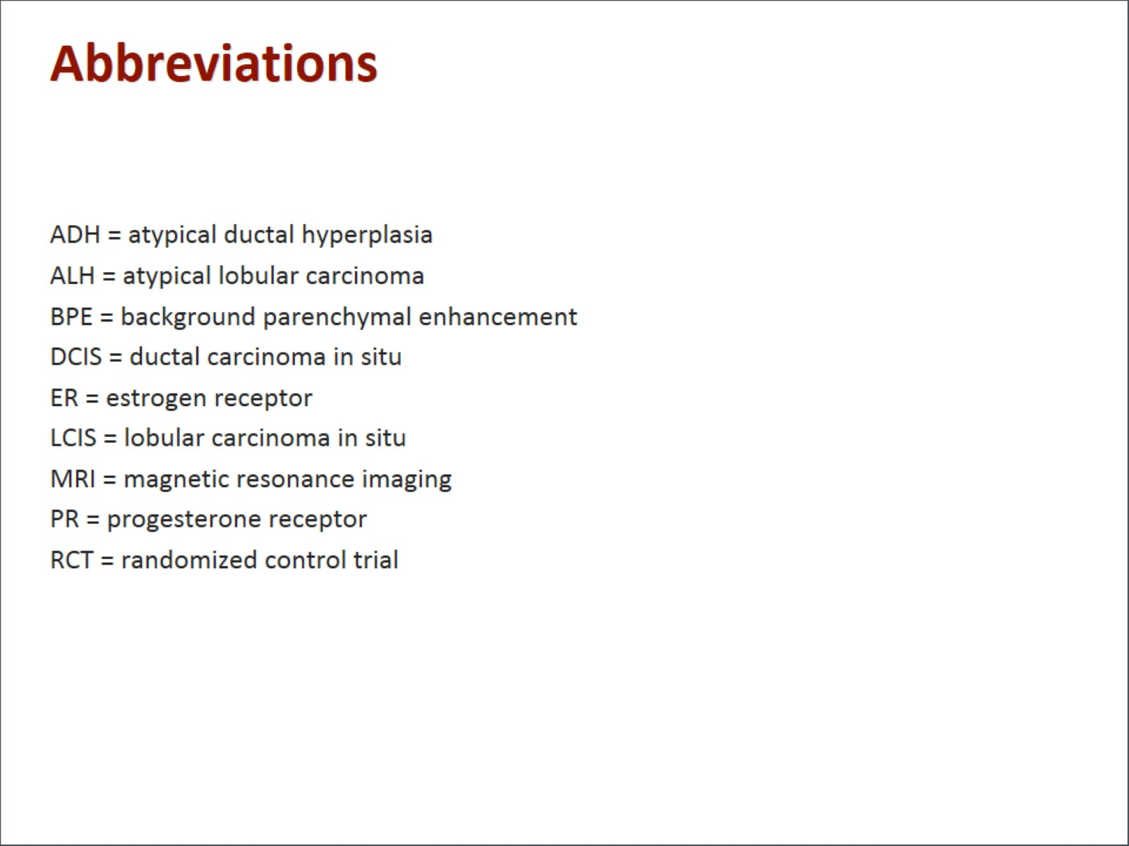
Abbreviations

Slide 41
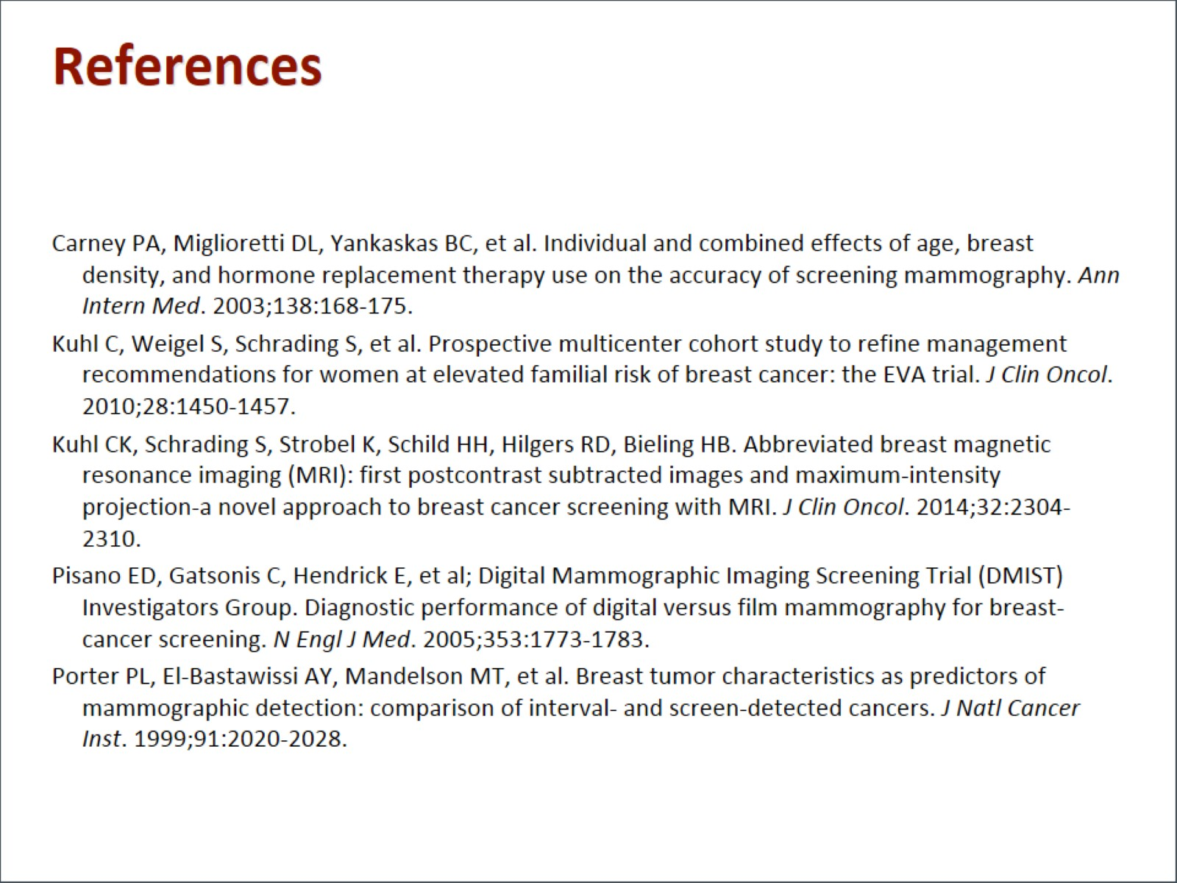
References

