Slide 1
Nontuberculous Mycobacterial Lung Disease

Slide 2
This program will include a discussion of off-label treatment and investigational agents not approved by the FDA for use in the United States.

Slide 3
Burden of NTM Lung Disease

Slide 4
Classification of NTM Pathogens by Growth Rate

Slide 5
US Regional Differences in NTM Lung Disease

Slide 6
Identifying NTM and Underlying Disease

Slide 7
Clinical Criteria for Diagnosis of NTM Lung Disease

Slide 8
Microbiologic Criteria for Diagnosis of NTM Lung Disease

Slide 9
Tracking Disease Progression: 3-Point Follow-up

Slide 10
Radiologic Patterns of NTM Lung Disease

Slide 11
Focal Bronchiectasis

Slide 12
Tree-in-Bud Appearance

Slide 13
Nodular Bronchiectasis

Slide 14
Cavitary Disease

Slide 15
M avium Complex

Slide 16
Which Patients Require Therapy?

Slide 17
Identification of NTM

Slide 18
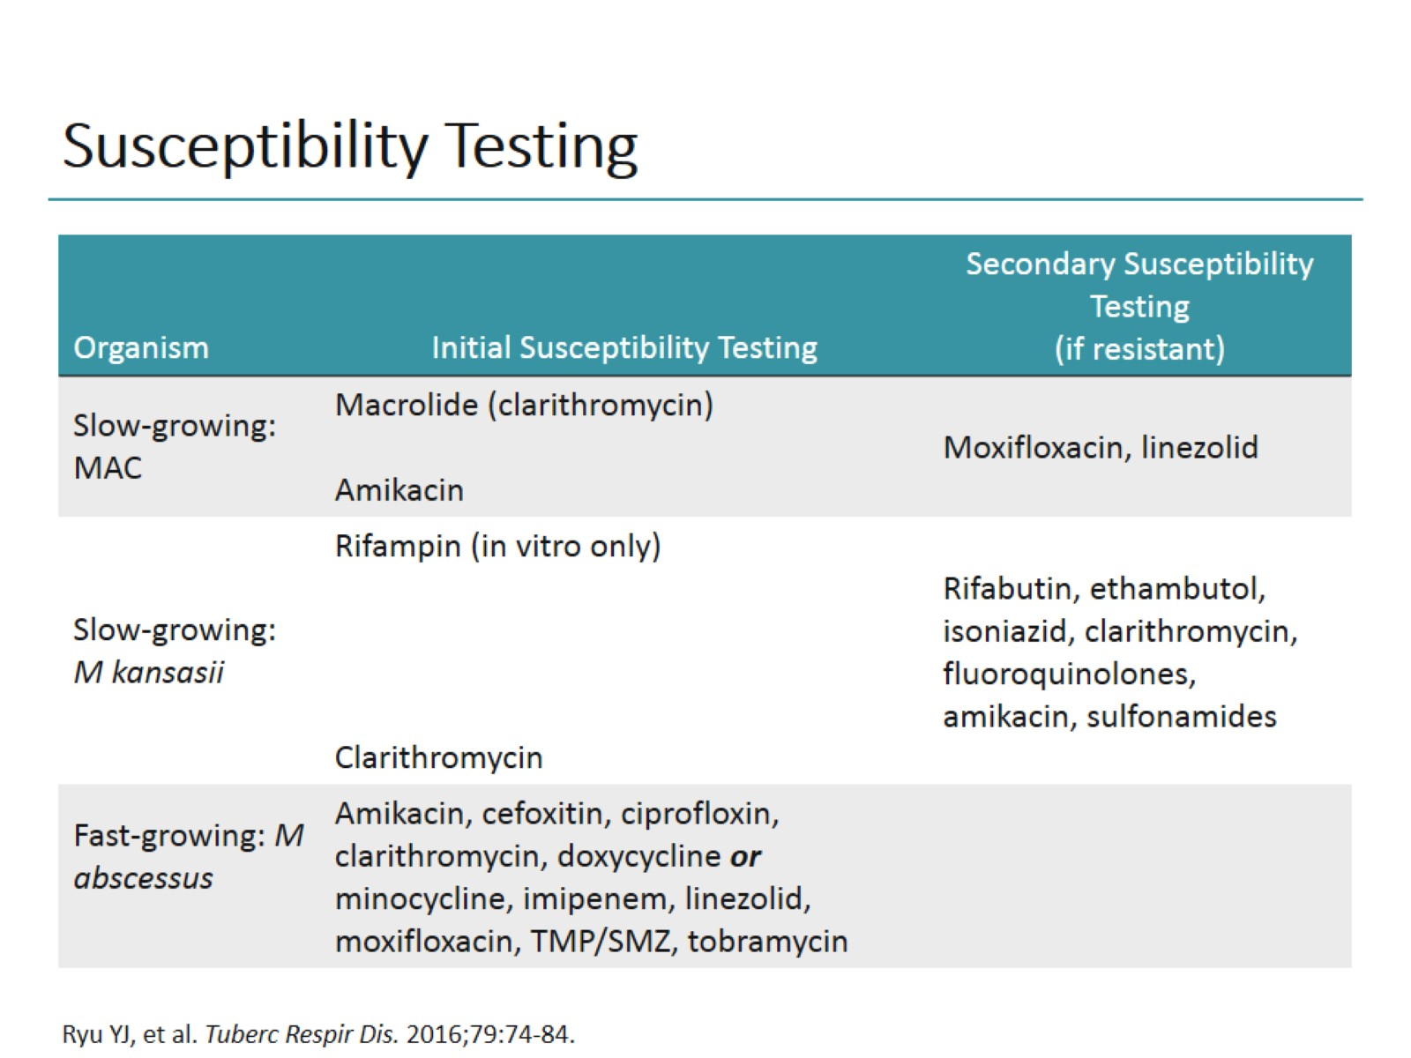
Susceptibility Testing

Slide 19
Challenges to Successful Diagnosis and Treatment of NTM

Slide 20
Treatment and Management of Macrolide-Susceptible NTM Lung Disease

Slide 21
M abscessus

Slide 22
M kansasii

Slide 23
How to Determine if Treatment Is Successful

Slide 24
Drug Toxicities: What To Watch For

Slide 25
What if Your Patient Shows No Improvement?

Slide 26
Emerging Therapies for NTM Lung Disease

Slide 27
Summary

Slide 28
Abbreviations

Slide 29
Abbreviations (cont)

